Slide 1
Be informed. Be prepared.
Understanding your Retirement Account
Debra Schmitt
Client Services Manager
Notes:
2018 SEMINAR SERIES:
8/25/18 Weatherford
9/15/18 Tulsa
10/13/18 Oklahoma City
11/3/18 Ardmore

Slide 2
OUTLINE
RETIREMENT PROJECTION
SERVICE & SALARY HISTORY
“MY OTRS” CLIENT PORTAL
Notes:
* Your Retirement Projection is based on …
* Your Service & Salary History.
* “My OTRS” is the Client Portal to your retirement account.

Slide 3
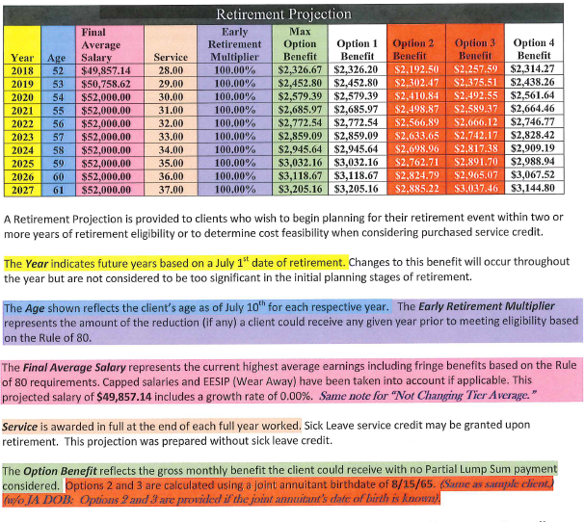
PROJECTIONS
PROJECTIONS - FOR PLANNING PURPOSES
Notes:
Projection Great Planning Tool
If > 12 months from retirement
Provides 10 different Years
Provides 5 Retirement Plan Options
The color-coded sample is your “Cliff Notes” to your retirement projection.
Provided to Help You Make Informed Decisions About Your Retirement
When to Retire – What Year.
Which Retirement Plan Option is best for you and your family.

Slide 4
RETIREMENT YEAR AND AGE
JULY 1 Retirement Dates on Projection
1st day of month used for retirement dates.
Fiscal Year ends June 30 for full credit July 1.
June 1 retirement dates if eligible by June 10.
AGE as of the July 10th
Grace period for birthdates 1st – 10th of month.
Same grace period as the last day worked.
Notes:
MOST IMPORTANT QUESTION: When to retire?
Why July 1?
1st day of the month
1st day of the Fiscal Year
June 1 retirement date is often used by 9- or 10-month employees
Why July 10?
Grace period of 10 days for age
Same grace period for work 10 days into retirement month

Slide 5
MEMBER SERVICE STATEMENT Year - Listed by ending year: 1991 = 7/1990 to 6/1991 Last Year -based on Employer’s Year-End Report Tier salaries at bottom are used in retirement calculations.
Sample Client
Notes:
Member Service Statement in packet – BASED ON FISCAL YEARS
Circle first year – Probably began work in fall of previous calendar year.
Circle last year - Based on last Employer year-end report submitted.
Individual years – Check salary and service credit.
If you disagree, contact TRS for audit/verification form.
Tier totals at bottom:
Uncapped tier – based on high 3/high 5 salary average
Comp U Cap – possible if worked at OU/OSU FY1996-FY2007
Through 1995 - $40k or $25k limit
Final Salary Average in Projection is Based on Average of above Tier Totals

Slide 6
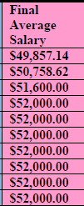
FINAL AVERAGE SALARY (FAS) ON PROJECTION
Salaries at bottom of Member Statement are averaged in Final Average Salary Column.
If FAS amount is changing, then more than one salary tier is being used. FAS shows a weighted salary average.
If FAS does not change, then only the Uncapped Salary Average is being used.
Notes:
The FAS is an average of the salaries listed in tier totals.
If FAS continues to change/grow, then more than 1 tier is used in salary calculation
If FAS stops growing, then 1 tier is used in the salary calculation.

Slide 7
SALARY FAQS (715:10-13-1)
REGULAR ANNUAL COMPENSATION =
Salary + Fringe – Flex Benefit Allowance
INCLUDES:
Employer-paid group health, disability, or life insurance
Annuities & pension contributions provided on a periodic basis to all qualified members of the employer.
EXCLUDES:
Flexible Benefit Allowance 26-105
National Board Certification.
Allowances or expense reimbursements
Payments for termination/retirement or payment for unused leave
Some employer-paid deferred comp plans (if not provided to all TRS members of the employer).
SALARY REDUCTION AGREEMENTS FOR DEFERRED COMP
* It may reduce taxable income, but will not reduce your TRS salary.
Notes:
REGULAR ANNUAL COMPENSATION (715:10-13-1)
INCLUDES True employer-paid true fringes
Does NOT include:
Flex Benefit Allowance paid by State NOR National Board Certification –laws exclude them.
Allowances/Expense Reimbursements
Termination/Retirement. Unused SL or vacation.
Some Deferred comp plans, if not provided to all TRS members.
Deferred Comp may reduce taxable income, but not TRS contributory salary.

Slide 8
SERVICE CREDIT
Purchased service:
Does not change membership date.
Tier value depends on the year performed.
Fractional Service depends on year performed.
Service Through FY2013
Fractions must be combined into whole years.
May qualify for 90-day round up provision if .75 or more.
Since FY2014:
All fractions are used in retirement calculations.
Since FY2017:
Service Rounded to Tenths.
0.95 rounded = 1.0; 0.94 rounded = 0.90
Notes:
Purchased service = based on year performed
Fractional service = depends on year it happened.
Draw line between FY2013 & 2014 on your MSS
Rule change regarding fractional service credit.
Draw line between FY2016 & 2017 on your MSS
Rule change for rounding service credit.

Slide 9
SICK LEAVE = Wild Card
Not on Member Service Statement, but may be added to retirement projections & estimates.
TIER: Same value as earliest membership year.
May be used to reach Comb80 or Comb90 and may be worn away in EESIP.
May be combined with service prior to FY2014.
May NOT be split to combine with different years.
Fractional service combined before sick leave added.
Round-Up Provision on service prior to FY2014.
After combining fractional service, you have at 0.75 +
Must have 120 days of sick leave at retirement.
Must complete the final contract year.
Notes:
SL is a WILDCARD – it has different values for different accounts.
MSS never lists SL, but it is used in estimates & projections
Tier – Same value as your earliest vested service.
May be used to reach Comb80 or Comb90
May be combined with service prior to FY2014.
Round-Up Provision on service prior to FY2014 –
CAREFUL - Round UP provision may be forfeit if work past July 1.
Use client portal or submit PIV to receive estimate with sick leave credit.

Slide 10
EARLY RETIREMENT MULTIPLIER
If Multiplier < 100%, then you have not yet reached Normal Retirement Eligibility.
Age Matters
Waiting Helps, Even If Not Working
100% = Normal Retirement Eligibility
Reached Comb 80, Comb 90, or Age
If not working, don’t wait to retire.
Notes:
If Multiplier is less than 100%, then
Fractions of age count
Waiting helps, even if not working.
Example: if 23 years + age 55 = 78. Client may way until age 57 (+ 23 = 80) to retire.
Normal Retirement Eligibility – 100% = Rule 80/90/Age 62.
Fractions of age do not matter & may not be combined with fractions of service
Questions?

Slide 11
EESIP - WORKING BEYOND JULY 1 NORMAL RETIREMENT ELIGILITY
EESIP = Education Employees Service Incentive Plan
Normal Retirement Eligibility = July 1.
Each year worked beyond eligibility, moves 2 years to UNCAPPED tier.
Projections include EESIP, if applicable.
Notes:
EESIP – WORKING BEYOND JULY 1 ELIGIBILITY
Only works on $40,000 CAP tier (not $25K cap or CompUCap).
If you reach eligibility mid year, then you reach eligibility July 1 of following year for EESIP purposes.
Projection is helpful when looking at EESIP.

Slide 12
FINAL 5 COLUMNS: LET’S TALK MONEY!
GROSS MONTHLY BENEFIT : 5 different options
CONSULT YOUR TAX PROFESSIONAL
Pay Federal taxes, but not FICA (social security).
State taxes (may have exclusion for TRS retirees).
Professional Dues OREA or RPOE (optional) .
Insurance premiums (may not tax-defer premiums).
PLSO (Partial Lump Sum Option) Amounts Are Not Provided On 10-Year Projections.
Notes:
Final 5 Columns.
Explanation of different options is in your projection packet.
Opt 2 & 3 provided if JA DOB was provided.

Slide 13
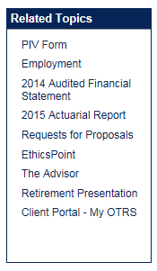
MY OTRS CLIENT PORTAL
>21,000 Registered Users
Access client portal through TRS link:
https://www.ok.gov/TRS
Notes:
If you want to access your account, then click on the client portal link in the “Related Topics” box.
It will take you to a secure site for registration.
A PIN letter will be mailed to your TRS address, so make sure it is current before registration.
Valuable Tool for both active and retired members.

Slide 14
MY OTRS CLIENT PORTAL ACCESSIBLE ANY TIME
Print Account Balances
Check History of Service & Salaries
Get Estimate of Retirement Benefits
Add or change number of sick leave days
Add or change joint annuitant date of birth
Provides the amount of TRS insurance subsidy.
Edit Personal or Contact Information
Review Benefit Payments (Retirees)
Notes:
Valuable Tool for both active and retired members.
Service & Salaries
Check again when FY2018 service & salary is in.
Calculates estimates for you
Change SL or JA DOB
Provides Subsidy
* Retirees use it to review benefit payments or get copies of tax forms before mailed.

Slide 15
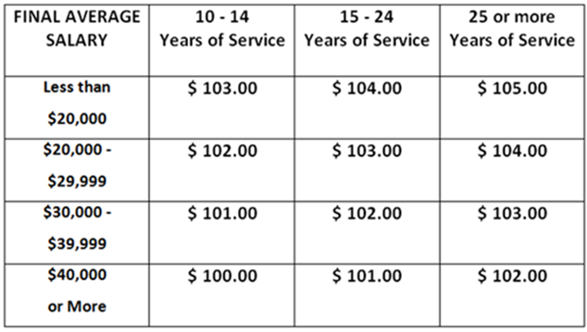
TRS Insurance Subsidy
10 years service = TRS Subsidy $100- $105
Please contact your insurance provider for insurance-related questions.
Notes:
Subsidy is provided in portal, but not provided in Projections, so here is a chart.
Please contact your insurance provider for insurance-related questions.

Slide 16
QUESTION & ANSWER
TRS contact information is at the top of your retirement projection.
I will do my best to address all of your questions
Please return surveys to Registration Table
Range:
Very Satisfied = 5
Not satisfied = 1
Comments or suggestions appreciated.
Notes:
Contact Information at top of projection
Please complete surveys & comments/suggestions help.
I will try to answer your questions.

