Slide 1
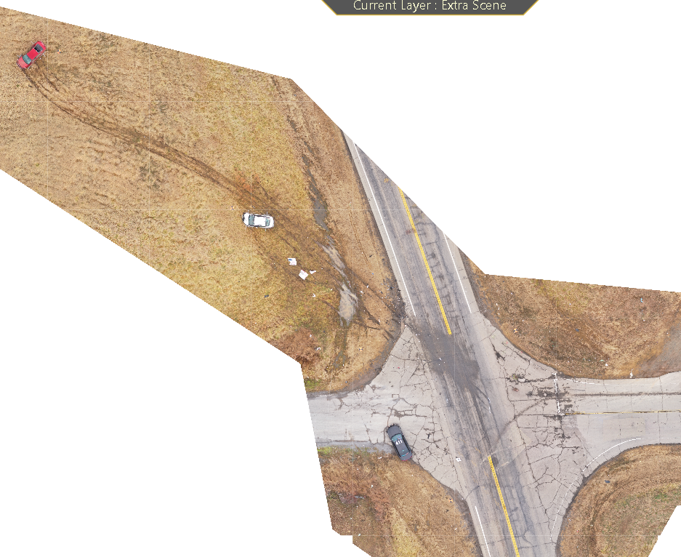


(UAS)
IN TRAFFIC COLLISIION INVESTIGATIONS

Slide 2
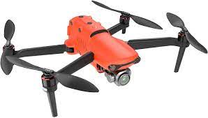
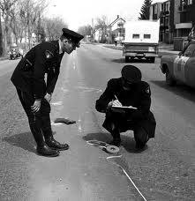
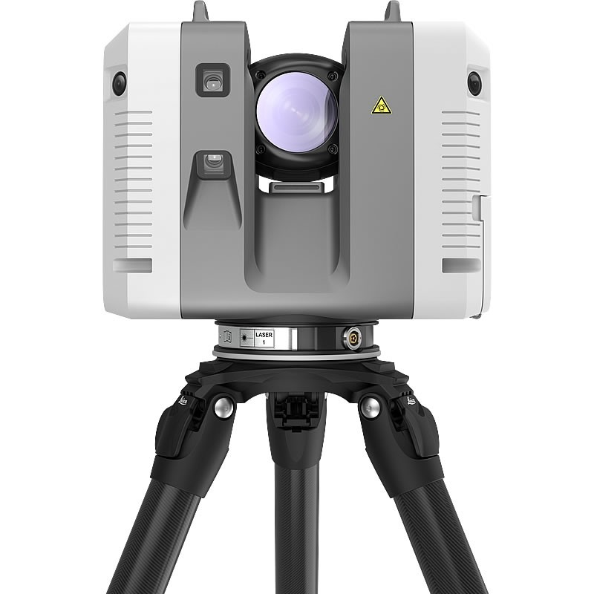
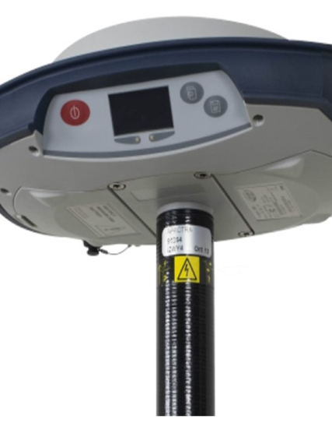
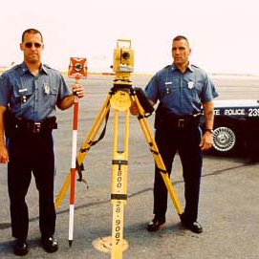
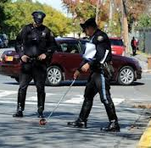
History of Documenting Techniques
Notes:
Quick clearance is one of the most important elements of managing traffic collisions in order to ensure the safety of officers and others on the roadway.
But that cannot be done before the scene is documented.

Slide 3
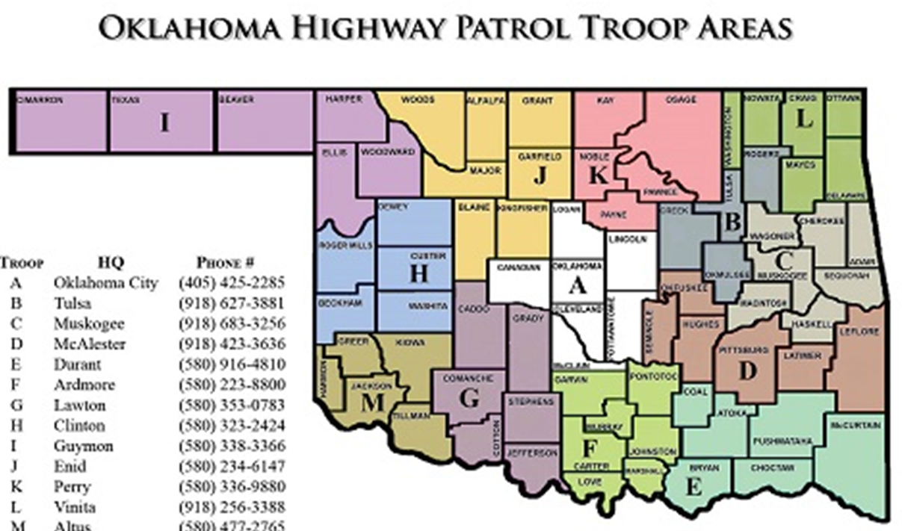
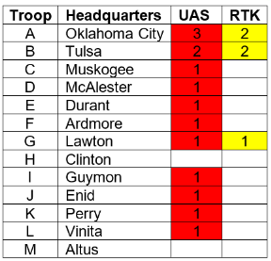
1
1
1
1
2
2
2
1
2
1
1
1
1
1
Notes:
11 of the 13 Field Troops have an investigator with a drone

Slide 4
Drones use to benefit the workflow!
Make documenting collision scenes faster.
Data collection is easier, with broader accessibility.
Reduce time spent on scene lowering human and financial costs.
Increase officer safety in the field.
Birds eye view of the scene.
Measurable outputs provide more detailed evidence to show in court.
Notes:
When an accident occurs, it’s in everyone’s best interest to clear the area ASAP, but the scene must be documented first.

Slide 5
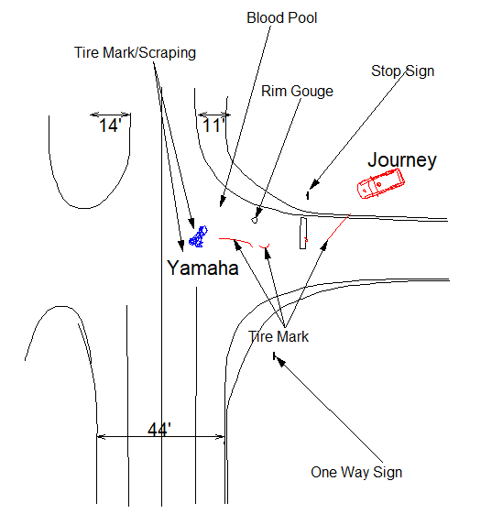
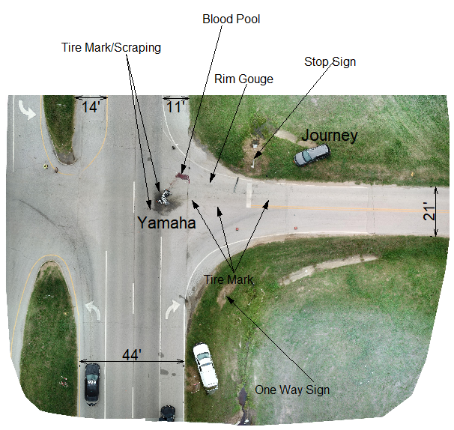
Example of OHP Total Station documentation and Drone Mapping Documentation
Total Station Documentation Drone Mapping Documentation
1 hour 45minutes 12-minute flight time
66 points mapped 245 pictures taken

Slide 6

What is the Accuracy of Drone Mapping?
When discussing accuracy, it’s important to distinguish between relative and absolute accuracy.
Relative accuracy is accuracy comparing features within a reconstruction. For example, if a model of a building is 10m wide, and this is the same distance as on the actual building, the model has high relative accuracy.
Absolute accuracy is the accuracy of the reconstruction in relation to its true position on the planet. If the same model of the building is not in the correct place on the base map, it has low absolute accuracy, even if it has high relative accuracy.

Slide 7
This model of a house has high relative accuracy as it's correctly reconstructed,
but low absolute accuracy, as it's in the wrong place

Slide 8
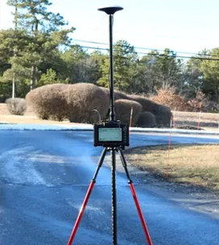
How to achieve Absolute Accuracy!
RTK is short for real time kinematics.
A GPS receiver capable of RTK takes in the normal signals from the Global Navigation Satellite Systems along with a correction stream to achieve sub-centimeter positional accuracy.
On top of these signals an RTK receiver takes in a correction stream and then calculates your location with sub-centimeter accuracy in real time.
Requires internet connection
Continuously Operating Reference Stations (CORS) Network
Faster setup than total station
Can be used at night

Slide 9
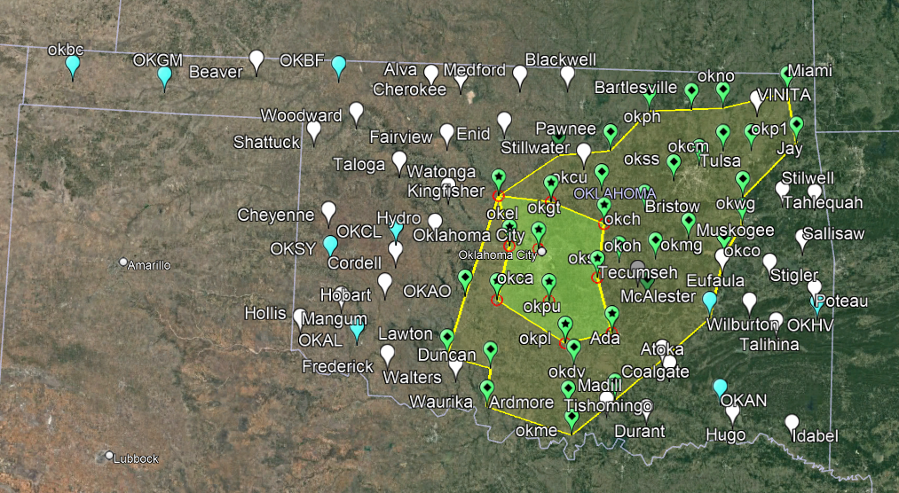
ODOT CORS NETWORK

Slide 10
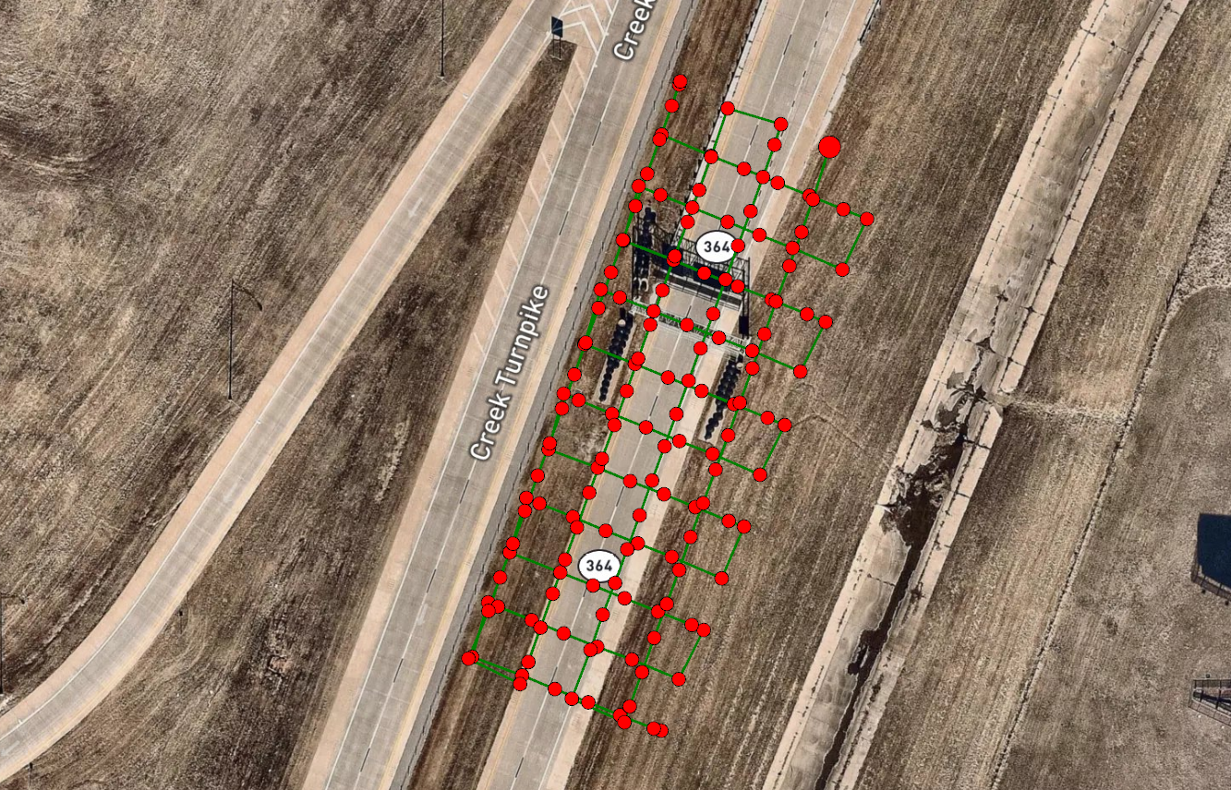
Pix4Dmapper view of Collision Scene

Slide 11
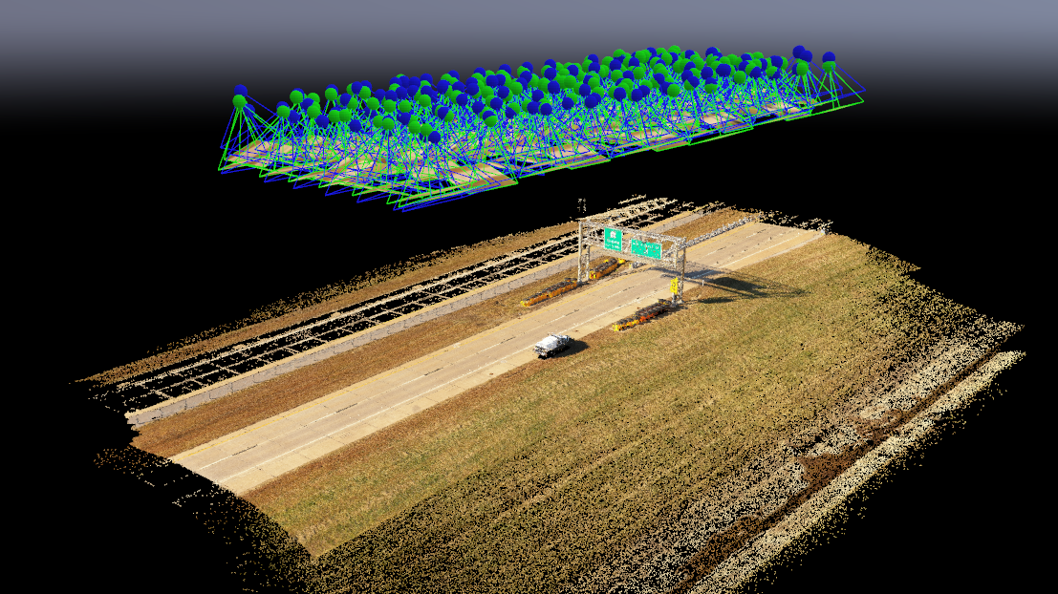
Camera Positions seen in Pix4Dmapper

Slide 12
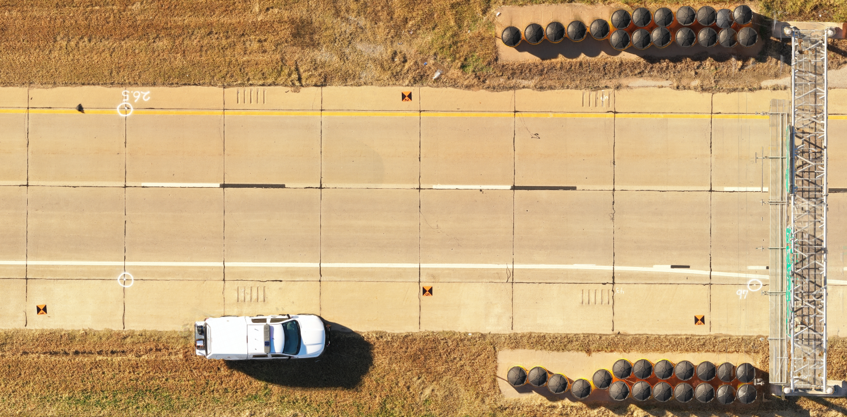
Ground Control Points
Scale Constraints

Slide 13
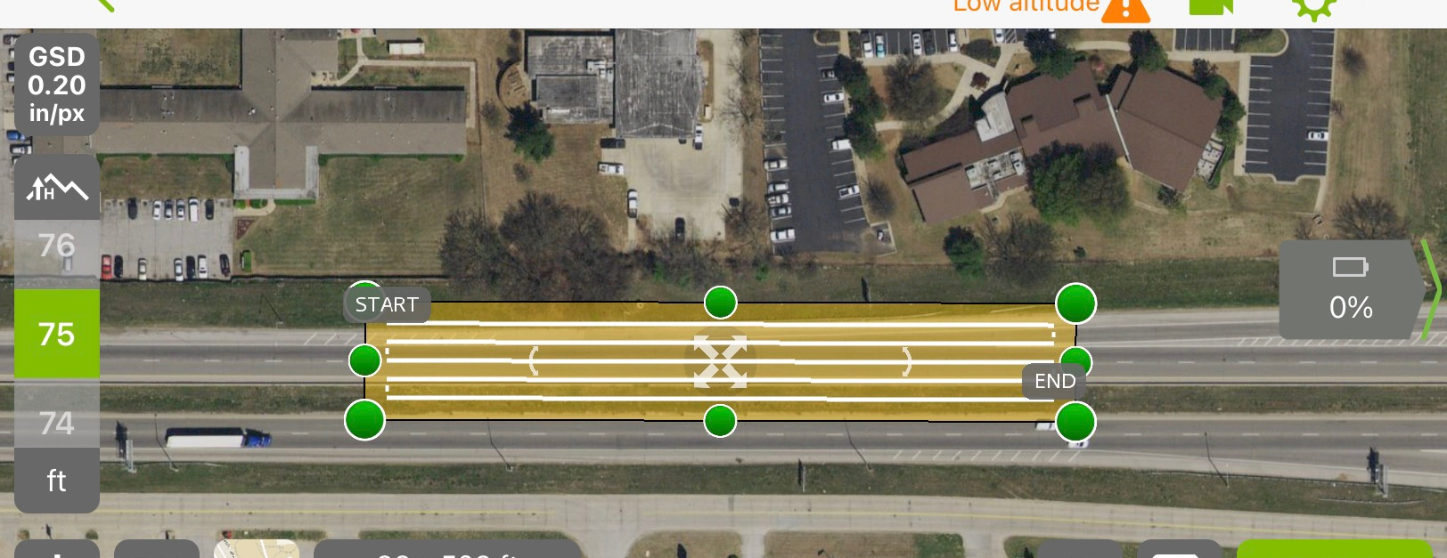
Pix4Dcapture View of Collision Scene

Slide 14
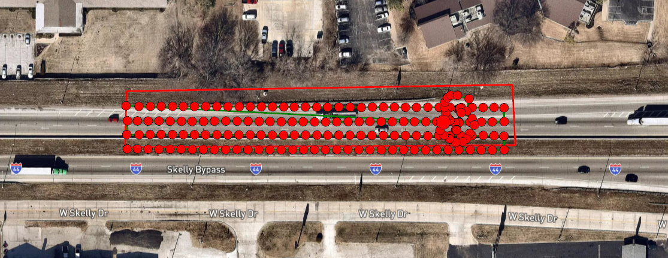
Pix4Dmapper view of Collision Scene

Slide 15
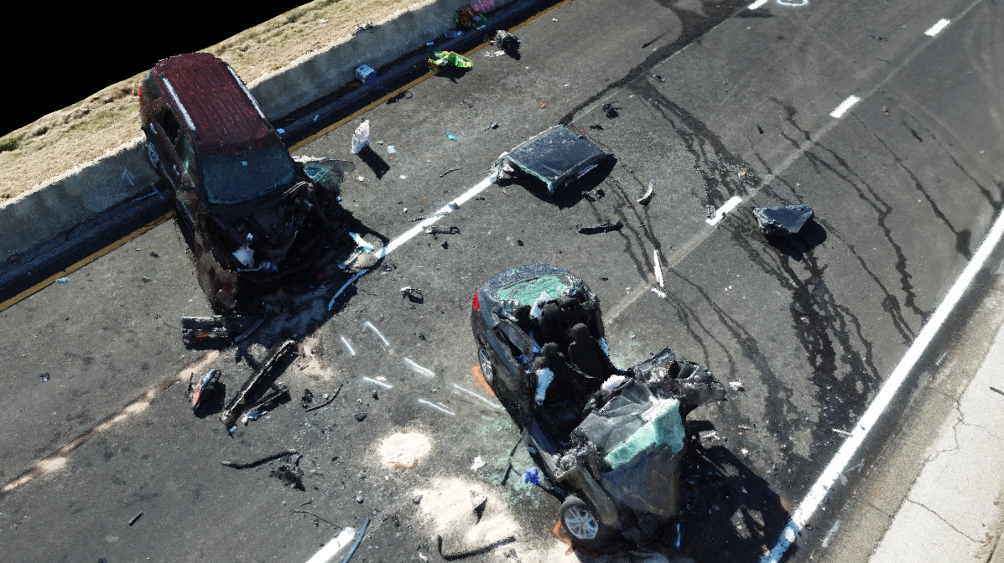
Pix4Dmapper Point Cloud - 3D View

Slide 16
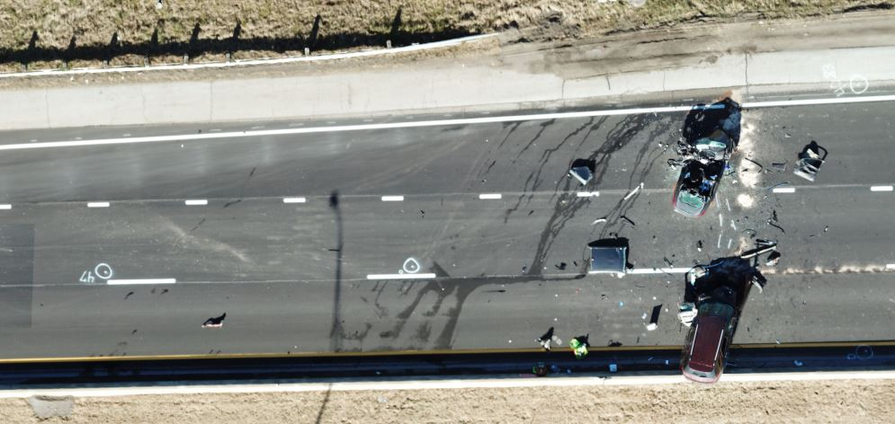
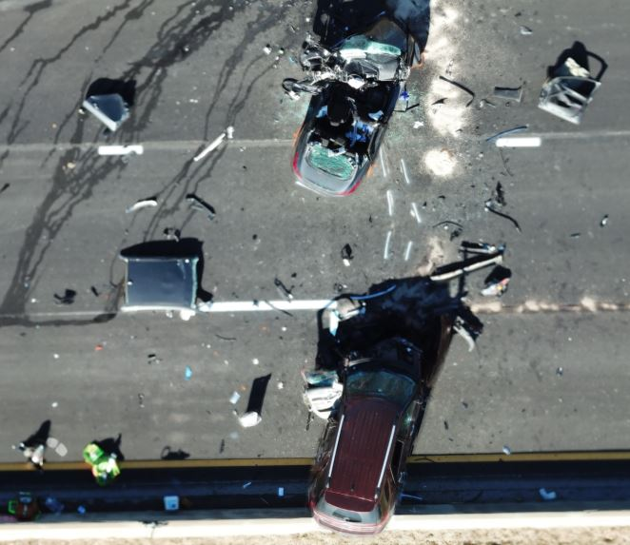
75 ft Altitude 180 pictures taken

Slide 17
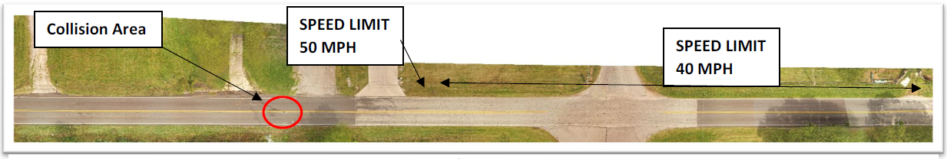
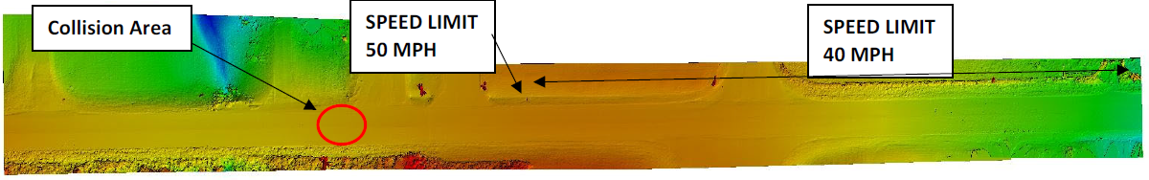
Pix4Dmapper Orthomosaic and Digital Surface Model

Slide 18
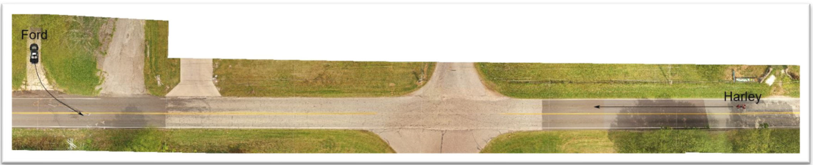
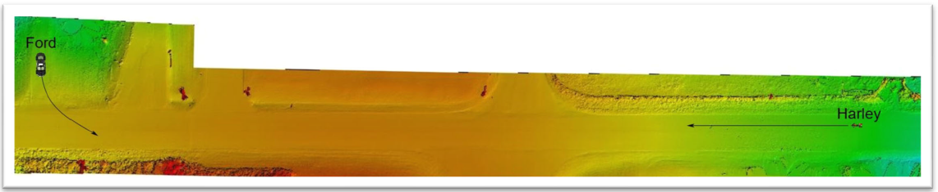
Pix4Dmapper Orthomosiac and Digital Surface Model

