Slide 1

Oklahoma Crowdsourcing
October 2022
Alan Stevenson
Asst State Maintenance Engineer
ITS, Fiber Optics, and Wireless Branch
astevenson@odot.org
(405) 521-6460

Slide 2
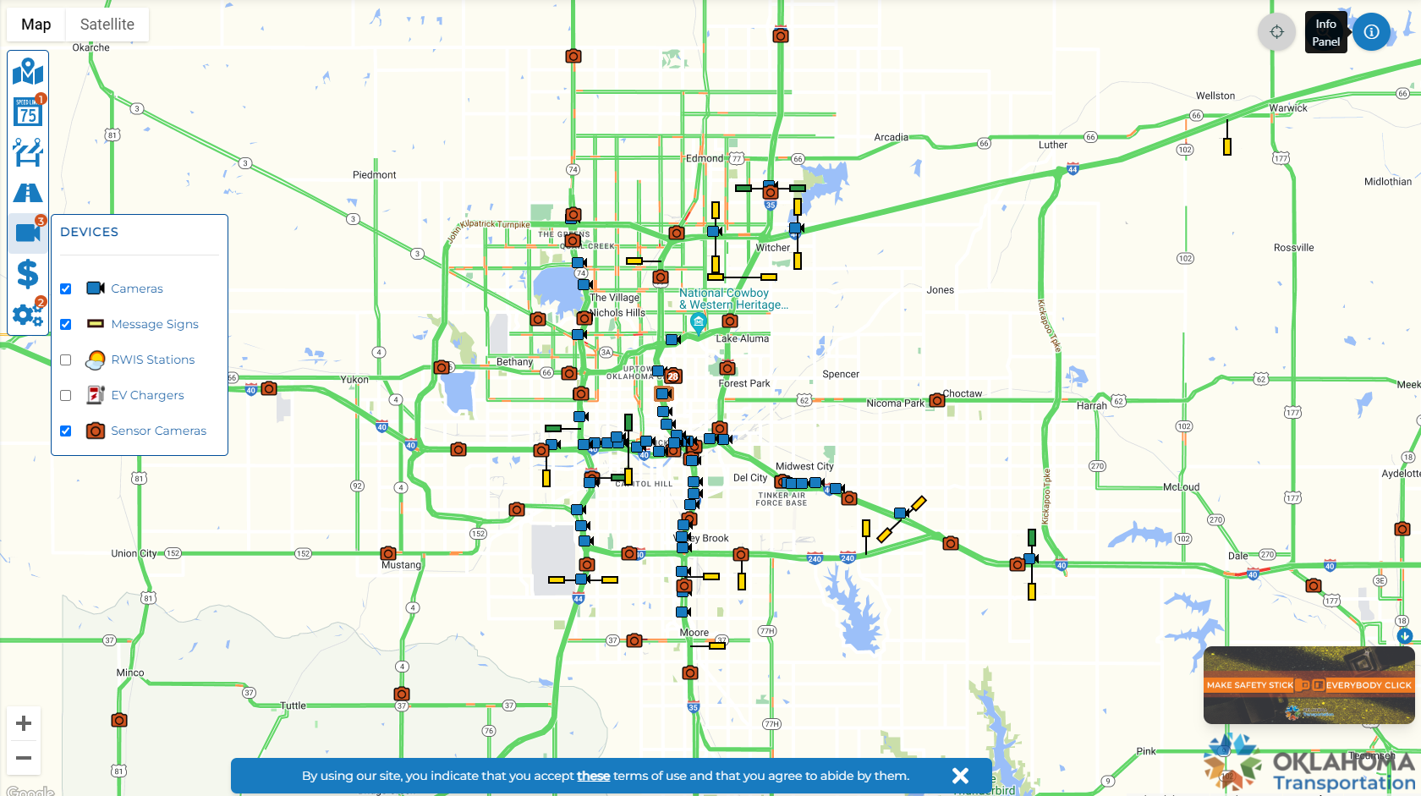
OKTraffic.org - Probe Data

Slide 3
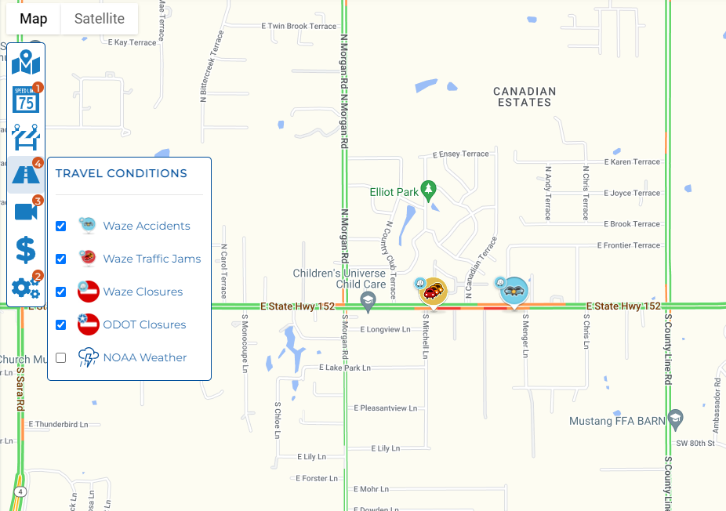
WAZE Integration

Slide 4
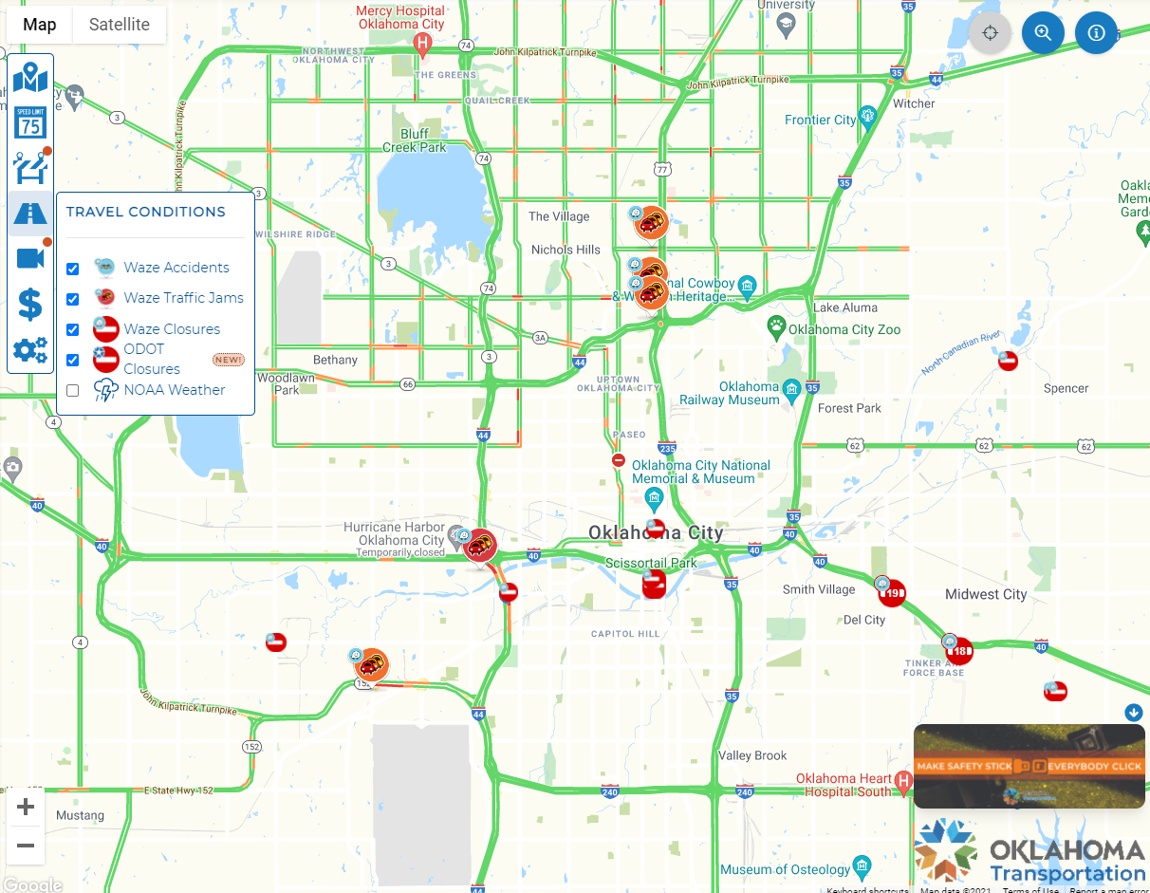
OKTraffic.org
Waze Data Sharing

Slide 5
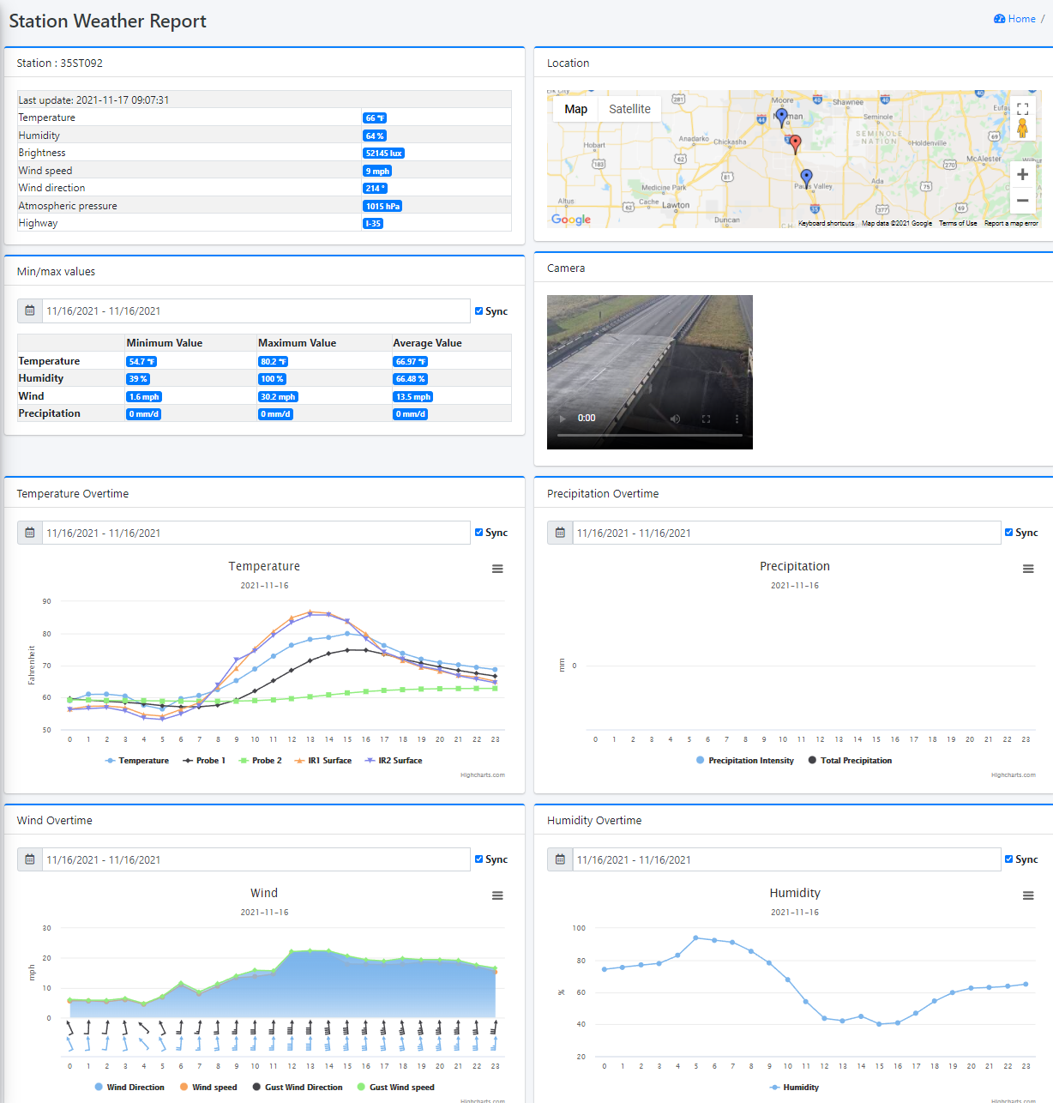

Road Weather Information System

Slide 6
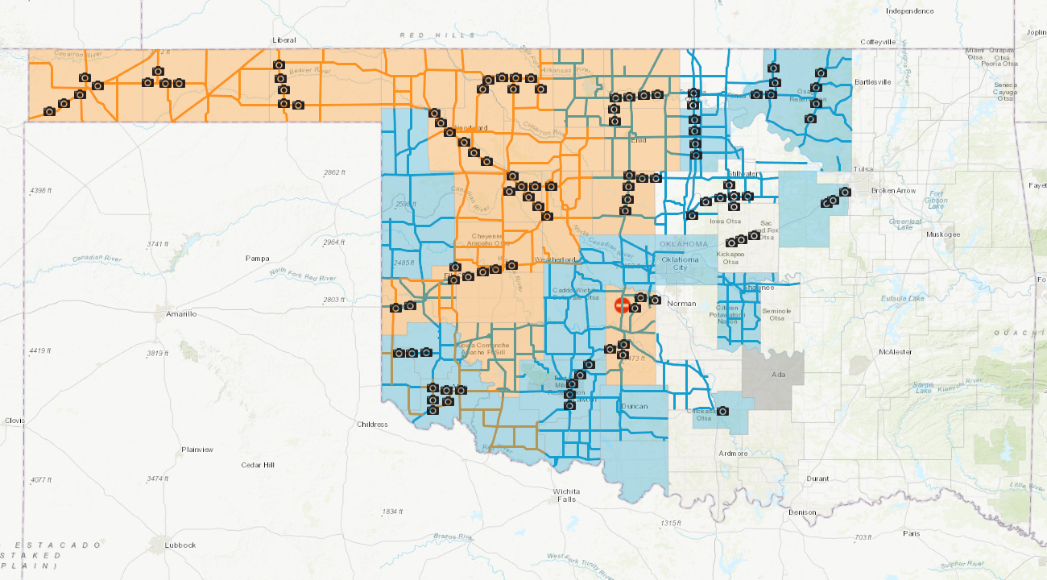
Road Conditions
OKRoads.org

Slide 7
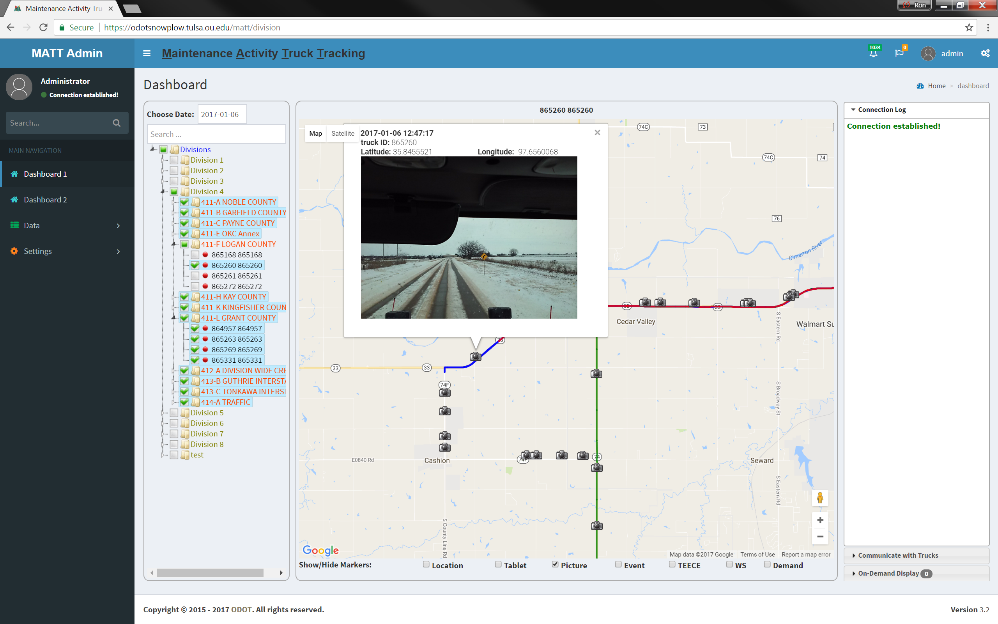
Snowplow Mobile Observation Systems
Notes:
Allows the superintendents to see where the plows have been and what has been plowed & when.
(Color Coded paths to show time since last plowing)
Provides plow up or down data & spreader dispersal rate information along with the images
Full data and images are stored for Department use, but images publicly published to okroads expire after 2 hours.
Snowplow Deployment
330 ODOT Truck Systems (of ~550 Total Trucks)
43 on OTA Trucks
BT Note: Looking at moving to Cell Phone as device in Truck rather than Tablets

Slide 8
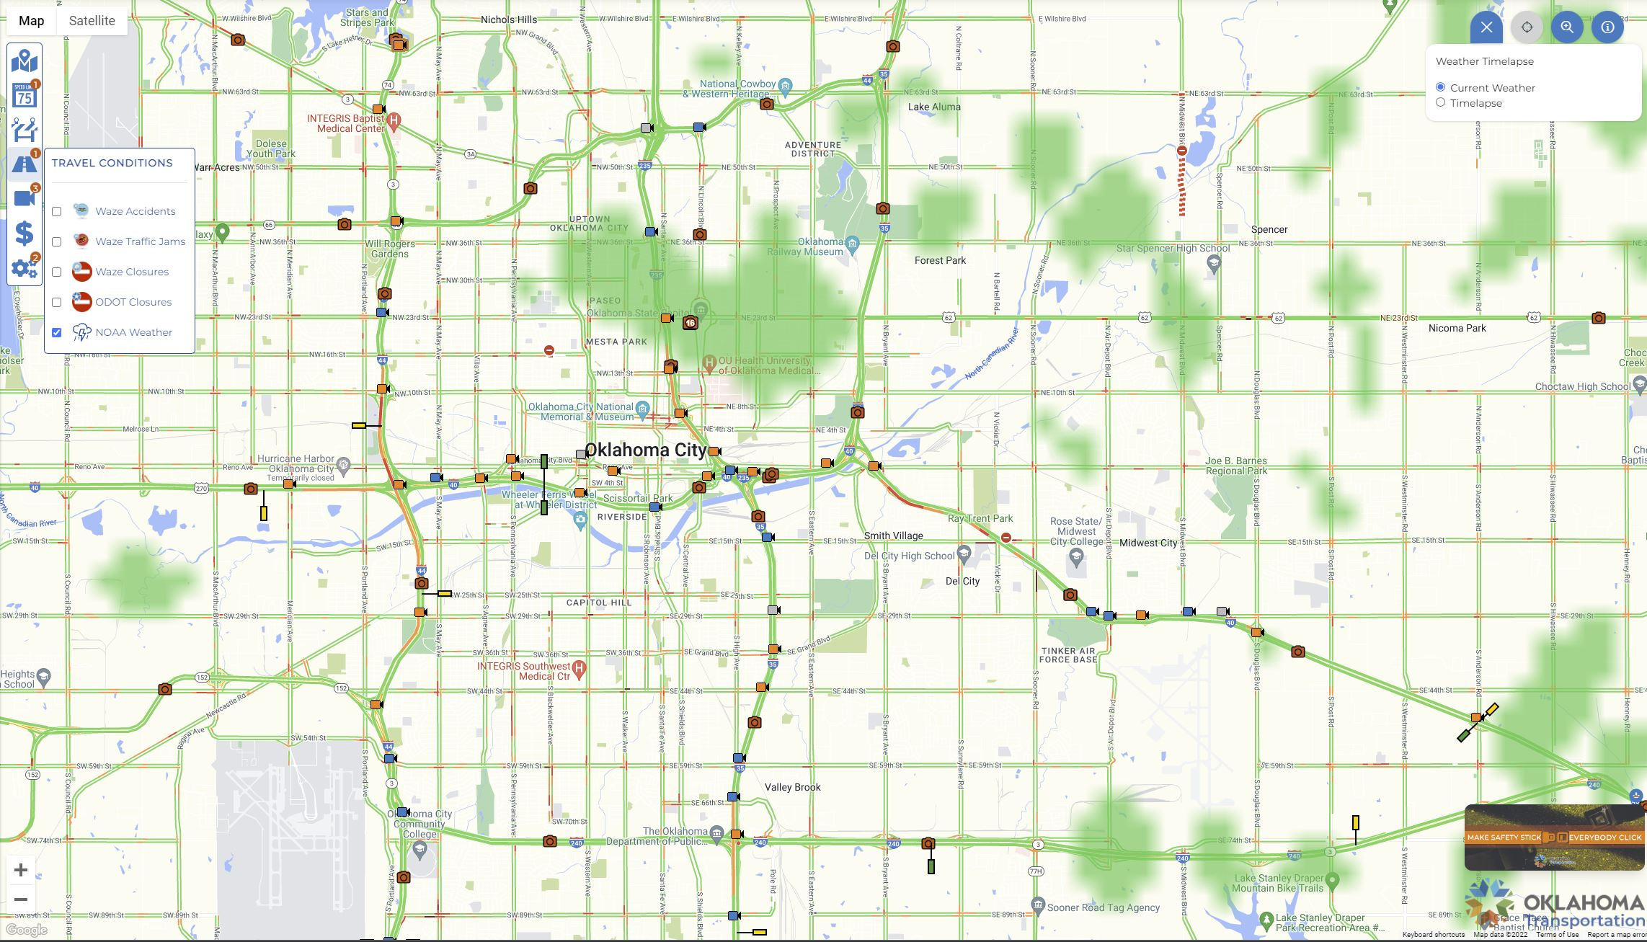
Integrated NOAA Weather Data

Slide 9
Data to Share Back

Slide 10
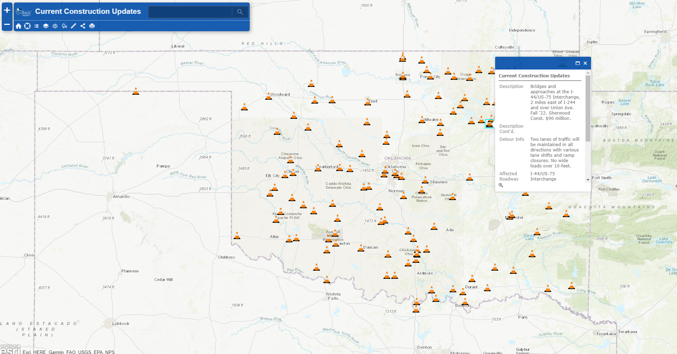
Old Construction Map

Slide 11

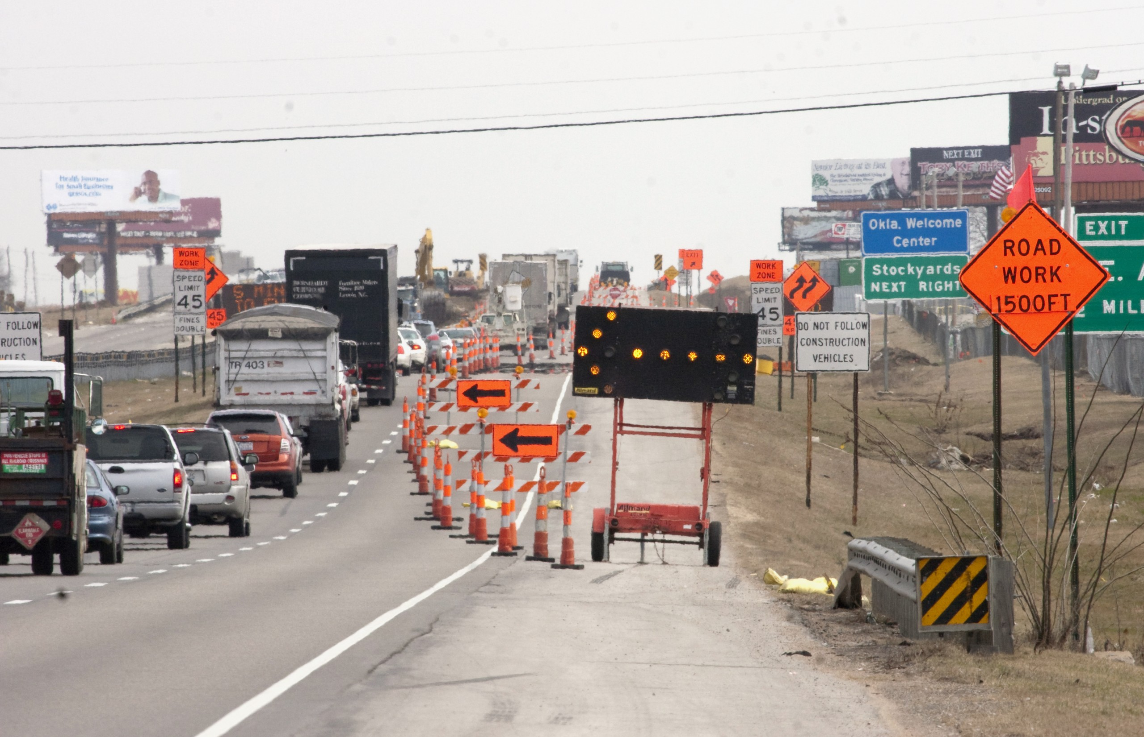
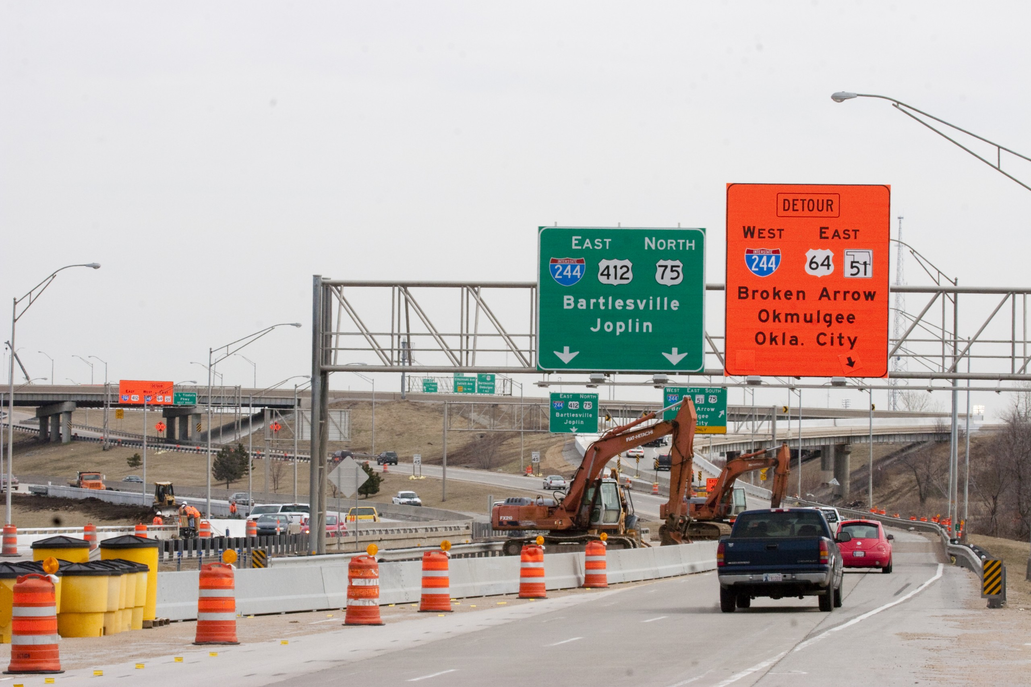
Construction App

Slide 12
Recording Construction Location
How the App Works
Click on Location Icon
Start the recording
Drive the construction route
Click End when finished with that direction
Add a New Route if you have multiple directions to route

Slide 13
How the App Works
Take Pictures and Videos
Click Photo Icon
Take multiple photos and a “Save” button will appear in the top right corner
Take up to a 30 second video by holding the capture button
Add a New Route if you have multiple directions to route

Slide 14
New Updates for FHWA/WZDX
Vehicle, Lane and Speed Impacts
Click Edit Contract
Add in an Estimated End Date
Add Vehicle/ Lane Impacts for each route
Add Original and Reduced Speeds
45mph

Slide 15
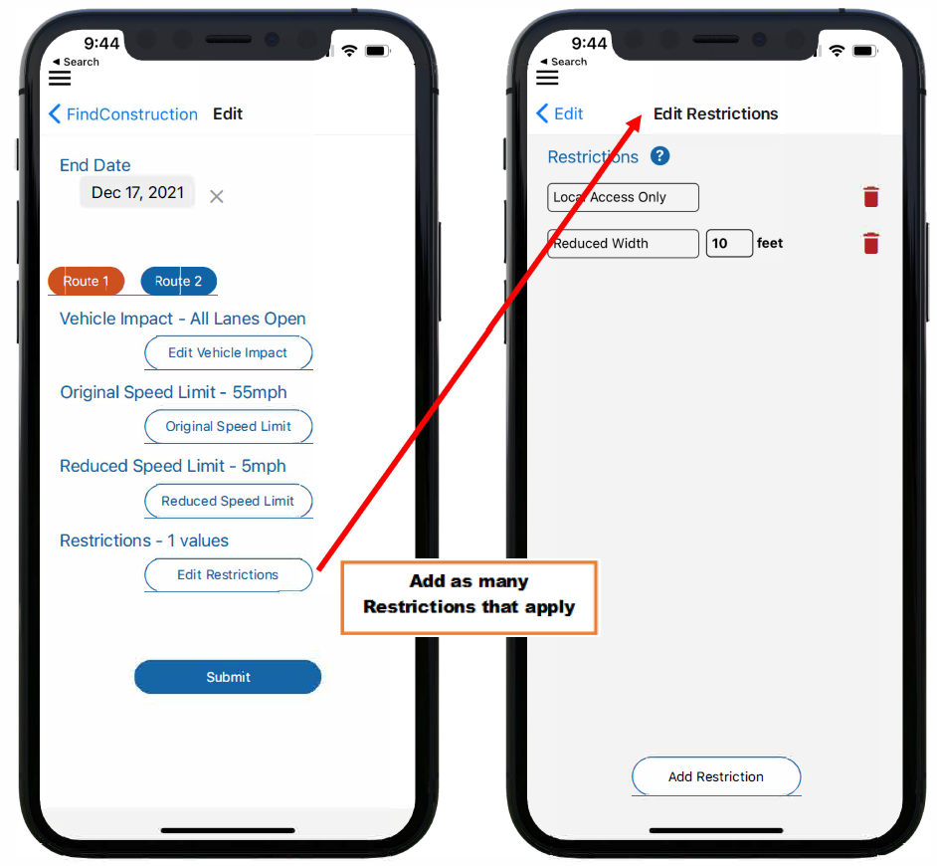
New Updates for FHWA/WZDX
Restrictions
Add as many Restrictions that apply for each route
Width, Height, and Length limits
Weight limits and oversized load information
Parking and Towing restrictions

Slide 16




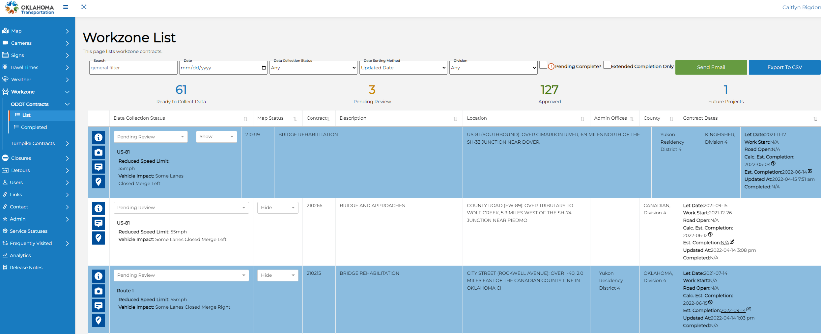
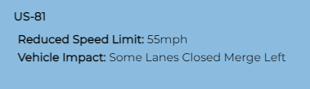
Work Zone List

Slide 17
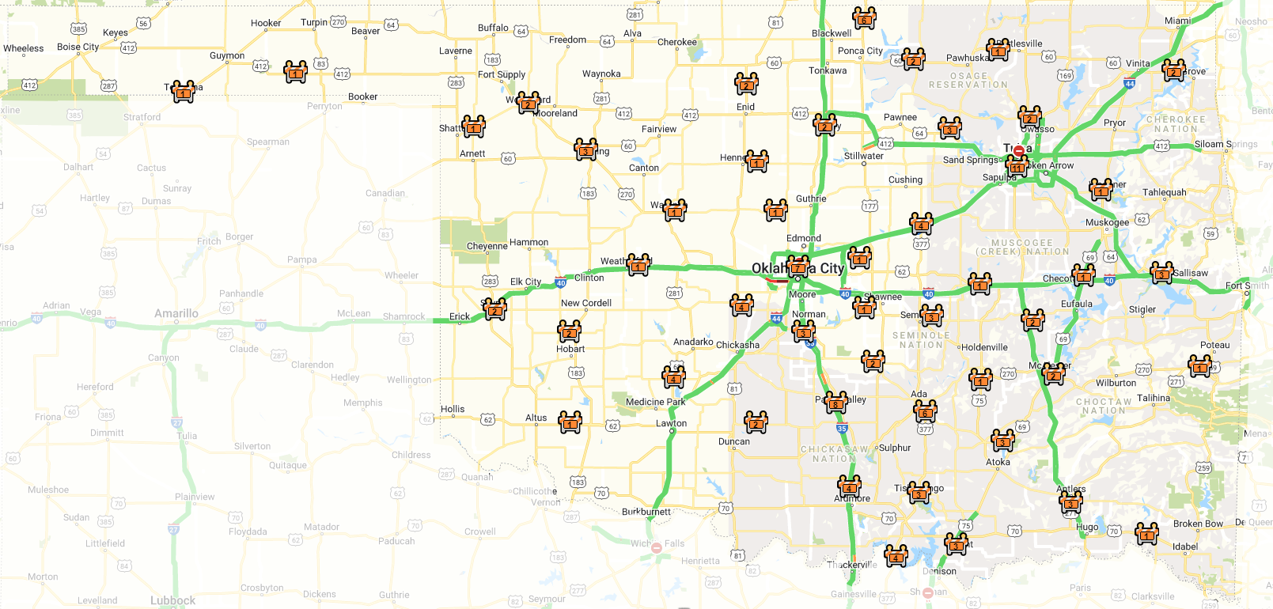


Statewide Projects
Projects Mapped as of April 2022

Slide 18
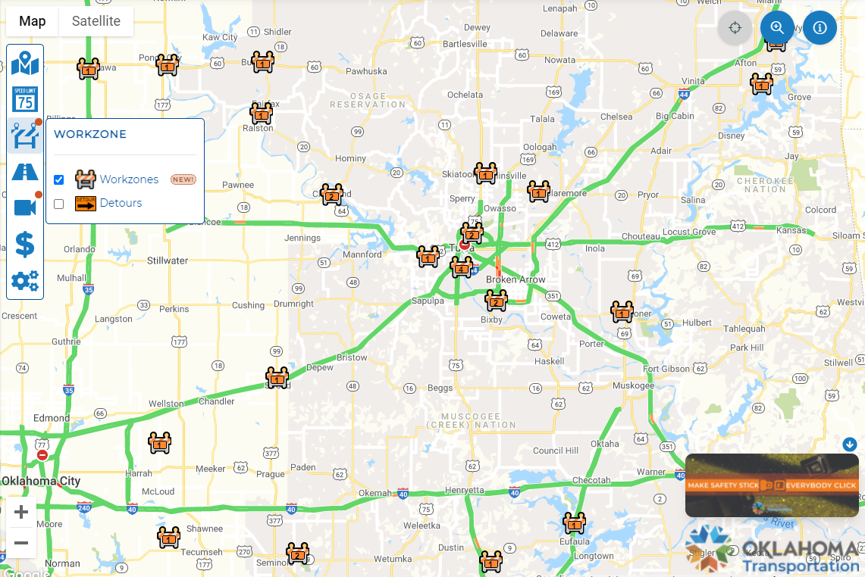
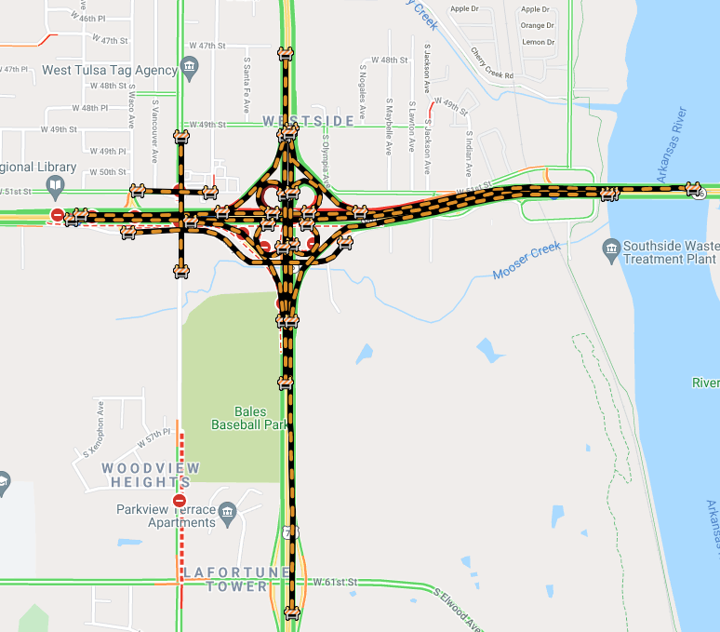
Projects mapped shown on Oktraffic.org

Slide 19
Questions?
Alan Stevenson
Asst State Maintenance Engineer
ITS, Fiber Optics, and Wireless Branch
astevenson@odot.org
(405) 521-6460

