Slide 1
Competitive Highway Bridge Program From Research to Implementation
Notes:
AKA CHBP AKA 34 Bridge Project
$225M to rural states (call for projects in 2018; awarded in 2019)
One of 20 projects awarded (ODOT submitted 3; this project was chosen as the top priority for the agency)

Slide 2
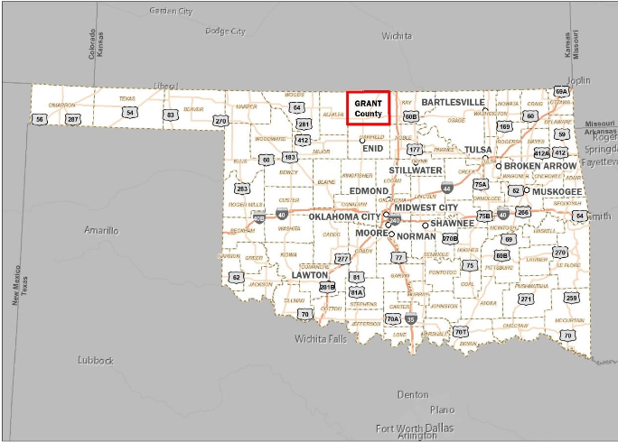
GRANT COUNTY
Population 4500
1920 road miles
92% are part of the
county highway system
Notes:
County highway system is critical in this area – rural, farming, oil and gas and wind turbines key in this area
Wakita – home of the movie Twister and 1 of 3 ARM (Atomospheric Radiation Measurement) facilities in the country south of Lamont

Slide 3
Bridges in Grant County at time of application
535 bridges
Most county bridges in state
174 of those are SD
33 % SD
*There are more SD bridges in Grant County than there are in the entire state of on-system bridges.*
Notes:
Structurally Deficient meaning one or more bridges elements rates in poor condition
70 % of bridges selected are on mail route, 50% are designated bus routes – low ADT does not decrease need!
highest # of bridges in state, more SD bridges than any other county & more than all of Oklahoma on-system
CURRENTLY 464 bridges and 20 SD

Slide 4
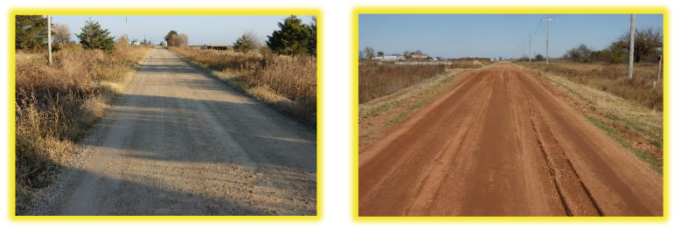
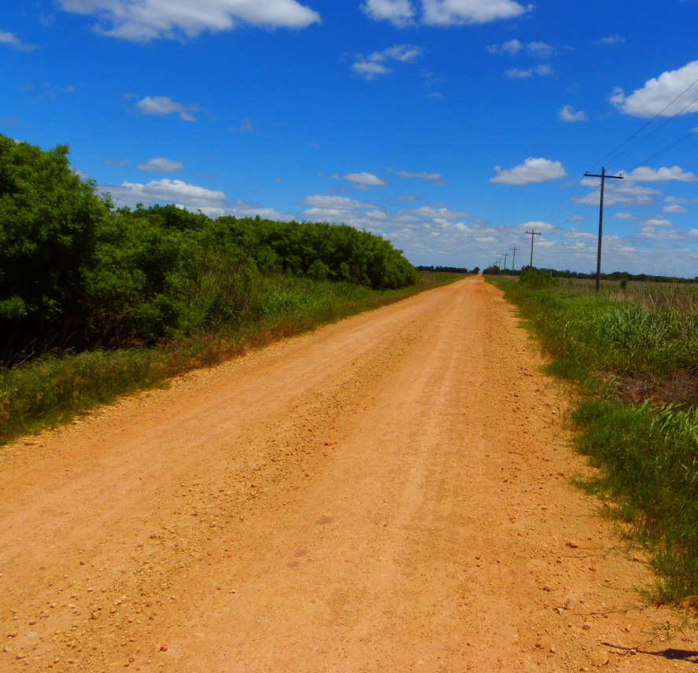
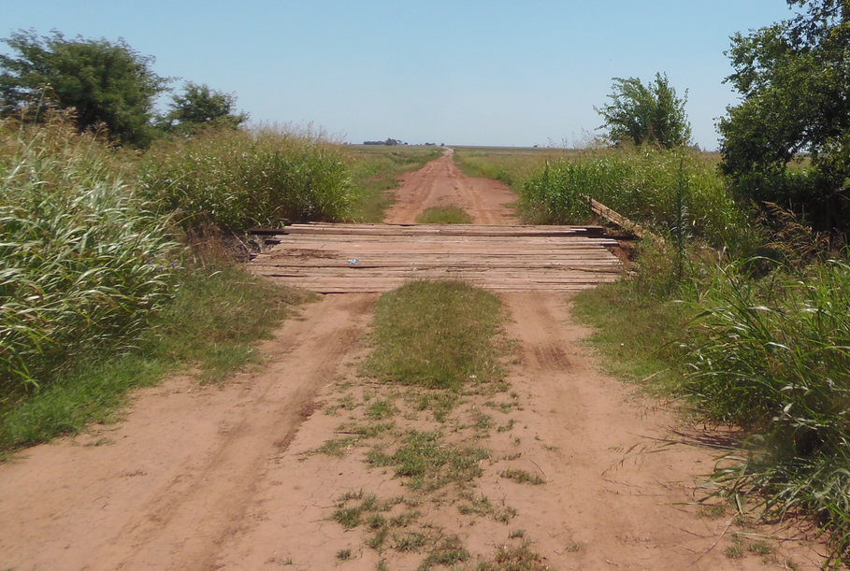
1920 miles
Over 1775 miles
County Maintained
Notes:
Remember, 4500 people, 1920 total miles – only 153 are highway (PAVED) – 1 mile section grid

Slide 5
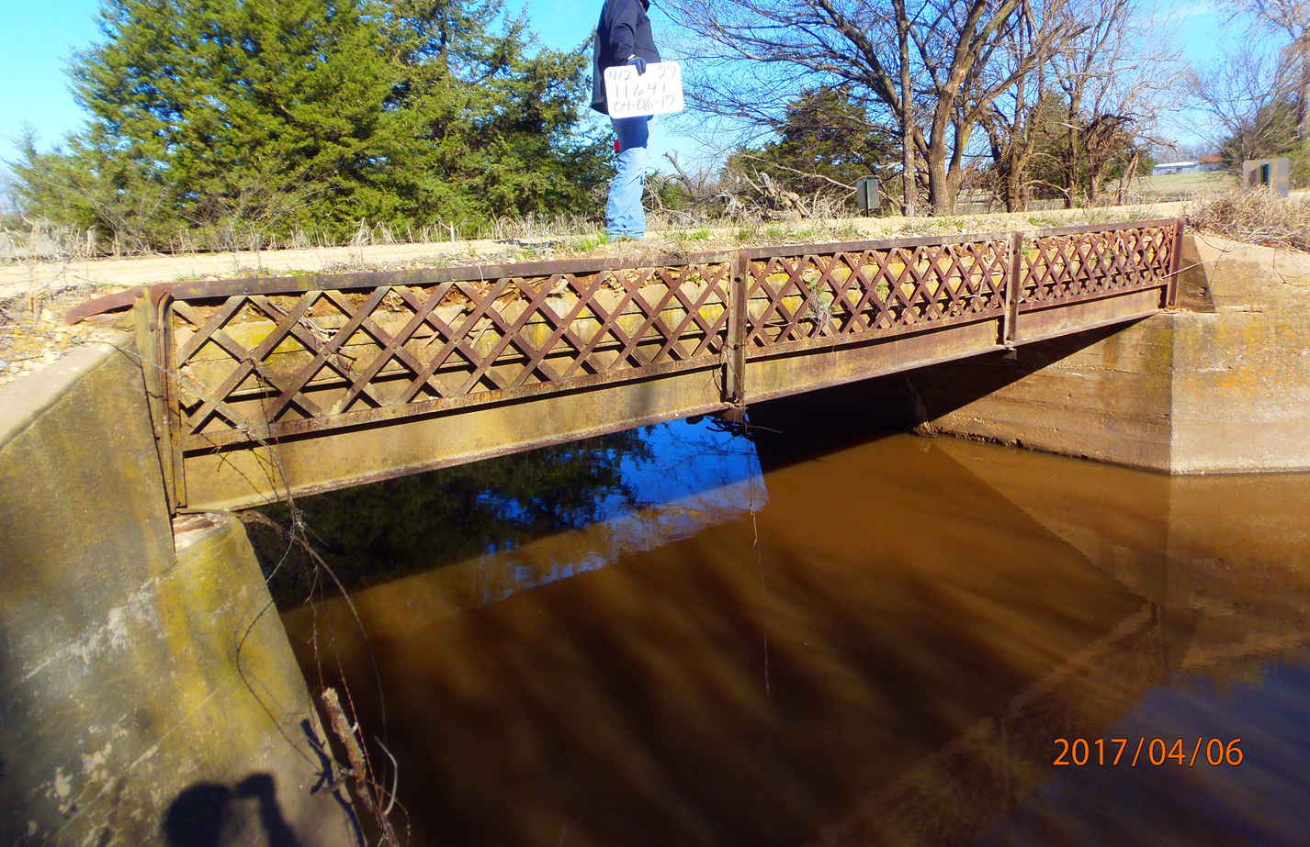
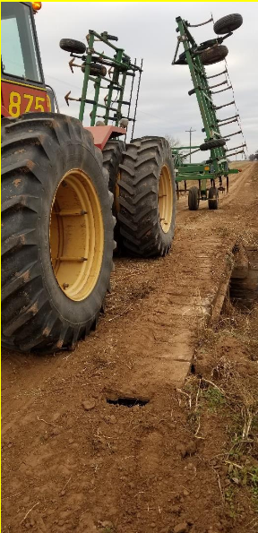
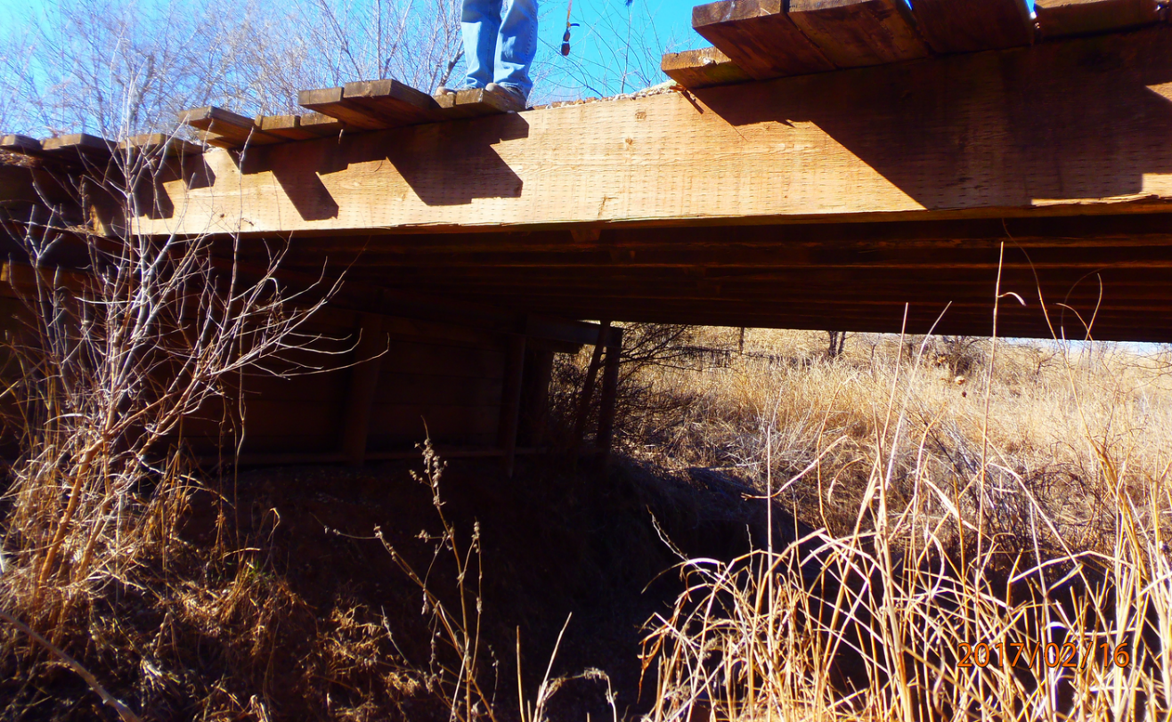
Notes:
Bridges are often 14-22’ wide – roadways are still access to homes, bus routes and mail routes

Slide 6
CHBP Grant Criteria:
Innovative Technology
Innovative Financing
Innovative Project Delivery
ODOT awarded $3.47 million for bundling of 34 bridge replacements
Notes:
Just read slide

Slide 7
Innovative Technology
Pre-cast concrete span beams
Easily fabricated, transported and erected on site
Pre-stressed elements, longitudinally tied
20’-40’ anticipated span lengths
Become part of County Bridge Standards
Additional Design Parameters:
28’ Clear Roadway – 10 Year Overtopping Hydraulic Design
Notes:
Innovative technology presented in grant proposal – ended up with 2 span lengths (30’ and 40’), 28’ wide, 18-24” thick segments.
Ended up not using the 20’ design due to hydraulics
Will be wider than what is typically out there now (good for farming equipment)

Slide 8
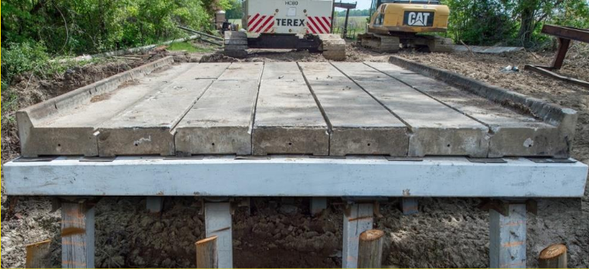
Pre-Cast Span Segmental Beams
Anticipate 20’ – 30’ – 40’ design lengths
Notes:
Example of bridge in Mississippi with pre-cast components

Slide 9
Innovative Technology
GRS Abutments:
Reduce Construction Time and Cost
Reduces Maintenance
Reduces Environmental Impact
Convenience and Flexibility
FHWA identified EDC Initiative
Notes:
Geosynthetic Reinforced Soil
Commonly called a “burrito”
No special equipment needed which opens the pool of potential bidders
No deep foundations – smaller environmental foot print
No “bump at the bridge”

Slide 10
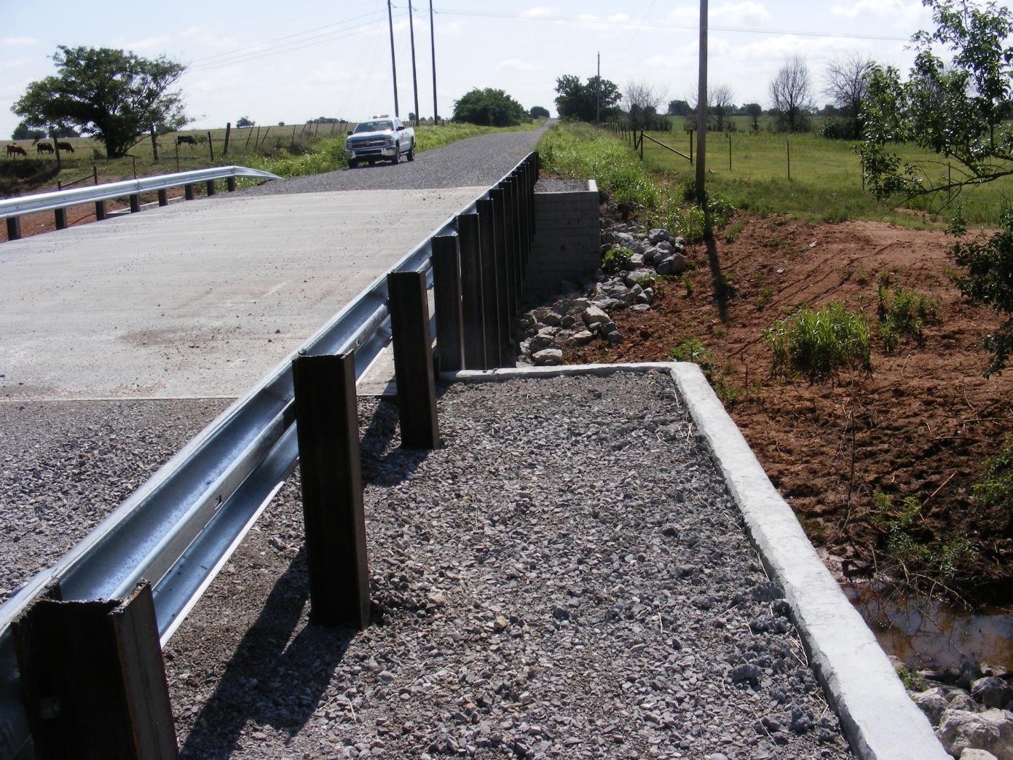
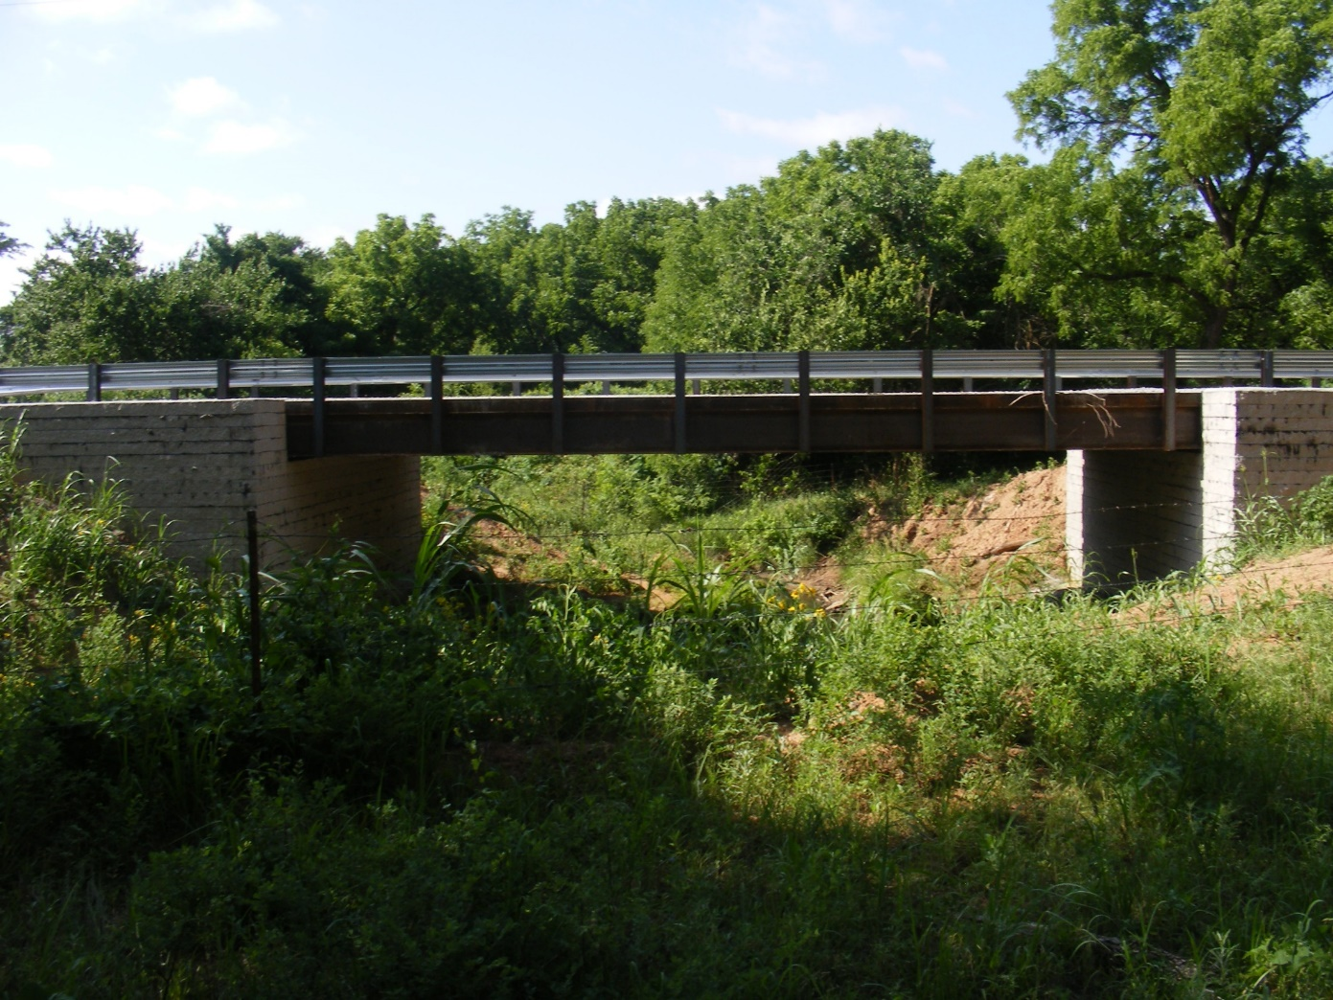
Notes:
Note these are using steel beams – sitting directly on the abutments

Slide 11
Innovative Financing
CIRB/STP | County | ODOT | CHBP Grant
$2,751,000 | $720,000 | $2,038,800 | $3,468,000
Economy of Scale – Estimate 12% Savings
Notes:
Makes use of multiple funding sources
Utilitzed ODOT resources for all pre-construction activities (would have cost $11.6M)
To replace 34 bridges with county funding would take over 40 years to accomplish – preliminary estimates $10.8M for construction – low bid was $11.7M
Would have cost over $22M to build individually

Slide 12
Innovative Project Delivery
1 Plan Set – 34 Bridges
Standard Design – reduce workload
Streamline Environmental Process and Permitting
Economy of Scale
Notes:
1 NEPA for all 34 bridges
1 404 permit

Slide 13
Innovative Project Delivery
Survey Complete | March 2020 Delivery
Hydraulics Complete | May 2020 Delivery
Environmental Underway | January 2021 Delivery
PS&E | June 2021 Delivery
Federal Authorization – Bid Letting | September 2021 Delivery
Notes:
Funds had to be authorized by the end of FFY21 (Sept 30) – only had from Sept. 2019-Sept. 2021
Huge commitment of resources – short time frame to deliver
Praise ODOT divisions and commissioners for commitment to seeing the project through

Slide 14
Benefits and Outcome
Reduce SD bridges in Grant county by 20%
Boost local economy
Improve traffic safety
Assist local communities with a sustainable transportation corridor
Notes:
Just read slide
Results in GRS standard that can be used in the future

Slide 15
Lessons Learned
Run hydraulics early
Plan for best case and worst case scenarios
Be flexible
Communication is key
Notes:
Had to remove bridges due to hydraulics being unable to meet Q10 with planned length
Best case – how will we capitalize if bids come in low? Designed extra bridges; Worst case – be ready and willing to find solutions if this happens (ex.-r/w taking too long)
This requires working with all stakeholders and asking for feedback from industry/contractors
Make sure communication is clear and all stakeholders are included
So far, SEVEN (7) bridges have been constructed and opened for use – that’s an average of 3-4 weeks per bridge!

Slide 16
Thanks to Grant County, ODOT Divisions, and FHWA!
ODOT Local Government Division
Melissa Davis – Project Manager
Notes:
Thank Grant County commissioners, ODOT divisions and staff, FHWA
Take questions

