Slide 1
Oklahoma IMO Update July 2022

Slide 2
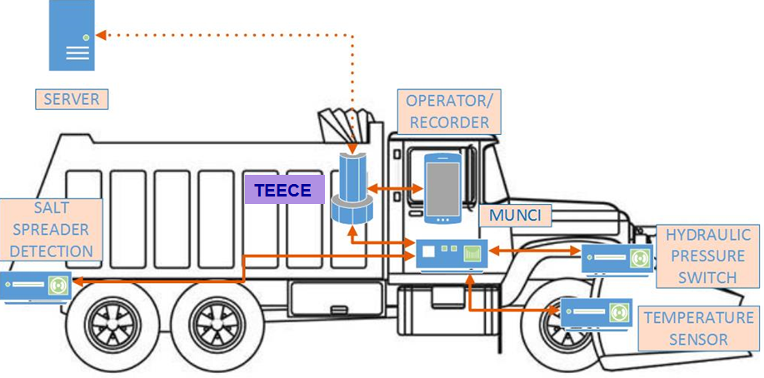
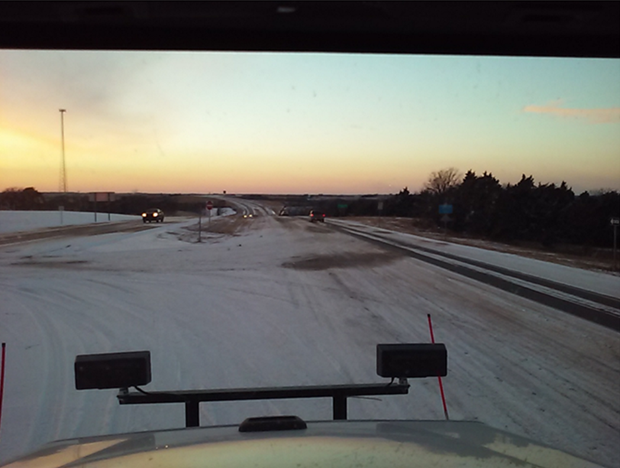
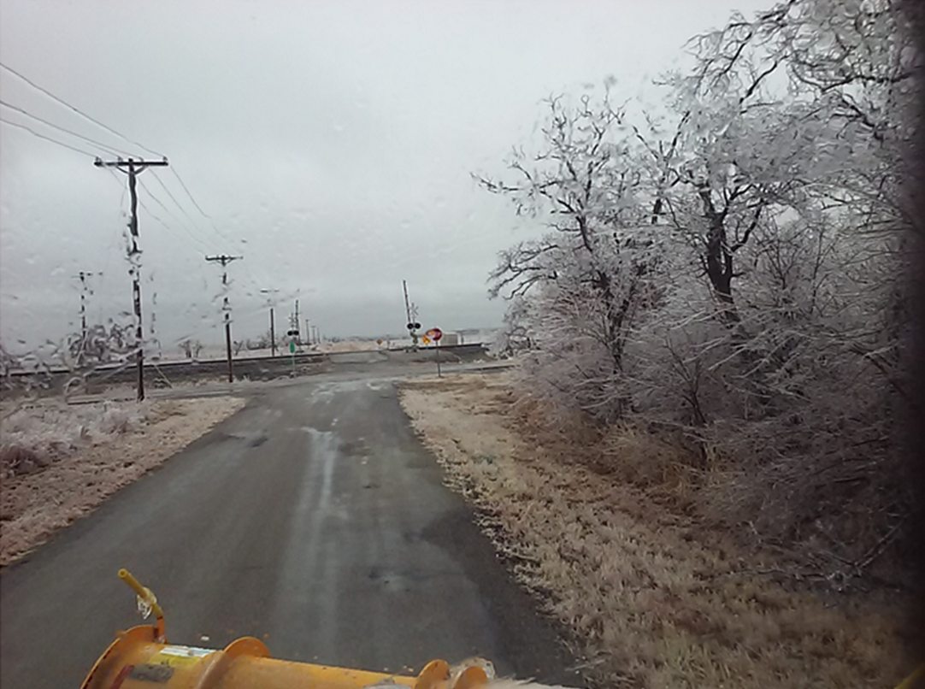
Snowplows - MATT

Slide 3
System Status
Current Deployment Level
Systems on 329 of 500 Existing ODOT Trucks
43 Systems on OK Turnpike Authority (OTA) Trucks

Slide 4
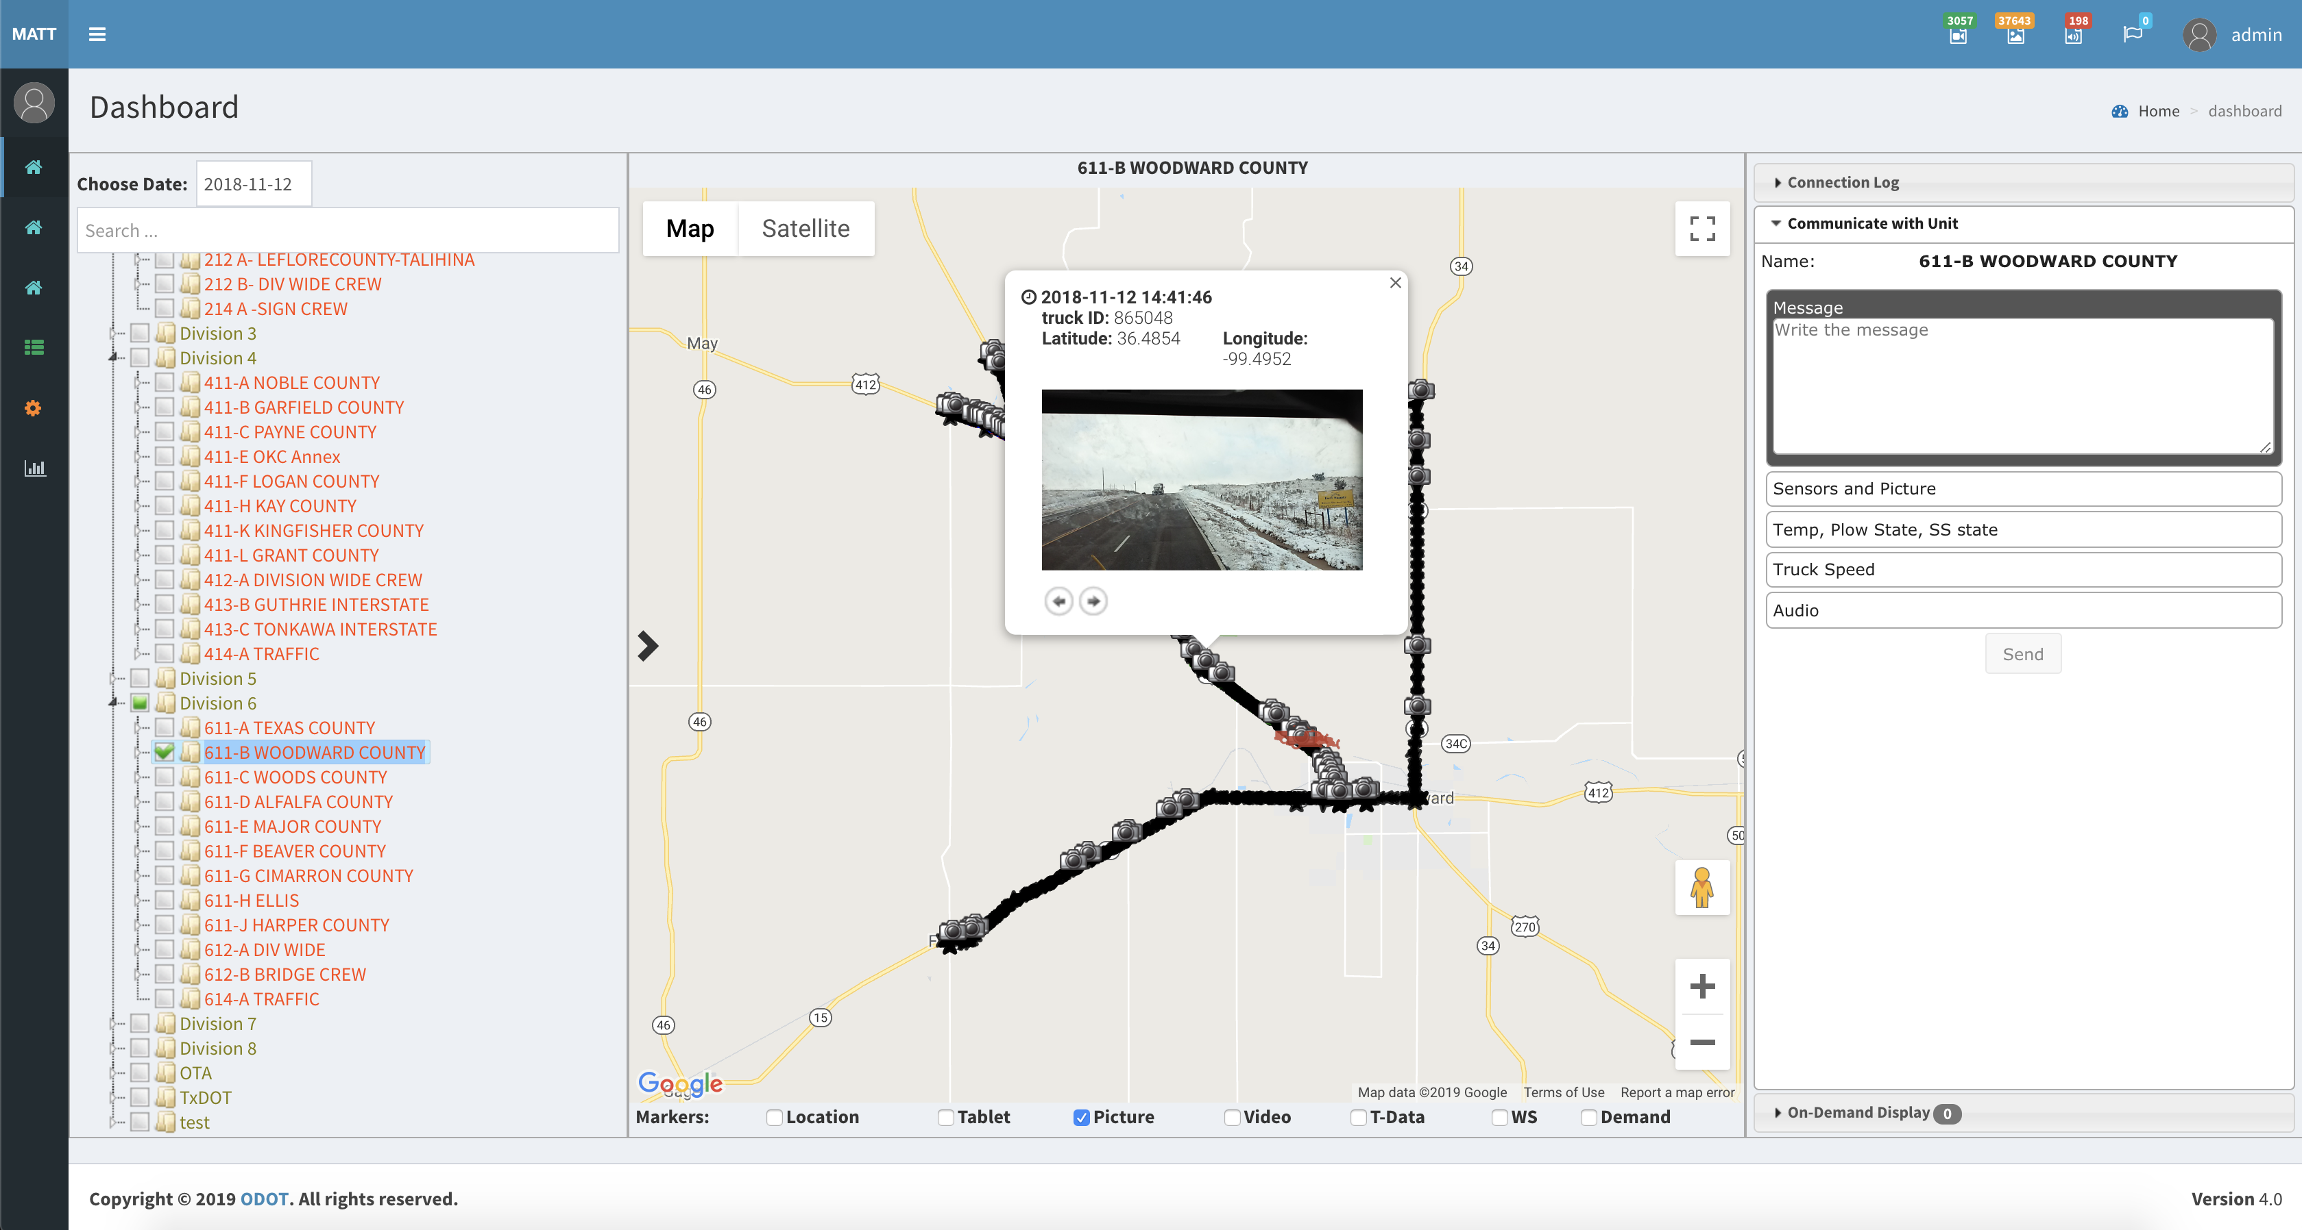
Dashboard 1: Truck Interaction

Slide 5
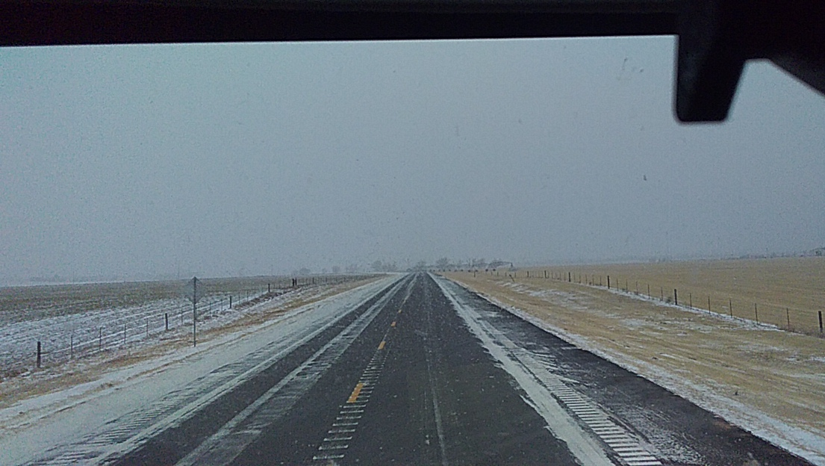
Snowplow image enlarged

Slide 6
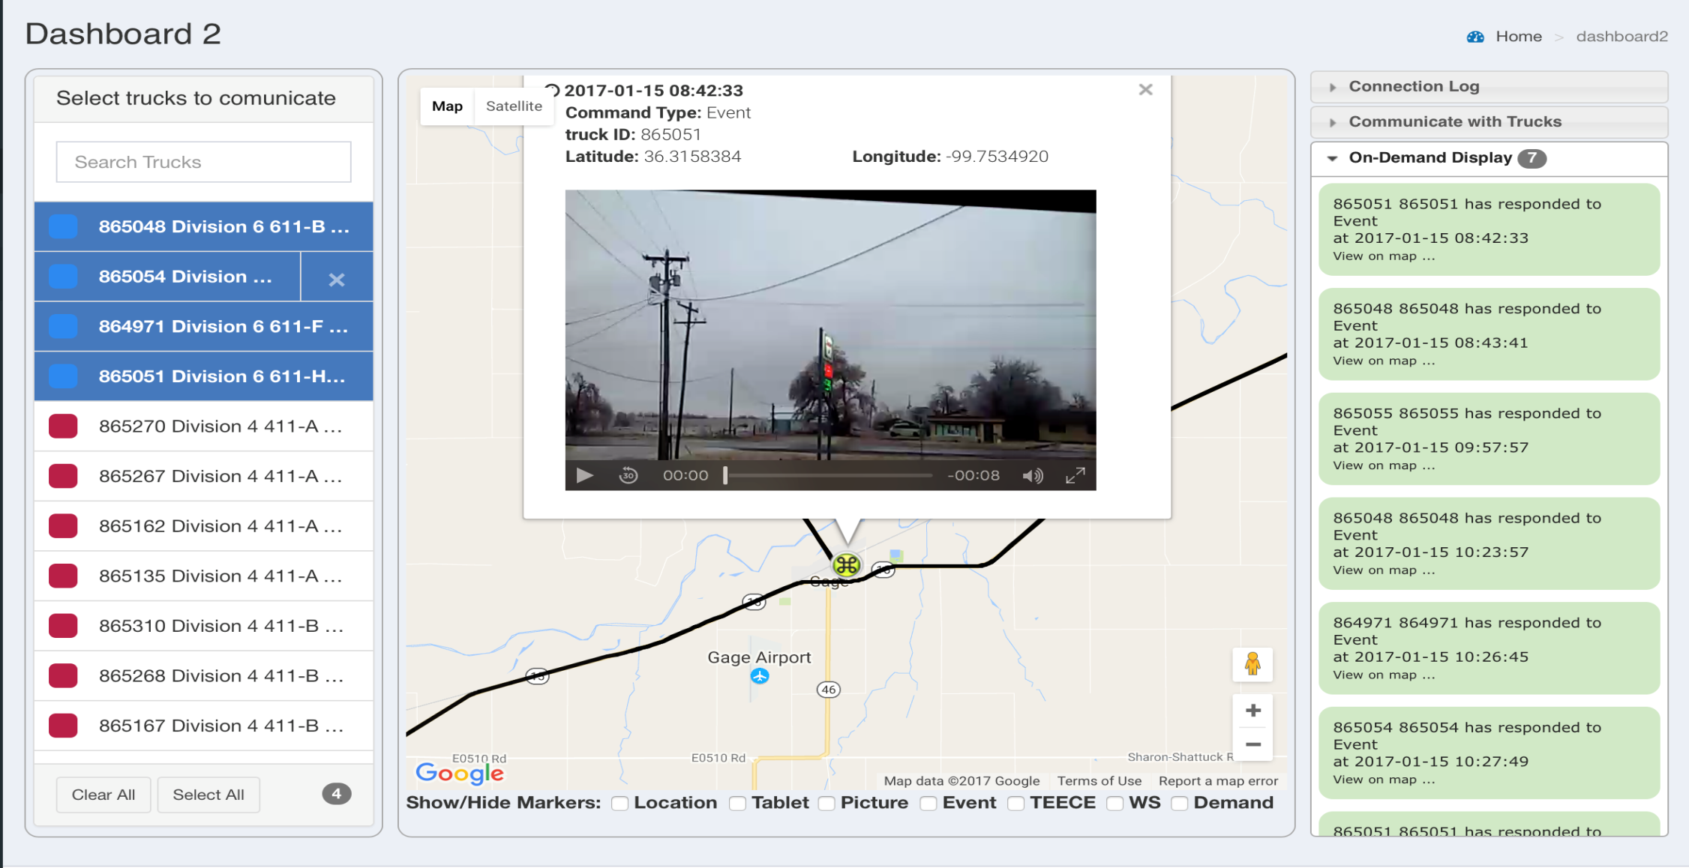
Dashboard 2: Active Trucks

Slide 7
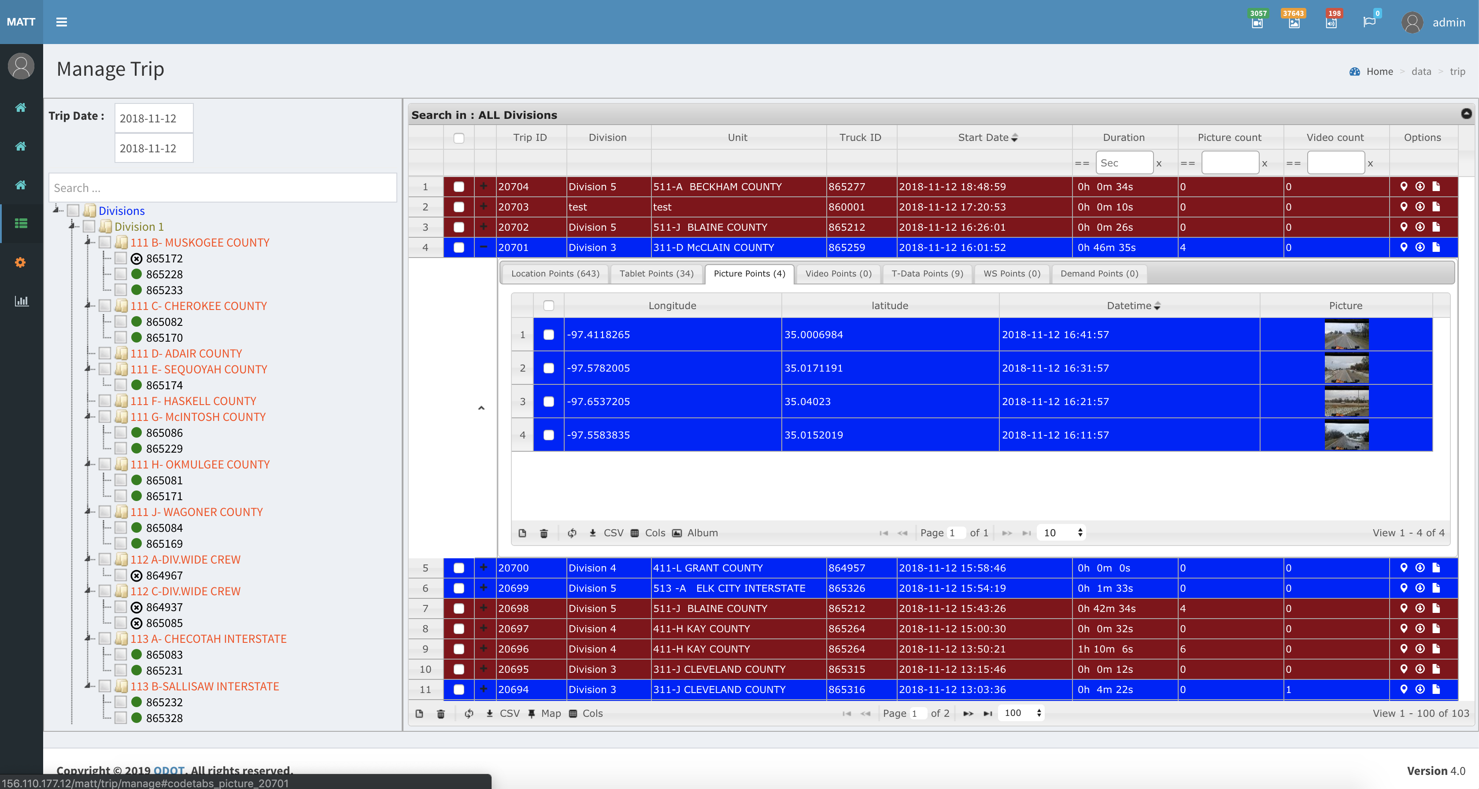
Data Review and Management

Slide 8
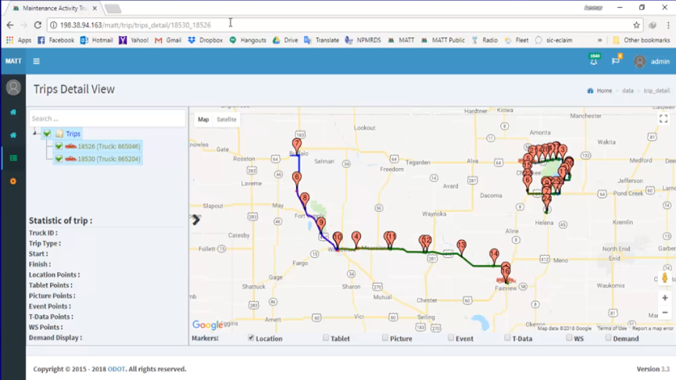
Trip Playback

Slide 9
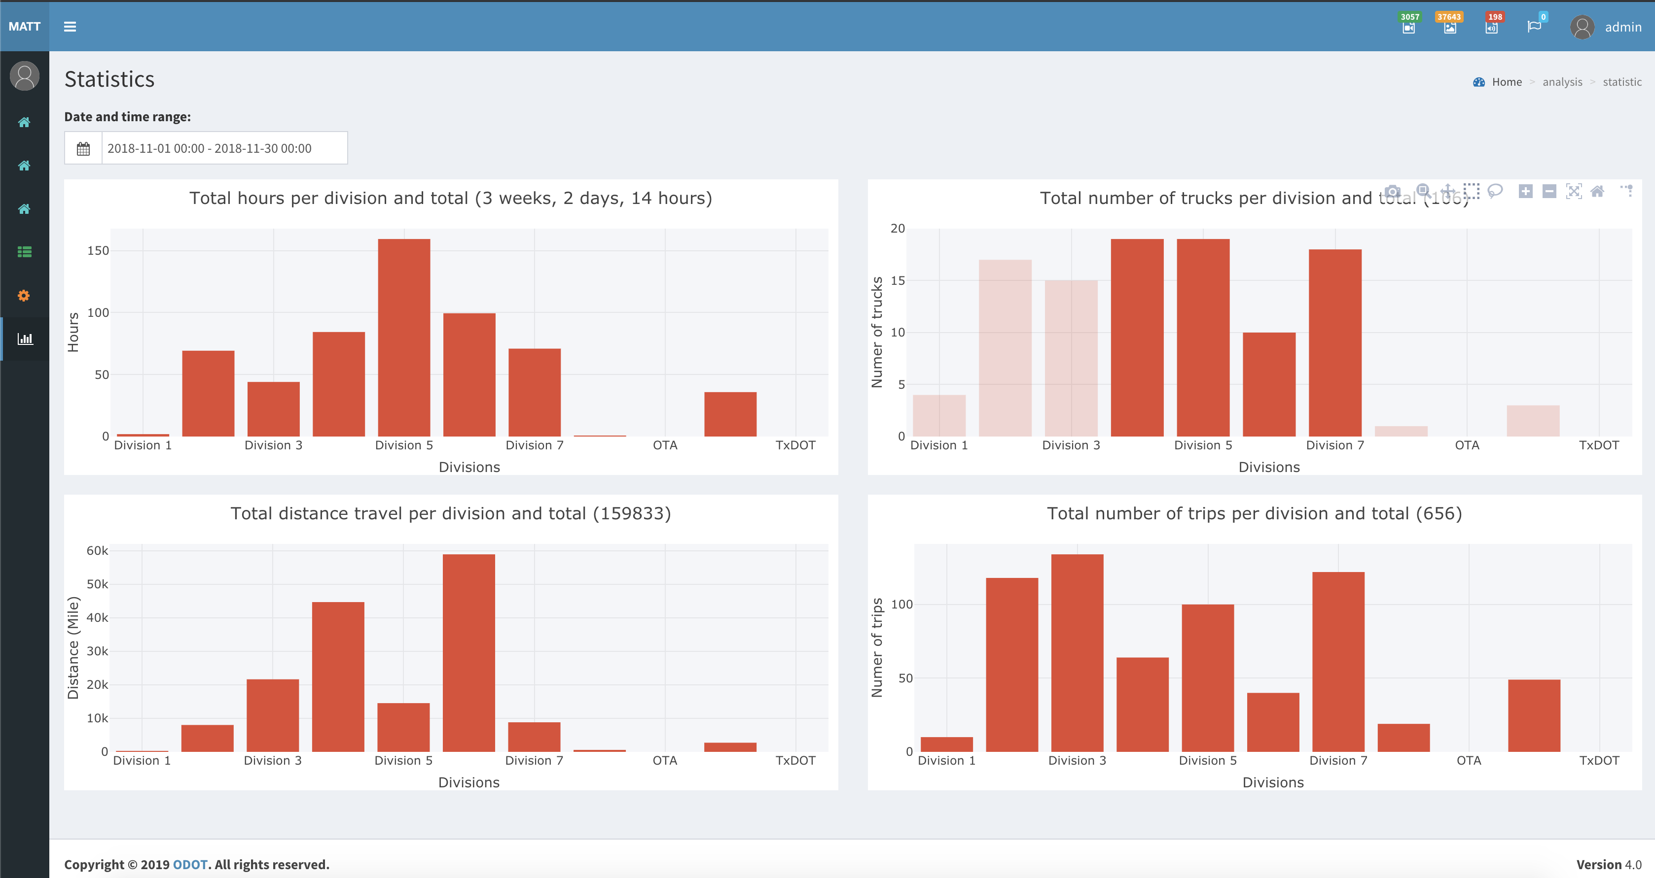
Data Mining and Analytics

Slide 10
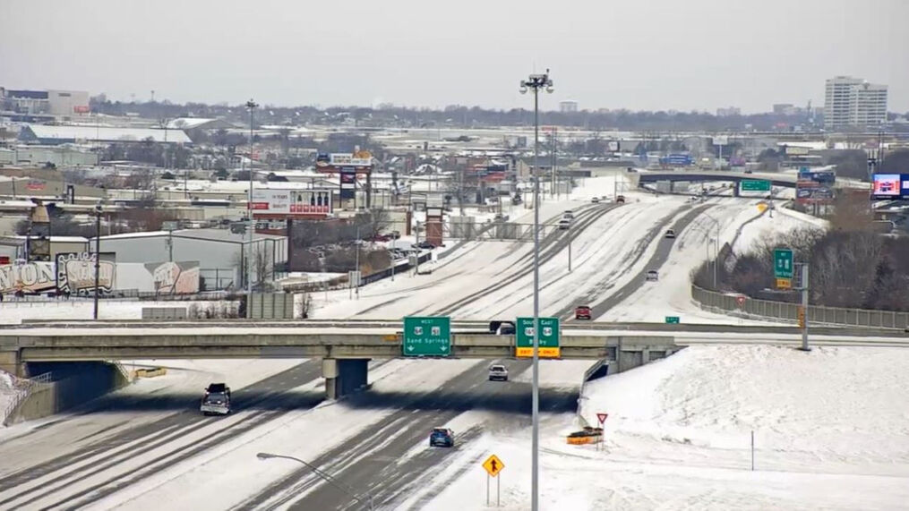
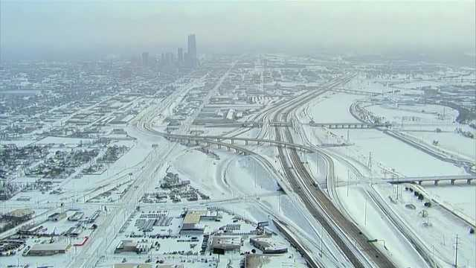
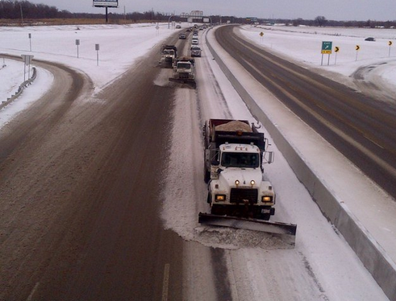
OKRoads.org
Real-Time Road Conditions

Slide 11
Overview
Public website for road conditions during weather events
Shows Moderate, Severe, or Closed road conditions
Data entered by ODOT, OTA, and DPS

Slide 12
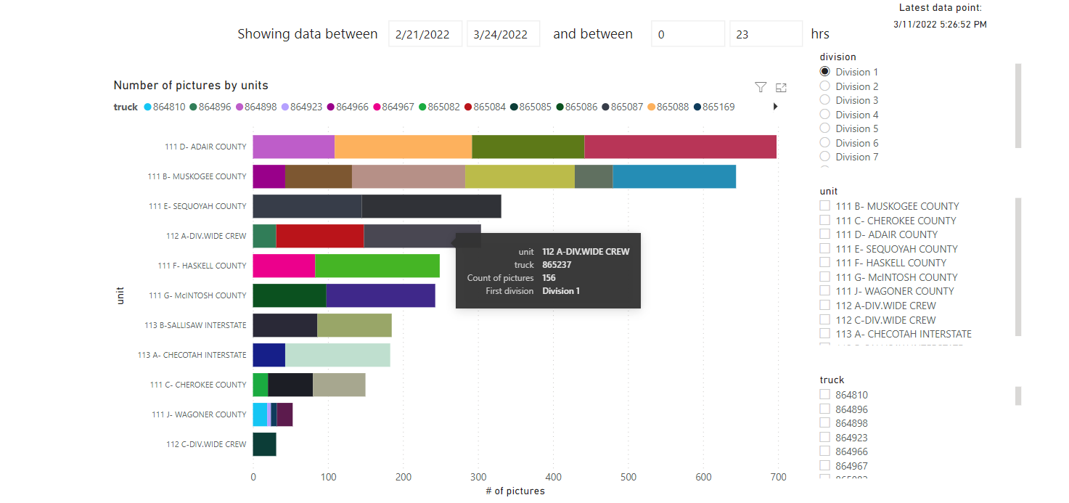
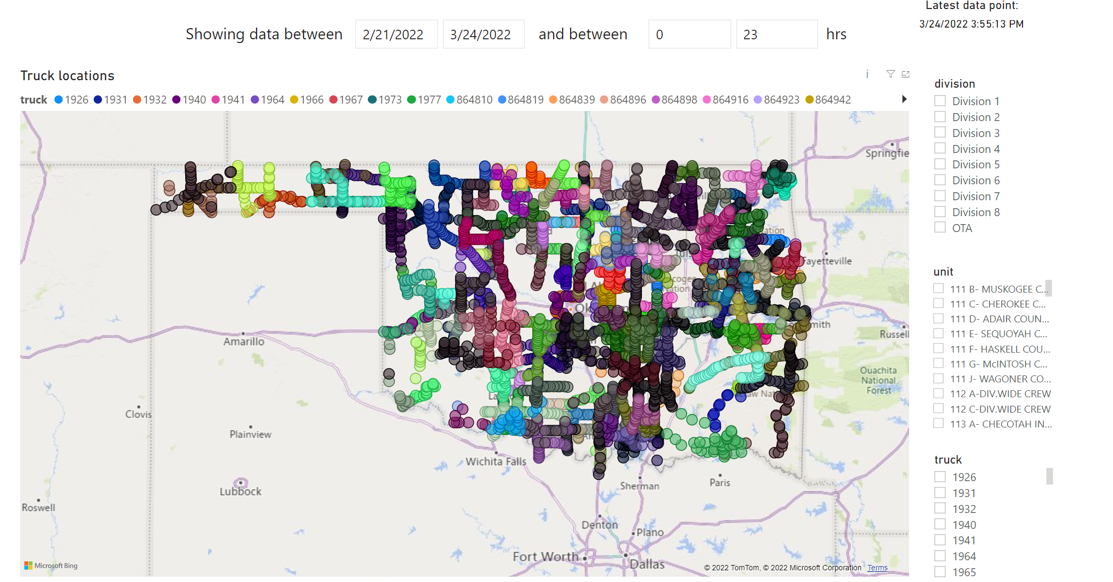
Latest Updates
Snowplow Analytics
Analytics and Reports can be easily made
Search Truck data by Date
Filter by Division, County, or Truck ID
Show the truck’s time stamped activity

Slide 13
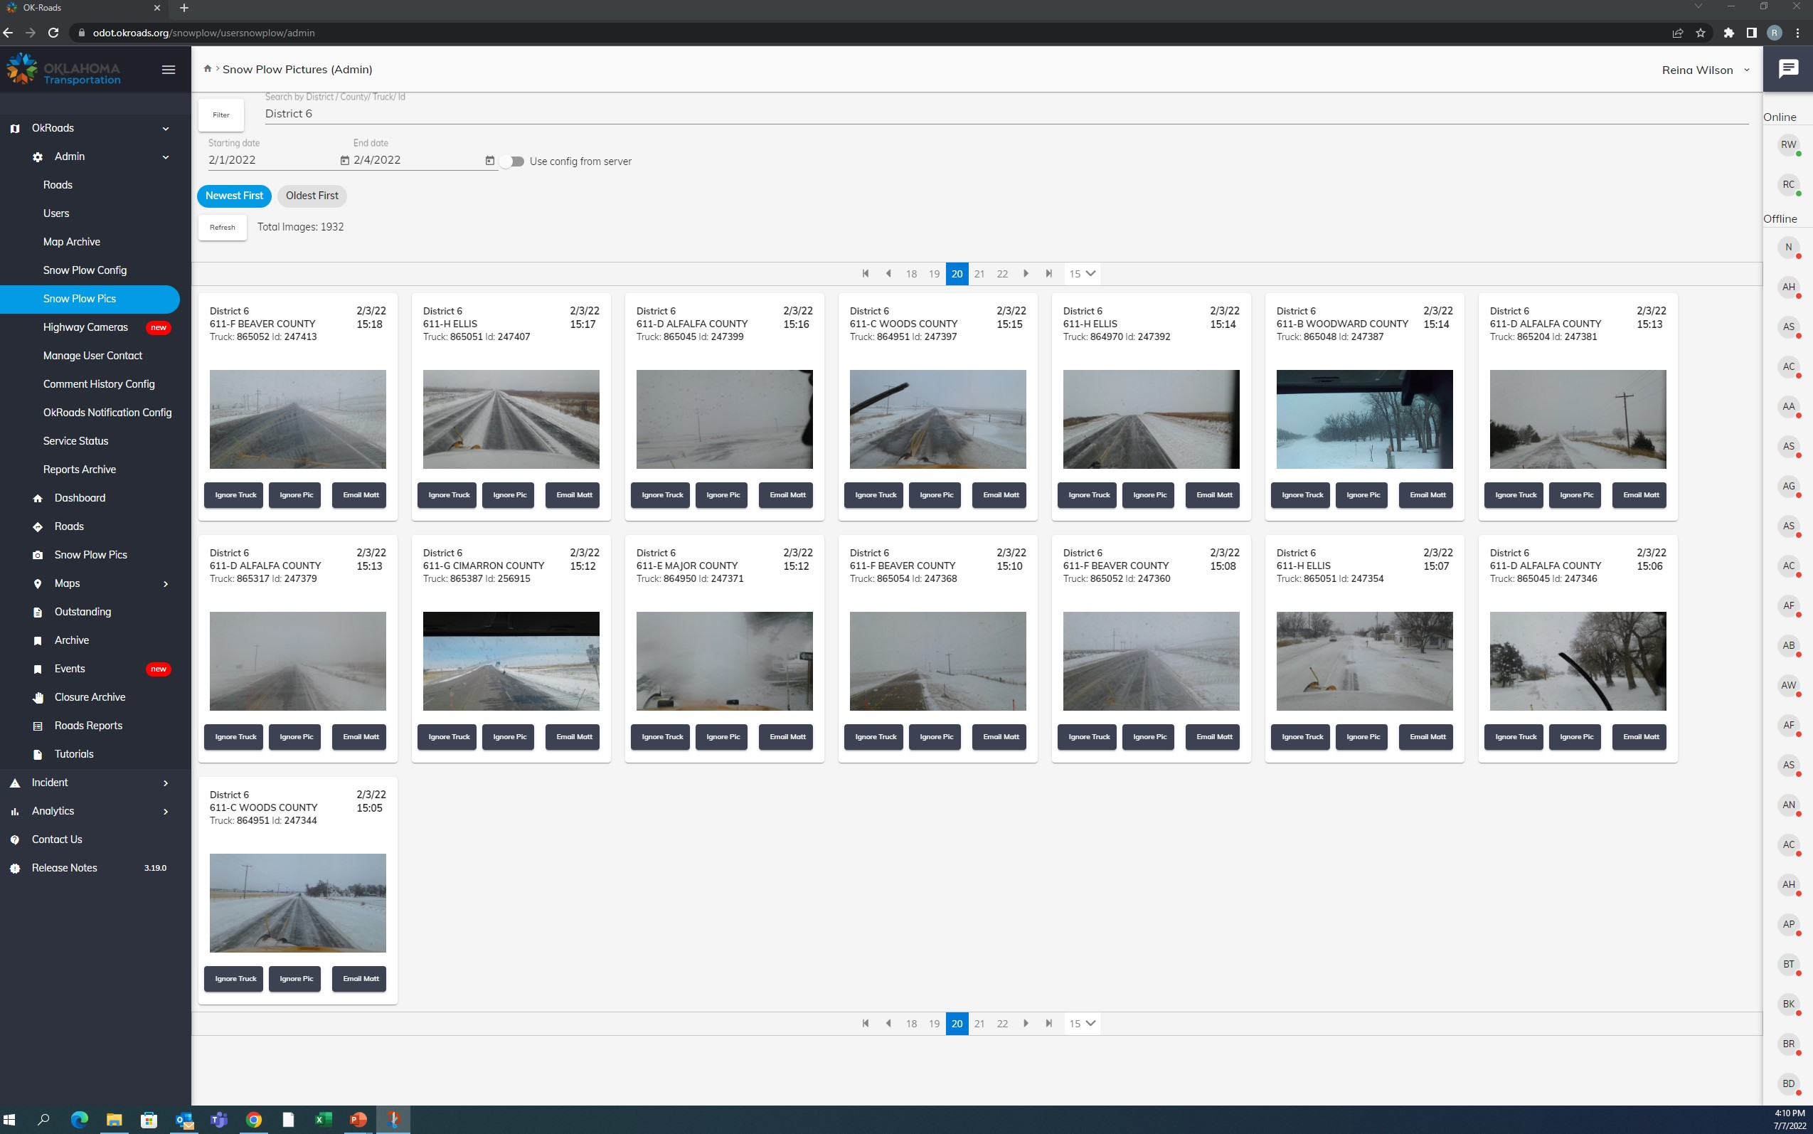
Latest Updates
Snowplow Images
Most recent images posted to the public map
Admin has ability to filter images that post to the public

Slide 14
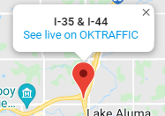
Latest Updates
Highway Camera Dashboard
When the County road conditions are turned on the Cameras placed around the Metro will show up on OKRoads
Location, Date and Timestamp are provided for each picture
Option to ignore a camera on OKRoads (used if it freezes or isn’t functioning correctly)
Option to view live camera on OKTraffic

Slide 15
Latest Updates
Map Archive
Easy to see the progression of a storm and how the roads were affected
Download a Zip File or email the video directly

Slide 16
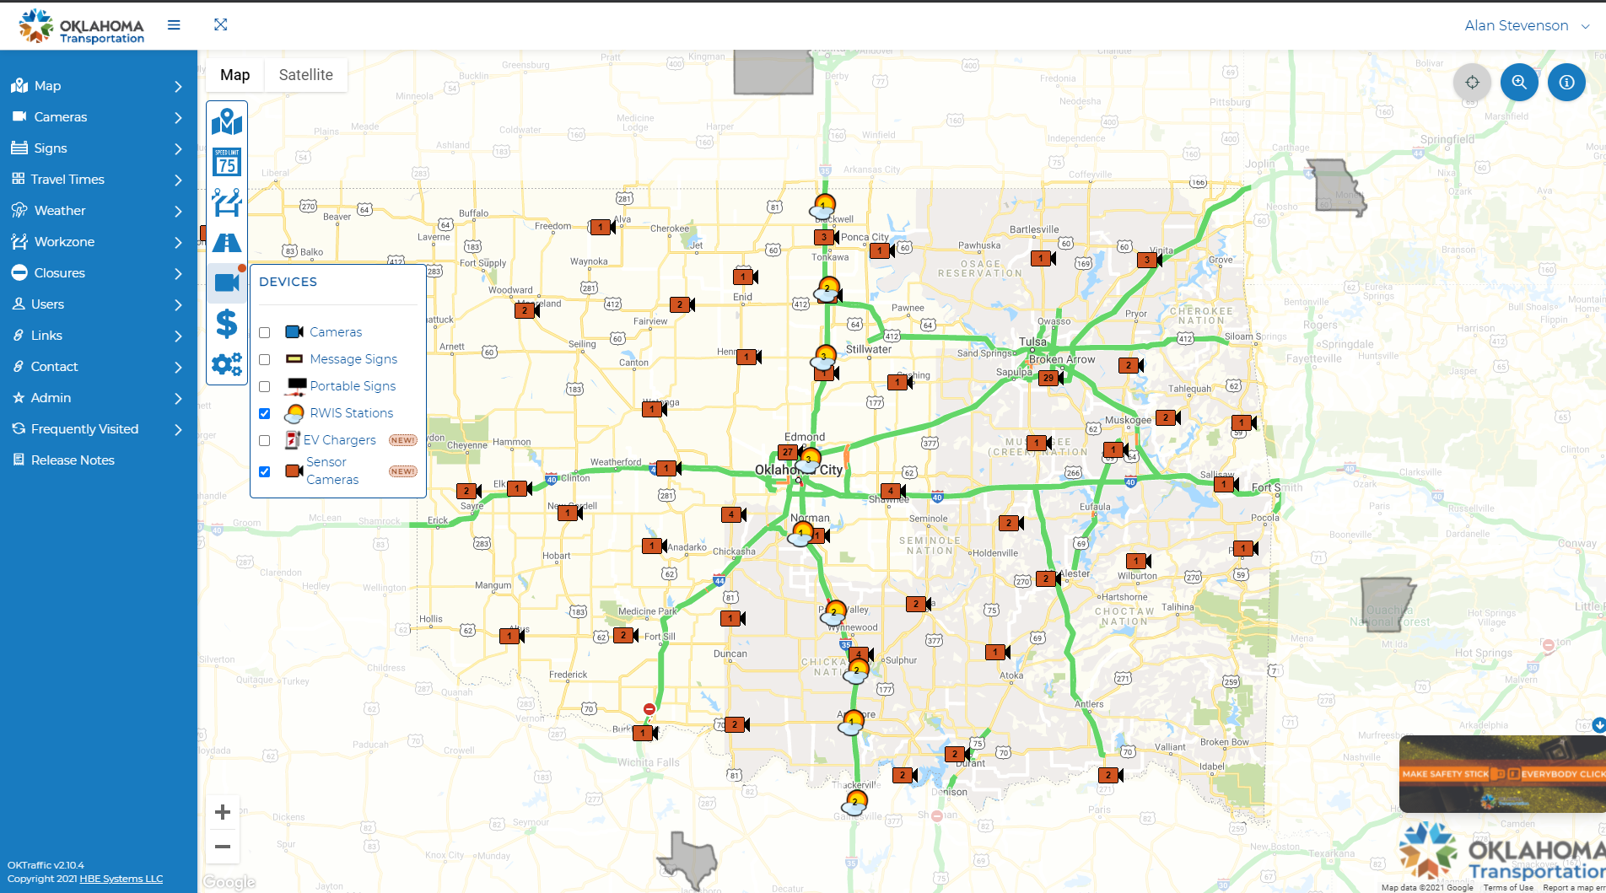
OKTraffic.org Weather – RWIS and SAPM AVC Sites
16 RWIS sites along I-35 from TX to KS Border
151 AVC sites across State

Slide 17
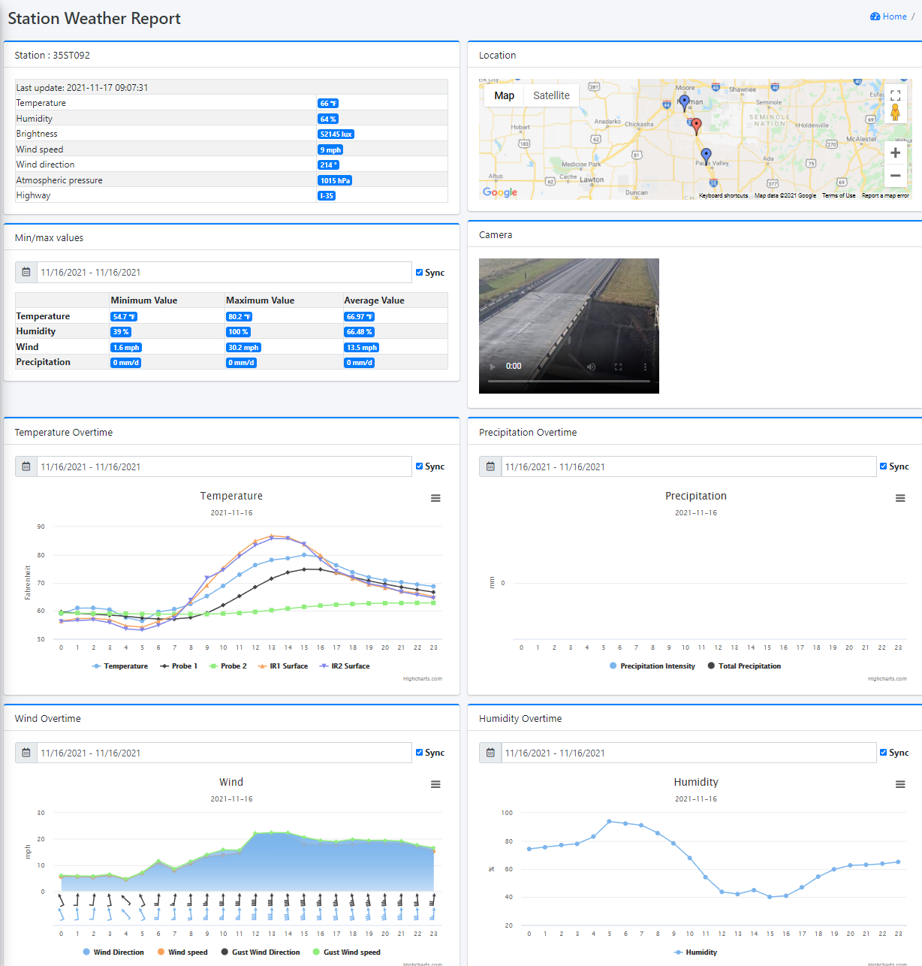
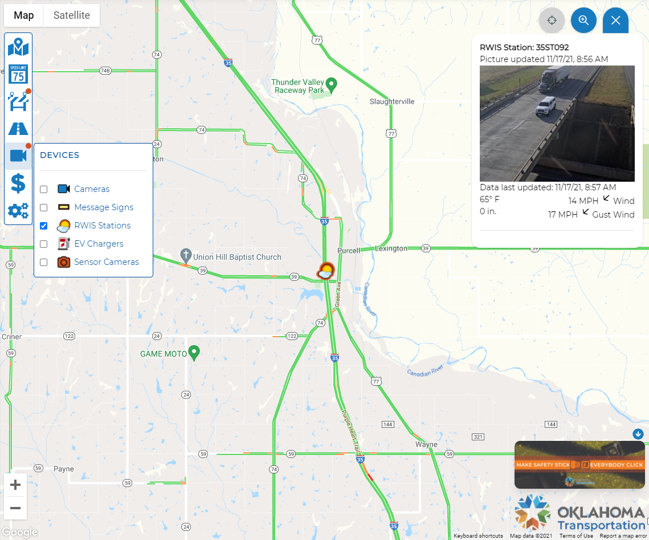
Road Weather Information System
5 Temperature Readings
Air, Bridge Surface, Road Surface, Pavement Embed, Subsurface
Precipitation, Wind, Humidity, Verification Camera

Slide 18
OKTraffic.org Weather Layer

Slide 19
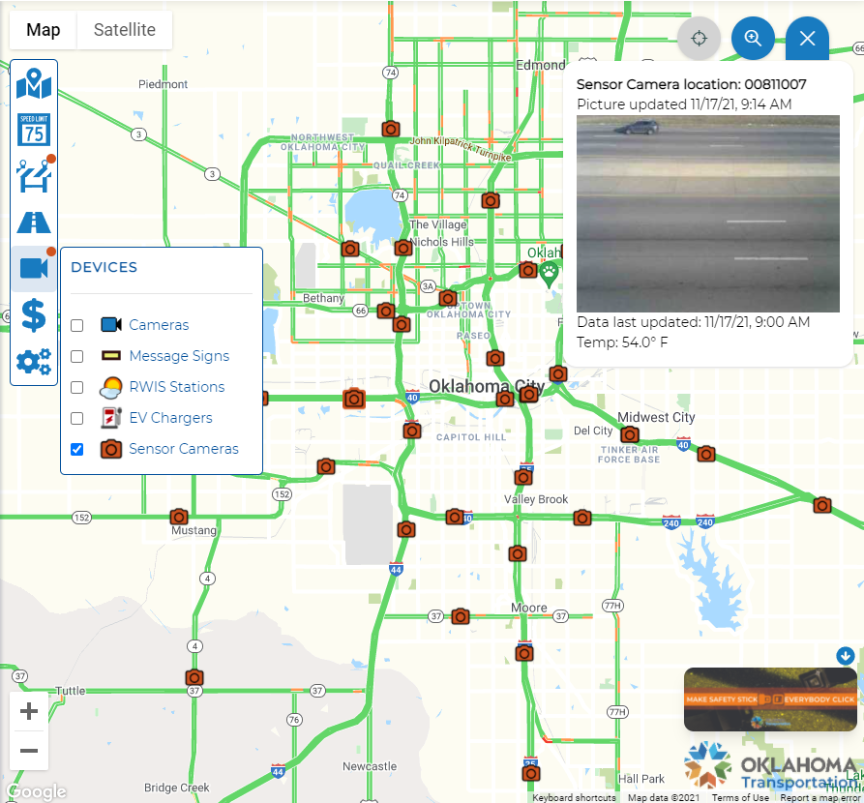
OKTraffic.org SAPM AVC Sensor Sites
Air Temperature and Snapshot Verification Camera

Slide 20
Questions?
Alan Stevenson
Asst State Maintenance Engineer
ITS, Fiber Optics, and Wireless Branch
astevenson@odot.org
(405) 521-6460

