Slide 1
GIS in Oklahoma’s Transportation Cabinet
Jeremy Planteen

Slide 2
Overview
Cabinet consists of three agencies
Department of Transportation
Responsible for all Federal Aid Highways (over 12k centerline miles)
Data aggregator for county roadway data used for apportionment
HPMS
Functional Classification
Turnpike Authority
Responsible for Turnpike infrastructure (approx. 600 centerline miles)
Non-appropriated agency with dedicated IT staff
Aeronautics Commission
Small agency with very directed focus
Some GIS capability

Slide 3
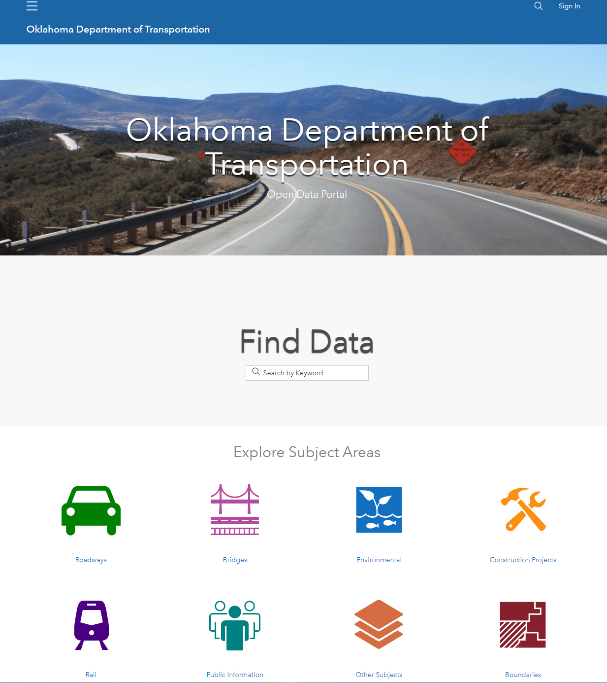
GIS Infrastructure
18 full time GIS staff (largest in OK state government)
Primarily use Esri Enterprise GIS infrastructure (ArcMap, ArcPro, Enterprise Server/Portal, ArcGIS Online)
Data endpoints built around REST apis (easy integration with other systems)
Fully matured public-facing GIS environment (Spotlight)
Extensive adoption of use internally, externally, and with partner agencies/firms
Diverse staff skillsets allow us to be able to tackle major GIS work that is uncommon in state DOT’s without third party consultants (Asset Inventories, LiDAR analysis, process automation, etc.)
LRS editors, HPMS coordinator, cartographers, analysts
Data stewards/coordinators for traffic count, safety, and pavement condition data

Slide 4
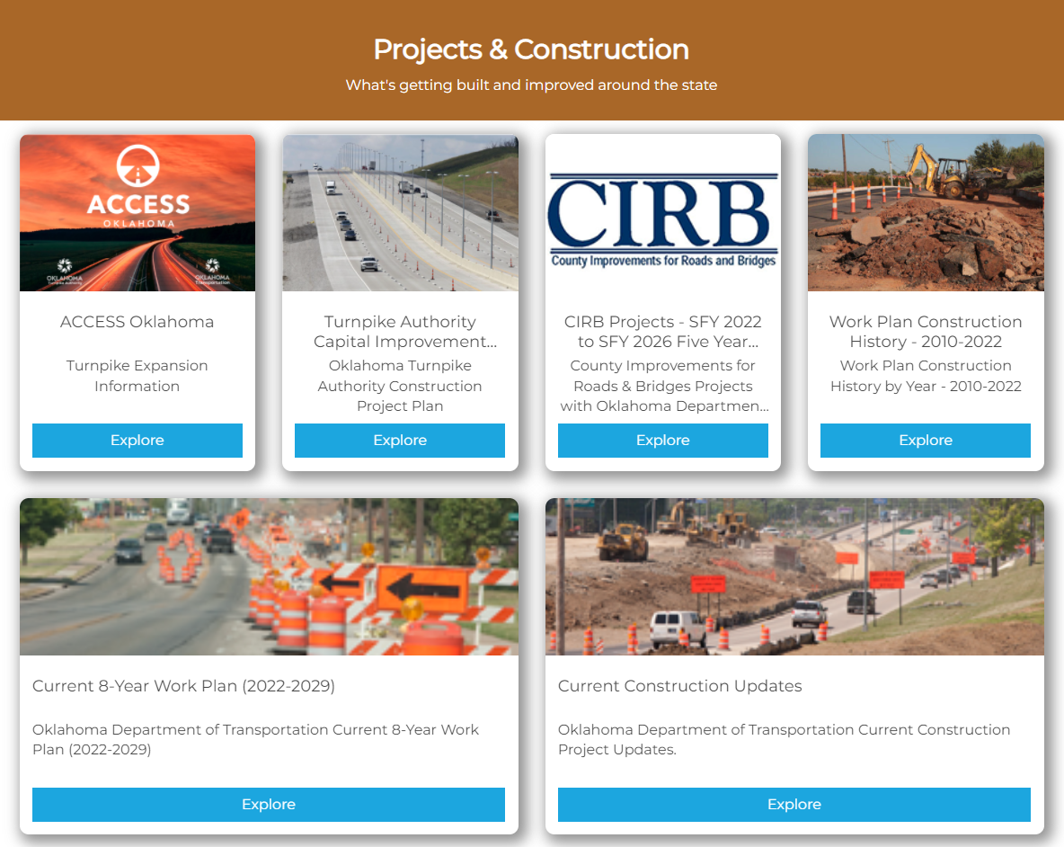
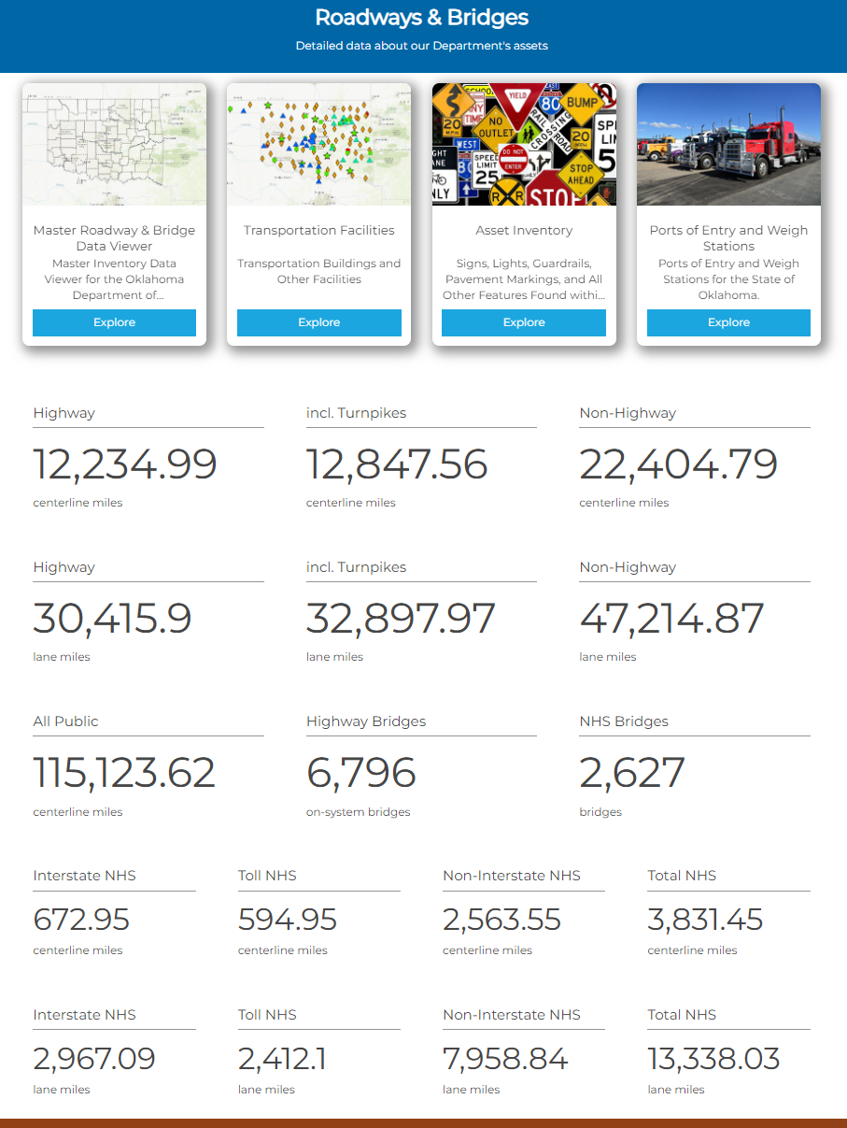
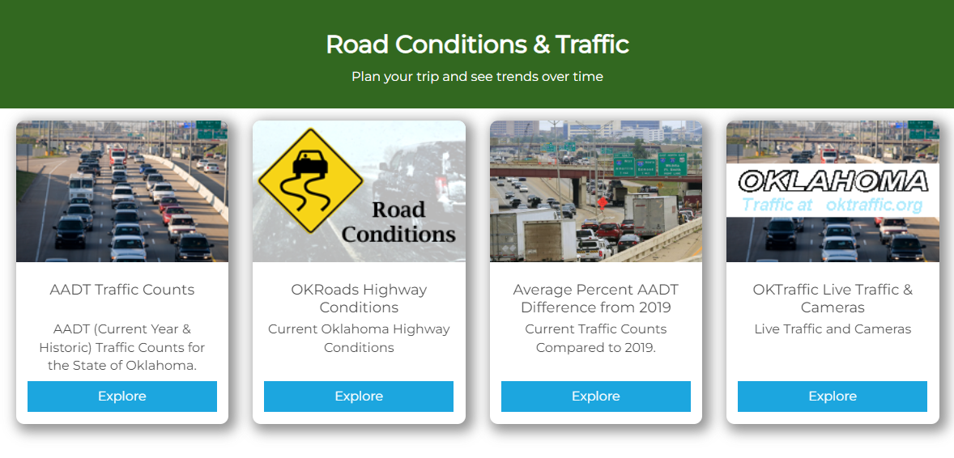
Spotlight Overview
Primary landing page for Oklahoma Transportation GIS and map data
Original ArcGIS Online page launched in early 2016
Significant ROI
Transition to Spotlight (Hub) format in 2021
Nearly 300 unique feature layers
Over 300 unique web mapping applications
Support for interactive surveys, mobile field data collection, web based GIS analytics, and more
Roadway & Bridge Data
Construction Data
Plan data (OTA)

Slide 5
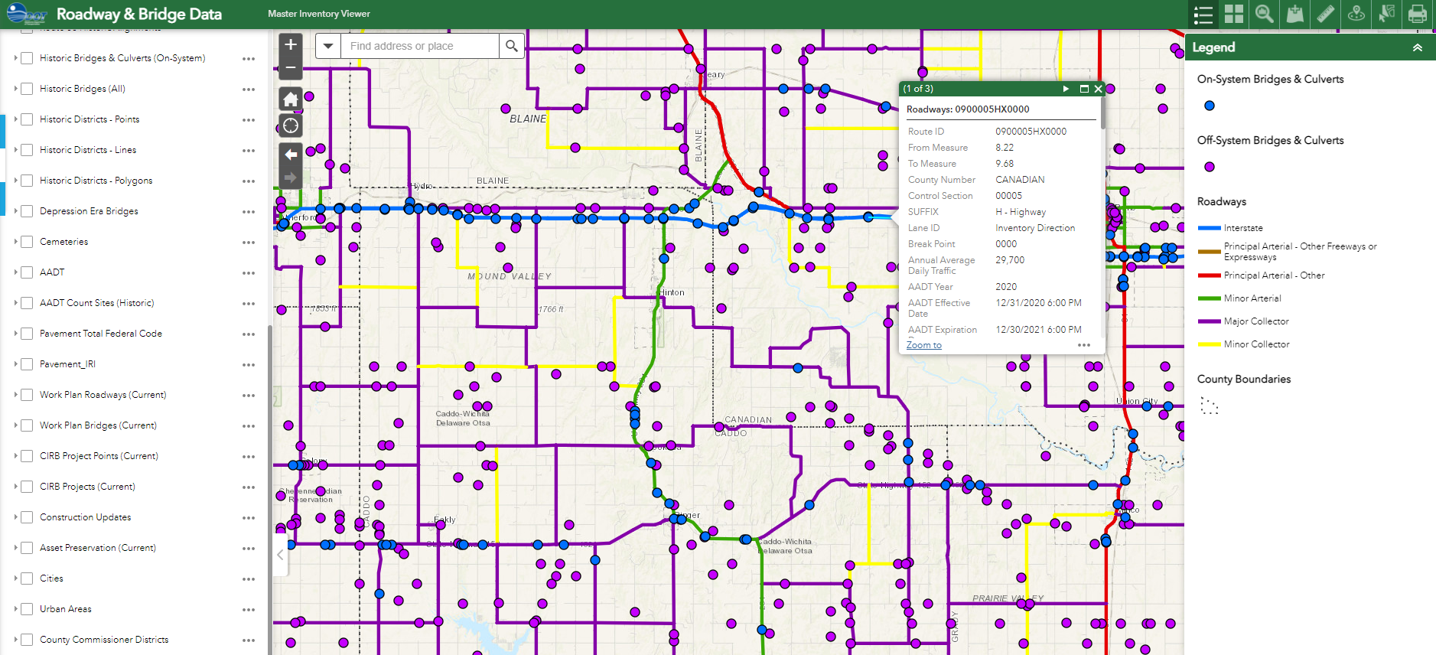
Roadway & Bridge Data Viewer
Replaced legacy GRIP viewer
One-stop-shop for most roadway and bridge data needs
Structural data, AADT, condition, etc.
Construction project data
Jurisdiction boundary overlays
Multiple available basemaps

Slide 6
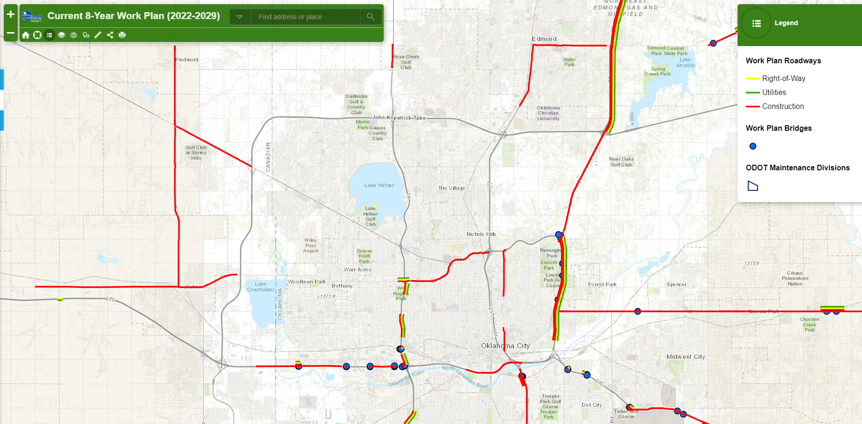
Construction Project Data
ODOT 8 Year Plan
Details planned jobs
Construction, ROW, utilities
Preliminary cost information and dates
Multiple available basemaps

Slide 7
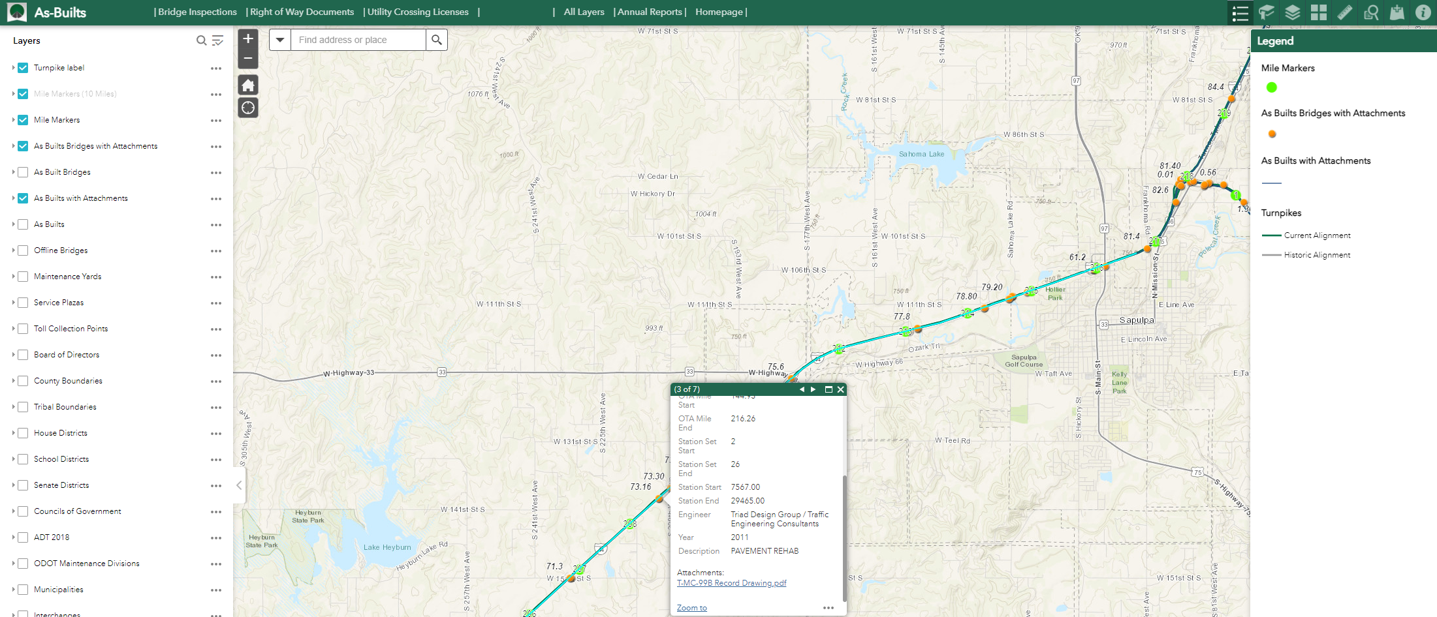
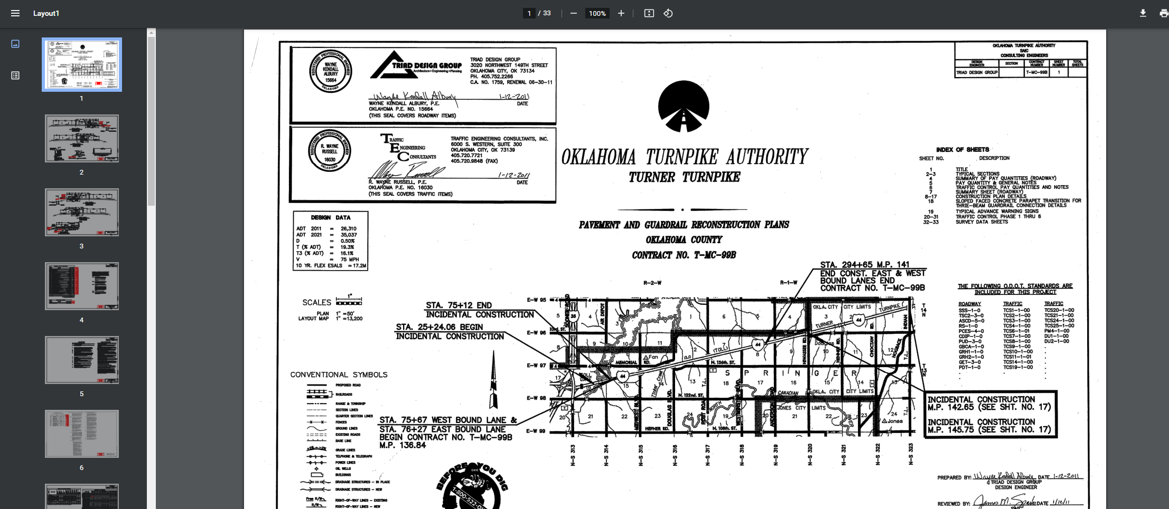
Document Access
OTA As-Built Plans, ROW Documents, & Utility Crossing Permits
Requires Login
Provides planners, consultants, and others self-service access
Greatly improves data availability and access times
Likely a dedicated version for ACCESS projects

Slide 8
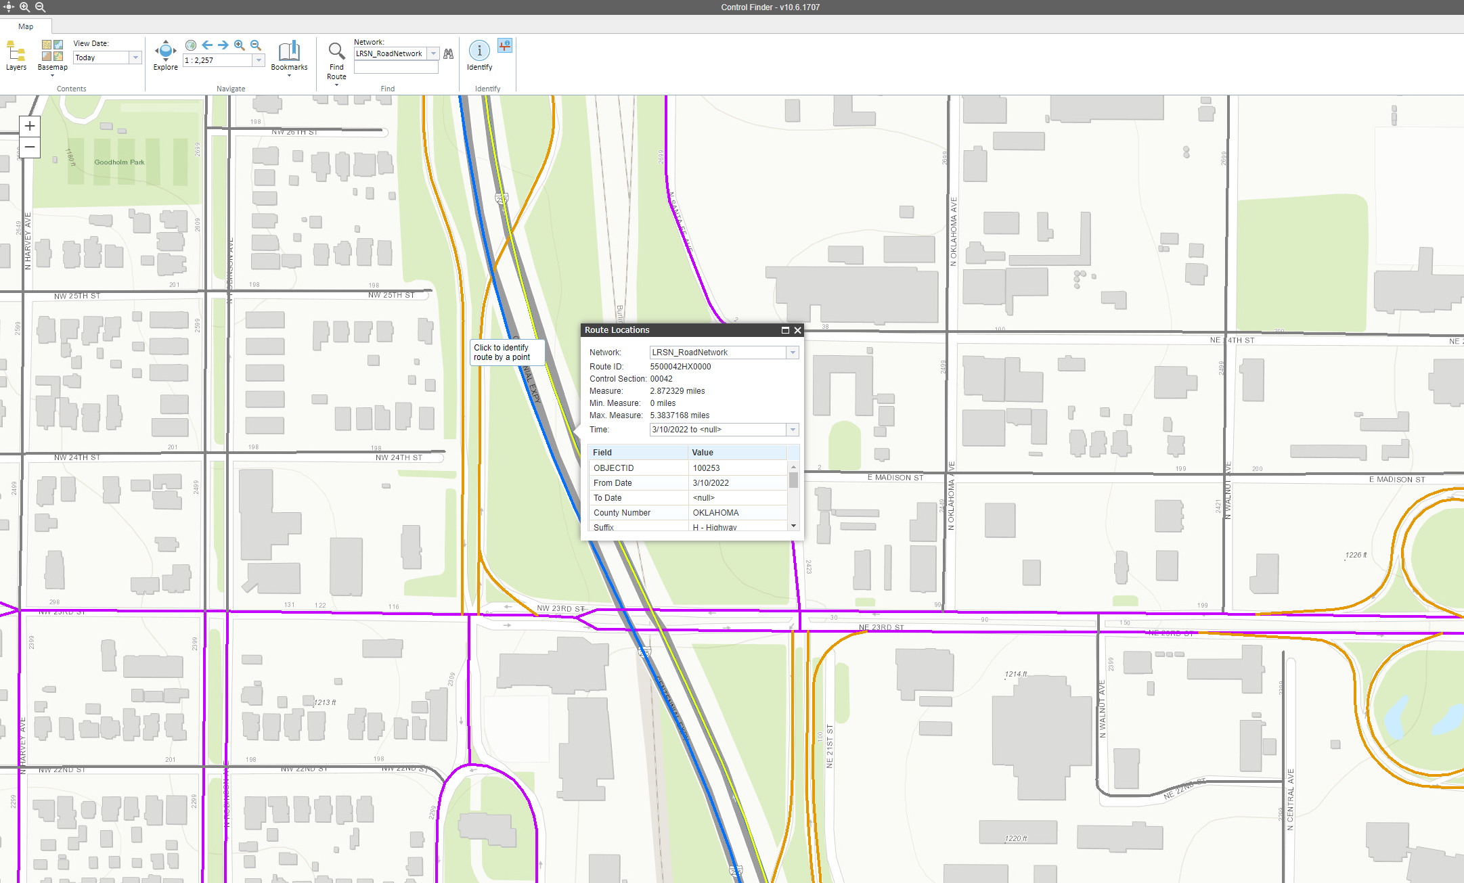
LRS Data Access
Web-based, Clickable interface
Provides Route ID and milepoints instantly
LRS data is base ‘source of truth’ for all roadway and bridge data in the agency
Project planning, construction, etc.
Significantly sped up LRS information encoding

Slide 9
Other Work
Traffic safety data geoenrichment
Decrease lag of officer report to analytics-ready from 6-8 months to less than a week
Environmental & OAC Mobile Field data collection
Survey Tools
Data integration with CAD software
MMS (Agile & VueWorks) Integration

Slide 10
Questions?

