Slide 1
HIGH FRICTION SURFACE TREATMENT (HFST)
Oklahoma Transportation
Office of Research and Implementation
Bryan W. Cooper

Slide 2
HFST Site Locations, Construction Dates
LOCATIONS:
1. SH 20 / 82 Mayes County North Site, 2013 (Calcined Bauxite)
2. SH 20 / 82 Mayes County Mid Site, 2013 (Calcined Bauxite)
3. SH 20 /82 Mayes County South Site, 2015 (Mine Chat)
4. I-40 / Town Center Drive, Oklahoma County, 2015 (Calcined Bauxite)
5. I-40 / SE 29th Street, Oklahoma County, 2015 (Calcined Bauxite)
6. I-44 / Airport Rd. Oklahoma County, 2015 (Calcined Bauxite)
7. System Implementation: Rogers, Lincoln, Tulsa, LeFlore, Mayes, & Sequoyah Counties, 2019

Slide 3
Original Locations Map

Slide 4
Mine Chat Location Map

Slide 5
I-40 WB at Town Center Drive MWC

Slide 6
I-40 WB over SE 29th St. MWC

Slide 7
I-44 WB at Airport Road OKC

Slide 8
SH-20 / 82 North Site Mayes County, June 2014

Slide 9
SH-20 / 82 North Site Mayes County, July 2015

Slide 10
SH-20 / 82 North Site Mayes County, July 2016

Slide 11
SH-20 / 82 North Site Mayes County, Jan. 2017

Slide 12
SH-20 / 82 North Site Mayes County, April 2018

Slide 13
SH-20 / 82 Mid Site Mayes County, June 2014

Slide 14
SH-20 / 82 Mid Site Mayes County, July 2015

Slide 15
SH-20 / 82 Mid Site Mayes County, July 2016

Slide 16
SH-20 / 82 Mid Site Mayes County, Jan. 2017

Slide 17
SH-20 / 82 Mid Site Mayes County August 2015

Slide 18
SH-20 / 82 Mid Site Mayes County, July 2016

Slide 19
SH-20 /82 Mid Site Mayes County, April 2018

Slide 20
SH-20 / 82 Mid Site Mayes County August 2015

Slide 21
SH-20 / 82 Mid Site Mayes County September 2016

Slide 22
SH-20 / 82 South Site Mayes Co. Mine Chat September 2015

Slide 23
SH-20 / 82 South Site Mayes Co. Mine Chat September 2016

Slide 24
S-20 / 82 South Site Mayes Co. Mine Chat January 2017

Slide 25
SH-20 / 82 South Site Mayes County, Mine Chat April 2018

Slide 26
I-40 WB, Town Center Dr. MWC, June 2015, Pre-Construction

Slide 27
I-40 WB, Town Center Dr. MWC, August 2015, Construction

Slide 28
I-40 WB Town Center Dr. MWC, August 2015 Construction

Slide 29
I-40 WB MWC Construction

Slide 30
I-40 WB MWC Construction

Slide 31
I-40 WB MWC Construction

Slide 32
I-40 WB MWC Construction

Slide 33
I-40 WB MWC Construction

Slide 34
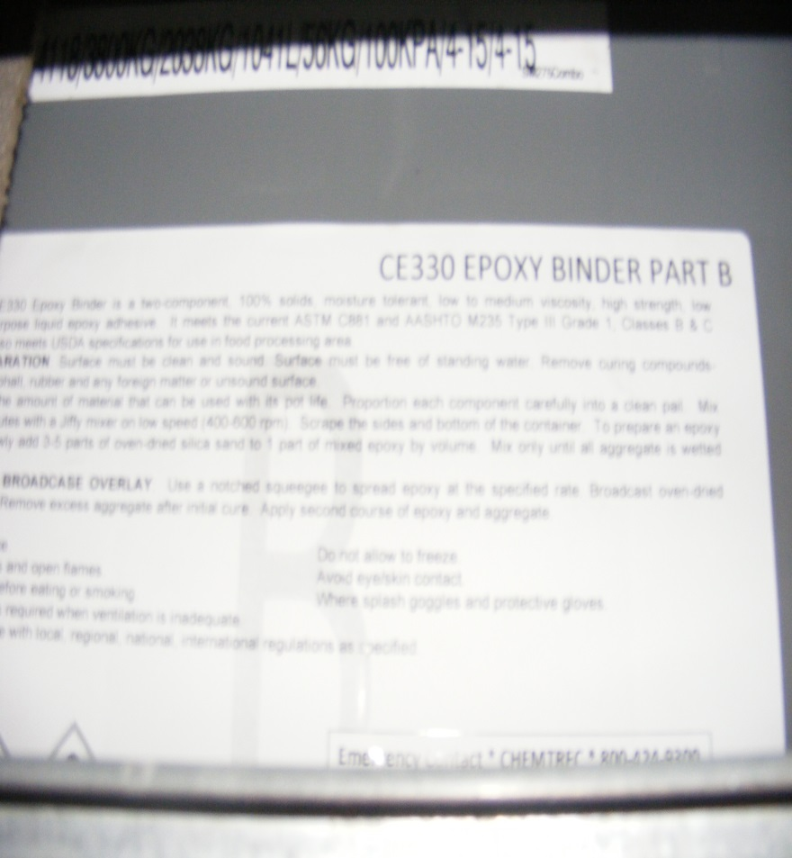
I-40 WB MWC Construction

Slide 35
I-40 WB, Town Center Dr. MWC, September 2016

Slide 36
I-40 WB, Town Center Dr. MWC, August 2017

Slide 37
I-40 WB, Town Center Dr. MWC, April 2017

Slide 38
I-40 WB, SE 29th Street MWC, September 2016

Slide 39
I-40 WB, SE 29th Street MWC, September 2016

Slide 40
I-40 WB, SE 29th Street MWC, August 2017

Slide 41
I-40 WB, SE 29th Street MWC, April 2018

Slide 42
I-44 WB, Airport Road, OKC, June 2015 Pre-Construction

Slide 43
I-40 WB, Airport Road OKC, September 2016

Slide 44
I-44 WB, Airport Road OKC, August 2017

Slide 45
I-44 WB, Airport Road OKC, April 2018

Slide 46
SH-20 / 82 North Site Mayes County Sept. 2016 Defect Distances

Slide 47
North Section Defect Data
High Friction Surface Treatment (HFST) |  |  |  | High Friction Surface Treatment (HFST)
SH-82 North Section South Bound |  |  |  | SH-82 North Section South Bound
Station | Defect |  | Date | Station | Defect |  | Date
0 | None |  | 9/23/2014 | 0 | None |  | 9/20/2016
40 | 6" Swath Across Lane, Min. Aggregate |  | 9/23/2014 | 40 | No Coverage on the Epoxy 6" Wide |  | 9/20/2016
55 | 8" Swath Across Lane, Min. Aggregate |  | 9/23/2014 | 55 - 65 | No Coverage on the Epoxy 8" Wide |  | 9/20/2016
84 | 24" Swath Across Lane, Min. Aggregate |  | 9/23/2014 | 84 - 87 | No Coverage on the Epoxy 24" Wide |  | 9/20/2016
108 | 6" x 6' Across Lane, Min. Aggregate |  | 9/23/2014 | 108 -117 | No Coverage at Edge Line 24" Wide |  | 9/20/2016
134 | 12" x 8' Across Lane |  | 9/23/2014 | 134 -218 | Estimated 5% Aggregate Loss Across Entire Lane |  | 9/20/2016
150 - 184 | Several Spots of No Aggregate |  | 9/23/2014 | 218 - 265 | RWP - 6" Wide Line of Aggregate Loss |  | 9/20/2016
159-200 | 2' from CL Intermittent Skips, 4' from Edge 1" Intermittent Skips |  | 11/20/2014 | 274 - 300 | LWP - 2" Wide Line of Aggregate Loss |  | 9/20/2016
200-209 | CL - 6" Swath |  | 9/23/2014 | 311 - 317 | No Aggregate Across Lane Due to Application Error During Construction |  | 9/20/2016
240 - 262 | 3 Spots of No Aggregate |  | 9/23/2014 | 341 | End Section |  | 9/20/2016
256-260 | 2" Swath 3' from Edge (Longitudinal) |  | 1/15/2015
274-278 | 2" Swath3' from CL |  | 1/15/2015
311 | 5' Swath Across Lane - 50% Aggregate Loss |  | 9/23/2014
341 | End - None |  | 9/23/2014
SH-82 North Section North Bound |  |  |  | SH-82 North Section North Bound
Station | Defect |  | Date | Station | Defect |  | Date
0 | Begin |  | 9/23/2014 | 0 | None |  | 9/20/2016
100 | None |  | 9/23/2014 | 100 | None |  | 9/20/2016
200 | None |  | 9/23/2014 | 200 | None |  | 9/20/2016
300 | None |  | 9/23/2014 | 223 - 237 | RWP - 3" Wide Line of Aggregate Loss |  | 9/20/2016
312-342 | R Wheel Path Showing Some Rutting |  | 11/20/2014 | 312 - 342 | RWP - Showing Some Rutting |  | 9/20/2016
400 | None |  | 9/23/2014 | 388 - 637 | RWP - 2 - 2" Wide Lines of Aggregate Loss |  | 9/20/2016
408 -432 | 1" Strip @ 3' from Edge (Longitudinal) |  | 9/23/2014 | 400 - 637 | LWP - 3" Wide Line of Aggregate Loss |  | 9/20/2016
442 - 455 | 1" Strip @ 4' from Edge (Longitudinal) |  | 9/23/2014 | 442 - 637 | At Centerline, 2" Wide Line of Aggregate Loss |  | 9/20/2016
442 - 490 | 3" Strip @ 2' from Edge (Longitudinal) Intermittent |  | 9/23/2014 | 637 - 660 | At Centerline, 2" Wide Line of Aggregate Loss |  | 9/20/2016
500 | None |  | 9/23/2014 | 660 - 839 | At Centerline, 3" Wide Line of Aggregate Loss |  | 9/20/2016
524-551 | 1" Strip @ 5' from Edge |  | 10/28/2014 | 731 - 742 | RWP - 4" Wide Line of Aggregate Loss |  | 9/20/2016
526-622 | 2" Swath @ 2' from Edge |  | 1/15/2015 | 864 - 900 | RWP - 2" Wide Line of Aggregate Loss |  | 9/20/2016
600 - 632 | 2" Strip @ 3' from Edge |  | 9/23/2014
609-633 | 2" Strip @ 6' from Edge |  | 1/15/2015
700 | None |  | 9/23/2014
757 - 824 | 2" Strip @ 6' from Edge |  | 9/23/2014
835 | 5" Strip 30" Long |  | 9/23/2014
863 - 900 | 1" Strip @ 5' from Edge |  | 9/23/2014
900 | End |  | 9/23/2014

Slide 48
Mid-Section Defect Data
High Friction Surface Treatment (HFST) |  |  | High Friction Surface Treatment (HFST)
SH-20 / 82 Mid Section South Bound |  |  | SH-20 / 82 Mid Section South Bound
Station | Defect | Date | Station | Defect | Date
0-6 | Wheel Paths 1" Wide Aggregate Loss | 1/15/2015 | 0 -6 | RWP - 12" Wide Aggregate Loss, LWP - 1" Wide Line of Aggregate Loss | 9/20/2016
0-7 | 2' from Edge, 1% Aggregate Loss | 9/23/2014 | 6 - 58 | Estimated 2% Aggregate Loss Across Lane | 9/20/2016
142-171 | 1' from CL, 6" Intermittent Spots | 9/23/2014 | 58 - 100 | Minimal Aggregate Loss Across Lane | 9/20/2016
175-226 | Intermittent Aggregate Loss Across Entire Lane | 9/23/2014 | 142 - 200 | Estimated 3% Aggregate Loss Across Lane | 9/20/2016
175-256 | Asphalt Aggregate Losing HFST | 1/15/2015 | 200 - 300 | Estimated 5% Aggregate Loss Across Lane | 9/20/2016
300 - 390 | Aggregate Loss in Wheel Paths | 9/23/2014 | 300 - 400 | Estimated 50% Aggregate Loss Across Lane | 9/20/2016
458 | End | 9/23/2014 | 400 - 449 | Estimated 2% Aggregate Loss Across Lane | 9/20/2016
0-458 | Crack Sealant Bleeding Through and Causing Aggregate Loss | 11/20/2014 |  |  | 9/20/2016
SH-20 / 82 Mid Section North Bound |  |  | SH-20 / 82 Mid Section North Bound
Station | Defect | Date | Station | Defect | Date
0-40 | 1' x 2" Intermittent Skips in Aggregate, 4' from Edge | 9/23/2014 | 0-40 | RWP - 2" x 12" Intermittent Skips in Aggregate | 9/20/2016
40-50 | 4' from Edge 2" Swath | 9/23/2014 | 40-50 | RWP - 2" Wide Line of Aggregate Loss | 9/20/2016
123 | 8" Circle, 2' from Edge | 10/28/2015 | 0 - 100 | 2% Aggregate Loss across Lane | 9/20/2016
147-195 | 4' from Edge, 1' x 2" Intermttent Skips in Aggregate | 9/23/2014 | 100 - 193 | 2% Aggregate Loss across Lane | 9/20/2016
195 | End | 9/23/2014 |  | Crack Sealant was over applied in this section in both directions. Most of the cracks have an | 9/20/2016
195 | 2' Wide Swath Across Entire Lane 40% Aggregate Loss | 1/15/2015 |  | application of up to 12" wide. When the road heats up, the sealant bleeds and then traffic
195 | 2' x 2' Square @ Edge, 80% Aggregate Loss | 1/15/2015 |  | spread it to another location and it has balled up and flattened. The bleeding of the sealant
0-195 | Some Bleeding from Crack Sealant | 11/20/2015 |  | has caused a significant amount of aggregate loss to this section.

Slide 49
Raw Skid Data

Slide 50
HFST Skid Data

Slide 51
Crash Data

Slide 52
Costs
ODOT received $417,696 from the Accelerating Innovation Deployment or AID program from FHWA to help fund the Oklahoma City projects. The total estimated project cost was $522,120 for 17,404 sq. yd. of HFST. The cost for the Calcinced Bauxite High Friction Surface Treatment works out to about $30.00 per sq. yd.

Slide 53
SH-20 / 82 North Site Mayes County Aug. 2015 Crash Evidence

Slide 54
SYSTEM IMPLEMENTATION

Slide 55
SH-20: Rogers Co. Keetonville, 2019

Slide 56
SH-20: Rogers Co. Keetonville, 2019

Slide 57
SH-20: Rogers Co. Keetonville, 2022

Slide 58
SH-51 to US-169: Tulsa Co. Tulsa, 2019

Slide 59
SH-51 to US-169: Tulsa Co. Tulsa, 2022

Slide 60
SH-82/100: Sequoyah Co. 2019

Slide 61
SH-82/100: Sequoyah Co. 2022

Slide 62
US-412A: Mayes Co. East of Locust Grove, 2019

Slide 63
US-412A: Mayes Co. East of Locust Grove, 2022

Slide 64
US-412A: Mayes Co. West of Locust Grove, 2019

Slide 65
US-412A: Mayes Co. West of Locust Grove, 2022

Slide 66
US-259: LeFlore Co. About 25Mi. South of Heavner

