Slide 1
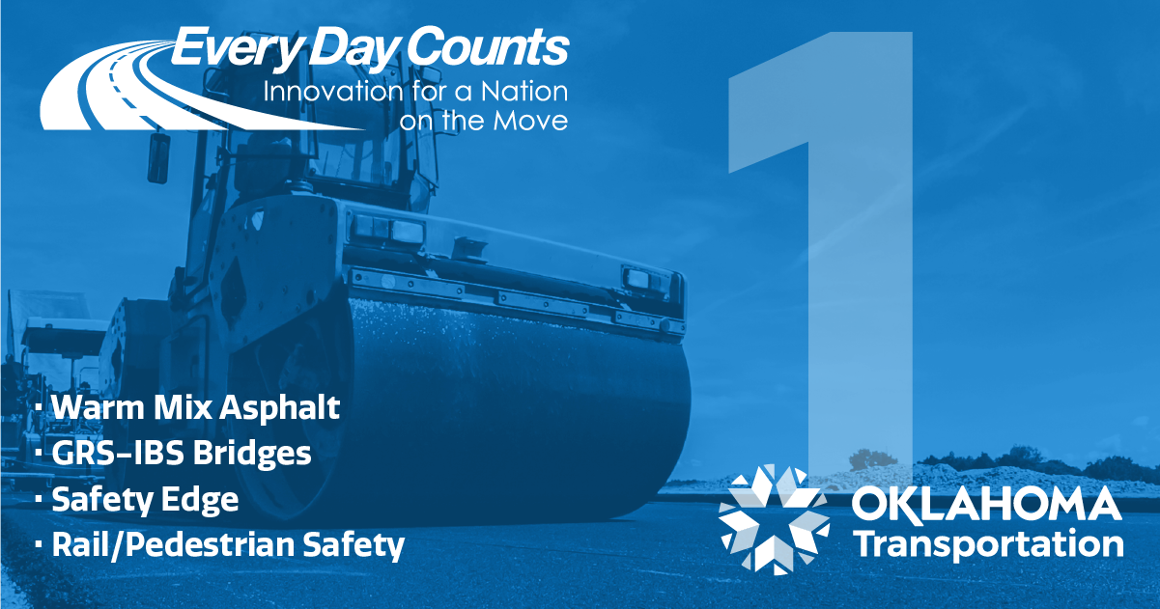
SAFETY EDGE
George T. Raymond, P.E.
Smith Roberts Baldischwiler
Former ODOT State Construction Engineer
District 6 Beaver County US-64, from 6.0 miles East of US-83, Extending East
8.0 Miles
District 6 Alfalfa County US-64, from 7.25 Miles East of SH-8, Extending East
6.6 Miles to the Grant C/L
September 30, 2021

Slide 2
SAFETY EDGE
Pavement edge drop-off on highways has been linked to many serious crashes and fatal collisions. Drop-offs occur when conventional paving techniques result in vertical or nearly vertical pavement edges. For drivers who inadvertently leave the road—even just one tire over the edge—returning to the pavement can be challenging if vertical edge drop-offs are present.
SafetyEdgeSM is a simple and effective solution for mitigating pavement edge-related crashes. This safety countermeasure, which is installed with a commercially available shoe that attaches to existing paving equipment, involves minimal time and cost to implement. It can be installed on pavements during paving or resurfacing projects, shaping the pavement’s edge to eliminate the vertical drop-off. SafetyEdgeSM provides a strong, durable transition so that even at high speeds, vehicles can return to the paved road smoothly and easily. A rigorous analysis showed a 35% reduction in drop-off related crashes and an 11% reduction in overall injury crashes on two-lane rural roads.
https://www.fhwa.dot.gov/innovation/everydaycounts/edc-1.cfm
FHWA – Center for Accelerating Innovation
SAFETY EDGE 2

Slide 3
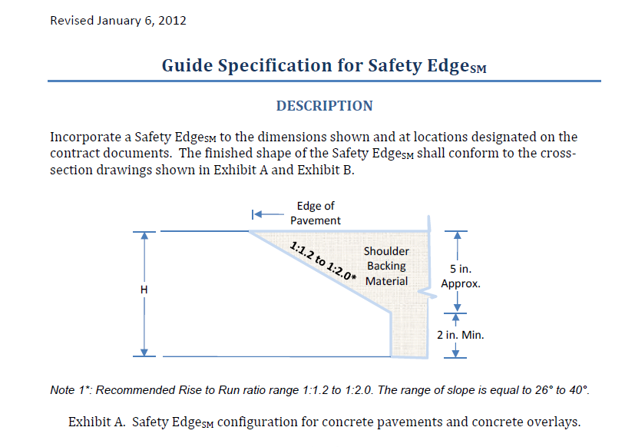
SAFETY EDGE
FHWA – Center for Accelerating Innovation
SAFETY EDGE 3

Slide 4
SAFETY EDGE
411-14(a-b) 09
2-27-13
OKLAHOMA DEPARTMENT OF TRANSPORTATION
SPECIAL PROVISIONS
FOR
ASPHALT SAFETY EDGE
These Special Provisions revise, amend, and where in conflict, supersede applicable sections of the 2009
Standard Specifications for Highway Construction, English and Metric.
411.01 DESCRIPTION (Add the following:)
The asphalt safety edge is a beveled pavement edge to help lessen the severity of roadway departures. When a driver drifts off the paved surface, the safety edge provides greater ease for re-entering the roadway, and reduces the risk of over steering and loss of control of the vehicle.
Safety edge is required on asphalt concrete highway construction (permanent or temporary), on all routes, for all design speeds and types of traffic, when the following conditions exists:
• the roadway is an open section (no curb),
• the increase in pavement thickness is 2" or greater, and
• the paved shoulder width is 4 feet or less.
With the Engineer’s approval, the safety edge may be constructed when the paved shoulder width is
greater than 4 feet.
ODOT – 2009 Special Provisions
SAFETY EDGE 4

Slide 5
SAFETY EDGE
ODOT – 2009 Standard PSE-1 Pavement Safety Edge
SAFETY EDGE 5

Slide 6
SAFETY EDGE
Future Safety Edge Considerations in Oklahoma:
Appears that currently only Asphalt Pavements require the Safety Edge
Consider use on PC Concrete Pavements
2019 Specifications added new Section 440 – Asphalt Safety Edge
Consider cross reference in Section 411 to Section 440
Consider revising Section 440 to include PC Concrete Pavement
ODOT – Potential Future Pavement Safety Edge Considerations
SAFETY EDGE 6

Slide 7
SAFETY EDGE
George T. Raymond, P.E.
Smith Roberts Baldischwiler
george.raymond@srbok.com
District 6 Beaver County US-64, from 6.0 miles East of US-83, Extending East
8.0 Miles
District 6 Alfalfa County US-64, from 7.25 Miles East of SH-8, Extending East
6.6 Miles to the Grant C/L
Questions??
SAFETY EDGE 7

