Slide 1


Oklahoma DOT
Warm Mix Asphalt
Kevin Suitor
Asphalt Branch Manager
ODOT
September 30, 2021

Slide 2
Oklahoma DOT
Warm Mix Asphalt
CONTENTS
Warm Mix Asphalt, WMA, Overview
  What is Warm Mix Asphalt
  How does Warm Mix Asphalt Work
  Specifications
  Why WMA
  Talking Points
  Questions

Slide 3
Oklahoma DOT
Warm Mix Asphalt
WMA, What Is It?
Plant Mix asphalt produced at typically lower temperatures while maintaining workability required to be successfully placed and compacted
WMA is a oxymoron – it’s still HOT ~ 275ºF
WMA can be produced at normal HMA temperatures ~ 325ºF as a compaction aid

Slide 4
Oklahoma DOT
Warm Mix Asphalt
WMA, How Does it Work ?
There are several different WMA technologies. The basic function of WMA is to alter the binder properties at lower temperatures to aid in maintaining workability and durability
Some of the types of processes are:
  Foaming
  Additives that change the structure of the binder
  Additives that enhance the performance of the binder

Slide 5
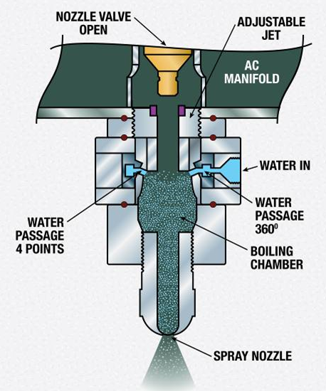
Oklahoma DOT
Warm Mix Asphalt
WMA, How does it work?
Foaming –
  By injecting water into the Hot Liquid AC, the water expands by a factor of 1,673, cools the AC and as a result reduces the viscosity
  The use of zeolites help release water into the WMA and foam the liquid AC. Zeolites are introduced as an additional aggregate in very small percentages

Slide 6
Oklahoma DOT
Warm Mix Asphalt
WMA, How does it work?
Wax
  Sasobit or Sasol Wax is an early pioneer of WMA in the US. It was widely accepted as early as 1997 and physically altered the liquid AC
Chemical Additives
  AC modifiers attach to the chemical makeup of the molecule
  AC additives enhance the physical characteristics of the liquid AC

Slide 7
Oklahoma DOT
Warm Mix Asphalt
WMA, ODOT Use? (ODOT SP, 2009)
411.01 DESCRIPTION Warm Mix Asphalt (WMA) is defined as an asphalt binder and aggregate mixture which, by additive or process, can be produced and placed at a reduced temperature from normal HMA temperatures. WMA requirements are the same as for HMA except where noted.
411.04 CONSTRUCTION METHODS (j) Compaction (1) General. Ensure that the WMA immediately behind the paver is at least 215°F [102°C].

Slide 8
Oklahoma DOT
Warm Mix Asphalt
WMA, ODOT Use? 2019 Standard Specifications
411.01 DESCRIPTION
This work consists of constructing one or more courses of bituminous mixture on the prepared foundation (roadbed or base).
Hot Mix Asphalt (HMA) includes Superpave, Stone Matrix Asphalt (SMA), and Rich Bottom Layer.

Slide 9
Oklahoma DOT
Warm Mix Asphalt
WMA, ODOT Use? 2009 Standard Specifications

Slide 10
Oklahoma DOT
Warm Mix Asphalt
WMA, ODOT Use? 2019 Standard Specifications

Slide 11
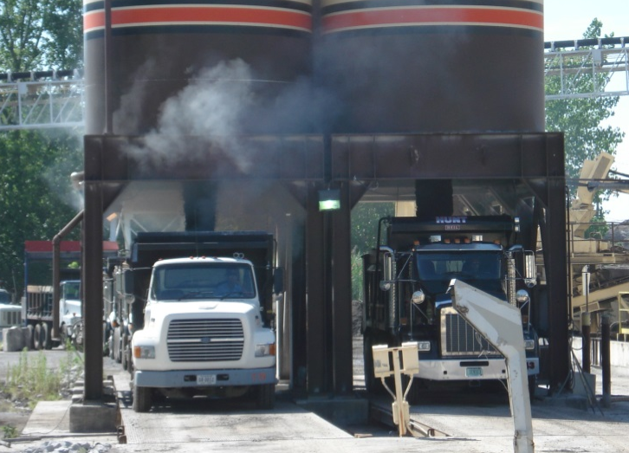
Oklahoma DOT
Warm Mix Asphalt
Why WMA?
Photo Courtesy of Virginia Asphalt Pavement Association

Slide 12
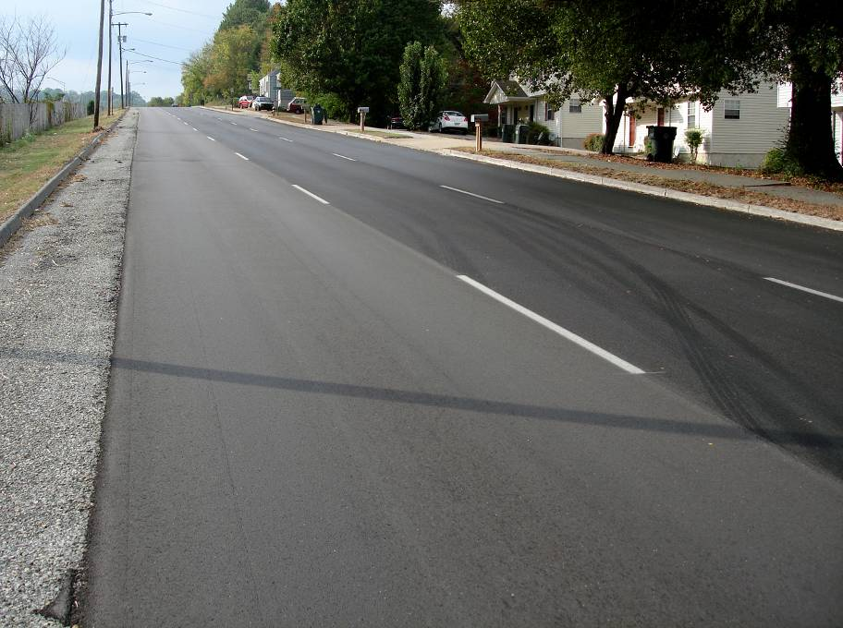
Oklahoma DOT
Warm Mix Asphalt
Why WMA?

Slide 13
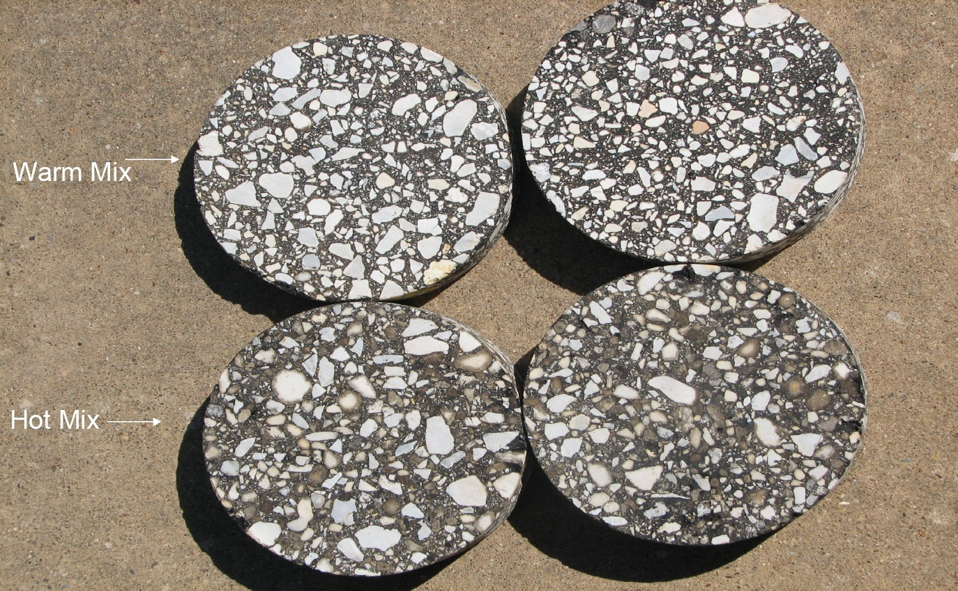
Oklahoma DOT
Warm Mix Asphalt
Why WMA?

Slide 14
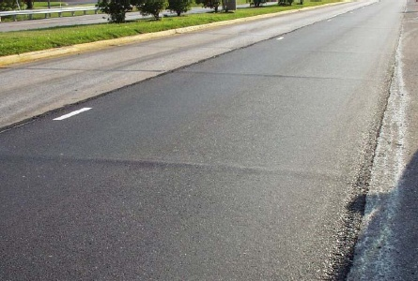
Oklahoma DOT
Warm Mix Asphalt
Why WMA?

Slide 15
Oklahoma DOT
Warm Mix Asphalt
Talking Points
ODOT allows production of WMA 275ºF +/- 20º
  Some states allow 275ºF Maximum
ODOT contractors by far use Foaming Process to extend the compaction time and temperature requirements
Approximately 30 to 40 percent of all ODOT designs are WMA
Unless specified on the contract documents, WMA is at the contractors option

Slide 16
Oklahoma DOT
Warm Mix Asphalt
Talking Points
Percentage Warm Mix Usage
Year | WMA Tons | Total Tons | Percentage |  | Year | WMA Tons | Total Tons | Percentage
2020 | 910,118 | 2,449,542 | 37.2% |  | 2014 | 1,239,435 | 2,339,050 | 53.0%
2019 | 873,723 | 2,165,179 | 40.4% |  | 2013 | 1,141,176 | 2,437,391 | 46.8%
2018 | 999,406 | 2,197,684 | 45.5% |  | 2012 | 523,369 | 2,266,697 | 23.1%
2017 | 1,221,502 | 2,619,400 | 46.6% |  | 2011 | 275,952 | 3,430,960 | 8.0%
2016 | 1,343,087 | 3,032,160 | 44.3% |  | 2010 | 48,284 | 3,839,465 | 1.3%
2015 | 1,512,829 | 2,610,644 | 57.9% |  | 2009 | 10,536 | 3,703,935 | 0.3%

Slide 17
Oklahoma DOT
Warm Mix Asphalt
Talking Points
Deb Mishra OSU is investigating the long term effects and advantages of using a chemical WMA additive
  Preliminary results from industry partners show $1 per ton for Chemical WMA is equating to 10 to 15+ percent longer pavement life. Project completion 2023
  Using Oklahoma liquid AC for investigation
Other projects to follow

Slide 18
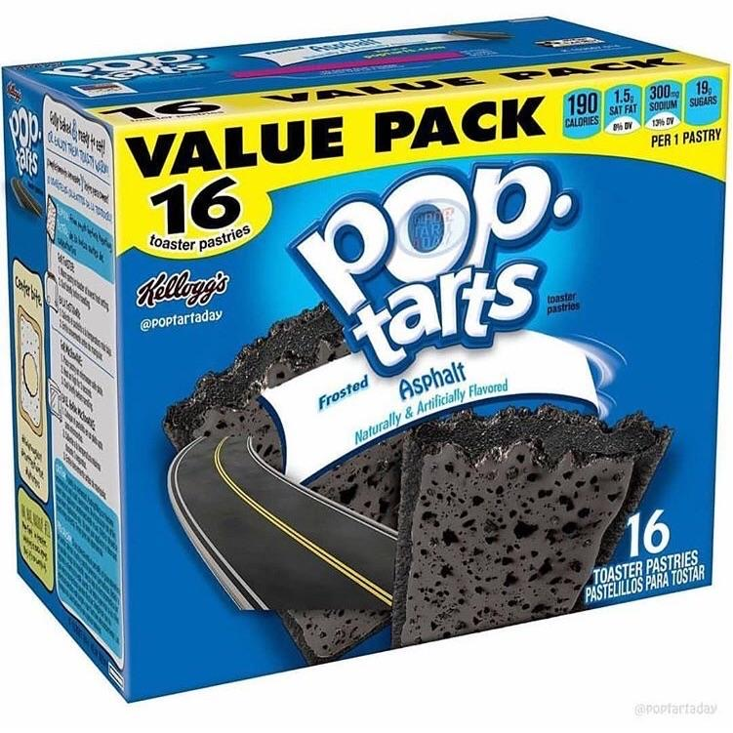
Questions???
Kevin Suitor, Asphalt Branch Manager
Oklahoma Department of Transportation
5201 NE 122nd Street, Bldg. 4011
Edmond, Oklahoma 73103
(405) 923-5897 – Mobile
(405) 522-4986 – Office
ksuitor@odot.org

