Slide 1
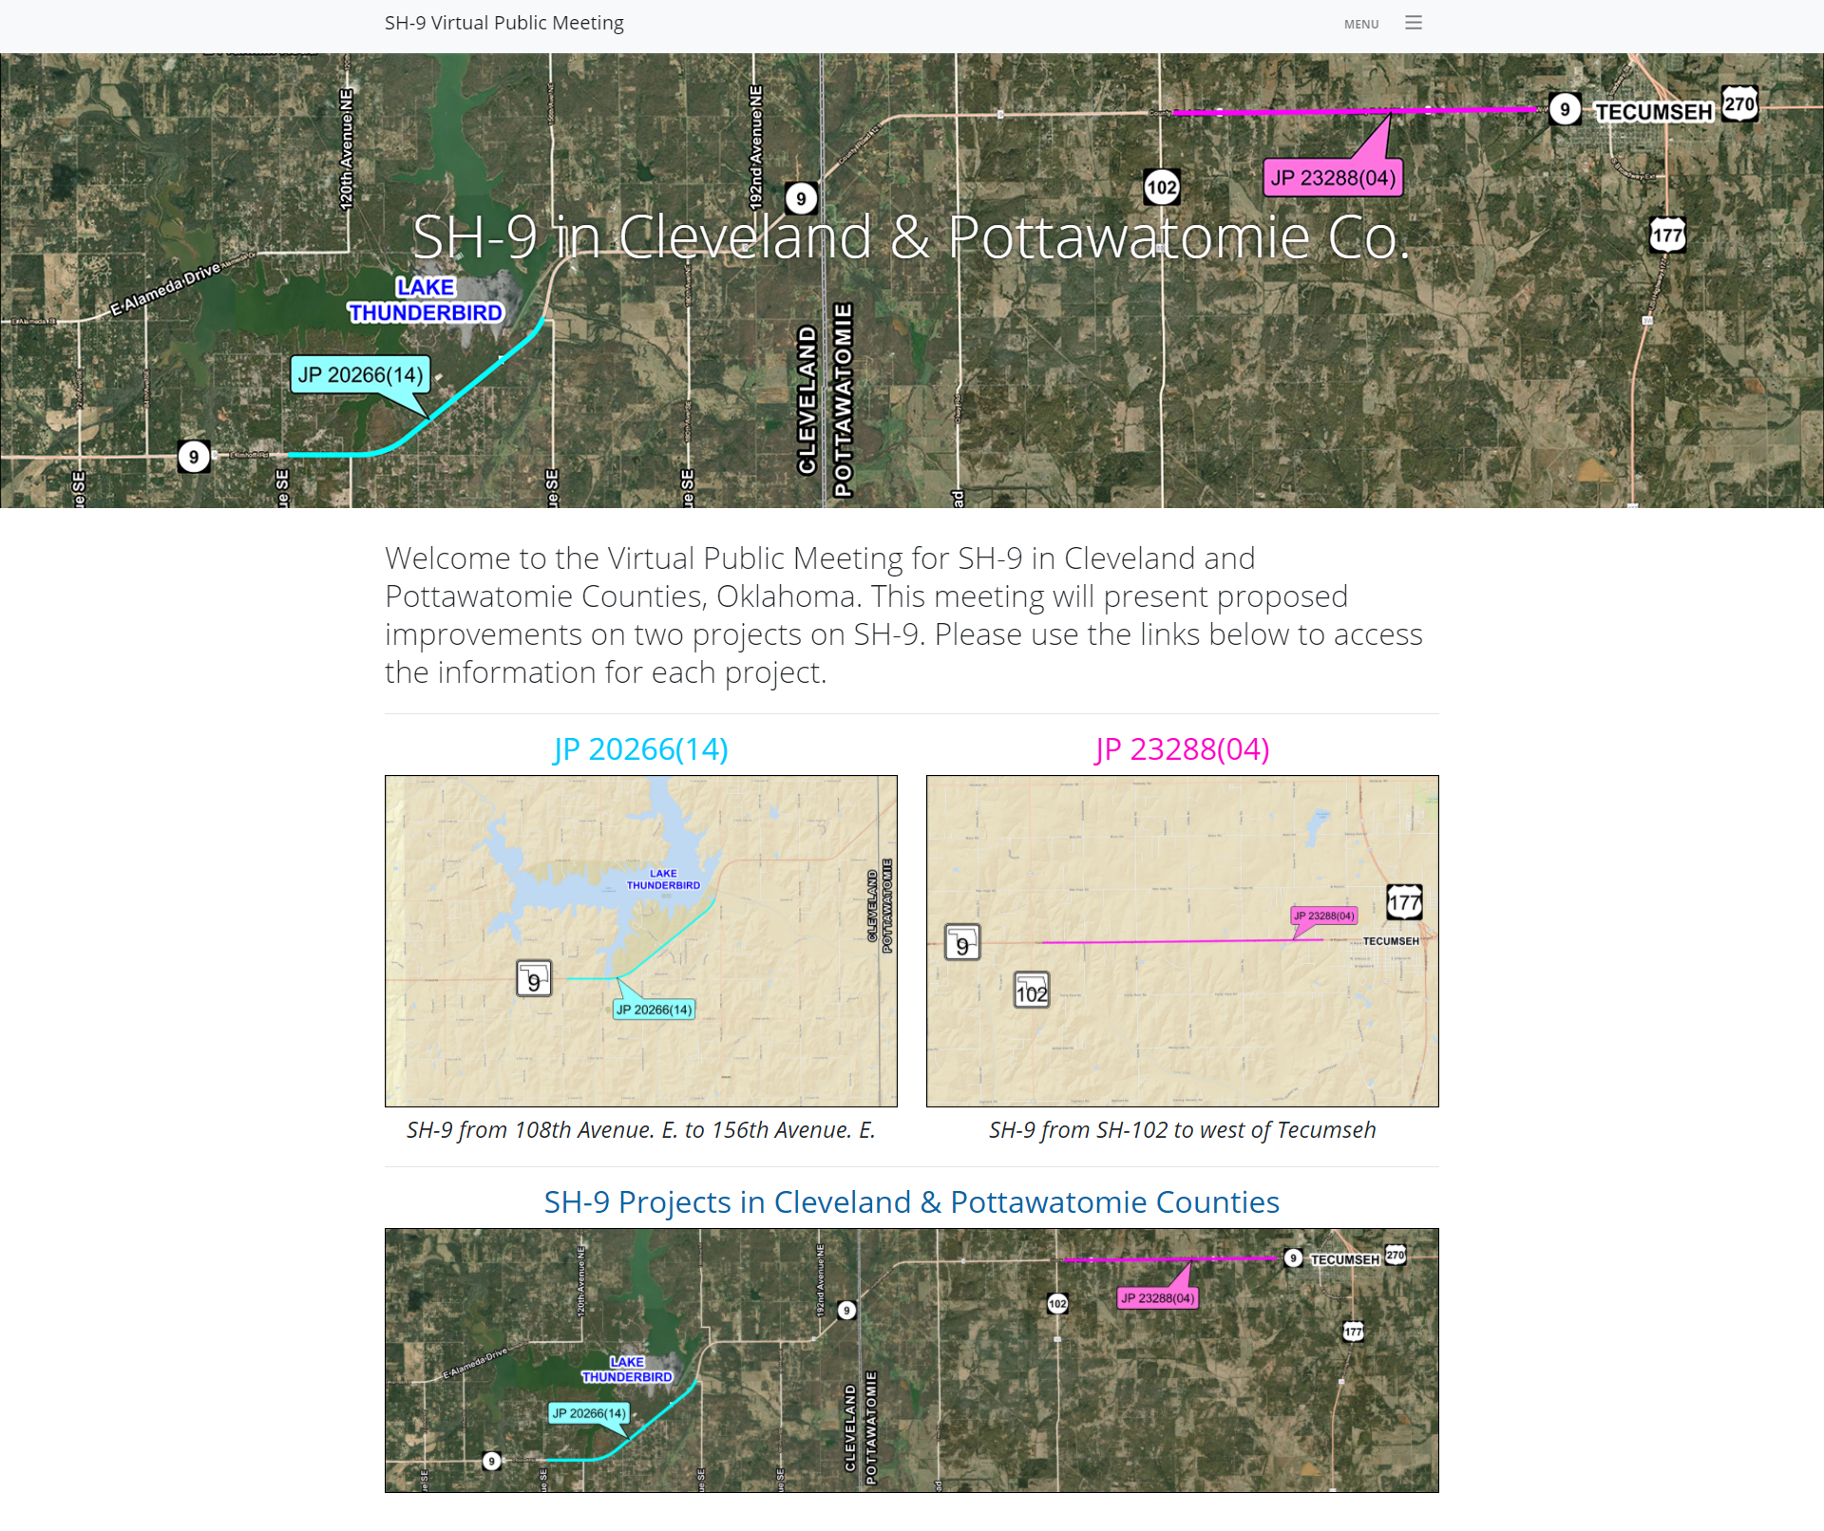
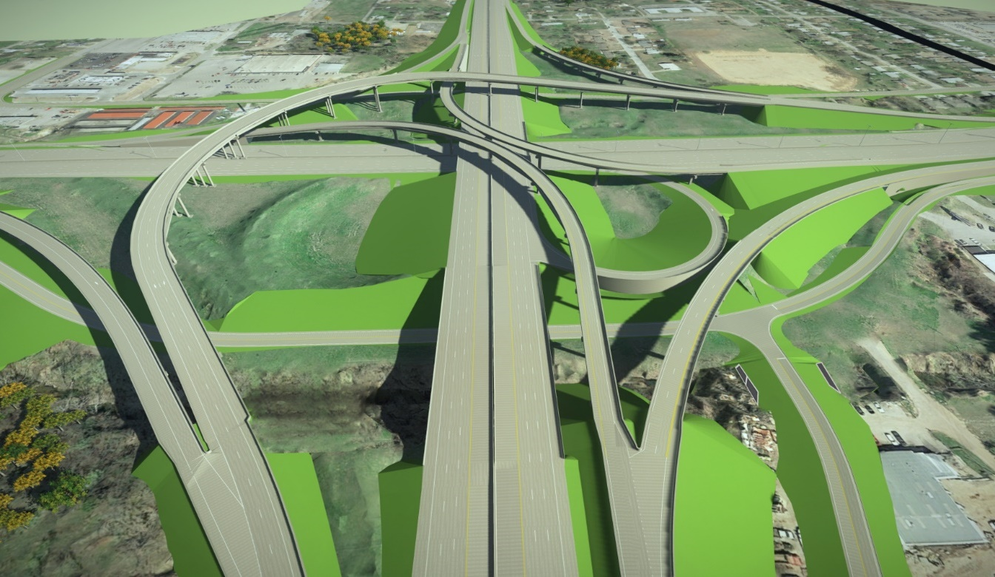
Public Involvement in the Virtual Era
Skelly Drive
US-75 Access Rd.
State Transportation Innovation Council (STIC) EDC-5 Webinar
November 10, 2022

Slide 2
Why is Public Involvement Important?
In a Nutshell
Public’s tax dollars pay for improvements
Projects affect communities, economies, and public safety
Communities being impacted have insight to their infrastructures that agencies may not have
Transparency fosters agency credibility and improves public trust
Notes:
So why is public involvement important? In a nutshell, the public are our customers, and their tax dollars pay for much of the improvements we propose. Our projects affect communities, economies, and public safety. The people we impact have insight their community infrastructures that agencies may not have. And last but not least, transparency fosters agency credibility and improves public trust.

Slide 3
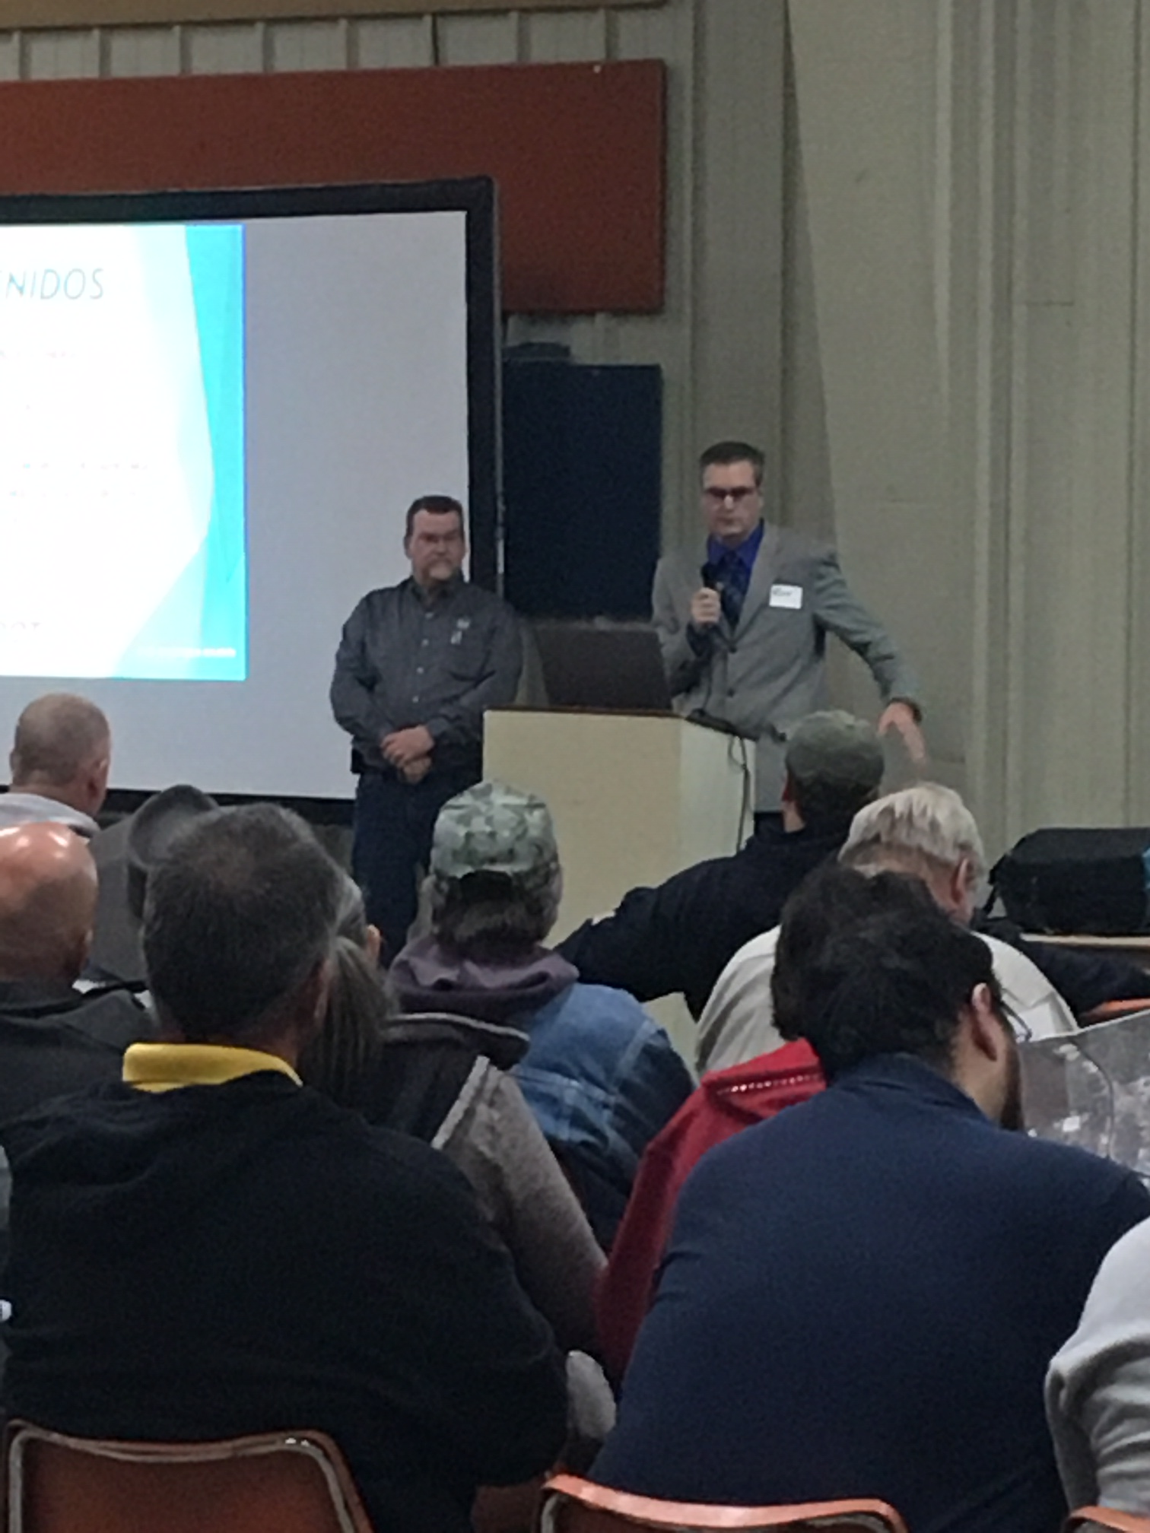
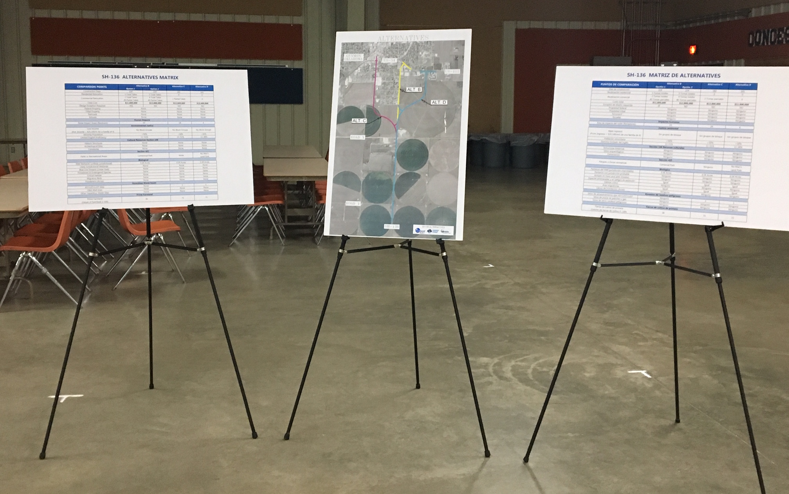
History of Public Involvement at ODOT
Looking Back
In the past 10 years ODOT has held over 150 public involvement events.
These events have ranged from traditional public meetings, open houses, informational meetings, public hearings, pop-up booths, virtual engagement, and hybrid outreach.
Face-to-Face Public Involvement
In-person connection
Internet not necessary
Virtual Public Involvement (VPI)
Websites, project visualizations, online surveys, electronic comment forms
Accessible to those who are unable attend an in-person event
Notes:
Over the past 10 years ODOT has held over 150 public involvement events. Our outreach ranged from traditional public meetings, open houses, informational meetings, public hearings, pop-up booths, virtual engagement, and hybrid outreach. Our primary means of outreach in the past was focused on face-to-face interaction. Prior to the pandemic, ODOT had dabbled, if you will, in virtual public involvement. We used the ODOT public meetings website to post outreach notices and MetroQuest for project surveys.

Slide 4
Challenges of COVID-19
Staying on Task
At the beginning of the pandemic our initial challenges were, how do we keep projects on schedule and how to do we reach the public without being able to meet with them face-to-face?
Uncertainty nationwide from DOTs and FHWA on how to get public input without face-to-face contact
To keep projects on track, we had to go virtual
Previously VPI was only piece of public outreach
Trial and error process to find what works
Duplication of effort
Offering quick responses to the public
Public inclusion
Notes:
Prior to the pandemic, ODOT had dabbled, if you will, in virtual public involvement. We used the ODOT public meetings website to post outreach notices and MetroQuest for project surveys. However, when the world locked down, our projects did not stop, and we had to figure out how to keep projects on schedule and how to reach the public without being able to meet with them face-to-face.

Slide 5
An Integrated Approach
Broadband access or quality
Time
commitment
Uncomfortable with technology
Travel
costs
Virtual
meeting
Hybrid
meeting
In-person
meeting
Personal/
work
conflicts
Lack of face-to-face interaction
Cultural
e.g., technology restrictions
Inadequate transportation

Slide 6
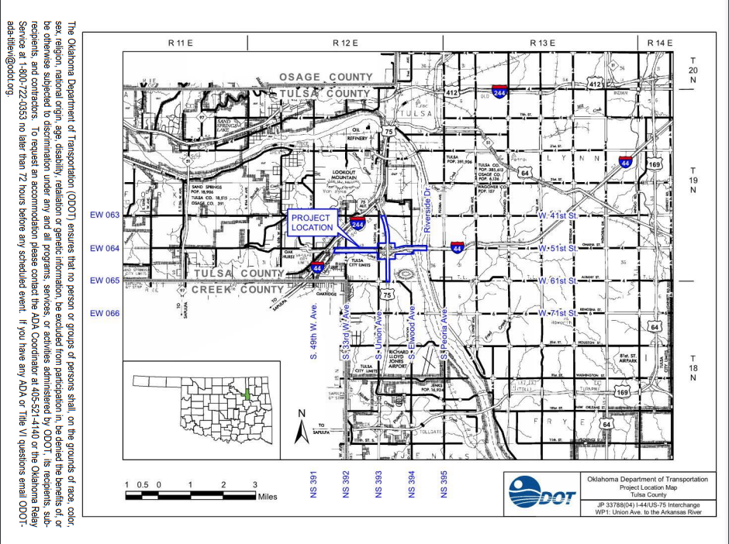
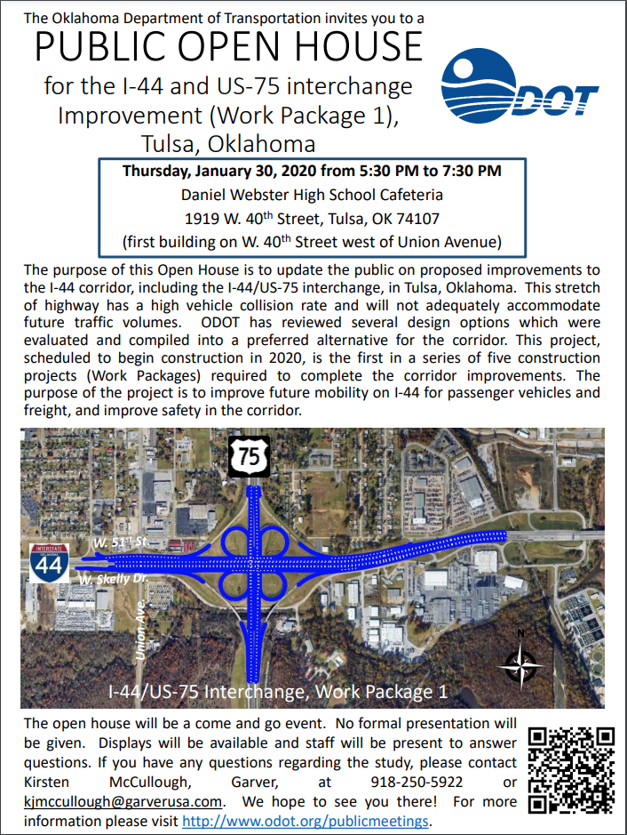
An Integrated Approach
USPS Every Door Direct Mail
Numerous others have utilized this tool for public outreach but prior to the pandemic the Oklahoma Department of Transportation (ODOT) had not tried it out, we did door to door flyers
Door to Door Flyers
Single page
Handed out to the homes and businesses adjacent to the project
Direct Mail
Pamphlets are multi page documents
These are mailed to postal routes within the community and often reach more than the door-to-door flyer would

Slide 7
An Integrated Approach
Trying to reach everyone, everywhere, all at once
Virtual tools provide increased transparency and access to transportation planning activities and project development and decision-making processes
Project websites
Virtual meetings
Online survey tools
Interactive maps
3D visualizations
Social media
Geofencing
Live streaming

Slide 8
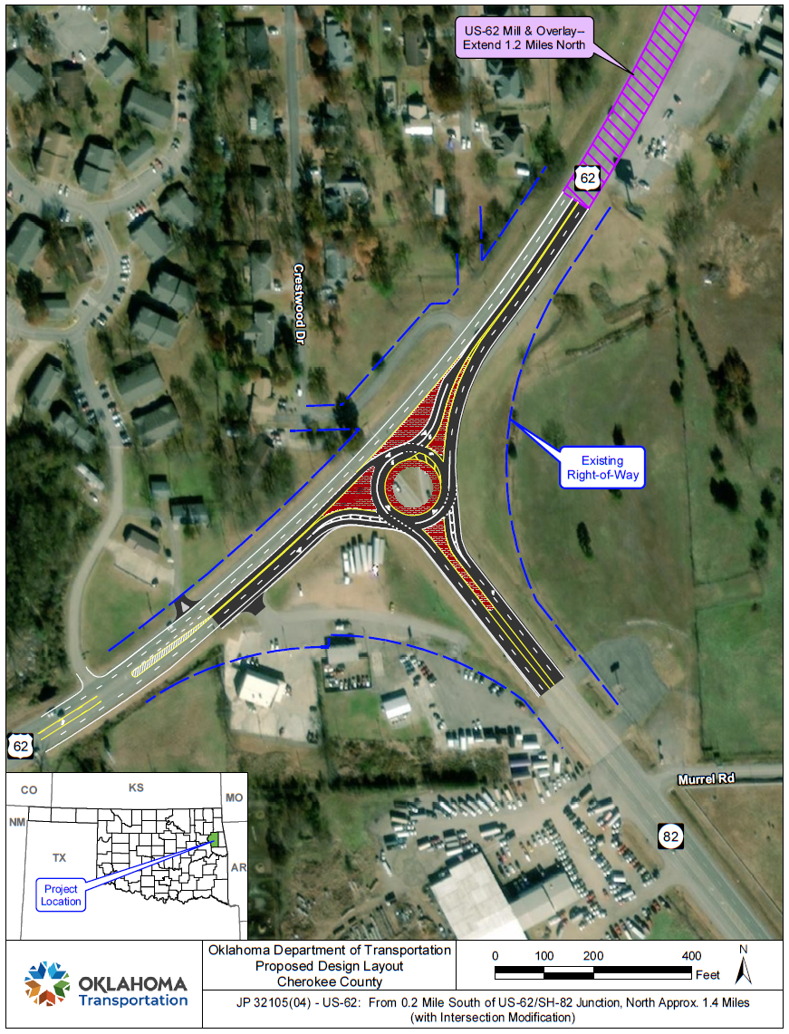
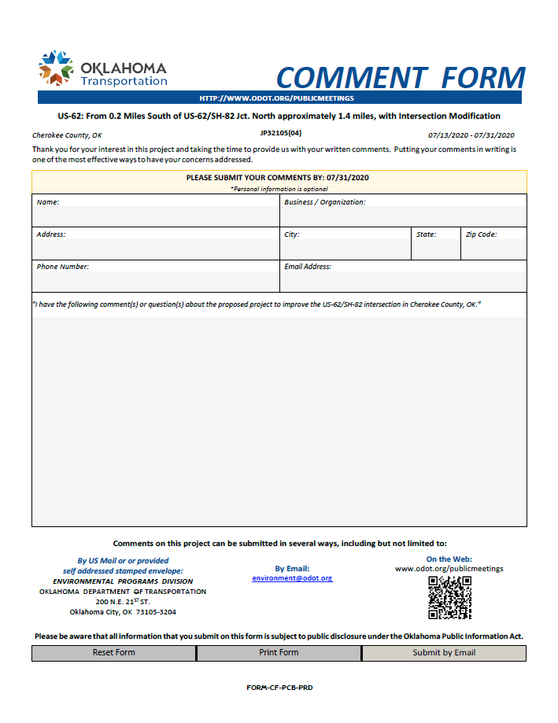
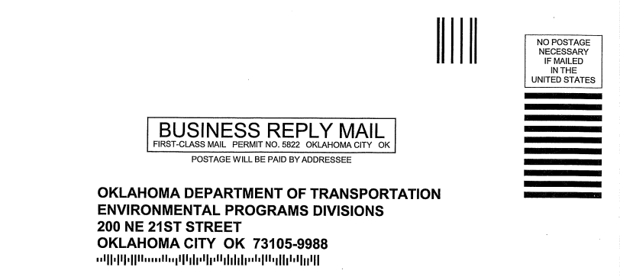
An Integrated Approach
Results
We receive comments, questions, and feedback through multiple outlets
Phone Calls & Voice Mails
Emails
Virtual Open House electronic comments
Mail in comment forms
We have had a major increase in public response due to our additional outreach via Direct Mail

Slide 9
What have we learned
Not all public involvement is created equal and it’s important to use new and innovative tools to reach everyone.
Face-to-face interaction will always be valuable
Virtual public involvement can be done on its own, but needs to include a variety of ways to engage the public
Notes:
When engagement is done early and often, projects aren’t held up by last minute discoveries and public outrage or controversy.

Slide 10
Questions?
Jenny Droscher
Public Involvement Officer
Oklahoma Department of Transportation
jdroscher@odot.org
405-246-6975

