Slide 1
Oklahoma DOT Experience with Geotechnical A-GaME Methods
G. Scott Garland, Jr., P.E.
Oklahoma DOT - Materials Division – Geotechnical Branch
ggarland@odot.org

Slide 2
Overview of Presentation
Brief summary of A-GaME initiative
Focus on A-GaME method I championed
Brief summary of other A-GaME methods we’ve used
Slide numbers are included for your convenience and reference

Slide 3
A-GaME in a Nut Shell
This was part of EDC-5
Encourage and educate geotechnical engineers on the use of other more advanced geotechnical exploration methods beyond routine/standard SPT testing
Exploration methods included CPT, Resistivity, Seismic, and MWD
Participants were encouraged to champion a specific method and achieve some level of implementation of it within their organization
Implementation had various levels; full-implementation was strongly encouraged
Notes:
Implementation could vary from simply including it in your specifications as an acceptable means to perform geotechnical exploration, to encouraging its use through sub-consultants to full-on day-to-day use internally, through consultants, or any other method.

Slide 4
What method did you champion?
Initially I was most interested in MWD
I ran into various problems and hurdles which stone-walled my efforts
This was a blessing in disguise, in my opinion
This is still a promising technology, I look forward to seeing it further develop
Ultimately I chose to champion CPT
Notes:
Implementation could vary from simply including it in your specifications as an acceptable means to perform geotechnical exploration, to encouraging its use through sub-consultants to full-on day-to-day use internally, through consultants, or any other method.

Slide 5
Brief History of CPT Use at ODOT
We apparently have a long history of using cones for subsurface explorations
Mechanical cones were used previously and advanced using a drilling rig
CPT was adopted at some point in the 80’s
Initially advanced using a drilling rig
Purpose-built, light-weight CPT truck was purchased in late 90’s or early 2000’s
Reduced data was limited to the correlations preprogramed in the software such as ConePlot
Any correlations not preprogrammed in the software were calculated manually/via spreadsheets
We had no software which could directly use CPT data
Much of what was done was considered state-of-the-art at the time

Slide 6
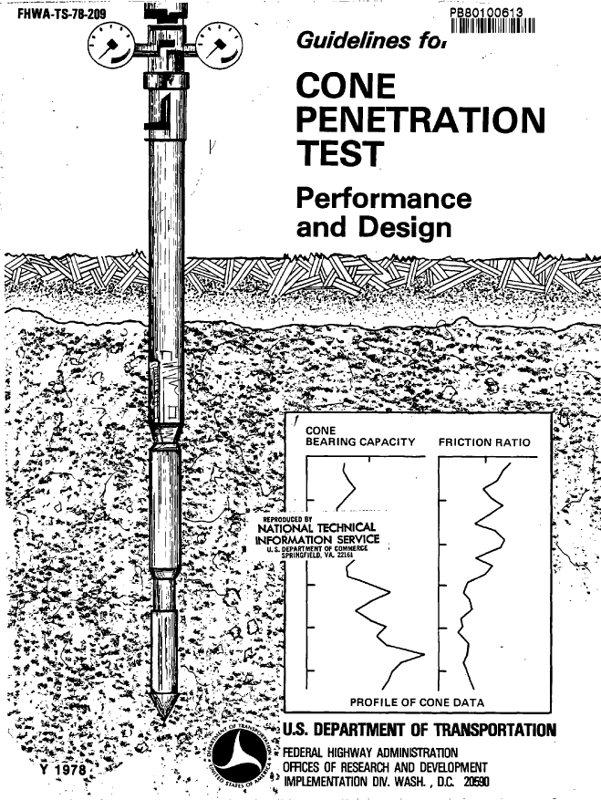
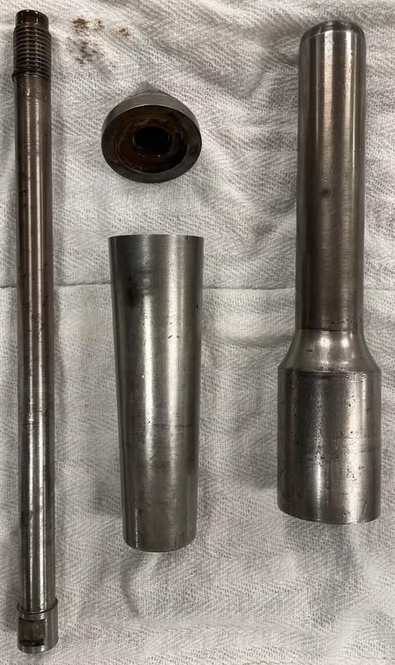
Mechanical Cone
Notes:
These are mechanical cones we still posses
Looking at this stuff makes me glad to be called a millenial

Slide 7
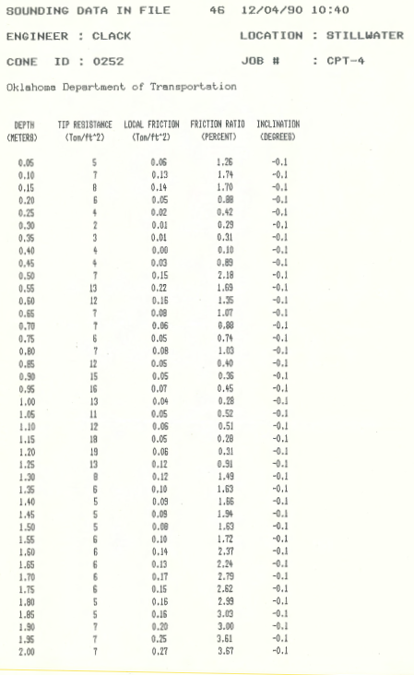
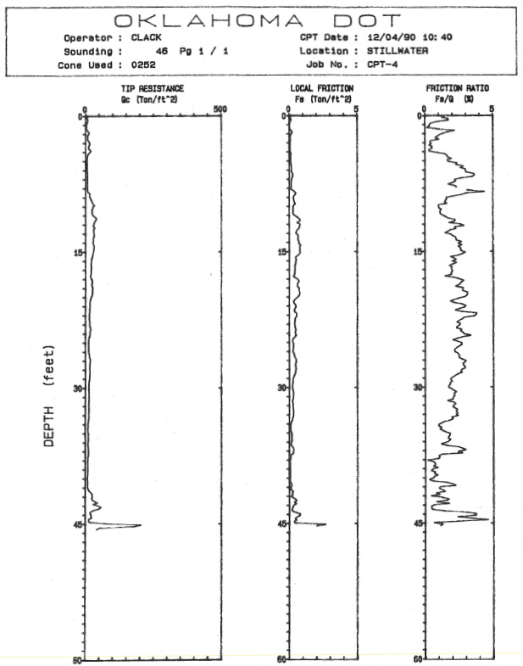
The “Old” Cone Truck
Slide #7
Notes:
Here is some example of how data was presented in the 90s and a photo of what we refer to as our old cone truck

Slide 8
So what was left to implement??
Well, I’m glad you asked…
Some personnel changes occurred (retirements, transfers, etc.)
Much of our internal experience regarding CPT both in terms of operation and data reduction was lost
Equipment fell into disrepair
Did not keep up with the times with regards to software
Effectively lost the capability to perform soundings and analyze the data
Notes:
There were a handful of engineers who knew how to perform and/or analyze the data. One retired and one took employment at another division in ODOT. We were left with 3 engineers in the geotechnical branch, 2 of whom were poorly motivated to learn. Equipment was abused and neglected and eventually fell into disrepair and the one engineer who knew how to handle the data wasn’t able to collect it anymore. Additionally, even if the equipment happened to be able to work one day, we did not keep up with the times regarding software and data processing. So parsing through hundreds, if not thousands, of lines of raw data in excel spreadsheets was not an efficient use of time. Any time saved performing the soundings in the field was lost reducing data in the office and the speed advantage of CPT was nullified.
We basically lost the capability to perform soundings and analyze the data.

Slide 9
Steps Towards Re-implementation
I obtained support of my supervisors
My supervisors and senior staff recognized the value in this equipment
Through the tremeandous support of people around me, I was able to get the purchase of a new light-weight CPT truck approved
The full process was about 2 years to get the CPT truck
This was during the very beginning of the pandemic
We didn’t sit idle
In the meantime I was able to purchase software which greatly improved the speed of data reduction as well as analysis we were performing for things like:
Settlement
Slope stability
Piles
While waiting for the CPT truck, we used this time to educate and familiarize ourselves with the software. This helped to reduce the steepness of the learning curve
Notes:
Thanks to Tremeandous support from my direct supervisors within the materials Division, people within our maintenance division (who purchase equipment), and even senior staff, I was able to get the purchase of a new light weight CPT truck approved.
Luckily we took delivery of this truck the winter before shut downs started to occur and supply chains were being disrupted
Although it took a couple of years to get the truck, I was able to purchase software and educate myself and my team on it in preparation for delivery of the CPT

Slide 10
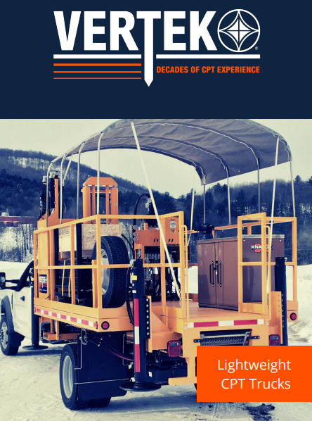
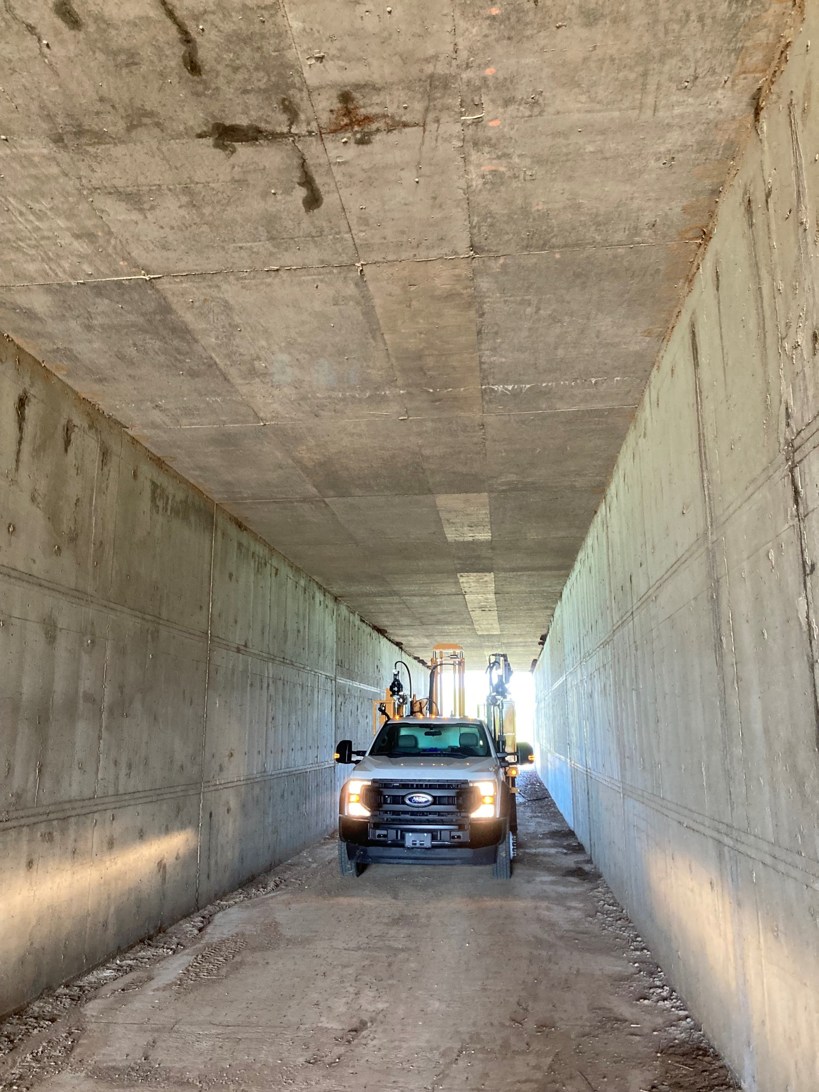
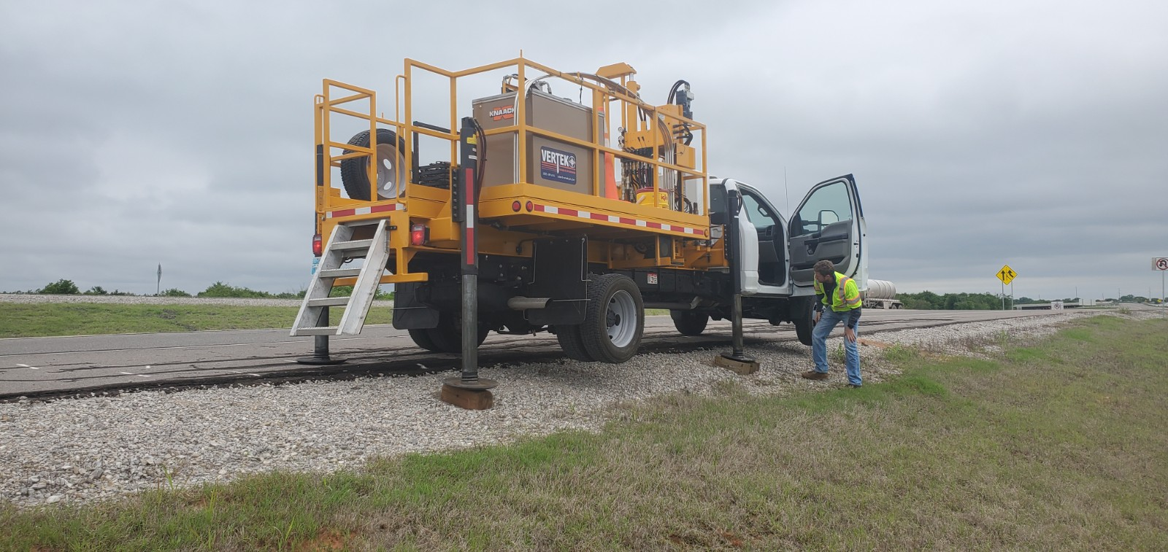
The New Cone Truck
Notes:
Here are some photos of our new cone truck
The truck presented in vertek’s catalogue is our actual truck. Youll notice the awning covering the deck- this was something we asked them to do, and it’s the first time they did it. Its an excellent addition, and really helps keep our guys out of the sun
The photo in the middle was in Duncan Oklahoma and gives an idea of access we can gain with the truck
The photo on the right is on a current projectin Blackwell OK. We’re driving under I-35 in a 14 x 14 concrete box. We would not have been able to do this in a rig. We are even considering coring the box and pushing a cone under this box.

Slide 11
Benefits Experienced So Far
Much faster and easier than drilling
Reduced crew burnout and fatigue
Much safer
Quality of data is exceptional compared to SPT and other methods
Minimized the need for mobilizing a drilling rig
Our cone truck came with a soil sampler
We need a rig, typically, to core rock or obtain Shelby tube samples now that we have CPT
When drilling is still required, we can tailor our drilling operations and be prepared
Target specific layers for Shelby tube sampling, for example
Be prepared for loose, flowing sands
Good idea where depth to rock is when rock cores are sought
It has been a great tool to confirm slope stability models
Notes:
Crew burnout and fatigue is a real issue. We often times don’t appreciate the level of effort and work our field crews put in to complete the field work we request. Anything I can do to reduce fatigue and burn-out is among my top priorities and considerations when purchasing equipment or assigning work.
We all know the data is nearly continuous. I heard this over and over again, and I could imagine the value of such data, but until I actually experienced it I never understood how incredible and valuable this was. I like to use an an analogy: If when your mom told you not to touch the hot stove, you never touched it, you’d live the rest of your life “knowing” that stove was hot, but would you “understand” I knew this would be of value, but I never understood it until I started realizing the benefits of it.
I effectively don’t need a drilling rig unless I’m trying to get Shelby tube samples or core rock. There may be exceptions out there, but this is basically what it has boiled down to for us.
Being able to have a very very good idea of what youre going to encounter before you go out there can be a major advantage.
For example, if you need to core rock, you pretty much have a great idea of where it is already and you can basically drill straight to it, then start your rock coring operations
You can be prepared for the possibility of loose flowing sands and bring out appropriate drilling fluids
Instead of blindly sampling with Shelby tubes and sort of praying you didn’t miss an important or sensitive layer, you can target exactly what you need. In relatively homogeneous layers, this has the effect of reduced sampling and reduced laboratory testing since you don’t blindly collect a sample every 5 feet.
I’ll show an example later, but coupled with some laboratory testing, you can pretty accurately estimate the depth to the slip surface just by looking at the tip resistance or other correlations. When your modelling is complete, its very satisfying to see how closely things line up. This gives you and your end-user a lot more confidence in decision making.

Slide 12
Hurdles Experienced
Initial learning curve
Operating the equipment
Reducing the data
Modeling software
Took some time to gain confidence
Initially we over-tested job sites
Performed a lot of parallel lab testing before feeling confident with CPT correlations
Some colleagues (both private and public sector) are still unfamiliar/uncomfortable with it
“Great, so, ummmm, what’s the N-value?”
“When in doubt, build it stout.”
“I want to see the soil.”
“What do I do in rock?”
“That’s fancy equipment, good for you.”
Notes:
Operating equipment – we learned its best to anchor any time that it is feasible to do so.
Reducing data – bracketing properties like soil strength and not agonizing over every peak and valley in the data took time
Modeling software – things like settlement and slope stability software can be daunting. Our learning curve here mainly revolved around how to use the actual software and also how best to implement the CPT data
Over-testing – we were performing 14 or 15 CPT tests across a shallow failure, when simply experience identifying shallow failures may have been sufficient on its own. Worst case, 6 soundings would have been more than enough “more holes more better”
Parallel lab testing – this was great and arguably necessary. It provided us with an intuitive sense for how CPT data compared to laboratory data that people traditionally trust. Stratification is excellent. Liquid Limits tend to e about 10 less than the lab value, but the trends are still accurate. Pore pressure measurements in saturated soils are excellent. Compression index in clays was pretty good, but not in silty clays or clayey silts. The list goes on. We probably have done enough
This equipment, its interpretation, the parallel lab testing we performed, software use, data reduction, and all the hurdles we faced absolutely made me a better engineer and a stronger critical thinker.

Slide 13
One Example
Shallow failure in Chickasha, OK
Nuisance for many decades
Our first slope stability project with CPT
Definitely over-tested
Major learning curve, lots of learned lessons
Greatly increased our confidence with CPT

Slide 14
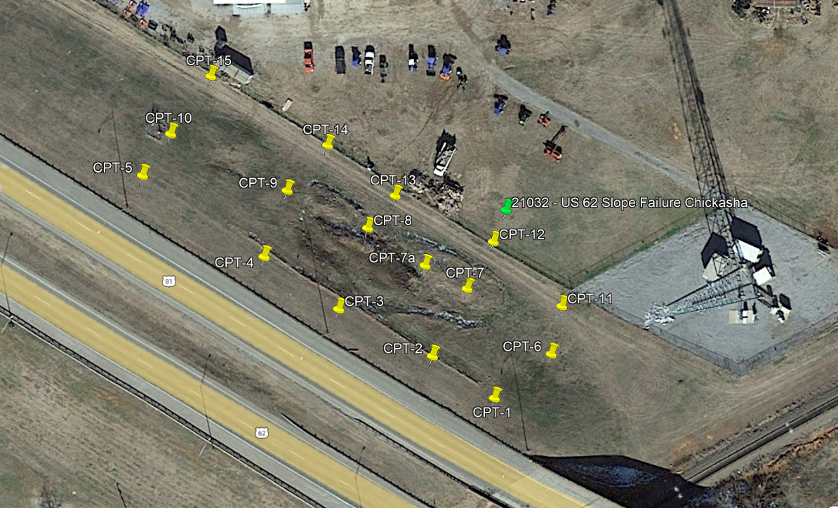
CPT Test Locations
Notes:
This is the first slope failure we used CPT on- it’s a great example of a project we did much more testing than was necessary, however this ties into what I was saying as far as our learning curve and lack of confidence when we first started using this.
This was a shallow failure in Chickasha, OK which has been a nuisance for many decades. I tried to lay out our proposed soundings in areas which were clearly failing as well as in areas which appeared to be in decent shape.

Slide 15
One moment please…

Slide 16
Other Methods I Like
I’m particularly fond of resistivity testing and seismic testing
We don’t have the capacity to perform resistivity testing in-house
I subcontract this to our partners in private sector
We can perform seismic testing
We under-utilize this
Mostly used for construction projects when questions about rippability arise

Slide 17
I-40 Port of Entry
Notes:
The one large slide in the middle is 100 yards long
Accessibility is very difficult
Can’t get equipment onto the failing mass
Based on visual observation, it appeared that the depth of rock varied quite a bit laterally and longitudinally
Hired a private consultant to perform seismic and resistivity testing. They basically laid out X shapes across each of these. Coupled with the borings we were able to complete/access, the District and now any contractor, has an excellent idea of the elevation of rock across this site.

Slide 18
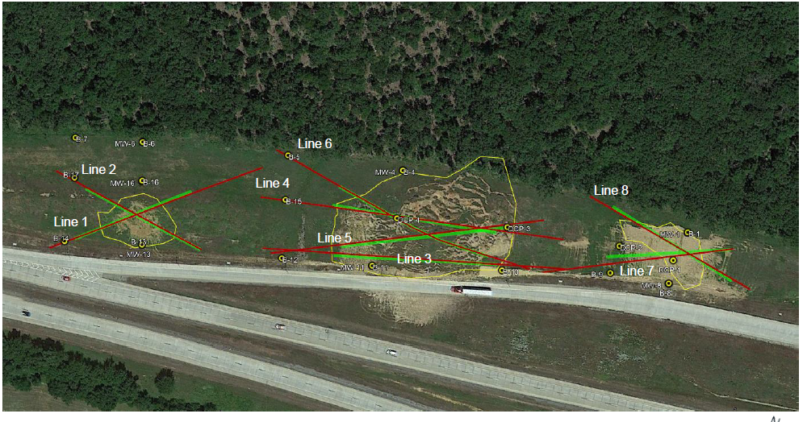
Testing Layout
Notes:
This is the layout of the testing they performed for us
I think Green was electrical resistivity and Red was seismic shear wave

Slide 19
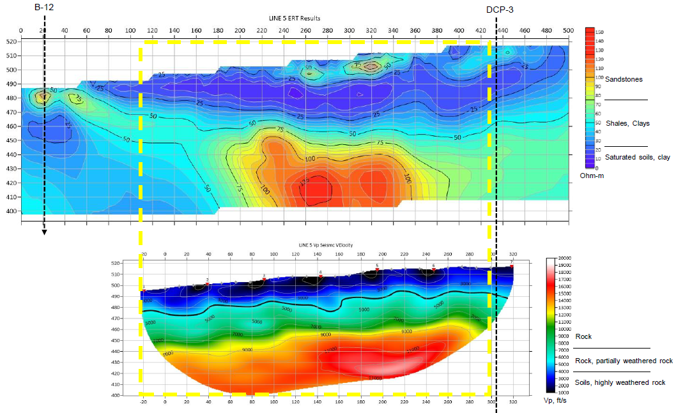
Results of Testing
Notes:
Good luck putting something together like this with SPT or even CPT.
Good luck even getting your equipment onto the slope.

Slide 20
Thank you

