Slide 1

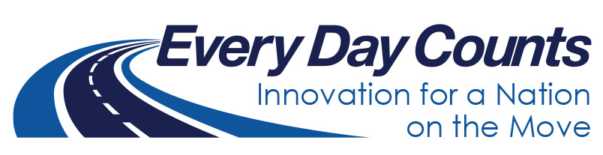
Pavement Preservation
Where, When, and How
David Vivanco, P.E. – Asphalt Branch Manager
ODOT Materials Division

Slide 2
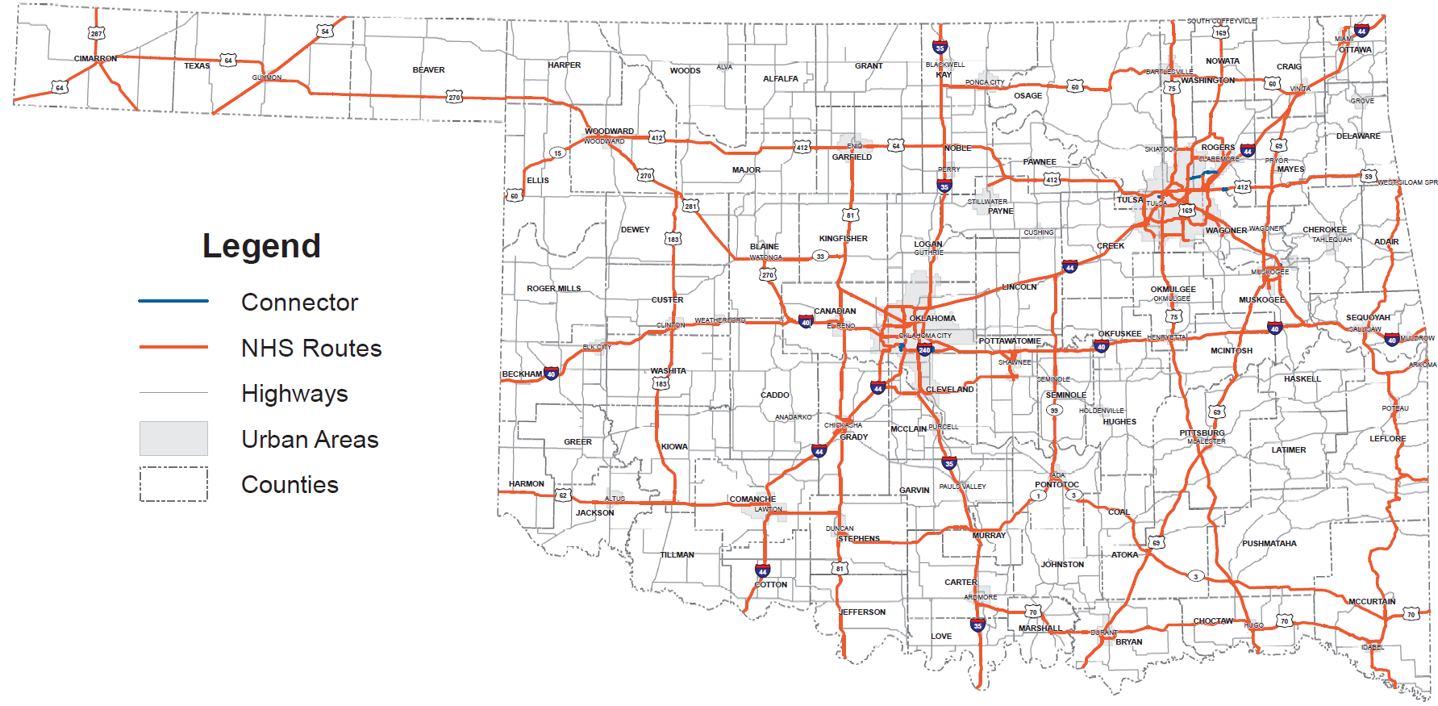
Where? – Inventory
Total lane miles: 30,389
  Interstate: 2,917
  Non-Interstate: 6,729
  Non-NHS: 20,743
Total Bridges: 6,744
  NHS: 2,790
  Non-NHS: 3,954
Oklahoma National Highway System
Source: ODOT 2019

Slide 3
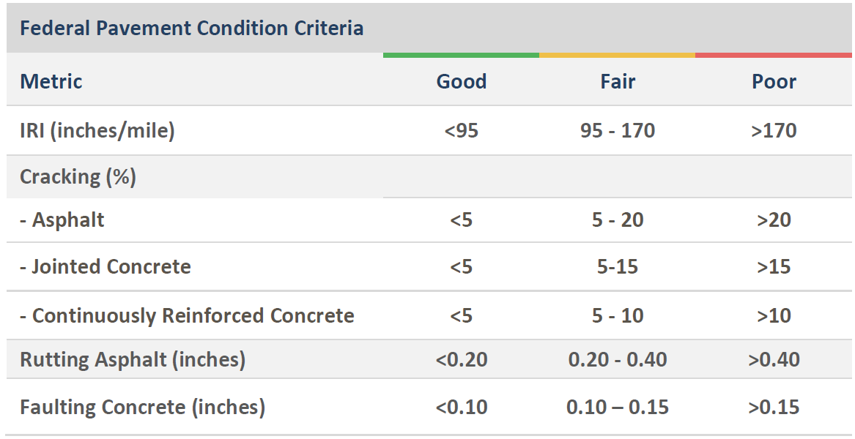
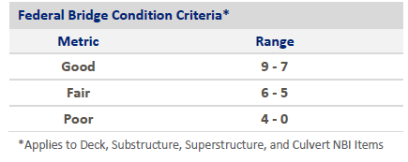
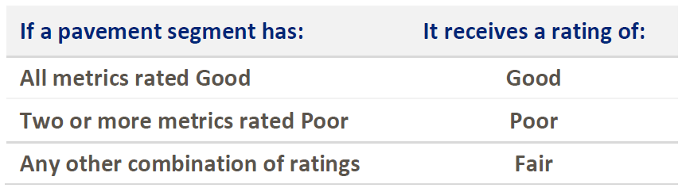
Where? – Condition
Source: ODOT 2019

Slide 4
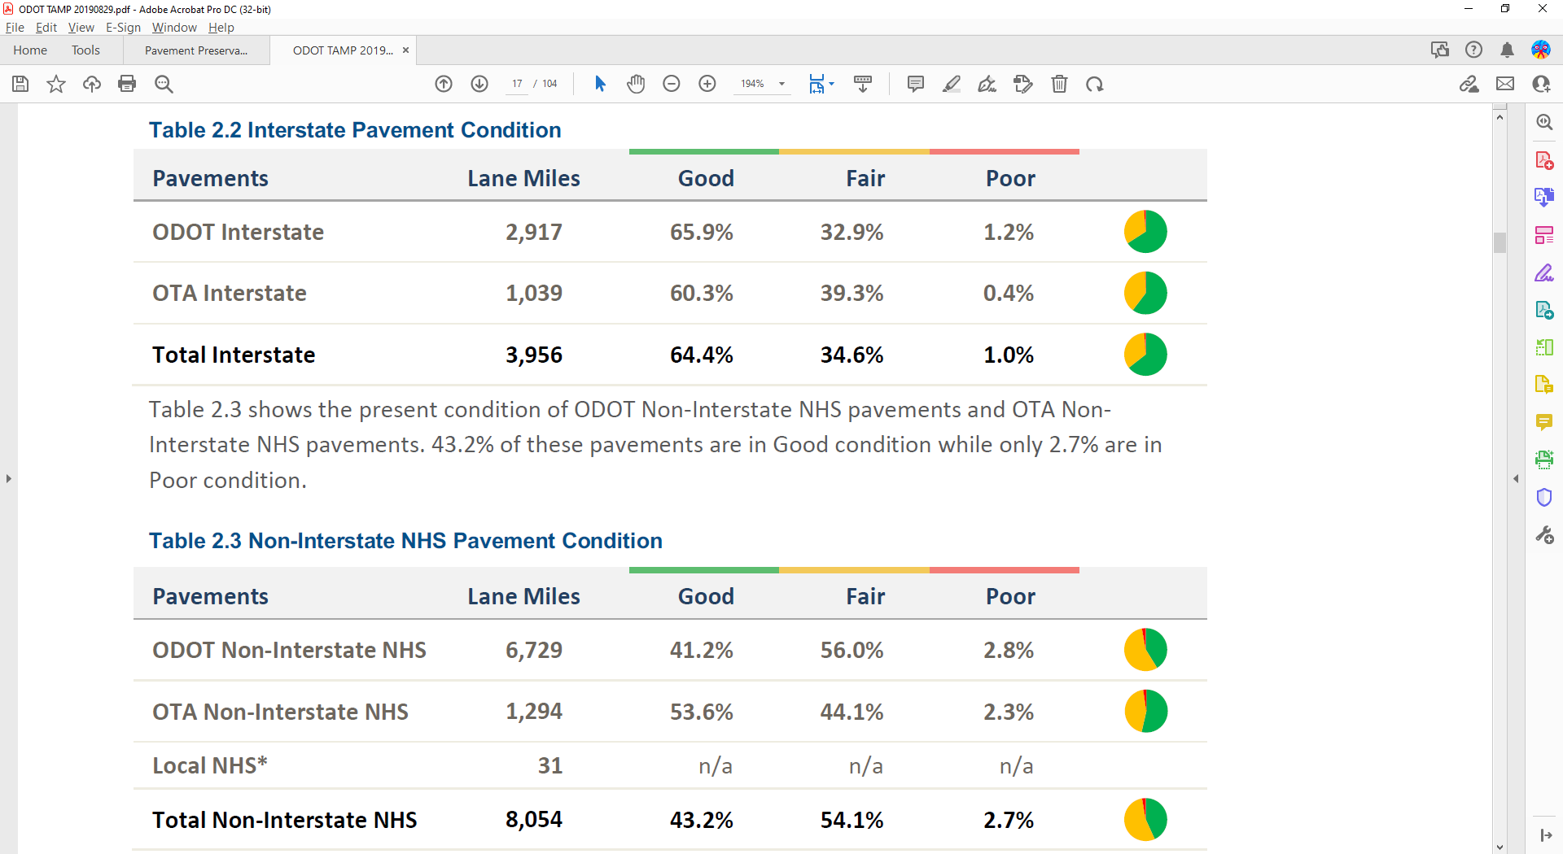
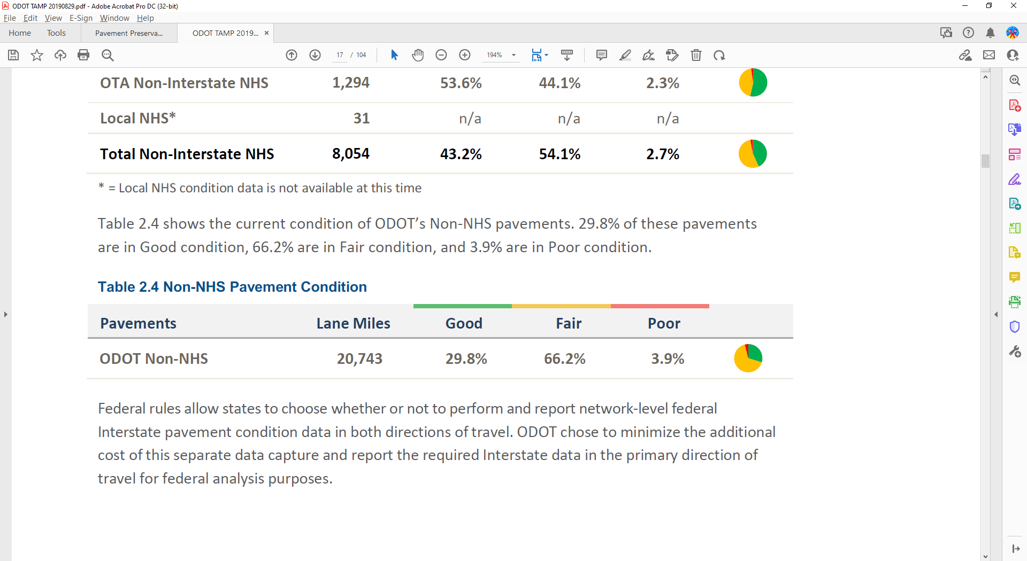
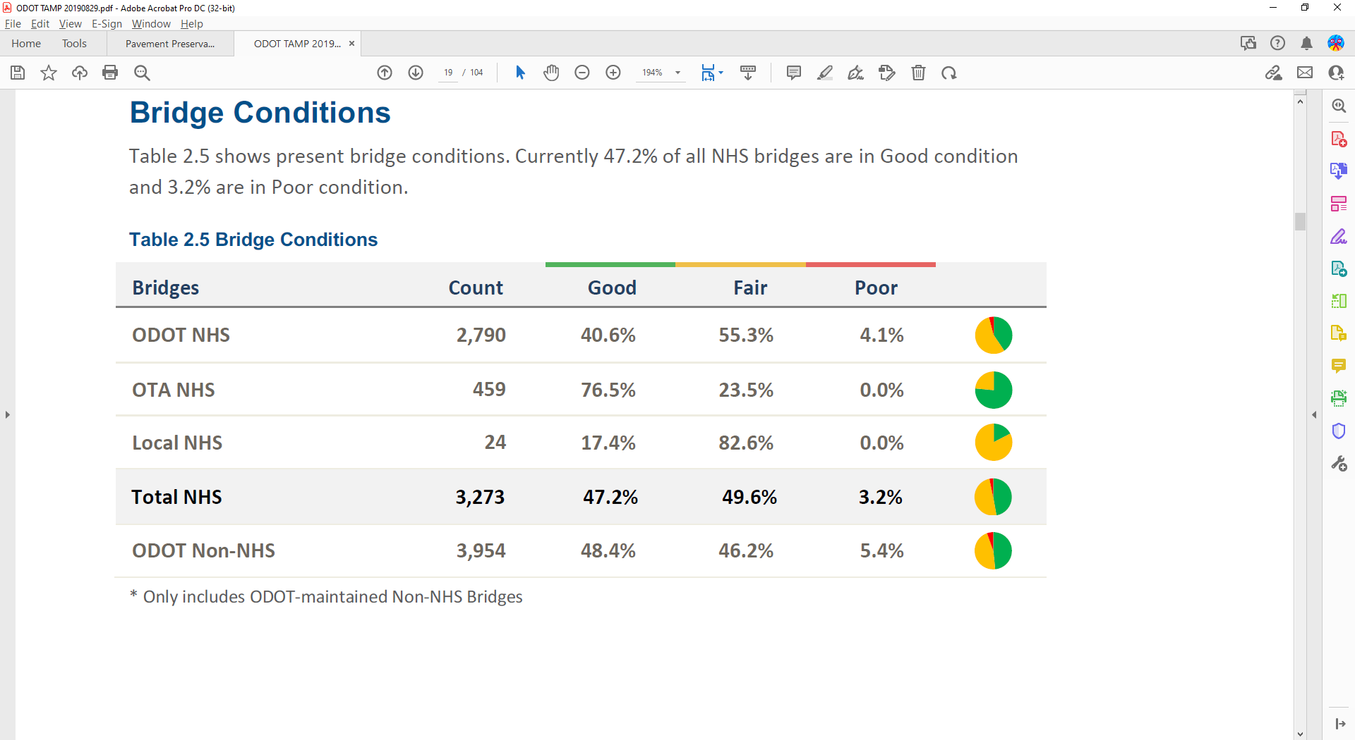
Where? – Condition
Source: ODOT 2019

Slide 5
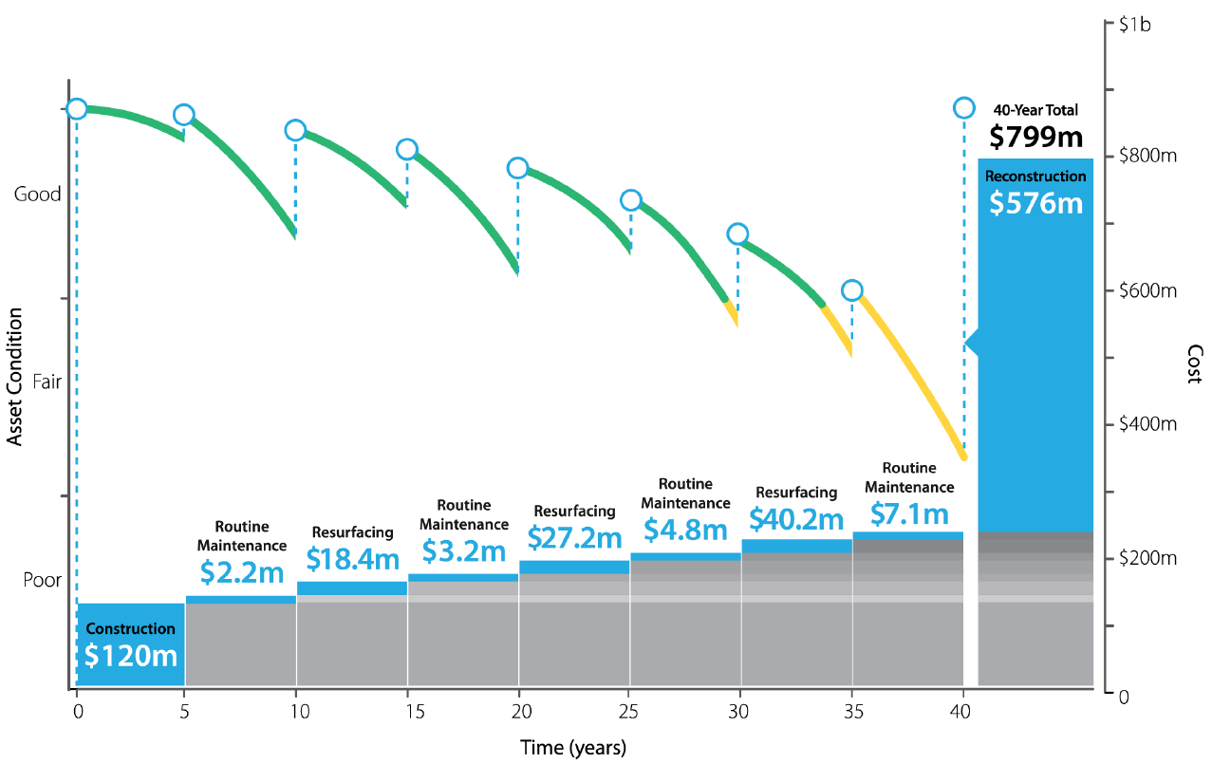
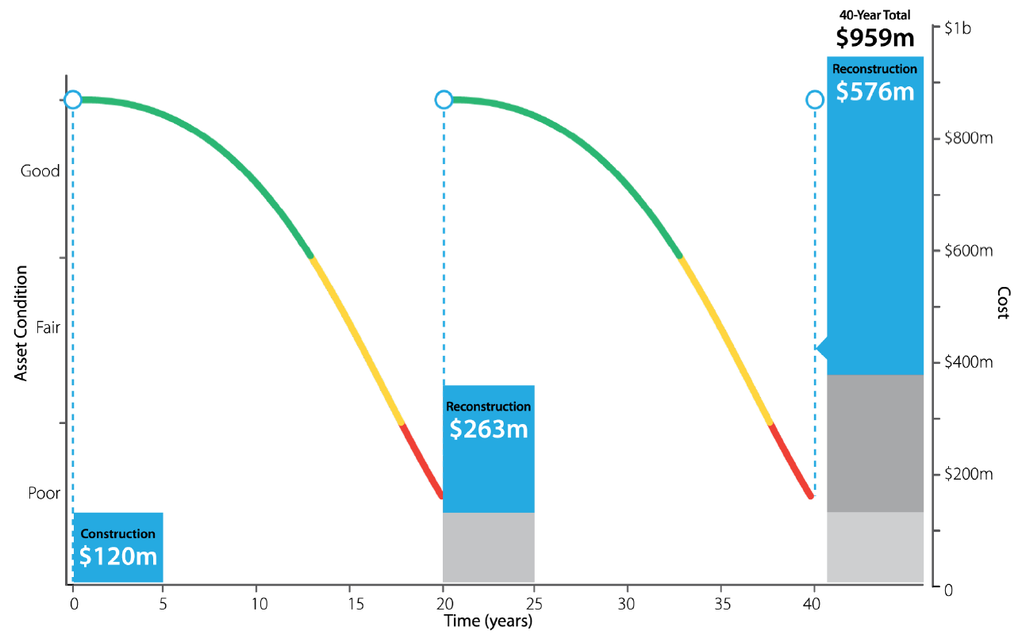
When? – Economics of Life Cycle Planning
Regular Maintenance Every 5 Years
Two major reconstruction events
$ 160m difference for 40-Year Total Investment
About 17% Increase in spending after 40 years
Source: Rhode Island DOT (based on an analysis originally published by Texas DOT)

Slide 6
When? – Impact of Planning on Performance
Regular Maintenance Every 5 Years
Two major reconstruction events
33 total years of Good condition
7 years of Fair condition
No Poor condition periods in 40 years
26 total years of Good condition
10 years of Fair condition
4 years of Poor condition
Source: Rhode Island DOT (based on an analysis originally published by Texas DOT)

Slide 7
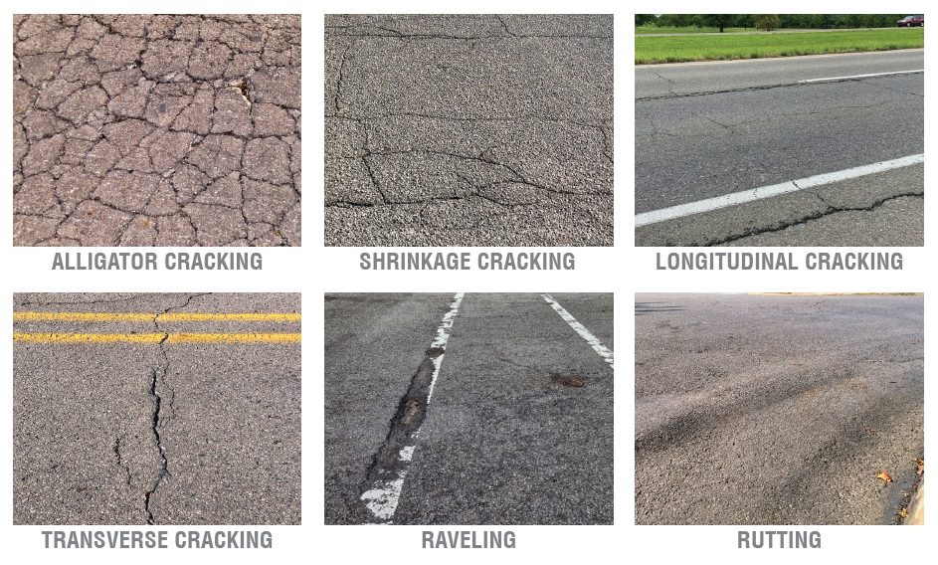
How? – Pavement Preservation Programs
Pavement Management System
  Implemented 2001
  Used for condition monitoring and decision making
Pavement Preservation Program (3P)
  Implemented 2004
  Allows use of Federal funds for preservation
State Surface and Bridge Rehabilitation Programs (SSR) and (SBR)
  Implemented 2009
  Increased State funds for resurfacing
Routine and Special Maintenance Funding

Slide 8




How? – Much?
2022 – 2029 Construction Work Plan
  4,002 lane miles of pavement improvements
  682 bridges
2022 – 2025 Asset Preservation Plan
  2,500 lane miles of pavement preservation
  102 bridges
$7.7 billion total investment (CWP)
  $320 million State, $480 million Federal-Aid
$480 million total investment (APP)
  $120 million per year
Source: ODOT 2021

Slide 9
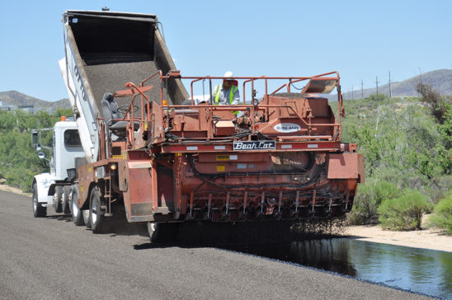
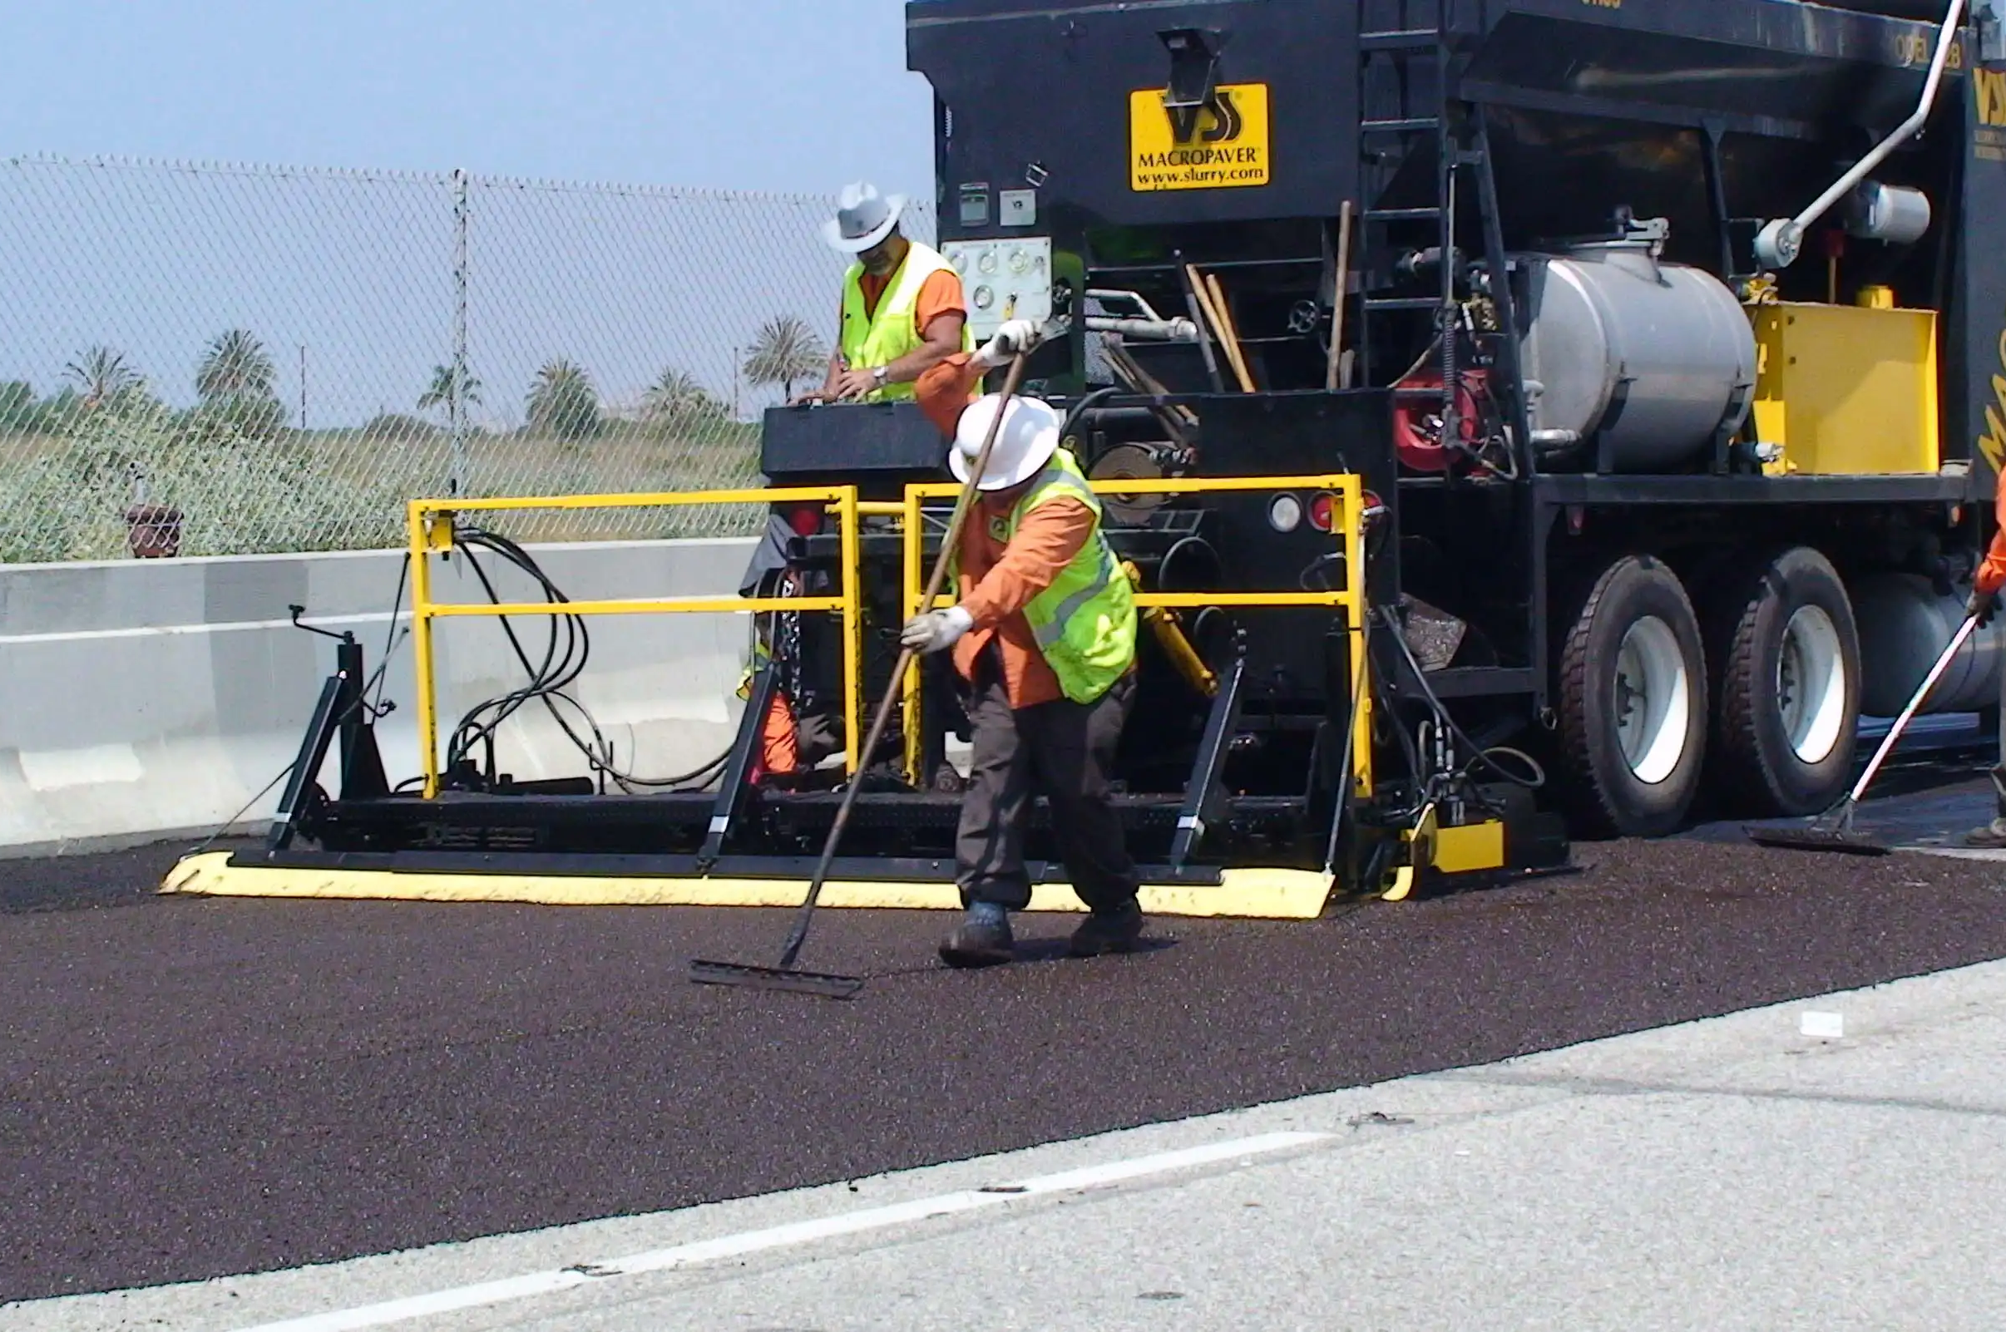
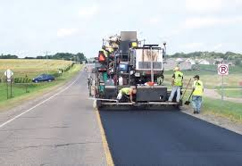
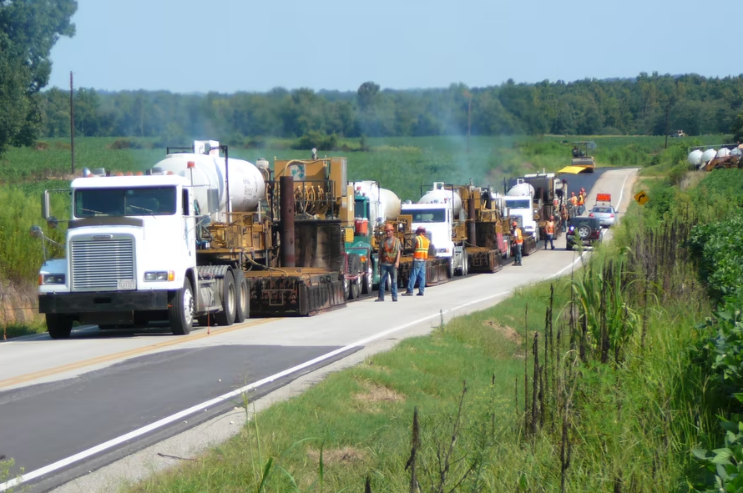
How? – Pavement Preservation Treatments
Asphalt
  Chip Seal
  Microsurface
  Thin Overlay 1”-2”
  Ultra-thin Bonded Wearing Course (UTBWC)
  Medium Overlay 2”-3”
  Hot In-Place Recycle (HIR)
  HIR Cap with UTBWC
  HIR Cap with Overlay 1”-2”
  Milling (w/ surface treatment)
Chip Seal
Microsurface
UTBWC
HIR
Sources: Sunland Asphalt 2022, World Highways 2022, MnDOT 2015, ForConstructionPros 2018

Slide 10

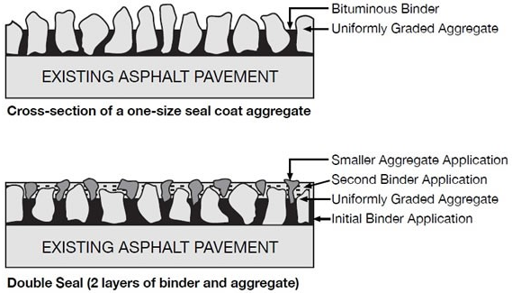
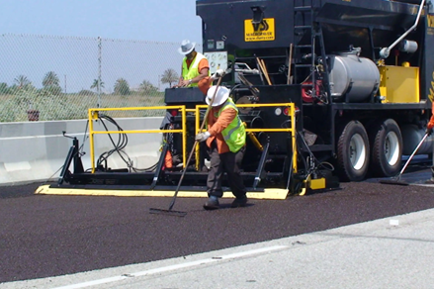
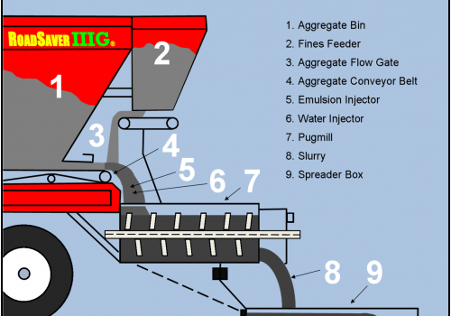
How? – Asphalt Preservation Treatments
Chip Seal
  Combines one or more layers of binders or emulsions with one or more layers of crushed aggregate
  Keeps pavement in good condition
  Seals cracks and water intrusion
Microsurface
  Combines a polymer-modified emulsion with mineral aggregates, water, and additives, mixed and uniformly spread
  Preserve underlying pavement
  Provide new driving surface
Gransberg and James 2005
Rayner 2022

Slide 11
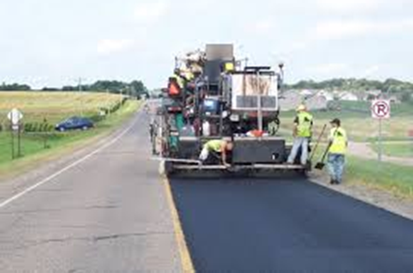
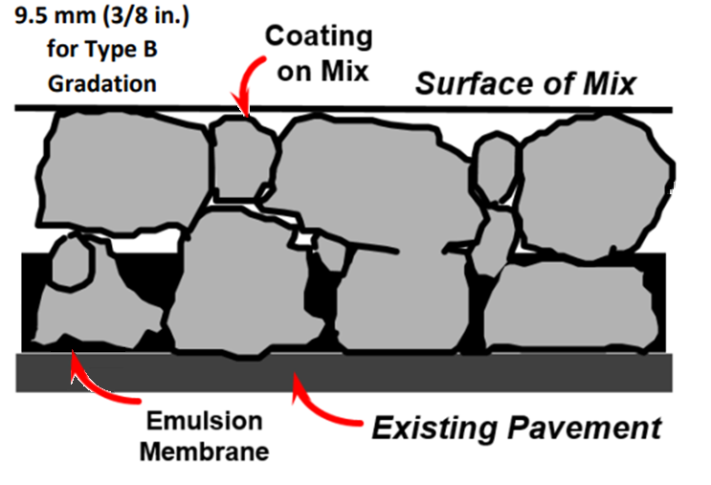
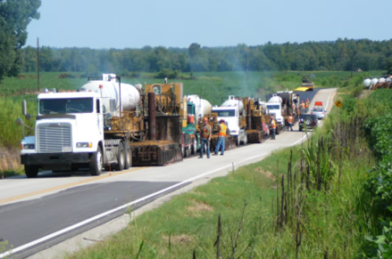
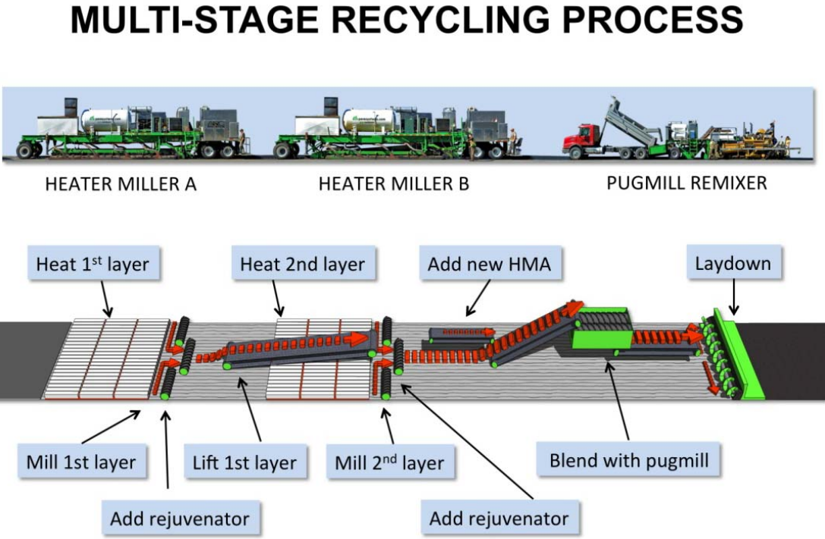
How? – Asphalt Preservation Treatments
Ultra-Thin Bonded Wearing Course (UTBWC)
  Combines one layer of relatively thick polymer-modified emulsion sprayed onto the existing pavement, then covered with a thin open-graded HMA layer
Hot-In-Place Recycle (HIR)
  Existing asphalt is heated and scarified, mixed with a recycling agent, then paved over the existing surface
MnDOT 2018
Fyvie 2014

Slide 12
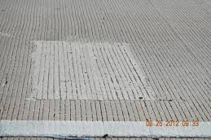
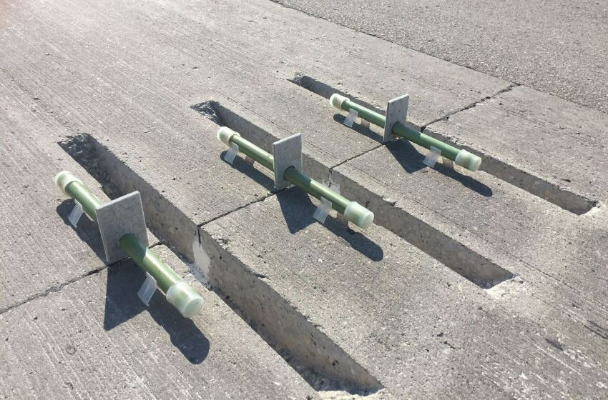
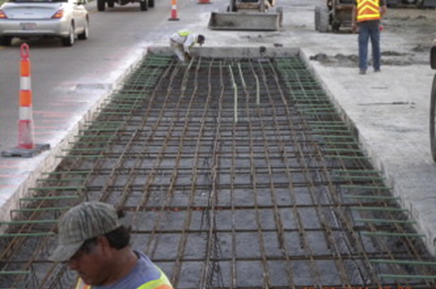
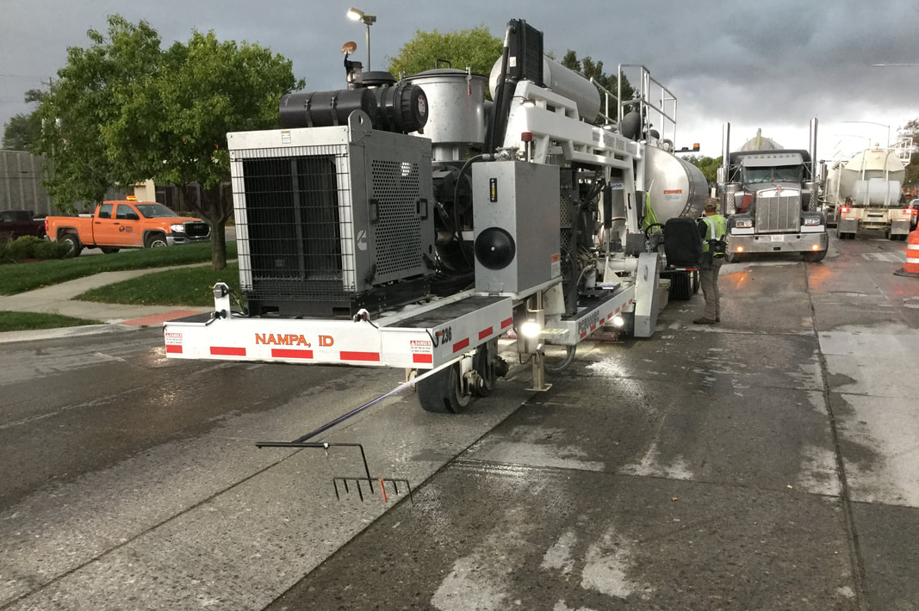
How? – Pavement Preservation Treatments
Jointed Concrete
  Patching
  Dowel Bar Retrofit
  Diamond Grinding
Continuously Reinforced Concrete
  Full-Depth Punchout Repair
  Diamond Grinding
Patching
Dowel Bar Retrofit
Full-Depth Repair
Diamond Grinding
Sources: TxDOT 2022, Concrete Construction 2017, Hao Chen 2013, ICPA 2022

Slide 13
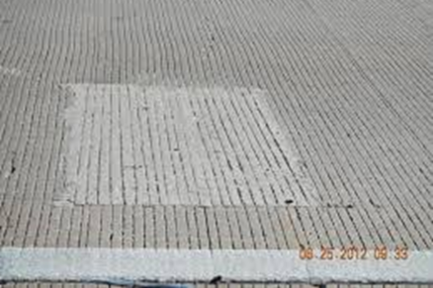
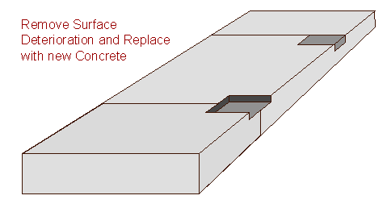
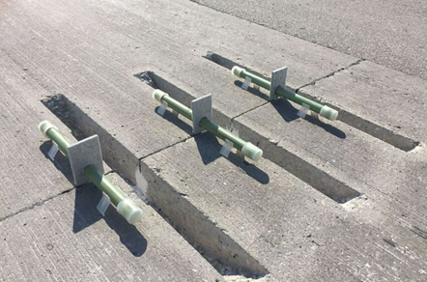
How? – Concrete Preservation Treatments
Patching
  Removal of deteriorated surface and replace with new concrete or asphalt patching
Dowel Bar Retrofit
  Reinforce joints or cracks from jointed concrete pavement, improves load transfer, and mitigate faulting
ACPA 2013
CalTrans 2015

Slide 14
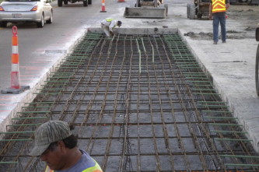
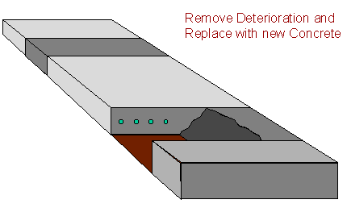
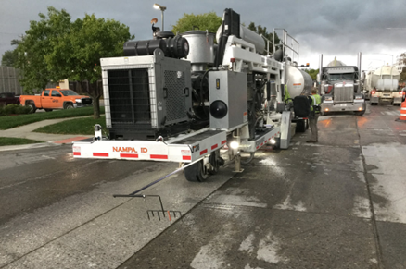
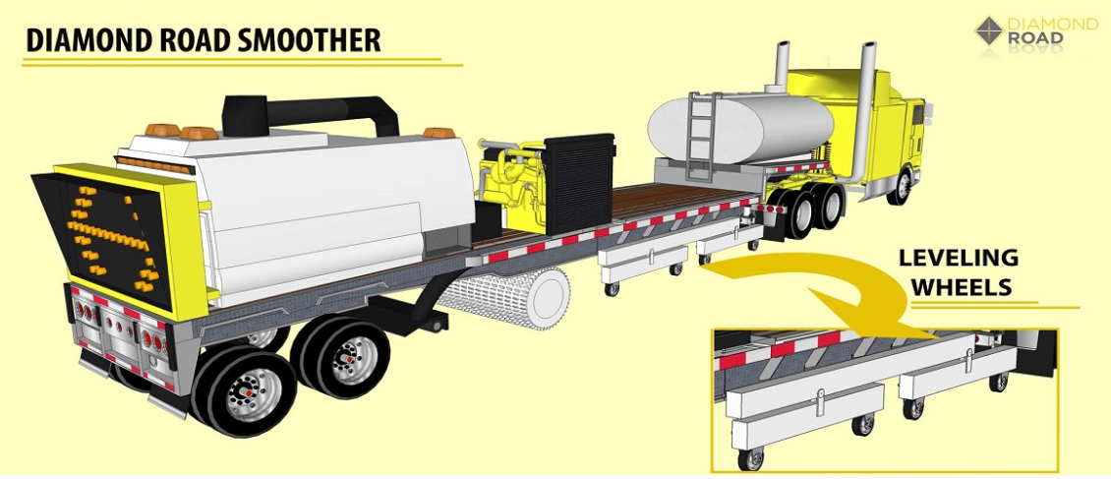
How? – Concrete Preservation Treatments
Full-Depth Punchout Repair
  Replacement of deteriorated pavement section and replace with a new panel, may add dowel bars
Diamond Grinding
  Removes surface irregularities by grinding, helps mitigate faulting, warping, or curling of concrete sections
ACPA 2013
Diamond Road 2022

Slide 15
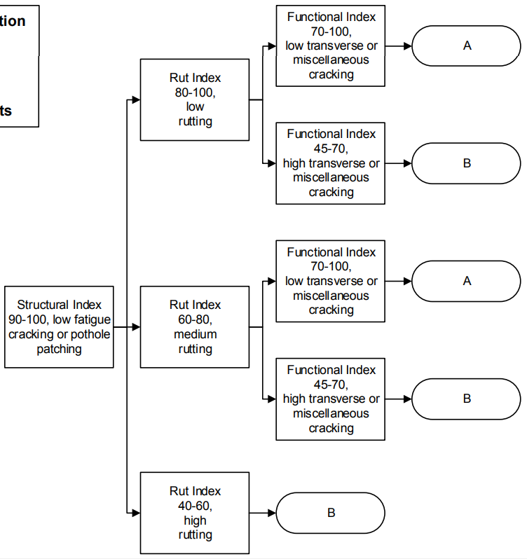
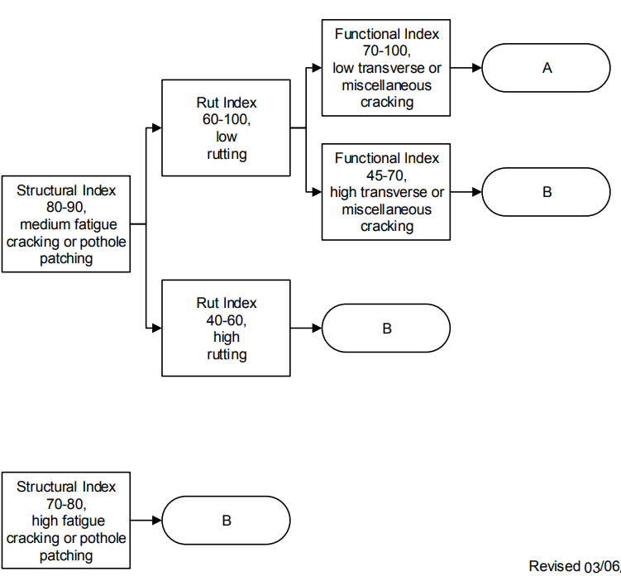
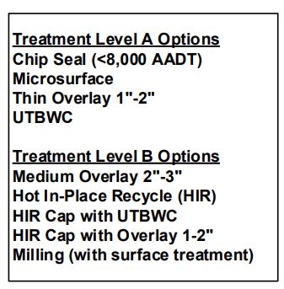
How? – Asphalt Preservation Treatments
Criteria (Decision tree)
Source: ODOT 2017

Slide 16
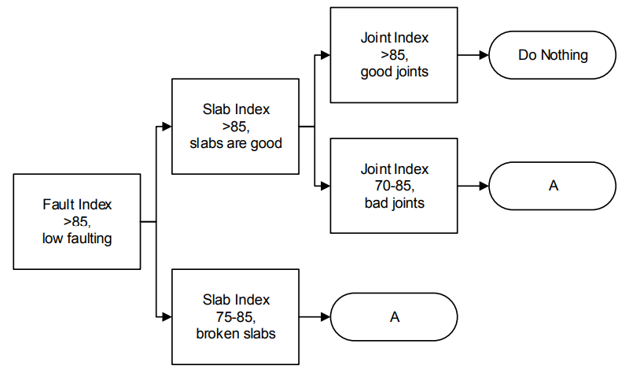
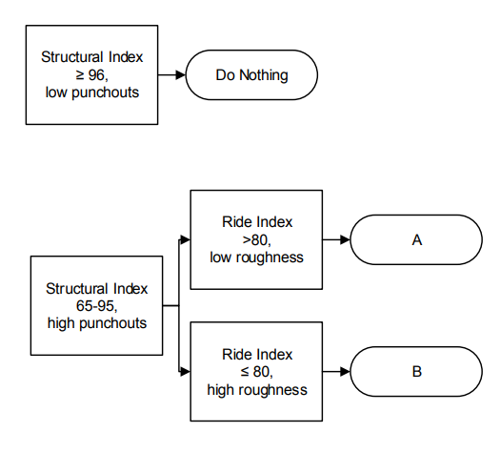

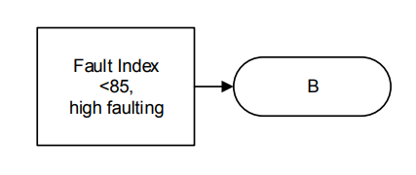
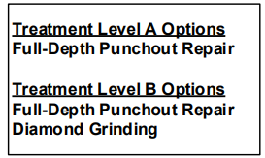
How? – Concrete Preservation Treatments
Jointed Concrete
Continuously Reinforced Concrete
Source: ODOT 2017

Slide 17
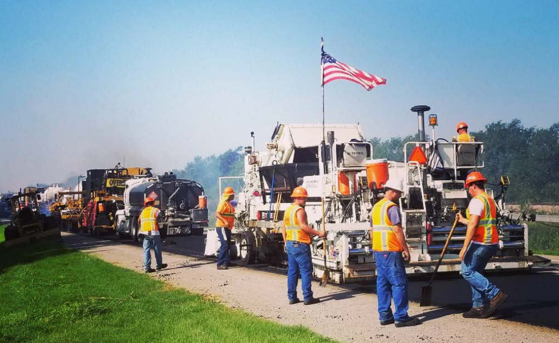
Thank You
David A. Vivanco, P.E.
405.522.4986
dvivanco@odot.org

