Slide 1
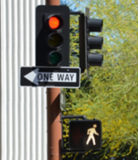
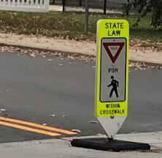
Every Day Counts so OK up (Safe Transportation for Every Pedestrian) OK STIC EDC-4 STEP Webinar July 13, 2022

Slide 2
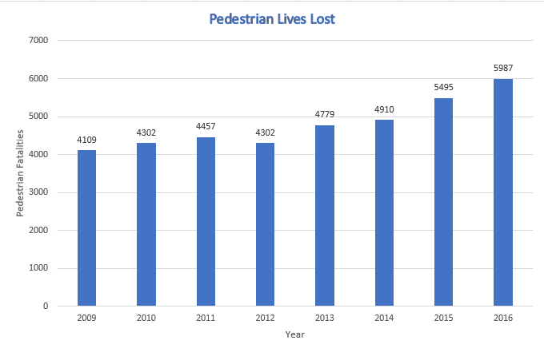
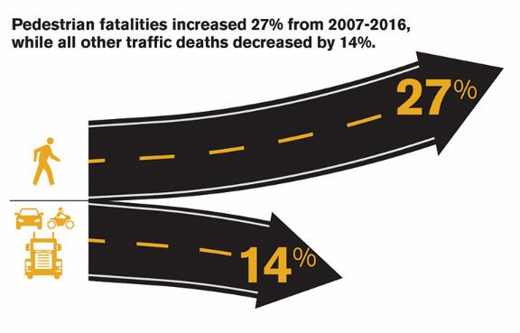
The numbers in 2017 when STEP initiated
Photo Credit: GHSA
Pedestrians now account for a larger proportion of traffic fatalities (16%) than they have in the past 33 years
2

Slide 3
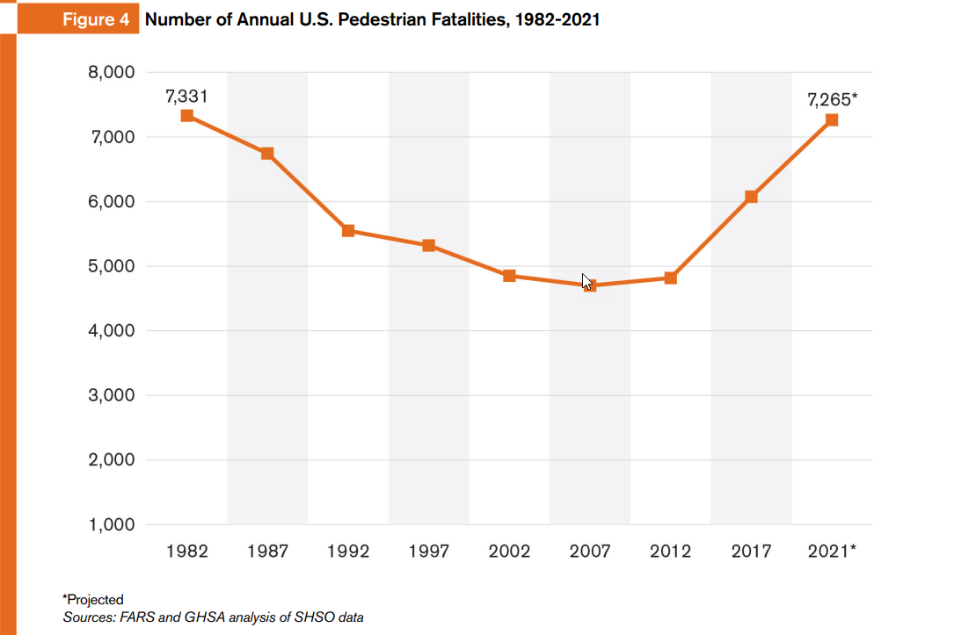
The numbers from the latest GHSA Report

Slide 4
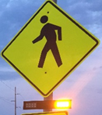
Why STEP?
Over 72% of pedestrian fatalities occur at non-intersection locations (mid-block)
Roughly 27% of pedestrian fatalities occur at intersections (with more at uncontrolled)
4

Slide 5
The Fabulous Five to Spectacular Seven
Crosswalk Visibility Enhancements
Raised Crosswalks
Pedestrian Refuge Island
Rectangular Rapid Flashing Beacon (RRFB)
Pedestrian Hybrid Beacon (PHB)
Road Diets
Leading Pedestrian Interval (LPI)

Slide 6
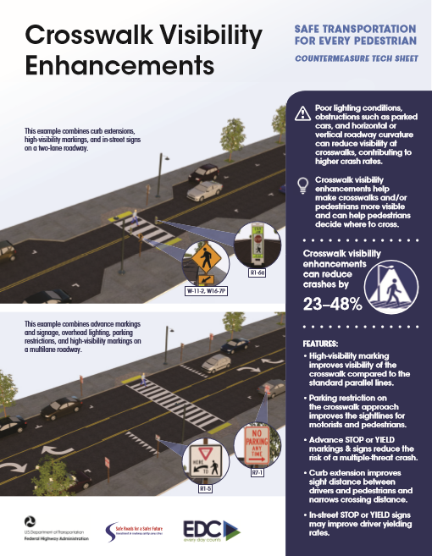
Crosswalk Visibility Enhancements
High Visibility Marked Crosswalks
Signing and Markings
Lighting
Curb Extensions / Bulb Outs
Parking Restrictions
Curb Radius

Slide 7
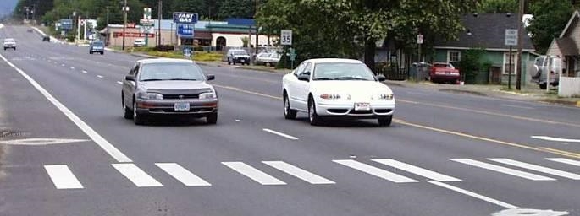
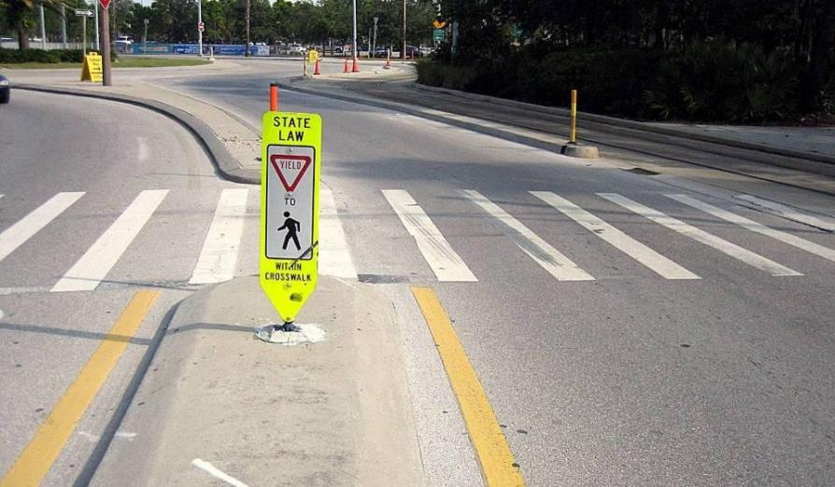
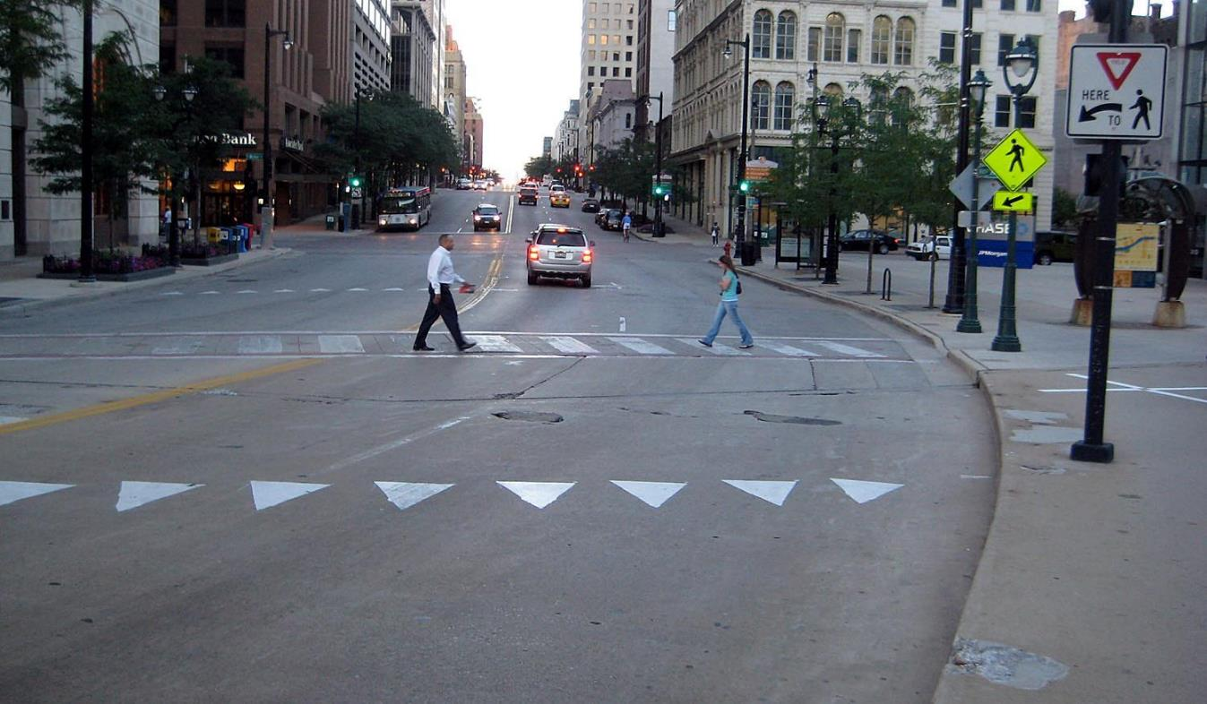
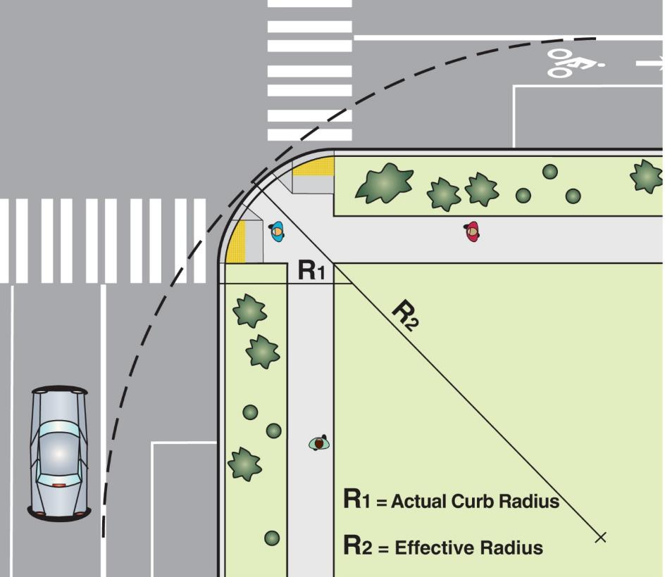
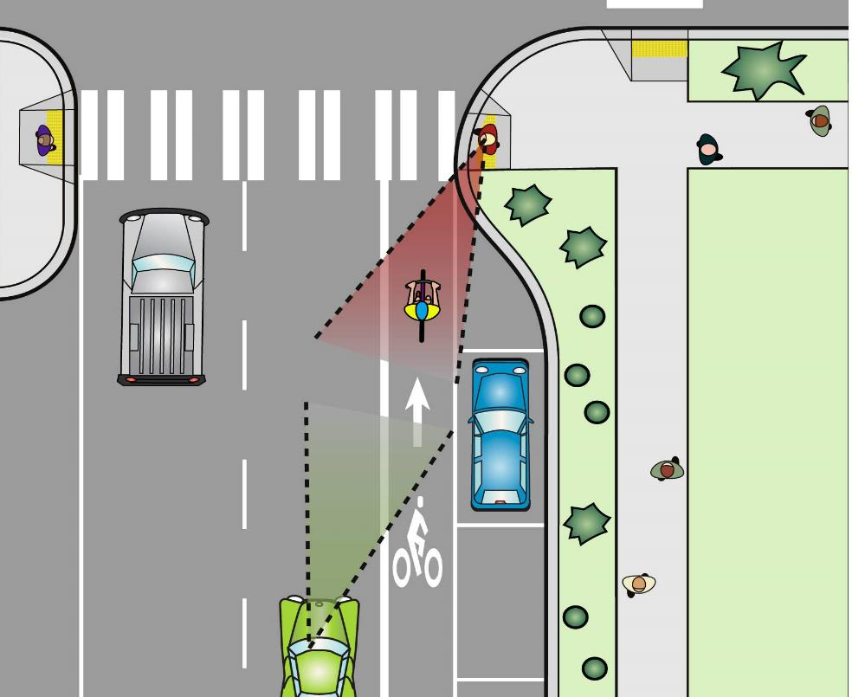
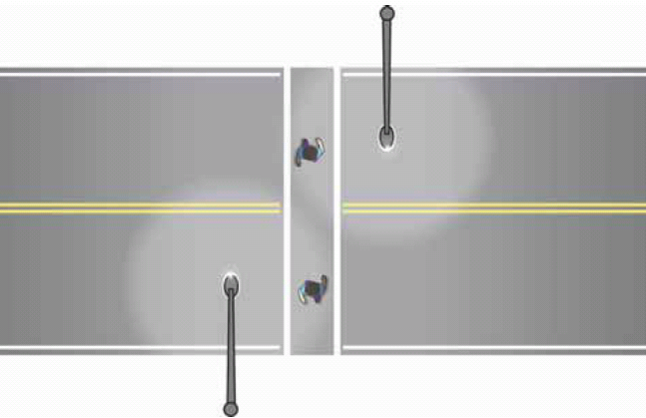
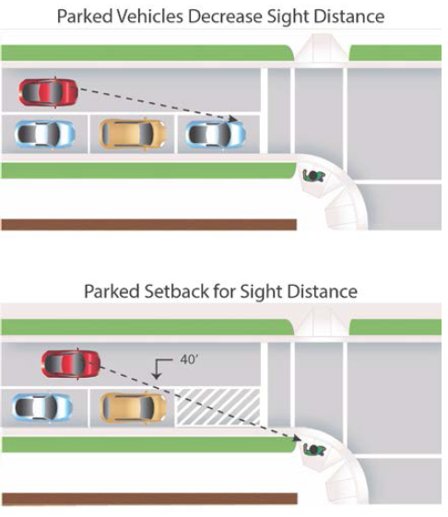
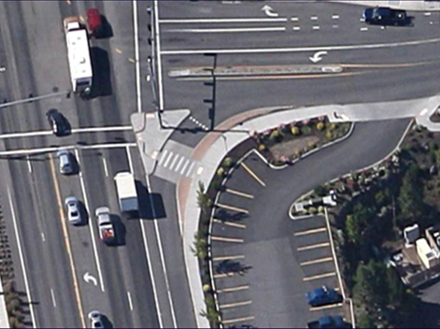

Slide 8
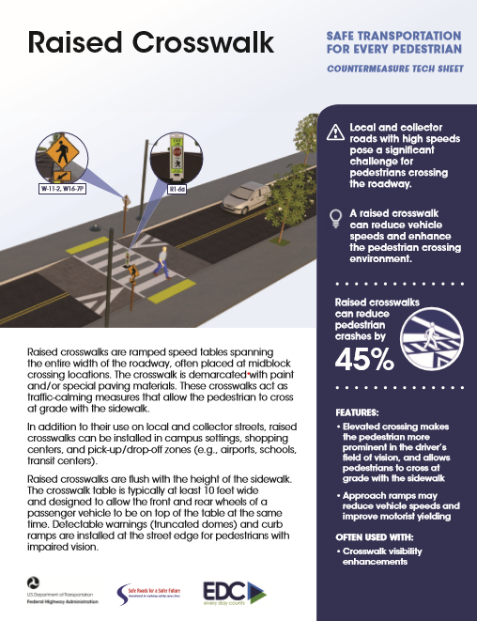
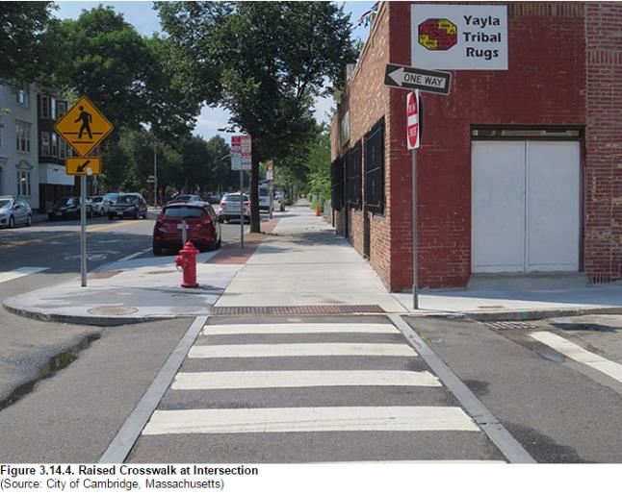
Two or three lanes
Speed limits of 30 mph or less
AADT below 9,000

Slide 9
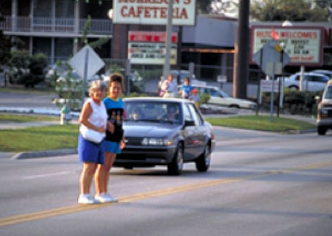
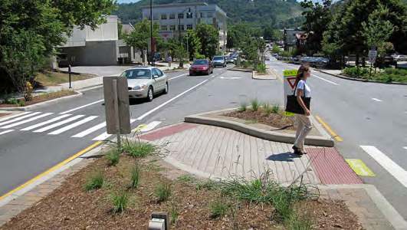

Slide 10
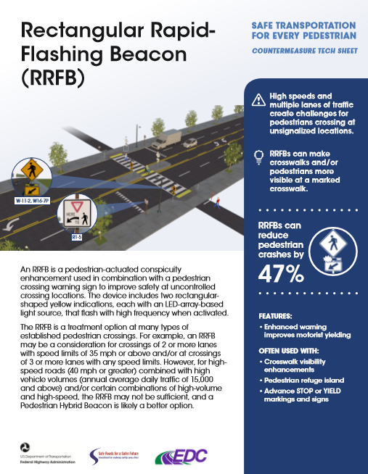
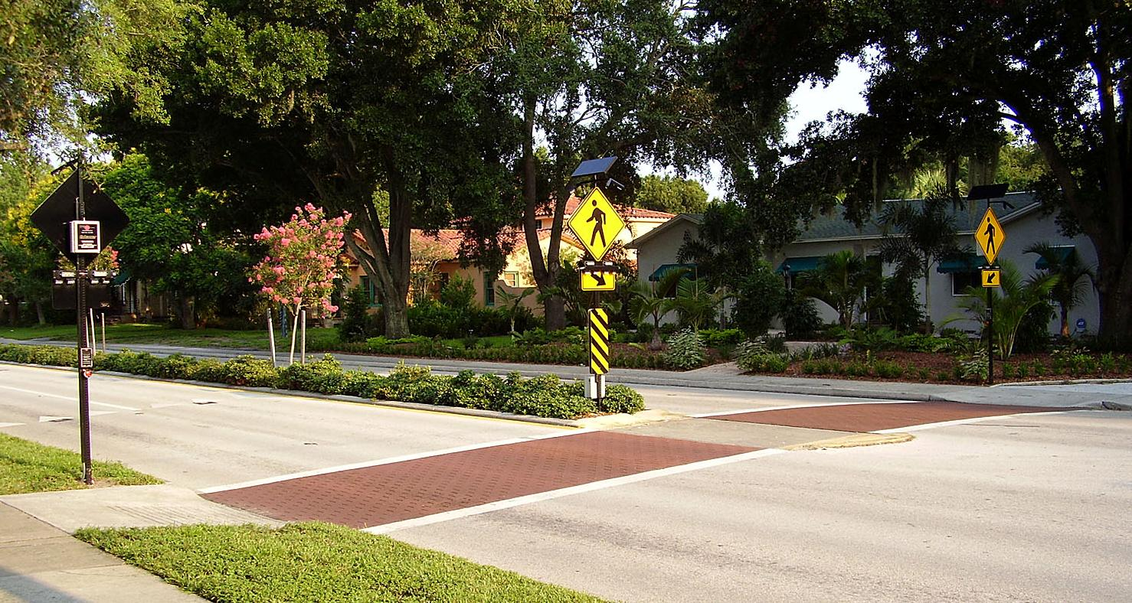

Slide 11
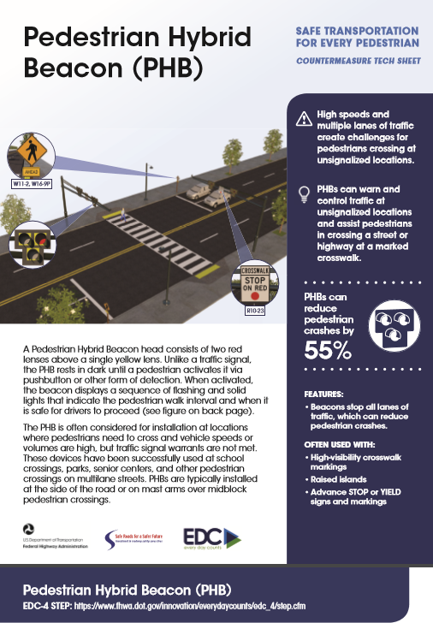
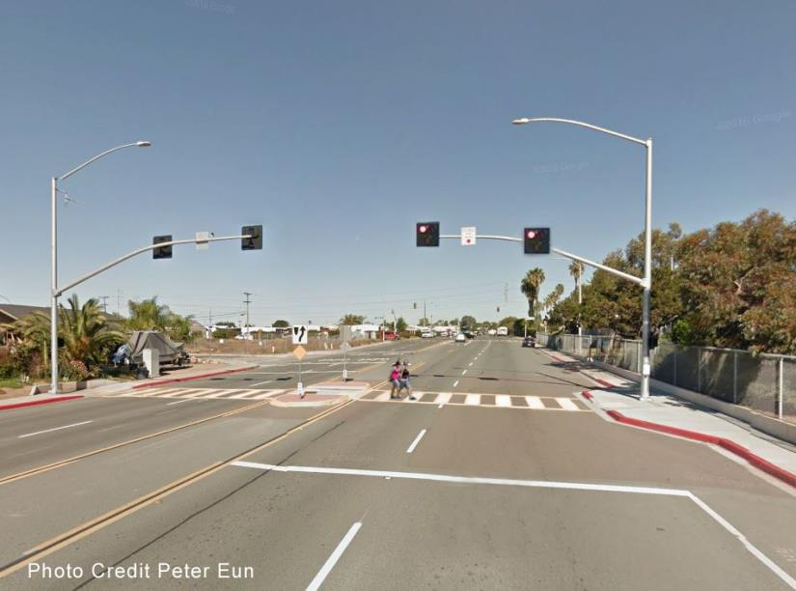
https://sahuaritaaz.gov/DocumentCenter/View/5621/Sah_bill-insert_Summer-2020_web?bidId=
Notes:
Town of Sahuarita AZ
Bullet Points from Richard Nassi
Speed Limit 45mph
85th Percentile guesstimated at least 50 mph.
Observed for about an hour
Driver compliance 100%.
Installation cost $26,000.
Device manufactured in Phoenix.
Very effective

Slide 12
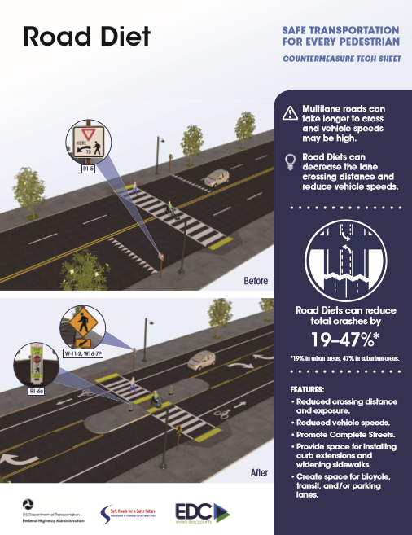
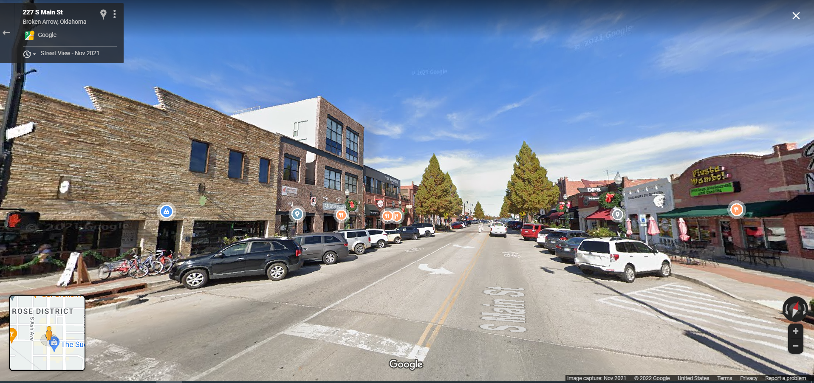
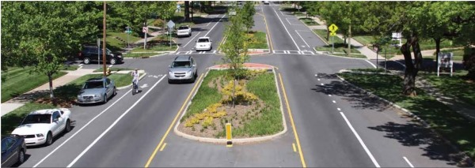

Slide 13
General Guidelines for Traffic Volumes
LESS THAN
10,000 ADT
10,000 – 15,000 ADT
15,000 – 20,000 ADT
GREATER THAN
20,000 ADT
Great candidate for Road Diet
Very good candidate for Road Diet
Good candidate for Road Diet
Potential candidate for Road Diet
In most instances traffic will likely not be negatively affected.
Agencies should conduct intersection analysis to study potential traffic operational effects and consider signal retiming as needed.
Agencies should conduct a corridor analysis since traffic operations may be affected at this volume depending on the “before” condition.
Agencies should complete a feasibility study to determine whether this is a good location for a Road Diet. Operations may be affected at this volume.
There are examples across the country where Road Diets have been successful with ADTs as high as 26,000

Slide 14
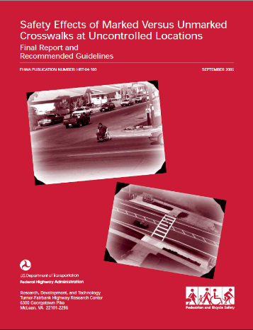
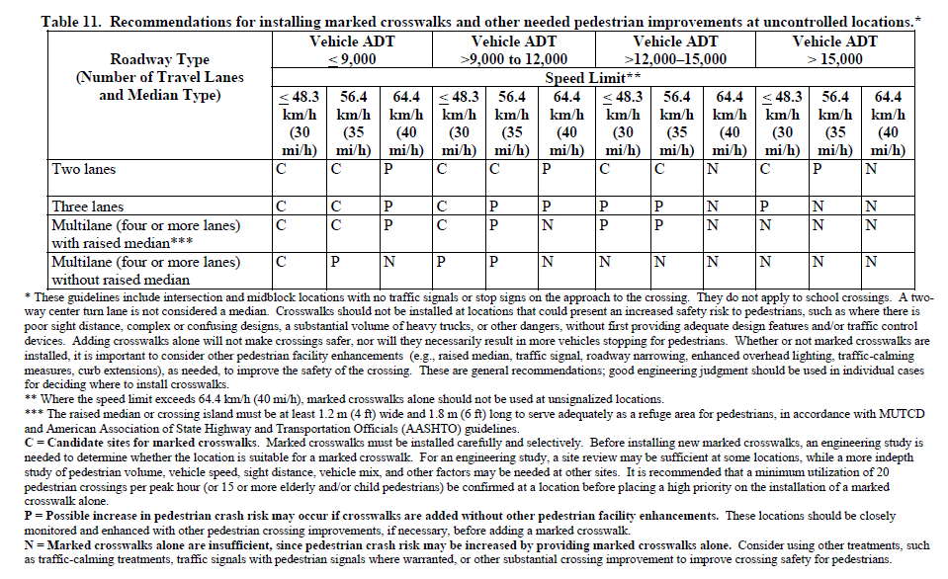
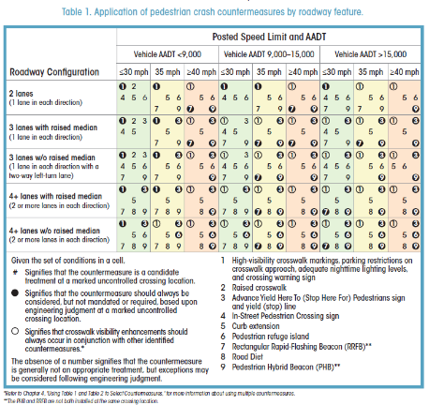
2005
2018

Slide 15
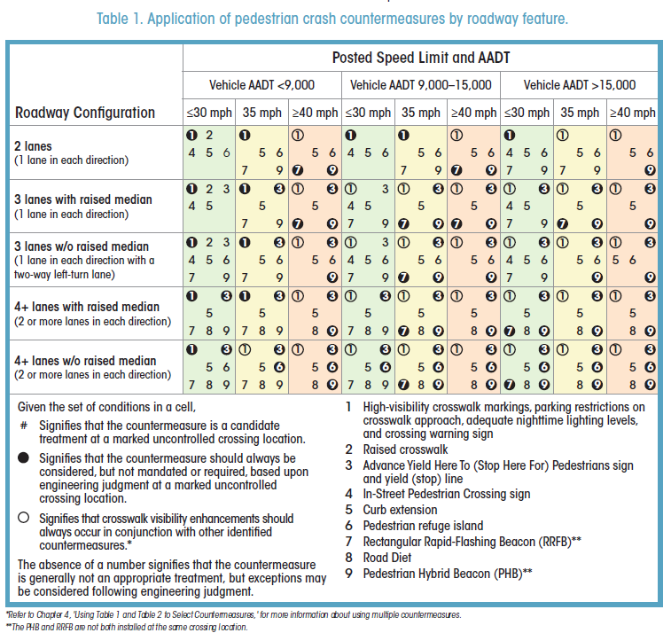

Slide 16
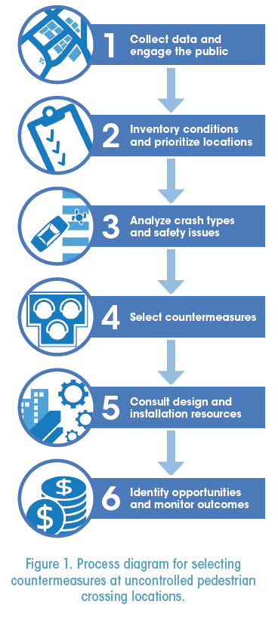
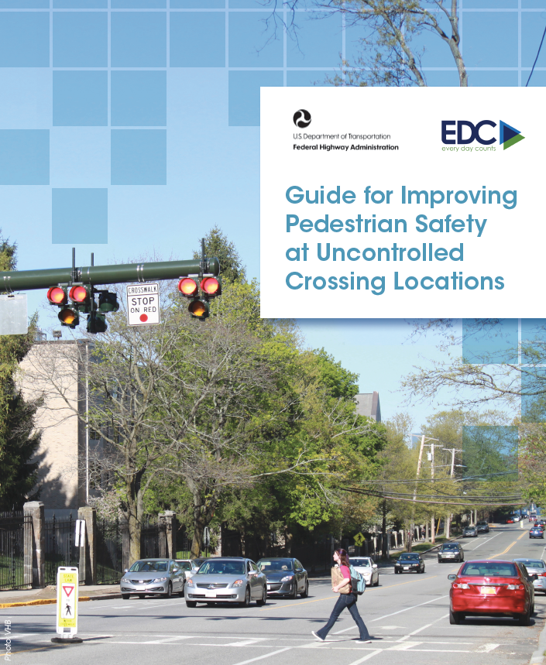
Guide for Improving Pedestrian Safety at Uncontrolled Crossing Locations
www.fhwa.dot.gov/innovation/everydaycounts/edc_4/guide_to_improve_uncontrolled_crossings.pdf

Slide 17
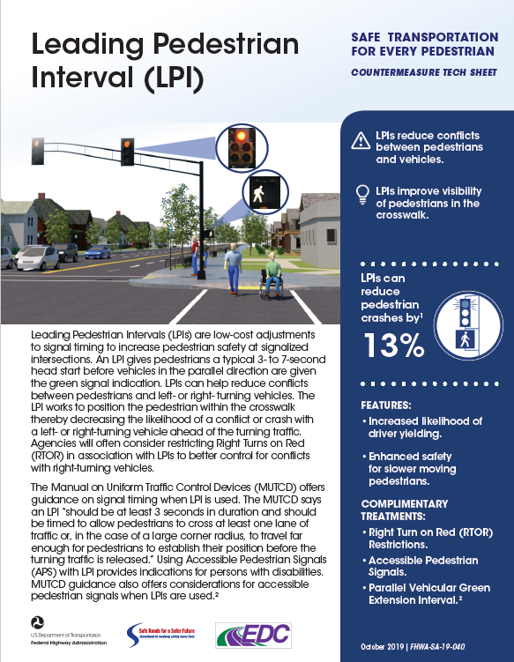
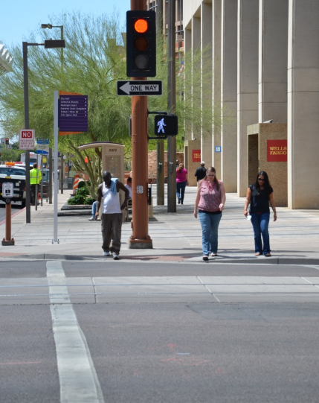

Slide 18
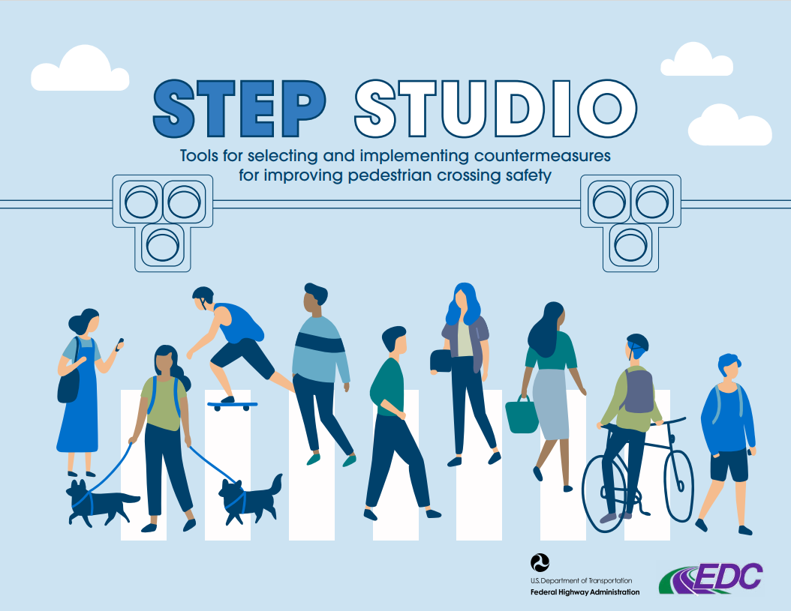
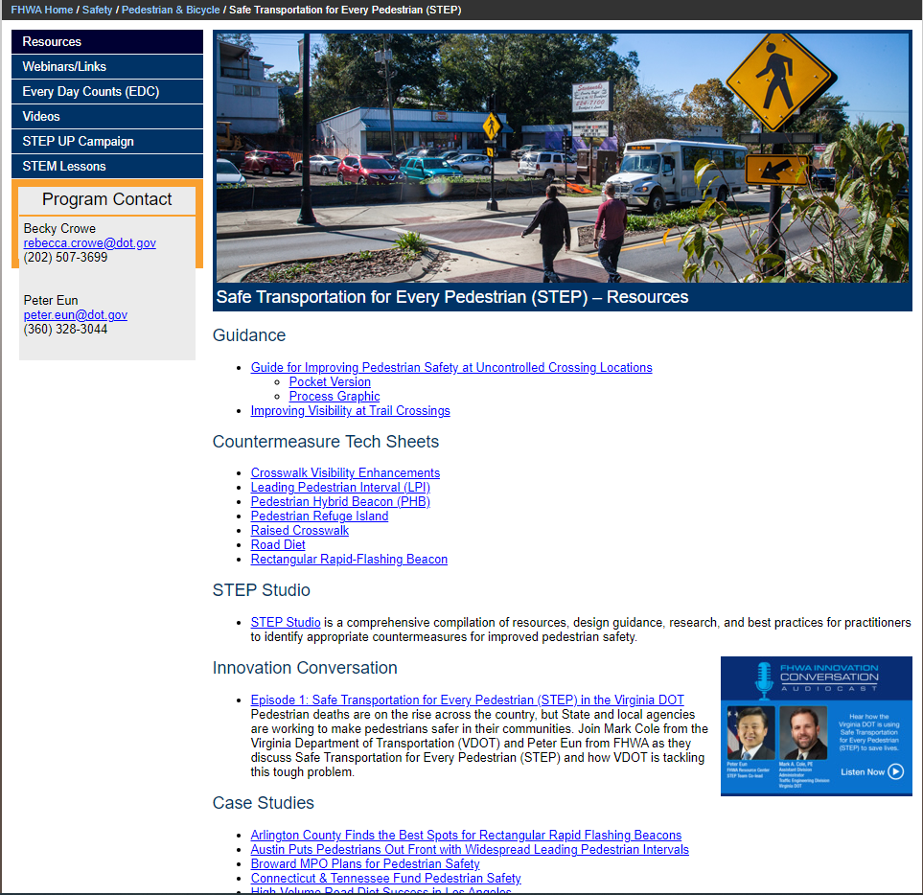
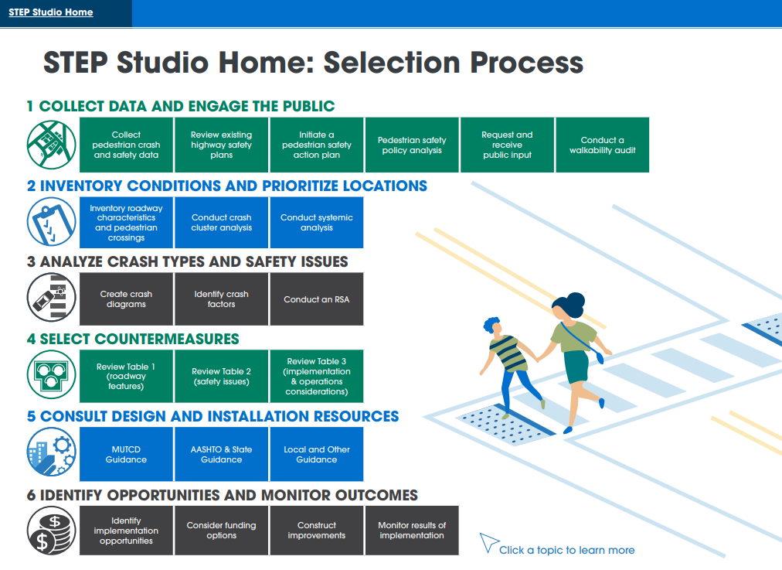
FHWA STEP Website https://safety.fhwa.dot.gov/ped_bike/step/resources/

Slide 19
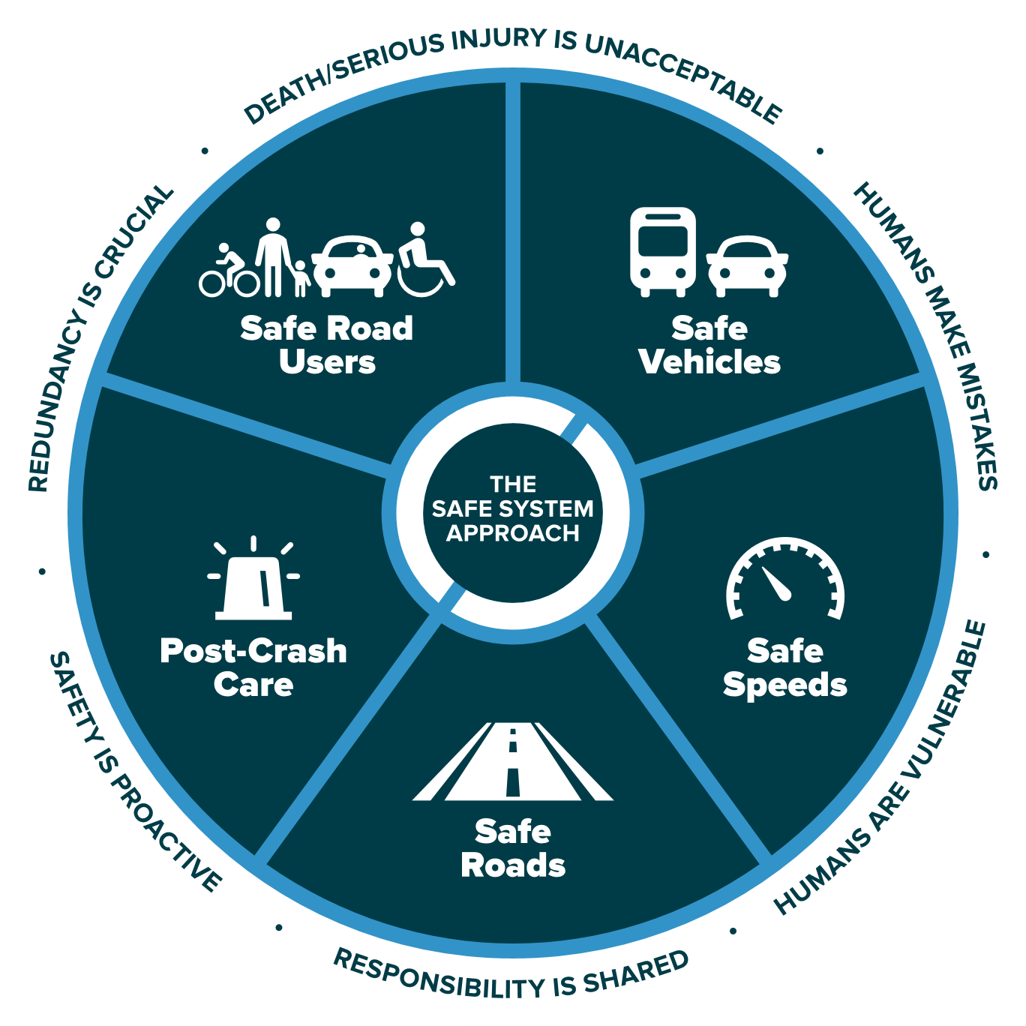
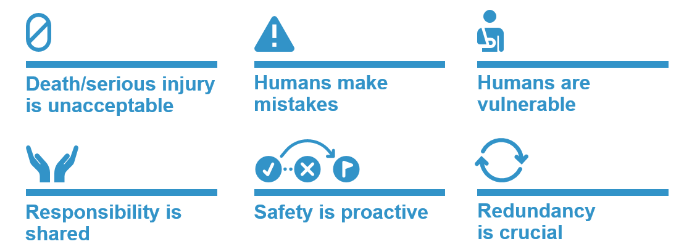
The Safe System Approach
Zero is our Goal. a Safe System is how we get there
Source: FHWA
19

Slide 20
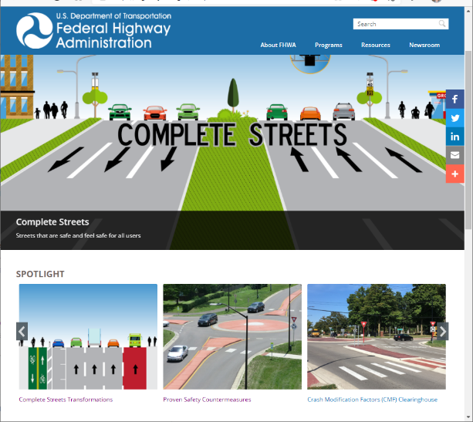
Now Live: FHWA CS Web Portal
Public facing web-portal to:
Publish all Complete Streets products
Link to CS resources across FHWA program offices and other stakeholders
https://highways.dot.gov/complete-streets
20

Slide 21
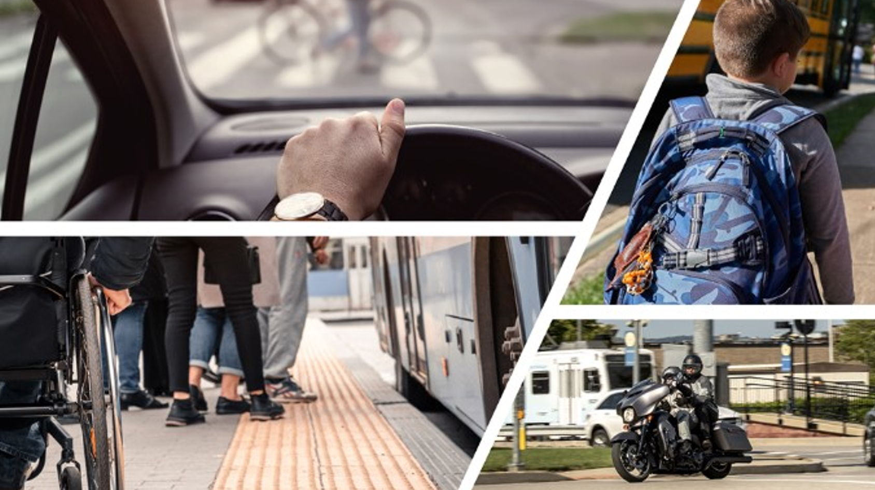
Safe Streets and Roads for All (SS4A) Grant Program
Funds regional, local and Tribal initiatives to prevent roadway deaths and serious injuries
$5 billion in appropriated funds over the next 5 years. In fiscal year 2022 (FY22), up to $1 billion is available.
The SS4A program funds regional, local, and Tribal initiatives through grants to prevent roadway deaths and serious injuries.
Visit www.transportation.gov/SS4A to:
Find resources, FAQs and application information
Applications are due September 15, 2022 5 pm EDT

Slide 22
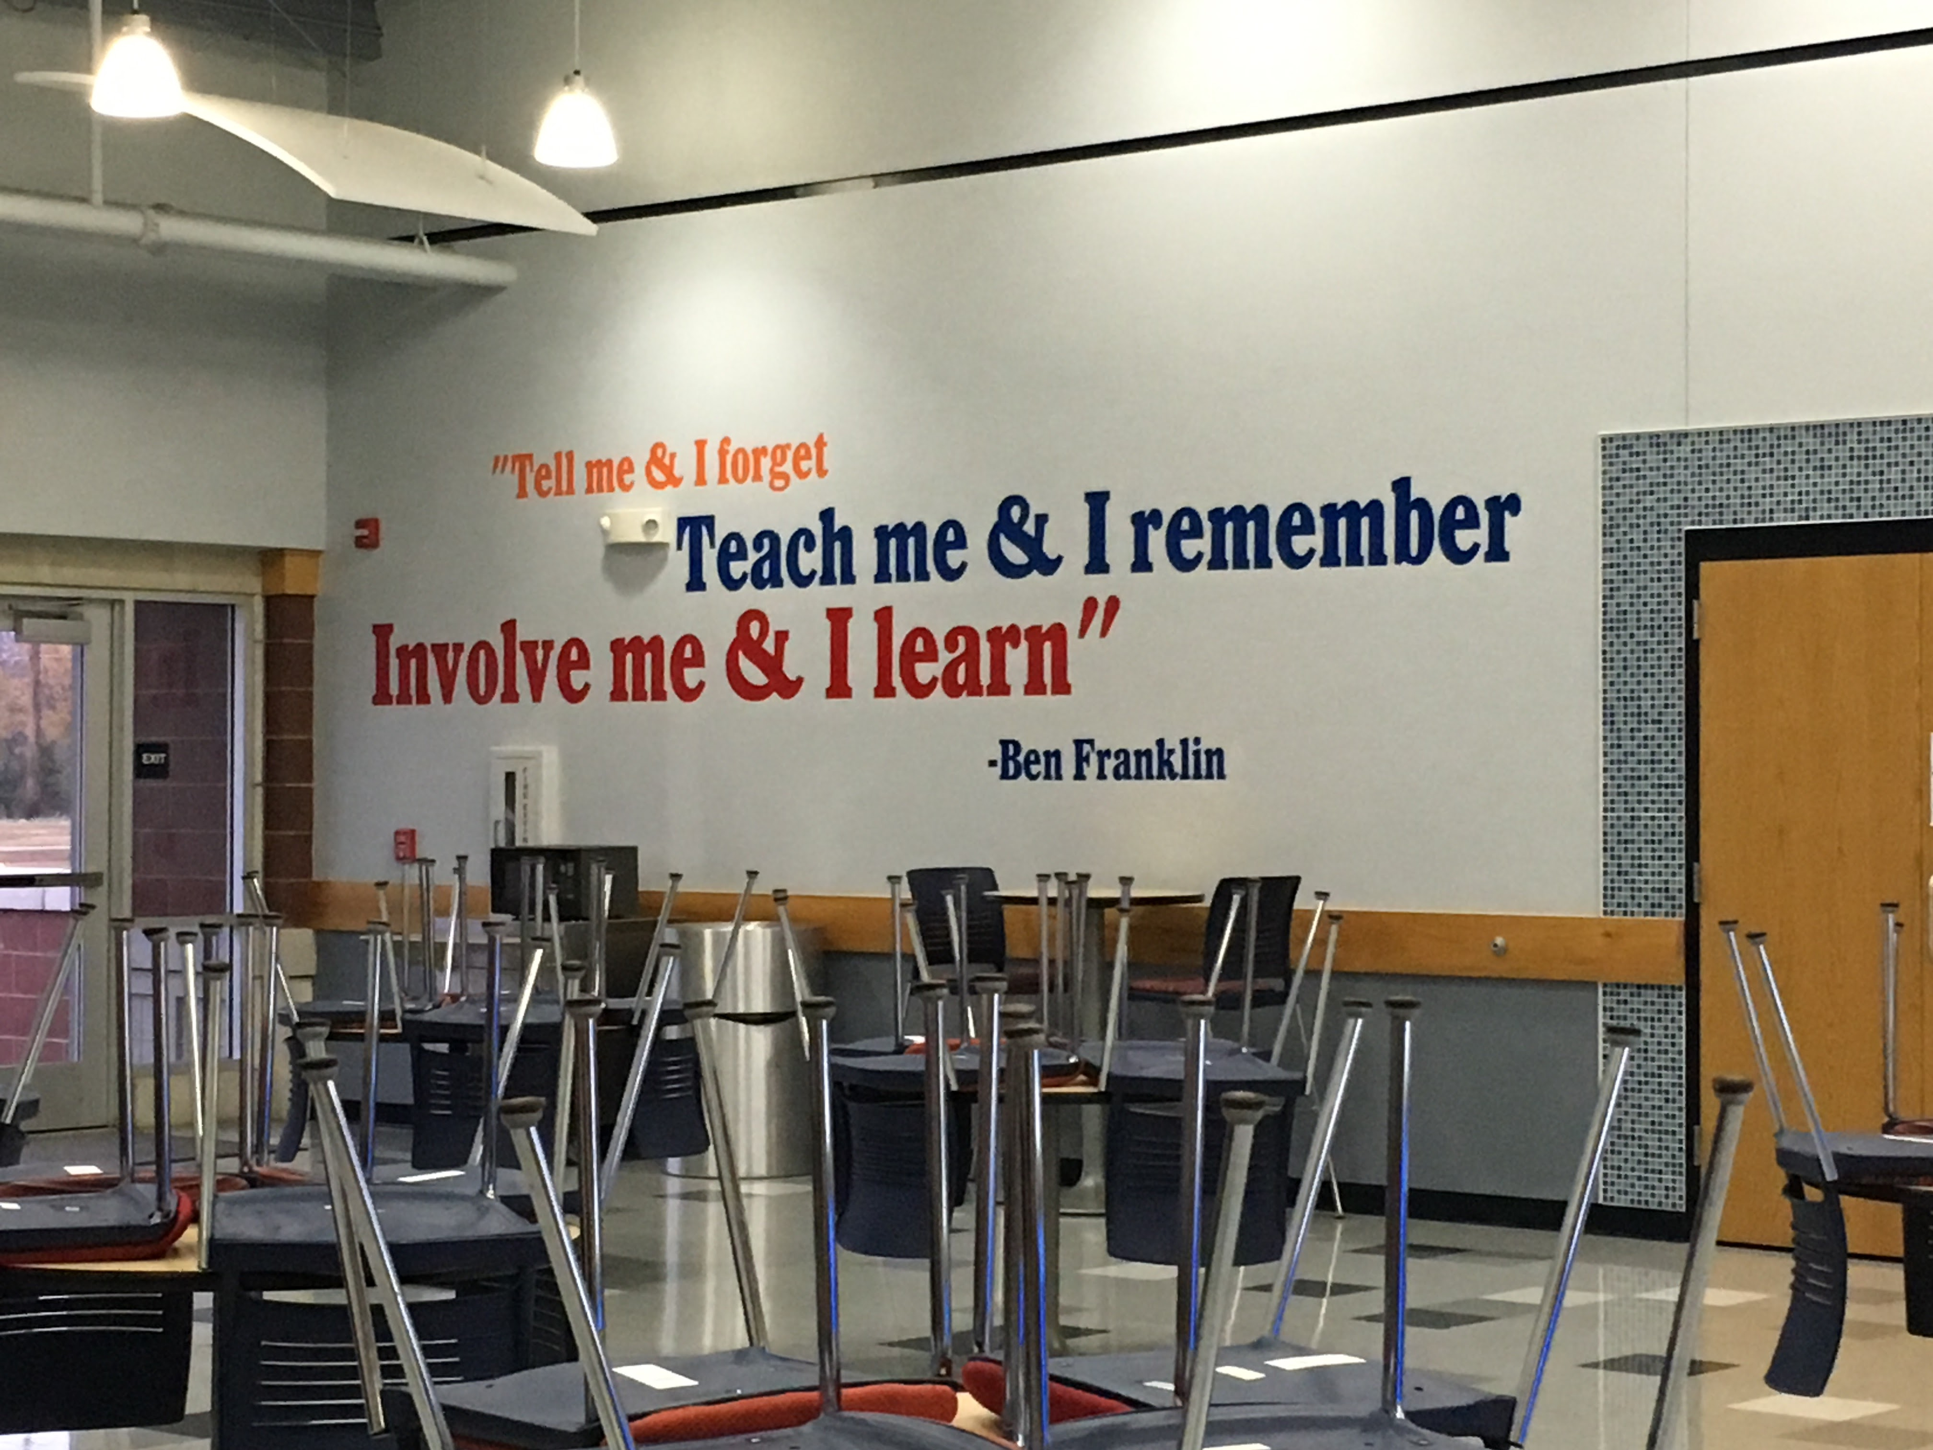
Taken at my first STEP Workshop in Claremore OK

Slide 23
Oklahoma DOT Piloting and training on STEP countermeasures
Shelby Templin
ODOT Active Transportation Coordinator

Slide 24
STEP Workshops
Safe Transportation for Every Pedestrian Workshops
3 classes held November 2017
Coordination between FHWA, ODOT and Oklahoma LTAP
Each class included classroom instruction (Peter Eun), field examinations, and site analysis

Slide 25
STEP Workshops
Classroom Learning – Lawton Class

Slide 26
STEP Workshops
Site examination and field observation – Edmond Class

Slide 27
STEP Workshops
Site analysis and countermeasure proposal – Claremore Class

Slide 28
Countermeasures and options
Current considered options and treatments
Road Diets
Pedestrian Hybrid Beacons
Pedestrian Refuge Islands
Raised Crosswalks
Crosswalk Visibility Enhancements
Education is key
Must know what treatments are appropriate for individual locations

Slide 29
STEP Plan development
State of Oklahoma STEP Plan
Plan development session held at ACOG offices on Nov. 30, 2017
Representatives from ODOT, ACOG, INCOG, OHSO, FHWA and the Seminole Nation attended
Draft STEP Plan developed through discussions between group at brainstorming session
Several ODOT divisions reviewed the plan document and made decisions for the policy guidance based on the countermeasures discussed

Slide 30
STEP Plan development
Finalization and distribution end of 2018
Copies sent to all Divisions and Field Districts
Countermeasures are now encouraged, when applicable

Slide 31
STEP Plan: Next “Steps”
Buy in from ODOT Divisions, FHWA Oklahoma, MPOs, RTPOs, ADA Development, etc
Increased awareness about Pedestrian Safety to the general public
Continue to encourage countermeasures, where appropriate
Stay up to date when countermeasures are being integrated into plan design

Slide 32
Placemaking with Road Diets in oklahoma
https://vimeo.com/277314570

