Slide 1
DATA DRIVEN SAFETY ANALYSIS
Presented by
Marty Farris, P.E.
State Highway Safety Engineer

Slide 2
Data Driven Safety Analysis
Predictive Analysis
Systemic Analysis

Slide 3
Benefits
Informed Decision Making
Targeted Investment
Improved Safety

Slide 4
DDSA Toolbox
Highway Safety Manual
Interactive Highway Safety Design Model
Spreadsheets

Slide 5
DDSA Toolbox
Crash Modification Factors Clearinghouse
SPF Tool
Safety Analyst Software
Numetric

Slide 6
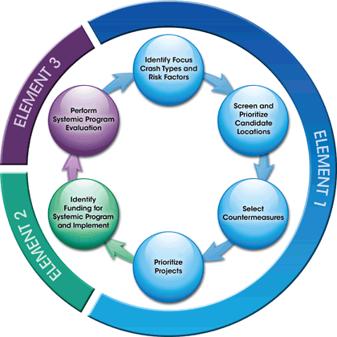
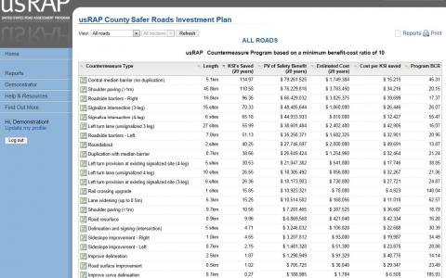
DDSA Toolbox
Systemic Analysis
Systemic Safety Project Selection Tool
US Road Assessment Program

Slide 7
OKLAHOMA TOOLBOX IMPLEMENTATIONS

Slide 8
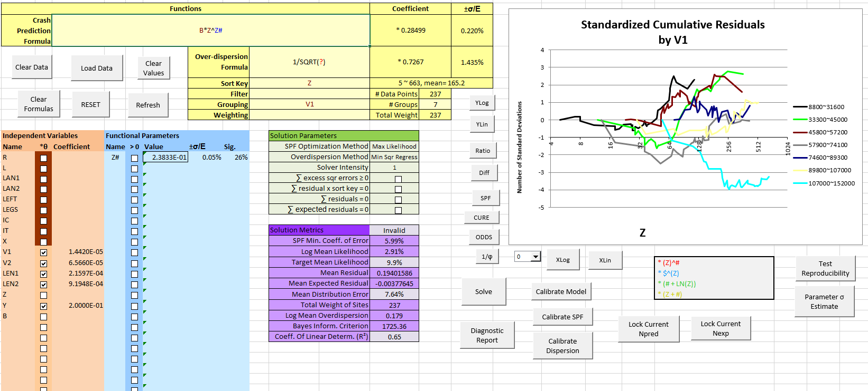
Spreadsheets

Slide 9
CMF Clearinghouse

Slide 10
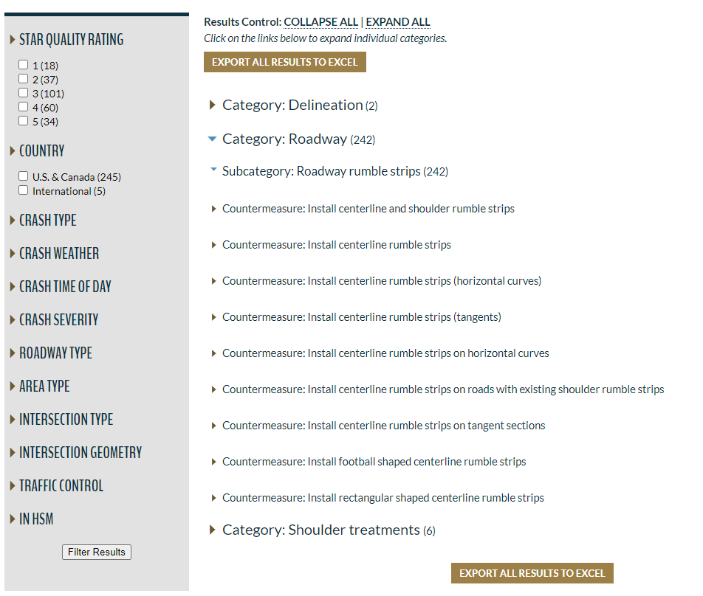
CMF Clearinghouse

Slide 11
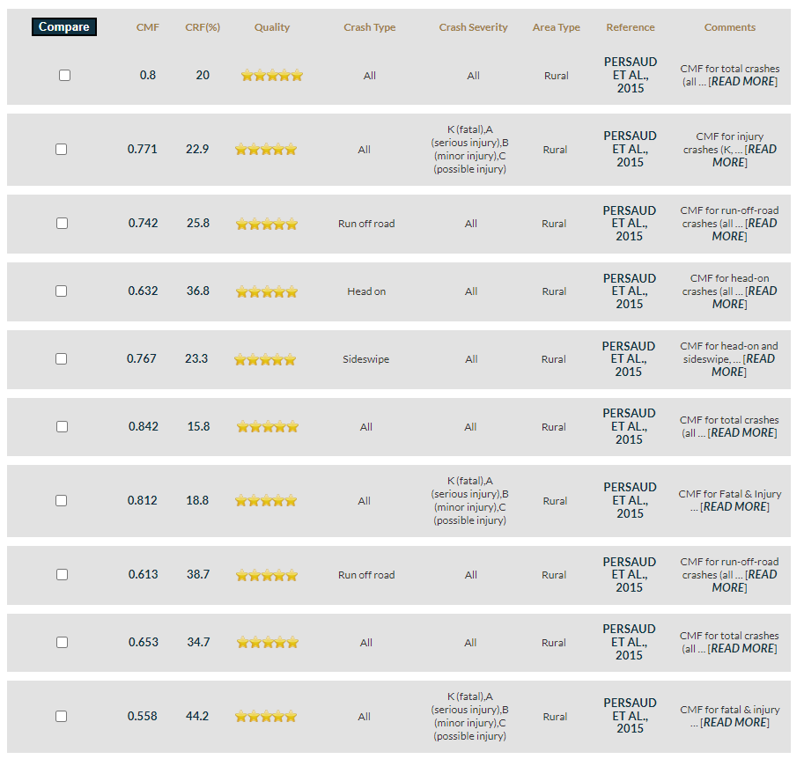
CMF Clearinghouse

Slide 12
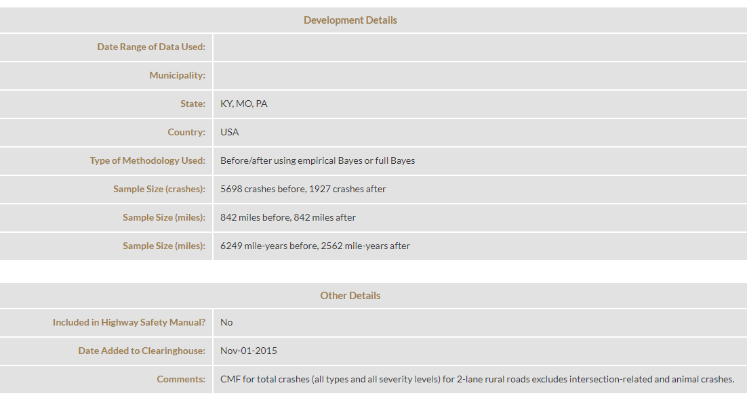
CMF Clearinghouse

Slide 13
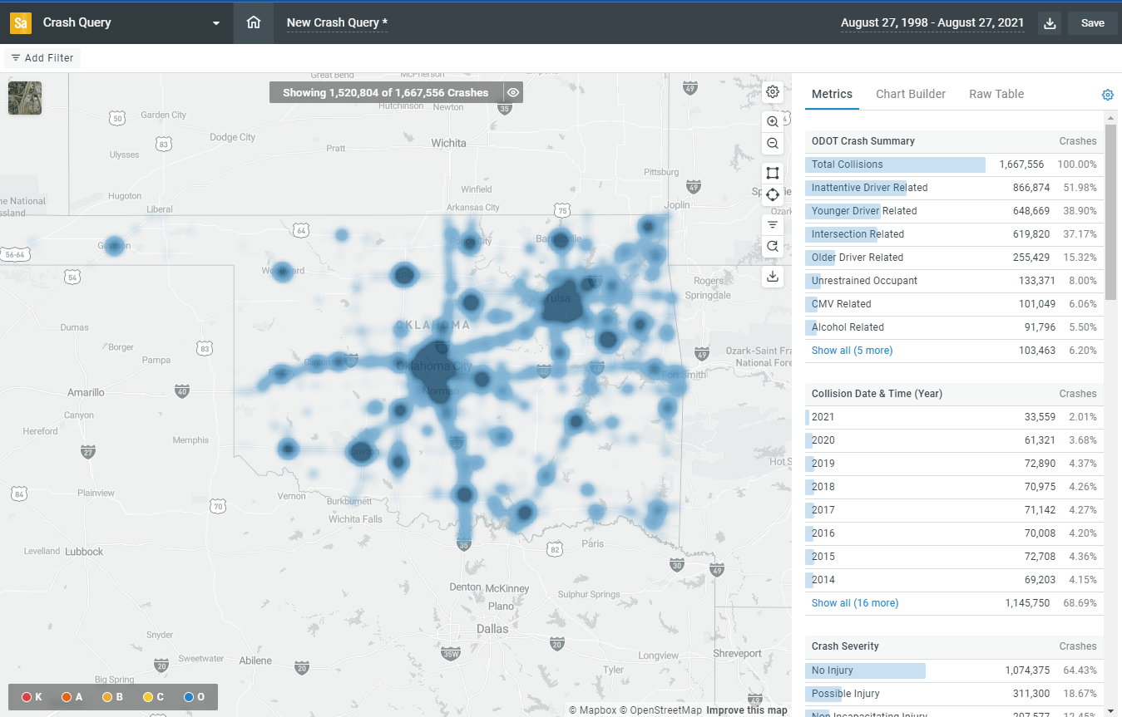
Numetric

Slide 14
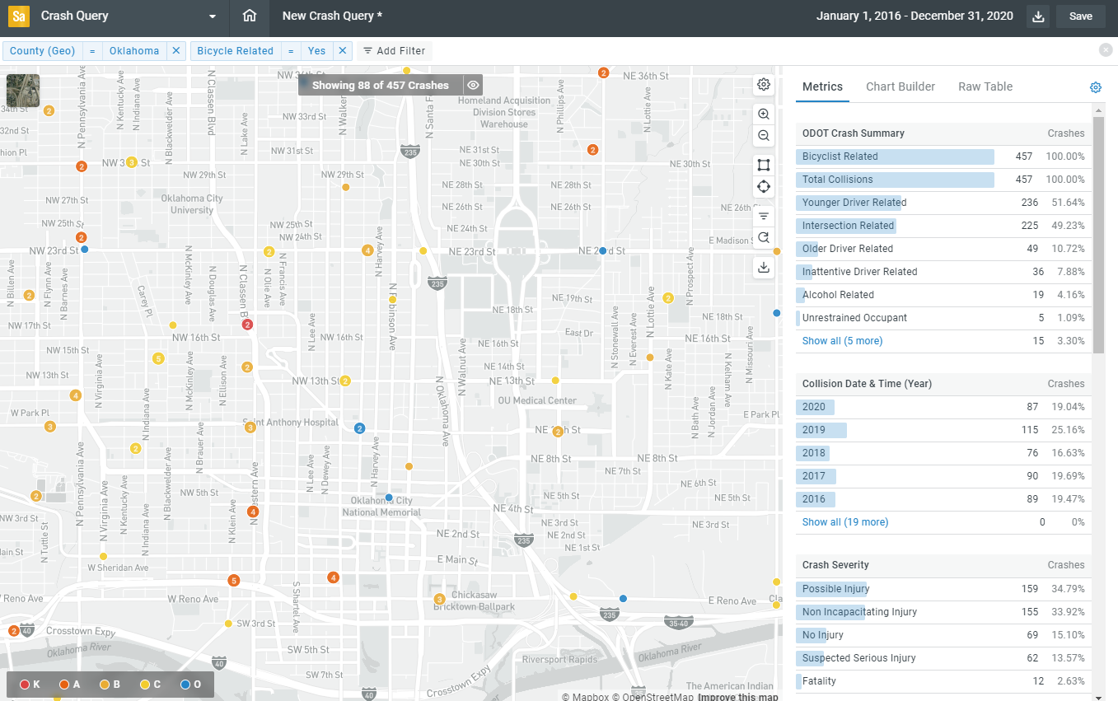
Numetric

Slide 15
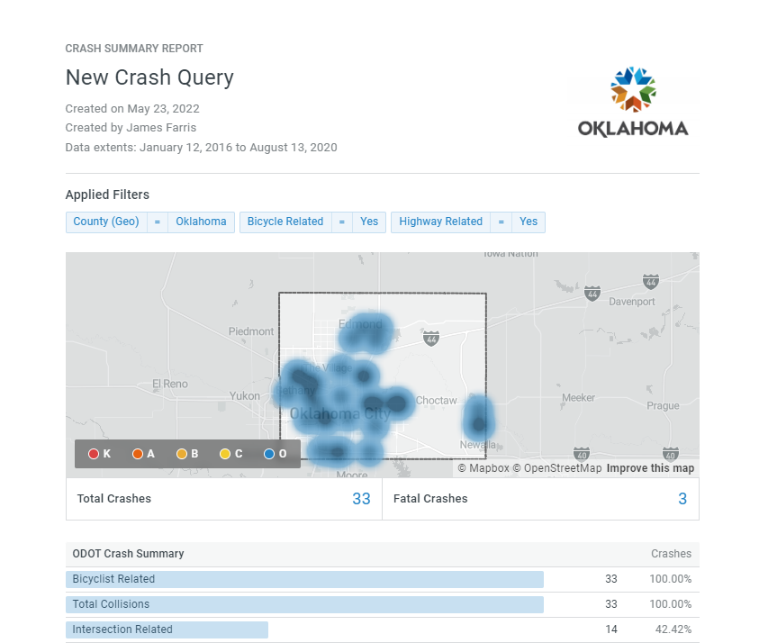
Numetric

Slide 16
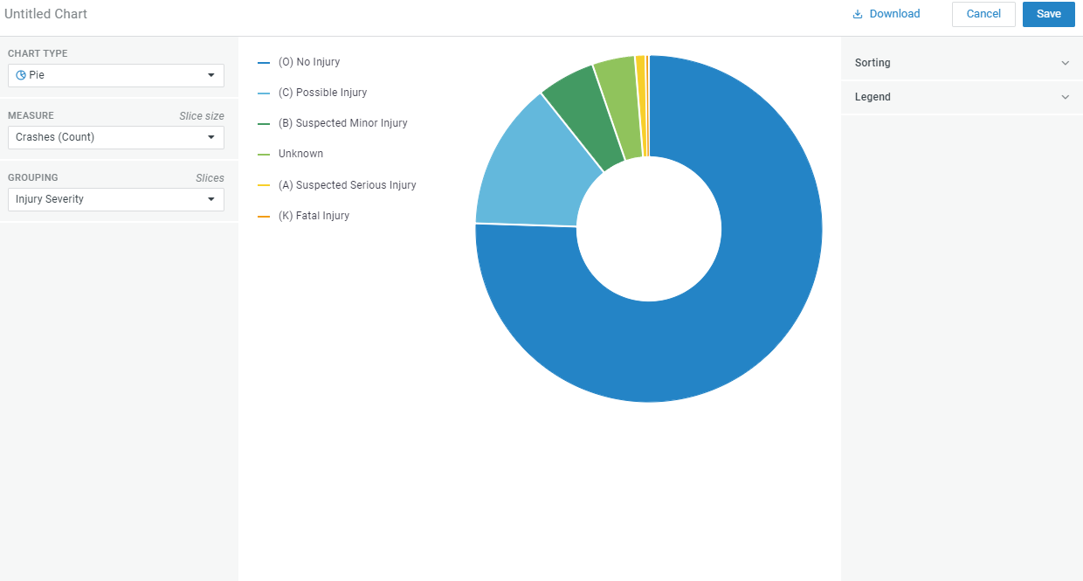
Numetric

Slide 17
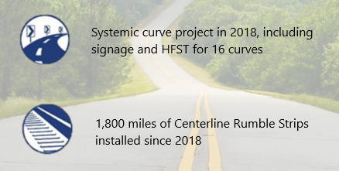
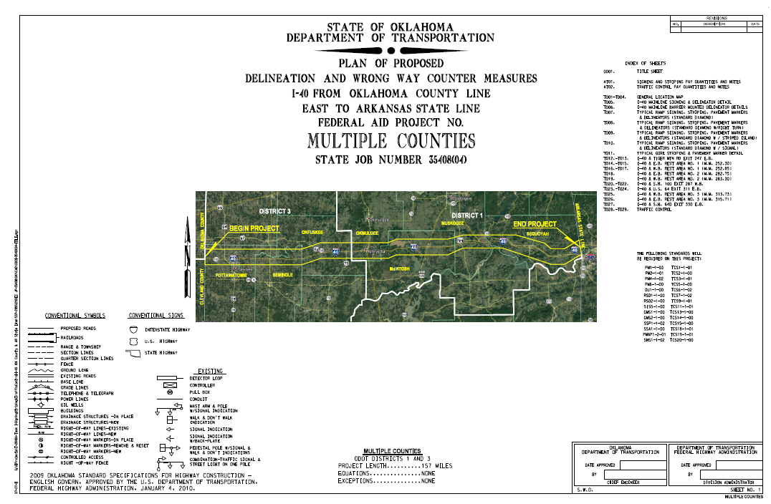
Projects
High Speed Curves
Centerline and Edge Rumble Strips
Wrong Way Drivers

Slide 18
Thank You!
Marty Farris P.E.
Jfarris@odot.org

