Slide 1
Intelligent Compaction (IC) – Education and Experience
Presented to:
Oklahoma State Transportation and
Innovative Council
Location: Webinar
Date: March 24, 2022

Slide 2
Summary
Educational Introduction
  ODOT Special Provision
Educational Training
Experience - IC Projects and Research
Increase Experience
Educational Improvement

Slide 3
Educational Introduction
Task Force Meet to Develop ODOT Special Provision
  Representatives: FHWA, ODOT Materials and Construction, and OAPA
Special Provisions: 1-10-2015, 1-10-2020
  2020 Link: Intelligent Compaction of Asphalt

Slide 4
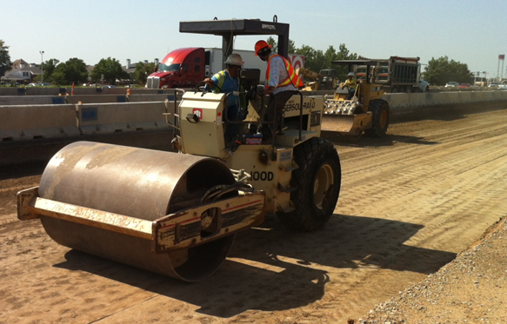
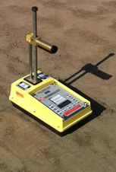
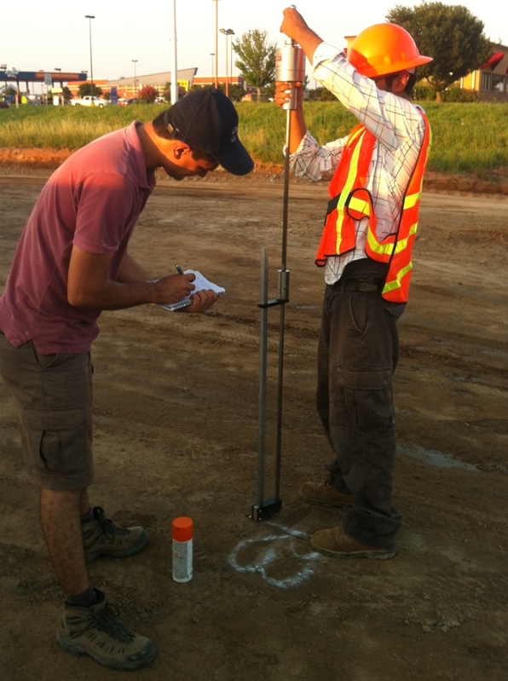
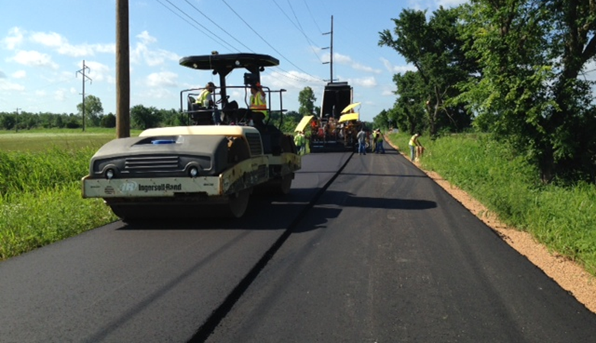
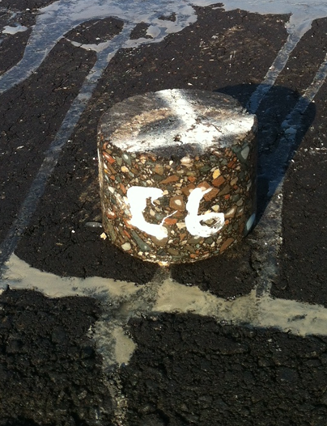
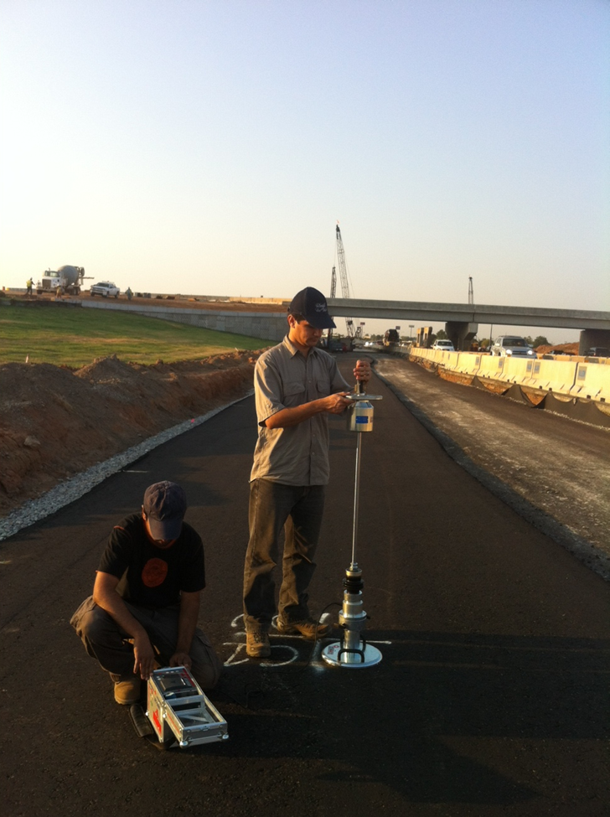
Traditional Compaction: Weaknesses
NDG
Disadvantages
Quality Control (QC) through spot tests
QC check only after compaction
Entire area not covered
Under/over-compacted regions are not identified and remediated
DCP
Compaction quality
?
Conventional QC methods
Subgrade
Compaction quality
Core
?
LWD
Asphalt layer
Conventional QC methods

Slide 5


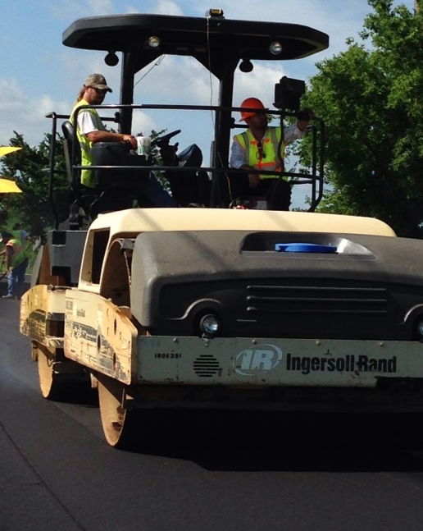
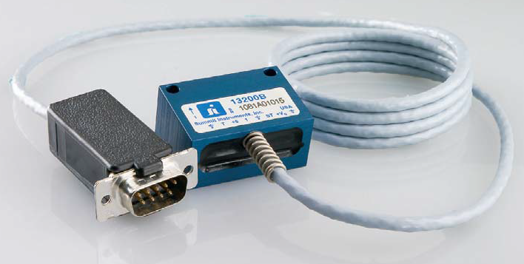
Intelligent Compaction: Advantages
Advantages
QC throughout the compaction
Provide real-time evaluation
Entire compacted area covered
Under/over-compacted regions can be identified and remediated
Georeferenced color-coded strip chart

Slide 6
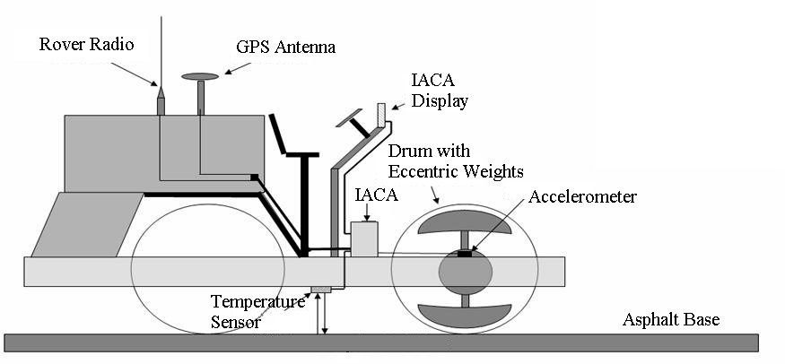
Intelligent Compaction Analyzer (ICA)
Intelligent Compaction Analyzer (ICA)
Also, called Intelligent Asphalt Compaction Analyzer (IACA)
Subgrade/asphalt layer
Developed at The University of Oklahoma (S. Commuri and M. Zaman)

Slide 7

Intelligent Compaction Analyzer (ICA) Video

Slide 8
Educational Training
Veta Software Training and Workshops
2015 Projects with Minimum 10,000 Tons HMA Let with Lump Sum Pay Item: 411(K) Intelligent Compaction
Bituminous Engineer and IC Vendor Attended Pre-Construction Meeting
  Bituminous Engineer Meet with Construction Residency and Demonstrated Veta Software

Slide 9
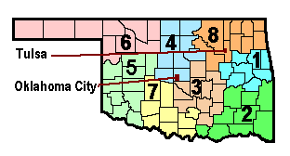
Experience - IC Projects and Research
Review of ODOT Average Bid Prices
  IC used 2015Q2 through 2017Q1 in Districts 1, 3, 5, 6, and 8
Next Slides Highlight Findings from OU’s Last IC Research Project

Slide 10
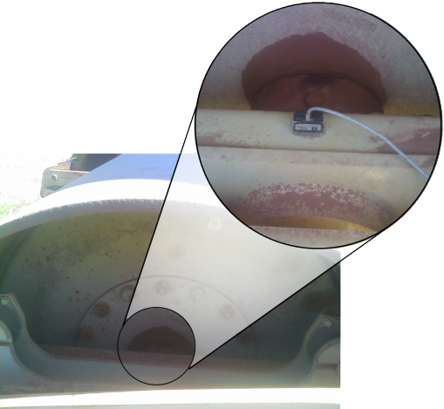
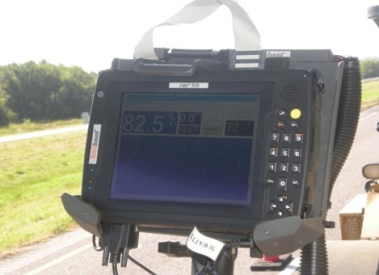
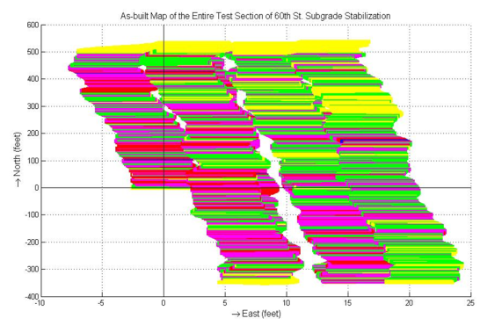
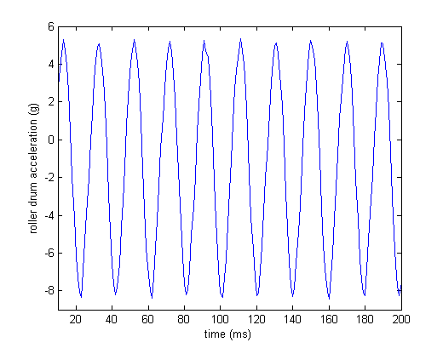
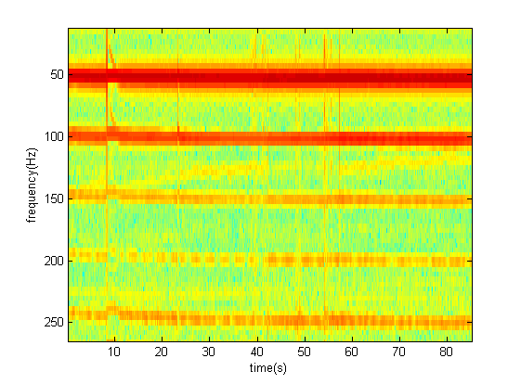
Intelligent Compaction Analyzer (ICA)
Accelerometer
As-built map for Density/M_{r}/E*
Roller
Artificial Neural Network (ANN)
Fast Fourier Transform (FFT)

Slide 11
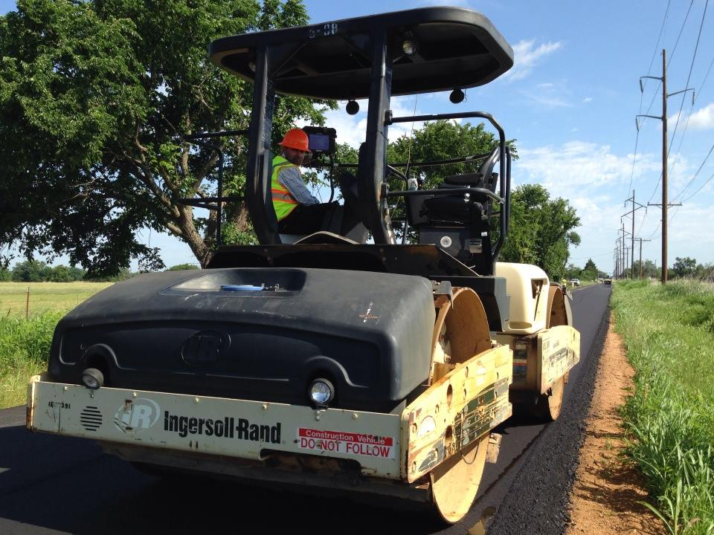
Application of IC
Two IC Technologies Used:
Intelligent Compaction Analyzer (ICA) Estimates density
Commercially available IC Technology Estimates CCV, CCMV, etc.
Only asphalt layer compaction discussed
Asphalt Layer Compaction
Notes:
ccv=Compaction Control Value, ccmv=Compaction Control Meter Value?

Slide 12
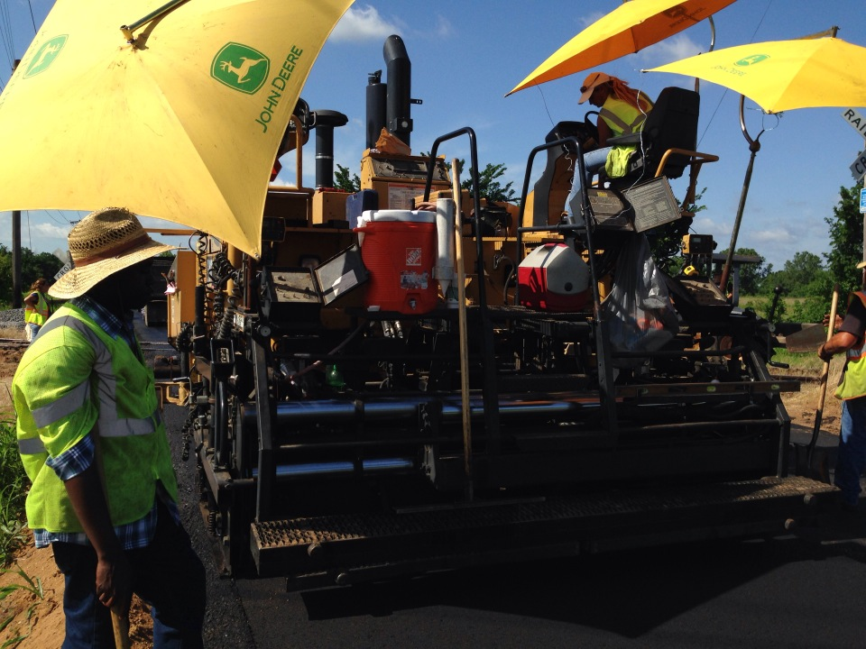
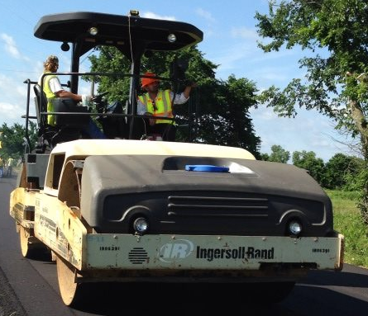
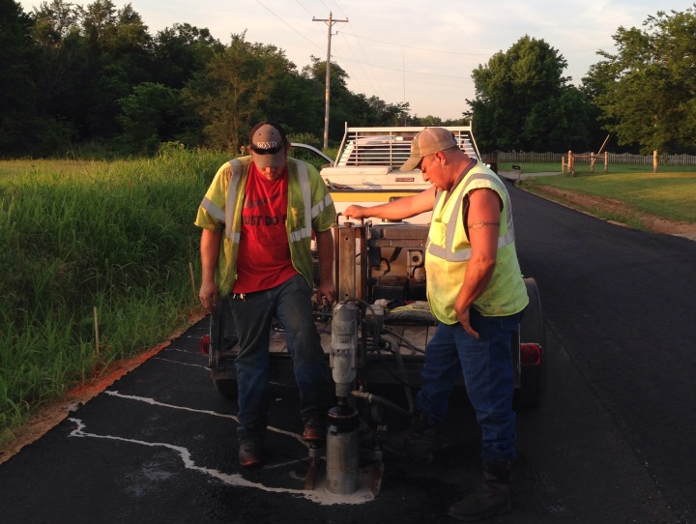
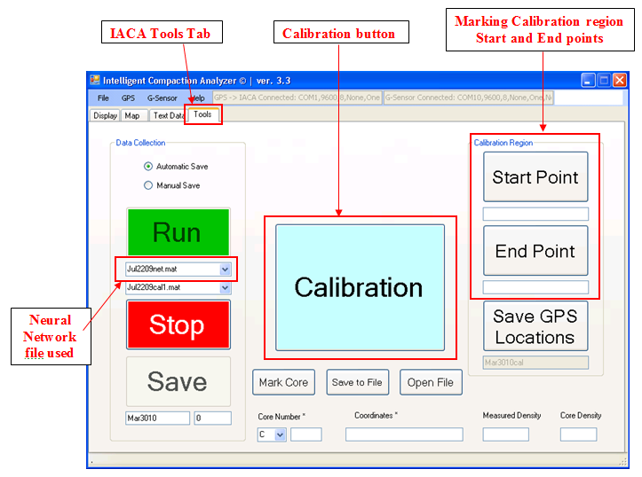
Field work: ICA Calibration
Record roller vibration at the very first pass (laydown density)
Record roller vibrations at other successive passes (intermediate and target densities)
Core density
Final calibration
Preliminary calibration

Slide 13
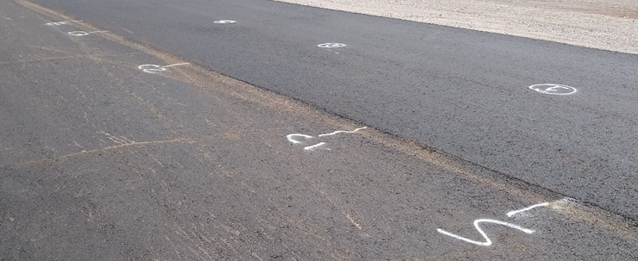
Calibration of ICA

Slide 14
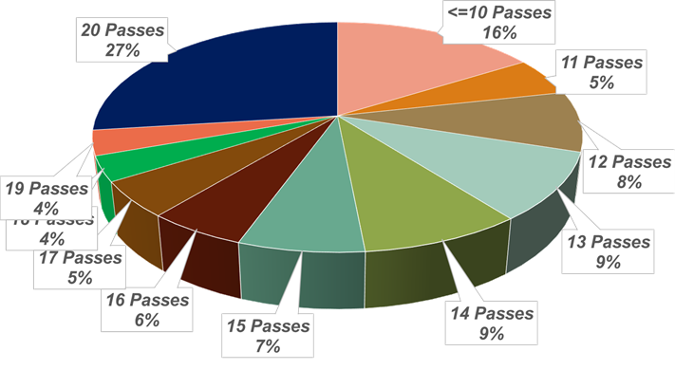

VETA 5.1 Features
Data Import:
Direct Download from Cloud
MOBA thermal profile data
TOPCON raw ungridded IC data
Data filtering (project boundary layout)
Import Raw Ungridded Data
Veta 5.0-: BOMAG and Old SiteVision Office IC data
Veta 5.0 : TOPCON IC Data
Analysis flexibility
VETA Output:
Coverage (# of passes as a % of area)
ICMV (see caution note in link)
Temperature
Roller speed
Frequency
Statistical parameters (mean, average, S.D.)
Pie chart; Frequency distribution

Slide 15
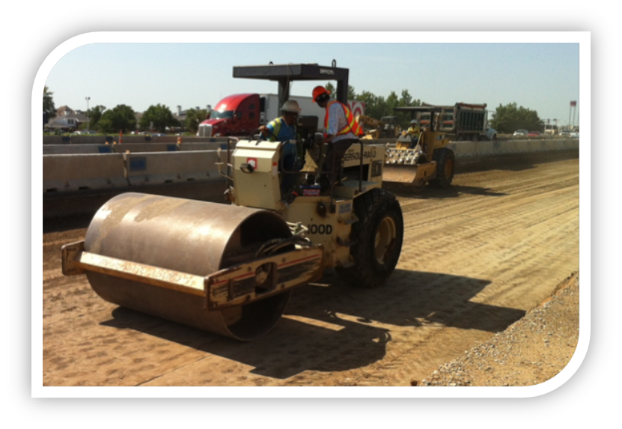
Phase 1: Three Projects
Analyze IC data from three selected projects
  Project 1: Highway 38
  Project 2: Highway 9
  Project 3: Highway 58
  Use free IC data management and analysis software, VETA
  VETA 5.1 version used
  Check data completeness, quality, compliance
  Missing data, corrupt file, file naming,
  project boundary, compliance with special provision
  Focus analysis on coverage (number of passes as a % of area)
  Temperature
  Speed
  Frequency
  Identify necessary improvements for future IC data collection

Slide 16
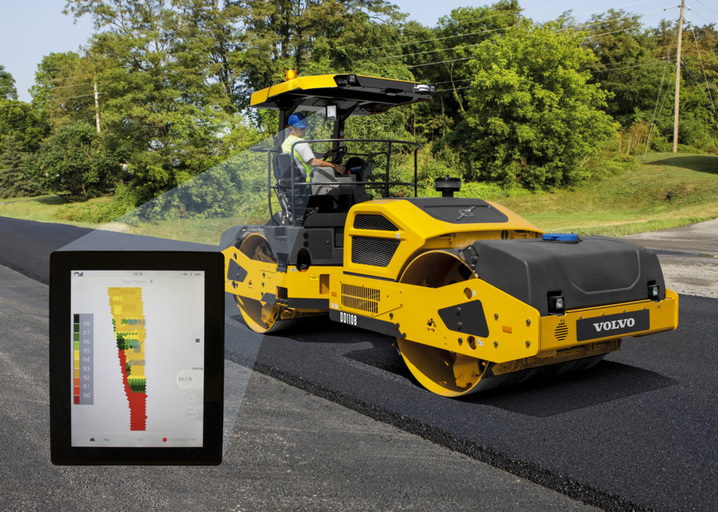
Grid Point Based Pass Count
Data Recording for Two Passes
Time | Lat | Long | Elevation_FT | Pass Number
2016-Sep-30 12:55:32.739 | 36.66701 | -98.1817 | 1247.425 | 1
2016-Sep-30 12:57:49.739 | 36.66701 | -98.1817 | 1247.557 | 2
Data Recording for Three Passes
Time | Lat | Long | Elevation_FT | Pass Number
2016-Sep-30 13:23:13.155 | 36.66878 | -98.1817 | 1249.217 | 1
2016-Sep-30 16:30:52.155 | 36.66878 | -98.1817 | 1249.243 | 2
2016-Sep-30 16:33:36.155 | 36.66878 | -98.1817 | 1249.187 | 3

Slide 17
Data Filtering for Boundary Layout
Roller Movement
Actual Road Boundary

Slide 18
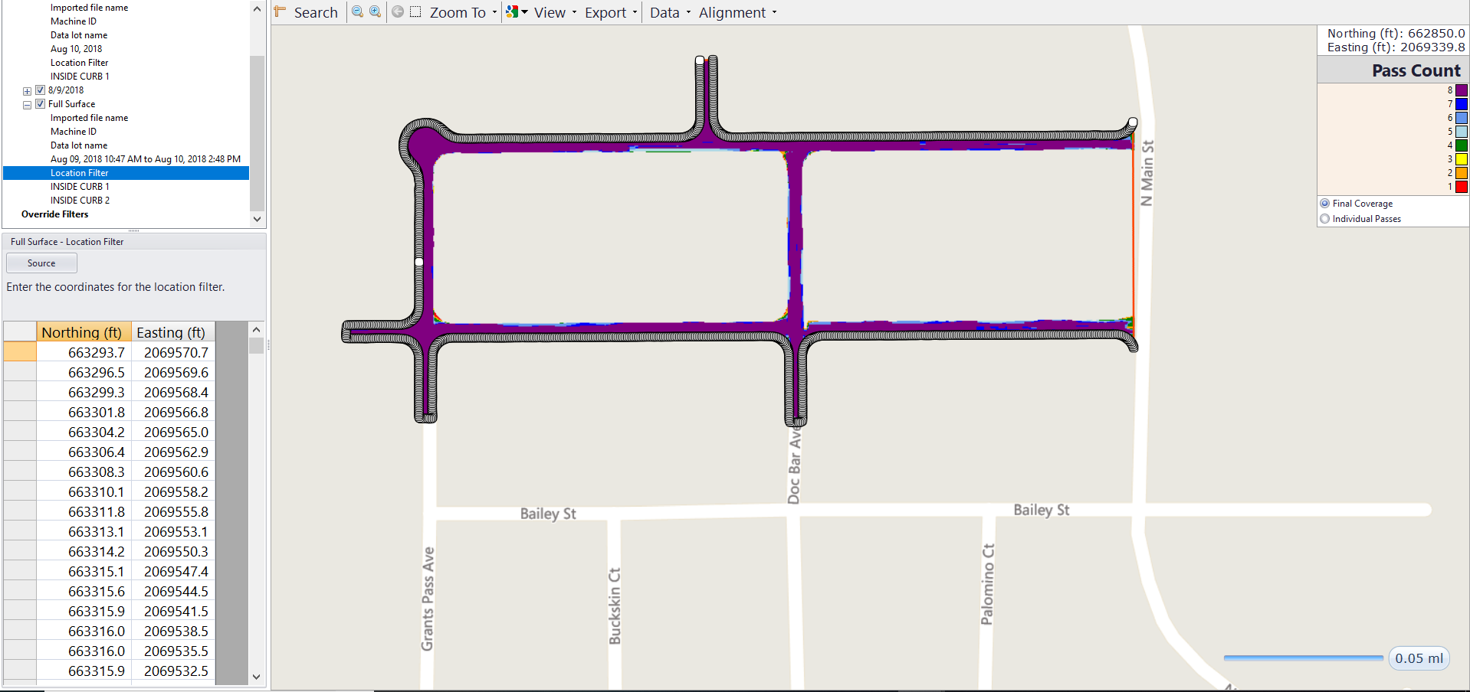
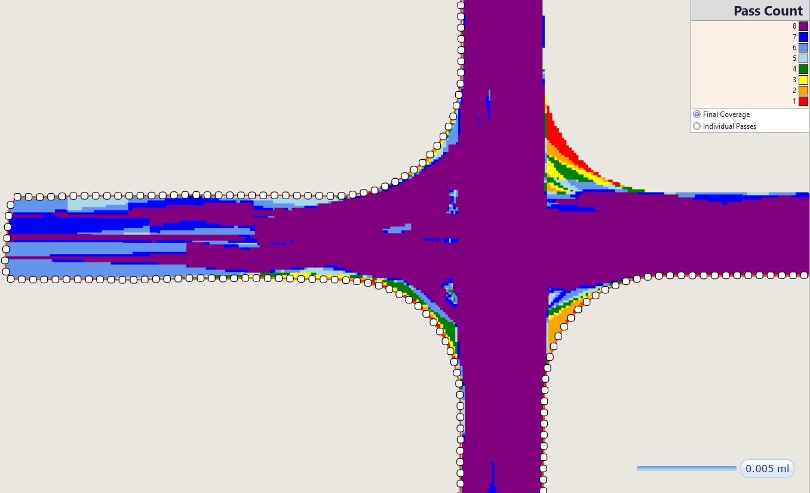
Boundary Adjustment
Filtering the IC data based on road boundary GPS data
Project Boundary
GPS data

Slide 19
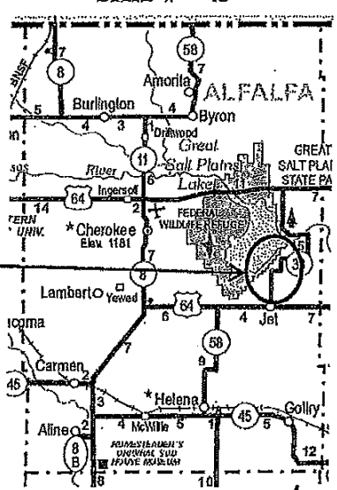



Project 1: Highway 38
County: Alfalfa
Segments analyzed: 12
(based on the number of files)
Corrupted files: 0
Contract ID: 160001
Call order: 20

Slide 20
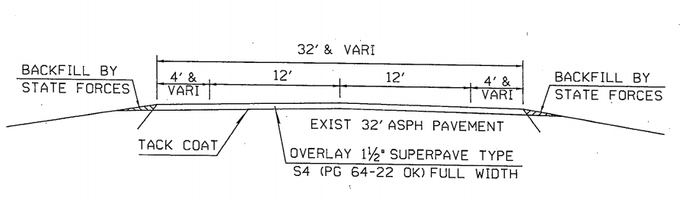
General Information
Asphalt tonnage: 11,160 tons (S4 mix)
Type of work: Resurfacing
Typical lane width (with shoulder): 16-ft
Construction period: Oct. 4 – Oct. 22, 2016
16-ft
Typical Cross Section

Slide 21
Summary of Coverage
No target coverage (# of passes) provided
Two wheel passes considered target (TP)
Date | Total Area (ft²) | Target pas (TP) | No pass | 1 pass | 2 passes | 3 passes | 4 passes
4-Oct-2016 | 17,547 | 2 | 5.5 | 52.1 | 30.9 | 11.0 | 0.5
6-Oct-2016 | 145,232 | 2 | 11.8 | 2.1 | 25.0 | 11.7 | 13.4
8-Oct-2016 | 183,275 | 2 | 12.3 | 2.0 | 20.8 | 9.0 | 11.8
12-Oct-2016 | 78,962 | 2 | 4.5 | 1.8 | 22.0 | 9.6 | 14.5
13-Oct-2016A | 58,414 | 2 | 3.6 | 1.6 | 21.7 | 11.1 | 13.1
13-Oct-2016B | 15,539 | 2 | 0.0 | 2.1 | 21.6 | 13.0 | 14.9
17-Oct-2016 | 89,944 | 2 | 9.7 | 3.7 | 22.9 | 12.0 | 14.7
18-Oct-2016 | 150,821 | 2 | 7.9 | 2.8 | 22.6 | 10.3 | 13.3
19-Oct-2016 | 171,861 | 2 | 9.3 | 2.6 | 24.9 | 9.1 | 11.5
20-Oct-2016 | 177,467 | 2 | 7.7 | 3.3 | 21.3 | 10.5 | 12.8
21-Oct-2016 | 127,291 | 2 | 7.7 | 2.8 | 23.2 | 10.4 | 14.6
22-Oct-2016 | 34,058 | 2 | 0.0 | 3.7 | 29.0 | 10.5 | 15.3

Slide 22
Summary of Coverage (Cont’d)
Date | 5 passes | 6 passes | 7 passes | 8+ passes | % Covered with TP
4-Oct-2016 | 0.0 | 0.0 | 0.0 | 0.0 | 42.4
6-Oct-2016 | 13.6 | 6.0 | 5.5 | 10.8 | 86.0
8-Oct-2016 | 15.8 | 7.4 | 6.7 | 14.2 | 85.7
12-Oct-2016 | 16.3 | 6.9 | 6.5 | 17.9 | 93.7
13-Oct-2016A | 20.3 | 7.8 | 7.3 | 13.5 | 94.8
13-Oct-2016B | 21.3 | 7.8 | 6.6 | 12.7 | 97.9
17-Oct-2016 | 14.7 | 7.7 | 6.2 | 8.4 | 86.6
18-Oct-2016 | 17.7 | 7.8 | 6.4 | 11.2 | 89.3
19-Oct-2016 | 17.7 | 7.0 | 5.8 | 12.1 | 88.1
20-Oct-2016 | 17.4 | 7.4 | 6.3 | 13.4 | 89.1
21-Oct-2016 | 15.4 | 7.6 | 5.8 | 12.6 | 89.6
22-Oct-2016 | 24.4 | 5.4 | 4.5 | 7.1 | 96.2

Slide 23
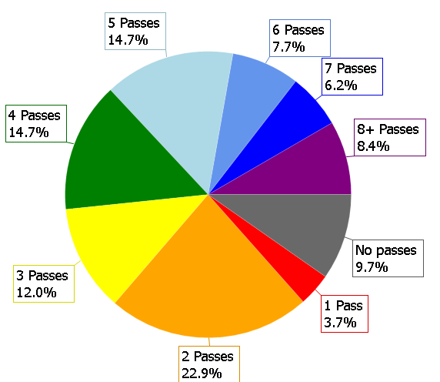
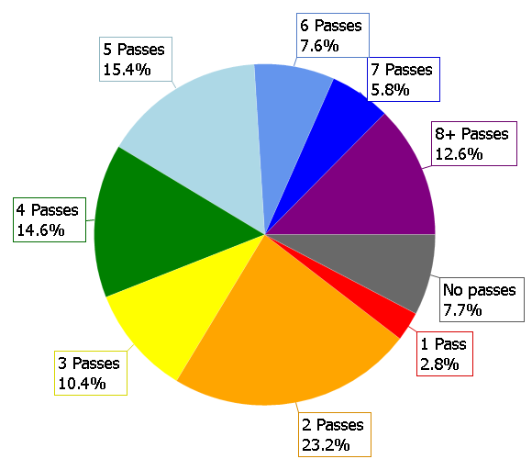
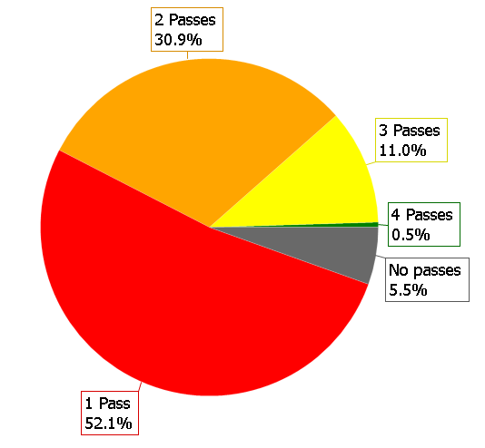
Coverage Pie Chart
On October 13 about 98% area covered with 2 or more roller passes.
Whereas, for worst case on October 4 only 42.2% area covered with 2 or more roller passes.
Best Case: Oct 13, 2016
Worst Case: Oct 4, 2016
Average Case: Oct 21, 2016

Slide 24
Summary of Temperature Results
Date | Temperature>=180F (% of constructed area) | Maximum Temperature (°F) | Minimum Temp. (°F) | Mean Temperature (°F) | Standard Dev. (°F)
4-Oct-2016 | 78.0 | 254.7 | 84.6 | 191.0 | 47.8
6-Oct-2016 | 89.0 | 284.9 | 76.5 | 213.6 | 26.3
8-Oct-2016 | 80.0 | 286.0 | 56.7 | 194.4 | 26.6
12-Oct-2016 | 93.0 | 280.9 | 63.9 | 210.6 | 24.4
13-Oct-2016 | 81.0 | 273.4 | 60.8 | 194.1 | 25.4
13-Oct-2016 | 85.0 | 279.9 | 55.2 | 206.5 | 24.1
17-Oct-2016 | 96.0 | 272.8 | 68.9 | 219.3 | 23.6
18-Oct-2016 | 95.0 | 272.8 | 93.7 | 218.3 | 21.5
19-Oct-2016 | 97.0 | 277.9 | 58.3 | 218.4 | 20.4
20-Oct-2016 | 99.0 | 293.5 | 60.3 | 221.8 | 21.8
21-Oct-2016 | 94.0 | 279.3 | 55.2 | 218.0 | 24.1
22-Oct-2016 | 78.0 | 272.8 | 51.1 | 200.1 | 34.9
Only 78% of total area satisfied ODOT temperature requirement on October 4

Slide 25
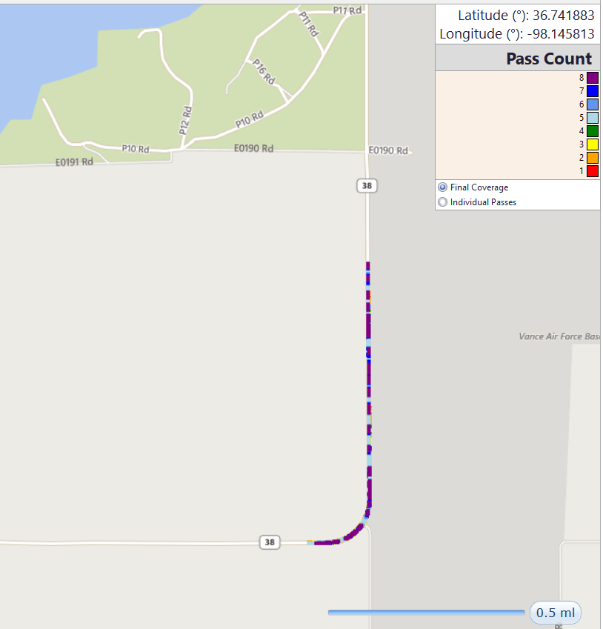
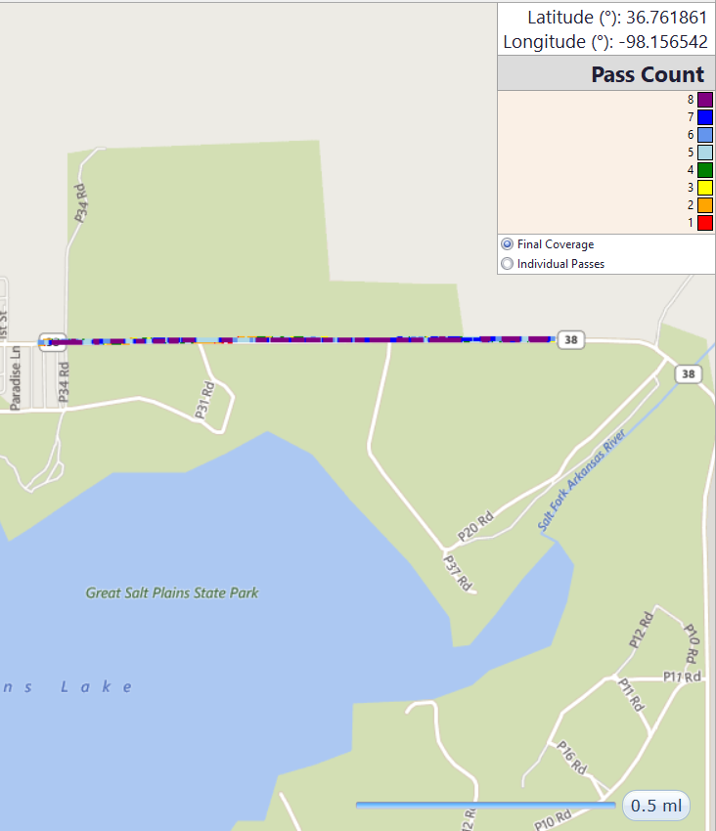
File Naming Problems
Two IC data files having same date (October 13)
Inconsistent file naming (Year, Month, Date, Extra)
AASHTO format: Month, Date, Year
All Passes (20161013 160957)
All Passes (20161013 161528)

Slide 26
Phase 2: Comparison of Two IC Technologies
Description of Constructed Projects
Proj. ID | Location | Const. Type | Asphalt Type | Asphalt Thick (inch) | No. of Lane | Project Length (Lane miles) | No. of Cores | Month of Const.
Proj. 1 | Cypress Way, Jones, OK | New Asphalt Base | S3 HMA with PG 64-22 | 4 | 8 | 4.6 | 6 | June 2019
Proj. 2 | Hwy 92, Chickasha, OK | Asphalt Overlay | S4 HMA with PG 70-28 | 1.5 | 2 | 3.7 | 6 | July 2019
Proj. 3 | 108th St., OKC, OK | Asphalt Overlay | S4 WMA, PG 64-22 and 20% RAP | 1.5 | 2 | 4.0 | 6 | October 2019

Slide 27
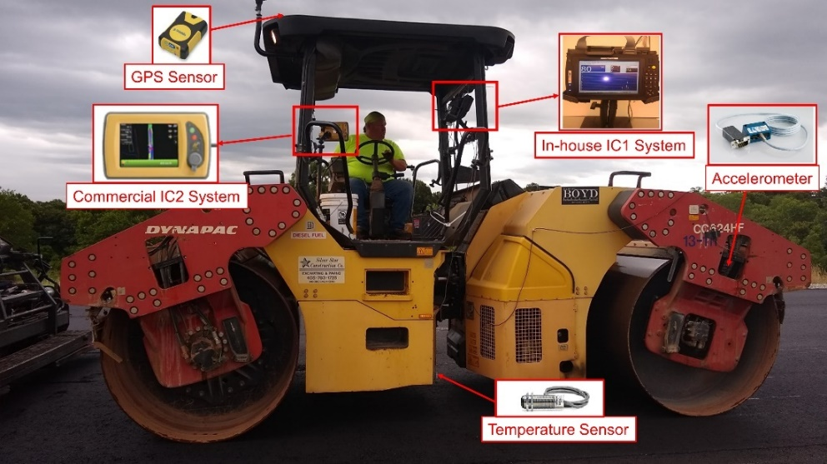
Comparison of IC Technologies (Cont’d)

Slide 28
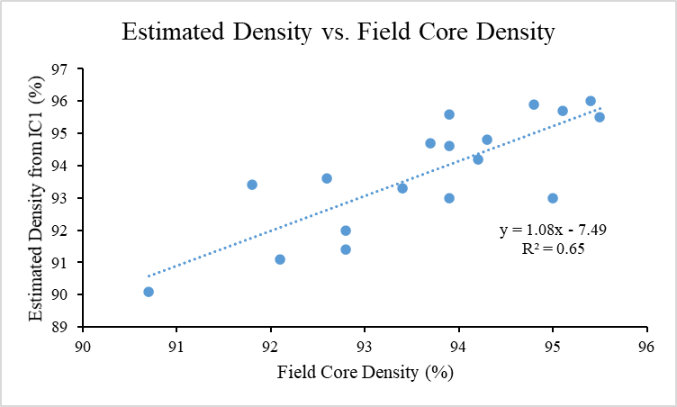
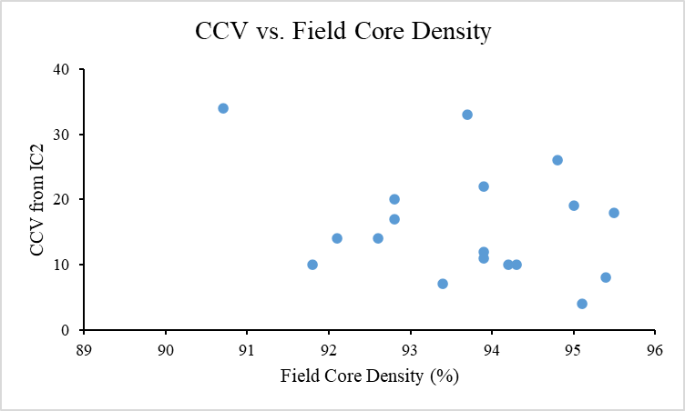
Comparison of IC technologies
Relationship Between Estimated Density from the IC1 System and CCV Values from the IC2 System with Field Core Density

Slide 29
Comparison of Mat Temperature
 | Project ID | Maximum Temperature (°F) | Minimum Temperature (°F) | Average Temperature (°F)
IC1 System | Project 1 | 350.1 | 141.5 | 251.9
 | Project 2 | 320.4 | 187.2 | 253.8
 | Project 3 | 300.7 | 150.5 | 222.0
IC2 System | Project 1 | 251.6 | 141.5 | 202.0
 | Project 2 | 237.2 | 155.0 | 196.0
 | Project 3 | IC2 system malfunctioned

Slide 30
Compliance and Missing Data
Items | Standards | Recommendations | Project 1 | Project 2 | Project 3
GPS Coordinate System | ODOT Special Provision | Universal Transverse Mercator (UTM) or Oklahoma State Plane | Met | Met | Met
File Naming | AASHTO PP 81 | MDDYY(Month-Date-Year) format | Met | Met | Did not meet
Optimal Pass Number | ODOT Special Provision | At least 90% of the total area should be covered with optimum number of passes | Did not meet | Met | Met

Slide 31
Compliance and Missing Data
Items | Standards | Recommendations | Project 1 | Project 2 | Project 3
Survey Markers Location | AASHTO PP 81 | At least two survey markers at the start and at the end (in total four) and one survey marker in every 2.5 KM | Missing Data | Missing Data | Missing Data
Survey Markers Accuracy | AASHTO PP 81 | less than or equal to 30 mm in X, Y, and Z directions | Missing Data | Missing Data | Missing Data

Slide 32
Compliance and Missing Data
Items | Standards | Recommendations | Project 1 | Project 2 | Project 3
GPS accuracy | AASHTO PP 81 | Should be checked daily | Missing Data | Missing Data | Missing Data
Temperature sensor calibration | AASHTO PP 81 | Should be performed periodically | Missing Data | Missing Data | Missing Data
Brief Description of Compacted layers | AASHTO PP 81 | Should be provided | Missing Data | Missing Data | Missing Data

Slide 33
Conclusions
Number of roller passes and % coverage from IC1 and IC2 systems were comparable. For both systems, Projects 1 and 2 satisfied the ODOT requirement (90% coverage with 2 roller passes). However, Proj. 3 did not.
The results indicate a need for using densities of the entire pavement surface than core densities from a few locations.
Significant variations observed between measured temperatures by the IC1 and IC2 systems due to different sensor type, accuracy, and locations.
Surface temperatures may not reflect the actual compaction temperature because of spraying of water by the compactor.
For all three projects, relatively small variations were observed between the IC1-estimated densities and the field cores densities.
The CCV parameter did not show any meaningful correlations with core densities. Also, no significant correlations found between the IC1-estimated densities and the CCV values.
Pass-by-pass measurements from individual projects exhibited improved correlations between the IC1-estimated densities and the CCV values.
Intelligent compaction is a promising technology, but additional works remain for broad-based application.
Notes:
ccv=Compaction Control Value, ccmv=Compaction Control Meter Value?

Slide 34
Increase Experience
ODOT Should Let More Projects
Visit Other District’s IC Projects if None in Your District
Participate in IC Workshops

Slide 35
Educational Improvement
Attend IC Conferences
Visit with IC Vendors at Conferences
  Discuss Their IC Technology
  Ask Them to Review ODOT’s Special Provision
  Ask Them if Their Technology Data Imports into Veta Software
Participate in IC Workshops
Review IC Papers

Slide 36
Educational Links
Intelligent Construction/Compaction + Veta + More
  IC Terminology and Glossary
Rosa - Continuous Real Time Measurement of Pavement Quality During Construction
Rosa – Evaluation of Performance of Asphalt Pavements Constructed Using Intelligent Compaction Techniques
ODOT Research Highlighters
  Highlighter July 2017, ResearchGate - Intelligent Compaction Data Analyzing
Oklahoma Transportation Library
Federal Highway Administration Research Library

Slide 37

Contact Information
https://www.ou.edu/coe/cees/research_centers/pmsg
OU – Kenneth Ray Hobson, P.E.
  kenneth.ray.hobson@ou.edu 405.323.5669

