Slide 1
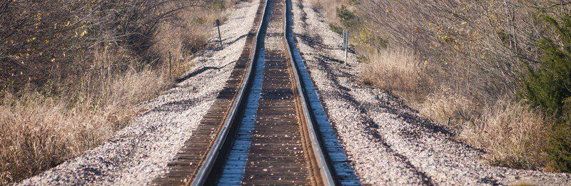

Getting on the Right Track

Slide 2

Preventable
Last (3) Years – 57 Pedestrian Cases (47 struck by on-track equipment)
Highest cases in Oklahoma County, Cleveland County*, Le Flore County and Tulsa County
(2) Trespassing Fatalities

Slide 3
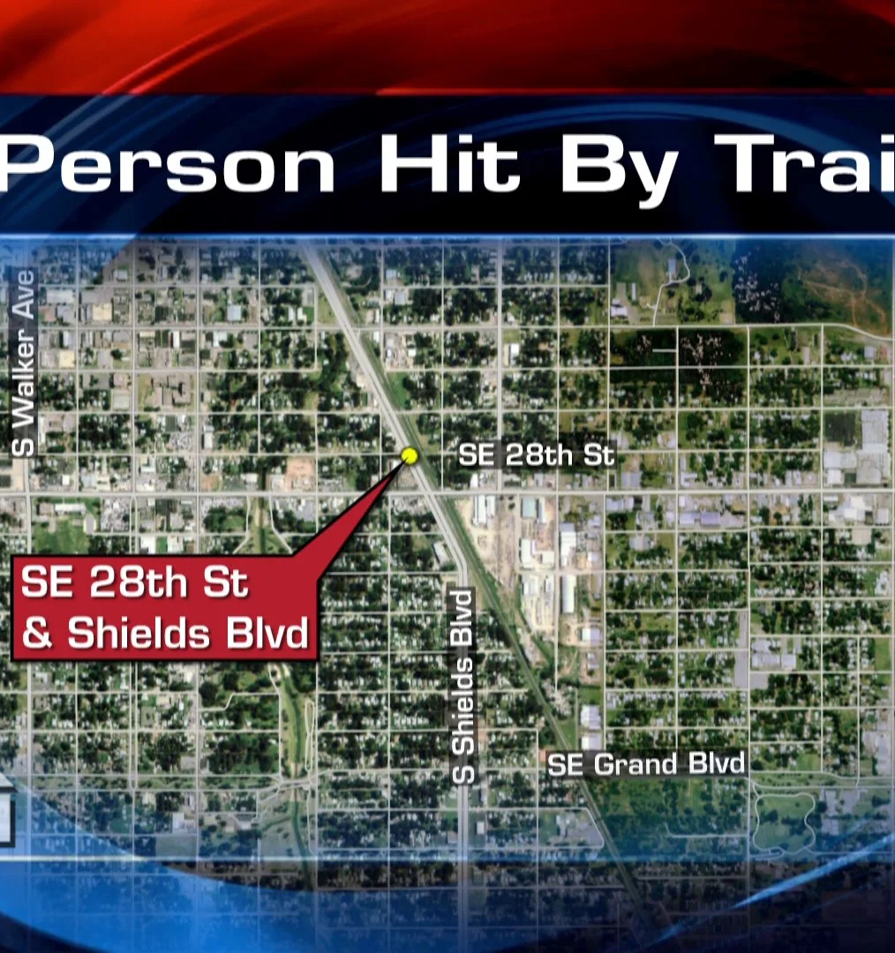
Making a Difference
Education (Prosecutors)
Target Audiences
Root-Cause Analysis
Awareness Programs
Enforcement

