Slide 1
GRS/IBS Bridge Abutments
Shannon Sheffert, PE
(405)742-7884
Shannon.sheffert@gmail.com

Slide 2
Why a GRS Abutment?
Simple to design
Simple to build
CHEAP
No bump at the end of the road/bridge
And again, inexpensive and simple to build

Slide 3
What is GRS/IBS
A system of stacked concrete blocks for a wall facing
The fill behind the wall is composed of gravel interlaid with geotextile fabric
The bridge deck sits on the compacted gravel mass and not on the wall itself
These can be built quickly
Only a few hands track hoe are need to build a bridge
There is little or no maintenance needed
No settlement at the end of the bridge

Slide 4
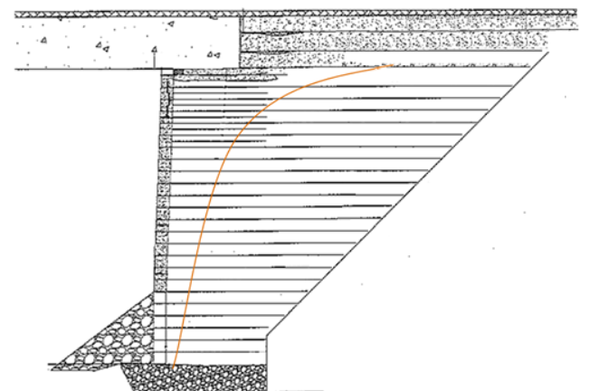
Abutment and Deck Detail

Slide 5
Fine print Details: Basically, it is a gravity structure with 12” layers

Slide 6
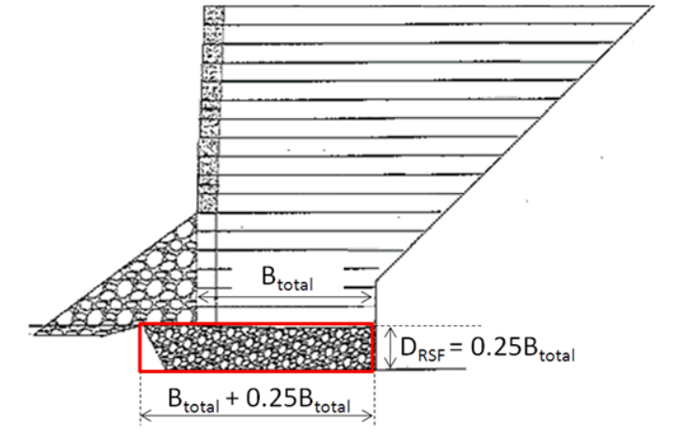
The ‘burrito’ detail for the base and layers for the mass abutment

Slide 7
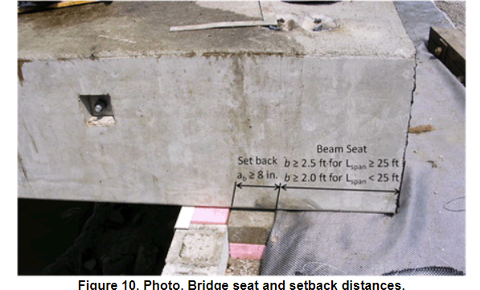
The deck sits on the compacted gravel mass

Slide 8
For more info go to the FHWA Website
https://www.fhwa.dot.gov/publications/research/infrastructure/structures/11026/004.cfm#:~:text=Publication%20Number%3A%20FHWA-HRT-11-026
Or simply EVERY DAY COUNTS
Geosynthetic Reinforced Soil Integrated Bridge System

