Slide 1
Graduation Requirements
Updates from HB 3021

Slide 2
OK HB 3021
HB 3021 ensures that every Oklahoma graduate earns the same diploma while providing a graduation pathway designed around each student's unique interests, talents, and future goals.
One Diploma
Personalized Pathways
Unlimited Possibilities

Slide 3
Why This Matters
The new requirements affect:
  Course sequencing
  Transition planning
  Graduation timelines
The shift to a single standard high school diploma structure means schools need to be clear about how students:
  Earn credits
  Access supports
  Progress toward meaningful postsecondary goals.
Course decisions should be connected to student’s ICAP, strengths, needs and future goals.

Slide 4
Class of 2030, Out of State Transfers, and Beyond
Current/Previous Structure |  | Class of 2030, OFS Transfers, and Beyond
Multiple diploma/course pathways |  | Single standard high school diploma structure (plus alternate diploma)
Core vs. College Prep/Work Ready distinctions |  | One set of graduation requirements that ALL must meet
Electives often treated broadly |  | Pathway units should align to ICAP and postsecondary goals
Graduation planning happens in high school |  | Planning must begin earlier, especially for students with IEPs
Incoming freshman and transfers: There is one standard diploma, and students must meet the minimum requirements in order to graduate.

Slide 5
Transfer Students: Class of ’27,’28, and ‘29
HB 3021 does not affect just class of 2030 and beyond
Subsection D. subject to the provisions of subsection E of this section, in order to graduate from a public high school with a college-career-ready diploma, students enrolled in grades eight through twelve in the 2024-25 school year shall complete the curriculum units or sets of competencies for the CCWR diploma. The subsection shall be unavailable as a diploma pathway to students not enrolled in a public high school accredited by the State Board of Education prior to the 2025-26 school year for the completion of their diploma and who have not previously started the pathway provided in this subsection
Bottom Line: Anyone not enrolled in OK prior to 2025-26 will be on the 2030 Requirements for Graduation

Slide 6
Minimum Requirements
4 English
4 Math
3 Science
3 History/ Citizenship
6 Pathway Units
3 Electives

Slide 7
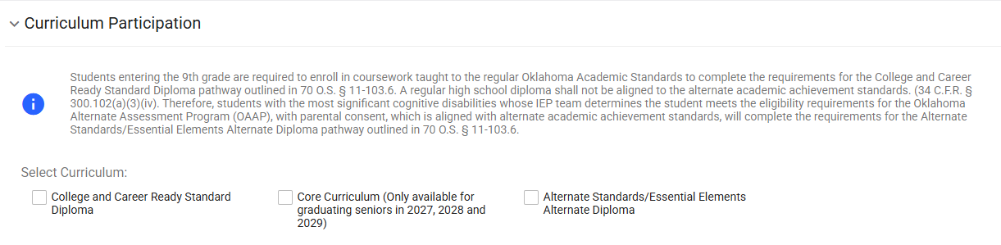
New Information Starting August 1 – Recording Curriculum Participation - 2
As IEP or 504 teams are meeting, teams will need to discuss “Curriculum Participation”. Options include:
    College and Career Ready Standard Diploma
    Core Curriculum (Only available for graduation seniors in 2027, 2028, 2029 )(will not count for ACGR)
    Alternate Standards/Essential Elements Alternate Diploma (IEP students only)

Slide 8
New EdPlan Selections Starting August 1 –
Recording Curriculum Participation
"Students entering the 9th grade are required to enroll in coursework taught to the regular Oklahoma Academic Standards to complete the requirements for the College and Career Ready Standard Diploma pathway outlined in 70 O.S. § 11-103.6. A regular high school diploma shall not be aligned to the alternate academic achievement standards. (34 C.F.R. § 300.102(a)(3)(iv). Therefore, students with the most significant cognitive disabilities whose IEP team determines the student meets the eligibility requirements for the Oklahoma Alternate Assessment Program (OAAP), with parental consent, which is aligned with alternate academic achievement standards, will complete the requirements for the Alternate Standards/Essential Elements Alternate Diploma pathway outlined in 70 O.S. § 11-103.6."

Slide 9
Specific Changes in the Law – HB 3021

Slide 10
College Admissions Coursework
Courses required for credit for high school graduation under this subsection shall also be approved for college admissions requirements. ( Section C. 1 )

Slide 11
English Requirements – What the Law Says
Four units or sets of competencies of English to include Grammar, Composition, Literature, an Advanced Placement English Seminar, or any English course approved for college admission requirements;
**This course does require additional training through APSI to be qualified to teach. The subject code will be available for the 2027-2028 school year.

Slide 12
Math Requirements – What the Law Says
Four units or sets of competencies of mathematics, two of which shall include Algebra I and either Algebra II or Geometry. The other two units may include Algebra II, Geometry, Trigonometry, Math Analysis, Calculus, Statistics, Math of Finance, Computer Science, college courses approved for dual credit, a full-time postsecondary career and technology program that teaches math content with a real-world application, or locally approved math-based application course, or any mathematics course with applied knowledge of content and rigor above Algebra I.

Slide 13
Math Requirements – What the Law Says
For the purposes of this section, a full-time postsecondary career and technology program that teaches math content with a real-world application shall not include courses categorized as Arts, A/V Technology and Communications, Education and Training, Hospitality and Tourism, or Human Services, including, but not limited to: Barbering, Cosmetology, Culinary Arts, Esthetician, Event Management, Horticulture, or Hospitality Management;

Slide 14
Math Requirements
The fourth math is intended to be flexible. As long as it exceeds the rigor of Algebra 1 and is approved by the local school board, it can be used as a “Locally Approved Math.”
Contextual math courses must be taught to the standards and rigor set forth for that course and approved through the Regents to count as one of the three math required for college admissions purposes.

Slide 15
Science Requirements – What the Law Says
Three units or sets of competencies of laboratory science requirements including one unit or set of competencies of life science meeting the standards for Biology I; one unit or set of competencies of physical science meeting the standards for Physical Science, Chemistry, or Physics; and one unit or set of competencies from the domains of physical science, life science, or earth and space science, or full-time postsecondary career and technology program that teaches science content with a real-world application or locally approved science-based application course, or any science course with applied knowledge of content and rigor above Biology I or Physical Science.

Slide 16
Science Requirements – What the Law Says
For the purposes of this section, a full-time postsecondary career and technology program that teaches biology or physical content with a real-world application shall not include courses categorized as Arts, A/V Technology and Communications, Education and Training, Hospitality and Tourism, or Human Services, including, but not limited to: Barbering, Cosmetology, Culinary Arts, Esthetician, Event Management, or Hospitality Management;

Slide 17
Science Requirements
The three science courses required MUST be taught as a laboratory science.
All three must meet college admissions requirements for lab science.
Locally approved courses must be submitted to OSRHE to determine college admissions eligibility and must be above the rigor of Biology 1 or Physical Science.
Contextual science courses must be taught to the required standards and rigor set forth for that course.

Slide 18
History and Citizenship
Three units or sets of competencies of history and citizenship skills including one unit of American History, one-half (1/2) unit of Oklahoma History, one-half (1/2) unit of United States Government, and one unit from the subjects of History, Government, Geography, Economics, Civics, or non-Western culture;
No major changes to the history requirement.

Slide 19
Pathway Units
Six pathway units or sets of competencies approved at the discretion of the school district board of education which align with each student's Individual Career and Academic Plan (ICAP) and may include, but are not limited to, any additional units or sets of competencies as provided in paragraphs 2 through 5 of this subsection,
World language, Indigenous language spoken in North America, or non-English language, computer technology, Junior Reserve Officers' Training Corps (JROTC), internship or apprenticeship programs, career and technology education courses, concurrently enrolled courses, Advanced Placement courses, International Baccalaureate courses, music, art, drama, speech, dance, media arts, or other approved courses;

Slide 20
Additional Units Approved for College Admissions
At least two additional units or sets of competencies from paragraph 2, 3, 4, 5, 6, 7, or 8 which are required to be approved for college admissions by the State Regents for Higher Education when the student is enrolled in the eighth grade, or at any time thereafter when the student completes the course, but prior to graduation.
This does not add to the total number of credits required. The purpose is to align with college admissions requirements and can be fulfilled through pathway units, electives, or other credits as long as the course is approved for college admissions.

Slide 21
Additional Requirements
Students must still meet the additional requirements below:
Personal Financial Literacy – in 10th grade or later.
CPR (§70-1210.199)
ICAP (Title 70 O.S. § 1210.508-4)
US Naturalization Test
FAFSA (opt out is available)

Slide 22
HB 2031 Alternate Diploma Graduation Requirements for Class of 2030
English – 4
Math – 4 NEW REQUIREMENT FOR CLASS OF 2030
Science – 3
History & Citizenship – 3
World & Non-English Language or Computer & Technology – 1
Arts – 1
Career Readiness – 3
Life Skills – 3
Electives to total 23 units of sets of competencies

Slide 23
Additional Items
The Law Also Discusses Addition Items That Are Necessary for Graduation

Slide 24
Oklahoma’s Promise
Page 20, Number 6
A school district shall not be required to offer every course listed in subsections C, D, and E of this section but districts shall offer sufficient courses to allow students to meet the graduation requirements and ensure the student meets the coursework requirements established for Oklahoma's Promise by the Oklahoma State Regents of Higher Education.

Slide 25
Completing Courses Prior to 9th Grade
Page 20, Number 10
  Math for high school credit can be completed as early as 8th grade. Any math courses taken prior to 8th grade can count as an elective credit but cannot count as math.
Page 8, Number 9
  The two additional units approved for college admissions must be taken in 8th grade or later.
Bottom Line: Only coursework taken in 8th grade or beyond will count for high school credit.

Slide 26
Non-Standard Course Waiver
Page 21, Letter H
  States the OSDE/CTE/Regents must develop a non-standard course waiver for submission and review of any locally approved courses. It gives requirements to be included on the form.
  Courses must be submitted to Accreditation by March 1st of each year.
  Accreditation has 30 days to give feedback to the district.
  The course framework, crosswalk, syllabus, etc. must be made publicly available on OSDE website.

Slide 27
Is “this” course approved?
Wondering if a specific course has been approved for college admissions and meets that new element of the law?
Check here: OK College Start Courses to Take
For deeper information about specific courses approved, click on the link that says, “more detailed course requirements.”

Slide 28
Exceptions for Military Students
Page 28, Letter C
  Allows military students entering the state at ANY time an exemption for Oklahoma history in two cases:
  The student completed a similar state history class or other one-half unit or set of competencies in history or citizenship skills in another state.
  The student completes a project or writes a paper, without the assistance of AI, subject to approval of the school district, that demonstrates competencies and knowledge of Oklahoma history or US Government.

Slide 29
Transcribing Replacement Credits
Title 70-24-114 (C) states:
“For purposes of this subsection, “transcript” means the permanent academic record of a student and shall include the name… an inventory of courses taken, all grades received, all degrees conferred and extracurricular or after-school activities.”
When recovering credits, transcripts must include:
All courses taken
All grades received
**GPA calculations are a local district policy decision.

Slide 30
Returning Students, Which Requirements?
Title 70. Schools §70-5-132:
Allows students over the age of 21 and under the age of 30 to return to complete high school graduation requirements for a standard high school diploma.
Provides state aid for these students.
Only available if the district offers full-time virtual programming. (Must be completed virtually)
Which requirements?
  Students are required to complete the coursework for their graduating cohort.

Slide 31
Course Planning and Academic Advising

Slide 32
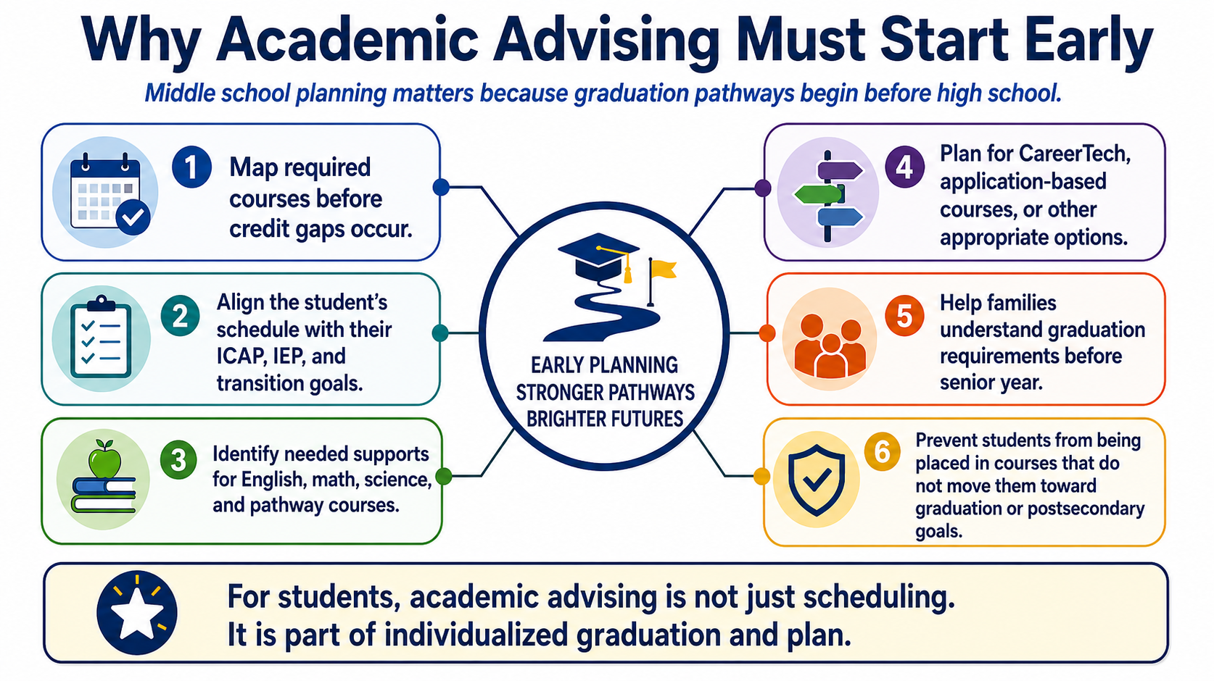

Slide 33
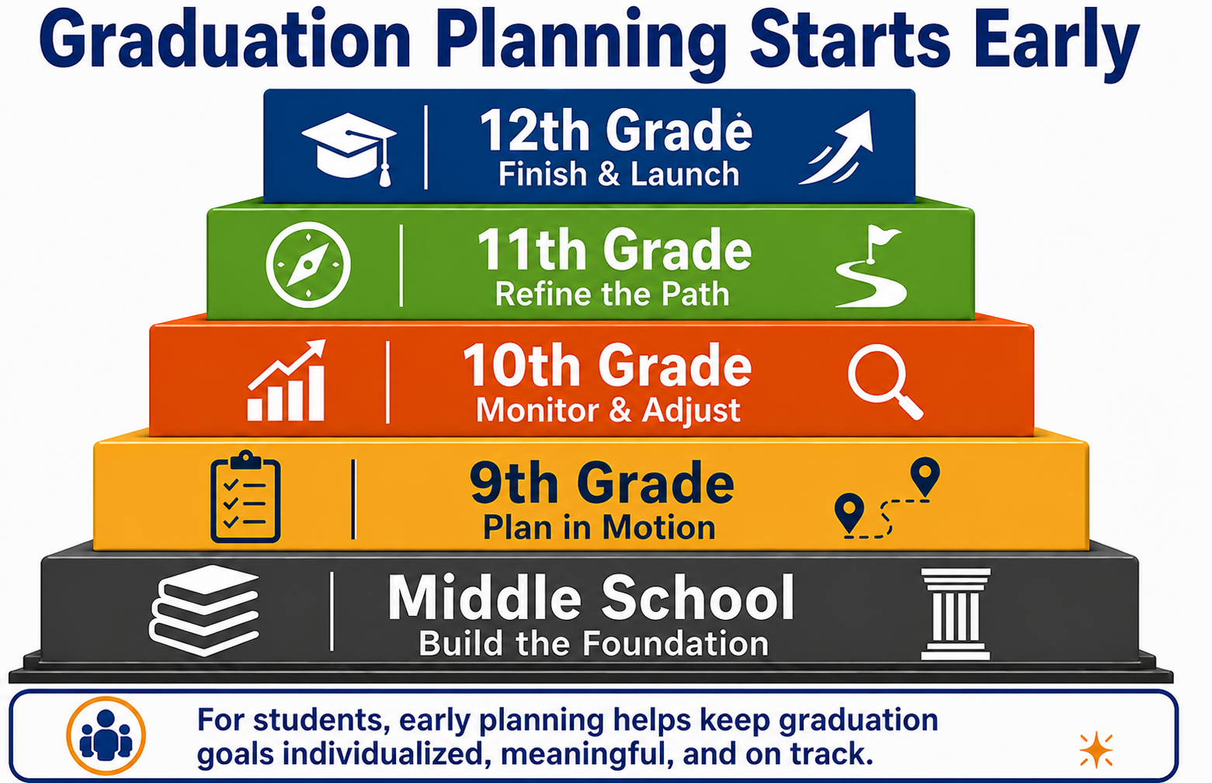
Course Planning Timeline
Middle School
  Introduce graduation requirements.
  Begin ICAP and career interest exploration.
  Explore strengths, needs, and transition related data.
  Identify early supports needed.
  Identify potential pathway interests.
  Map initial 4-year course plan.
  Talk about options like Career Tech, employment, military, college.

Slide 34
Course Planning Timeline
Freshman Year
  Confirm the 4-year course plan.
  Make sure required courses are schedule in the right sequence.
  Align ICAP, and graduation pathway.
  Monitor first semester grades, attendance, and credit accrual closely.
  Make sure families understand what “on track” means.
  Make plans to catch up on any failed classes.

Slide 35
Course Planning Timeline
Sophomore Year
  Review credits earned.
  Update ICAP
  Discuss CareerTech, work-based learning, concurrent, or application-based options.
  Address failed courses early so students don’t enter junior year significantly behind.

Slide 36
Course Planning Timeline
Junior Year
  Conduct a detailed credit check against graduation requirements.
  Confirm remaining required courses for senior year.
  Review whether pathway units align with goals.
  Begin planning for senior year experiences such as internships, job shadowing, capstones, or agency referrals when needed.

Slide 37
Course Planning Timeline
Senior Year
  Confirm requirements are met or are scheduled for completion.
  Monitor grades, attendance, and credit accrual.
  Support completion of Extra requirements: FAFSA, Citizenship Test, CPR, ICAP, PFL

Slide 38
Shared Roles in Graduation Planning
Teacher Role
Teachers see daily evidence of whether students can access, participate in, and complete required coursework.
Primary Responsibilities
Planning Questions
Monitor progress, grades, attendance, and course performance
Implement accommodations, supports, and specially designed instruction.
Share classroom data with counselors and administrators
Communicate concerns early with families, counselors, and administrators
What barriers are showing up in daily coursework?
Are supports being used consistently and effectively?
Is the student earning credit or falling behind?
What information should be brought to parents, counselors, or admiration.
Handoff Focus: Course access, academic progress, support needs, and early warning signs.

Slide 39
Shared Roles in Graduation Planning
School Counselor Role
School counselors help connect graduation requirements, course sequences, ICAP, and postsecondary goals.
Primary Responsibilities
Planning Questions
Lead academic advising and graduation planning conversations
Review credits, course sequences, and pathway options
Align ICAP with interests, strengths, and postsecondary goals
Help students and families understand requirements and options
Is the student on track for required credits?
Do planned courses align with the student’s ICAP goals?
Are pathway units meaningful and appropriate?
What needs to be communicated clearly to the family?
Handoff Focus: Graduation status, course sequencing, ICAP alignment, and family-facing planning information.

Slide 40
Shared Roles in Graduation Planning
Administrator Role
Administrators create the systems that make graduation planning possible, consistent, and equitable.
Primary Responsibilities
Planning Questions
Ensure access to required courses and pathway options
Support schedules, staffing, and systems for student success
Monitor implementation of graduation planning across teams
Promote collaboration and clear communication with families
Are required courses available to all students?
Do schedules and staffing support access to all needed services?
Are teams reviewing credit progress early and consistently?
Where do systems need to improve before students fall behind?
Handoff Focus: Course access, staffing and schedule decisions, team coordination, and implementation follow-through.

Slide 41
Connecting Pathway Untis, ICAP, and Real-World Experiences

Slide 42
Service Learning
2775 Service Learning
Focus: Community needs, civic responsibility, and academic learning.
Structure: Integrated into a course; involves reflection and service to a non-profit or community partner.
Goal: To apply academic knowledge while benefiting the community.
Outcome: Personal growth, leadership, and new perspectives.

Slide 43
Internship
2790 Internship I and 2791 Internship II
Focus: Career readiness, industry skills, and academic application.
Structure: Structured programs (internships, clinicals, apprenticeships) with an employer, for academic credit. An FAQ and additional guides for setting up an Internship program can be found at https://www.okedge.com/business-community/service-work-based-learning/
Goal: To gain practical skills, experience, and knowledge in a specific field.
Outcome: Improved employability and industry connections.

Slide 44
Work Study
2795 Work Study
Focus: Performing specific job tasks in exchange for wages.
Structure: Employer-defined; may not have a structured learning plan.
Goal: Earn income, develop basic professional skills (punctuality, reliability).
Outcome: Immediate income and general work experience

Slide 45
Standard Diploma Resources
Academic Advisement Resources

Slide 46
Resources and Contacts
For subject matter questions, Standards and Learning is your best resource:
  https://oklahoma.gov/education/services/standards-learning.html
General graduation questions or not sure who to reach out to:
  studentdevelopment@sde.ok.gov or Deana Edgar, deana.edgar@sde.ok.gov; or Christi Sturgeon, christi.sturgeon@sde.ok.gov
Pathways or ICAP questions:
  studentdevelopment@sde.ok.gov or Jennifer Peters, jennifer.peters@sde.ok.gov
Work-based learning questions:
  studentdevelopment@sde.ok.gov or Meredith Dennis, meredith.dennis@sde.ok.gov

Slide 47
Special Education Resources
•OK Special Education Policies and Procedures
•Alternate Diploma Collaborative
•Alternate Diploma Guidance Briefs CURRENT
  Alternate Diploma Course Codes, Titles, and Descriptions
  Side-by-Side Comparison of Standard v. Alternate
  Alternate Diploma Graduation Checklists (current and Class of 2030 with 4 math units)
  And many other informative Alternate Diploma Guidance Briefs
•Plan Your Way OK – Oklahoma’s Secondary Transition website for Students, Families, Educators, Professionals and Businesses

Slide 48
Secondary Transition and Alternate Diploma Contact Information
Claudia Beckner
Claudia.beckner@sde.ok.gov
405-521-6462
Lori Chesnut
Lori.chesnut@sde.ok.gov
405-521-4802

Slide 49
The Bottom Line
Know the requirements
Start planning early
Connect every student’s courses, ICAP, and future goals

