Slide 1
Financial Management of
Special Education Programs
Federal IDEA Part B Funds
Special Education Services

Slide 2
Federal IDEA Part B Funds
IDEA Part B funds are Federal funds the Local Education Agency (LEA) receives to help support the special education program and implement IDEA.
(IDEA stands for Individuals with Disabilities Education Act)

Slide 3
Federal IDEA Part B Funds
These funds are what enables Project 621 IDEA Flow Through, and Project 641 IDEA Pre-School.
LEAs also use these funds for Project 623 Early Intervening, Voluntary or Mandatory set aside for CEIS and CCEIS, Project 625 Flow Through Private and Project 642 Pre-School Private.

Slide 4
Allowable Use of Federal Funds
IDEA funds have a 27-month life span.
Funds issued for FY25 – July 1, 2024, through June 30, 2025, equals 12 months. Any of those funds that carry over would be available from July 1, 2025, through June 30, 2026, which would now be 24-month-old.Those funds are only available for obligation through September 30, 2026, which now meets their 27-month availability. Expenditure reports for those funds would be required to be submitted by January 1. After that period, those funds would no longer be available.

Slide 5
Use of IDEA Part B Funds
When an LEA accepts IDEA-B funds they are agreeing those funds will be used to supplement and not supplant state and/or local funds.
Funds must be used to:
  Pay the excess costs of special education and related services.
  Supplement State and Local funds.
(Supplement is to provide or make a supplement to something while supplant is to take the place of; to replace, to supersede).

Slide 6
Allowable Use of Federal Funds
All federal funds are to be used on a reimbursement basis only.
IDEA Part B Federal Funds may be used for:
  Appropriate Technology for Special Education
  Coordinated Early Intervening Services
  Special Education & Related Services

Slide 7
Use of IDEA Part B Funds
To be considered a valid charge a cost must be:
  Reasonable (is considered whether the nature and price of goods or services reflect what a prudent person would have done.)
  Allocable (must be treated consistently across similar circumstances and in accordance with the relative benefits received by the projects.)
  Allowable (it is permitted by the governing regulations (e.g., federal regulations, sponsor's guidelines) and is not explicitly excluded.)

Slide 8
Excess Cost/Maintenance of Effort
Excess Cost / Maintenance of Effort

Slide 9
Excess Cost / Maintenance of Effort
IDEA contains two separate requirements for LEAs to ensure sufficient funding for special education programs:
    Excess Cost
    Maintenance of Effort (MOE)
While these requirements have some similarities, there are separate requirements requiring separate calculations.

Slide 10
Excess Cost
Excess costs ensures funds are only used to pay the cost that are above what the LEA spends on average for students enrolled at the elementary and secondary level.
Because a student with a disability is a student entitled to an education first, the concept of excess costs establishes that:
  Students with disabilities receive educational support like non-disabled students, and
  IDEA Part B funds only pay for the excess cost of educating students with disabilities.

Slide 11
Excess Cost
Example:
If an LEA pays $7,000.00 on their general ed student, they must spend $7,000.00 on their special ed student. This would be using State and/or local funds.
General Ed child cost $7,000.00
Special Ed child cost $10,000.00
The difference, $3,000.00, would be the excess cost paid with IDEA funds. If you paid the $10,000.00 all with IDEA funds you would be supplanting.

Slide 12
Excess Cost
An LEA must meet excess cost in both elementary and secondary, otherwise the district will be found not meeting excess cost and will be issued a citation, and a reduction in State Aid funding will be imposed.
An LEA will receive notification through email in February - March if they have not met Excess Cost.

Slide 13
Excess Cost
An LEA not meeting their Excess Cost has the right to appeal their penalty within 30 calendar days of receiving their first notification. All appeals must be submitted in writing, to OSDE-SES. As with Maintenance of Effort, miscoding is not a reason for the appeal. Should the LEA refute the OSDE-SES decision the LEA can make an appeal to the Secretary of the U.S. Department of Education within 20 days of the OSDE-SES rejection.

Slide 14
Excess Cost
For districts choosing to submit an appeal, the penalty amount will be withheld from their State Aid funds until the final decision has been made. Should the appeal be in favor of the district, the funds will be returned.
Districts can view their Excess Cost online through the Oklahoma Cost Accounting System.

Slide 15
Excess Cost
Tips for determining Excess Cost
Ask the following questions:
In the absence of special education needs, would this cost exist?
If no, then the cost is an excess cost. If yes, then the cost is not an excess cost.
Is this cost also generated by students without disabilities?
If no, then the cost is an excess cost. If yes, then the cost is not an excess cost.
If it is a student specific service, is the service documented in the student’s IEP? If yes, then the cost is an excess cost. If no, then the cost is not an excess cost.

Slide 16
Excess Cost
Things to check if you receive a NOT MET:
  Check expenditures coded to site code 050.
  Review services are coded to the correct site code.
  Are capital expenditures coded correctly?
  Salaries coded to Elementary but might also need to be coded to Secondary. Should be coded to site child attends.
  Any expenditures coded to 450 or 700 are removed from the equation.
  Review the Excess Cost calculation work sheet in the OCAS manual.

Slide 17
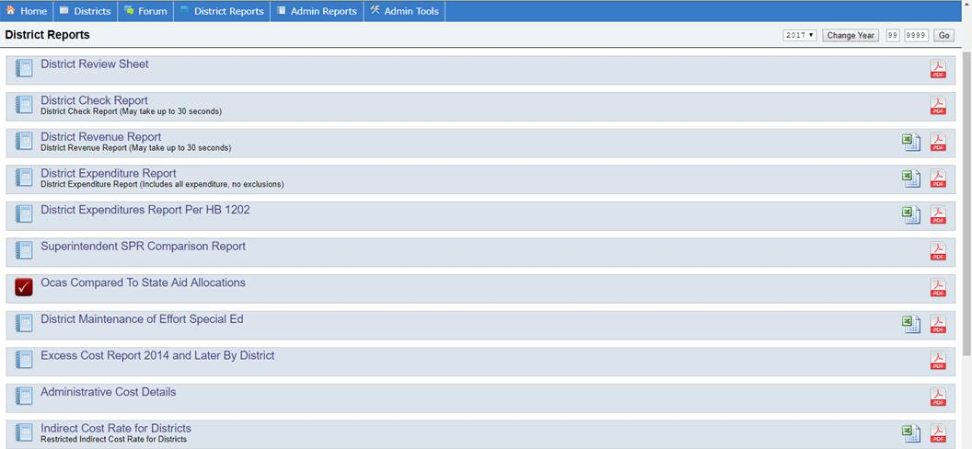

Slide 18
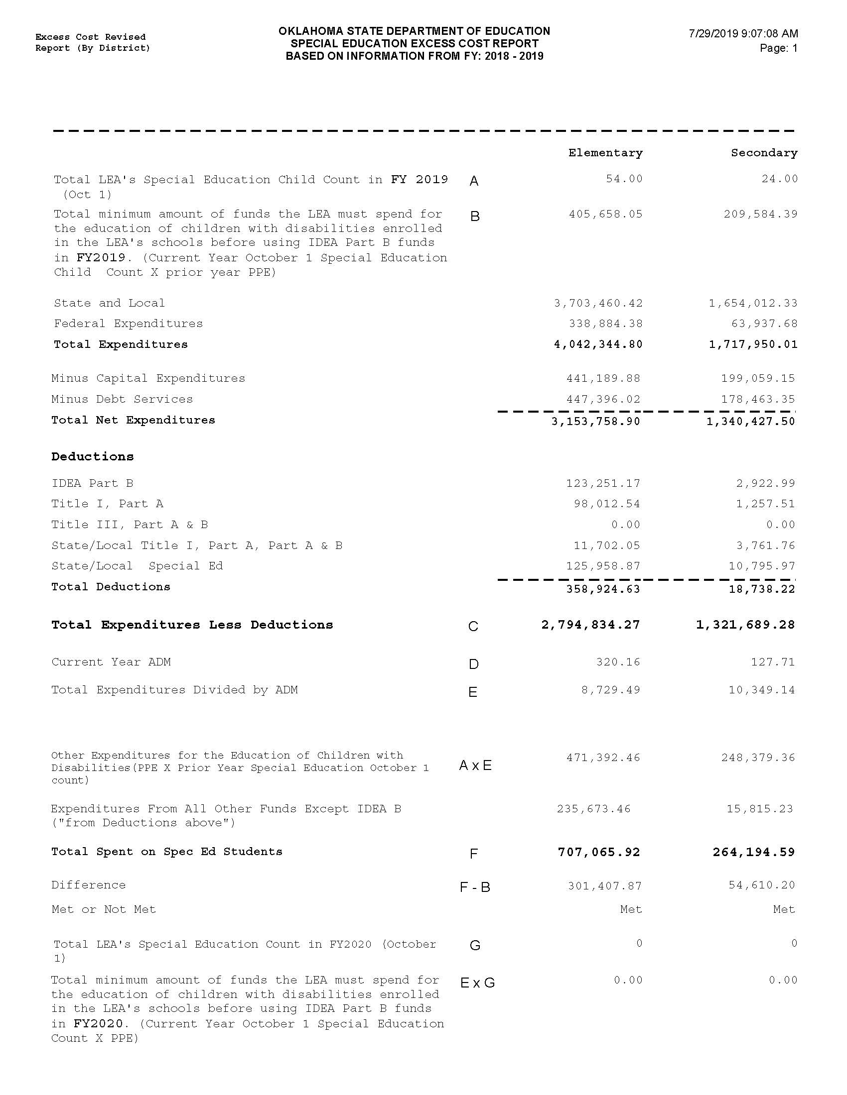

Slide 19
Maintenance of Effort
The purpose of Maintenance of Effort (MOE) is to help ensure sufficient non-federal funding is available for students with disabilities. The U.S. Department of Education does not intend for LEAs to use federal funds as the primary means of providing services to students with disabilities.
There are 2 areas required under MOE.
Eligibility - Prior to a grant award, the LEA must demonstrate it will maintain spending.
Compliance – After the fiscal year, the LEA must demonstrate it did maintain spending.

Slide 20
Maintenance of Effort
An LEA is not eligible to receive IDEA Part B funds until it has met the MOE eligibility standard.
Districts are required to input MOE data information when completing their new fiscal year LEA Agreement. This would show compliance with the eligibility requirement.

Slide 21
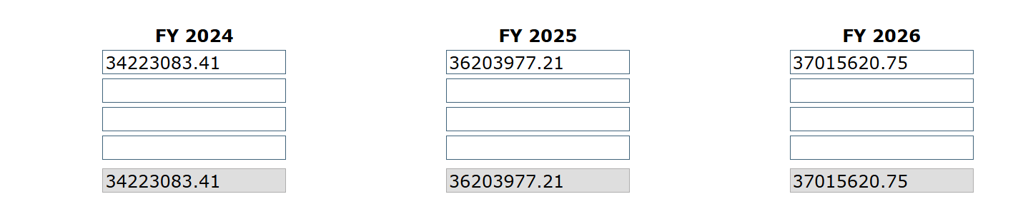
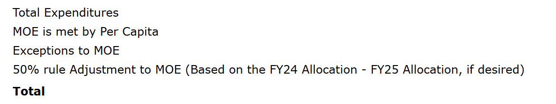
Maintenance of Effort

Slide 22
Maintenance of Effort
All MOE data information must match data submitted through Oklahoma Cost Accounting Services (OCAS).
LEAs must update the MOE data in their LEA Agreement once their data has been certified through OCAS.

Slide 23
Maintenance of Effort
LEAs must maintain 100% level of expenditures from State and/or Local funds spent on special education and related services from year to year. If in any fiscal year, an LEA fails to maintain effort, the level of expenditures required for the subsequent year is the amount that would have been required to maintain effort in the absence of that failure, not the LEAs reduced level of expenditures (34 CFR 300.203).

Slide 24
Maintenance of Effort
Example:
During FY2020-21, the LEA had a required level of effort of $100,000.00 and an actual level of $100,000.00, the LEA met MOE requirements.
During FY2021-22, the LEA had a required level of effort of $100,000.00, and an actual level of $90,000, the LEA did not meet MOE requirements by $10,000.00.
During FY2022-23, the LEA had an actual level of $90,000, the LEA did not meet MOE by $10,000.
The LEA will have a required level of $100,000 rather than $90,000.00 until they meet MOE.

Slide 25
Maintenance of Effort
An LEA meets the compliance standard if it does not reduce the level of expenditures for the education of children with disabilities made by the LEA from at least one of the following sources below the level of those expenditures from the same source for the preceding fiscal year. An LEA may use one of four methods to demonstrate they have met MOE requirements under IDEA.
  local total expenditures
  local per capita
  state and local total expenditures
  state and local per capita

Slide 26
Maintenance of Effort
Oklahoma Cost Accounting System (OCAS) calculates Special Education MOE only 2 ways:
  The total expenditures of the LEA for special education and related services (state and local).
  Per capita amount spent on children receiving special education services (state and local).
If either the total amount of expenditures or the per capita amount decreased in the second (i.e., subsequent) year, the LEA has failed to meet the MOE requirement.

Slide 27
Maintenance of Effort
An LEA may reduce its level of effort under the eligibility and compliance standards if there is an allowable exception.
Starting in February an LEA will receive notification that the MOE requirement has not been met. An opportunity will be provided for the LEA to submit documentation of allowable exceptions.

Slide 28
Maintenance of Effort
There are 5 exceptions that may apply to MOE.
Exceptions:
  Voluntary departure, by retirement or otherwise, or departure for just cause, of special education or related services personnel.
  A decrease in the enrollment of children with disabilities.

Slide 29
Maintenance of Effort
Exceptions:
  The termination of the obligation of the agency, consistent with this part, to provide a program of special education to a particular child with a disability that is an exceptionally costly program, as determined by the SEA, because the child
    has left the jurisdiction of the agency;
    has reached the age at which the obligation of the agency to provide Free Appropriate Public Education to the child has terminated; or
    no longer need the program of special education.

Slide 30
Maintenance of Effort
Exceptions:
  The termination of costly expenditures for long-term purchases, such as the acquisition of equipment or the construction of school facilities.
  The assumption of cost by the high-cost fund operated by the SEA.

Slide 31
Maintenance of Effort
There are no exceptions for mis-coding. This is why it is important to review your data throughout the year. Districts should review their MOE and Excess Cost reports after any data changes have been made and prior to the superintendent certifying the data.

Slide 32
Maintenance of Effort
Special Education Services (SES) can assist your district.
  SES will receive a list of LEAs failing to meet MOE from OCAS.
  Working with LEAs, SES will contact and request specific documentation.

Slide 33
Maintenance of Effort
Examples of the documentation that the LEA can provide are:
    Employee Earnings Audit report
    Detailed Financial Analysis report
    Expenditure Analysis report
    Employee Encumbrance/Expenditure report

Slide 34
Maintenance of Effort
If an LEA fails to meet its MOE compliance standard, the SEA must repay the US Department of Education. The State’s repayment, must be met using non-federal funds. The SEA requires the LEA to reimburse the SEA using state and/or local funds.

Slide 35
Maintenance of Effort
LEAs failing to meet MOE, will be issued a citation and receive a reduction to their next years State Aid funding.
If a district does not receive State Aid funding, nor receives enough State Aid funding to cover the penalty, the district will be required to submit a check in the amount of the penalty to OSDE-SES.
Paying the penalty does not reduce your base. You must maintain the MOE base set prior to the penalty.
If an LEA meets one of the exceptions, then the base amount will change to reflect that exception.

Slide 36
Maintenance of Effort
Fifty Percent Flexibility
The 34 CFR 300.205 allows districts with an increase to their IDEA allocation to reduce their MOE by up to 50% of the amount of the IDEA increase, provided the freed-up local funds are used for Elementary and Secondary Education Act (ESEA) activities. This is a voluntary process for districts that have an increase in IDEA allocations and meets certain criteria.

Slide 37
Maintenance of Effort
Fifty Percent Flexibility
Districts that elect to use MOE flexibility must submit an IDEA MOE 50% Reduction form to the Special Education Services Finance Division. All MOE reduction records are subject to audit by the Oklahoma State Board of Education.

Slide 38
Maintenance of Effort
Fifty Percent Flexibility
Specific criteria for districts
  Must be in a “Meets Requirement” status on their district data profile.
  Must not be found “Significantly Disproportionate”.
District should not complete the worksheet and cannot reduce MOE.

Slide 39
Maintenance of Effort
An LEA not meeting Maintenance of Effort has the right to appeal their penalty within 30 calendar days of receiving their first notification. All appeals must be submitted in writing, to OSDE-SES. Since miscoding is not an exception, it will not be accepted as an allowable reason for the appeal.

Slide 40
Maintenance of Effort
Should the LEA refute the OSDE-SES decision the LEA can make an appeal to the Secretary of the U.S. Department of Education within 20 days of the OSDE-SES rejection.
For districts choosing to submit an appeal, the penalty amount will be withheld from their State Aid funds until the final decision has been made. Should the appeal be in favor of the district, the funds will be returned.

Slide 41
Assurances, LEA Agreement, and Consolidated Application

Slide 42
Assurances and LEA Agreement
Superintendents must complete Assurances and LEA Agreement each year prior to the start of the new fiscal year.
Assurances and LEA Agreement are required by law to be completed prior to July 1st.
Assurances and LEA Agreement must be completed before the IDEA Consolidated Application will become available.

Slide 43
Assurances and LEA Agreement
Superintendents are not to share their sign-on information with any staff.
Only the superintendent can submit an application within the GMS.
In sharing your password you could be at risk should any fraudulent activity occur.

Slide 44
Assurances and LEA Agreement
You will be required to upload specific documentation in your LEA Agreement:
  District policies and procedures regarding Child Find or the identification process.
  Policies/Procedures on Discipline/Expulsion.

Slide 45
IDEA Consolidated Application
Once the Assurances and LEA Agreement are completed and submitted, and the Special Education allocation has been awarded, a district will be able to complete the Consolidated Application.

Slide 46
Use of IDEA Part B Funds
IDEA Part B Federal funds must be fully budgeted in the Grants Management System (GMS).
All expenditures must be submitted through the GMS.

Slide 47
Supplemental Funds
New for FY27 are funds classified as Supplemental Funds.
All districts will receive an allocation for both, Flow Through and PreSchool. The allocations are not large, but every little bit counts.
These funds can be used the same as IDEA Part B funds. They will have their own project numbers.
They too have a 27month life expectancy.
Funds must be fully budgeted in the Grants Management System (GMS).
All expenditures must be submitted through the GMS.

Slide 48
Coordinated Early Intervening Services (CEIS)

Slide 49
Coordinated Early Intervening Services (CEIS)
CEIS are services provided to children who are not currently identified as needing special education or related services, but who need additional academic or behavioral support to succeed in general education.
  LEAs may voluntarily reserve up to 15 percent of their IDEA funds for CEIS.

Slide 50
Coordinated Early Intervening Services
CEIS activities that may be funded under IDEA include:
Provide educational and behavioral evaluations, services, and supports, including based literacy instruction.
Provide professional development for teachers and other school staff to enable such personnel to deliver scientifically based academic and behavioral intervention-based literacy instruction and where appropriate, instruction on the use of adaptive and instructional software.

Slide 51
Comprehensive Coordinated Early Intervening Services (CCEIS): Significant Disproportionality

Slide 52
CCEIS / Significant Disproportionality
Revised regulations on significant disproportionality (34 CFR §300.636) have been finalized by the Office of Special Education Programs (OSEP). These regulations enforce the use of IDEA funds to be used on mandatory Comprehensive Coordinated Early Intervening Services (CCEIS).

Slide 53
CCEIS / Significant Disproportionality
LEAs found to be significantly disproportionate are required to set aside 15 percent of their total allocations (IDEA FlowThrough, IDEA PreSchool). This would also include allocation adjustments.
The LEA must serve children age 3 through grade 12 who are and are not currently identified as needing special education or related services but are in need of additional academic and behavioral support.
Funds must be used to identify and address the factors which contributed to the significant disproportionality for the identified category.

Slide 54
CCEIS / Significant Disproportionality
LEAs may use CCEIS funds for training, professional development, behavioral evaluations, and supports such as:
-Functional Behavioral Assessments
-Behavioral Intervention plans
But only to the extent to address the factors identified as contributing to the significant disproportionality identified by the State.

Slide 55
CCEIS / Significant Disproportionality
LEAs are required to submit a Summary Analysis within their CCEIS application. The summary must be approved through the SES Assistant Program Director prior to any claim approvals.

Slide 56
CCEIS / Significant Disproportionality
LEAs required to set aside funds for CCEIS cannot reduce the districts MOE (50% Reduction).
Funds cannot be used to provide services already required by law.
Funds cannot be used to provide services that were paid for with other funds in a previous year.

Slide 57
COOP / co-op
COOP / Interlocal co-op

Slide 58
COOP / Interlocal co-op
LEAs that select to pool their funds are known as COOPs or Interlocals. Participating cooperative LEAs other than interlocal co-ops, must elect one LEA to act as the lead fiscal agent for funds.

Slide 59
COOP / Interlocal co-op
All LEA’s participating in a COOP/Interlocal co-op must complete a COOP/Interlocal Arrangement For Consolidated Funding application. The application can be found in the districts LEA Agreement under the COOP/Interlocal tab within the GMS. The application must be signed by all LEA superintendents participating in a COOP/Interlocal and will instruct SES Finance the amount of funding to be transferred to the lead LEA.

Slide 60
COOP / Interlocal co-op
Assurances and the LEA Agreement for Special Education must be submitted for each LEA participating in the cooperative or interlocal.
In addition, each participating LEA is still responsible for the compliance with IDEA Part B of the cooperative or interlocal as it relates to each child of the LEA served by the cooperative or interlocal.

Slide 61
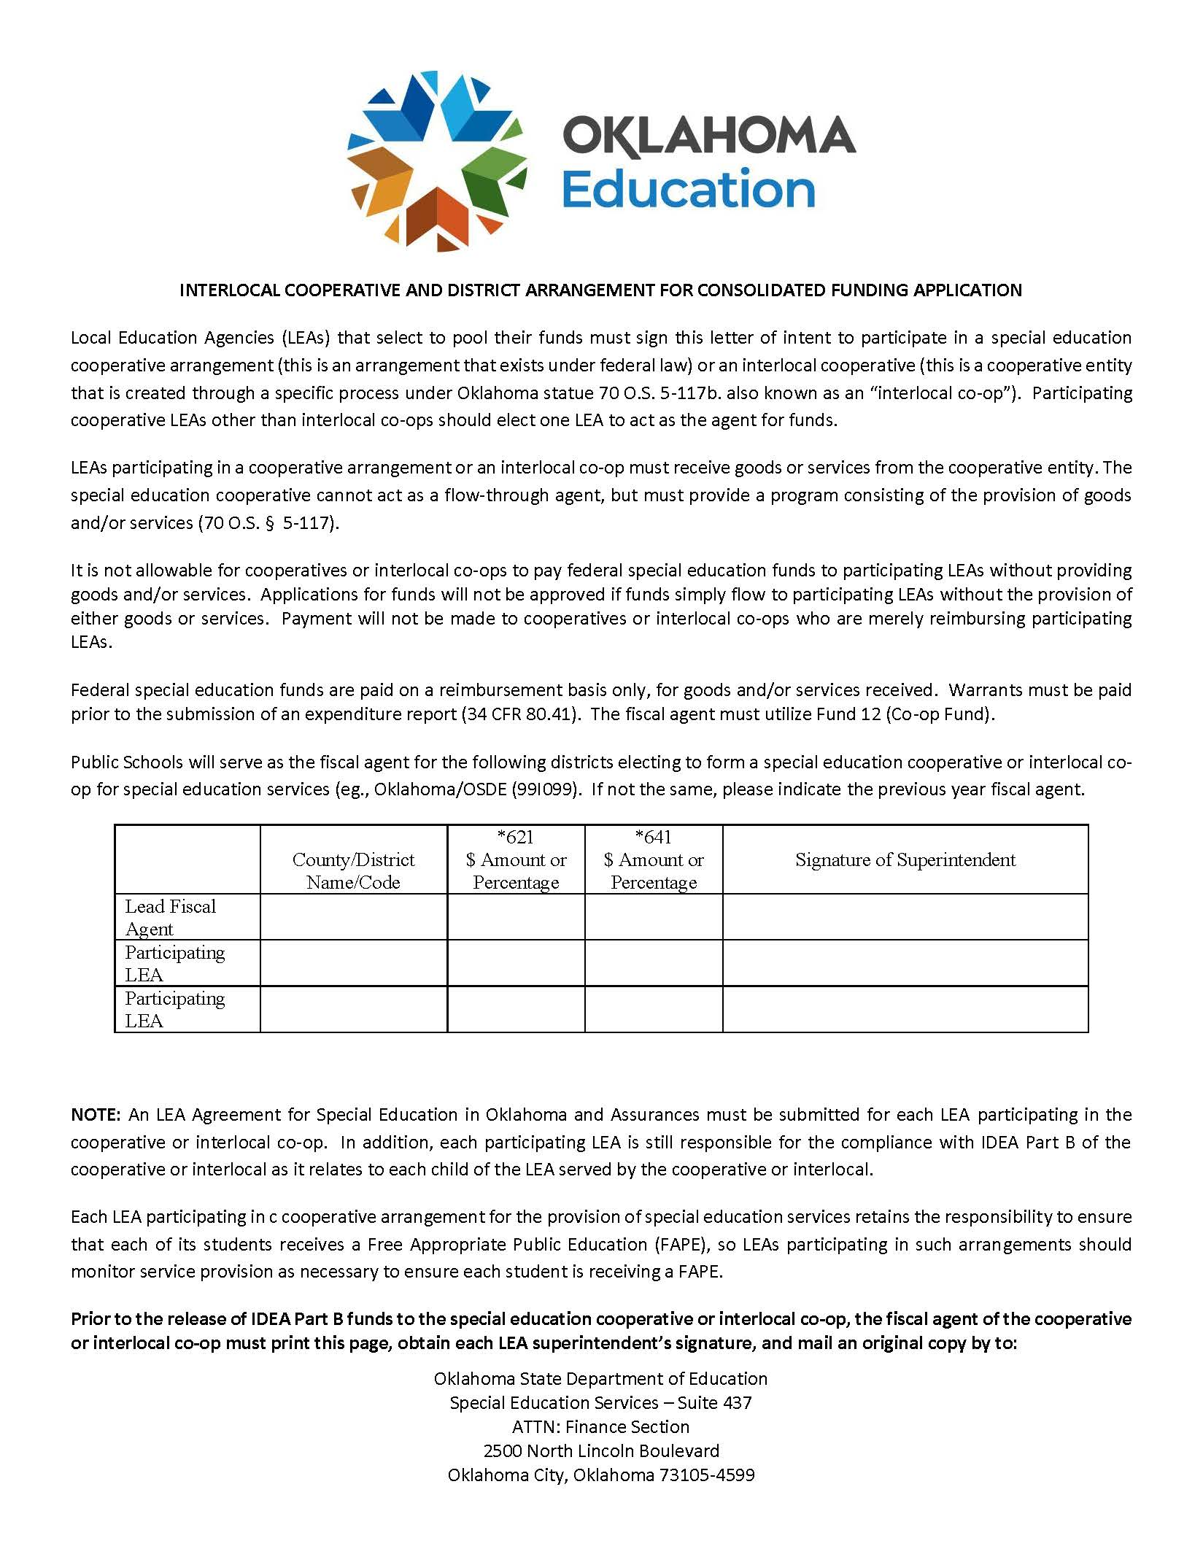

Slide 62
COOP / Interlocal co-op
LEAs participating in a cooperative arrangement or an interlocal co-op must receive goods or services from the cooperative entity. The special education cooperative cannot act as a flow-through agent but must provide a program consisting of the provision of goods and/or services (70 O.S. § 5-117).

Slide 63
COOP / Interlocal co-op
Each LEA participating in a cooperative arrangement for the provision of special education services retains the responsibility to ensure that each of its students receives a Free Appropriate Public Education (FAPE), so LEAs participating in such arrangements should monitor service provision as necessary to ensure each student is receiving a FAPE.

Slide 64
Submitting Expenditure Reports for Reimbursement of Funds

Slide 65
Expenditure Reporting
LEAs must have completed an online budget application within the GMS for all funds and receive approval from SES finance before applying for expenditure reimbursement.
All special education expenditures must be necessary, reasonable, and allowable.

Slide 66
Expenditure Reporting
Reimbursement claims are submitted online through the Grants Management Services.
NO claim will be paid without a valid UEI number and current expiration date.
Attach supporting documents which must include the Summary Expenditure Report, the Detailed Expenditure Report and all required invoices and receipts.

Slide 67
Expenditure Reporting
Supporting documentation includes:
Requisition
Receipt(s)
Invoice Payment
Without supporting documentation, LEAs cannot prove compliance with IDEA Part B federal grant requirements.

Slide 68
Expenditure Reporting
Summary and Detail Expenditure Report must be signed by the Superintendent, or a representative authorized by the local board of education.
Do NOT use special characters in your PDF title. (#, @, &, etc.)

Slide 69
Expenditure Reporting
If an authorized representative has signed the report, the district must have completed the Board Authorization tab located in their Federal Programs Consolidated Application.
The district must also upload the authorization on school letterhead indicating the appointment.

Slide 70
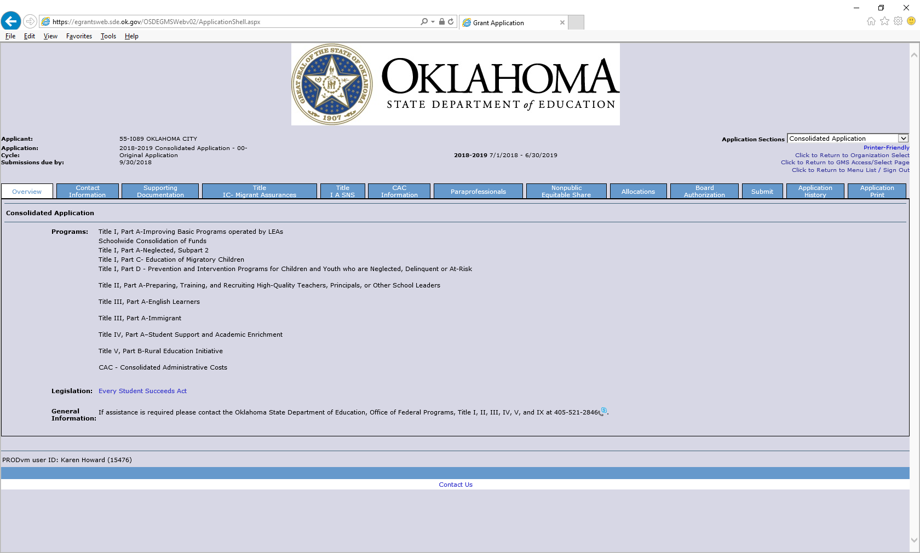

Slide 71
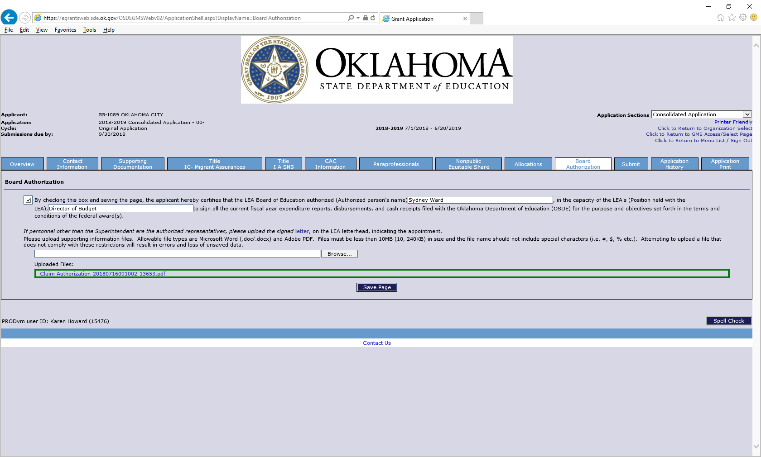

Slide 72
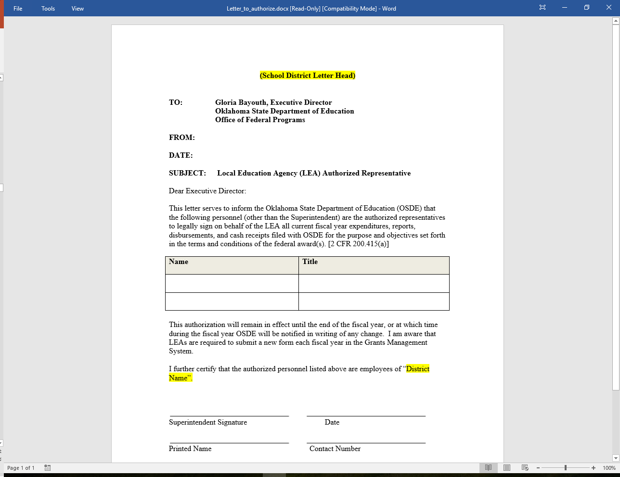

Slide 73
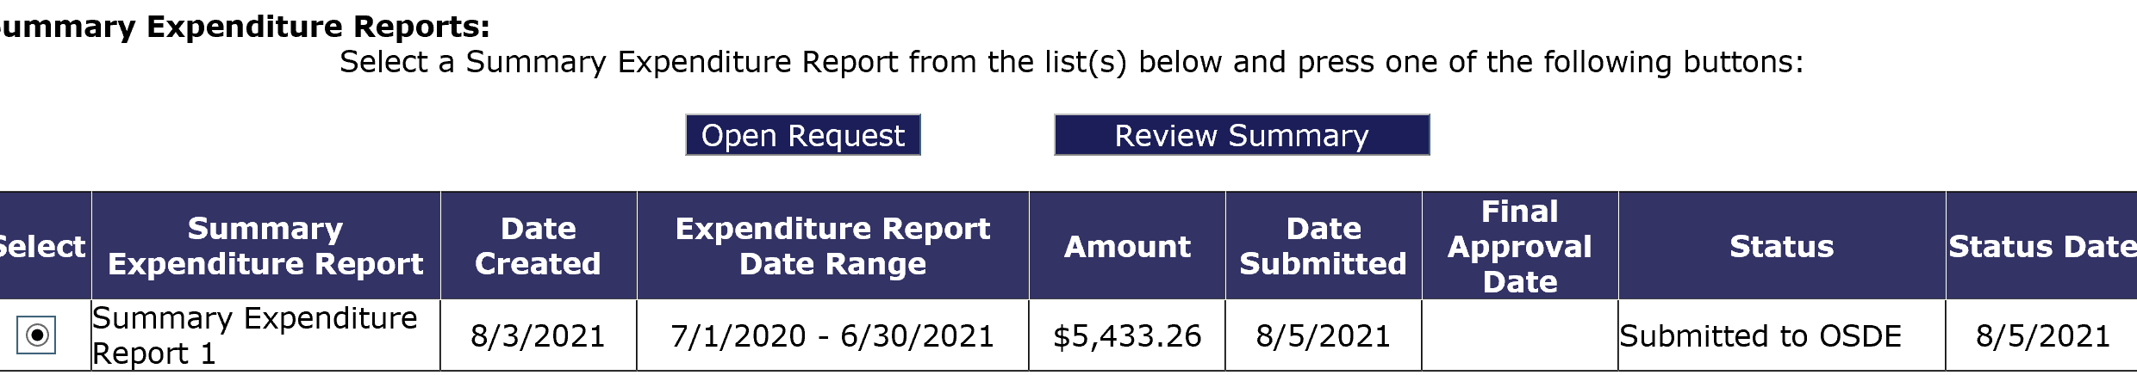
Expenditure Reporting
If a claim is returned, a message can be viewed informing the district what needs correcting. To view the message go into the Summary Expenditure Report Menu, select which report has been returned, then click the Review Summary button.

Slide 74
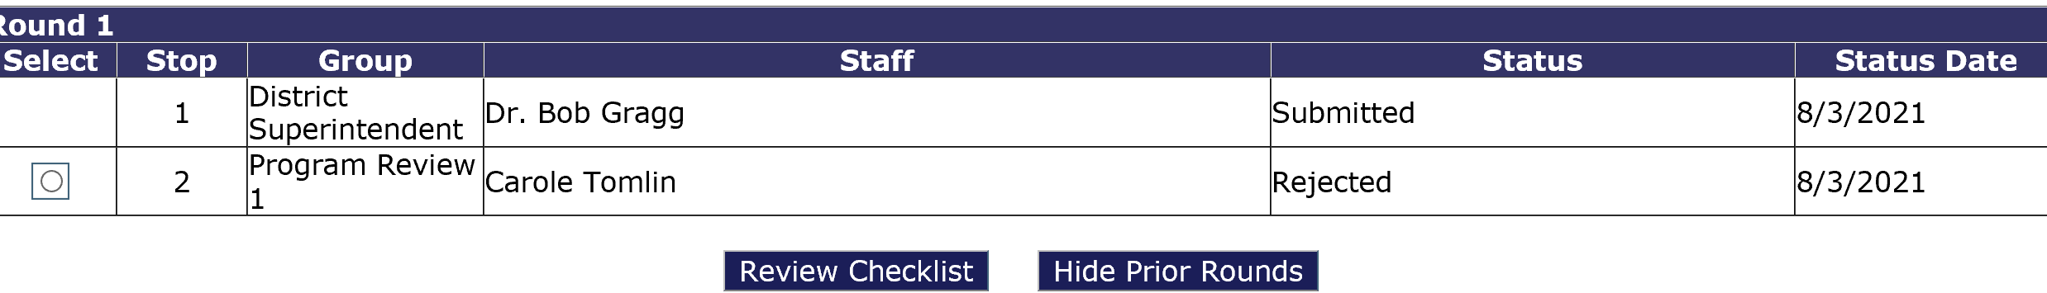
Expenditure Reporting
Select which program review, then click on the Review Checklist button. Once the checklist appears, you will be able to review the message informing why the claim has been returned.

Slide 75
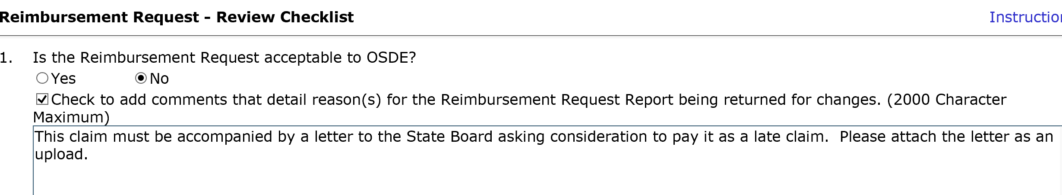
Expenditure Reporting
If you do not see the below screen, check to see if your pop-up blockers are on.

Slide 76
Proper Use of Codes
For a list of proper use of codes in Special Education see the State Department of Education website, listed under Oklahoma Cost Accounting.
  http://sde.ok.gov

Slide 77
Time and Effort
Year End CloseOut

Slide 78
Year End Closeout
Districts must perform a closeout to end the fiscal year.
  Closeouts must be completed by September 1.
  The closeout informs the SDE that the district has concluded expenditure reporting for the year.
  Closeouts also move all unspent funds to the next fiscal year for budgeting.
  The closeout process is a simple procedure that closely resembles the creation of an expenditure report.

Slide 79
Year End Closeout
Projects that require a closeout to be completed are:
Projects 621, 623, 625, 641, 642.
Projects NOT requiring a closeout to be completed are:
Projects 611,613, 615, 616, 618, 619, 626, 627, and 630.

Slide 80
Year End Closeout
When completing the closeout report, a district must upload a Time and Effort Report and a Vendor Performance Review form, if applicable.
  A Time and Effort report is required if IDEA Part B funds are used to pay any salary (object code 100).
  A Vendor Performance Review is required for each vendor if IDEA Part B funds are used to pay any Contract Service (object code 300).

Slide 81
Time and Effort
Time and Effort

Slide 82
Time and Effort
In general, salaries and wages of employees who work on federally funded programs may be paid with federal funds as long as they are working on the grant objectives and appropriate time and effort records are maintained.

Slide 83
Time and Effort
All employees must maintain documentation showing that their salaries are allocable to a federal program.
That documentation must be based on records that accurately reflect the work performed.

Slide 84
Time and Effort
Federal regulation requires that any salaries and benefits charged to a federal award(s) must be documented in writing.
  Reflect actual time spent on activities to which federal program(s) are being charged.
  It is recommended documentation is to be signed by the employee and the employee’s supervisor.

Slide 85
Time and Effort
Time and effort reports should be prepared for any staff with salary and benefits that are charged:
  Directly to a federal award.
  Directly to multiple federal awards.
  Directly to any combination of federal awards and other State or Local fund sources.
Keep time and effort reports on file at the district.

Slide 86
Time and Effort
Single Cost Objective
A single work activity that may be funded by one or more fund sources.
Semi-annual time and effort documentation is made in arrears.
Must be signed by the supervisor.
(Arrears is a financial and legal term that refers to the status of payments in relation to their due dates. The word is most commonly used to describe an obligation or liability that has not received payment by its due date.)

Slide 87
Time and Effort
Multiple Cost Objectives
  For employees who have different jobs or are paid with different funds;
  Must reflect an after-the-fact distribution of the actual activity of each employee;
  Must account for the total activity for which each employee is compensated;
  Must be prepared monthly and coincide with one or more pay periods; and
  Must be signed by the employee and supervisor.

Slide 88
Time and Effort
Remember:
  One time and effort report of an actual employee must be uploaded during the district’s closeout.

Slide 89
Special Education Professional Developent
Project 613

Slide 90
Project 613
The intent of this grant is to encourage district involvement in Professional Development opportunities. Funds may be used to help pay costs associated with attending SES sponsored events.
Acceptable events can be located on our website.

Slide 91
Project 613
The application is located on the Grant Management System. This project is to reimburse districts the costs of travel, substitute teachers, registration, and hotel for eligible events/training.
Funds for this project are limited and based on availability.
No district will receive an allocation.
These funds do not carry over.

Slide 92
Project 613
Required information:
  Name and title of staff members attending the event/training
  Event/training title and assigned number and date
  Estimated cost breakdown

Slide 93
Project 613
Reimbursement will include:
  Mileage
  Substitute cost
  Registration
  Hotel
  OSDE will consider the US General Service Administration (GSA) rate as the reasonable and necessary rate for reimbursement.

Slide 94
Project 613
Reimbursement will not include:
  Individual Reimbursement
  Per Diem / Food

Slide 95
Special Education Professional Development/District
Project 615

Slide 96
Project 615
The purpose of this project is to provide additional funds to districts, based on their most recent child count, and are used only for professional development activities that increase the ability of teachers to ensure positive outcomes for students with disabilities.

Slide 97
Project 615
Examples of usage are:
  Inviting Speakers
  Purchasing Books for Staff
  Attending Conferences
  Conducting Trainings
  Attending Webinars

Slide 98
Project 615
The application will be completed online through the Grant Management System.
The application will ask for an explanation of the activity and must be completed for the entire allocation.
Districts must complete an online budget by December 31 or forfeit their allocation, in which the funds will be retrieved back by Special Education Services.
These funds do not carryover.

Slide 99
Project 615
If found in noncompliance and/or has not met the state target in the same area/indicator across three consecutive years (for indicators 4,9,10,11,12,13, and DMR Level 3 or 4) LEAs will be required to use a portion of their 615 funds to address their improvement plan implementation.
The amount of funds to be directed will be determined within a consultation with SES.

Slide 100
Certification Examination Reimbursement
Project 616

Slide 101
Project 616
The purpose of this project is to reimburse districts for assisting teachers that need to take and pass additional subject area certification examinations.
It is limited to one exam per individual, and districts must provide justification for the necessity of each individual to take and pass the subject area examination.

Slide 102
Project 616
Funds for this project are limited and based on availability.
A copy of the Board Policy is required to be uploaded. The policy must address the approval of using these funds since they are considered salary.
These funds do not carryover.

Slide 103
Secondary Transition Funds
Project 618

Slide 104
Project 618
This project is to provide one-time additional funds to districts for the purpose of developing or expanding transition programs for all transition students with disabilities on IEPs ages 15 through 22 (must be 21 by September 1).

Slide 105
Project 618
These funds may only be used for purchases of curriculum, equipment, and/or materials to support secondary transition or professional development directly supporting secondary transition, such as postsecondary education/training, employment, independent living, or community participation, thus improving student post-secondary outcomes.

Slide 106
Project 618
Districts will receive an allocation based on their most recent October 1, child count.
The application can be located in the Grant Management System (GMS). The allocation received can be located on the allocation tab. Districts not completing a budget by December 31, will forfeit their allocation, and funds will be returned to the Oklahoma State Department of Education, Office of Special Education Services.
These funds do not carryover.

Slide 107
Project 618
Examples of usage are:
Purchase of hard copy or digital curriculum related to transition skills, including student licenses
Purchase of equipment related to transition skills (e.g., washer, dryer, stove/oven, etc.)
Purchase of materials related to transition skills (e.g. task boxes, folding boards, etc.)

Slide 108
Project 618
Purchase of assistive technology related to transition skills (e.g. assistive time devices, adaptive kitchen utensils.)
Expenses associated with staff training related to transition skills (e.g. registration fees, staff stipends for summer training, travel to training, substitutes while staff is at training, etc.)

Slide 109
OKMTSS
Project 619

Slide 110
Project 619
The purpose of this project is to assist a select group of districts in developing or improving a Multi-Tiered System of Support (OKMTSS) framework which will be implemented, with fidelity, using evidence-based academic and/or behavior continuum of interventions through tiered support.
The districts selected for this project have been chosen based on proficiency of their IEP subgroup for 4th and 8th, on the ELA and Math State Test in 2025. Schools selected have 0% proficiency for all four assessments.

Slide 111
Project 619
Districts will not receive an allocation for this project. Districts will complete an application online same as project 613.
Funds will be allocated under various elements designed to improve results for children with disabilities. MTSS is a framework that incorporates evidence-based practices with early intervention for all children.
These funds do not carryover.

Slide 112
Project 619
The project funding serves to incentivize, through stipends to school personnel, time invested in developing or improving alignment to the essential components for implementing an evidence-based MTSS framework.

Slide 113
Project 619
There are 5 elements for funded opportunities:
  Element 1: Screening: $5,000.00 Allocated
  Element 2: Progress Monitoring: $5,000.00 Allocated
  Element 3: Data-Driven Decisions: $5,000.00 Allocated
  Element 4: Multi-Tiered Supports: $5,000.00 Allocated
  Element 5: Infrastructure: $10,000.00 Allocated

Slide 114
Paraprofessional Assistance
Project 630

Slide 115
Paraprofessional Support
The purpose of this project is to provide additional funding, up to 75 percent of salaries and benefits, to aid districts with the cost of providing paraprofessionals for students attending School for the Blind and/or School for the Deaf as required within the students Individualized Education Program (IEP).

Slide 116
Paraprofessional Support
Districts applying must complete an online application through the Grants Management System (GMS) by October 31st. When applying for these funds, districts are required to: 1) Upload a copy of the paraprofessional’s contract for salary verification, 2) Affirm an Assurance within the application to verify a one-to-one paraprofessional is required, 3) Input the Student Testing Number to confirm attendance. Allocations will be based on the number of qualifying applications.
These funds do not carry over.

Slide 117
Behavioral Support
Project 611

Slide 118
Behavioral Support
For the purpose of assisting districts when they have exhausted their own capacity to address behavioral support at the district level.
Districts will not receive an allocation but will be allowed to apply for these funds, as long as funds are available. Districts may access the funds to support a single student during the current fiscal year. Based on the needs of the student, it may be necessary for the behavior specialist to engage with the student or support staff implementation on more than one occasion.

Slide 119
Behavioral Support
Funds can only be used toward contract services with any qualified behavioral professional, such as a Board-Certified Behavioral Analyst (BCBA or BCBA-D), Licensed Psychologist, Licensed Mental Health Professional with specific behavior training/credentials, etc.
Budget and expenditure reports must be completed on-line through the Grants.

Slide 120
Behavioral Support
Districts must include provider credential/licensure, proof of contract, and invoices from the qualified behavioral professional along with the submission of an expenditure report.
These funds do not carry over.

Slide 121
High Needs
Tier I and Tier II

Slide 122
High Need Students
Tier I
  Out-of-State residential placements (prior OSDE approval required).
  Must be written in the students IEP.
  Must have acceptance letter from the Out-of-State resident facility.

Slide 123
High Need Students
Tier II
  Applicants must meet the following qualifications:
    At least three times the average per pupil expenditure in Oklahoma.
    At least 10% of the LEA’s previous year’s Flow-Through allocation (for all high need children).
    Funds will be awarded based on availability.

Slide 124
High Need Students
Applications for Tier I and Tier II programs will be available on the SDE Special Education web site.
Applications for Tier I and Tier II programs will be due on the Fourth Friday of July.

Slide 125
Finance Resources
Finance Resources

Slide 126
Finance Resources
http://ok.gov/sde/finance
Due date for financial activities
Frequently asked questions-Maintenance of Effort
Time and Effort Samples and FAQ
Board Policy Sample
High Need Student Application
COOP/Interlocal Coop Application
CloseOut Power Point
Finance Funding Manual
Joint Federal Programs Claims Procedures
Memorandums regarding Special Projects (611,613,615,616,618,619,630)

Slide 127
Finance Due Dates
For the new fiscal year ;
GMS opens first Friday in May
Due prior to July 1
  Assurances
  LEA Agreement
Due by the fourth Friday of July
  Tier I Out-of-State Residential Application
  Tier II High Needs Application

Slide 128
Finance Due Dates
October 31
  IDEA Consolidated Applications
June 1
  Last day to file a payable claim to be guaranteed payment by June 30
June 30
  Last day to submit a budget amendment

Slide 129
Finance Due Dates
August 1
  Expenditure Reports Due, (all expenditure reports submitted after August 1 are subject to the approval of the State Board of Education)
September 1
  District Closeout

Slide 130
Finance Due Dates
December 31
  Project 615 application. LEAs not submitting an application by December 31 will forfeit their allocation. These funds will be re-allocated to LEAs with a submitted application.
  Project 618 application. LEAs not submitting an application by December 31 will forfeit their allocation.

Slide 131
Finance Team
Janet Felton, Finance Specialist (405) 522-1578
Mitchell Kern, Finance Specialist (405) 521-4857
Carole Tomlin, Project Manager (405) 521-2335
Karen Howard, Program Manager (405) 521-3587
Email address
first name.last name@sde.ok.gov

