Slide 1
Differentiated Monitoring System
Indicators 4, 9, & 10
Notes:
Welcome to the discussion for Indicators 4, 9, & 10. This session is recorded and posted on the Compliance page of the SDE website.

Slide 2
Introduction
Indicator 4, 9, 10
Understanding the Indicators
Website Updates
Timelines
Recap
Introduction to EdPlan Monitoring Tool
Contact Information
Notes:
Today we will be discussing:

Slide 3
Indicators 4, 9, & 10
Required Activities

Slide 4
Activities
Locate
Locate your Board approved Policies and internal practices then complete the Toolkit aligned to the appropriate indicator.
Complete
Complete the toolkit practice and procedure questions and develop an improvement plan.
Monitor
Implement improvement plan and monitor progress and report twice in the spring.

Slide 5
Who | Required/Optional | What | When
DDP has (***) | Required | Complete the appropriate indicator toolkit in EdPlan. Upload the Board Approved Policy. Complete procedure and practice review questions. | December 31st December 31st December 31st December 31st
 | Required | Address root cause. Develop improvement plan. 1st improvement plan progress review. 2nd improvement plan progress review. Submit Professional development documentation. | January 12th January 12th March 31st ^{May 31st} May 31st
Notes:
If the DDP has three asterisks *** the district is required to submit the Board Approved Policy aligned to the indicator by December 31st and complete the indicator toolkit in EdPlan. Upload PPP supporting documentation at the bottom of the toolkit. The SDE will review the district policy and all other documentation submitted through the toolkit
We’ve noticed there is a correlation between Indicators 9 and 10 with districts that are identified as significantly disproportionate. If this is the case, we highly encourage districts to identify the root cause, develop and plan and monitor progress.

Slide 6
Exception
If a district has been identified noncompliant and/or not met state target in the same area/indicator for three consecutive years, the district must also complete additional activities.
The activities are developed on a tiered system depending on the number of consecutive years for an area with a growth measure built in.
Notes:
If a district did not meet the target three consecutive years for the same area/indicator, you will complete additional activities.
The purpose of the activities is for the LEA to work with the staff and the community as a team to meet compliance requirements and performance expectations.
To determine if you fall in this group, you will need to locate and review the most recent and the past two DDPs.
For additional detailed information reference pages 14-16 in the General Supervision System.

Slide 7
Exception: Tiered Process
Tier 1 (2nd Year)
Identify root cause findings
Update/develop and implement policy, internal procedures and document practices related to indicator.
Tier 2 (3rd Year)
Review previous years root cause findings
Review implementation of PPP implemented previous year.
Develop and implement plan of improvement
Tier 3 (4th Year)
Review past 2 years root cause findings
Utilize 615 funds to address improvement plan implementation.
Develop/utilize Parent Advisory Board
Notes:
LEAs will have additional required activities if found in noncompliance and/or have not met the state target in the same area/indicator for
three consecutive years.
Activities are developed on a tiered system based on the number of consecutive years for one area with a growth measure built in.
The purpose of these activities is for the LEA to work with district staff and the community as a team to meet compliance requirements and performance expectations.
If a 10% growth is demonstrated while implementing the improvement plan, the current tier will be the same for the next year. If there is not growth or decline the district can move to the next tier below placement.
Note: Beginning this school year 23/24, if the district is identified as DMR Level 3 or DMR Level 4 and did not complete the confidential student file monitoring by the deadline may receive a Notice on the accreditation report.
Refer to General Supervision System for additional detailed information on pages 14-16.

Slide 8
Dates to Remember
Notes:
This is the Compliance Monitoring Dates to Remember, it is updated annually, and it is placed on the website under compliance.

Slide 9
Notes:
23/24 General Supervision System Manual
Updated annually and placed on the website under compliance.

Slide 10
Determination for Indicator 4, 9, & 10
Notes:
If your determinations have three ***, you are required to complete the appropriate toolkit in EdPlan.
You are highly encouraged to really look at why you are struggling with this indicator. It is also highly recommended that you develop a team to identify the root cause, then develop and implement a plan of improvement.
In the past, we have seen a correlation between one or more of these Indicators and becoming Significantly Disproportionate which will require the district to set aside funds to address the issue.

Slide 11
Indicator 4 Significant Discrepancy in Suspension/Expulsion Toolkit
Indicator 4a Risk ratio for all students with disabilities with long-term suspensions/expulsions: rates of suspension and expulsion.
Indicator 4b Findings of (a) a significant discrepancy by racial identity and (b) policies, procedures or practices that contribute to the finding and do not comply with requirements. This district has been notified that significant discrepancy was found, and OSDE-SES must review policies, procedures, or practices before determining if the district “meets target”.
Purpose
This district has been notified that significant discrepancy was found, and OSDE-SES must review policies, procedures, or practices before determining if the district “meets target”.
All districts who have three asterisks (***) for Indicator 4 and /or identified that policies, procedures, or practices may be leading to inappropriate identification, refer to the District Determination and address the following: (see exception below).
Upload Board Approved Policy (by December 31st).
Complete Procedure and Practice Review Questions (by December 31st).
Submit an Assurance Statement signed by the Superintendent and Special Education Director (by December 31st).
Address Root Cause (by January 12th).
Develop an improvement plan including professional development aligned to the indicator (by January 12th).
Establish monitoring tools to measure effectiveness of the improvement plan (by January 12th ).
Review the progress of the improvement plan twice (by March 31st and again by May 31st).
Submit professional development documentation (summary and sign-in sheets by May 31st).
Notes:
Indicator 4 Toolkit is in EdPlan.

Slide 12
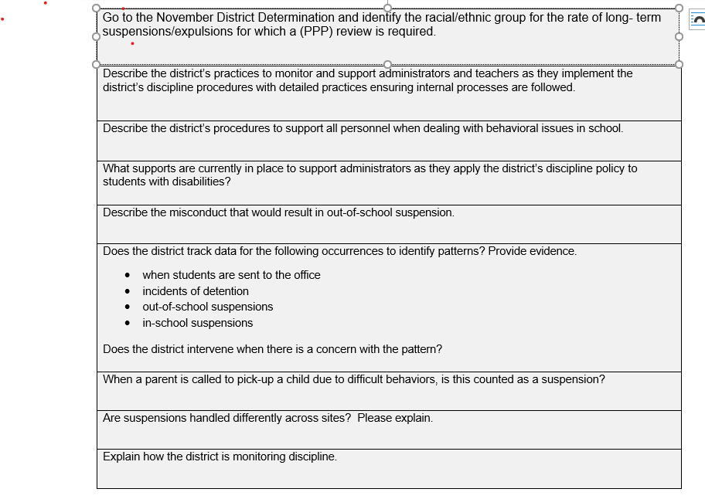
Notes:
Complete the Practice and Procedure Plans and add indicator 4 Improvement plan.

Slide 13
Notes:
Toolkits are located in EdPlan. Select Tools from the menu bar.

Slide 14
Notes:
Once you click Tools, the secondary menu bar opens, and you will click on the Indicator tab.

Slide 15
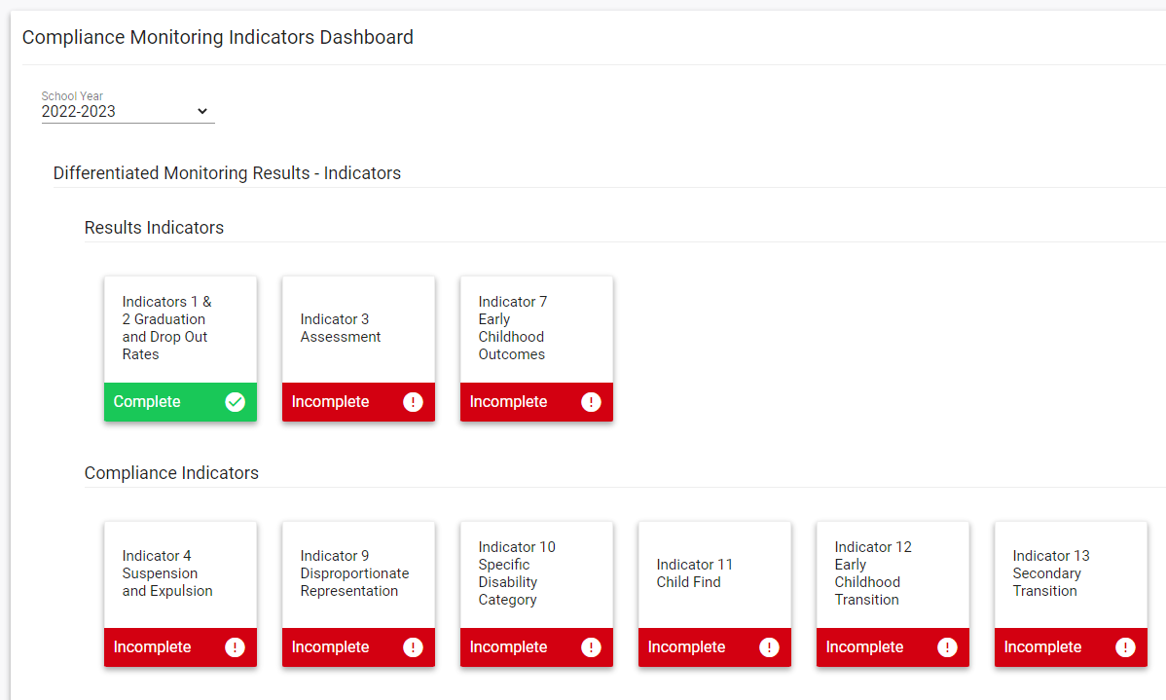
Notes:
Select the current school year.
You will be able to return to the previous year’s plan to review the plan and progress from the previous by selecting the previous year.
This will assist you with completing the current year’s plan.

Slide 16
Notes:
Select the appropriate indicator and open it.
If the indicator is noncompliant , you will be able to open the indicator. If it is compliant, you will not be able to access the toolkit.

Slide 17
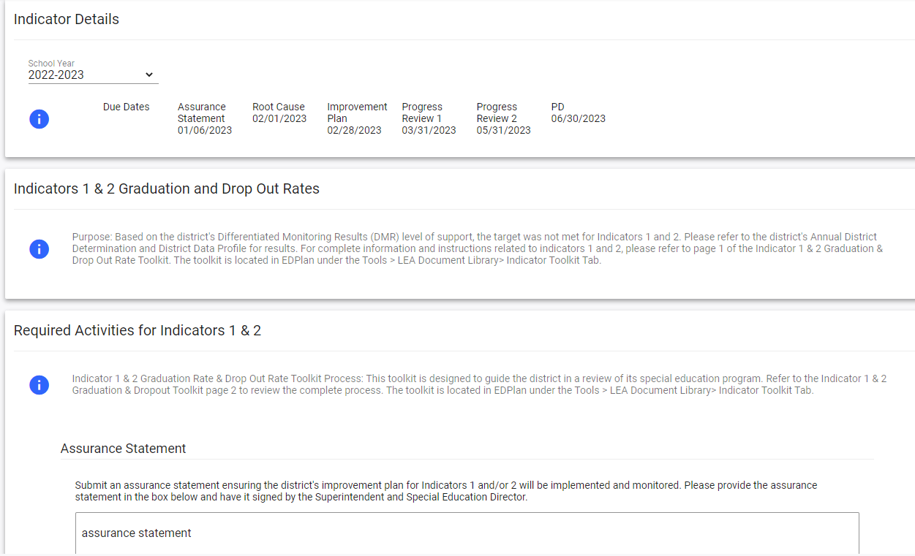
Notes:
The Indicator tile will open to the indicator detail page. Select the current year.

Slide 18
Notes:
You can review the timelines on the indicator detail page .

Slide 19
Notes:
Each toolkit will list the indicator purpose.

Slide 20
Notes:
Each toolkit will list the required activities.
Complete the Assurance Statement.

Slide 21
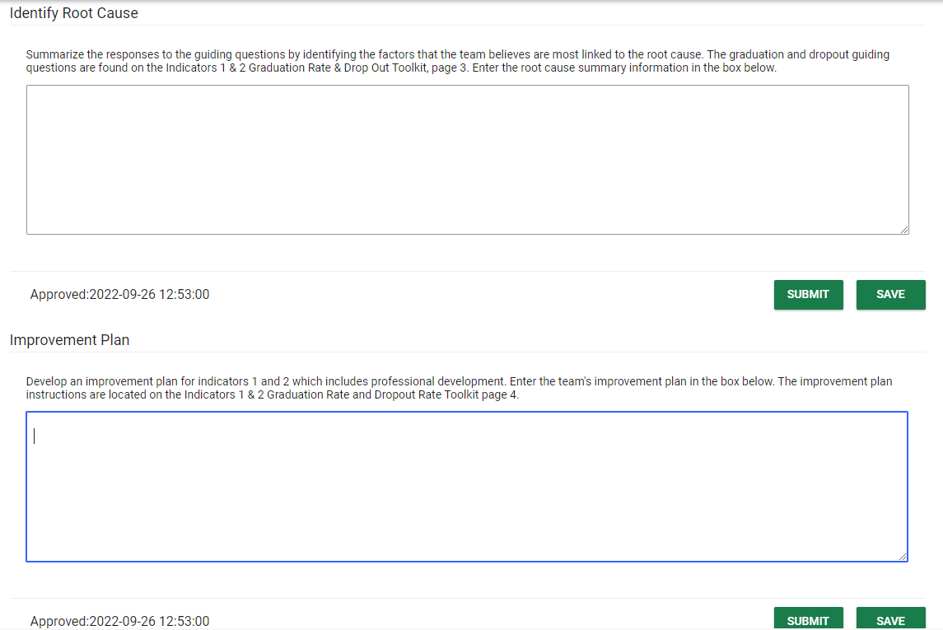
Notes:
Identify and submit the root cause summary here.

Slide 22
Notes:
Detail the improvement plan here and submit.

Slide 23
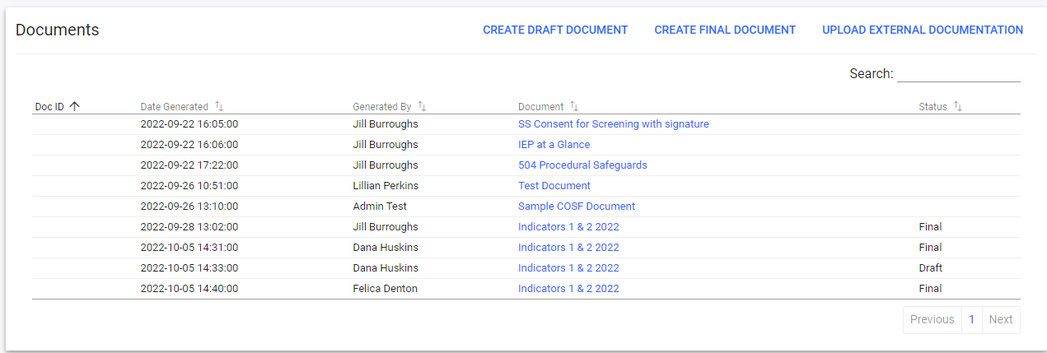
Notes:
Upload supporting documentation here.
Located at the bottom is where you will upload your policy, procedures, and practices. Please make sure and title your uploads.

Slide 24
Understanding the Indicators

Slide 25
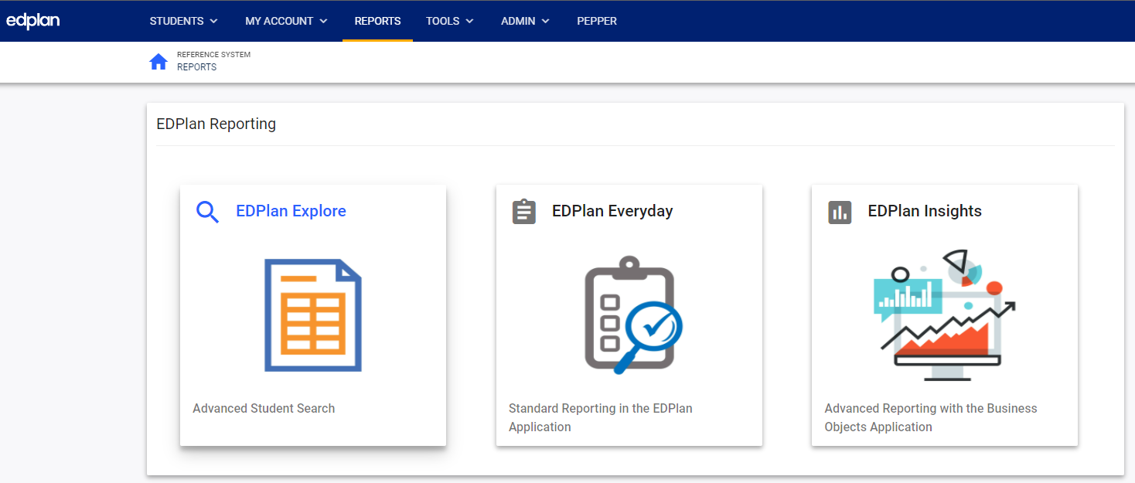
Notes:
To access the reporting in EdPlan, select Reports on the menu page.

Slide 26
Notes:
Select EdPlan Insights.

Slide 27
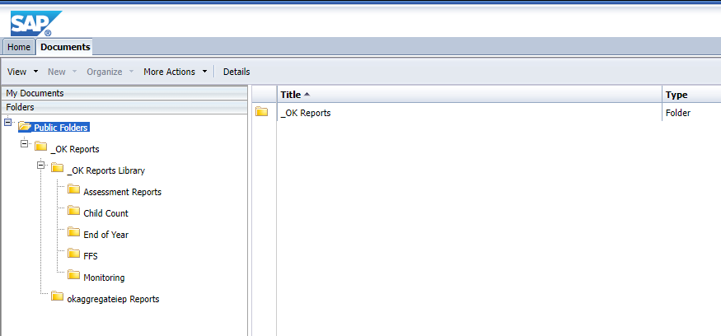
Notes:
To access the reporting in EdPlan, go to Ok Reports.

Slide 28
Notes:
OK Reports Library

Slide 29
Indicator 4
Indicator 4 A – Risk Ratio for all students with disabilities with long-term suspension/expulsion: rates of suspension and expulsion.
Indicator 4B – Findings of a significant discrepancy by racial identity and policy, procedures, or practices that contribute to the findings and do not comply with requirements.
Notes:
4A-Rates of suspension for students with disabilities and long-term suspensions/expulsions.
4B- Practices contributing to findings that don’t comply with requirements, a) significant discrepancy of racial identity or b)PPP.

Slide 30
Consider the Following
Data to consider
District suspension data
Compare the rate of students with disabilities –vs- nondisabled students
Compare the race of the students with and without disabilities
Questions to consider
Does your district have established detailed written policy and procedures?
What non-suspension options are available?
Has your district implemented a plan for PBIS (Positive Behavioral Intervention System)?
Notes:
This is what to consider.

Slide 31
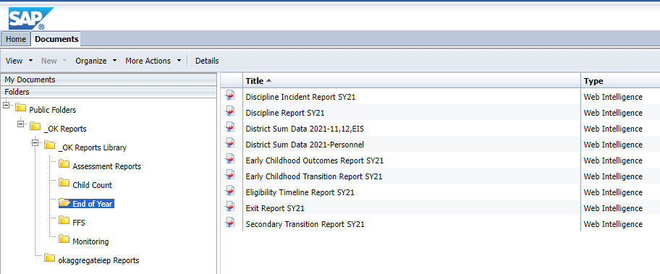
Notes:
Select End of Year

Slide 32
Notes:
Discipline Report

Slide 33
Indicator 9
Racial and Ethnic Representation: Disproportionate representation of racial and ethnic groups in special education and related services that is the result of inappropriate identification.
Notes:
Racial and ethnic groups in special education related services

Slide 34
Consider the Following
Data to consider
Questions to consider
Check how the district gathers race and/or ethnic information.
Check to make sure the teams are identifying students based on the data gathered.
Does your district have established detailed written policy and procedures to guide teams in determining eligibility?
Have you reviewed your data and practices to determine whether differences exists in identification based on race and/or ethnicity?
Notes:
This is what to consider.

Slide 35
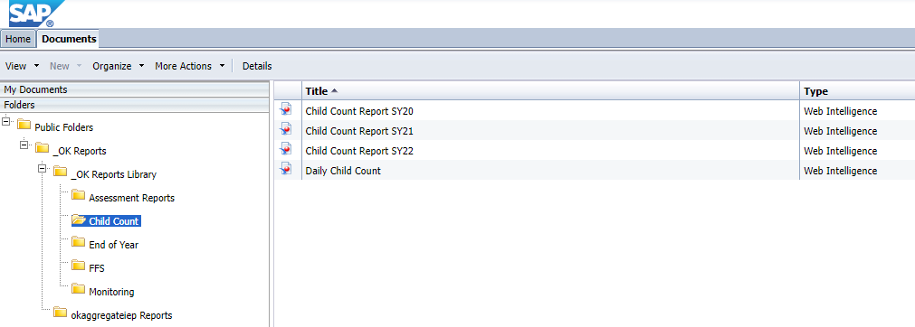
Notes:
Select Child Count

Slide 36
Notes:
Select Child Count Report and appropriate year

Slide 37
Indicator 10
Disproportionate representation of racial and ethnic groups in specific disability categories that is the result of inappropriate identification.
Notes:
Racial and Ethnic groups in a specific disability category.

Slide 38
Consider the Following
Data to consider
Check how the district gathers race and/or ethnic information
Questions to consider
Does your district have established detailed written policy and procedures to guide IEP teams in eligibility determinations?
Check to make sure the teams are identifying students based on the data gathered.
Have you considered why one or more racial or ethnic groups is over-identified in your district in certain disability categories?
Notes:
This is what to consider.

Slide 39
Notes:
Select Child Count

Slide 40
Notes:
Select Child Count Report.

Slide 41
Sample: Goal
Weak
Will provide administrators training regarding IDEA and behavior intervention plans.
Strong
After meeting with site administrators, we have identified the need to develop tools to assist administrators in identifying students with disabilities. This includes behavior plans and ensuring equity when determining consequences. Once the tools are implemented, suspension data will be monitored to identify strengths and areas of continued improvement.
Notes:
Develop a plan of improvement. (sample provided)

Slide 42
Sample: Progress Review
Weak
Professional development was provided on February 25, 2021.
Strong
We have developed discipline tools and provided training to all district administrators. Since we have implemented the new tools, there has been a 10% decrease in suspensions in our highest ethnic group. We will continue with this plan.
We will be looking at benchmark data to determine if there has been an increase in the areas of reading and math.
Notes:
The progress review identifies the districts progress or lack of progress.
It will assist the district’s team in determining if the plan needs to be changed or continued.
The last progress review will provide a starting point at the beginning of the next school year to continue implementing the plan.

Slide 43
Website Updates

Slide 44
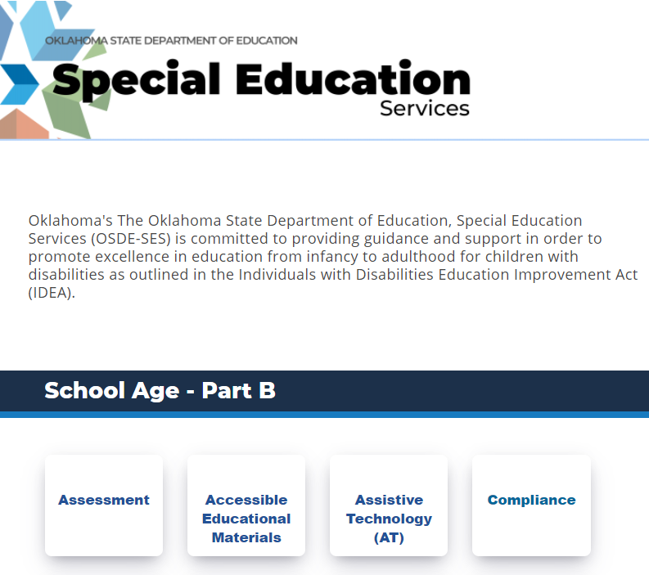

Slide 45
Notes:
The indicator tab is where you will find the toolkits for each indicator.

Slide 48
Notes:
Update

Slide 49
Timelines

Slide 50
Timelines
December 31, 2023
Complete indicator Toolkit located in EdPlan: EdPlan>Tools>Indicator
Upload Board approved Policies to the bottom of the appropriate Indicator.
January 12, 2024
Improvement plan due
March 31, 2024
First Progress Review
May 31, 2024
Final Progress Review
Notes:
Make sure you are meeting all timelines. Missing timelines can impact the next DMR score.

Slide 51
Introduction to EdPlan Monitoring

Slide 52
EDPlan Monitoring
Streamlines the monitoring process
Allows SDE and districts to maintain compliance documentation in one central location
Provides districts with a structure for ongoing internal monitoring
Allows SDE and districts to maintain compliance documentation in one central location
Streamlines the monitoring process

Slide 53
District Documentation Page
Notes:
To Upload documentation, Select Tools.
OSDE and District Admin can upload documents here.

Slide 54
District Documentation Page
Notes:
Select LEA Document Library.
OSDE and EDPlan District Admins can upload documentation here.

Slide 55
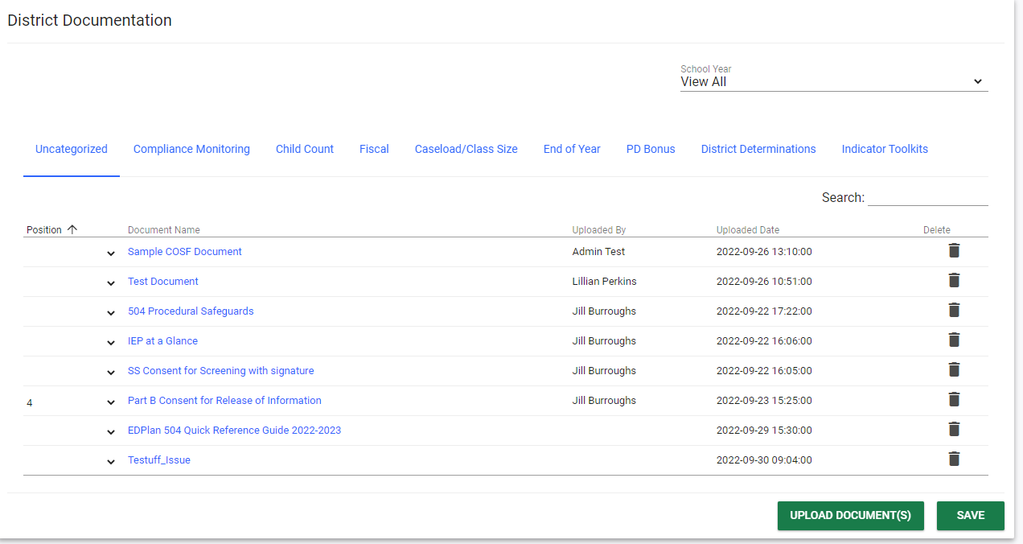
District Documentation Page
Notes:
Select School Year.
OSDE and EDPlan District Admins can upload documentation here.

Slide 56
District Documentation Page
Notes:
Select Category. Categories have been added to upload documentation for all Special Education Services.
We will use the Compliance Monitoring tab for submissions. If you submit information in caseload , send an email to notify us regarding the information you have uploaded for our review.

Slide 57
District Documentation Page
Notes:
The delete options can be utilized by the OSDE only. If you upload a document in the incorrect category or the incorrect document, you will need to email your specialist with detailed information on where and what needs to be deleted and then upload the document into the correct category.

Slide 58
District Documentation Page
Notes:
You will select the upload documents to locate and upload external documents. Do not forget to click save.

Slide 59
Recap

Slide 60
Activities
Locate
Locate your Board approved Policies and internal practices then complete the Toolkit aligned to the appropriate indicator.
Complete
Complete the toolkit practice and procedure questions and develop an improvement plan.
Monitor
Implement improvement plan and monitor progress and report twice in the spring.

Slide 61
Who | Required/Optional | What | When
DDP has (***) | Required | Complete the appropriate indicator toolkit in EdPlan. Upload the Board Approved Policy. Complete procedure and practice review questions. | December 31st December 31st December 31st December 31st
 | Required | Address root cause. Develop improvement plan. 1st improvement plan progress review. 2nd improvement plan progress review. Submit Professional development documentation. | January 12th January 12th March 31st ^{May 31st} May 31st
Notes:
If the DDP has three asterisks *** the district is required to submit the Board Approved Policy aligned to the indicator by December 31st and complete the indicator toolkit in EdPlan. Upload PPP supporting documentation at the bottom of the toolkit. The SDE will review the district policy and all other documentation submitted through the toolkit
We’ve noticed there is a correlation between Indicators 9 and 10 with districts that are identified as significantly disproportionate. If this is the case, we highly encourage districts to identify the root cause, develop and plan and monitor progress.

Slide 62
Timelines
December 31, 2023
Complete indicator Toolkit located in EdPlan: EdPlan>Tools>Indicator
Upload Board approved Policies to the bottom of the appropriate Indicator.
January 12, 2024
Improvement plan due
March 31, 2024
First Progress Review
May 31, 2024
Final Progress Review
Notes:
Make sure you are meeting all timelines. Missing timelines can impact the next DMR score.

Slide 63
Contact Information

Slide 64
Contact Information: Data Team
Travis Thompson Project Manager of Data
Travis.Thompson@sde.ok.gov
405-522-5203
Brooks Sawyer
Specialist of Data
Brooks.Sawyer@sde.ok.gov 405-521-4871
Notes:
Data Team contact information

Slide 65
Contact Information: Compliance
Felica Denton
Coordinator of Fiscal Monitoring
Felica.Denton@sde.ok.gov
405-522-9562
Megan Withers
Early Childhood Specialist
Megan.Withers@sde.ok.gov
405-522-5168
Tina Spence
Assistant Program Director of Special Education Services
Tina.Spence@sde.ok.gov
405-521-4513
Notes:
Compliance Team contact information

