Slide 1
Indicator Toolkits
November 28, 2023
Notes:
Welcome to the first Compliance Open Door Meeting

Slide 2
Topics
Locating Indicator Toolkits
Questions and Answers
Uploading Documentation
Completing Required Activities
Notes:
Todays topics are:
Locating Indicator Toolkits
Completing Required Activities
Uploading Documentation
Questions & Answers

Slide 3
Indicator Toolkits for Compliance and Performance
Compliance and Performance Toolkits

Slide 4
Toolkits
District Data Determinations are provided annually to identify compliance and performance indicators.
1
Toolkits are designed to guide districts with addressing compliance and performance.
Notes:
District Data Determinations are included in the November Packet.
The November packets are sent out to districts around November 15th.
The determination provides information on compliance indicators as well as result-based indicators.
The determinations consists of compliance and performance indicators, including timely completion of monitoring requirements (child count and end of year training).
Make sure you review the documents when you receive them.

Slide 5
Indicator Toolkit Dates to Remember
Compliance Indicators: 4, 9 & 10 Due 12/31/23
Fiscal Risk: Due 1/12/24
Performance Indicators: 1 & 2, 3, 7 Due 1/12/24
Compliance Indicators: 11, 12 & 13 Due 1/12/24
Notes:
The compliance indicators and performance indicators have different due dates.
Compliance indicators 4, 9 & 10 are due 12/31/23.
Performance indicators 1 & 2, 3, 7 are due 1/12/24.
The Fiscal Risk indicator is due 1/12/24.
You can utilize the Dates to Remember to assist with meeting the timelines.

Slide 6
Accessing the Indicator Toolkits
Log into EdPlan, select Tools> Indicators > to access the indicator toolkits
Complete the required activities for all indicators that have been flagged.
Notes:
Select Tools>Indicators, to access the indicator dashboard.
The indicator dashboard contains a tile for each indicator.
If the district is flagged for a specific indicator the tile will be blue.
Select the indicator(s) to be completed.
If there are multiple indicators, select the indicator tab for each one and complete the activities.
If the indicator is grey, there are no activities to be completed. You will not be able to open it.

Slide 7
Accessing the Indicator Toolkit
To access indicator Toolkits select
Tools>Indicators from the Main Menu Page in EdPlan.
Notes:
Select Tools>Indicators to access the indicator dashboard.
The indicator dashboard contains a tile for each indicator.
If the indicator tiles are blue, select the tile and complete the indicator toolkit.
If the indicator tile is grey, no activities are required.

Slide 8
Compliance Monitoring Dashboard
If the indicator is noncompliant and requires activities to be completed, the indicator tile will display a different color.
If the indicator is compliant the indicator tile will display grey and the toolkit will not open.
The toolkit will open to the indicator detail page. The detail page will display timelines and the required activities for the indicator.
Notes:
Select the indicator tile to access the indicator detail page.
If the toolkit requires activities to be completed it will have a different color to signify noncompliance.
Select the indicator tab for each noncompliant indicator and complete the activities.
If the indicator tile is grey, there are no required activities to complete.
Complete all required activities and submit timely.
Toolkits are time stamped when submitted.

Slide 9
Indicator Detail Page
The indicator detail page displays timelines, gives a description of the indicator and the purpose, including the required activities.
Notes:
The indicator detail page displays:
Timelines for the indicator components,
A description of the indicator and purpose,
And the required activities for the indicator.

Slide 10
Required Activities
Assurance Statement
Root Cause
Improvement Plan
Progress Reviews
Professional Development
Notes:
The indicator toolkits have 5 required activities.
Assurance Statement
Root Cause
Improvement Plan
Progress Reviews (1 & 2)
Professional Development

Slide 11
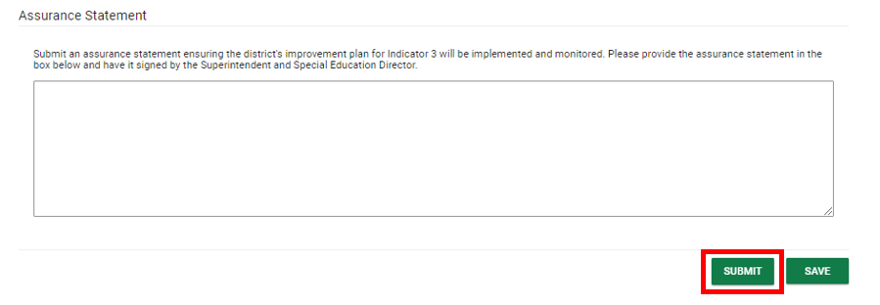
Assurance Statement
Noncompliance requires a letter of assurance to inform the OSDE-SES that noncompliance is corrected to 100%.
In accordance with 34 CFR 300.600(e), noncompliance must be corrected as soon as possible, and in no case later than one year from the date on which the LEA is notified of a finding of noncompliance.
Notes:
If the district is noncompliant an assurance statement is required.
The assurance statement is the districts guarantee to correct noncompliance.
The statement requires the signature of both the district superintendent and special education director.

Slide 12
Root Cause
Summarize responses to the guiding questions and determine what the team believes is most linked to the root cause.
Notes:
The root cause should discover the cause of what is causing the problems.
Meet with your team and summarize the guiding question answers and discuss facts and patterns.
Look at direct and indirect causes.
Find a solution
Implement the solution
Verify the solution is effective.

Slide 13
Improvement Plan
Develop an Improvement Plan and include the following:
Include Professional Development as a part of the plan.
Describe the progress review activity that will measure growth.
Identify the person responsible for monitoring improvement plan progress.
Improvement plans identify:
areas of strength
improvement areas
barriers
SMART goal(s)
action steps
person(s) responsible,
completion timelines
expected outcomes.
Notes:
Improvement plans assist with improving the area of focus.
Develop an improvement plan describing the professional development needed for improvement.
Specify the title, area of focus, date professional development is provided, and explain how the activity and progress is measured.
Identify the person responsible for monitoring the improvement plan progress.

Slide 14
Develop an Improvement plan and describe the professional development needed for improvement. Provide the improvement plan summary in the box including professional development aligned to the indicator.
Notes:
Develop improvement plan.
Describe the professional development for indicator (topic, audience & date). Describe progress review activity and how it will be measured. Identify the person responsible for monitoring improving plan progress.

Slide 15
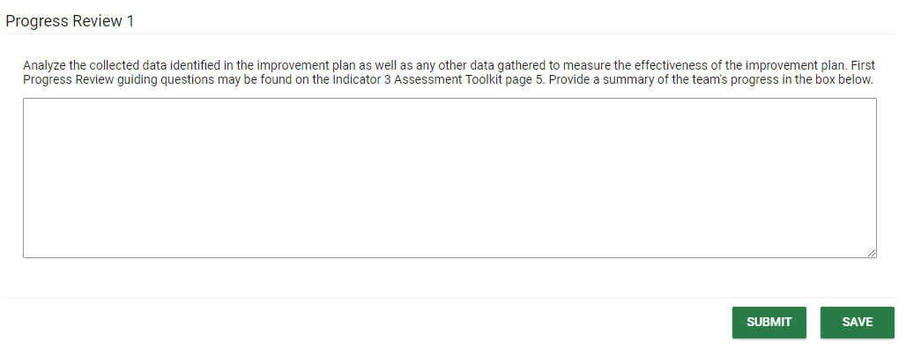
March 31st Progress Review #1
Analyze data collected identified in improvement plan to measure growth.
Analyze any other data collected to measure progress.
Utilize the guiding questions and provide a summary of progress.
If adequate progress is determined continue with current plan.
If progress is not determined, review plan and make necessary edits/changes.
Notes:
March 31st Progress Review #1
Assess data collected, measure growth, and provide summary to complete the progress review.
Progress reviews can’t be completed at the same time. The May 31st review must be completed in May for accurate progress.

Slide 16
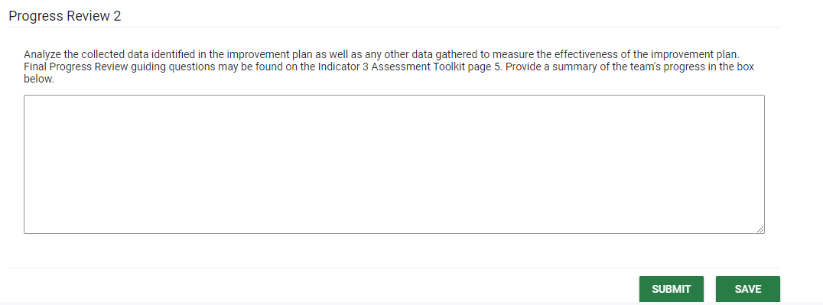
May 31st Progress Review #2
Analyze data collected identified in improvement plan to measure growth.
Analyze any other data collected to measure progress.
Utilize the guiding questions and provide a summary of progress.
If adequate progress is determined continue with current plan.
If progress is not determined, review plan and make necessary edits/changes.
Notes:
Repeat progress 1 review steps.
May 31st Progress Review #2
Assess data collected, measure growth, and provide summary to complete second progress review.
Progress reviews can’t be completed at the same time. If both progress reviews were completed in March for the first review, it must be updated in May for the second approval.

Slide 17
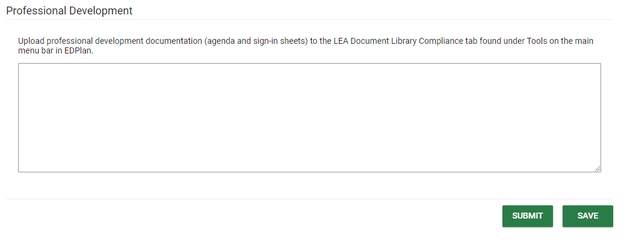
Professional Development
Complete professional development after receiving the November packet to ensure alignment with the improvement plan.
Professional development documentation must align to the improvement plan including a summary and sign-in sheet with title and date(s).
Notes:
Professional Development is due by May 31st.
It can be submitted before May 31st, anytime after receiving the November packet.
Professional development must align with the improvement plan and indicator toolkit for the area of focus, including a summary and sign-in sheet with date and title.
Documentation can be attached to the corresponding toolkit, by scrolling to the bottom of the toolkit page to upload external documents.
PD can also be uploaded to the LEA Document Library>Tools>Compliance.

Slide 18
Submitting Required Activities
Complete each toolkit activity
Verify toolkit timelines
Save the response
Submit responses to OSDE
The OSDE will review responses for approval.
The OSDE will request additional information if needed
Toolkit submission is noted with a date/time stamp.
Notes:
Complete each section of the toolkit.
Remember to save and submit toolkit responses.
Documentation is time stamped when submitted.
The monitoring coordinator will review documentation for approval and contact district if additional information is required.

Slide 19
LEA Document Library
Select Tools> LEA Document Library to access the LEA Document Library
The LEA Document Library displays the categories at the top of the page.
Documents that were uploaded last year will fall into the ‘Uncategorized’ category.
To access documentation from the previous year in the uncategorized category select the year
Notes:
To access the LEA Document Library, Click Tools> LEA Document Library
Select the previous year to access documents uploaded last year

Slide 20
LEA Document Library
Select Tools> LEA Document Library to access the LEA Document Library
The LEA Document Library displays the categories at the top of the page.
Documents that were uploaded last year will fall into the ‘Uncategorized’ category.
To access documentation from the previous year in the uncategorized category select the year
Notes:
To access the LEA Document Library, Click Tools> LEA Document Library
Select the category to upload documentation.

Slide 21
Submitting Documentation
Upload additional documentation in the LEA Document Library.
Select LEA Document Library, click Tools > LEA Document Library>Compliance

Slide 22
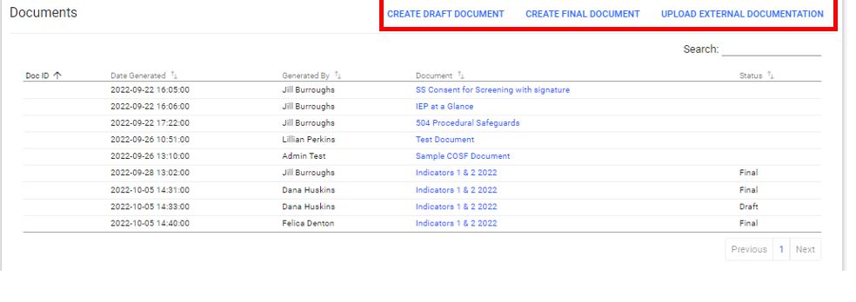
Indicator Documents
The document panel is located at the bottom of each indicator detail page.
You have the option of creating a final document after completing the required activities with approval. Final documents are not required.
External documents can be uploaded in the documents panel.
Notes:
The document panel list the documents submitted and is located at the bottom of each page.

Slide 23
Uploading Documentation
Select Tools > LEA Document Library>Compliance to upload additional documentation.
Select the compliance category.
Select the arrow in the left-hand corner to upload file
Select the drop-down box arrow in the right-hand corner to select categories
Select the category and confirm.
Notes:
Upload documentation to compliance tab.
Board Policies and Professional Development documentation to the compliance tab.

Slide 24
Dates to Remember
Indicators 4, 9, & 10
Due December 31st
2nd Progress Review & Professional Development
Due May 31st
1st Progress Review
Due March 31st
Indicators 11, 12, & 13
Indicators 1 & 2, 3, 7
& Fiscal
Due January 12th
Notes:
Dates to remember.

Slide 25
Question and Answer
Do you have any questions?
Notes:
Are there any questions?

Slide 26
Contact Information: Compliance Team
Felica Denton
Fiscal Monitoring Coordinator
Felica.Denton@sde.ok.gov
405522-9562
Megan Withers
Early Childhood Specialist
Megan Withers@sde.ok.gov
405-522-5168
Tina Spence
Director of compliance & Monitoring
Tina.Spence@sde.ok.gov
405-521-4513
Notes:
This is our team contact information. Please don’t hesitate to contact us.

