Slide 1
Building a Culture of Data Quality
How Oklahoma Program Managers Strengthen Data Management and Program Performance

Slide 2
Why We Needed Change

Slide 3
The Old Model – State Office Driven
Reviews Data
Finds Errors
Corrective Actions
Notes:
Previous model relied heavily on the Part C Data Manager finding missing data and sending out notification to get data input for the entire year. Corrective actions were necessary by the time it came to the state in terms of finding letters

Slide 4
The Challenges
Data quality varied across Districts
  Data was viewed as a state-level responsibility
Errors identified at the end of reporting periods
  Corrective actions were reactive rather than preventative
Notes:
Self Descriptive

Slide 5

The Shift
State Office ↔ Local Program Managers
Shared Ownership
Shared Accountability
Shared Improvement
Notes:
Mindset shift to this data does not belong to the State it belongs to the local programs.

Slide 6
New Model - District Program Manager
Reviews Data
Finds Errors
Leads on Local Corrections
Notes:
The new model has the District Program Manager stepping into the role of local data manager. We will talk about some of the benefits we’ve seen so far in a later slide.

Slide 7

Improvement Does Not Happen by Accident
Initial Training
Excel Templates
Written Guidance
Individual Technical Assistance
Peer Support
Monitoring/Quarterly
Notes:
Describe the system created to help support and train the Program Managers into proficiency

Slide 8

What Program Managers Now Do
    Data Review and Reporting
    Data Validation
    Compliance Monitoring
    Staff Coaching
Notes:
Self descriptive

Slide 9
But Did It Work?
Before
Now
Repeated documentation issues
Delayed corrections
Inconsistent local practices
Earlier identification of concerns
Stronger local oversight
Faster correction
Buy-In
CONSISTENCY
Notes:
I don’t like this slide so I need to make it better…..

Slide 10

Local Success Story
Notes:
Jenisa will do a short 2 to 3 minute talk about some of the benefits for D9

Slide 11
On Site Monitoring
Co-Hort One

Slide 12
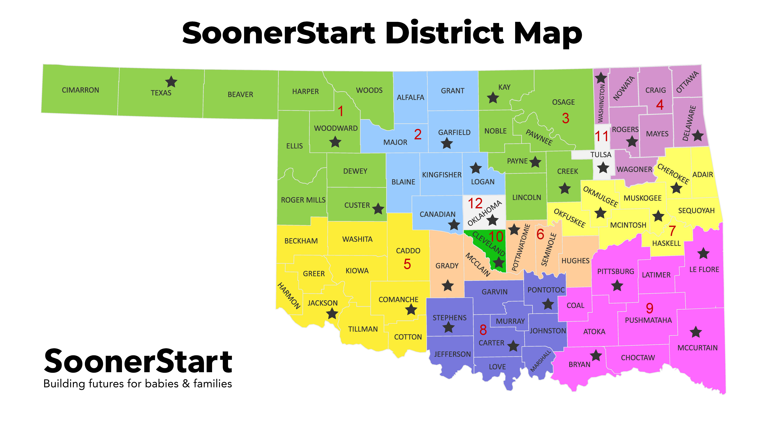
Notes:
Give an overview of what monitoring looks like and what the purpose is based on OSEP and SoonerStart.

Slide 13
Related Requirements Focus
Timely progress notes
Prior Written Notices regarding transition activities
Hearing and Vision documentation on IFSP
Signed Medicaid consents
Justification completed for services provided in Non-Natural Environments
Notes:
Talk about OSEP requirements and the shift from just performance or compliance indicators into looking at the related requirements that help support those other indicators. These RRs are selected by Oklahoma and can be re-evaluated each year based on trend data or local report of problem areas.

Slide 14
Key Takeaways
SoonerStart’s workforce remains wholly committed to families and compliance
Teams shared novel ideas for program improvements
Technology problems are creating barriers on efficiency
Continued capacity strengthening and coordination to effectively support children across vast areas
Notes:
Nothing to add

Slide 15

Looking Foward
Strengthen
Enhance
Expand
Focus
Notes:
Strengthen local data leadership
Enhance data-driven decision making
Expand use of data dashboards and analytics
Focus on data practices that improve outcomes for children and families

Slide 16
Questions?
Christi.Landis@sde.ok.gov

