Slide 1
SoonerStart
Determinations and Data Profiles
Federal Fiscal Year 2024 - 2025

Slide 2

The Purpose
The Lead Agency must send annual determinations to ensure the following:
  Adherence to IDEA Part C
  Families are getting services on time and correctly
  Local SoonerStart Districts are getting official results to know their strengths and where improvement is needed.
Notes:
The lead agency must send out site determinations for IDEA Part C because it’s part of their responsibility to make sure each local program is doing what the law requires for infants and toddlers with developmental delays.
Think of it like a yearly “progress report” for each district or site. The lead agency (OSDE):
Checks how well each program is following the rules, such as timelines, evaluations, services, and transitions.
Looks at data to see whether children and families are getting services on time and correctly.
Identifies areas that are working well and areas where improvement is needed.
Provides official results back to the districts so they know how they’re doing.
IDEA requires states to monitor all local programs, and sending these determinations is how the state shows it is meeting that responsibility. It keeps programs accountable and ensures babies and families get consistent, high-quality early intervention services across the state.

Slide 3
The Explanation
Report Card
Part C Indicators*
  See Handout
Data captured July 1 – June 30
Accurate and timely data, compliance, and performance
Meets Requirements
Needs Assistance
Needs Intervention
Needs Substantial Intervention
Notes:
Local Early Intervention Programs/sites/districts receive this determination, which can be compared to an annual report card. It is the district-level data for the first 8 indicators (see handout). SoonerStart takes all of the data, both compliance and performance, and based on that year’s data issues a determination based on a preset of perimeters. Meets requirement reflects 85% and up, NA is 10 to 84.9, Needs intervention is 55 to 69.9 and below 55 is substantial intervention.
Everyone is judged by the same matrix. All determinations must be sent to the local site by December 1, 2025, based on SoonerStart general supervision guidelines.

Slide 4
The Process
Child Records
Local Data Entry
Cleanup
Statewide Data
Notes:
The process of determining local and statewide results starts with local district staff inputting timely and accurate data – progress notes, workspace data entry for individual children, then quarterly and annual clean-up. This is all calibrated together for statewide results. The Part C Data Manager then disaggregates the data back to the local level.

Slide 5
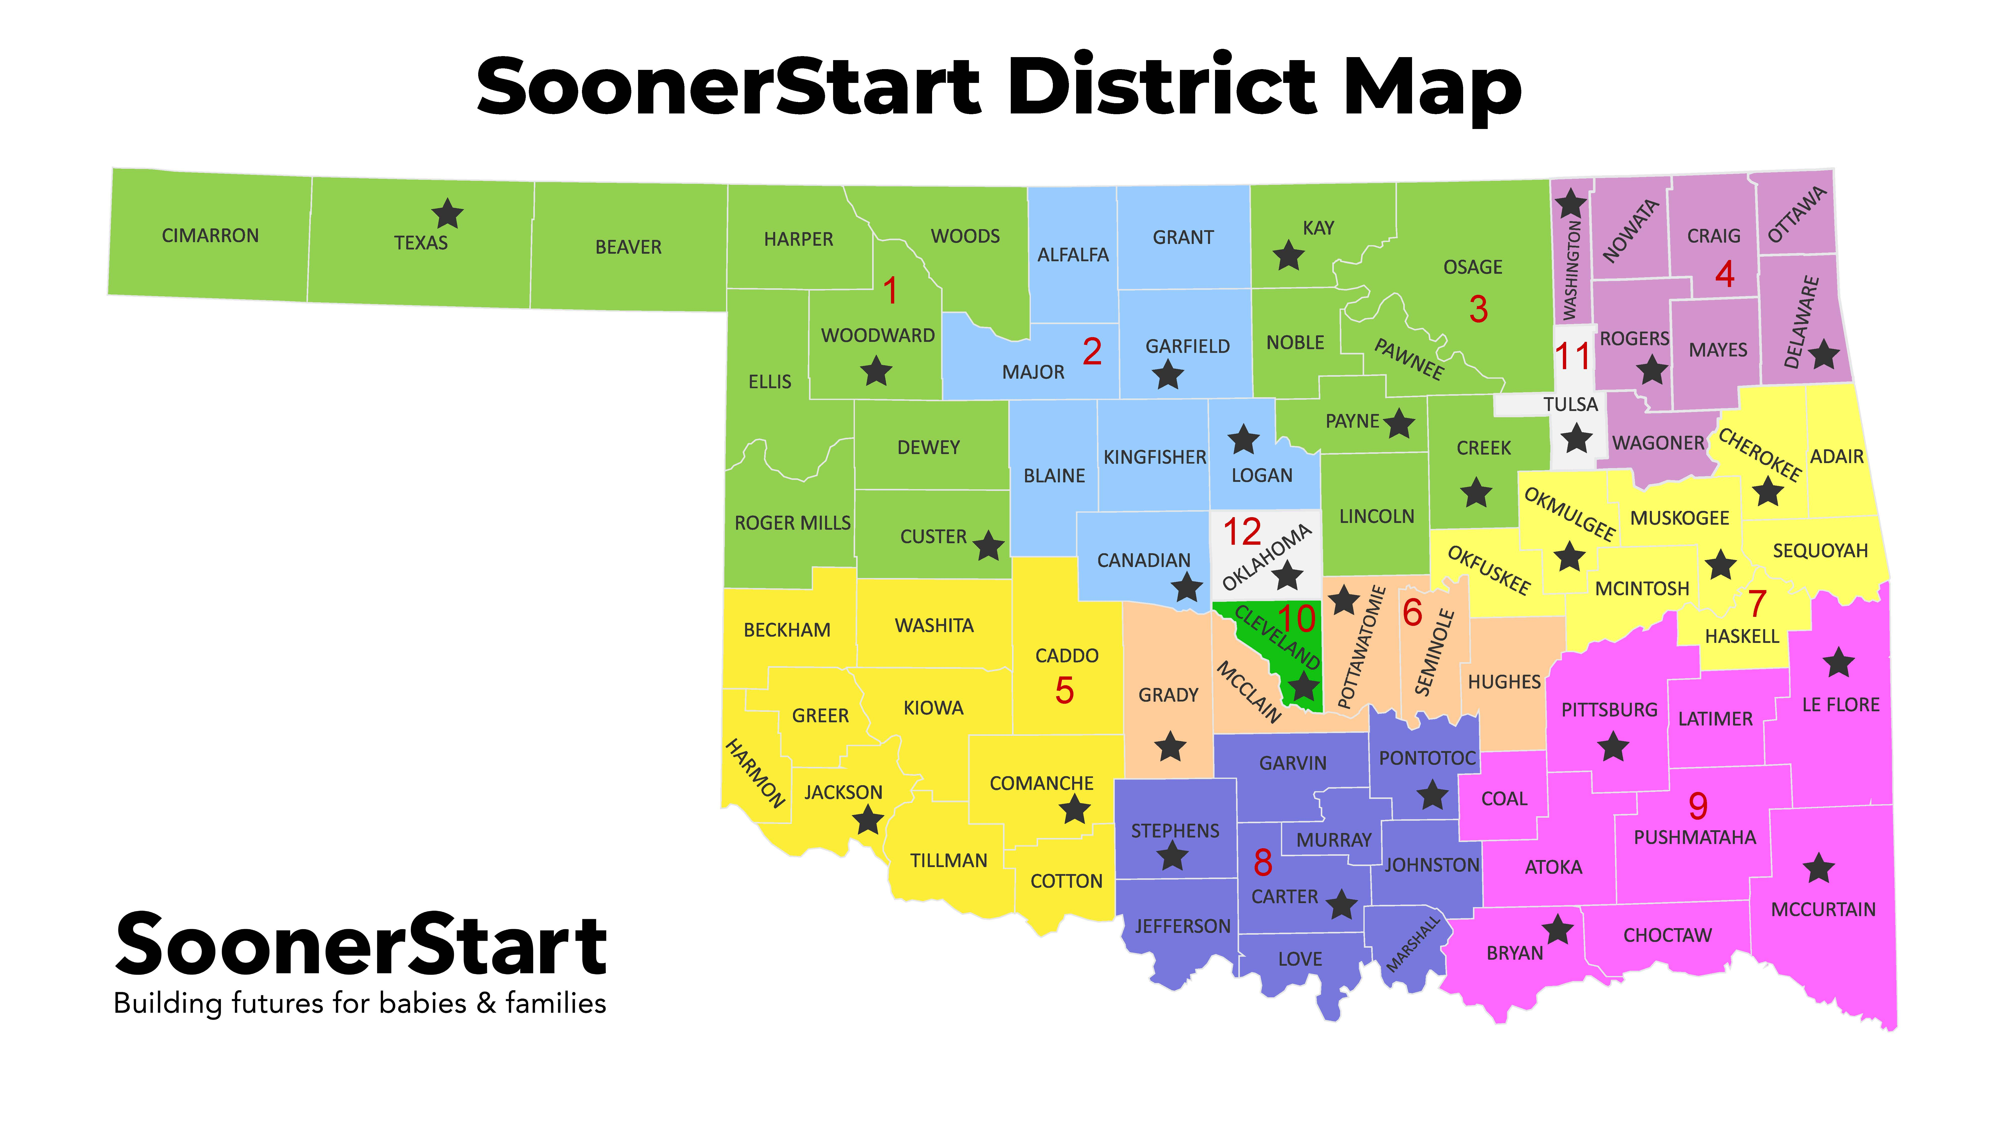
Notes:
SoonerStart has 12 individual districts that each receive a data profile and determination. This years results are:

Slide 6



Slide 7
The Strengths
Natural Environment
Transition
Timely and Accurate Data
Notes:
Several districts had high rates of non-natural environments for a variety of reasons. There were big improvements made in moving services back into the natural learning environment. Transition data had several 100 percent compliance (even statewide). Increase in Part C and Part B transitions and acceptance into schools.

Slide 8
Focus Monitoring
Notes:
SoonerStart focuses on an indicator or “related” requirement each year for monitoring. Two years ago we focused on natural environment and that has improved. We can hypothesize that focusing on that increased the percentage. One of the most common challenges experienced during these calculations and analysis is the lack or incompleteness of progress notes. While quantitative data help find our percentages and summations, it does not tell the story, qualitative data, especially progress notes and narratives in the workspace of our data system do. OSEP is also citing many states for a lack of fiscal monitoring, for SoonerStart those tasks can be accomplished by utilizing Progress note timeliness and completion as well as ensuring we have complete Medicaid consent for all families. We would like to also keep Natural Environment not only looking at percentages, but if justification exists when it is not utilized as required by OSEP. Complete Hearing and Vision on the IFSP to ensure we are not overlooking a potential sensory loss contributing to delays and finally Prior Written Notice for Transition Related Activities.

Slide 9
State Performance Plan and Annual Performance Review
Federal Fiscal Year 2024

Slide 10
The What When and Why!
Annual Report due to the Office of Special Education Program the first Monday in February providing data, narrative and root cause analysis.
SoonerStart reported on data from July 1, 2024, to June 30, 2025.
Obligations to the federal grant include timely and accurate reporting of data to OSEP on 12 Part C Indicators.

Slide 11
Indicator 1 – Timely Provision of Services
Target - Compliance | FFY 2023 | FFY 2024
100% | 99.31% | 98.22%

Slide 12
Indicator 2 – Services in Natural Environments
Target - Performance | FFY 2023 | FFY 2024
96% | 94.17% | 96.70%

Slide 13
Indicator 3 – Early Childhood Outcomes A1 and A2
Target – Performance | FFY 2023 | FFY 2024
84.50% | 81.34% | 79.55%
49.50% | 40.99% | 41.39%
Notes:
% of infant/toddlers with IFSPs demonstrating improved Positive Social-Emotional Skills (including social relationships). Summary Statement ONE refers to IMPROVEMENT while Summary Statement TWO refers to FUNCTIONING WITHIN AGE EXPECTATIONS.

Slide 14
Indicator 3 – Early Childhood Outcomes B1 and B2
Target – Performance | FFY 2023 | FFY 2024
85.50% | 82.82% | 82.94%
40.50% | 35.56% | 35.04%
Notes:
% of infant/toddlers with IFSPs demonstrating improved Acquisition and use of knowledge and skills (including early language/communications). Summary Statement ONE refers to IMPROVEMENT while Summary Statement TWO refers to FUNCTIONING WITHIN AGE EXPECTATIONS.

Slide 15
Indicator 3 – Early Childhood Outcomes C1 and C2
Target – Performance | FFY 2023 | FFY 2024
85.50% | 82.47% | 83.89%
44.20% | 37.92% | 39.49%
Notes:
% of infant/toddlers with IFSPs demonstrating improved Use of appropriate behaviors to meet their needs. Summary Statement ONE refers to IMPROVEMENT while Summary Statement TWO refers to FUNCTIONING WITHIN AGE EXPECTATIONS.

Slide 16
Indicator 4 – Family Involvement A, B, and C
Target – Performance | FFY 2023 | FFY 2024
89.00% | 95.73% | 95.99%
89.50% | 97.17% | 95.88%
97.50% | 96.97% | 95.99%
Notes:
% of families participating in EI reporting that EI services helped families A Know their rights, B effectively communicate children needs and C Help their children develop and learn.

Slide 17
Indicator 5 – Child Find (Birth to One)
Target - Performance | FFY 2023 | FFY 2024
0.80% | 0.74% | 0.70%
Notes:
% of OKLAHOMA’s population for this demographic served by having an ACTIVE IFSP

Slide 18
Indicator 6 – Child Find (Birth to Three)
Target - Performance | FFY 2023 | FFY 2024
1.70% | 1.88% | 1.68%
Notes:
% of OKLAHOMA’s population for this demographic served by having an ACTIVE IFSP
332 children birth to one
Total served is 2420 a decrease of 300 from last year.

Slide 19
Indicator 7 – 45-Day Timeline
Target - Compliance | FFY 2023 | FFY 2024
100% | 98.55% | 99.64%
Notes:
% of infants/toddlers with initial evaluation, assessment and IFSP meeting were conducted within Part C’s 45-day timeline

Slide 20
Indicator Eight – Transition A, B, and C.
Target – Compliance | FFY 2023 | FFY 2024
100% | 100% | 100%
100% | 99.34% | 100%
100% | 97.55% | 97.42%
Notes:
% of toddlers with disabilities exiting Part C with timely transition planning for whom the Lead Agency has (A) developed an IFSP with transition steps and services. (B) Notified the SEA and LEA of the toddler’s potential eligibility for Part B preschool services. (C) Conducted transition conference

Slide 21

Indicator Nine and Ten – Resolution and Mediation
Notes:
SoonerStart has no baseline for mediation or resolution sessions as we have had fewer than 10 incidents each year. The actual number is zero.

Slide 22
Indicator 11 – State Systemic Improvement Plan
Target - Compliance | FFY 2023 | FFY 2024
63.00% | 51.18% | 70.41%

Slide 23
Deeper Dive?
Christi.Landis@sde.ok.gov
405-885-9164

