Slide 1
Child Nutrition Programs (CNP)
Charter Schools
Training FY2024
Notes:
Hello, my name is ___________________________, …. For the State Department of Education. Thank you for letting me present information concerning Charter Schools and the Child Nutrition Programs available to you.

Slide 2
Talking Points
Challenges
Programs available to Charter Schools
Regulations
Getting Started
Funding
Records
Training & Reviews
Notes:
The topics we will discuss today will include what programs the Child Nutrition Operates and to let Charter Schools know they can participate in one or more of these programs, what the basic regulations are to be on the Child Nutrition Programs, types of programs, self op, vended, and Food Serving Management Company. How the funding works, what records are required, and the monitoring from the State Agency.

Slide 3
Before You Start CNP
All Child Nutrition Programs are voluntary
Important questions
Does your charter school want to offer meals to the students? If so, which meals?
If meals are offered, is each site going to be self-operating or contracted?
Notes:
There are many things you will need to think about if your charter school would like to participate in Child Nutrition Programs.

Slide 4
Questions for Charter Schools
What kind of kitchen equipment does your facility have?
What type of kitchen/cafeteria facilities are available
Do you have an establish reliable administrative systems in place to receive reimbursement
Notes:
Charter schools have cited challenges to participating in the CNP’s including a lack of equipment, limited access to kitchen and cafeteria facilities, and the inability to establish reliable administrative systems to received reimbursement for eligible students. However, these challenges should not prohibit charter schools from offering school meals to students through the CNPs. Federal, State, and local administrators should encourage charter schools to leverage the Federal funding available to support school based CNPS.

Slide 5
Federal Regulations
Institutions cannot participate unless there is a physical place
Institutions that do not participate in our meal program may not distribute to their students Free/Reduced-Price Meal Applications
Must have a person designated as a Food Service Director
Notes:
USDA Regulations prohibit an institution from participating in Child Nutrition Programs unless the institution is going to serve the meals to its children. The Free/Reduced-Price Application is to be used solely to qualify students for free or reduced-price meal benefits. Households completing this form will be expecting to obtain a free or reduced-price meal if they qualify.
If your school chooses NOT to participate in our program(s), USDA regulations prohibit your institution from distributing and “approving” the free/reduced meal applications.
All districts must have a designated Food Service Director

Slide 6
Federal Programs Available
National School Lunch Program (NSLP)
School Breakfast Program (SBP)
After-School Snack Program (ASSP)
Seamless Summer (SSO)
Summer Food Service Program (SFSP)
Notes:
Child Nutrition Programs is different from other sections within the State Department of Education because our programs are administered by the United States Department of Agriculture, rather than the United States Department of Education. All of our programs are federally funded. With the National School Lunch Program receiving a State Matching which is required to be paid to keep the Federal Reimbursement.
Our department administers and regulates the programs listed on this slide and the next.
NSLP
SBP
ASSP – allows students that have an enrichment activity after the school day has ended to enjoy a snack
Seamless Summer/ Summer Food Service Program – allows schools to prepare meals for children during the summer months when school is out of session.
CACFP is a program for entities a meal program after the school day ends.

Slide 7
Federal Programs Available
Child and Adult Care Food Programs (CACFP)
At-Risk Afterschool Meals (lunch/supper or snack)
Fresh Fruit and Vegetable Program Grant (FFVP)
Farm to School (F2S)
Special Milk Program
Notes:
Our department also administers and regulates the programs listed on the slide.
Special Milk Program – Allows split-session kindergarten and prekindergarten to have milk during their school day, if the children do not have access to lunch, breakfast, and/or after-school snack
Child and Adult Care Programs (CACFP) – Also known as CACFP. Allows public and private non-profit institutions to serve meals to children or adults who are in “care” during the day
At-Risk Afterschool Meals – CACFP Program. Afterschool Program that serves a meal and /or snack to children in low-income areas. This is a separate program from the National School Lunch and Breakfast programs operated by the State Department.
Fresh Fruit and Vegetable Program Grant – Grant for elementary sites – approved to serve fresh fruits and vegetables outside the regular meal service. This is a grant program and you are reimbursed expenses.
Farm to School-Helps local schools incorporate local foods into their menus. Provides support through grants, training and technical assistance.
Farm to Summer Program-Offers nonprofits sponsors opportunities to serve fresh, local foods and hands on activities that help children develop health habits.

Slide 8
How to Apply
Before you apply, we require you to be in the OSDE system with a County-District Code
Step One: Contact Becky Gray Becky.Gray@sde.ok.gov Let her know what programs you would like to offer
Step Two: Send you an Application
Step Three: Charter school completes the Application and sends it back to Becky Gray. Give her one week for approval or look for an email for corrections
Step Four: Approval visit from your Program Specialist

Slide 9
Participation Requirements
Completion of Application/Agreement, Policy Statement for State Agency-CARS
Distribution and Approval of Free/Reduced-meal Applications
Participation in Direct Certification
Maintain a count of reimbursable meals by eligibility
Serve meals which meet USDA meal pattern requirements
Notes:
On this slide and the next you will see a list of required activities to be completed and maintained in order to participate in the National School Lunch Program.
Every year at the beginning of school you must complete the Application/Agreement/Policy Statement for your School Food Authority (SFA) and be approved by our office before being allowed to claim reimbursement.
Free and Reduced –Price Applications must be distributed to your students and then approved for the correct benefits.
Participation in direct certification activities is also required at least three times per year.

Slide 10
Participation Requirements (cont.)
Document the meals served
Recordkeeping requirements
Numerous reports to State Agency
ABVM & Civil Rights Mandatory Training (annually)
School Wellness Policy
Procurement Plan
Notes:
Meals that meet the pattern requirements by the appropriate age-grade categories must be served.
The use of an approved meal counting and claiming process must be maintained. Keep daily production records to document what was served to student and that meal patterns were met.
There are numerous reports that much be completed and forwarded to our offices throughout the school year. These reports must be completed by the Charter school and sent to SA in a timely manner.
USDA requires at least one person per SFA attend an Application, Benefit Issuance, Verification, Meal Counting and Claiming Training per year to participate in the National School Lunch/Breakfast programs.

Slide 11
Self-Operating vs. Contract Meals
Contract
May contract with a school district participating in Child Nutrition Programs or with a Food Service Management Company
There are special procurement regulations if school district is under a Food Service Management Company
Training will be available in Jan/Feb 2024
Notes:
A charter school can be it’s own SFA, the charter would enter into an agreement with the State Agency to administer the program(s). Requirements for the agreement can be found at 7CFR 210.9.
A charter may enter into an agreement with another SFA. Under such an agreement, the other SFA could assume responsibilities for various programs services, such as who determines the free/reduced status, verification, providing meals, and doing the counting and claiming. However, even if a charter enters into such an agreement the charter holds the agreement with the State agency and is ultimately responsible for ensuring all programs are administered according to statutory and regulations.
Charter’s that uses a Charter Management Organization (CMO) The regulations for a CMO to administrator the Charter’s Food Service would be the same as a Food Service Management Company and will be required to follow (7 CFR 210.2) Like any other School District a Charger must follow all the Federal Procurement Requirement s in 7 CFR 210.21 and 2 CFE 200.318-.326 to solicit bids/proposals to contract with a FSMC.

Slide 12
Funding
Year #1
Federal Reimbursement for meals served and claimed
Check with the Department of Human Services regarding commodities
Year #2
Apply for the After-School Snack Program (ASSP)
Eligible to receive State Matching funding
Notes:
Year #1
As the charter school continues to operate, there are additional funds open to them. During the first year of operations, the school continues to and claim meals for reimbursement by correct categories?
During the first year you will have to contact the Department of Human Services about USDA Commodities.
Year #2
Sites are eligible for the After School Snack Program (ASSP)
During year 2 you start receiving the State Matching funds which are based on the total number of lunches served in the previous year.

Slide 13
Funding (Continued)
Year #2 (continued)
Elementary Sites can apply for the Fresh Fruit and Vegetable Program Grant
Counting & Claiming Alternatives Options:
Provision 2 or 3
Community Eligibility Program (CEP)
Talk with your Regional Program Specialist or call the State Agency for more details
Notes:
Year #2
If you have elementary sites they are now eligible to apply for the Fresh Fruit and Vegetable Program Grant.
You can apply for alternatives to counting and claiming meals. Often these programs will reduce paperwork and offer free meals to all students
If you are interested in any of these programs you need to contact your Field Consultant or the State Agency for more details and the appropriate paperwork that will need to be filled out.

Slide 14
Funding Deposits
Federal Reimbursements deposited into account chosen by the charter school
State Matching funds are deposited into the Sponsor’s Account
Notes:
The charter school collects all of its own meal counts and eligible counts each month to report on its own claim for reimbursement.
Upon approval of the claim by our office, the Federal reimbursement from the claim is deposited into whatever bank account the charter school has set up with the State Department of Education.
All State Match Funds are deposited into the sponsor’s account these are paid currently bi-annually. Sponsored charters (of a regular school district), the State Matching funds are sent to the sponsor district.

Slide 15
Required Records
Edit Check (Meal Counts) Monthly
Verification of 3% of Applications and Report (Annually)
Claim for reimbursement (Monthly)
Inventory by site
Separate Commodity Inventory
Low Income Report (Annually)
Health Department Requirements
Notes:
Verification –SFA is required to verify 3% of the free/reduced applications on file as of October 1st each year. This report must be submitted to SA for ALL SFA’s including Provision and CEP’s. When reports are not submitted on time, the CARS System will lock you out of the Claims, therefor, you cannot enter the next month’s claim until certain reports are certified and submitted to the SDE.
Reimbursement claims for meals served must be filed monthly.
Inventory records of your food and beverages are required. Must keep a separate inventory of your USDA donated foods (commodities).
Low Income Report, free/reduced eligible must be reported by site at the end of October
Health Department, required to have two health inspections per school year.

Slide 16
Required Reports (continued)
Paid Lunch Equity Report (after first year)
Non-Program Food Expenditure Report (Annually)
Professional Standards (Annually)
Invoices/Receipts
Procurement Process
Wellness Policy
HACCP
Notes:
Paid Lunch Equity – after the first year. Report to determine full price lunch charges for SFA, usually due in the Spring for the coming school year.
New schools must charge at least the difference between the free and paid reimbursement (for 2023-2024 $3.85)
Non-Program Food Expenditure-tracks your non-program food cost compared to your non-program revenue (review information)
Professional Standards, all CNP Worker/volunteers must have Professional Standard hours yearly.
All Invoices and receipts must be kept and available for reviews
Procurement Plan-detail plan of how you will purchase food/supplies for your Child Nutrition Program.
Wellness Policy-SFA must have a documented Wellness Policy to detail how the SFA will deal with food sold/brought from home on the campus.
HACCP- Hazardous Analysis Critical Control Points- These are standard operating procedures for you SFA.

Slide 17
Training Opportunities
Available trainings are located in the CARS system:
https://cnp.sde.ok.gov/oknslp/
Other Documents
Training Information section
Zoom courses
OSDE Connect (self-paced)
Annual in-person trainings
USDA provided online & self-paced trainings
Notes:
Read slide.

Slide 18
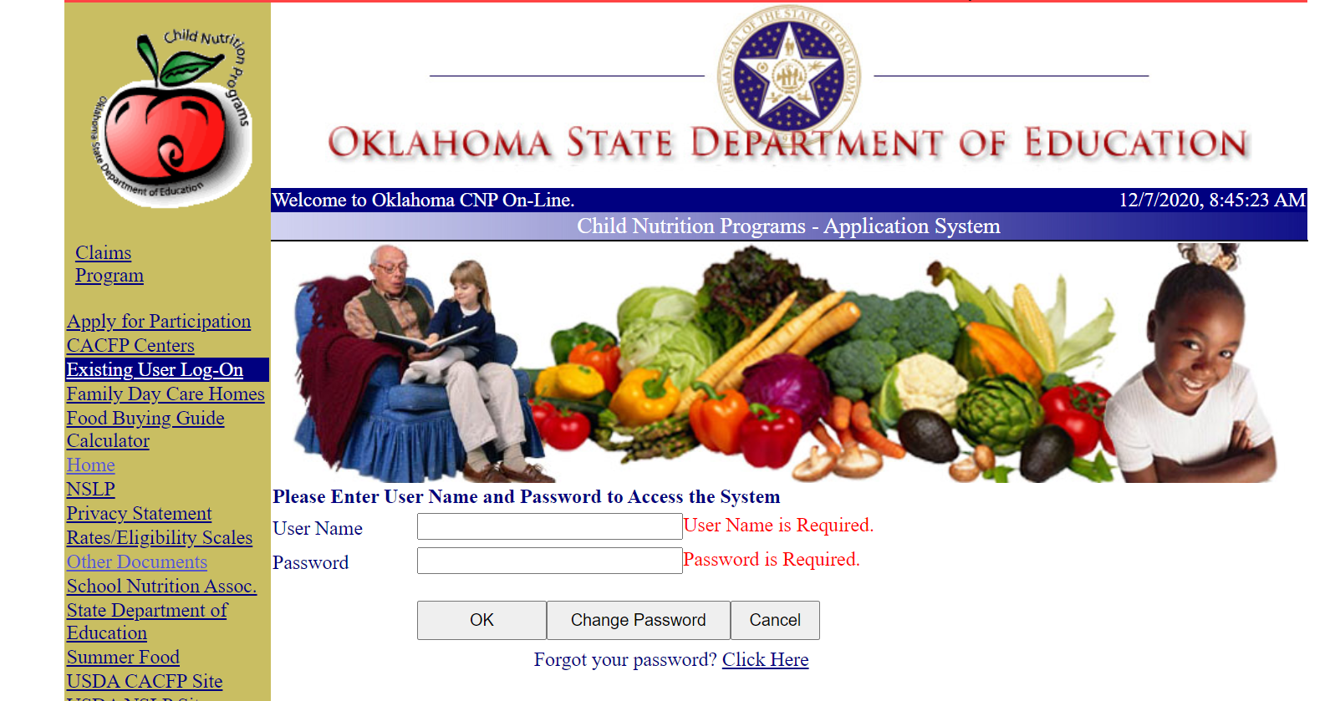
Child Nutrition Website
Other Documents section available to everyone

Slide 19
Child Nutrition Reviews
Each institution receives TWO Child Nutrition Reviews:
Administrative Review
5-year cycle
Procurement Review
3 to 5-year cycle
Notes:
Read Slide.

Slide 20
Contact Child Nutrition
Email: NSLP@sde.ok.gov
Office Phone Number: (405) 521-3327
Provide schools with Technical Assistance
Go to the OKSDE Website:
Click on Services → Child Nutrition Programs → Nutrition Documents
Notes:
OKSDE is here to assist our program participants whenever and however possible. As you see there on the screen, I have included contact information for help/technical assistance as well as directions to access our documents on the SDE website.
As a new program participant you will have an Approval Visit after your completion and approval of your Application/Agreement. Our Area Consultants are periodically offering various workshops in locations convenient to schools at different times throughout the year.
These workshops are on topics to assist them in the ever-changing requirements and information sent down from USDA. Once every 3 years we review our program schools for compliance with regulations.
We want every participant to be in compliance and remain there. Our programs can sometimes seem very daunting, and we want to work through any issues with you that we can.

Slide 21
Child Nutrition Programs State Department of Education
THANK YOU!
This institution is an equal opportunity provider.
Notes:
Questions?

