Slide 1
Accreditation
Ryan Pieper
Executive Director of Accreditation

Slide 2
Regional Accreditation Officers
Mat Luse
Brent Meeks
LeGay Riggs
Crystal Shaw
Mike Teel
Melody Toma
Kirk Warnick
Kelly Bowen
Doyle Edwards
Patrick Gay
Jim Gilmartin
Kim Hale
Leslie Janis

Slide 3
Regional Accreditation Officers Territory

Slide 4
Purpose of the RAO’s
Educate!
Act as liaison between the SDE and the schools.
Resource for information.
Provide guidance and make recommendations.
Conduct audits & gather information for other departments.
We are here to help you by the best leader you can be!
Do not hesitate to call your RAO!

Slide 5
Accreditation
YOUR GOAL AS AN EFFECTIVE LEADER
Every Site Accredited With…
NO DEFICIENCIES
Accredited schools are meeting state requirements
State aid is paid ONLY to accredited schools
A deficiency indicates the school is not in compliance with one or more requirements, but is still accredited
Repeated same deficiencies can lead to being non-accredited. The steps typically move from one deficiency, deficiency with warning, probation, followed by non-accredited

Slide 8
Resources You can find multiple resources on the SDE Accreditation Webpage with a simple search
Professional Development
Days to Hours Worksheet
Standards of Accreditation Guide
Education Law Book
Subject Codes
RAO Information
Student Transfers
Board Member Report
Much More!

Slide 9
Site Code & Grade Span Changes
Site code and grade span change requests must be turned into the accreditation office by Sept. 1 of each new school year. Appropriate documentation to provide to the Accreditation Office includes:
1) Board memo written on school letterhead stating their local Board of Education voted to change/expand a site’s grade formation & must be signed by the superintendent.
2) Board minutes of meeting during which their Board of Education approved to change a site’s grade set-up.

Slide 10
Annual Audits
August-October: Fall Accreditation Visits
September-October: FBA (Flex Benefit Audit)
October-November: FQSR (First Quarter Statistical Report)
December-May: Bilingual Audit
January-February: FBA (Flex Benefit Audit)
February-May: Spring Accreditation Visits
May-June: ASR (Annual Statistical Report)

Slide 11
Preparing For Your Audits
Organize your supporting evidence in the order requested.
Try to provide all listed documentation to avoid rescheduling.
Check over paperwork before the RAO arrives making sure it’s correct and complete.
Use a binder or file box to organize materials.
Do NOT use plastic sleeves.
Use this opportunity to demonstrate the great things going on in your school district!

Slide 12
ONLINE ACCREDITATION APPLICATION

Slide 13
Accreditation Application
Administrators can delegate job tasks
but cannot delegate responsibility!
Each year the application can reflect a few changes, so be sure to watch for those—Don’t skip questions & answer all questions correctly.
Application opens on Oct. 1 and closes in approx. 2-3 weeks with the exception of the upload section, which is open all year.
Some information will be uploaded for immediate viewing instead of being required during Accreditation visit. Upload exactly what is requested & be sure the uploaded information is current for the school year.
Do not use co-teachers UNLESS there is a true co-teaching situation.
Be sure to put Career Tech information in the system correctly.
If you have questions, call for clarification–405-521-3335

Slide 14
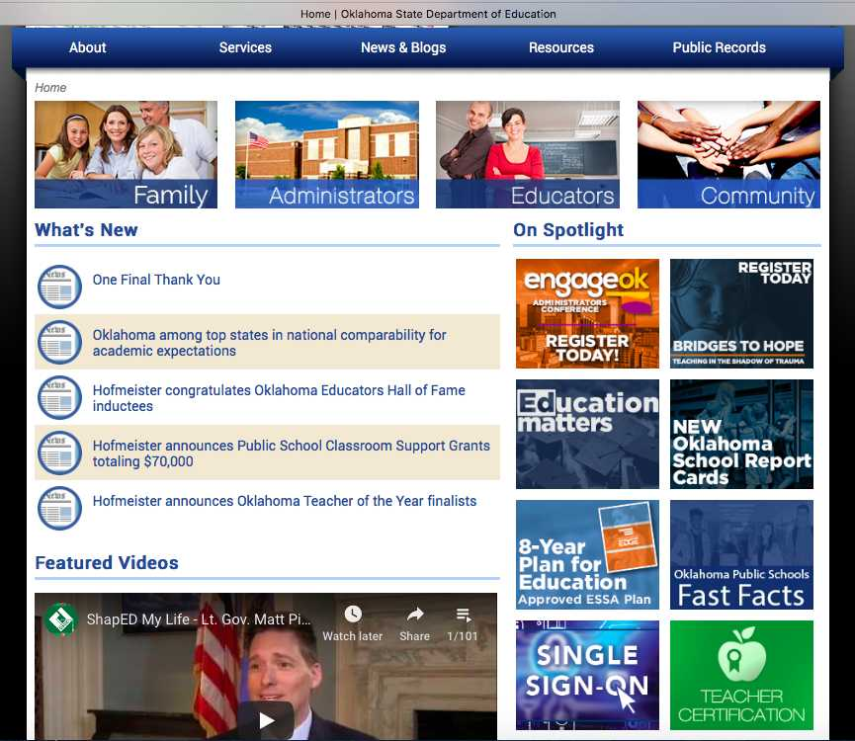

Slide 17
Accreditation Application
Once the district & all site tabs are accurate & complete, the superintendent must certify the report. If an error is found before the closing deadline, you may contact the Office of Accreditation to reopen your application.
District Tab:
Many of the items from this tab will be uploaded or checked in the spring
Data for the October 1 Report is pre-populated from your school’s software. Accuracy in your SIS is imperative–State Aid depends on it.
Economically Disadvantaged
Bi-Lingual/English Learners
Student Counts and Demographics

Slide 18
Accreditation Application-Cont.
Site Tabs:
Calendar Tab: Accuracy is very important – check calendar dates and times. Be sure all sites have the correct calendar. Changes may occur as the school year progresses, but you will not be able to get into this application to change data. Instead, you will upload changes as needed
School Day Tab: Times should match times shown on the Days to Hours Worksheet. Changes may occur as the school year progresses.
Library Tab: If your libraries are not going to be staffed according to the standards, you should apply for a Dereg. Sites sharing a library should count the combined number of students for both sites to determine staffing requirements.

Slide 19
Accreditation Application-Cont.
Site Tabs:
Health Tab:
One certified staff member and one support staff member should be listed as trained in CPR/Heimlich by a certified provider.
Current certificates should be uploaded on the Single Sign On. Certification should be valid for the duration of the school year. Please check expiration dates. Certifications are generally valid for 2 years.
Counselor Tab:
Elementary schools are required to provide counseling services by a qualified counselor or counseling service.
Secondary counselors are required to be Certified by the State Department of Education. One full time counselor for
every 450 students per site.

Slide 20
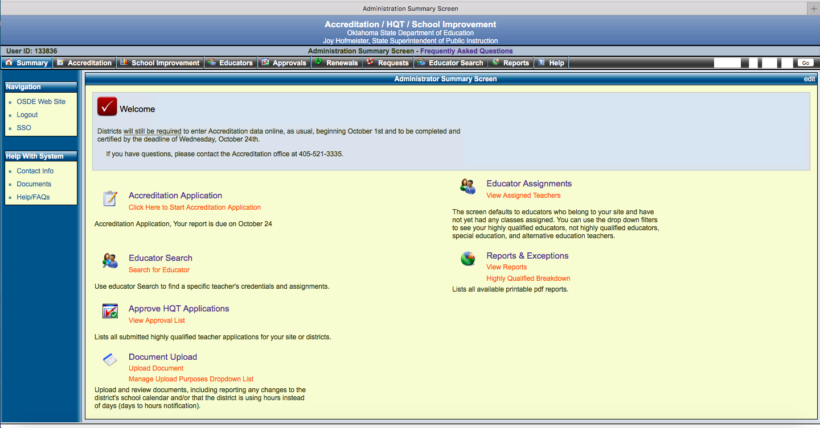

Slide 21
Accreditation Audits - UPLOADS
Uploads
PLEASE—Before uploading, be sure to save your district, site and document name in the title. Please be sure documents are readable & not upside down! The Upload link is open all year to update documents as needed.
To Upload Documents
Sign in to SSO (Single Sign On)
Click the Accreditation Tab
From the Summary Tab, scroll down to document upload & click upload link
There, listed in red, you will find a list of things that need to be uploaded as well as the appropriate documentation that is expected
Scrolling down from there you will find a “choose file” button for your upload
Select the item you are uploading that has been saved with your district and site, date and document in the title.
A description of the documents to be uploaded is listed.
You may delete previous year’s documents, but it’s not recommended.

Slide 22
Uploaded Documents
Days to Hours Notification-Deadline Oct 15
Calendar Change Notifications
Class Schedules
CPR/Heimlich Cards
Healthy & Fit School Advisory Committee
Safe School Committee
Annual College Remediation & Dropout Report
Career Tech course approval board minutes
Treasurer/Encumbrance Clerk trainings
Bonds for Superintendent, Treasurer & Clerks

Slide 23
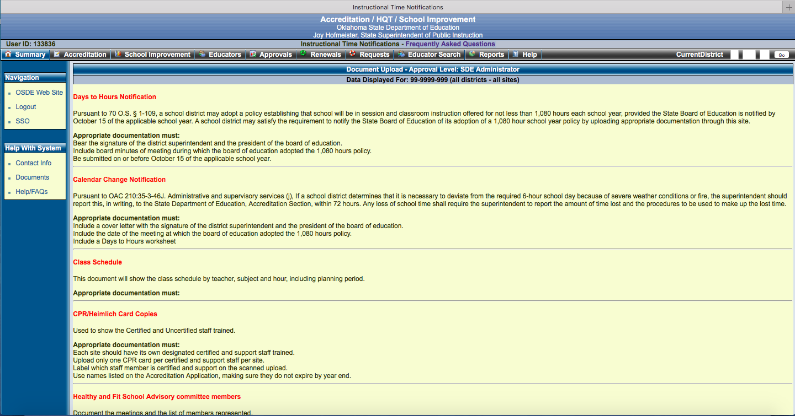

Slide 24
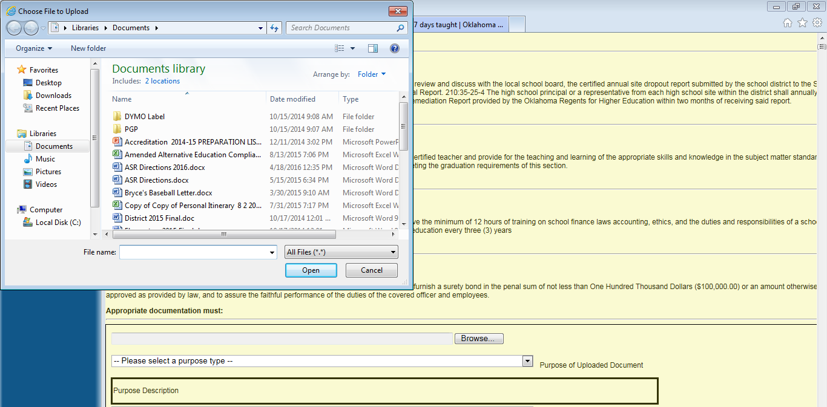

Slide 25
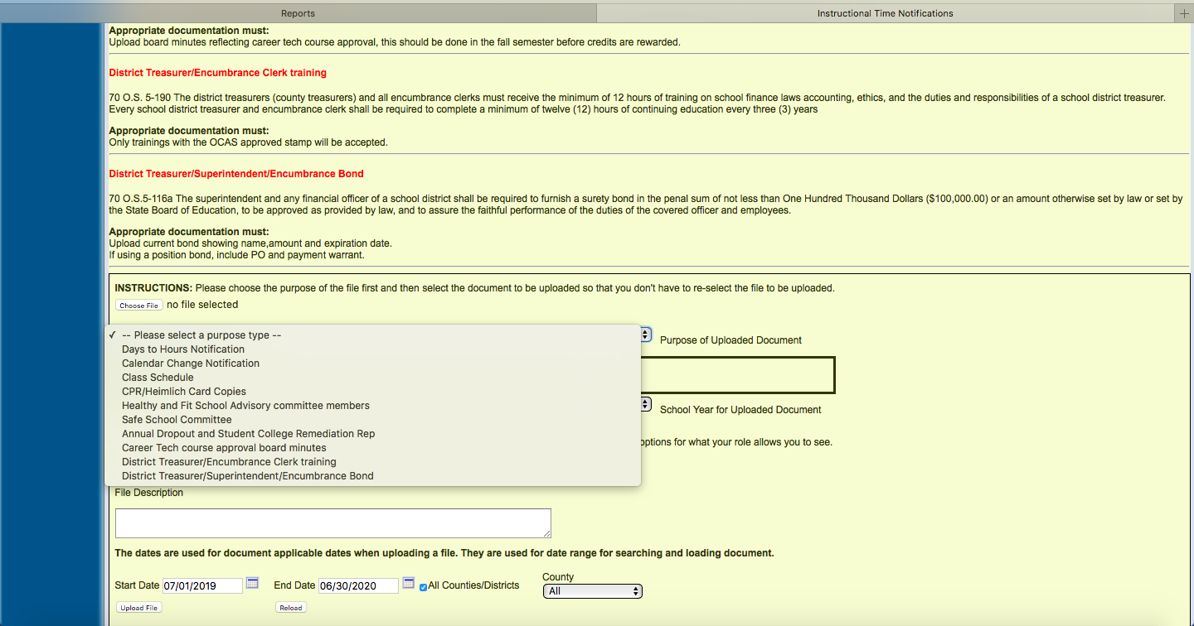

Slide 26
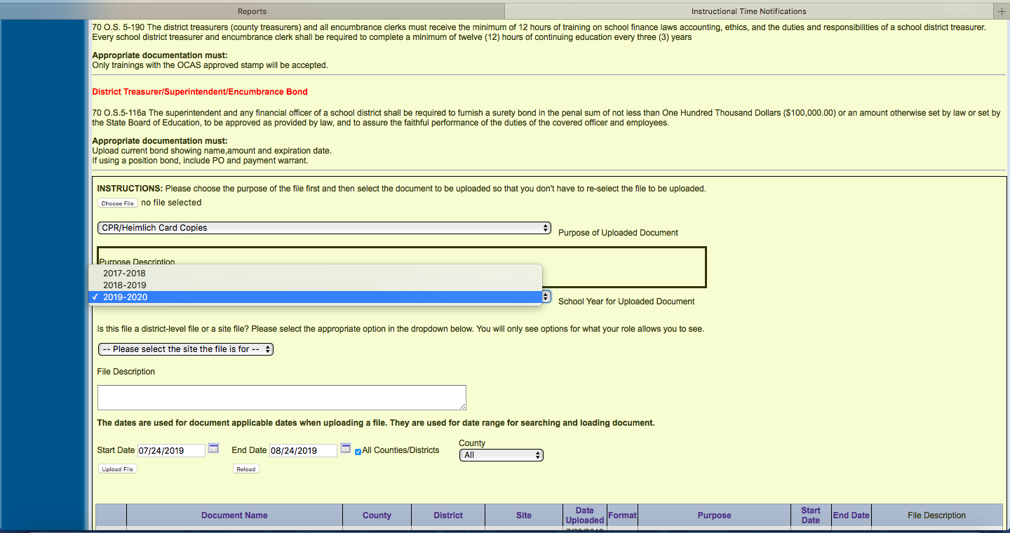

Slide 27
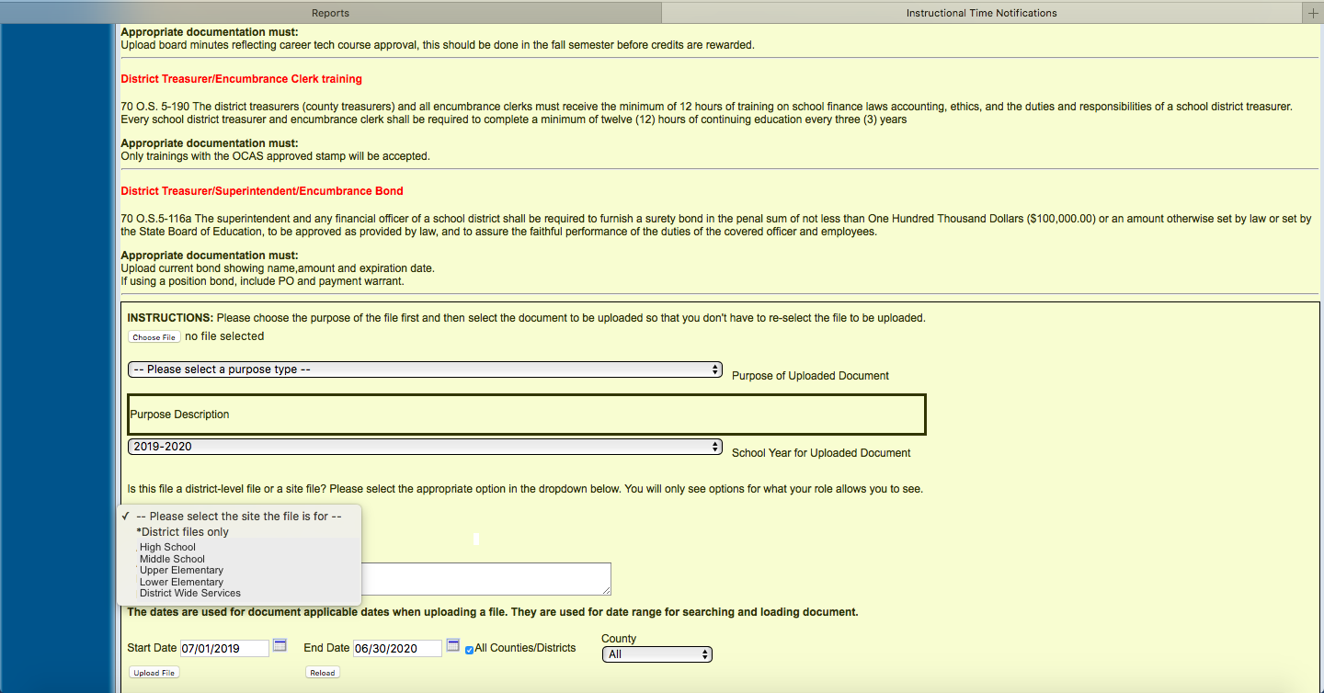

Slide 28
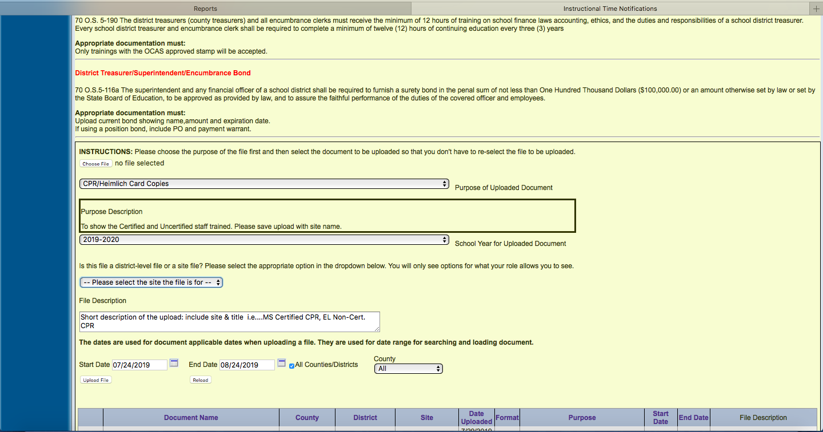

Slide 29
Spring Compliance Checks Below are items from other SDE Departments that can result in a Deficiency

Slide 30
Ryan Pieper
Executive Director
Office of Accreditation
405.521.3335
QUESTIONS ?

