Slide 1
Oklahoma State Board of Examiners for LONG- TERM CARE ADMINISTRATORS
January 27, 2021 Board Meeting
Public attendees are requested to “mute’ their microphones for the duration of the meeting unless a direct question is asked of them. The MEETING WILL START AT 10:00 AM

Slide 2
OSBELTCA
This meeting is being recorded…
January 27, 2021 Board Meeting
Public attendees are requested to “mute’ their microphones for the duration of the meeting unless a direct question is asked of them. The MEETING WILL START AT 10:00 AM

Slide 3
AGENDA
The agenda has been published on our website at www.ok.gov/osbeltca
Board members have been provided an electronic copy of the agenda portfolio including supplemental information to follow along during the meeting
File names have been referenced in this presentation
Virtual and Hybrid Meetings are still somewhat new to everyone – please be patient with each other and we will achieve our objectives

Slide 4
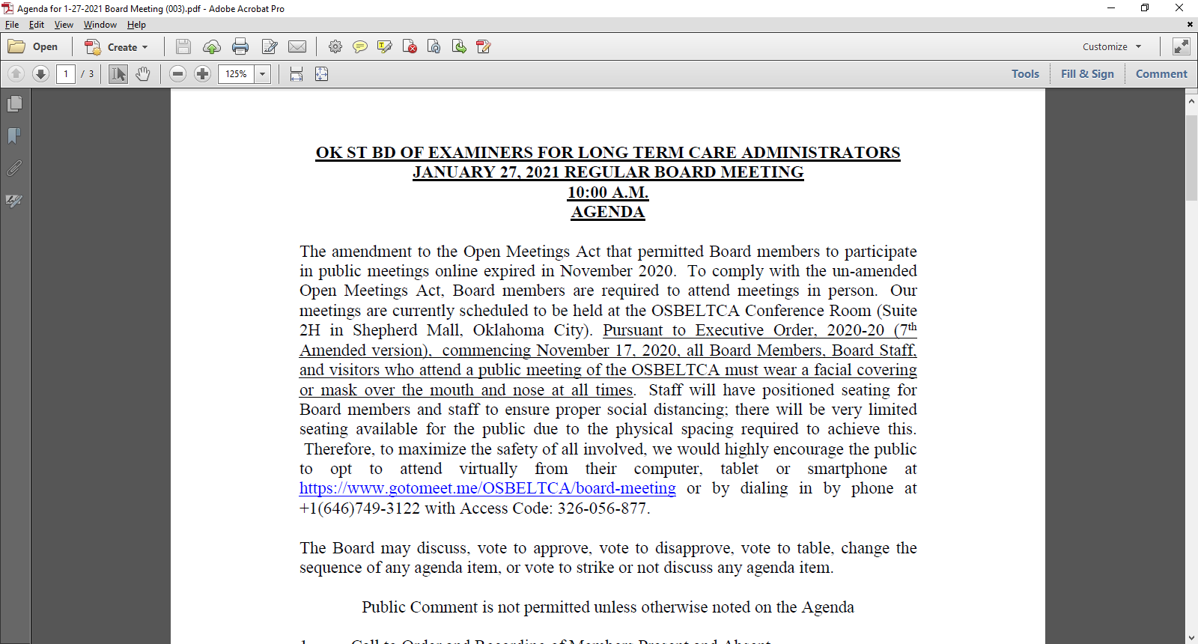

Slide 5
Agenda Item #1
Call to Order and Recording of Members Present and Absent – Compliance with Open Meeting Act and Authority
Only the names of Board Members are called for this purpose…

Slide 6
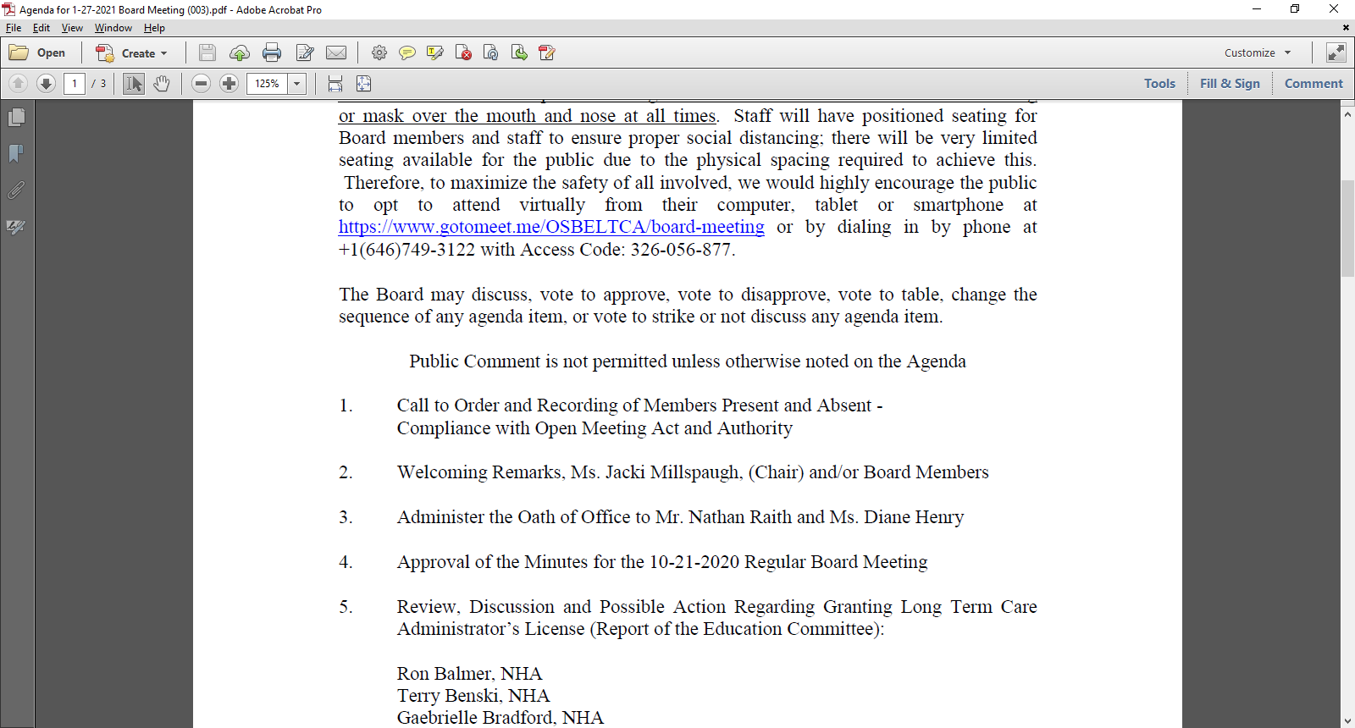

Slide 7
Agenda Item #2
Welcoming Remarks, Ms. Jacki Millspaugh, (Chair) and/or Board Members

Slide 9
Agenda Item #3
Administer the Oath of Office to Mr. Nathan Raith and Ms. Diane Henry

Slide 10
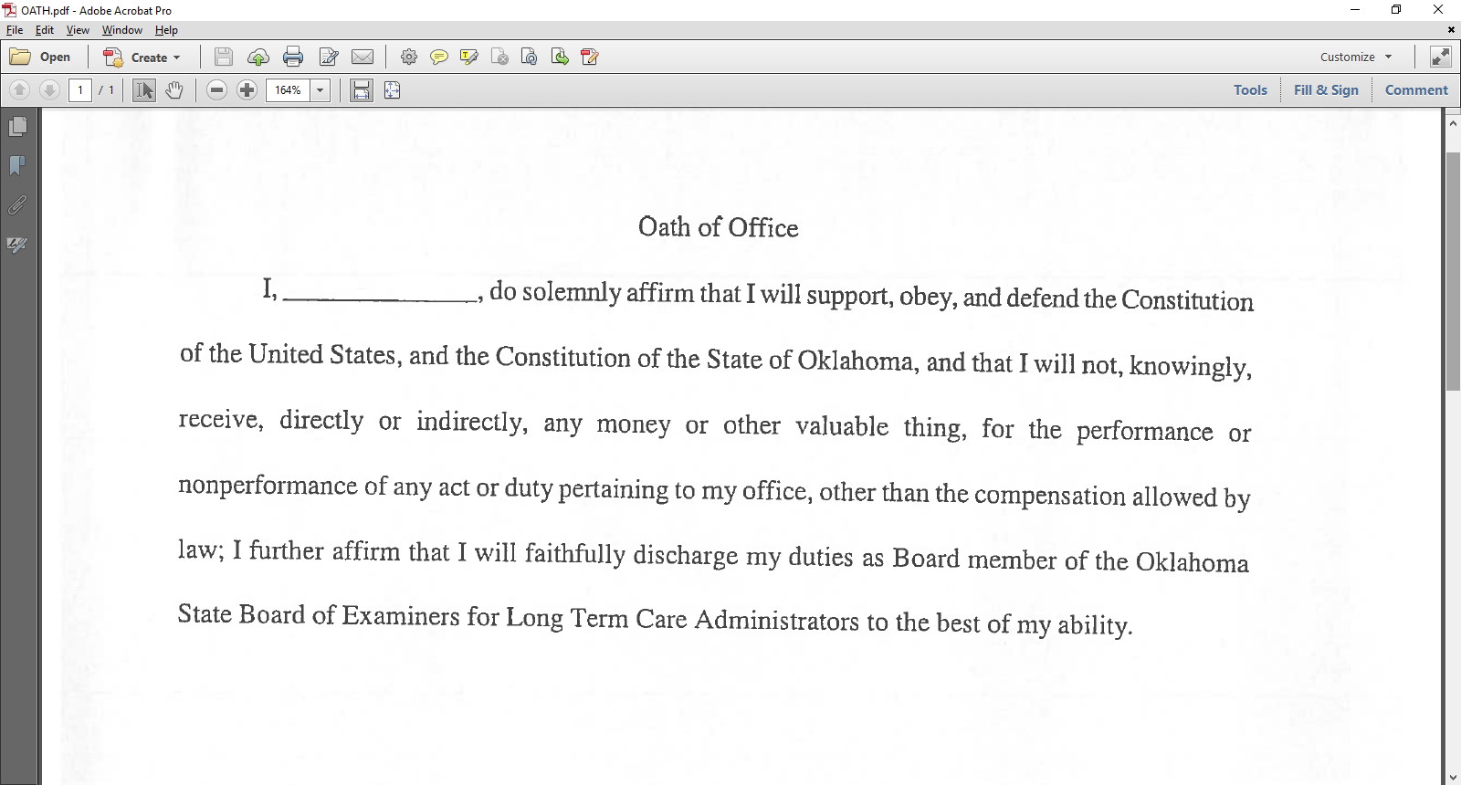

Slide 11
Agenda Item #4
Approval of the Minutes of the 10-21-2020 Regular Board Meeting

Slide 12
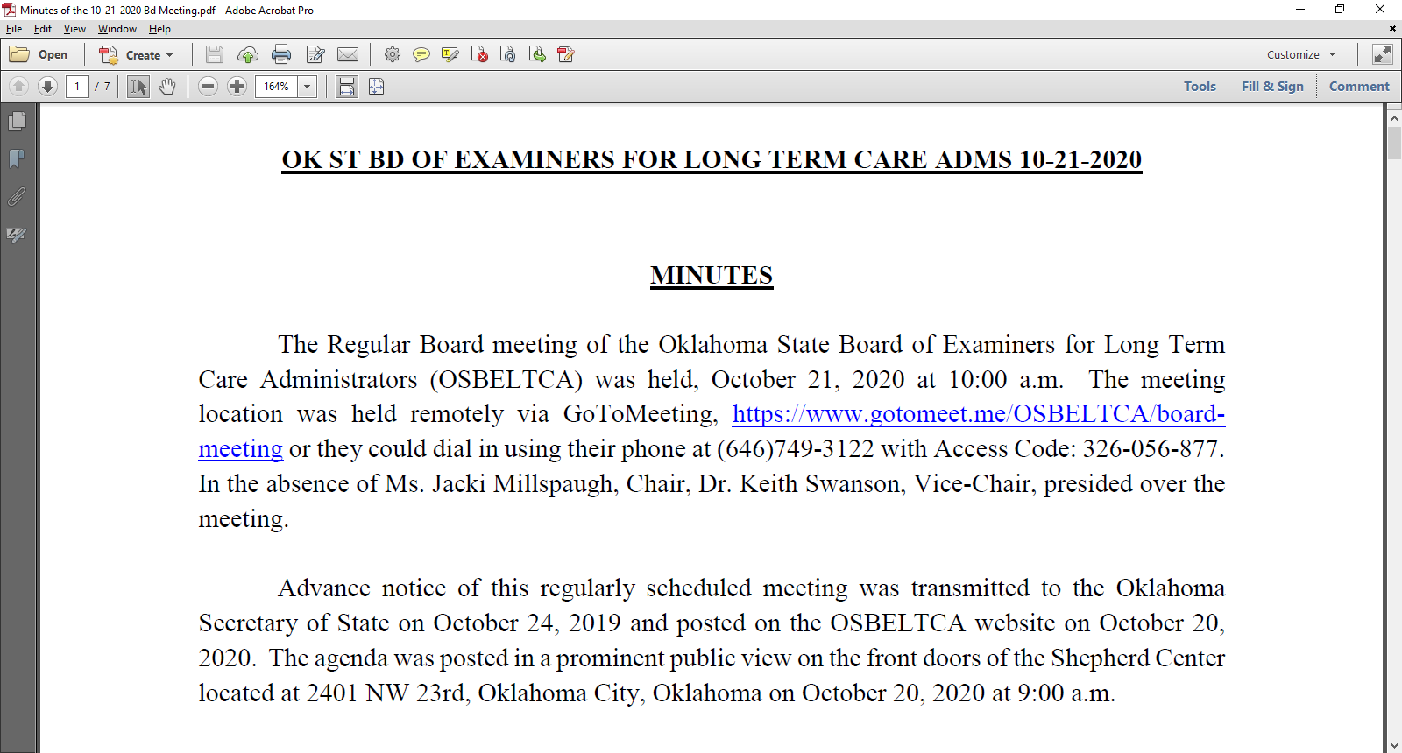

Slide 13
Agenda Item #5
Review, Discussion and Possible Action Regarding Granting Long Term Care Administrator’s License (Report of the Education Committee):
Ron Balmer, NHA
Terry Benski, NHA
Gabrielle Bradford, NHA
Kristel Brewer, RCAL
Robert Garner, NHA
Cayley Inmon, NHA
Rebecca Jackson, CAA
Trischa Kwiatkowski, RCAL
Stephanie McConnell, RCAL
Holly Pendleton, RCAL
Amanda Rains, RCAL
Shanley Reed, NHA
Tonya Rideaux, RCAL
Board Members were previously provided with the resume’ and a summary of training/testing/experience of each individual being considered for licensure

Slide 14
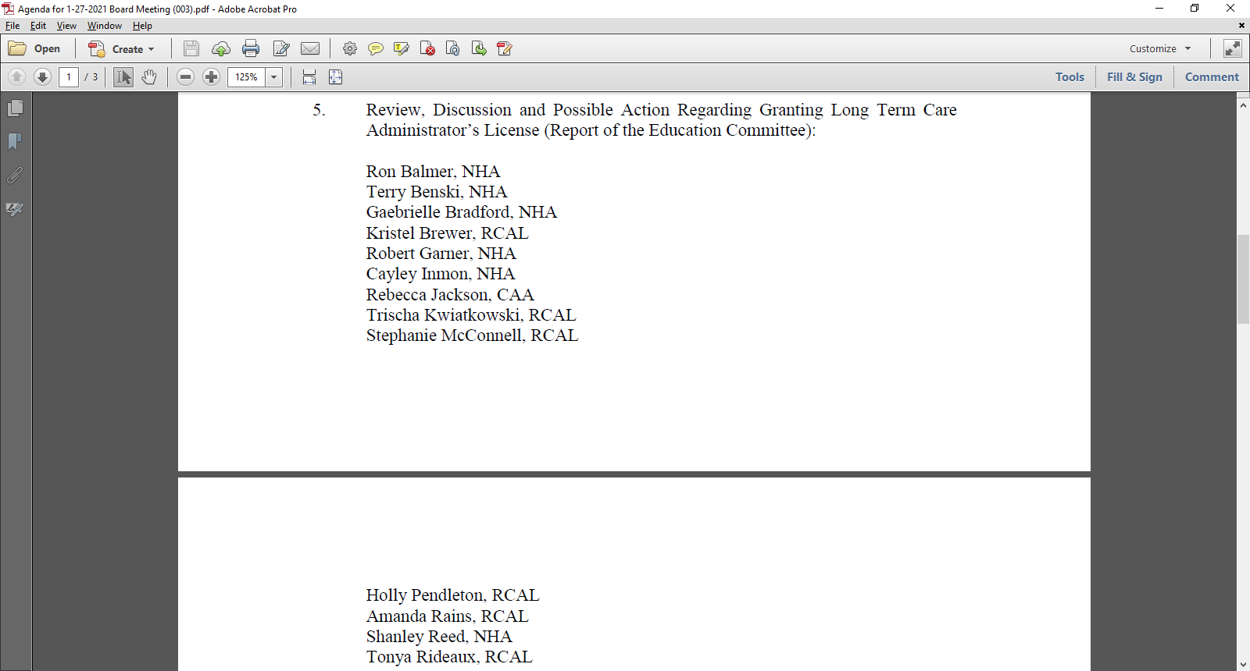

Slide 15
Agenda Item #6
OSBELTCA V. SHERRI HILBURN. License No. 1196, Case No. 19-056(D). Presentation of Proposed Agreed Order. Possible motion to convene into and exit from Executive Session pursuant to 25 O.S. § 307(B)(7) (discussing any matter where disclosure of information would violate confidentiality requirements of state or federal law) AND/OR pursuant to 25 O.S. § 307(B)(8) (engaging in deliberations or rendering a final or intermediate decision in an individual proceeding pursuant to Article II of the Administrative Procedures Act). Possible action. LP, KS

Slide 16
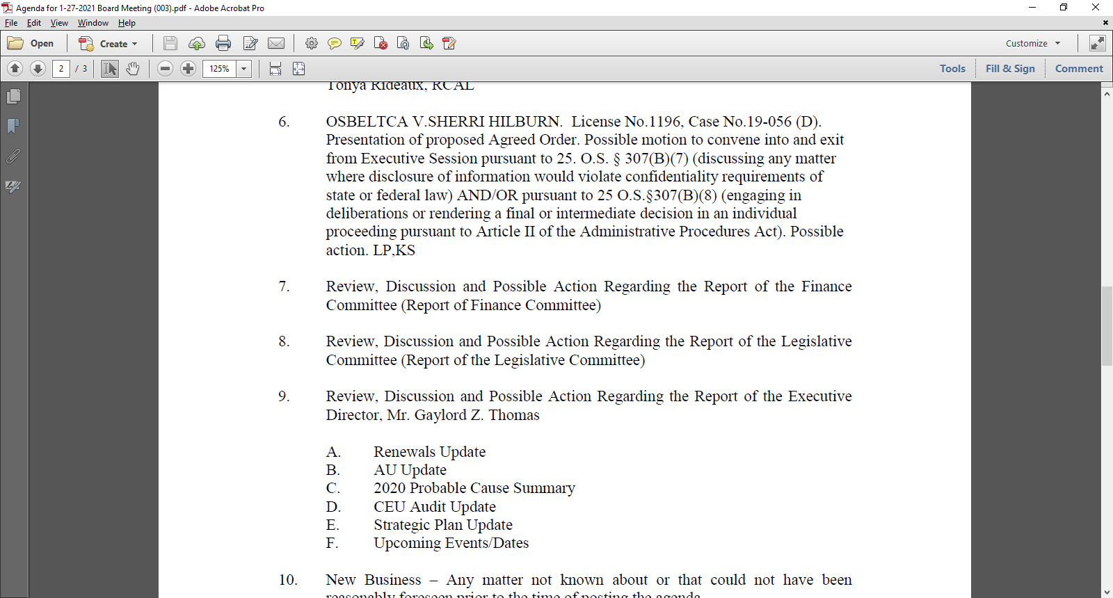

Slide 17
Agenda Item #7
Review, Discussion and Possible Action Regarding the Report of the Finance Committee (Report of the Finance Committee)

Slide 18
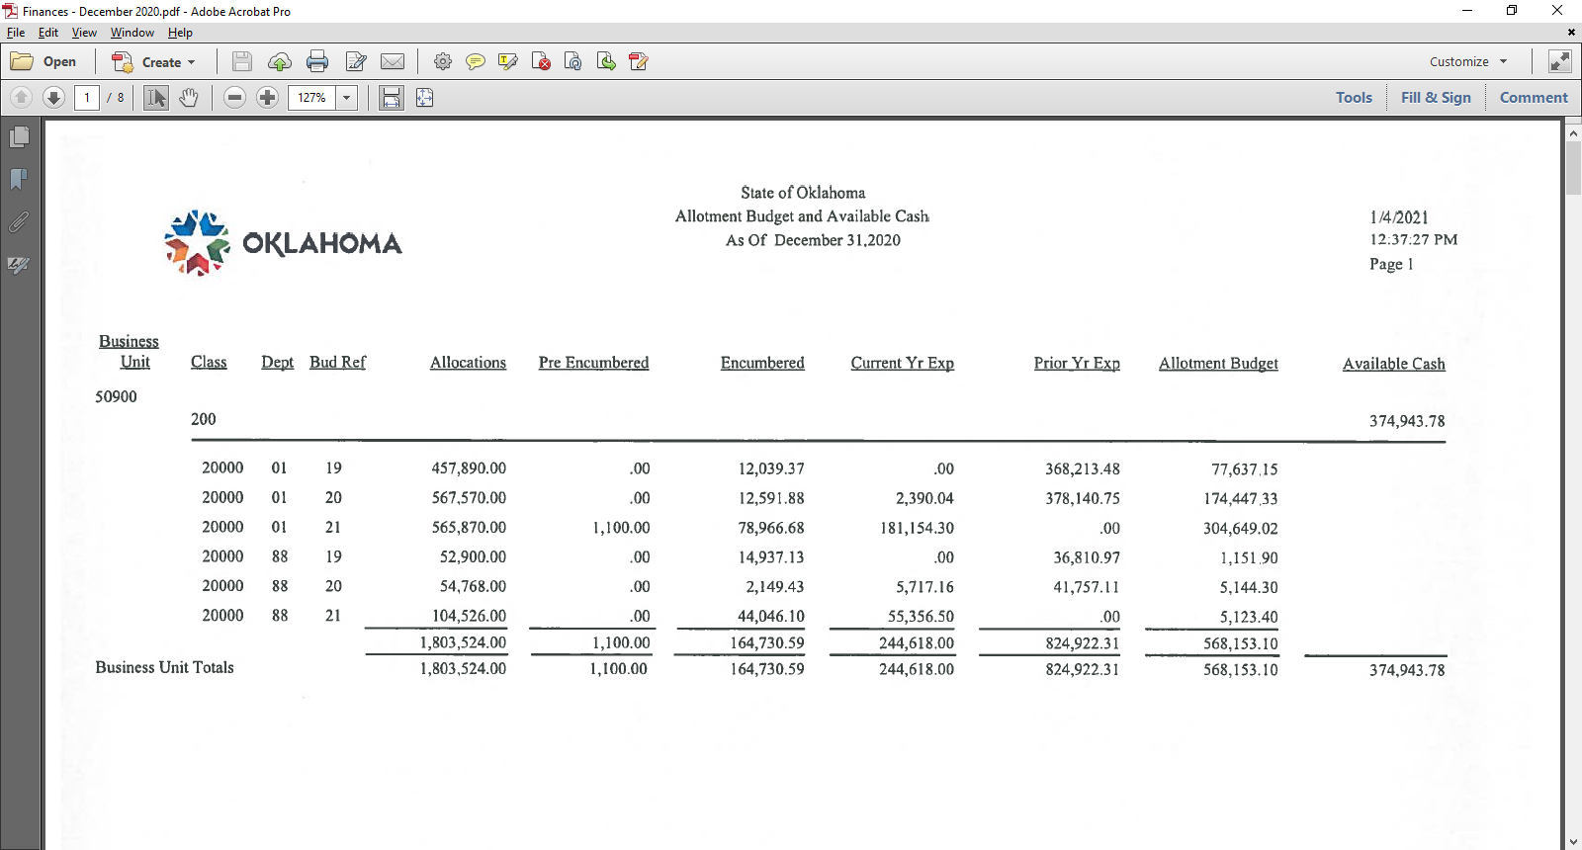

Slide 19
Agenda Item #8
Review, Discussion and Possible Action Regarding the Report of the Legislative Committee (Report of the Legislative Committee)

Slide 20
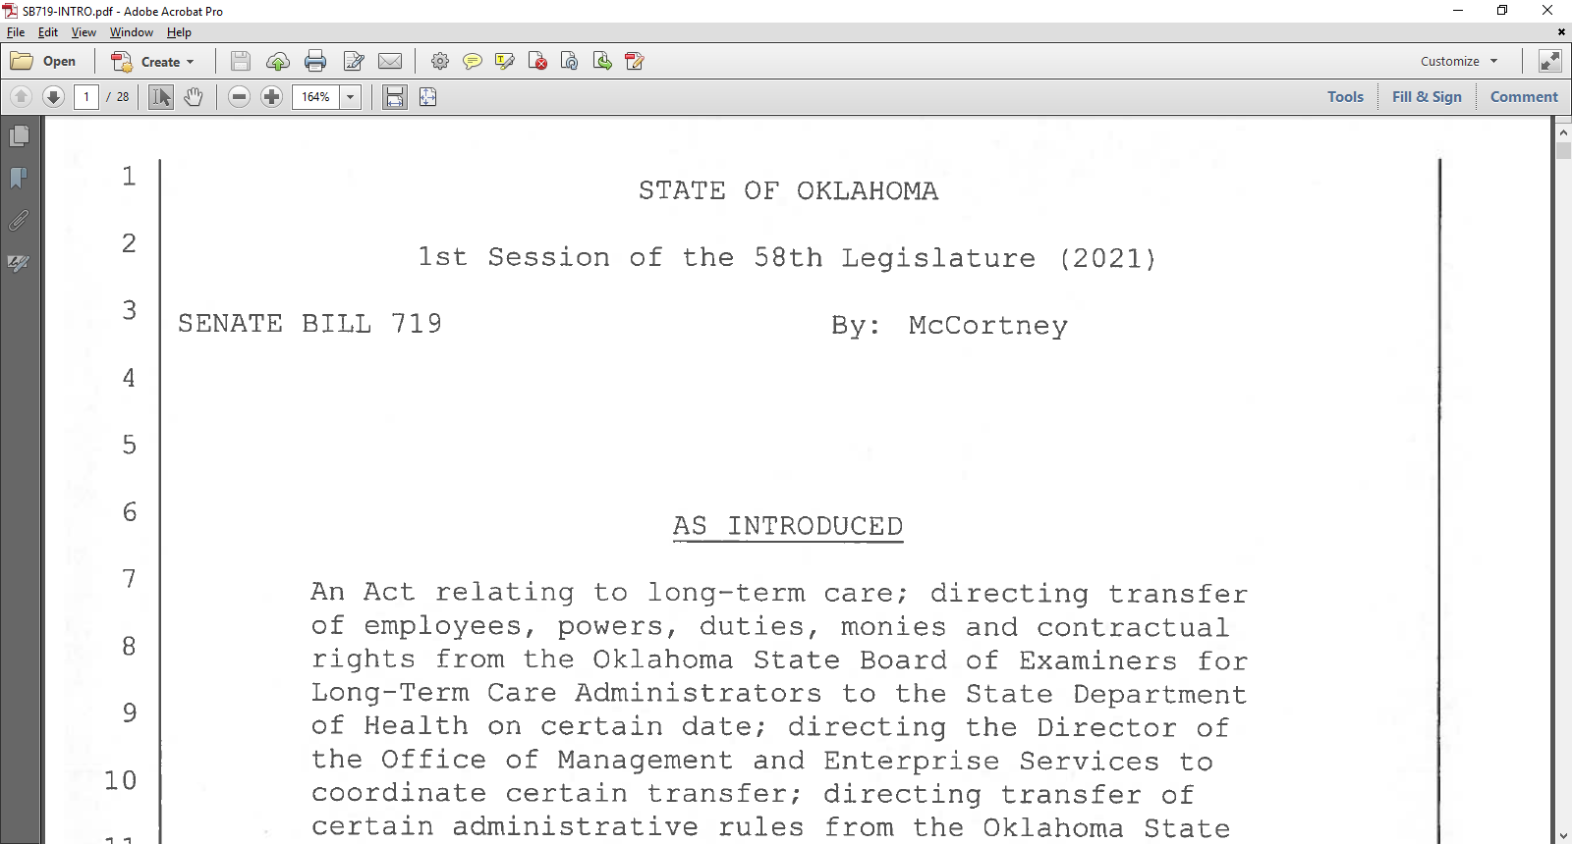

Slide 21
Agenda Item #9
Review and Discussion and Possible Action Regarding the Report of the Executive Director, Mr. Gaylord Z. Thomas
Strategic Plan Update
AU Update
2020 Probable Cause Summary
CEU Audit Update
Strategic Plan Update
Upcoming Events/Dates

Slide 22
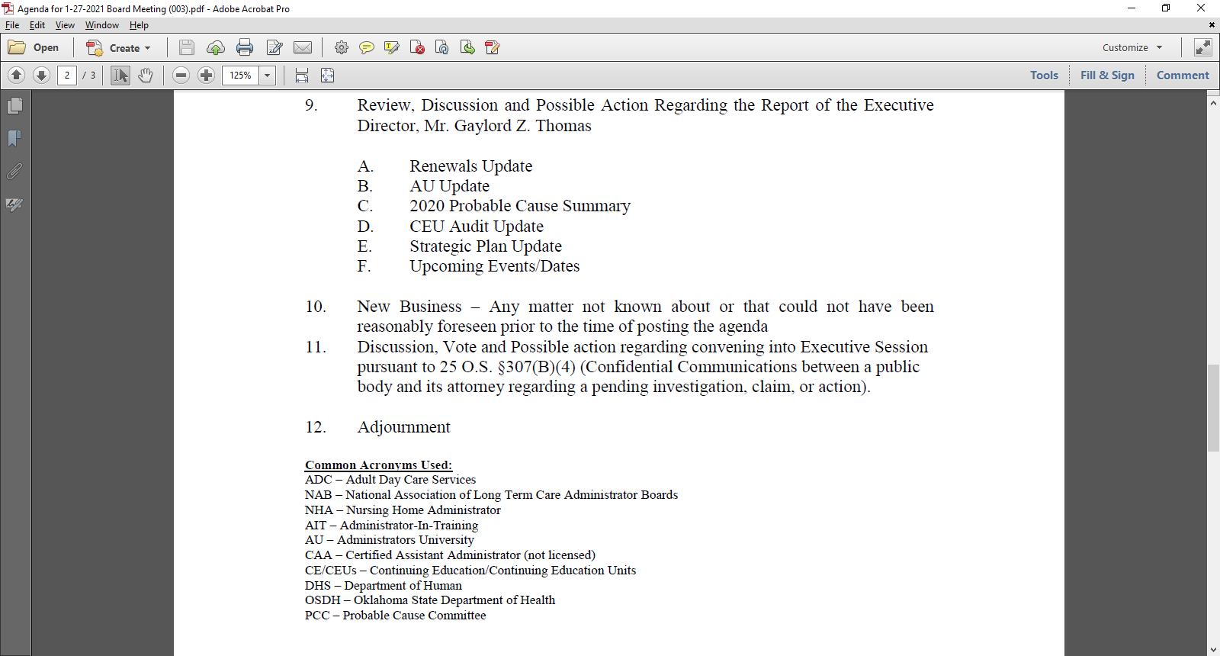

Slide 23
Agenda Item #10
New Business – Any matter not known about or that could not have been reasonably foreseen prior to the time of the posting of the agenda

Slide 24
Agenda Item #11
Discussion, Vote and Possible Action regarding convening into Executive Session pursuant to 25 O.S. § 307(B)(4) (Confidential Communications between a public body and its attorney regarding a pending investigation, claim, or action).

Slide 25
Agenda Item #12
Adjournment

Slide 26
Thank you!

