Slide 1


Slide 2
Plan Year 2023
Benefits Option Period
Employee Benefits Department
Human Capital Management

Slide 3

Option Period
Plan Year 2023
Benefits Option Period: Oct. 1-31, 2022.
Benefits and enrollment review.

Slide 4

Highlights
Definitions.
Rate and benefit allowance changes.
Plan changes.
Employee deadlines:
  HealthChoice Tobacco-Free Attestation – Nov. 11.
  Life insurance applications – Oct. 31.
Refer to pages 4-7 in your Benefits Enrollment Guide.

Slide 5
Important dates
HealthChoice Tobacco-Free Attestation
Opened Sept. 6
Life insurance applications
Starts Sept. 19
Closes Nov. 11
Closes Oct. 31

Slide 6
Required forms
Opt-Out Form plus proof of other coverage.
  Those covered under Indian Health, VA, SoonerCare (dependents only) or an individual Medicare plan are not eligible to opt out.
Common-Law Spouse Form.
Spousal Exclusion Form.

Slide 7
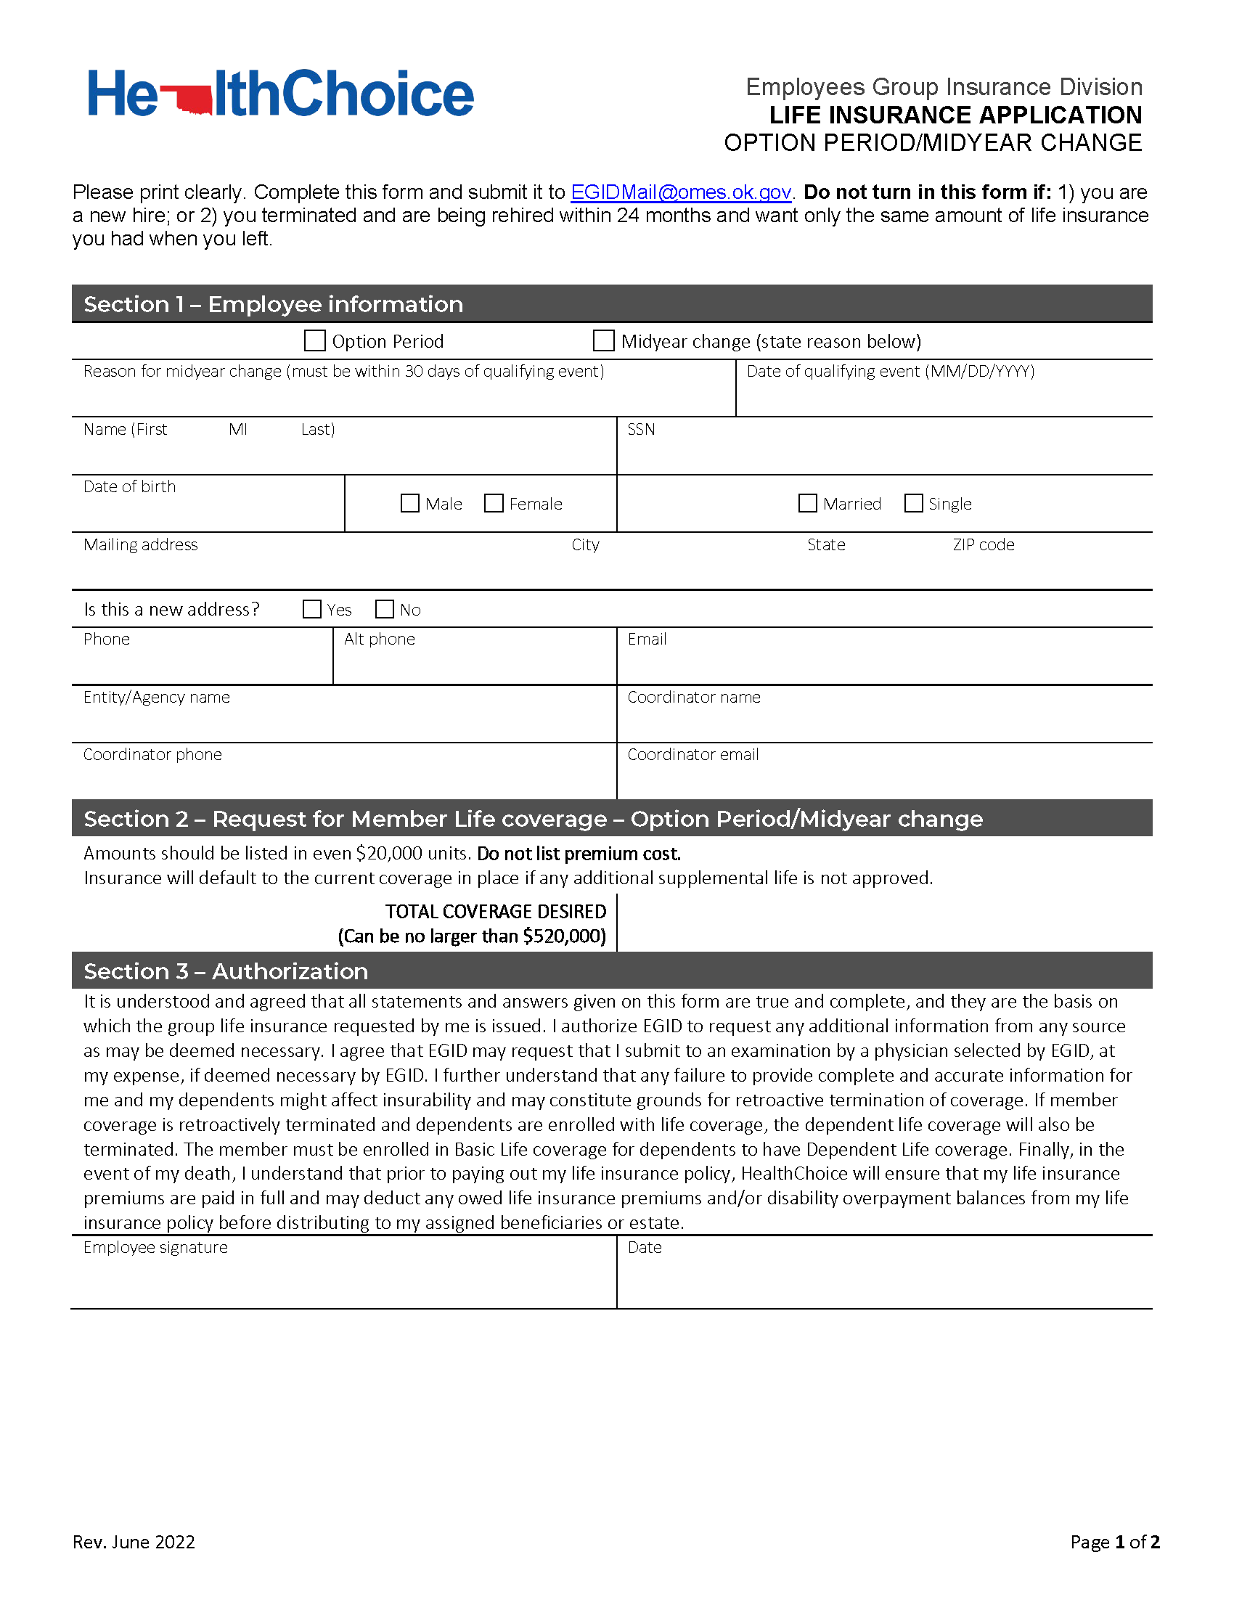
Life Insurance Application➥ Page 1
The application can be emailed and completed on the computer.
Indicate Option Period or Midyear change and the reason for a midyear change and date of event.
Assist member with this page and email to EGID as directed by Oct. 31.

Slide 8
Life Insurance Application➥ Section 1

Slide 9
Life Insurance Application➥ Section 2

Slide 10
Life Insurance Application➥ Section 3

Slide 11
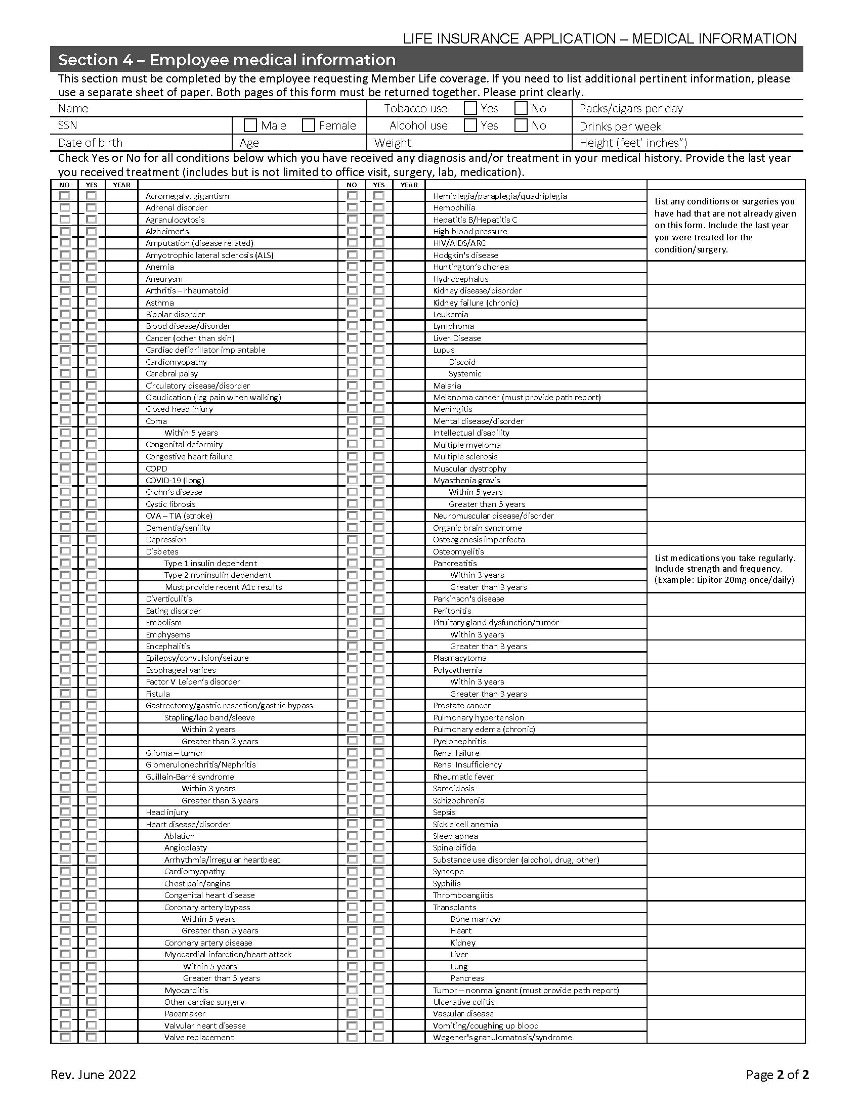
Life Insurance Application➥ Page 2
Member must complete.
It is a fillable form and can be completed on the computer.
Return by Oct. 31 deadline.

Slide 12
Life Insurance Application➥ Section 4

Slide 13


Contacts
Joy Fite, director of benefits
  405-522-6691
  joy.fite@omes.ok.gov
Sharon Saunders, flexible benefits manager
  405-522-1181
  Sharon.sauders@omes.ok.gov
Deniece Bryan, flexible benefits representative
  405-522-1162
  sharon.saunders@omes.ok.gov
Peggy Utter, flexible benefits representative
  405-522-1182
  peggy.utter@omes.ok.gov

Slide 14
Benefits in Workday@OK
Benefit Plans & Coverage Details.
Benefit Election History.
Dependent information.
Notes:
•Navigate directly to an employee’s Worker Profile and selecting Benefits from the Profile Menu, you have the access to view and update select Benefits information, including:
•Benefit Plans, Coverage Details
•Benefit Election History
•Dependent Information

Slide 15
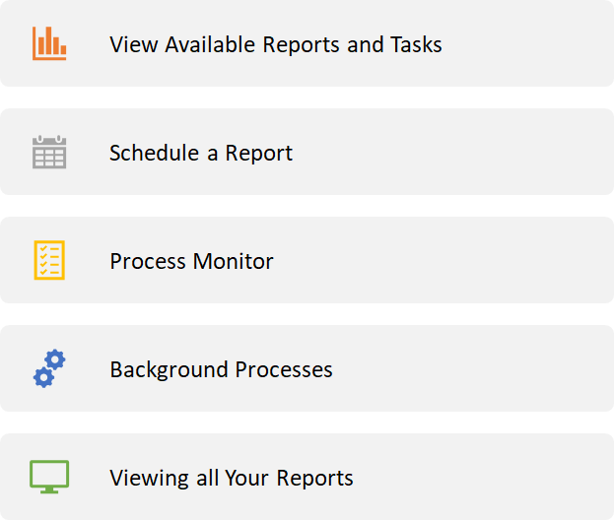
Workday@OK key reports
Notes:
In the app “Report”, there are 5 tools:
The tool “View Available Reports and Tasks”, you can view:
You can “Schedule a Report”, then select a report type from the list, and select a run frequency for a recurring purpose (Default to run the report now), select “OK”.
The tool “Process Monitor” allows you to monitor the ongoing integration/job/report process.
You can review background processes for a process.
Finally, you can select “View All My Reports” to view your available reports.
Report Navigation
Workday@OK has extensive reporting capabilities and there are several ways to optimize your use of these reports.
•Sort and filter.
To sort the displayed report by this column, select either Ascending or Descending. The results will be updated in the report table.
To filter the report data and show only some of the rows:
•Choose the filter conditions (e.g., not equal to, is empty, etc.).
•Enter the value(s) you wish to filter on. Only values that appear in the report data will appear in the filter list.
•Select Filter. The results will be updated in the report table.
Full-screen mode.
Select the double arrow icon in the upper right, just above the report grid. The grid will expand to fill the window. Select the icon again to restore to original size.
Exports reports.
Various export options. Exercise caution: when exporting reports, you are removing the data / information from Workday@OK’s security framework.

Slide 16
Common benefit reports
RPT00283 – Benefit Census with Benefit Plan
  View workers who meet the criteria defined by the eligibility rule associated with a specific benefit group.
RPT00284 – Current Benefit Elections
  List of current benefit elections for a selected worker.
RPT00299 – Agency Transfers
  Lists employees transferred in/out of agencies within a selected date range.
Notes:
Here are three common Benefit Reports:
RPT means it is a report the State of Oklahoma customized for you all.
You can use the search bar to type in report name or number and it will provide a list of results of your search.
RPT00283 Benefit Census with Benefit Plan
View workers who meet the criteria defined by the eligibility rule associated with a specific benefit group. Details include demographic and job-related information about workers and their current benefit elections. Enables you to communicate benefit enrollment information to external benefit partners.
RPT00284 – Current Benefit Elections
List of current benefit elections for a selected worker.
RPT00299 – Agency Transfers
Lists Employees transferred 'In / Out' of Agencies within a selected date range.

Slide 17
Demonstration tenant used for training
Certain values have been scrambled to protect personal identifiable information.
The tenant may look slightly different than what you will experience as a user at go-live.
Notes:
A scrambled tenant is not anonymized, so it looks like it contains real data. For the most part, most of what you see in the scrambled tenant is scrambled. Names and Organizations are accurate, but most other information, such as Phone numbers, addresses, emails, compensation etc, are scrambled and do not reflect actual data.

Slide 18

Demonstration
Viewing employee benefits.
Initiate a life event.
Pull a report.
Notes:
•Navigate directly to an employee’s Worker Profile and selecting Benefits from the Profile Menu, you have the access to view and update select Benefits information, including:
Viewing Employee Benefits - Proxy as: Joy Fite – Look at Patricia Baker's worker profile.
Demonstration instructions:
Navigate to the employee’s Worker Profile
On the left side of the page, select Benefits from the Profile Menu
You will see the various tabs:
1.Benefits
1.Benefit Plans, Coverage details
2.Benefit Election History
1.Details on benefit elections (e.g., open enrolment, event date)
4.Dependents - Dependent information and elections
Initiate a life event as a BP and employee. Navigate to Actions on worker profile. Highlight benefit partners can take action and will operate in this section. When a benefit partner takes the action of Change Benefits. They are initiating the business process and it will go to the employee's inbox for them to complete the information and upload the required documents.
Pull a report. Navigate to search bar and type C

Slide 19
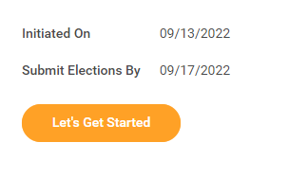
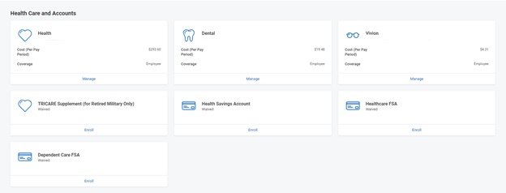
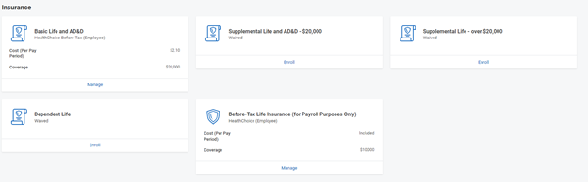
Open enrollment
Notes:
Here we are going to walkthrough the process of what an employee will see and need to complete in Workday@OK for Open Enrollment.

Slide 20
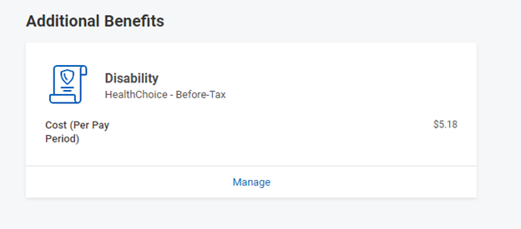
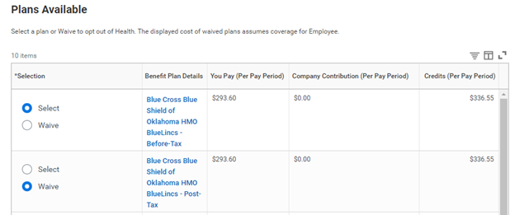

Open enrollment

Slide 21
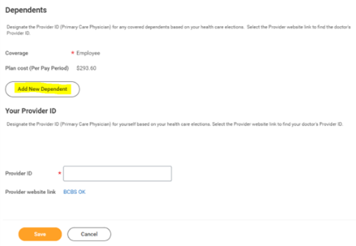

Open enrollment

Slide 22

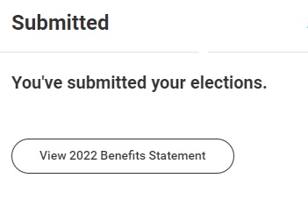
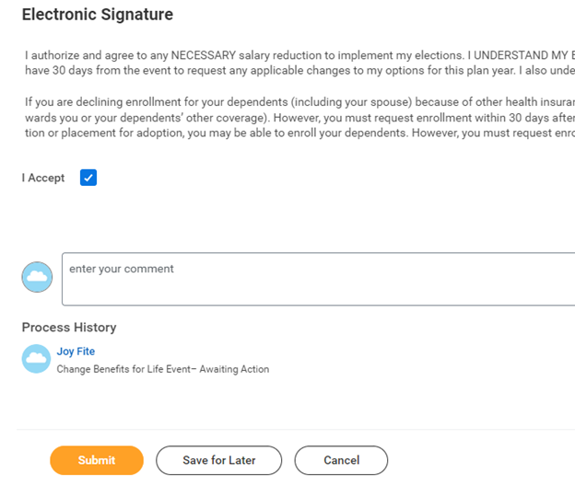
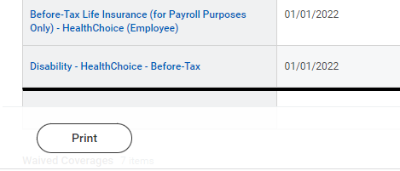
Open enrollment

Slide 23

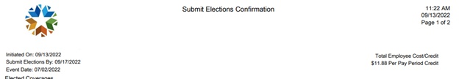
Open Enrollment

Slide 24
Support model and supplemental materials
To access additional information, visit the Workday@OK webpage from the Human Capital Management homepage at omes.ok.gov.
Schedule one-on-one training with the central Benefits team.
User guides:
Employee Pay and Benefits for Agency HR and Shared Services.
Correct Employee Benefits for Benefit Partner.
Workday Reports and Crosswalk.
Notes:
•Navigate directly to an employee’s Worker Profile and selecting Benefits from the Profile Menu, you have the access to view and update select Benefits information, including:
•Benefit Plans, Coverage Details
•Benefit Election History
•Retirement Savings Elections
•Dependent Information

Slide 25

Thrive Employee
Wellness Program
Susan Robinson, Ed.D, CHES, CPM
Thrive Coordinator

Slide 26

Thrive program focus

Slide 27
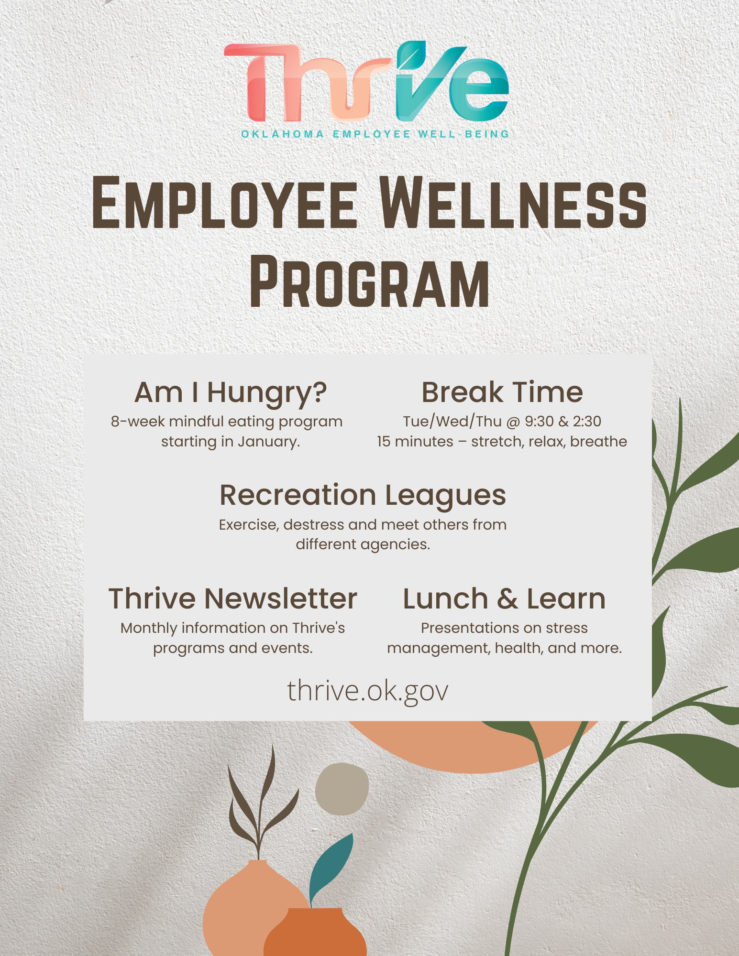
Current Thrive programs
A variety of virtual an in-person presentations and meetings.

Slide 28



Thrive interactive communications
Monthly Newsletters
Quarterly Toolkits
Challenges

Slide 29
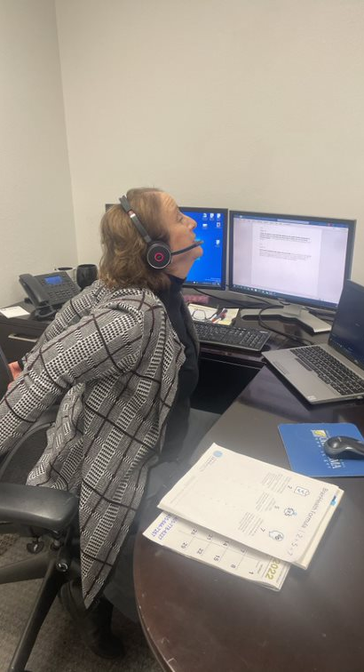
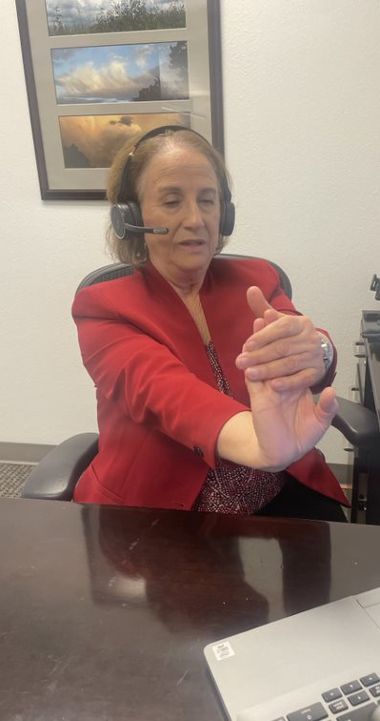
Break
Time
Meets: Tuesday, Wednesday, Thursday.
Time: 9:30 a.m. and 2:30 p.m.
  Desk stretches.
  Relaxation breathing.
  Health tip.
  Comments from attendees:
  “This meeting reminds me to take a moment for myself even if it is just 10 minutes.”
  “The stretches and information are beyond helpful.”

Slide 30

Am I Hungry?
Focus on changing beliefs, thoughts and feelings first.
Non-diet, weight-neutral approach.
Mindfulness-based strategies to eat with intention and attention.
Notes:
The Am I Hungry? Mindful Eating Program will empower your employees to take charge of their decisions about eating, physical activity, health, and self-care so they can invest fully in their lives and work.
Delving far beyond the obvious advice of “eat less, exercise more,” Am I Hungry? Programs focus on changing beliefs, thoughts, and feelings first, so changes in behaviors will last. The non-diet, weight-neutral approach frees participants from the restrictive and consuming strategies offered in conventional workplace interventions and provides them with a method for rediscovering their expert within.
Dynamic, fun, and interactive workshops
A comprehensive step-by-step process to increase self-efficacy and build optimal health
Simple yet powerful internal tools for recognizing when, what, and how much to eat
Practical nutrition information without confusing, arbitrary rules
A small steps approach to rediscovering joy and vitality in physical activity
Meaningful and sustainable changes in attitudes and health behaviors
Life-management tools to increase long-term success, productivity, and quality of life

Slide 31
Dine and Discover
Topic:
Parents Helping Parents Inc.,
providing a source of hope
“At Parents Helping Parents, I found a group of friends who ‘got it’ without me having to explain. It was like coming home.”
– Bill G.
Oct. 16, 2020
Quarterly lunch and learn presentations on various health topics:
  Stress management.
  Brain health.
  Motivation.

Slide 32

State Employee
Recreation Leagues
Notes:
April 2 – Lake Murray State Park.
May 14 – OKC Lincoln Park Golf Course.
June 11 – Old Page Belcher.
July 16 – Arrowhead State Park.
August 13 – Roman Nose State Park.

Slide 33

State Employee
Recreation Leagues
Notes:
April 2 – Lake Murray State Park.
May 14 – OKC Lincoln Park Golf Course.
June 11 – Old Page Belcher.
July 16 – Arrowhead State Park.
August 13 – Roman Nose State Park.

Slide 34
Windy Cup Tour 2022
April 2 – Lake Murray State Park.
May 14 – OKC Lincoln Park Golf Course.
June 11 – Old Page Belcher.
July 16 – Arrowhead State Park.
August 13 – Roman Nose State Park.

Slide 35

Health and Payroll Deduction Expo
Voluntary payroll deductions vendors.
2023 health, dental and vision insurance plan representatives.
Immunizations.
Health and wellness screenings.

Slide 36
New program development
Survey on current health status revealed employees are still experiencing stress and burnout.
Possible health coaching.
New presentation: Anatomy of Goal Setting.

Slide 37
Contact
Susan Robinson, Thrive Employee Wellness Coordinator
405-522-1195
Susan.Robinson@omes.ok.gov
thrive@omes.ok.gov
thrive.ok.gov

Slide 38
Contact
Susan Robinson, Thrive Employee Wellness coordinator
  405-522-1195
  susan.robinson@omes.ok.gov
  thrive@omes.ok.gov
thrive.ok.gov

Slide 39

Break
Notes:
•Navigate directly to an employee’s Worker Profile and selecting Benefits from the Profile Menu, you have the access to view and update select Benefits information, including:
•Benefit Plans, Coverage Details
•Benefit Election History
•Retirement Savings Elections
•Dependent Information

Slide 40





Health plans

Slide 41
BlueLincs HMOSM
2023

Slide 42



Your Benefits with BlueLincs HMO
Saving you Money
  No deductible
  Low copay for primary doctor visits
  One of the most affordable HMO options
Access to Health Care
  Largest HMO network in the state, available in all 77 Counties
  No referrals required within the network
  Remote options: 24/7 Nurseline, Virtual Visits & Dispatch Health
Service when you need it
  Blue Access for MembersSM on your smart phone or computer
  24/7 customer service number
  Health & Wellness support programs
*DispatchHealth is currently only available in the OKC metro area

Slide 43
Lower Cost = Savings
No Annual deductible
Blood & Blood Products
Home Health Services
Hospice
Medical Transportation Services
Preferred Generic Rx
Primary Care Physician (PCP) Visits
Virtual Visits
X-ray and Routine Lab Services
Allergy Treatment & Testing*
Maternity*
Physical/Manipulative Therapy*
*Some restrictions apply; consult your benefits guide for full benefit description.

Slide 44





Knowing Where to Go Can Save You Money
Remote Health Care, Virtual Visits | Primary Care Doctor | Urgent Care, Dispatch Health | Hospital ER | Independent ER
$0 | $25 Copay | $50 Copay | $300 Copay | Highest Possible Cost

Slide 45

Well onTarget® Wellness at Your Fingertips

Slide 46

Fitness Program: How it Works
It’s easy for Blue Cross and Blue Shield of Oklahoma members and dependents to get started.
Go to
Blue Access for MembersSM
To enroll by phone, call 888-762-BLUE (2583)
Sign gym waiver
and get gym
key fob
Find
participating gyms
Take member
ID to gym
Notes:
Revised 01/22
EMI Team – Russell Sails, Chris Hinkle
Reviewed by Jessica LeBeau

Slide 47
Reward Yourself for Healthy Living
Blue PointsSM: Members can earn points for working out and redeem them for apparel, books, electronics, health and personal care items, music and sporting goods.¹
Get 2,500 points for joining the Fitness Program
Earn additional points for weekly visits
WholeHealth Living
Choices Program
Discounts on complementary and alternative medicine (CAM)
Access to this CAM network is available to all Fitness Program members at no additional fee²
Save money through a nationwide network of 40,000 health and well-being providers, such as acupuncturists, massage therapists and personal trainers
To register for CAM Discounts, log on to whlchoices.com
1
Member agrees to comply with all applicable federal, state and local laws, including making all disclosures and paying all taxes with respect to their receipt of any reward. Blue Points Program Rules are subject to change without prior notice. See the Program Rules on the Well onTarget Member Wellness Portal for more information.
The Well onTarget member rewards redemption service is provided by an independent third party.
The WholeHealth Living Choices program is administered by Tivity Health™ Services, LLC. This is NOT insurance. Some of the services offered through this program may be covered by a health plan. The relationship between these vendors and Blue Cross and Blue Shield of Oklahoma is that of independent contractors. BCBSOK makes no endorsement, representations or warranties regarding any ‭products or services offered by the above-mentioned vendors.
Notes:
Revised 01/22
EMI Team – Russell Sails, Chris Hinkle
Reviewed by Jessica LeBeau

Slide 48
Contact Us
bcbsok.com/state
• Find a doctor
• Check prescription drug coverage
• Log into Blue Access for Members
CUSTOMER SERVICE
855-609-5684
• 24 hours a day, 7 days a week

Slide 49
State, Education & Local Government
2023 Active & Pre-Medicare Benefits

Slide 50
CommunityCare Values the Partnership
CommunityCare has been committed to the State of Oklahoma, Education and Local Government members for 28 consecutive years!
Our 2023 plan offering demonstrates that commitment with significant enhancements.
1. Service Area Expansion into Oklahoma City
2. Provider Network Expansion into Oklahoma City
3. Significantly Reduced Premiums
CommunityCare has the lowest overall premium HMO plan for 2023!

Slide 51
2023 ZIP Code Service Area Expansion
Canadian
Cleveland
Hughes
Kingfisher
Lincoln
Logan
Okfuskee
Oklahoma
Pottawatomie
Significant expansion to the CommunityCare service area adding nine new counties!
With the service area expansion, we are increasing from 24 to 33 counties!
The current service area in northeastern Oklahoma will remain the same.

Slide 52

2023 Provider Network Expansion
Service area expansion made possible through our unique partnership with INTEGRIS Health Partners+.
INTEGRIS Health, along with additional providers, will be available in the nine new counties included in the service area expansion.

Slide 53


2023 Provider Network Expansion
The nine new counties include a broad and robust network for members to choose:
Over 15 NEW Hospitals/Emergency Rooms
Over 200 NEW Primary Care Physicians
Over 800 NEW Specialists

Slide 54


2023 Provider Network Expansion
OSU Medical Center and McAlester Regional Health Center have also been added to the State network.
These two health systems add additional providers:
Over 50 NEW Primary Care Physicians
Over 125 NEW Specialists

Slide 55
No Medical Plan Changes!
  The CommunityCare medical plan remains unchanged
  The lowest HMO family out of pocket: $8,000
  The lowest HMO routine lab, X-ray and complex imaging:
    $0 for routine lab and X-ray
    $200 copay for MRI, CT, MRA or PET Scans
  The lowest HMO emergency room copay: $200
  Affordable copays for outpatient surgery for $300 copay and inpatient hospital for $350 copay/day
    (Maximum $1,750/admission)

Slide 56
No Prescription Drug Plan Changes!
  Prescription Copays: Mail Order:
  $15 Preferred Generic CVS Caremark and
  $40 Preferred Name Brand AllianceRx Walgreens Prime
  $70 Non-Preferred (90-Day Supply)
  $160 Specialty
  $0 Copay Program: Select Generic Medications
    - Blood Pressure - Cholesterol
    - Anti-Depressants - Anti-Inflammatory

Slide 57








CommunityCare Network

Slide 58

Custom Website: http://state.ccok.com
  View all providers
  View and print your EOBs
  View claim history & out-of-pocket amounts
  Print temporary ID cards
  Order replacement ID cards

Slide 59
CommunityCare Contact Information
Customer Service: (918) 594-5242 or Statewide: 1-800-777-4890
  Hours: 8 a.m. - 6 p.m., Monday through Friday
Pharmacy Help Desk: 1-877-293-8628
  Hours: Answered 24 Hours a day/seven days a week
24-Hour Nurse Line: 1-800-777-4890
  Press option #4
Custom Website: http://state.ccok.com
After 28 consecutive years serving State of Oklahoma members, we hope you will see the value in the CommunityCare 2023 HMO plan offering. This demonstrates our commitment and dedication to you by providing high-quality, cost-effective health care services, plus an expanded service area and network, all for the lowest overall premium cost!

Slide 60



STATE OF OKLAHOMA
Employees & Educators Plan
January 1-December 31, 2023
MPP 2023
MLGMH23-ST

Slide 61
Choose a plan that puts its MEMBERS FIRST!
19
continuous years of serving State of Oklahoma employees and educators!
“GlobalHealth helps me because they have a real good drug plan that saves me money on the drugs that I purchase. Anytime I’ve called a Generations rep for anything, they’ve gone out of this world to help. They’ve gone beyond, what I consider, the call of duty to help.”
Jim, GlobalHealth Member

Slide 62
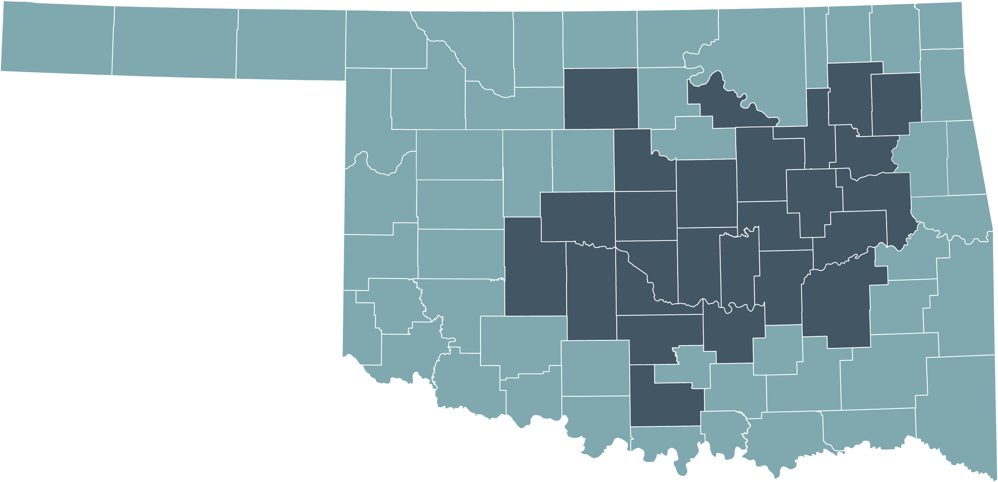
ELIGIBILITY & SERVICE AREA
26 COUNTY SERVICE AREA
Must be a permanent resident in our service area
Must be a current State of Oklahoma employee and/or educator

Slide 63

Monthly Plan Premiums
COVERAGE FOR
THE FAMILY
2023 Monthly Premium | Employee | Employee & Spouse | Employee, Spouse & Child | Employee, Spouse & Children | Employee & Child | Employee & Children
 | $932.72 | $2,309.50 | $2,842.14 | $3,179.32 | $1,465.36 | $1,802.54

Slide 64








2023 State of Oklahoma Employees and Educators
Key Plan Benefits
Benefit | Copay
Primary Care Physician Visit | $0 copay for unlimited visits
Specialist Visits | $50 copay
X-Rays & Labs | $10 copay
Physical Therapy | $35 copay
Urgent Care | $25 copay
Specialty Scans | $250 copay preferred facility $750 copay non-preferred facility
Outpatient Surgery | $300 copay preferred facility $800 copay non-preferred facility
Inpatient Hospital | $300 copay per day $900 maximum copay per admission
Out-of-network care is not covered except for emergency or urgent care situations.

Slide 65





STAY AHEAD of whatever life throws!
Unlimited $0 Primary Care Physician Visits
GlobalFit® Gym Membership Discounts
$500 Maternity
Delivery Copay
$20 Tier 1 Generics
for a 30-day supply

Slide 66

THOUSANDS OF PROVIDERS in our provider network
Tulsa Area
Harvard Family Physicians
Utica Park Clinic Physician Group
Hillcrest Medical Center
Hillcrest South Hospital
Hillcrest Hospital Claremore
Hillcrest Hospital Pryor
Tulsa Spine & Specialty Hospital
Oklahoma Heart Institute
Oklahoma Surgical Hospital
OSU Medical Center
OSU Physicians
Bailey Medical Center, Owasso
Oklahoma Spine and Brain Institute
McAlester Regional Health Center
Oklahoma City Area
Centennial Health
Mercy Hospital
Mercy Primary Clinics
Integris Baptist Medical Center
Integris Deaconess Hospital
Integris Health Edmond
Integris Southwest Medical Center
Integris Primary and Specialty Care Clinics
Oklahoma Heart Hospitals (North & South)
Bone & Joint at St. Anthony
St. Anthony Hospital
Variety Care Clinic
Lakeside Women’s Center of Oklahoma
This is not a full list of providers. Other providers are available in our network. The provider network may change at any time. You will receive notice when necessary. To see if your local provider or hospital is in network, visit www.GlobalHealth.com or call Customer Care at 1-877-280-5600 (TTY: 711)
9 a.m. to 5 p.m., Monday-Friday

Slide 67

Connect with us!
877-280-5600 (TTY: 711)
www.GlobalHealth.com/Oklahoma/MyStatePlan
StateAnswers@globalhealth.com
H3706_STPRESENTATION_2023_M

Slide 68

4818

Slide 69

WHY CHOOSE HEALTHCHOICE?
Five flexible health plan choices offer a variety of options to best fit your and your families needs.
PPO plans.
Large medical provider and pharmacy networks.
Network and non-network benefits.
Self-referrals to a specialists.
Free and easy mobile benefit app.

Slide 70

CHANGES FOR 2023
HealthChoice is partnering with UMR effective Jan. 1 for claim processing and UMR Care for clinical support.
UMR CARE – clinical support and resources for healthy lifestyles.
Members will receive a new ID card.
Updated benefits app with new features and easy navigation.

Slide 71
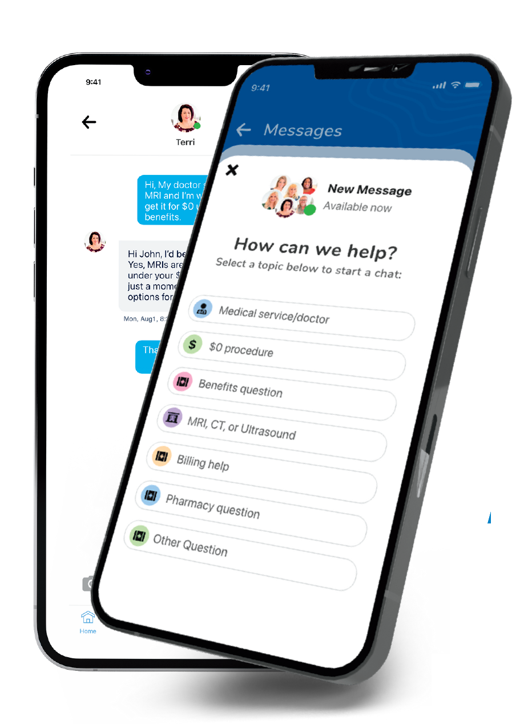

HEALTHCHOICE APP
Save time, money and frustration with an app that has it all!
Chat with a Care Guide – Guides are available 24/7 and can help guide you to care, answer benefit questions and even help make appointments!
Save Money – Access $0* medical care including MRIs, CT scans, ultrasounds, surgeries, and much more.
Access:
  Claims and EOBs.
  Insurance cards.
  Find network providers.
  Access SwiftMD – Telemedicine.
  Check deductible and out-of-pocket maximum amounts and more!
Meet Your Care Guides
*HDHP members must first meet their deductible.
Search HealthChoice in your app store and download

Slide 72
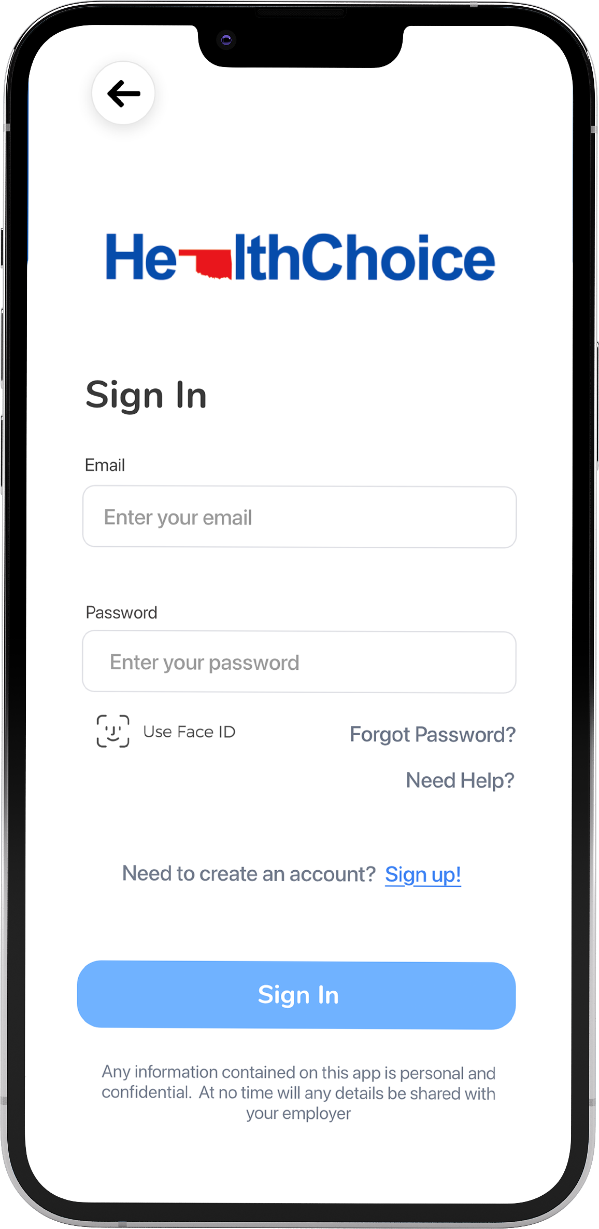
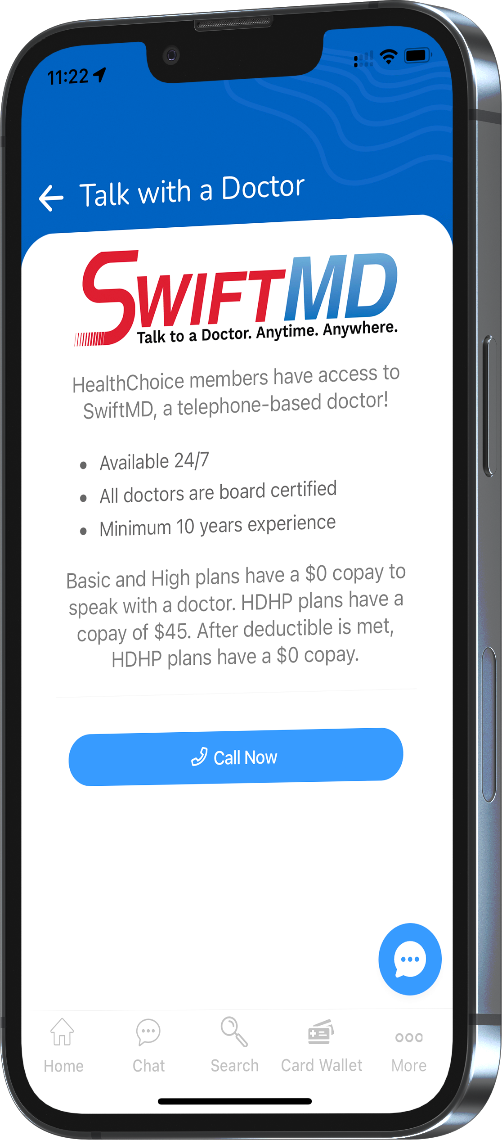
Telemedicine – SwiftMD
Available 24/7 with no limit on visits.
Board-certified physicians.
$0 cost for High and Basic plans.
$45 for HDHP members.
Swift MD.com.
Passcode HCOK20.
Access SwiftMD through the HealthChoice App!

Slide 73

Telehealth – you choose provider
    Local network or non-network provider of your choice when available.
    Virtual visits.
    Standard benefits apply.

Slide 74
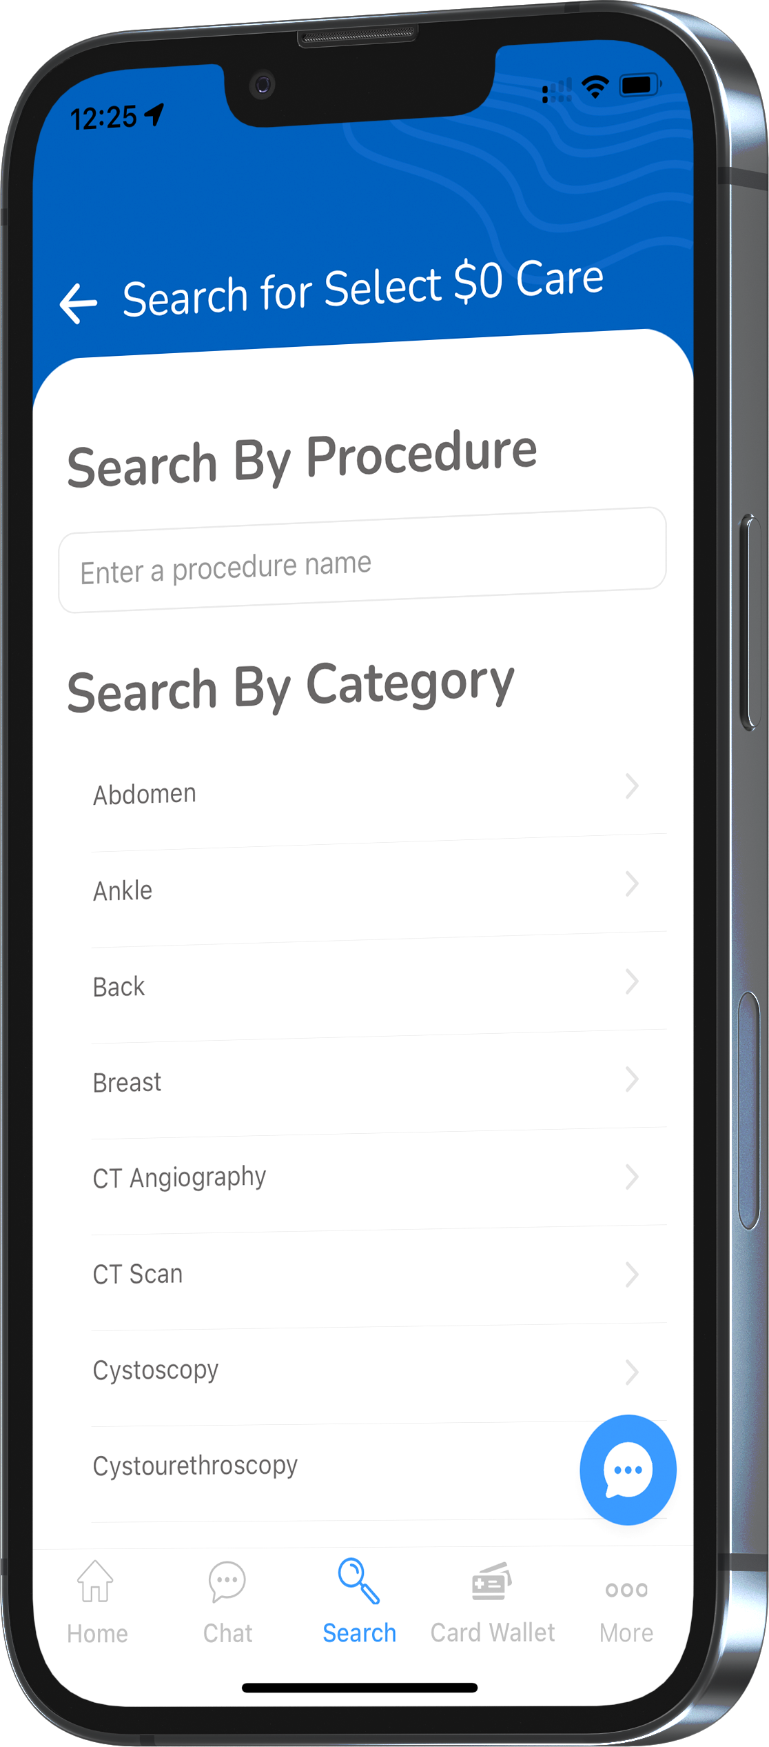
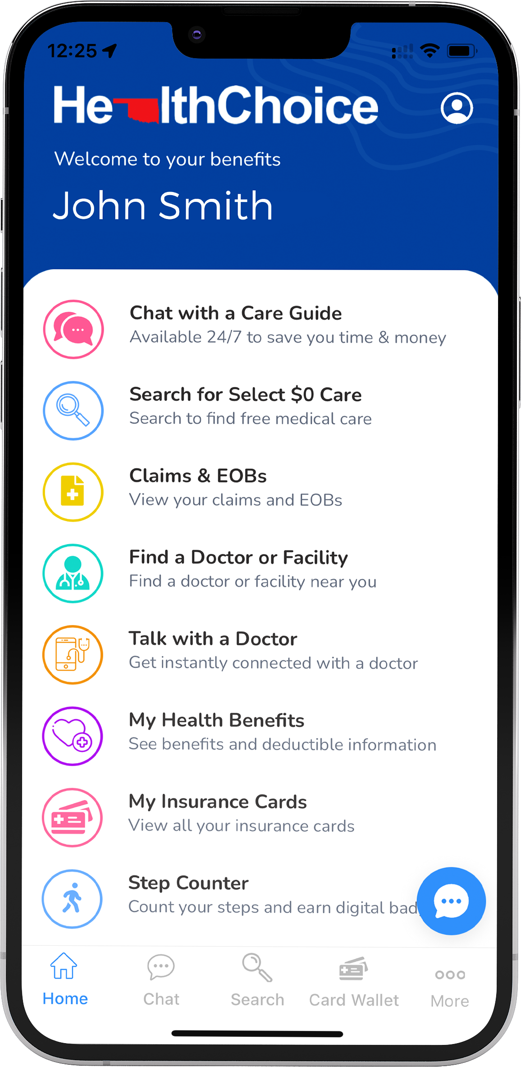
$0 Select Program – all plans
    Select services and procedures are covered at 100% of the bundled allowable.
    Select services include:
      MRI scans.
      CT scans.
      Ultrasounds.
      Some surgeries and more!
    No age limit or limits on the number of procedures.
    Incentive payments.
    HDHP members must meet their deductible first.
Accessible through the HealthChoice app!

Slide 75

Pharmacy benefits – all plans
    30- and 90-day supply.
    Generic, Preferred, Non-Preferred, and Specialty copays.
    High and Basic: $100 pharmacy deductible per individual before pharmacy copays apply.
    HDHP: $1,750 medical and pharmacy deductible combined per individual/$3,500 per family must be met before pharmacy copays apply.

Slide 76

CARE Programs – NEW
  CARE programs – all members
    Maternity CARE
      One-on-one calls with an OB/GYN nurse.
      Ongoing support for those who are pregnant.
      Receive health resources and answers about body changes and baby’s growth.
      Participants can receive a $25 reward card.

Slide 77

CARE Programs – NEW
  CARE programs – all members
    Ongoing Condition CARE
      Personalized guidance – diabetes, high blood pressure, heart disease, asthma or other serious health conditions.
      CARE professionals help participants manage symptoms of depression.
      Participants who complete the program may be eligible for a $100 reward card.

Slide 78
CARE Programs – NEW
  CARE programs – all members
    Wellness CARE
      Focuses on personal health.
      Wellness coordinators provide support and resources.
      Provides education and motivation for focusing on healthy behaviors.
      Interactive opportunities to learn about fitness, nutrition, stress management and lifelong habits.

Slide 79

WHICH PLAN IS RIGHT FOR YOU AND YOUR FAMILY?
Tobacco-free plans
FLEXIBILITY Enjoy the flexible use of your health plan. | BUDGET-FRIENDLY Offers first-dollar coverage. Ideal for those with minimal health care needs. | SAVINGS Lower your premium to maximize your savings.
  HealthChoice High
  Option 1
  HealthChoice Basic
  Option 2
  HealthChoice HDHP
  Option 3
    Copays for office visits.
    Lowest deductible and out-of-pocket maximum.
    Alternative plan for tobacco users.
    HealthChoice pays first $500 of covered medical expenses.
    No copays for network services.
    Alternative plan for tobacco users.
    Lowest premiums available.
    Copays for network services after deductible.
    Use with a health
    savings account
    (HSA) for tax
    advantages.

Slide 80

ALTERNATIVE HEALTHCHOICE PLANS
Tobacco Users
HealthChoice High Alternative Option 1 | HealthChoice Basic Alternative Option 2 . | HealthChoice HDHP Option 3 .
    Calendar year deductible $1,000 Ind./$2,750 family.
    Lowest deductible and out-of-pocket maximum.
    Network calendar year out-of-pocket maximum $3,550 Ind./$8,400 family.
    Premium is the same as HealthChoice.
    HealthChoice pays first $250 of covered medical expenses.
    Calendar year deductible $1,250 Ind./$1,750 family.
    No office copays for network services.
    Premium is the same as HealthChoice Basic plan.
    Plan features and premiums are the same as Tobacco-Free HDHP plan.

Slide 81

Tobacco-free attestation
Attestation must be completed by Nov. 11, 2022.
Applies only to returning HealthChoice High and Basic plan members.
Attestation is waived for first year of enrollment but is required each year thereafter to remain enrolled.
If you are in the process of quitting tobacco, you must be tobacco free for 90 days prior to attesting.
Tobacco users still qualify for the High or Basic plan if you:
    Show proof of an attempt to quit using tobacco.
    Provide a letter from your physician.
  Failure to complete will result in being moved to HealthChoice High Alternative or Basic Alternative plan Jan. 1.

Slide 82

HealthChoiceOK.com
  Log in now to:
  View your Things-to-do, a personalized benefit to-do list.
  Check your benefits and see what’s covered.
  Check what you owe and how much you’ve paid.
  Find a doctor in your network.
  Learn about medical conditions and your treatment options.

Slide 83

RESOURCES
  HealthChoiceOK.com
  Health Insurance Handbook.
  Provider Search page.
  HealthChoice Connect.
  EGID Member Services
  405-717-8780 or 800-752-9475
HealthChoice Customer Care
  800-323-4314
  TTY 711

Slide 84






Dental plans

Slide 85
BlueCare DentalSM
2023

Slide 86
BlueCare DentalSM Benefits — Simplified.
SAVING YOU MONEY
Affordable plan options to fit your budget
Discounts throughout the network
Cost comparison tool to shop for dental services
ACCESS TO HEALTH CARE
Large Dental network across the whole country
Choose BlueLincs HMOSM to have all dental and medical info together
Dental Wellness Center: online resource tool
SERVICE WHEN YOU NEED IT
Find a Dentist – No matter where you are
Blue Access for MembersSM
Comprehensive Oral Health & Wellness support program

Slide 87
NO COPAY
PREVENTIVE CARE
Cleanings and Routine Oral Exams
Full-Mouth and Bitewing X-Rays
Sealants
Space Maintainers
Topical Fluoride Application
DEDUCTIBLE* | HIGH PLAN | LOW PLAN
Individual | $25 | $50
Family | $75 | $150
ANNUAL MAX | HIGH PLAN | LOW PLAN
Per Individual | $2,500 | $1,500
*Deductible only applies to Basic Care and Major Care category services.

Slide 88
HIGH PLAN | LOW PLAN
15% In-Network / 30% Out-of-Network Copay
BASIC CARE*
Amalgam and Composite Fillings
Cleaning, Scaling, and Root Planing
Emergency (Palliative) Treatments
Endodontic and Periodontal Services
Extractions and Oral Surgery
Topical Fluoride Application
HIGH PLAN | LOW PLAN
40% In-Network / 50% Out-of-Network Copay | 50% In-Network / 50% Out-of-Network Copay
MAJOR CARE*
Bridges, Dentures
Crowns, Inlays, and Onlays
Implants
Reline, Rebase, Recementaions, and Repairs
HIGH PLAN | LOW PLAN
50% Copay
$5,000 Lifetime | $1,500 Lifetime
ORTHODONTIA
Coverage for dependent children to age 19
No waiting period
Lifetime Maximum Benefit
*Deductible applies to these services.

Slide 89
Contact Us
bcbsok.com/state
• Find a dentist
• Check prescription drug coverage
• Log into Blue Access for Members
CUSTOMER SERVICE
855-609-5684
Blue Access for Members online

Slide 90

YOUR CIGNA
DENTAL BENEFITS
Plan year: January 1, 2023 –
December 31, 2023
Offered by Cigna Health and Life Insurance Company, Connecticut General Life Insurance Company, or their affiliates.
862420 b

Slide 91

Welcome to Cigna!
When it comes to
your health,
we’re in this
together.

Slide 92
A plan where one dentist coordinates your care within a network that provides general and specialty dental care
You choose a primary care dentist in the DHMO network where you can receive all your care
By using dentists in the DHMO network you may pay less than you would with other types of dental plans
You pay an office visit fee and the charge listed on your Patient Charge Schedule
There is no out-of-network coverage (except in emergencies)**
There are no deductibles and no annual dollar maximums
Cigna Dental Care® Dental Health Maintenance Organization (DHMO*)

Slide 93

Prepaid Plan (DHMO)
Coverage with no deductibles or waiting periods
Examples of covered services*
Preventive care, such as cleanings and exams, at no added or low cost
Additional cleanings, fluoride, and fluoride varnish available for a copay
Temporomandibular joint (TMJ) diagnosis
General anesthesia/IV sedation when medically necessary
Coverage for brush biopsy, a noninvasive diagnostic procedure for detecting oral cancer
Coverage for teeth whitening (take-home bleaching gel with trays) and athletic mouth guards
No age limit on sealants
Coverage for advanced procedures like crowns and bridges over implants
Second opinions covered
Emergency care
Orthodontic coverage for children AND adults
Notes:
Each member of your family can choose their own network dentist. This is important when, for example, your child is away at school or your spouse needs to find a dentist near work.
Second opinions are covered. Just call Customer Service and they’ll help you make the arrangements.
If you’re in pain and need immediate care, call Customer Service for the name of a nearby network dentist. If an emergency occurs after business hours or a network dentist isn’t available, or you are out of the area, you can use any dentist. Cigna Dental will reimburse up to [$50] of your costs, less applicable patient charges. Or, according to the group agreement/member booklet, e.g., Texas and Pennsylvania have no $ limit.
General Anesthesia/IV sedation is covered when medically necessary and performed by a participating oral surgeon or periodontist.

Slide 94
Your coverage
 | Prepaid Plan- LOW | Prepaid Plan- HIGH
Annual deductible | No deductible | No deductible
Lifetime maximum | None | None
Calendar-year maximum | None | None
Office Visit Fee | $5 | $0
PERCENTAGE YOUR PLAN PAYS
Copay Examples
Preventive care | $0 | $0
Basic restorative Example: Dental Filling- one surface | $23 | $0
Major restorative Example: Root canal, Anterior | $375 | $210
Orthodontia Example: Child/Adult Orthodontia (24-month Treatment) | $2,472 Child $3,384 Adult | $2,040 Child $2,376 Adult
Implants Surgical placement of implant | $1,215 | $1,025

Slide 95

Cigna Dental Oral Health Integration Program®
Available at no added cost to Cigna dental plan members
Pays out-of-pocket costs for specific dental services* if you:
  Have a medical condition that can be affected by gum disease or tooth decay
  Are currently being treated by a doctor for this condition
Eligible conditions: Heart disease, stroke, diabetes, pregnancy, chronic kidney disease, organ transplants, head and neck cancer radiation
Discounts on prescription mouthwash, gels and toothpaste**
Enroll at myCigna.com or call the phone number on back of your Cigna ID card
  Want to know more? Visit myCigna.com or call 800.Cigna24 anytime.
  * You do not need to meet your plan's deductible to receive reimbursement for these services. Any reimbursement you do receive will apply to and is subject to your plan's annual maximum.
  Review your plan materials for a list of covered and non-covered services.
  ** Discounts available through Cigna Home Delivery Pharmacy only. This is a discount, and NOT insurance. If you have other insurance coverage, you should first confirm
  pricing/availability through your insurance carrier as it may result in a lower cost to you.
Notes:
You do not need to meet your plan’s deductible to receive reimbursement for these
services. However, any reimbursement you receive will apply to and is subject to your
plan’s annual maximum

Slide 96

myCigna is your Cigna – Dental
Your personalized Cigna website
Register on myCigna.com in a couple of minutes
Log in anytime to access information, tools and resources
What you can do on myCigna
Take an interactive quiz to measure your risk for cavities, gum disease or oral cancer*
Search for dentists by specialty, procedure, location and language
Check balances, monitor services and manage your dental plan
Use easy tools to estimate costs for over 400 common dental procedures
* These tools are for informational purposes only and should not be used for self-diagnosis. Always see your dentist for appropriate care recommendations and treatment.

Slide 97
We’re here 24/7/365
i
By phone – 800.244.6224
Call anytime day or night for live customer service
Ask for a Spanish-speaking representative or speak with us in your preferred language – interpreter service is available in over 200 languages
Get help finding a dental office
Check your eligibility
  Download the myCigna Mobile App*** for easy access on the go!
myCigna – online or through the mobile app
Review your plan information and check a claim status
Find network dentists
Print temporary ID cards
Change your DHMO dental office*
View year-to-date dental costs and estimate approximate costs prior to treatment
Take oral health assessments that you can share with your dentist

Slide 98
THANK YOU FOR YOUR TIME!

Slide 99
Appendix A
DHMO for residents of Minnesota and Oklahoma
Minnesota Residents: When enrolling in a DHMO plan, you must visit your selected network dentist in order for the charges on the Patient Charge Schedule to apply. You may also visit other dentists that participate in our network or you may visit dentists outside the Cigna Dental Care network. If you do, the fees listed on the Patient Charge Schedule will not apply. You will be responsible for the dentist’s usual fee. We will pay 50% of the value of your network benefit for those services. You’ll pay less if you visit your selected Cigna Dental Care network dentist. Call Customer Service for more information.
Oklahoma Residents: DHMO for Oklahoma is an Employer Group Pre-Paid Dental Plan. You may also visit dentists outside the Cigna Dental Care network. If you do, the fees listed on the Patient Charge Schedule will not apply. You will be responsible for the dentist’s usual fee. We pay non-network dentists the same amount we’d pay network dentists for covered services. You’ll pay less if you visit a network dentist in the Cigna Dental Care network. Call Customer Service for more information.

Slide 100

2023 Dental Benefits Options
for State, Education & Local Government Employees

Slide 101





We Deliver a Superior Customer Experience
DDOK does not deny
coverage due to
pre-existing conditions
No waiting periods before you can begin receiving treatment
Our coverage includes replacement of a missing tooth, even if it was lost prior to your DDOK coverage
We allow benefits for comprehensive orthodontic cases, even if treatment was started prior to DDOK coverage
Overall member satisfaction rating – and percentage of inquiries (calls) resolved during initial contact

Slide 102
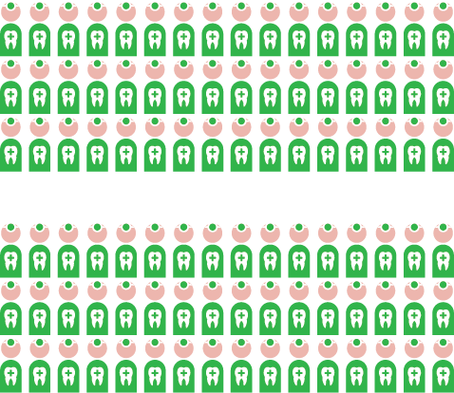


We Deliver the Largest Network of Dentists
Oklahoma’s Largest Dental Network
Our unmatched network strength means
your dentist likely participates with Delta Dental –
ask if your dentist is a Delta Dental PPO provider
to enjoy maximum savings!
Nearly 1,800 dentists practice in the state, and nearly 1,100 of those dentists participate in Delta Dental’s PPO network.
Nationwide
Access

Slide 103
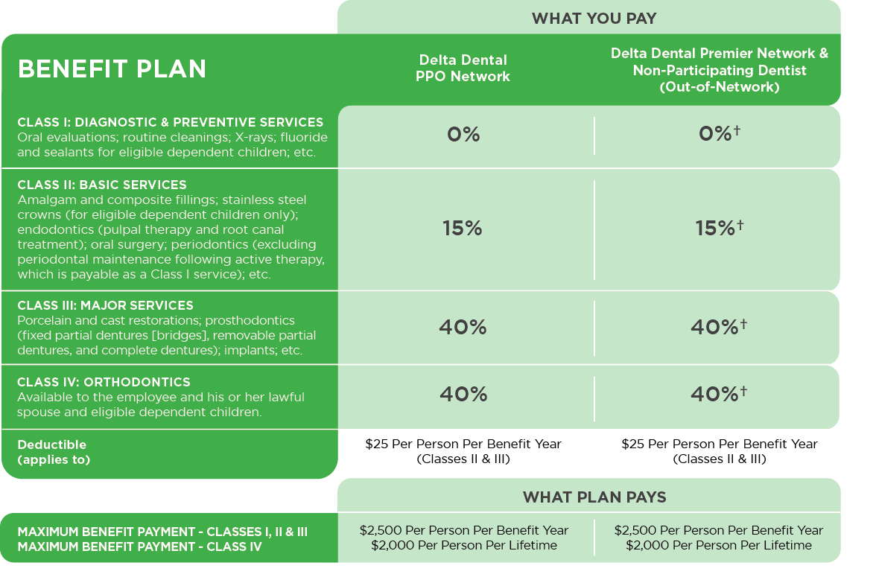
Option 1: Delta Dental PPO**
†If you receive treatment from a Delta Dental Premier provider, you will be responsible for the difference between the PPO allowable and Premier allowable amounts. If you are treated by a dentist who does not participate with Delta Dental (out-of-network), you will be responsible for the difference between the dentist charge and the PPO allowable amount.
**Dependents eligible To age 26

Slide 104
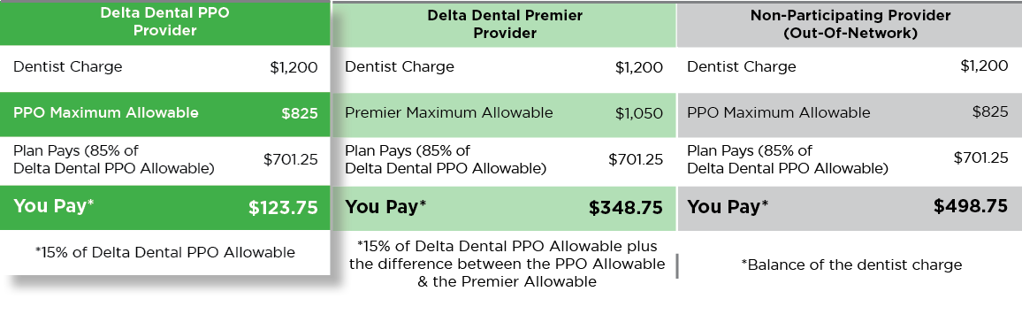
Option 1: Delta Dental PPO
This plan option provides access to both the Delta Dental PPO and the Delta Dental Premier networks. Subscribers of this plan are welcome to receive treatment from the licensed dentist of their choice, but will have lower out-of-pocket expenses when they visit a Delta Dental PPO participating dentist.
Example
Payment of a covered Class II dental service**
**Assumes deductible is satisfied

Slide 105
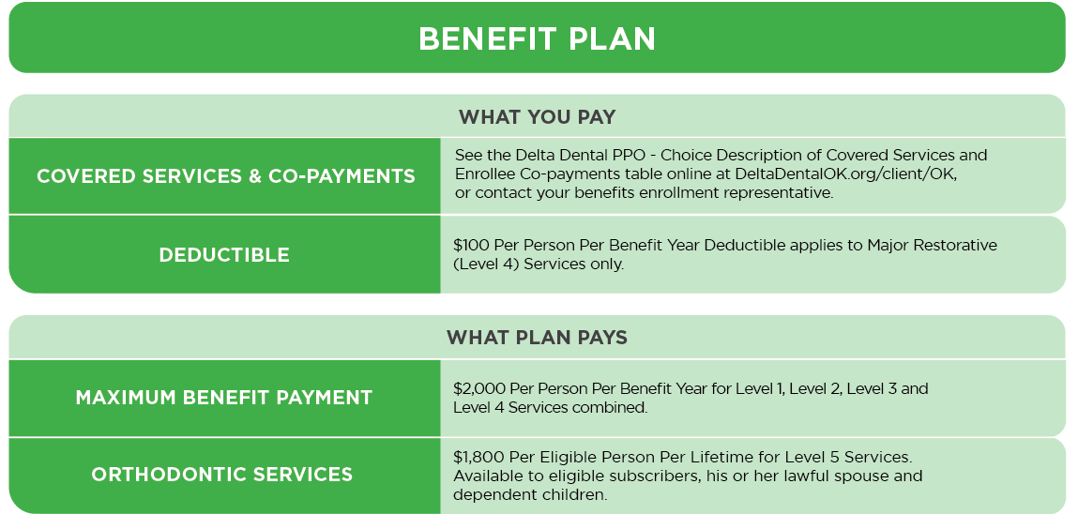
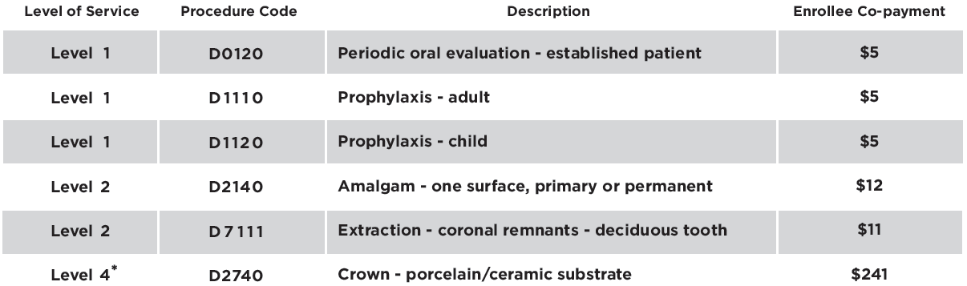
Option 2: Delta Dental PPO – Choice**
Members who select this low-cost program have access to the Delta Dental PPO network and will be responsible for the amounts reflected in the Delta Dental PPO – Choice Description of Covered Services and Enrollee Co-payments table along with any deductible. Their out-of-pocket expenses will be lower if they use a Delta Dental PPO provider.
Examples of Covered Services & enrollee Co-payments
*Assumes deductible is satisfied
**Dependents eligible To age 26

Slide 106

Visit Our Custom Website for State Employees
To learn more about the plans and services available to you with Oklahoma’s leading dental benefits provider, please visit DeltaDentalOK.org/client/OK
Review Plan Information
Search for Participating Dentists
Access Monthly Health Tip
Learn Answers to FAQs
Register for Spotlight to access:
  electronic ID card
  plan information,
  including Explanation of Benefits (EOBs)
  claim status and history, and more!
Initiate secure messages with our Customer Service team
Visit DeltaDentalOK.org/client/OK today!

Slide 107

We would welcome the opportunity to serve you and your family in 2023.
Please do not hesitate to contact us with any questions.
Live Answer Customer Service
Monday – Thursday, 7:00 a.m. – 6:00 p.m.
Friday, 7:00 a.m. – 5:00 p.m.
405-607-2100 (OKC Metro) 800-522-0188 (Toll Free)
DeltaDentalOK.org/client/OK

Slide 108

Dental Plan
WE LOVE TO MAKE
YOU SMILE!
HealthChoiceOK.com

Slide 109

WHY CHOOSE HEALTHCHOICE DENTAL?
  Network and non-network benefits available.
  Network providers file your claims for you.
  No limit on orthodontic benefit for members under age 19.
  $2,500 calendar year maximum benefit per person for preventive, basic and major services.

Slide 110

Preventive Services
Network and non-network covered at 100% of allowable amounts.
Cleanings and topical fluoride treatments; two per calendar year.
Bitewing X-rays; two per calendar year.
Full mouth X-rays; one every 36 months.

Slide 111

Basic Restorative Services
Extractions, including wisdom teeth.
Oral surgeries, including general anesthesia.
Root canals and crown repairs.
$25 per individual/$75 per family calendar year deductible.
Plan pays 85% of allowable amounts when using a network provider.

Slide 112

Major Restorative Services
  Initial placement of full or partial removable dentures.
  Dental implant approved by FDA.
  Inlays, onlays and crown restorations.
  $25 per individual/$75 per family calendar year deductible.
  Plan pays 60% of allowable amounts when using a network provider.

Slide 113

Orthodontic Services
  No lifetime maximum.
  No calendar year deductible.
  Orthodontic services for members under age 19.
  Orthodontic services for treatment of TMD at any age.*
  12-month waiting period applies to new enrollees to the plan.
  Plan pays 50% of allowable charges.
*If diagnosed with TMD, certification may be required.

Slide 114

Resources
HealthChoiceOK.com
  Dental handbook.
  Provider Search page.
  EGID Member Services
  405-717-8780 or 800-752-9475
HealthChoice Customer Care
  800-323-4314
TTY 711

Slide 115

Dental Insurance
Prepared for: State of Oklahoma
ADF# D2797.22

Slide 116

Why are dental benefits so important?
High cost of dental treatments
Benefit of preventive care
Connection between oral health
and overall health

Slide 117





A plan that offers savings, choice and anywhere, anytime service
Negotiated fees typically [30% to 45%] less than the average charges in the same area¹
Choose from a large
network of carefully selected participating dentists
Plus access to international dentists in more than 200 countries through MetLife’s International Dental Travel Assistance Program²
Flexibility to go to any dentist –
in or out of the network
Easy access to pre-treatment estimates, real-time claims processing and 24-hour customer service by phone, fax or online

Slide 118
Benefits High/Low plan design for
State of Oklahoma employees
Services Provided for High and Low plan | In Network: Percentage of Negotiated Fee | Out Of Network: Percentage of Reasonable & Customary (R&C)³
Type A: Preventive Services Exams X-rays Fluoride Treatment Cleanings | 100% Deductible Waived/ No Deductible | 100% No Deductible

Slide 119
Benefits High/Low plan design for
State of Oklahoma employees
Services Provided for High and Low plan | In Network: Percentage of Negotiated Fee | Out Of Network: Percentage of Reasonable & Customary (R&C)³
Type B: Basic Services Most Fillings Simple Extractions Root Canal | Services Covered at 85% High plan/70% Low plan, Deductible Applicable | Services Covered at 85% High Plan/70% Low plan, Deductible Applicable
Type C: Major Services Inlays/Onlays Crowns Bridges/Dentures | Services Covered at 60% High plan/50% Low plan, Deductible Applicable | Services Covered at 60% High plan/50% Low plan, Deductible Applicable
Annual Deductible | High plan - $25 Individual/$75 Family Low plan - $50 Individual/$150 Family | High plan - $25 Individual/$75 Family Low plan - $50 Individual/$150 Family
Annual Benefits Maximum [excluding Orthodontia] | High plan - $5,000 per person Low plan - $1,500 per person | High plan - $5,000 per person Low plan - $1,500 per person

Slide 120
Orthodontia
Services Provided for High and Low Plan | In Network: Percentage of Negotiated Fee | Out Of Network: Percentage of Reasonable & Customary (R&C)³
Type D: Orthodontia Orthodontic Treatment Orthodontic Appliances | Services Covered at 60% High plan 50% Low plan | Services Covered at 60% High plan 50% Low plan
Annual Deductible | High plan - $25 Individual/$75 Family Low plan - $50 Individual/$150 Family | High plan - $25 Individual/$75 Family Low plan - $50 Individual/$150 Family
Orthodontia Lifetime Benefits Maximum | High plan - $5,000 Adult and Child Low plan - $2,000 Adult and Child | High plan - $5,000 Adult and Child Low plan - $2,000 Adult and Child

Slide 121
Find a Dental Provider
With MetLife Dental insurance, you can choose from thousands of general dentists and specialists nationwide. You can find the names, addresses, languages spoken and phone numbers of participating dentists by searching our online Find a Dentist directory.
Step 1:
Go to metlife.com
Step 2:
Select “Find a Dentist” next to What would you like to do today?"
Step 3:
Select "PDP" next to
"Choose your network."
Enter your Zip, City or State and select the
“Find a Dentist” button. You will then be prompted to select your plan from the list. The plan name
is located in your Schedule of Benefits.

Slide 122


Helping you make smarter choices
Oral Health Education made easy
Dentist Education &
Communication
Patient Education &
Communication
Visit MetLife’s Oral Health Library
www.oralfitnesslibrary.com

Slide 123
Creating your own personal safety net
MetLife provides you...
So you can...
decades of experience in the
dental benefits industry
rest assured that we have the experience
to understand what matters most to you
benefits designed with input
from dentists and other specialists
feel confident that you have the
coverage you need with a broad
network of pre-screened dentists
a knowledgeable service team
utilize our services to help you make
the most of your benefits
educational tools and resources
make informed decisions about
your benefits and your oral health

Slide 124

After you enroll
Register with MyBenefits today!
www.metlife.com/mybenefits
Customer Service Information
Preferred Dentist Program
1-800-942-0854

Slide 125
Footnotes and disclosures
[* Please note: This is a hypothetical example that reviews a crown – porcelain/ceramic substrate (D2740) in the Philadelphia area, zip 19151. It assumes that
the annual deductible has been met. Fees in your area may be different.
** Please note that the in-network patient responsibility copayment may not necessarily represent the full extent of your out-of-pocket expense. Where two or more professionally acceptable treatments under generally accepted dental standards exist and where the treatment is a covered service, your MetLife plan bases reimbursement, and your copayment, on the least costly treatment alternative. If a treatment rendered is more costly than the alternative treatment on which your benefit is based, you are responsible for the amounts "including, but not limited to: any deductibles, the copayment for the treatment upon which your benefit was based, and, if your treatment was rendered by an participating provider, the amount by which the scheduled fee for the treatment actually rendered exceeds the scheduled fee for the less costly alternative, and if your treatment was rendered by an out-of-network provider, the amount by which the amount charged by your provider exceeds the scheduled fee for the less costly alternative.
† Not available in all states.
†† Assumes there is no gap in MetLife dental coverage under your employer’s plan. Exact timeframes are determined by the employer.
††† MetLife coverage refers to dental plans underwritten or administered by MetLife.
Based on internal analysis by MetLife. Negotiated Fees refers to the fees that in-network dentists have agreed to accept as payment in full for covered services, subject to any co-payments, deductibles, cost sharing and benefits maximums. Negotiated fees are subject to change.
International Dental Travel Assistance services are administered by AXA Assistance USA, Inc. AXA Assistance USA, Inc. provides dental referral services only. AXA Assistance is not affiliated with MetLife, and the services and benefits they provide are separate and apart from the insurance provided by MetLife. Referral services are not available in all locations.
R&C fee refers to the Reasonable and Customary (R&C) charge, which is based on the lowest of (1) the dentist’s actual charge, (2) the dentist’s usual charge
for the same or similar services, or (3) the charge of most dentists in the same geographic area for the same or similar services as determined by MetLife.
Reimbursement for out-of-network services is based on the lesser of the dentist’s actual fee or the Maximum Allowable Charge (MAC). The out-of-network Maximum Allowable Charge is a scheduled amount determined by MetLife.
Like most group benefit programs, benefit programs offered by MetLife and its affiliates contain certain exclusions, exceptions, limitations, waiting periods, and terms for keeping them in force. Please contact MetLife or your plan administrator for costs and complete details.

Slide 126
Thank you.
Notes:
Thank you all for your time and I will be happy to answer any questions you may have.

Slide 127

YOUR BENEFITS FROM SUN LIFE
Discover new ways to protect what you love
Janet Ruggiano
Benefit Counselor, Sun Life

Slide 128
Dental Insurance
PROTECTS YOUR SMILE.
PREVENTS OTHER HEALTH ISSUES.
LOWERS OUT-OF-POCKET EXPENSES.

Slide 129

Dental problems can impact your overall health
Treating the inflammation from periodontal disease can help manage other health problems such as heart disease and diabetes.¹
50% of adults over the age of 30 are suffering from periodontal disease.²
1. https://www.perio.org/consumer/gum-disease-and-other-diseases (accessed 07/21)
2. https://www.perio.org/newsroom/periodontal-disease-fact-sheet (accessed 07/21)

Slide 130

PPO Plan Key Points
Deductible: $30 per person*
Annual Maximum: $2,000 per person**
Freedom to choose dentists both in and out of the network
*Per calendar year
**Type IV expenses is a Lifetime max, all other expenses are per calendar year

Slide 131

Coinsurance for covered services
These are the percentages you pay of the provider’s fee (after any applicable deductible has been satisfied).
PROCEDURE | IN-NETWORK | OUT-OF-NETWORK
Type I Services | 100% | 100%
Type II Services | 85% | 70%
Type III & IV Services | 60% | 50%

Slide 132

Network dentists can save you* $$
EXAMPLE | NETWORK DENTIST | NON-NETWORK DENTIST
Average charge for crown** | $1,180 | $1,180
Minus network discount | 30% | NA
Actual Fee | $826 | $1,180
Insurance pays 50% | $413 | $590
Claimant pays | $413 | $590
You could save $177 by going to a network dentist!
*This example is for illustrative purposes only. Cost of dental procedures may differ depending on location or dental provider. Savings may also differ in cases when deductibles apply or if the dentist’s discount differs from 30%
**Based on 2020 Fair Health data. Figures have been rounded to the nearest dollar.

Slide 133
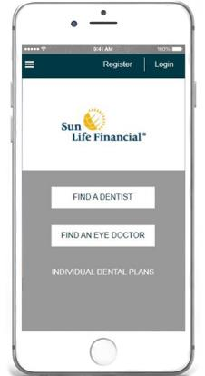
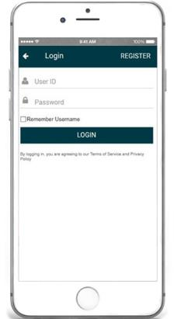
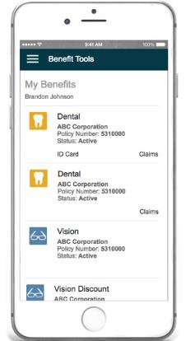
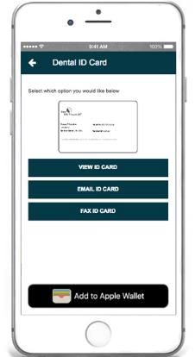
Benefit Tools
Quick & easy mobile access
Learn more at Sunlife.com/mobileapps
Your Benefits Information – An Overview of Coverage Details
Find a Dentist “Anywhere” or “Nearby”
Find & Access Critical Information
On The Go!
View, Email, Fax and Print Dental ID cards

Slide 134

How to find a dentist
Visit www.sunlife.com/findadentist
  Select the network listed on your
  ID Card
  Enter your search criteria and a
  list of participating
  dentists will be provided
Call customer service at 800-442-7742 for assistance in locating a network dentist
Use the Provider nomination card if your dentist is not in our network of dentists.

Slide 135
Questions?

Slide 136
Not approved for use in New Mexico.
This dental plan does not provide coverage for pediatric oral health services that satisfies the requirements for “minimum essential coverage” as defined by the Patient Protection and Affordable Care Act. (“PPACA”).
Group insurance policies are underwritten by Sun Life Assurance Company of Canada (Wellesley Hills, MA) in all states, except New York, under Policy Form Series 15-GP-01 and 16-DEN-C-01. In New York, group insurance policies are underwritten by Sun Life and Health Insurance Company (U.S.) (Lansing, MI) under Policy Form Series 15-GP-01 and 16-DEN-C-01. Product offerings may not be available in all states and may vary depending on state laws and regulations. Prepaid dental products are provided and administered by Sun Life Assurance Company of Canada (SLOC) under Form Series BDC-GDSA, PDC, and are provided by prepaid dental companies, affiliated with SLOC, under Form Series BDC-GDSA, UDC-CA-GA06-UDC, UDC-CA-GA06-89, FB-NJ-0281, UDC-09-GDSA-TX, PDC in certain states except New York. Prepaid dental companies are Denticare of Alabama, Inc., United Dental Care of Arizona, Inc., UDC Dental California, Inc., United Dental Care of Colorado, Inc., Union Security DentalCare of Georgia, Inc., United Dental Care of Missouri, Inc., Union Security DentalCare of New Jersey, Inc., United Dental Care of New Mexico, Inc., UDC Ohio, Inc., United Dental Care of Texas, Inc., and United Dental Care of Utah, Inc. In New York, prepaid dental products are provided and administered by Sun Life and Health Insurance Company (U.S.) (SLHIC) (Lansing, MI) under Form Series BDC-GDSA-NY.
© 2019 Sun Life Assurance Company of Canada, Wellesley Hills, MA 02481. All rights reserved.
Sun Life and the globe symbol are trademarks of Sun Life Assurance Company of Canada. Visit us at www.sunlife.com/us.
GVMPPPT-EE-4496A-v SLPC 29760

Slide 137
Vision plan presentations

Slide 138
All vision plans
Coverage for exams, lenses, frames, contact lenses and more.
Designated provider networks.
Limited coverage for services by non-network providers.

Slide 139




Vision plans

Slide 140

PRIMARY VISION CARE SERVICES
An Oklahoma Vision Care Company
www.pvcs-usa.com | 888-357-6912

Slide 141


PVCS offers one easy to understand plan with year-round vision benefits
EXAMS
Exams are covered in full (Not limited to once per year)
MATERIALS
Frames – Member pays *wholesale cost
Lenses and lens options – Member pays *wholesale cost
Contact lenses – Member pays *wholesale cost (with a $50 copay for first time fittings)
Members are eligible for both glasses and contacts in the same plan year
*Wholesale cost is the manufacturer’s published list price plus tax and shipping rounded up to the nearest $5.00
Savings on glasses is approximately 50%

Slide 142

Network Benefits
Over 350 independent optometrists and ophthalmologists statewide
All providers dispense glasses and contacts
Glasses can be made at the lab of their choice, including their own lab resulting in quick delivery
No ID Card required
Simply select a PVCS provider and identify yourself as a PVCS member
Eye exams are covered 100% and not limited to once a year
Members are eligible for glasses and contact lenses in the same plan year
Members allowed as many pairs of prescription glasses as wanted or needed
Prescription glasses and contact lenses are provided at wholesale cost
Non-network benefit reimbursement up to $40 for an eye exam and up to $60 for prescription glasses or contact lenses in lieu of network benefits.

Slide 143
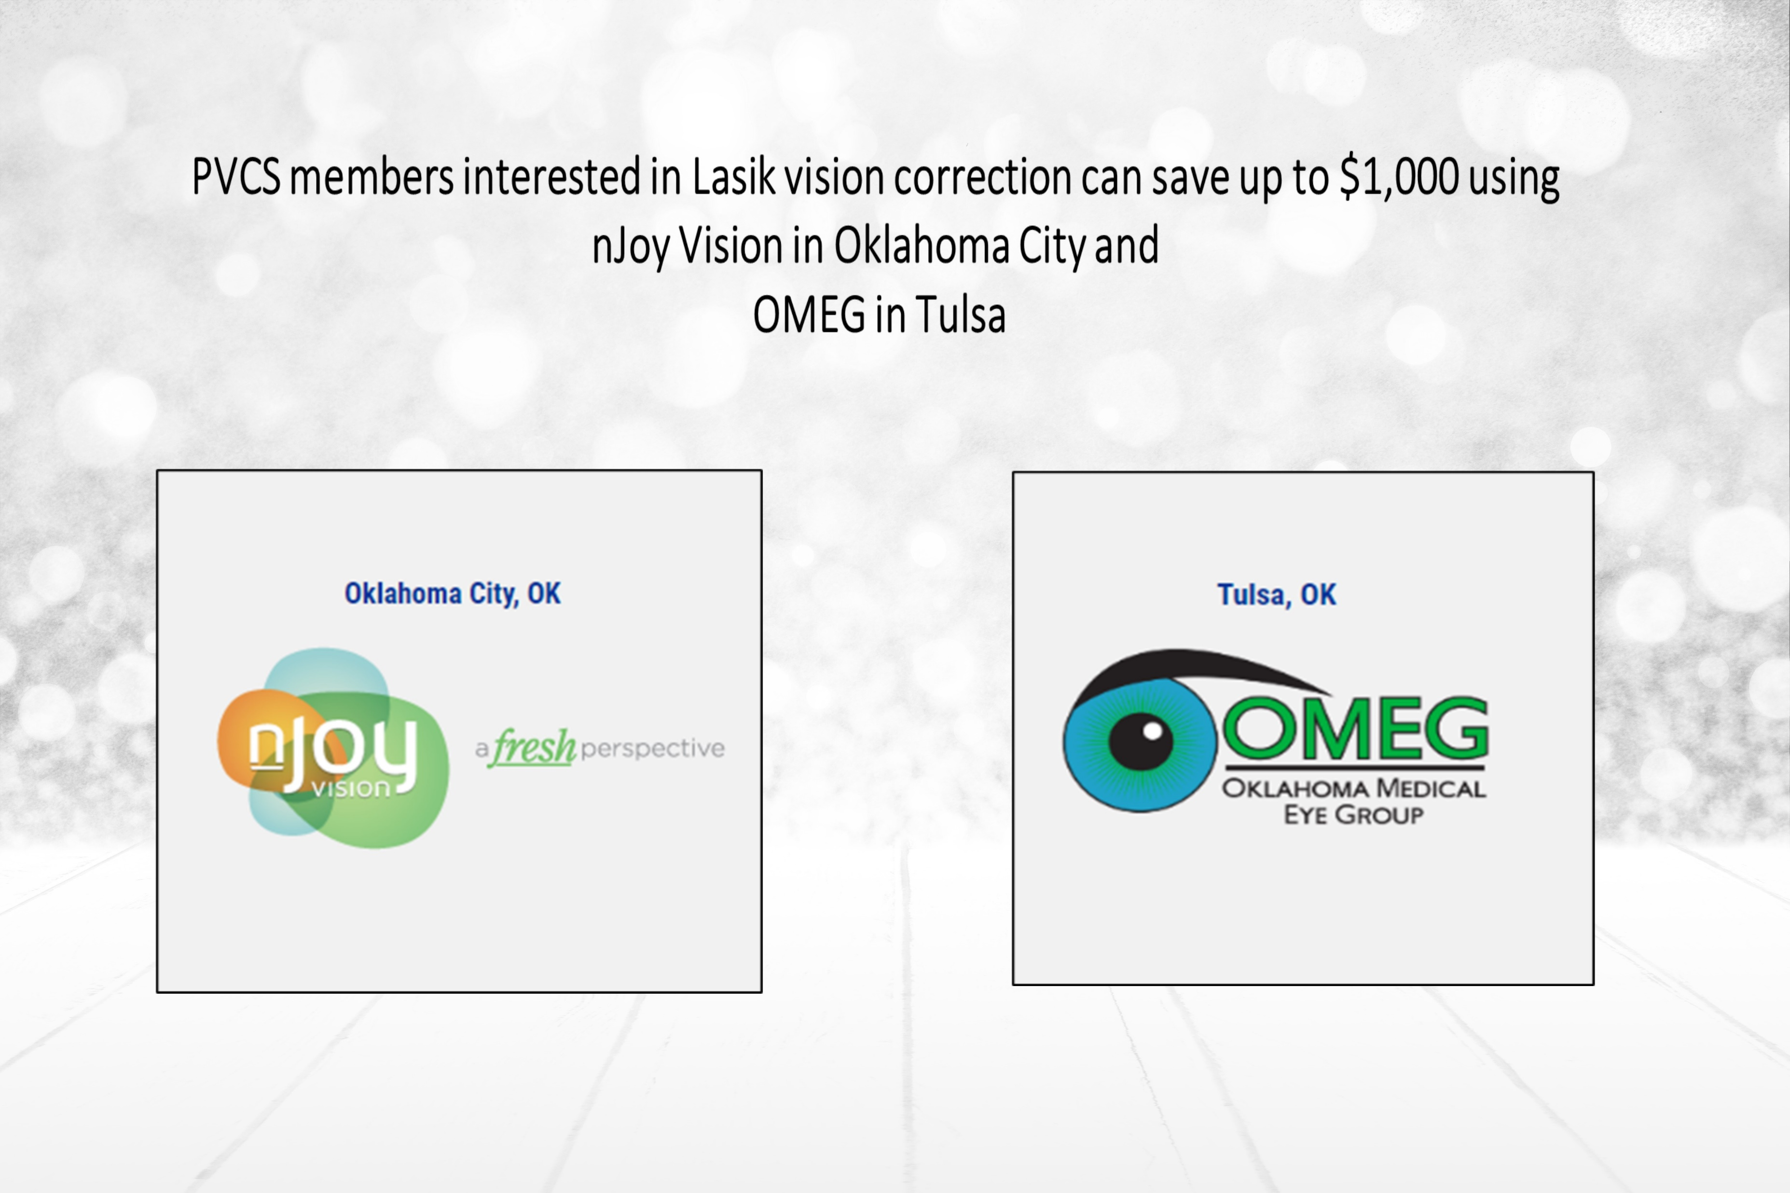

Slide 144

The difference is clear…

Slide 145


Questions?
Call our live answer Customer Service
1.888.357.6912
Email us at email@pvcs-usa.com
Visit our website at www.pvcs-usa.com

Slide 146

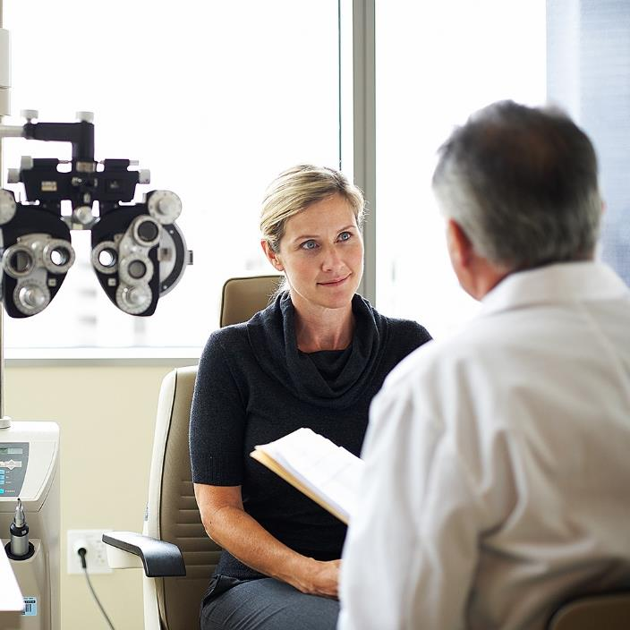
Open enrollment for State of Oklahoma
2023 plan year

Slide 147

An overview of your vision benefits
Offers flexibility and choice
In-network benefits available through network eye care professionals or go out-of-network and be reimbursed at your plan's out-of-network rates.
Find an in-network eye care professional at superiorvision.com. Call your eye doctor to verify network participation.
Obtain a vision exam with either an MD or OD.
Use different eye care professionals for exam and for eyewear.
No claim forms or vouchers required for in-network services.
Personalized ID card in the mail and in the app (not required, but recommended for convenience when visiting an eye
care professional).

Slide 148
Your in-network vision benefits
In-network benefit | Member copays
Routine eye exam (one per calendar year) Ophthalmologist (MD) or Optometrist (OD) | $10
Frames & lenses (one pair lenses per calendar year) Standard lenses (single vision, bifocal, trifocal and standard progressive lenses) | $25
Contact lens fitting (one per calendar year) | $25
In-network benefit | Member allowances
Frames (one per calendar year) | $150 retail allowance
Contact lenses (one allowance per calendar year) Elective Medically necessary | $150 retail allowance Covered

Slide 149
Your out-of-network vision benefits
Out-of-network benefit | Member reimbursement
Routine eye exam (one per calendar year) Ophthalmologist (MD) or Optometrist (OD) | $34, less $10 copay (MD) $26, less $10 copay (OD)
Eyeglass lenses (one pair lenses per calendar year) Standard lenses (single vision, bifocal, trifocal) | $26, less $25 copay (Single) $39, less $25 copay (Bifocal) $49, less $25 copay (Trifocal) $39, less $25 copay (Standard Progressive Lens)
Contact lens fitting (one per calendar year) | Not Covered
Out-of-network benefit | Member reimbursement
Frames (one per calendar year) | $81, less $25 copay
Contact lenses (one allowance per calendar year) Elective Medically necessary | $100 $210

Slide 150



You can also get value-added discounts
Discounts on covered eyewear
20% for amounts over the frame or contact lens allowances, lens add-ons, and other prescription materials on first pair of glasses
10% off retail for specialty contact lens fit
Discounts on non-covered eyewear
30% on extra pairs of eyeglasses
30% off additional exams
20% for lens options on extra eyeglasses
20% off additional contact lenses
10% for additional, disposable contacts
$39 max out-of-pocket for retinal imaging
LASIK discounts
Members can see low prices (typically under $1,000 per eye) on LASIK procedures administered by QualSight.
*Out-of-pocket costs may vary based upon plan design.

Slide 151

Have questions?
Join us online or give us a call
  Website: superiorvision.com
  Phone: 1 (800) 507-3800
  Live support:
    Monday – Friday: 8AM – 9PM CST
    Saturday: 10AM – 4:30PM CST
  Benefit information
  Eligibility status
  Claims information
  Eye care professional listings
  Assistance with issues and special requests
We have answers!

Slide 152
MetLife Vision benefits are underwritten by Metropolitan Life Insurance Company, New York, NY. Certain claims and network administration services are provided through Superior Vision Services, Inc. (“Superior Vision”), a Delaware corporation. Superior Vision is part of the MetLife family of companies. Like most group benefit programs, benefit programs offered by MetLife and its affiliates contain certain exclusions, exceptions, reductions, limitations, waiting periods and terms for keeping them in force. Please contact MetLife or your plan administrator for costs and complete details.
SVS-MKG20-0293v001 PPT 06/2020

Slide 153


2023
VISION PLAN
OFFERING

Slide 154



Slide 155

2023 PLAN HIGHLIGHTS
We now have one of the largest networks in the state and are constantly adding
new providers!

Slide 156

2023 PLAN HIGHLIGHTS
Our national network now includes retail stores like:
Eyemart Express, Pearle Vision, Walmart and Sams Club and MyEyeDr.

Slide 157
2023 PLAN HIGHLIGHTS
No surprise out-of-pocket costs at time of service.

Slide 158



FOCUSED ON YOU
EYE EXAMS
GLASSES
CONTACTS
Comprehensive Eye Health
Early Disease Detection
ANY Frame
$150 Allowance
$150 Allowance
$65 Fitting Fee
$15 MEMBER FEE
$15 MEMBER FEE
$0 MEMBER FEE
Get a complete pair of glasses for as little as $30.00
Notes:
VCD is Patient Focused!
Even if you don’t wear glasses, we urge you to get an annual eye exam.
It is important to get your eyes checked each year since your doctor can see most chronic diseases before they become serious. You can go to and M.D. or and O.D. to have your exam The most important thing is you have an exam every year.
If you need multiple exams in a year, generally its due to a medical reason and by law will be billed to your health insurance and you will have to pay your specialty doctor co-pay. We believe you shouldn’t loose the value of the exam you are paying for, so we have flex exam that gives you $55 to cover those copays or anything you choose to spend it on in your doctor’s office. This is in lieu of your annual eye exam.
You pay only $15 for your exam, $15 for your lenses and we give you $130 to spend on frames, or in lieu of frames on contacts.
Unlike other plans, VCD does not require a prescription to get Sunglasses.
Next Slide

Slide 159

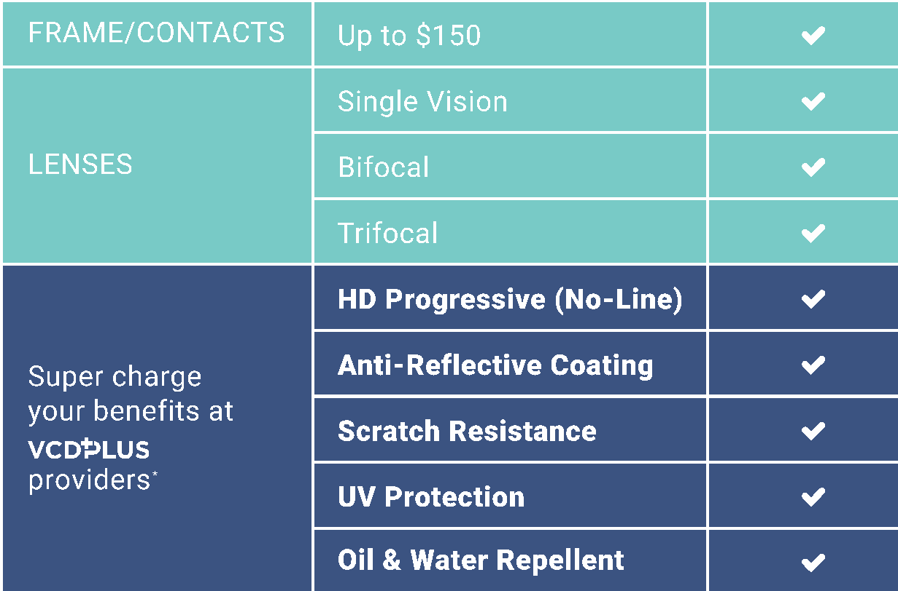

GREAT VCD BENEFITS, PLUS MORE.
At last, you finally have the freedom to use your materials allowance the way you want without all the surprise out of pocket expenses.

Slide 160






LASIK Discount Network Providers
Get full details and downloadable flyers at ok.vision/lasik-discount-network/

Slide 161

LOCALLY OWNED AND OPERATED
BY INDEPENDENT OPTOMETRISTS THAT LIVE AND WORK IN YOUR COMMUNITY
Local Customer Service
Tax Revenue Stays Local
Supports Teachers
Doctor Controlled Care
Patient Focused

Slide 162

CONTACT US
855-918-2020
www.okstate.vision
oklahoma@visioncaredirect.com

Slide 163

It’s Time to Enroll
Get to Know Your
VSP Vision Benefits.
Benefits Effective January 1, 2023

Slide 164
Your VSP Plan at a Glance
Exam | WellVision Exam covered every calendar year $10 Copay
Essential Medical Eye Care | Retinal imaging for eligible members with diabetes Additional exams and services beyond routine care to treat immediate issues from pink eye to sudden changes in vision or to monitor ongoing conditions such as dry eye, diabetic eye disease, glaucoma, and more Coordination with your medical coverage may apply. Ask your VSP network doctor for details
Frame Allowance | $170 Frame allowance every calendar year + $50 allowance for featured frame brands
Lenses (every calendar year) | Single vision, lined bifocal, or lined trifocal lenses for adults. $25 Copay for prescription lenses and/or frames Single vision, lined bifocal, or lined trifocal polycarbonate lenses for children. $25 Copay included in glasses
Lens Enhancements | Standard Progressive lenses and UV protection are covered with $0 copay 30% savings on lens enhancements like Scratch-resistant coating, or Anti-glare coatings
Contact Lens Allowance (instead of glasses) | $120 allowance for contacts lenses and copay up to $60 for contacts lens exam (fitting and evaluation)
Retinal Imaging | No more than a $39 copay on routine retinal screening as an enhancement to a WellVision Exam

Slide 165






Participating Retail Chains
There are more than 10,000 retail chain locations in
the VSP network in addition to Visionworks, including:
Walmart Vision Center
Costco Optical
Pearle Vision
MyEyeDr
Sam’s Club
and More!

Slide 166




Exclusive Member Extras
Get the Savings You Need.
With Exclusive Member Extras, savings never looked so good. VSP puts members first by providing you with exclusive special offers. Discover great deals on glasses, sunglasses, contact lenses, and more.
        Special Deal on Glasses - Extra $50 on Featured Frame Brands.
Save 30-40% on popular lens enhancements*.
Save 20% on eyewear
Offers vary based on state and benefit plan. Brands and offers subject to change.
*Savings based on doctor’s retail price and vary by plan and purchase selection; average savings determined after benefits are applied. Ask your VSP network doctor for more details.

Slide 167

Using Your Benefit is Easy
Once you’re enrolled…
Create an account at vsp.com and review your personalized benefit information.
You can find a VSP in-network doctor by visiting vsp.com or
calling 800.877.7195.
At your appointment, simply tell them you have VSP. No ID card needed—and we’ll take care of the rest! There are no claim forms to fill out when you see a VSP network doctor.

Slide 168

Enroll Today!
VSP helps you see well and be well with
the coverage and quality care you deserve.
Questions? Contact us.
Call 800.877.7195 or stateofok.vspforme.com.
©2022 Vision Service Plan. All rights reserved.
VSP, WellVision Exam, and "See Well. Be Well." are registered trademarks of Vision Service Plan.
All other brands or marks are the property of their respective owners. 102051 VCCM

Slide 169
Life plan

Slide 170

LIFE
PLAN
HELPING YOU BUILD A SOLID FOUNDATION
HealthChoiceOK.com

Slide 171

OVERVIEW
  Peace of mind with financial protection.
  Group term life plan.
    No cash-surrender value.
    Benefits do not decrease based on age.
  Basic and Supplement Life Insurance benefits available.
  First $40,000 of coverage includes Accidental Death and Dismemberment for employees who are actively working.
  Dependent Life is available to current employees enrolled in Basic Life.
  Beneficiary updates can be made at any time.

Slide 172
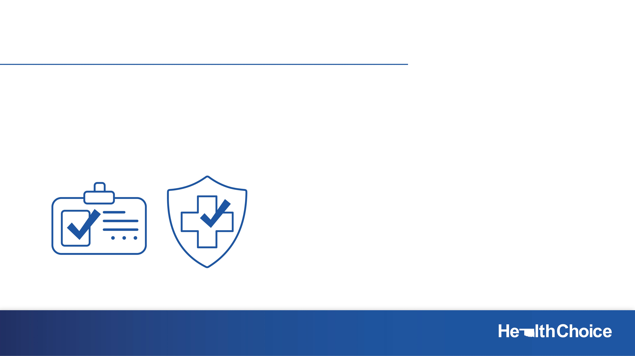
ELIGIBILITY REMINDERS
  Current employees
  Former employees
  Eligible to elect Basic Life if working for a participating employer and have verifiable group health coverage.
  Eligible former employees can keep all or a portion of the life coverage in effect at time of termination.
  You cannot reinstate any coverage you canceled unless you return to work with a participating employer.

Slide 173

CURRENT EMPLOYEE OPTIONS
Basic Life: $20,000 (includes AD&D).
Initial Supplemental Life: $20,000 (includes AD&D).
Maximum amount of Supplemental Life: $500,000.
  Guaranteed Issue: Amount of Supplement Life available only to new hires.
During annual Option Period: enroll in or increase life coverage.
Life insurance application required.

Slide 174

FORMER EMPLOYEE OPTIONS
  Keep member benefits in $5,000 units.
  Keep any Dependent Life coverage in force in $500 units.
  Decrease or drop life coverage during the annual Option Period.
  Dependent life premiums are per covered dependent.

Slide 175

CURRENT EMPLOYEE OPTIONS – DEPENDENT LIFE
  Primary member must be enrolled in Basic Life.
  Set premium per level, regardless of number of dependents.
  No Life Insurance Application needed.
  Three levels of coverage
  Low Option $6,000 spouse $3,000 per child
  Standard Option $10,000 spouse $5,000 per child
  Premier Option $20,000 spouse $10,000 per child
  Benefits for Dependent Life coverage are always paid to the primary member. No AD&D benefits included.

Slide 176

LIFE INSURANCE APPLICATION
  Required when enrolling in or increasing member life coverage.
    Current employees who are actively working only.
  Incomplete applications returned with automatic denial.
  Two years of medical records required for requests greater than $300,000.
  No application is needed when:
    No changes.
    Decreasing or dropping coverage.
    Adding Dependent Life only when Basic Life is in place.

Slide 177
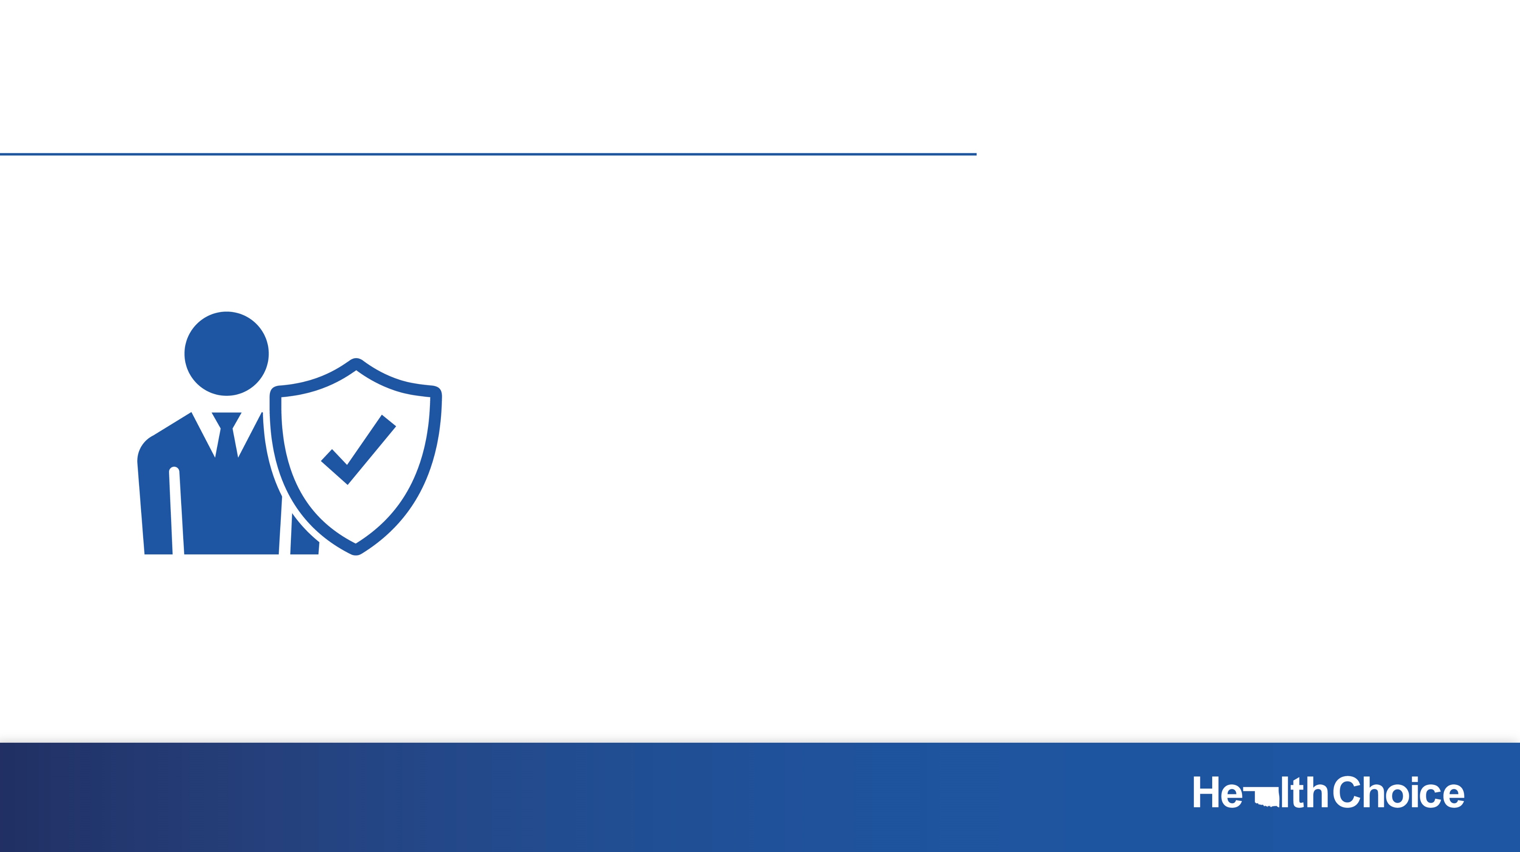
BENEFICIARIES
  Submit a Beneficiary Designation Form.
  Designate how you wish your life benefits be paid upon your death – to whom and how much.
  Designate a contingent as the alternate beneficiary.
  Life events happen; make sure your beneficiary information is current.
  If you do not name your beneficiaries, benefits are paid to your estate.
  HealthChoice has no option but to pay life benefits to the beneficiaries listed in our files at the time of death.

Slide 178
Beneficiary Designation Form
  In the event of your death, benefits are paid to your beneficiaries in a lump sum.
  You can change beneficiaries at any time, but you must submit an updated Beneficiary Designation Form or a written request for a change.
  If you do not name your beneficiaries, benefits are paid to your estate.
  HealthChoice has no option but to pay life benefits to the beneficiaries listed in our files at the time of death.

Slide 179
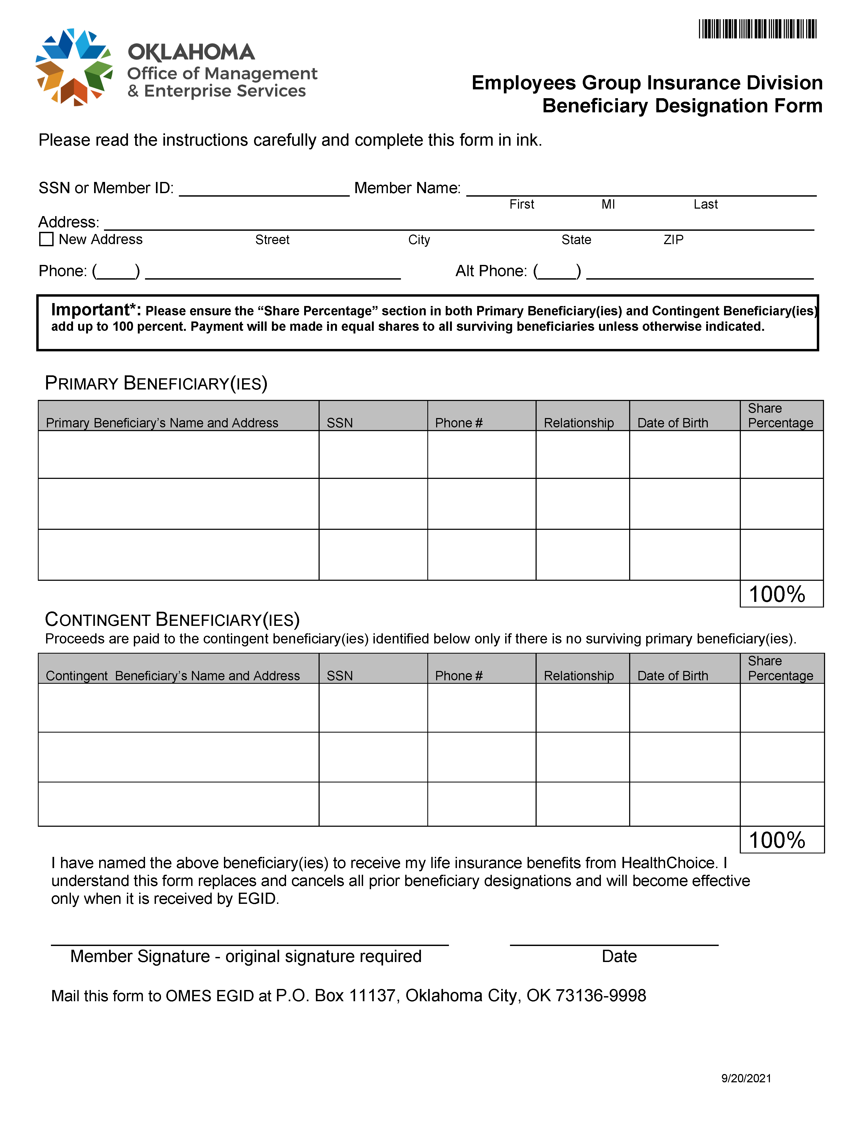
Beneficiary Designation Form
Encourage employees to update their beneficiary form.
Beneficiary information can be updated at any time.
Remind employees to keep copies at home.

Slide 180

Resources
HealthChoiceOK.com
  Life Insurance Handbook.
  Beneficiary Designation Form.
  Life Insurance Claim Form.
  EGID Member Services
  405-717-8780 or 800-752-9475
HealthChoice Customer Care
  800-323-4314
TTY 711

Slide 181

Thank you for attending

