Slide 1
Higher Education Payroll Processing & Reporting Jan 2016
Q & A Session
OCTOBER 14, 2015

Slide 2
Session Overview
Project Update
Employee Terminations Process
Security
HCM roles
OpenBooks
Payroll data
Financials roles
GL
AP
OST roles
ACES
Banking system
After separation security maintenance

Slide 3
Project Update
HCM > Financials
500 Misc
PFT
Testing
Each institute will provide a testing file during Integration or User Acceptance Testing
REMINDER:
Budgets must be in Hyperion (Email sent by Sheri Mauck on October 2, 2015)

Slide 4
Project Update
User Acceptance Testing
10/26/2015-11/25/2015
Training
11/03/2015
Journal Entry/Accounts Payable/Federal Tax Payments
OST Validation
11/16/2015-11/25/2015
Go Live
12/10/2015

Slide 5
Important Dates Reminder
October 14
ACA & Child Support Survey
October 26
Higher Ed FEINs
November 3
Training for Financials and OST
November 16
ACES and Participant Maintenance OST security forms
November 30
301JE security forms
301 security forms-TBD
Ayana.Wilkins@omes.ok.gov

Slide 6
Follow-up Items
Test files
Security
ACA
Axxx00.HIED.ACALIST.E000001T.RECD
Initial list from institutions
Axxx00.HIED.ACAMULT.E000001T.RECD
Information for printing/reporting of multiple agency employees
Information for printing/reporting of other employee
Open Books
File name
Chat Questions

Slide 7
Employee Termination Process
Options
Higher Ed to terminate all employees, all EmplRcds
OMES mass update to terminate all employees, all EmplRcds
Termination Info
HR Status: Inactive
Action: TRM (termination-Higher Ed)
Reason: HMT (Higher Ed Mass Term)
Effective Date: 01/01/2016
Last Date Worked: 12/31/2015
OMES update scheduled: tentatively for Saturday January 2, 2016

Slide 8
Security
HCM roles
OpenBooks
File upload
Desktop browse and load
Payroll data
Paycheck
W2
Balances

Slide 9
Security
Financials roles
GL
Higher Ed Payroll Load role
500 Misc
PFT
AP
TBD

Slide 10
Security
OST roles
ACES
Banking system

Slide 11
Security
After Separation Security Maintenance
PeopleSoft
HelpDesk Case
Email
Security form

Slide 12
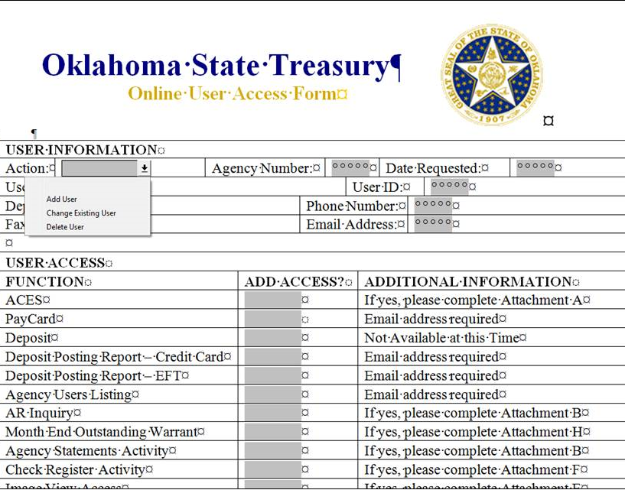
Security
After Separation Security Maintenance
ACES
OST banking system

Slide 13
Questions
Questions???
Ayana.Wilkins@omes.ok.gov

Slide 14
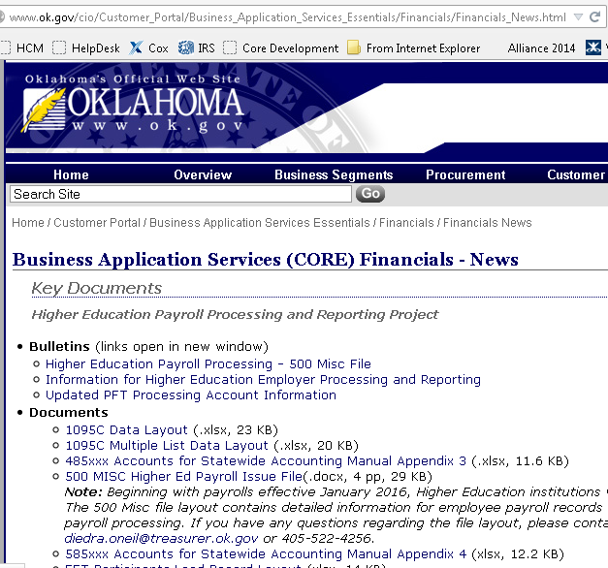
Website
http://www.ok.gov/cio/Customer_Portal/Business_Application_Services_Essentials/Financials/Financials_News.html

Slide 15
Recap
Roll call
ACA/Child Support survey
Chat window questions:
“090” “FTP” or “browse & load” or “not sure”
“090” “OTC yes” or “OTC no”

Slide 16
Next Session
October 28, 2015 3:00 – 5:00 pm
Project Update
Vendor File – employee payments
OTC annual employee reporting

