Slide 1
OMES New Template Revisited
Introducing the Procurement Information Request and the Acquisition Planning Worksheet

Slide 2
Learner outcomes
After the completion of this course, students will:
Know what stayed the same and what changed.
Understand the difference.
Confidently complete the Acquisition Planning Worksheet.

Slide 3
New contract structure
At the beginning of 2020, OMES Central Purchasing implemented a new contract structure.
A webinar in December 2019 outlined the changes.
Access the complete webinar presentation in Learn.
Find a condensed version of the slides on the OMES website.
Notes:
Thank you Louise……..
Welcome to the “new” Procurement Information Request.
We want to make sure that everyone has watched the December webinar that explained the new contract structure.
If you haven’t watched that webinar, that’s ok.
We’re going to give you a quick overview of some of the information that was discussed.
If you haven’t watched it please go to the webinar in Learn and watch this particular training.
The link to the Brown Bag webinar and the link to the information on the CP website you will need is on the slide.
Helpful information about the new structure will be covered today, however, please feel free to reach out to the Central Purchasing with any questions you may have.

Slide 4
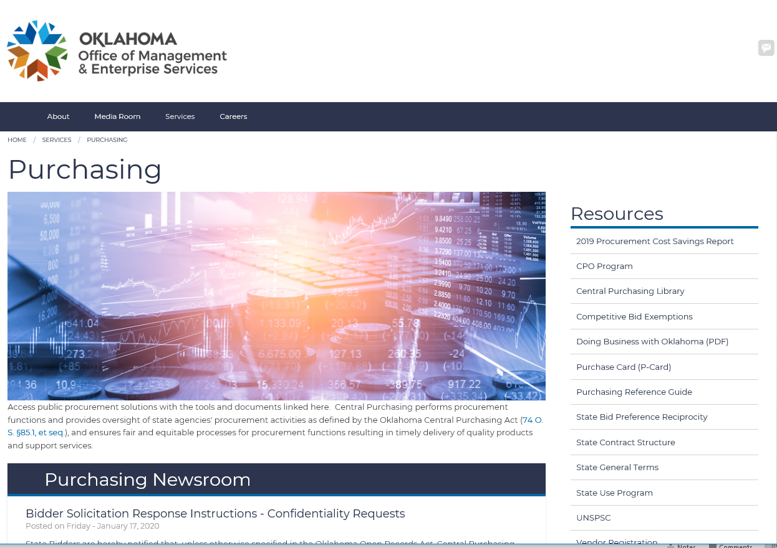
State contract structure
Notes:
The website address to take you to the new contract structure is on the screen at the top.
Once you get there click on the State Contract Structure under Resources.
This will take you to the links we’ve set up for you to go to the different aspects of the new template.

Slide 5
What is the same?
The information an agency attaches to a requisition submitted to OMES Central Purchasing is primarily the same except one new ask, listed as No. 1 on the next slide.
Notes:
Let’s talk about what is the same.
Nothing much has changed except one new ask.

Slide 6
What is different?
Two big differences:
The one agency ask:
An agency will need to compare its standard contract terms (formerly Section B of the RFP) to the State of Oklahoma General Terms.
Remove from agency terms any provisions that are duplicates of provisions in the state general terms. For many agencies, this deduplication has reduced terms to a few pages.
Note: An agency will go through this once. Afterward, the agencies should only revise their terms as required for specific acquisitions. OMES will not keep these terms on file. Attach a Microsoft Word list of contract terms the agency wishes to include in the procurement documents. Please confirm if no agency-specific terms are needed.
Notes:
OMES asks that you compare the agencies specific terms to the State General Terms.
The online location for these terms is on the slide.
Please remove any agency terms that are duplicates of General Terms.
After you’ve created your terms, you can use that document to submit for future contracts.
You can update your terms as needed but please don’t duplicate what is in the State General Terms.

Slide 7
What is different, cont.
Two big differences:
While the information is the same, the form in which the information is provided and its location in the procurement documents is not.
The structure of documents is entirely different.
The former RFP document – with sections A, B, C and so forth – is obsolete.
Therefore, attaching the former RFP format to a requisition will delay issuance of the RFP.
Refer to the webinar slides for a helpful guide between the former RFP sections and the sections of the new contract structure.
Notes:
Let’s talk about what is different.
The structure of the documents is different.
The former RFP is obsolete.
Please don’t use the old RFP documents after 7/1/2020 when submitting to Central Purchasing.
Once again, the December webinar has a helpful crosswalk for agencies.

Slide 8
What an agency provides Central Purchasing
An agency may use either of the two alternatives described in this presentation to provide the procurement information with a requisition.
We recommend Alternative 1 for agencies new to the change. OMES is glad to schedule a planning meeting before an agency submits information, if needed.
For agencies using Alternative 2, the online Acquisition Planning Worksheet may be a helpful guide.
Regardless of the alternative, the procurement documents will be sent to the agency as usual, along with a suggested timeline for approval prior to issuance of the bid.
Notes:
Now what do you send to Central Purchasing?
There are two alternatives.
Alternative 1 has an Acquisition Planning Worksheet to fill out and is recommended for an agency that is new to this structure.
Central Purchasing can meet with you to discuss the information in Alternative 1 prior to submitting your first requisition.
Alternative 2 may be used by an agency that has knowledge and experience with the new template.
As usual, Central Purchasing will send you the procurement documents and the timeline for approval prior to posting the Bid.

Slide 9
Questions
What was the one new ask from OMES?
OMES asks you to compare the agency’s specific terms to the state general terms.*
OMES asks you to continue to use the old formatted terms.
OMES asks you to not use the state general terms.
What was the same?
The information formatted in the old RFP.
The information an agency attaches to a requisition submitted to OMES Central Purchasing.*
Nothing is new.

Slide 10
State contract structure:
Alternative 1
Notes:
The new Procurement Information Request and the Acquisition Planning Worksheet are located at https://omes.ok.gov/services/purchasing.
Click on State Contract Structure and then click on the Procurement Information Request link.

Slide 11
Alternative 1
The Acquisition Planning Worksheet was created to ensure a smooth transition from the obsolete templates to the new structure.
The worksheet is used to capture information an agency attaches to the ePro requisition.
The contracting officer uses the worksheet and any accompanying documents and exhibits to build the procurement documents.
Provide any list of exhibits as “Exhibit titled [insert title].”
Avoid numbering or alphabetizing exhibits because the resulting contract will not include all exhibits, and numbers/letters fall out of order. Some exhibits relate to bidder instructions only and others relate to contract performance after award.
Likewise, renumbering exhibits at the time of award increases the likelihood an exhibit to the resulting contract will be missed.
Notes:
The Acquisition Planning Worksheet is located inside the Procurement Information Request and is used to capture information you will need for your Solicitation.
After the requisition is approved, the contracting officer will then build the procurement documents using the new template.
Any additional supporting documents will be named using “Exhibit”.
The old numbering and alphabetizing structure will no longer be used.
You will name these documents “Exhibit titled and then insert the title”.
An example would be “Exhibit titled Price”.

Slide 12
Acquisition Planning Worksheet
Clearly identify all information to correspond with the worksheet questions and include necessary exhibits.
The information:
May be listed within the Acquisition Planning Worksheet.
– or –
May be attached separately to the worksheet.
The next slides describe typical information requested of an agency for attachment to an ePro requisition.
Notes:
When using the Acquisition Planning Worksheet for any Alternative, the information may be listed within the worksheet or attached separately to the worksheet.
Please use word format. If we receive a PDF, it will delay the project and we’ll have to ask for the information in Word.
Let’s go over information you will input to the worksheet for the new template.

Slide 13
Acquisition Planning Worksheet
Purpose:
Provide a few sentences to explain the need for the contract.
Example:
This contract is for SoonerCare Waitlist Management Services.
[Add context if desired.]
Notes:
The Purpose explains the “why” and “what” of the Contract. A riveting procurement teaser: There will be another Brown Bag training soon to go over the Contract that results from the bid process and that is signed by the state and the Supplier.
For example; This Contract, resulting from the Bid is for SoonerCare Waitlist Management Services.
If you want to add more context in the Purpose please feel free to do so.
You can break the Purpose down into small paragraphs, if it is more detailed or gives background to the purpose.

Slide 14
Acquisition Planning Worksheet
Contract term
What is the initial term of the contract?
Examples: One year; through June 30, 2020.
When is the contract’s effective date?
Examples: The date of last signature; [a particular date].
Number of options to renew, if any?
What is the time period of any optional renewals?
Examples: One year; two years.
Notes:
The Contract Term is not new information but the Worksheet breaks it down into specific questions so no part is overlooked.
Example #1 shows two options, one year or through June 30.
If you choose one year, the contract starts on the effective date and runs for one year from that date.
If you choose through June 30, the contract will start on the effective date and run to the end of the fiscal year and then runs from FY to FY for all renewal years.
So, this is something to consider when you are choosing #2.
Will you have renewal options? This is up to the agency to determine but will be used by the contracting officer throughout this process.
And if you do want renewals, let us know how many renewals you want?

Slide 15
Acquisition Planning Worksheet
Sensitive data
List all categories of sensitive data the supplier will access, process, store or transmit.
Examples:
HIPPA.
FERPA.
CJIS.
Federal tax information.
Personally identifiable information of individuals.
Critical infrastructure information.
Information relating to relationship of IT devices, configurations, schematics, etc.
Notes:
We also need to know what Sensitive Data might be accessed, stored, processed or transmitted by the awarded supplier.
For those of you that aren’t familiar with the examples on the slide, please ask Central Purchasing to clarify with more information.
You can also ask some subject matter experts in your agency.
However, we are happy to help you with this.

Slide 16
Acquisition Planning Worksheet
Bid evaluation
Provide the criteria that will be used to score bids.
Examples:
Technical specifications.
Price and cost.
Financial responsibility.
Attach the evaluation tool, which should match the criteria listed above.
Identify the evaluation team members and provide contact information.
Notes:
The Bid Evaluation criteria is a list of all the parts of the evaluation tool that will be used to evaluate the bids.
For question #1, please be specific and make sure that this list matches your criteria in the evaluation tool that’s mentioned in question #2.
Also include the names and contact information for the evaluation team members.

Slide 17
Questions
Using Alternative 1, how can you help OMES gather information for the Solicitation?
Use the Acquisition Planning Worksheet.
Fill out the worksheet and return to the contracting officer that requested it.
All of the above.*
All information should be clearly identified to correspond with the worksheet questions and include necessary exhibits.
Yes.*
No.
What information is requested in the Acquisition Planning Worksheet?
Purpose.
Contract term.
Sensitive data.
Bid evaluation criteria.
All of the above.*

Slide 18
Acquisition Planning Worksheet
Bid information and requirements
Provide any desired historical usage, context, background information, etc.
Identify mandatory bid requirements.
Identify non-mandatory bid requirements.
Provide details of other information to be included in the bid, e.g., business references, value-added services, a required pricing structure, etc.
Notes:
The Bid Information and Requirements are what we formerly referred to as Section C in the old RFP.
Now these requirements are listed in 8.1 of the Bidder Instructions.
Please don’t confuse this with Supplier Requirements which are obligations of the Supplier when it is performing under the Contract.

Slide 19
Contract performance obligations
Provide a list of contract obligations to be performed after award of the contract.
Examples:
Supplier shall submit a report annually by Aug. 1 showing number of customers served, by month.
Agency shall provide a list of Oklahoma lakes the supplier will test and the reported results.
Notes:
Please provide a list of Supplier Requirements to be performed after award of the Contract – in other words, what performance obligations does the supplier have? NOT about their bid.

Slide 20
State contract structure:
Alternative 2
Notes:
For Alternative 2 you will still use the Procurement Information Request and the Acquisition Planning Worksheet
You will go to the same place in the website as you did for Alternative 1.
Click on State Contract Structure and then click on the Procurement Information Request link.

Slide 21
Alternative 2
Use Alternative 2 if an agency prefers to insert the relevant information in the procurement documents and attach them to the ePro requisition for review. Find templates on our webpage.
View the December 2019 webinar to learn more about the referenced procurement documents.
The submitted information should include:
Bidder instructions including bid specifications and requirements.
Attachment A, solicitation.
Attachment C, agency-specific terms.
Any required exhibits.
However, list all bid-related information only in Section 8.1 of the bidder instructions.
Notes:
Alternative 2 is more complex and should be used only by an agency with substantive experience and training with the new contract structure.
Using Alternative 2 prematurely will cause delay in the project.
In addition to normal documentation attached to an ePro requisition, the following documents that relate to the bid and contract will need to be submitted:
Bidder Instructions,
Attachment A,
Attachment C, if you have agency specific terms and
all Exhibits that you will need posted with the bid request.

Slide 22
Alternative 2, cont.
Attachment B; State of Oklahoma General Terms and Attachment D, IT Terms (if applicable) need not be attached to the requisition before submission to Central Purchasing.
As in the past, the agency provides all bid requirements, evaluation team list, and evaluation tool(s) or score tools.
Notes:
Attachment B; State of Oklahoma General Terms and Attachment D, IT Terms (if applicable) need not be attached to the requisition before submission to Central Purchasing.
As in the past, the agency provides all bid requirements, evaluation team list, and evaluation tool(s) or score tools.

Slide 23
Bid packet format
The bidder instructions should state in which section particular information is required to be inserted so evaluators review uniformly formatted bids.
Notes:
The Bid Packet Format is 8.2 of the Bidder Instructions.
The Bidder Instructions include references to a particular section.
The Sections on the next show how information will be provided in each Bid – in a uniform way that is more efficient to evaluate.

Slide 24
Bid packet format, cont.
The required bid packet format contains the following sections:
Section 1: Cover page
Section 2: Required forms, certifications and disclosures
Section 3: Bid portions requested to be held confidential
Section 4: Bidder-requested exceptions to terms
Section 5: Additional bidder terms
Section 6: Existing terms between bidder and state (that apply to the resulting contract)
Section 7: Executive summary
Section 8: Response to specifications and requirements
Section 9: Pricing
Section 10: Offer of value-added products or services
Section 11: Financial information
Section 12: Business references
Section 13: Additional company information
Notes:
As you get more familiar with the Bid Packet Format you will know exactly where to look for information as you check for responsiveness or need to refer back to something at a later date.
Be sure to add any exhibits needed for Section 9: Pricing
and name it rather than number it: Example: Exhibit titled Price
Also, if Sections 11 through 13 are used, be specific with the ask:
what kind of financial information?
Audited financials for the last 2 years?
Or a current balance sheet?
For Business References, how many do you want? For Additional company Information, what information do you want?

Slide 25
Questions
What is included in the bid information and requirements?
Provide any desired historical usage, context, background information, etc.
Identify mandatory bid requirements.
Identify nonmandatory bid requirements.
Provide details of other information to be included in the bid, e.g., business references, value-added services, a required pricing structure, etc.
All of the above.*
When does the supplier provide contract performance obligations?
Before award of contract
After award of the contract.*
When should you use Alternative 2?
You are a new CPO.
You have no previous training.
When an agency prefers to insert the relevant information in the procurement documents and attach them to the ePro requisition for review.*

Slide 26
Summary
While the new structure is a huge step forward, it will be tweaked through continued use.
OMES Central Purchasing is here to guide and help agencies through the process.
Easily locate and download all new template documents and the Acquisition Planning Worksheet from the OMES website.
As of July 1, the old RFP format will not be accepted for Central Purchasing contracts.
Upcoming Brown Bag training will cover the supplier contract that results from the new structure.
Notes:
The new structure is a huge step forward and we know that there will be need to tweak it as the state uses it.
We are here to guide you and help you.
Remember the old RFP will no longer be accepted by Central Purchasing, as of July 1, 2020.
The Acquisitions Planning Worksheet can be downloaded from the screen that Louise will pull up after the presentation.
It’s located in the lower right hand corner of the screen.
Please download the worksheet so you can use it in preparation of the deadline of July 1 or to get a jump start going forward.
We do encourage you to start now if you feel comfortable with the process.
Also starting July 1, the request for information will go out to anyone that submits the documents for a bid in the old format or if additional information is required.

Slide 27
OMES Central Purchasing
Agency Acquisitions Team
Richard Williams | 405-522-1040 | richard.williams@omes.ok.gov
Stephanie Beshears | 405-522-1037 | stephanie.beshears@omes.ok.gov
Sheri Diehm | 405-365-1964 | sheri.diehm@omes.ok.gov
Darlene Saltzman* | 405-694-7016 | darlene.saltzman@omes.ok.gov
Cinnamon Alexander* | 405-365-2581 | cinnamon.alexander@omes.ok.gov
Jacob Short* | 405-522-0437 | jacob.short@omes.ok.gov
Kimberley Coulter* | 405-328-3003 | kimberley.coulter@omes.ok.gov
Rickey Thomas* | 405-223-2693 | rickey.thomas@omes.ok.gov
*Acquisition approval workflow.
Notes:
These are the Central Purchasing team members that create contracts for acquisitions and approved workflow.
The team members that approve workflow for acquisitions are identified with an asterisk.

Slide 28
Requisition Submission
In follow up to a recent CPO announcement, an agency is to submit an e-Pro requisition for all transactions, whether non-IT or IT, in these instances:
when an agency requests the Central Purchasing Division to issue a solicitation or the first purchase order from a solicitation
when an agency requests to issue the first purchase order from an agency-specific contract resulting from a solicitation
when a change order is needed
Notes:
In follow-up to the recent CPO announcement, all requisitions for non IT or IT will need an epro requisition submitted.
We want you to know that OMES is working on making this process easier and we will continue to be customer service driven to GET STUFF DONE.
We’ll be providing more in depth FLASH training for submitting an ePro Requisition in the future.
Now we’ll take questions for the Q&A portion of the webinar.

