Slide 1
Oklahoma Multi-Agency Data Sharing Agreement
July 2018

Slide 2
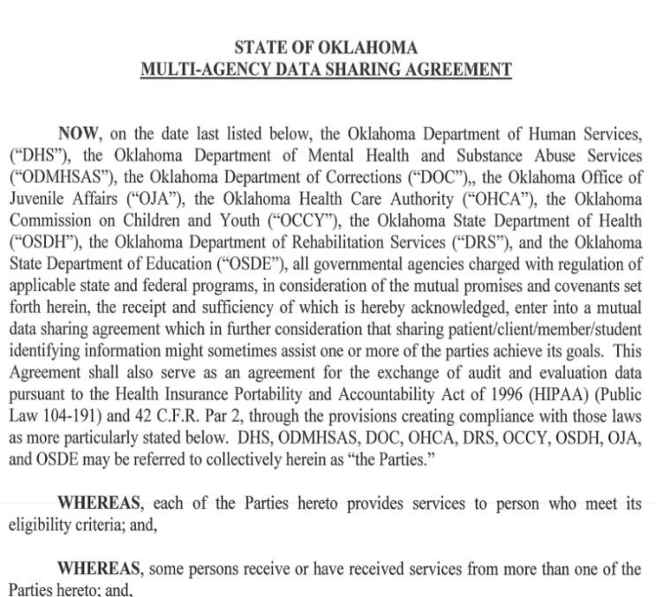
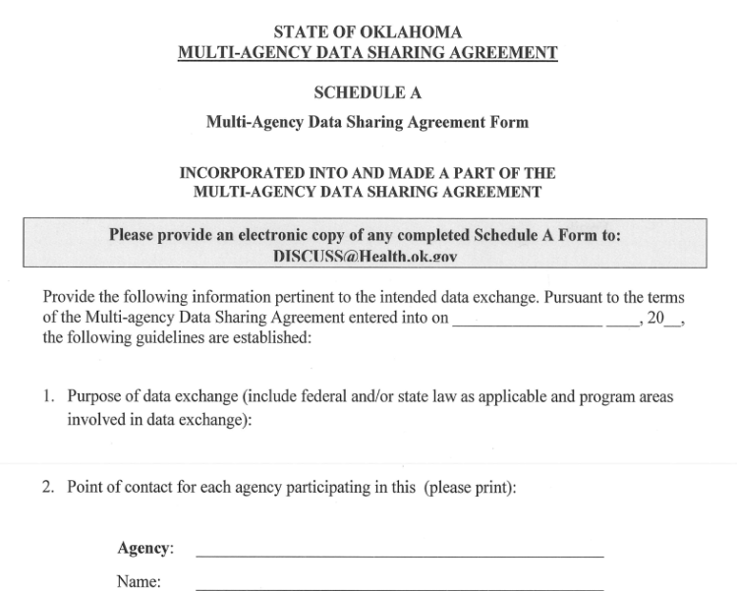
Multi-Agency Data Sharing Agreement
Nine Oklahoma State Agencies worked together to develop a Multi-Agency Data Sharing Agreement (DSA).
This allows participating agencies to streamline their data sharing processes as outlined in an overarching agreement. It also provides a form that can be used to detail an exchange of data between two or more of the agencies.
The form, or “Schedule A”, is used to detail data exchange criteria such as intended uses, constraints, confidentiality, security and methods of data sharing to be applied.

Slide 3
Purpose of the Agreement
Streamline Data Exchanges: The purpose of the data sharing agreement (DSA) is to streamline future data exchanges by providing an overarching agreement using standardized language that has been approved by the legal services and information security personnel of each participating agency.
Benefits: The agreement allows participating agencies to:
Learn of other services being offered or provided to its clients
Better regulate government programs and increase efficiencies
Maximize clients’ benefits received by the agencies
Notes:
The DSA provides a more efficient and effective way for participating agencies to share data for authorized regulatory and public purposes.

Slide 4
Participating Agencies
Oklahoma HHS Cabinet Agencies
Other Oklahoma Agencies
Commission on Children and Youth
Department of Human Services
Department of Mental Health and Substance Abuse Services
Office of Juvenile Affairs
Health Care Authority
State Department of Health
Department of Rehabilitation Services
State Department of Education
Department of Corrections
Participating DSA partners include non-HHS cabinet agencies who often serve shared populations.

Slide 5
Recommended Uses
Recommended uses for the Multi-Agency Data Sharing Agreement include:
Use for future data sharing projects involving one or more of the DSA participating agencies.
Use as a model or template for the development of future data sharing agreements among state and non-state entities.

Slide 6
Background
Streamline Data Sharing: Several years ago, State agencies recognized the need for a streamlined process that would allow agencies to more efficiently share information.
Agreement Signed: A Multi-Agency Data Sharing Agreement (DSA) was signed and put into effect in 2013.
Adding State Department of Education: In 2017 the agreement was expanded to enable SDE to participate.
Governance: The “Deliver Interoperable Solution Components Utilizing Shared Services Committee” (DISCUSS) is the information technology and shared services governance entity for Oklahoma Health and Human Services Cabinet (HHS) initiatives. It also serves as the governing body for the data sharing agreement.

Slide 7
Agreement Governance
DISCUSS seeks to improve lives and empower Oklahomans by leveraging the collective strengths of HHS Cabinet agencies.
Under the direction of the HHS Secretary, DISCUSS provides governance for the data sharing agreement (DSA).
DISCUSS also provides assistance to participating agencies by establishing and administering online access and storing of the agreement and supporting documents:
http://omes.ok.gov/services/information-services/data-governance/discuss

Slide 8
Key Provisions
Compliance: Participating DSA agencies remain subject to all applicable state and federal laws and regulations, including compliance with:
HIPAA - Health Insurance Portability and Accountability Act
HITECH - Health Information Technology for Economic and Clinical Health Act
FERPA - Family Educational Rights and Privacy Act
Use of Information: DSA partnering agencies commit to using shared information as agreed upon by each agency.
Notes:
For example, if DHS wants to engage in a project with OSDH that involve data sharing, the two agencies would agree to use the Multi-Agency Data Sharing Agreement (DSA) and then work out the specific details using a "Schedule A" form. The full agreement for each project then is the signed overarching DSA including its terms and appendices, and the completed "Schedule A“ Form(s).
Note: Approval by an Institutional Review Board (IRB) is a separate process. If the intended project involves human subjects research, then separate IRB approval would be required.

Slide 9
Key Provisions
Security: Participating agencies are responsible to provide for the protection, maintenance, confidentiality and security of the data being shared.
No new rules: The agreement allows agencies to share data in accordance with current state and federal requirements; the agreement provides no new rights, rules or laws.
Schedule A: When two or more participating agencies wish to engage in a project that requires the exchange of data, they jointly complete a "Schedule A" Form.

Slide 10
What is a "Schedule A" Form?
How the form is used:
Serves as an addendum to the overarching agreement.
Is not to be used as a stand alone agreement.
Provides specific details about an individual data exchange.
Is jointly completed by two or more DSA agencies that wish to share data.
Requires participating agencies to comply with:
State and federal rules and laws.
Stipulations as provided in the “Schedule A” form.
Requirements provided in the overall Data Sharing Agreement.
Any additional requirements agreed upon by the parties.

Slide 11
"Schedule A" Form
When two or more DSA agencies have identified a need to share data, the agency Points of Contact (i.e. IT Strategists, Program Manager, Agency ITOC, etc.) work together to complete a “Schedule A” Form detailing the purpose and specifics of the exchange, including:
Contact information for agency Points of Contact
Who owns the data being exchanged
A description of the data variables to be exchanged
How data will be used, secured, stored, published, tracked, transported, released, or published
When the agreement will end (if applicable)
How data will be returned (if applicable)

Slide 12
"Schedule A" Form
The completed Schedule A Form should also include any additional requirements agreed upon by the parties that aren’t addressed elsewhere, such as:
Reference to additional applicable state or federal rules or laws
Data management plan guidelines, protocols and standards
A matrix detailing individual agency requirements
Any rules that apply to the method of transfer, storage or destruction of the specific type of data being shared
A business rules glossary
Research, publication and distribution requirements

Slide 13
DISCUSS Email & Webpage
DISCUSS email address: datagovernance@omes.ok.gov
DISCUSS has developed an online webpage under the OMES Data Governance website, to provide a place to easily access the Multi-Agency Data Sharing Agreement, "Schedule A" Forms and FAQs about the agreement:
Webpage
http://omes.ok.gov/services/information-services/data-governance/discuss
Data Sharing Agreement
https://www.ok.gov/cio/documents/DataGovernanceMulti-AgencyMOU.pdf

Slide 14
DISCUSS Data Governance
Subcommittee Members
Agency | Voting Members | Designee
OHCA | Fred Oraene, Chair | Derek Lieser
DMHSAS | Tracy Leeper, Vice-Chair | Austin Ralstin
OSDH | Becki Moore | Derek Pate
OKDRS | Lyuda Polyun | Tiffany Davis
DHS | Molly Green | Tara Williams
JDMC | Erik Paulson | TBD
OJA | Len Morris | TBD
OSDE | Erik Friend | TBD
OMES | Patsy Leisering & Sumita Pokharel, Non-voting Members
OMES | Autumn Felty, Data Governance Manager
HHS DISCUSS | Nicole Prieto Johns, DISCUSS Program Administrator

Slide 15
Questions?

Slide 16
Thank you!

