Slide 1
Understanding the State Use Program Module 6

Slide 2
Learner Outcomes
Students will:
Recall the purpose of the State Use Program.
Memorize the title and section where State Use is found.
Recognize an exemption from the Central Purchasing Act does not exempt the agency from State Use.

Slide 3
What is the State Use Program
Preference program established in 1974 to provide employment opportunities to persons with severe disabilities.
Operated through qualified, nonprofit organizations that supply products and services to the state.

Slide 4
Question
What is the overall purpose of the
State Use Program?
It is a set-aside program established in 1974 to provide employment opportunities to persons with severe disabilities.
Notes:
It is a set-aside program established in 1974 to provide employment opportunities to persons with severe disabilities.

Slide 5
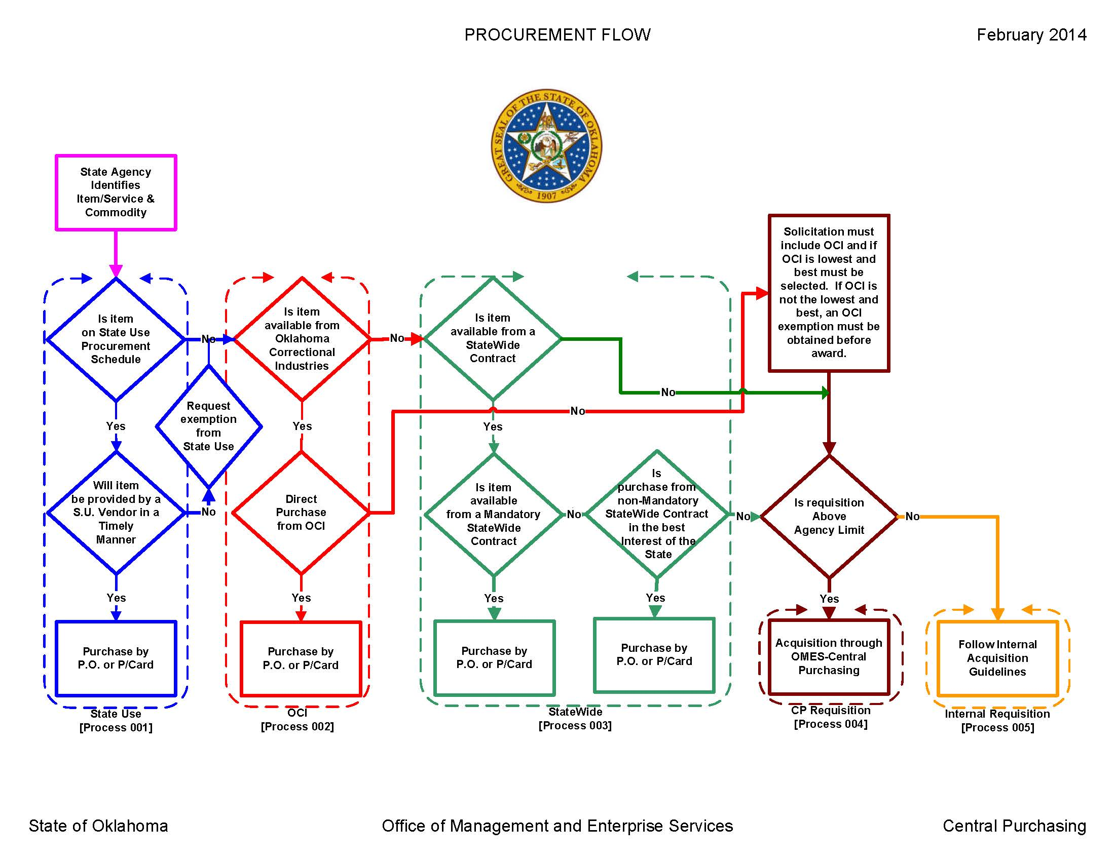
State Purchasing Hierarchy

Slide 6
Vendor Qualifications
Each organization or agency must:
Have proof of 501(c)3 nonprofit status with the IRS.
Have a Department of Labor certificate that allows below-minimum wage employment.
Have workers’ compensation insurance.
Be approved by the State Use committee.

Slide 7
State Use Governing Committee
Committee Members
Will Smith, Kiamichi Opportunities (past president of OCP).
David Oliver, Tulsa Goodwill Industries (governor appointee).
Robin Arter, parent of individual in the program.
Jim Kettler, designee for Administrator of Visual Services, DRS.
Stephanie Brown, designee for OMES Director Denise Northrup.
Regina Chace, designee for DHS Director Ed Lake.
Jerry Tate, designee for State Purchasing Director Ferris Barger.
Daron Hoggatt, State Use Administrator (non-voting member).
Committee meets 6 times a year
Title 74 O.S. § 3009 260:120-1-10(a)

Slide 8
State Use Program Procurement Schedule
First source when searching for goods and services.
All registered vendors in the State Use program listed.
All mandatory products and services provided by State Use vendors listed.
Remaining items (suitable to procure list) – State Use vendors must be included in any bid or quote.

Slide 9
Question
Who has the authority to add products/services to the procurement schedule?
The State Use committee.
Notes:
The State Use committee

Slide 10
Product/Service Determination
Product Comparison Test – AG Opinion (2010 OK AG 12)
W.A. DREW EDMONDSON, Attorney General of Oklahoma
RICHARD D. OLDERBAK, Assistant Attorney General
“It is, therefore, the official Opinion of the Attorney General that:
1. Pursuant to 74 O.S.2001, § 3007(B) a state agency is prohibited from evading the purchase of individual products or services listed on the State Use committee's procurement schedule, by issuing a solicitation for products or services that is a slight variation from the standards adopted by the State Use committee.

Slide 11
Product/Service Determination (Cont.)
2. The proper test to apply in determining whether a solicitation by a state agency violates State Use statutes is found within the language of subsection A and turns on whether or not the particular solicitation is for "any product or service included in the procurement schedule." 74 O.S.2001, § 3007(A). For example, a solicitation for prepared soup is not a violation of the intent of the State Use statutes even though it includes individual items on the schedule such as pasta, peas and beans, because the product of prepared soup is not an item on the procurement schedule. Likewise, a solicitation for a comprehensive package of computer parts and services would not violate the intent of the State Use statutes even though it includes an individual item such as toner, because the product/service of comprehensive computer services is not on the procurement schedule.

Slide 12
Product/Service Determination (Cont.)
3. Whether or not any given solicitation constitutes an evasion of the intent of the State Use program is a question of fact beyond the scope of an Official Attorney General Opinion. See 74 O.S.2001, § 18b(A)(5).
4. The determination of whether or not any purchase by a state agency violates the intent of the State Use laws is the responsibility of the State Use Committee. See 74 O.S.2001, § 3009(C).”

Slide 13
Question
Name one way a product/service can be considered for the procurement schedule.
Vendor request.
Agency request.
Requisition.
Notes:
1. Vendor request 2. Agency request 3. Requisition

Slide 14
Fair Market Value Pricing
It shall be the policy of the State Use committee, pursuant to Title 74 O.S. § 3005, and O.A.C. 260:120-1-4, to provide the herein described methodology and procedure for the preparation of fair market price analysis, which shall be presented to the State Use committee for approval and establishment of the fair market price.

Slide 15
Fair Market Value Pricing
Title 74 O.S. § 3005. Determination of fair market price.
“The committee shall determine the fair market price of all products and services included in the procurement schedule and shall revise such prices in accordance with changing market conditions; provided, however, a change in price shall not be effective prior to the expiration of fifteen (15) days from the date on which such change is made by the committee.”
Laws 1973, c. 20, § 5, operative July 1, 1973.

Slide 16
Fair Market Value Pricing
Fair Market Price Comparison Fair market price comparison is a reasonable price which can be charged by the qualified organization, which may include, but is not limited to, the cost of raw materials, labor, capital equipment cost amortization, overhead and profit, service charges, delivery and shipping costs.
Also, in determining fair market prices, consideration should be given to the following factors:
To the extent applicable, the amounts being paid for similar articles in retail quantities by federal agencies purchasing the commodities or services.
The price of commodities or services in similar quantities if purchased from a reputable in-state vendor engaged in the business of selling retail commodities.
To the extent possible, the amount paid by the state in any recent purchases of retail commodities or services in similar quantities, making due allowance for general inflationary or deflationary trends.
The fair market price of a commodity or service, determined after consideration of relevant factors of the before mentioned types may not be excessive or unreasonable.
The fair market price may include a reasonable charge for overhead and profit that is competitive with other retail markets.
Price comparison when appropriate should include wholesale and retail pricing of like commodities.
Fair Market Policy as approved by the State Use Committee 4-30-2014

Slide 17
Fair Market Value Pricing
Fair market price determination should be prepared by the qualified organization as follows:
3.1.1. The number of fair market comparisons obtained should be a fair and adequate representation of market pricing. Whenever possible a minimum of five (5) fair market comparisons should be obtained and the highest and lowest prices will be discarded with the remaining comparisons averaged to arrive at the fair market price.
Fair Market Policy as approved by the State Use Committee 4-30-2014

Slide 18
Fair Market Value Pricing
Administrative Rule 260:120-1-4. Determination of fair market price
(1) The contracting officer shall prepare a current market analysis to determine the fair price for the products or services requisitioned or used by state agencies utilizing internal as well as external sources and established pertinent criteria. When appropriate, the criteria may include, but not be limited to:
(A) A survey of comparable private contracts for like products and services.
(B) Research of other governmental entities within and outside the State of Oklahoma.
(C) Comparison, when appropriate, of wholesale and retail pricing of like commodities.
(2) Based on the data described in OAC 260:120-1-4(1), the contracting officer or designee shall recommend a fair market price with supporting documentation to the committee for consideration.
(3) The committee shall, by majority vote, approve, modify, amend or disapprove the recommended fair market price.
(4) Whenever the committee establishes a price, the price shall become the fair market price.
(5) If the product or service is one for which the pricing does not vary by state agency or location, the fair market price as approved, modified or amended shall remain in effect until the committee establishes a new fair market price.
(6) If the product or service is one for which the price does vary depending on the state agency, location, or specifications, the Committee shall approve, each contract for the product or service.
(7) If the product or service is one for which fair market has not been established, either because the fair market for the type of product or service has been determined to vary depending on the state agency, location or specifications, the Contracting Officer, with the approval of the State Purchasing Director, is authorized to award a contract in accordance with the State Use Fair Market Price Policy to a qualified individual or organizations, thereby establishing fair market price, which establishment shall be subject to ratification by the Committee at the next regular Committee meeting.
(8) In the event of an emergency, with approval of the State Purchasing Director, the contracting officer may award a contract to an individual or agency for a maximum period of three (3) months without prior Committee approval, but subject to Committee approval at the next regular Committee meeting. If the Committee approves the contract, the contract shall terminate at the end of the contract period.
[Source: Added at 31 Ok Reg 1551, eff 9-12-14; Amended at 32 Ok Reg 1786, eff 9-11-15]

Slide 19
Question
How many price comparisons are required
from the vendor to establish a
fair market value?
A minimum of 5 comparisons.
Notes:
A minimum of 5 comparisons

Slide 20
Fair Market Value Pricing
Cost Analysis
Cost analysis means the determination made by the qualified organization, with advice from the contracting officer and support staff, of the monies needed to be expended to produce a commodity or provide a service. Adequate weight will be given to legal and moral imperatives to pay workers with severe disabilities equitable wages.

Slide 21
Fair Market Value Pricing
This determination may include, but is not limited to, items such as:
The cost of raw materials.
Supplies.
Labor.
(Prevailing wage) fringe benefits.
Capital expenditures.
Equipment maintenance.
Overhead.
Profit.
Workshop charges.
Delivery costs.
Other usual, customary and reasonable costs of manufacturing.
Marketing and distribution of a commodity or service.

Slide 22
Fair Market Value Pricing
Value Added
4.1. Value added is anything that will enhance a product, i.e., repackage, inventory, delivery; or additional benefits such as those identified in the economic benefits studies that have been conducted.
4.1.1. List all value added items in the documentation for initial fair market determination.
Fair Market Policy as approved by the State Use Committee 4-30-2014

Slide 23
Question
Name one way a vendor can
“add value” to a product.
Repackaging.
Assembling.
Labeling, AND MANY MORE WAYS.
Notes:
1. Repackaging 2. Assemble 3. Labeling AND MANY MORE WAYS

Slide 24
Exception Process
Exception request is to be emailed to the State Use program administrator.
The reason for the request is reviewed.
The product comparison must be equal.
If price is the reason for exception, the two prices are evaluated against the current economic advantage of the program (currently at 25 percent).
The economic advantage is based upon the number of persons with disabilities that are involved in the program and the current average of $2,366/person/year for government services not being paid to the disabled employee due to job income.
In FY 2016, there were 2,423 disabled employee in the program. The government services savings were $26,280,823.76.
The exception request is sent to the vendor to try to match or beat the exception price.

Slide 25
Exception Process
If the vendor’s price is above the 25 percent economic advantage difference and can not be lowered, the exception is granted.
If the total dollar exception request is for less than the 25 percent economic advantage difference, the exception request is generally denied.
AG Opinion (2009 OK AG 22)
W.A. DREW EDMONDSON, Attorney General of Oklahoma
RICHARD D. OLDERBAK, Assistant Attorney General
“State agencies shall make acquisitions from suppliers on the State Use Committee procurement schedule regardless of the acquisition purchase price if the supplier's delivery date meets state agency requirements. State Use Committee contracts are mandatory contracts.”

Slide 26
Question
How much is the economic advantage when using the State Use program contracts?
25 percent – based upon the number of people employed by the State Use vendors.
Notes:
25% - based upon the number of people employed by the State Use vendors.

Slide 27
Statutory Requirements
Who is statutorily required to utilize the State Use Program contracts?
Title 74 O.S. § 3007. State or agency to procure a product or service at fair market price.
A. Whenever the State of Oklahoma or any of its agencies intends to procure any product or service included in the procurement schedule, that entity shall secure the product or service from a qualified nonprofit agency providing employment to people with severe disabilities at the fair market price determined by the committee if the product or service is available within the period required by the entity.
B. An agency of this state shall not evade the intent and meaning of this section by slight variations from standards adopted by the Office of Management and Enterprise Services.
C. Provided, the requirements of this section shall not apply to the procurement of janitorial services by the Oklahoma State Bureau of Investigation. The Bureau shall conduct background investigations and national criminal history record checks on companies and individuals with which it contracts to provide janitorial services.
D. When the fair market price for a product or service approved by the Committee exceeds a current market price for the same product or service, and such lower market price has been verified by the agency through compliance with the fair market analysis process approved by the Office of Management and Enterprise Services, the state use contracting officer may grant a temporary exception to a requesting agency so that the agency may purchase the product or service from the vendor offering the lower market price. The temporary exception shall automatically expire when a new fair market price is established by the State Use Committee.

Slide 28
Statutory Requirements
Who is statutorily authorized to utilize the State Use Program contracts?
Title 74 O.S. § 3010. Municipalities or county agencies – Purchases from sheltered workshops – Exemption from competitive bid requirements.
Any municipality or county agency of this state is authorized to purchase products and services from any qualified nonprofit agency providing employment to persons with severe disabilities which is certified as a sheltered workshop by the Wage and Hour Division of the United States Department of Labor. Procurements made pursuant to the provisions of this section shall not be subject to competitive bid requirements. To participate, a qualified nonprofit agency for the severely disabled must be able to meet the needs and specifications for the products or services required by the purchasing body at a fair market price.

Slide 29
Question
Are municipalities required to use the
State Use program contracts?
They are not required but encouraged and allowed.
Notes:
They are not required but encouraged and allowed.

Slide 30
Review
State Use is the first source for procurement needs.
State Use products and services are provided by nonprofit agencies that employ people with disabilities.
Fair market determination.
State Agencies are statutorily required to use the State Use program.

Slide 31
Review
An exemption from the Central Purchasing Act does not exempt the agency from State Use.
State Use is found in Title 74 O.S. § 3001-3010.

Slide 32
CONTINUE TO MODULE 7

