Slide 1
Change Agent Network
October Touchpoint
October 22, 2021

Slide 2
October Agenda
1
Welcome 10:00 am - 10:05 am
2
BrightPath Project Updates & Activities 10:05 am – 10:10 am
3
BrightPath Agency Pulse Assessment 10:10 am – 10:25 am
4
CAN Do Checklist & Activities 10:25 am – 10:30 am
5
Celebrate 10:30 am – 10:40 am
6
Q&A/Closing 10:40 am - 11:00 am
2
2

Slide 3
CAN Administrative Tasks & Reminders
Please remember to manage the monthly change agent activities for your respective agency.
Change Agent Tracker Track your activity for communications and activities in the CAN Tracker on SharePoint.
BrightPath Feedback Collect feedback from agency colleagues and submit via the feedback form.
3

Slide 4






BrightPath Project Milestones
Below are key BrightPath milestones prior to Workday go-live midyear 2022.
Plan Architecture Configure & Prototype Test Deploy
DEMO
Nov 2020–Jan 2021 jAN 2021-MAY 2021 May 2021-Oct 2021 Oct 2021-APR 2022 apr 2022-July 2022
Develop Testing Stage
Milestone Risk Assessment
Deliver Customer Confirmation Sessions
Conduct Tenant Testing
Conduct User Acceptance Testing
we are here
6/4-10/28
8/9-9/3
11/8-3/1
2/9-4/7
7/5-8/6
9/30
11/19
Conduct
Unit Testing
Finalize Change
Impact Deliverable
Finalize Training Plan and Curriculum
4

Slide 5







Initial Agency Assessment Report
The BrightPath Agency Pulse Assessment will track the movement of workforce sentiment along the adoption curve over the course of the BrightPath project with results shared by the Change Agent Network.
Objectives
Analysis & Distribution
Gauge the effectiveness of initial organizational change management (OCM) efforts to prepare the State of Oklahoma workforce to adopt Workday
  The OCM Team analyzed and assessed results to identify trends, areas of success and opportunities
  The OCM Team prioritized and created a plan to prepare impacted audiences based on key findings
Track workforce sentiment, awareness, attitudes and level of engagement as stakeholder groups prepare to adopt Workday
  Change agents share the Assessment results with agency colleagues via email
Establish audience-specific baselines to measure improvements in readiness over time
  Change agents host Office Hours to talk with agency colleagues and answer questions about the Assessment and BrightPath

Slide 6
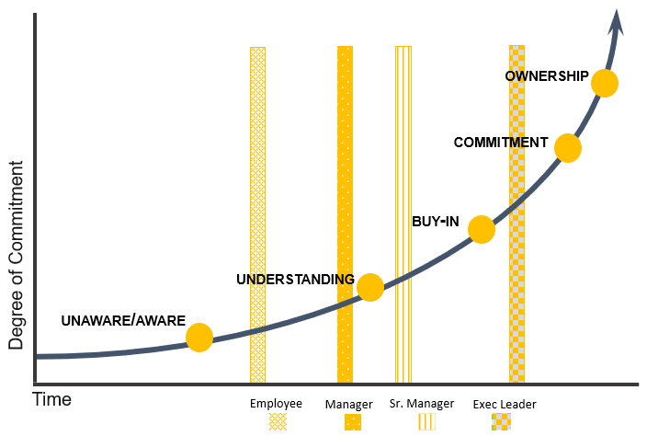



BrightPath Pulse Assessment Dashboard
Response Rates
Readiness by Role
Employee Readiness
6,088 responses
Exec Leader
Sr. Manager
Manager
Employee
“I have no idea what BrightPath is, what it's about or it's purpose. Why are we doing it?”
“Have a training that shows specifically what the employee will be doing. Going step by step in the process.”
17% response rate*
77% of agencies participated
2,067 open-ended responses
3.9
3.5
3.3
3.2
3.
*Based on employee population of 34,942
Address (0.0 – 2.49)
Monitor (2.5 – 3.99)
Ready (4.0 – 5.0)
Participation
Employee Engagement
2%
1.8
Executive Leader
Senior Manager
5%
21%
Awareness
Communications
Manager
Employee
72%
64%
17%
10%
7%
2%
<1%
Leadership
Organization Readiness
Strongly Disagree
Somewhat Disagree
Neutral
Somewhat Agree
Strongly Agree
Cohort A
Cohort B
Cohort C
Cohort D
Cohort E
Cohort F
1
2
3
4
5
6

Slide 7
Overall Response Cadence
Change agents sent three emails to agency colleagues inviting and reminding them to complete the assessment by September 30, 2021.
Assessment link sent
Assessment reminder email sent

Slide 8
Cohorts A & B
Cohort A agencies are defined by agency size or existing/known complexities that could drive core requirements of the overall design of Workday. Cohort B agencies are defined as medium to large agency size, include mostly in-house functions, have large groups of seasonal workers, and have mass hiring.
Cohort A
Cohort B
Career and Technology Education
Commerce Dept.
Corrections Dept.
Environmental Quality Dept.
Health Department
Human Services Department
Juvenile Affairs Office
Labor Dept.
Mental Health and Substance Abuse Services
Military Department
Office of Management and Enterprise Services
Public Safety
Rehabilitation Services Department
Transportation Dept.
Wildlife Conservation Dept.
Agriculture Food and Forestry
Bureau of Investigation
Bureau of Narcotics
Corporation Commission
Educational Quality and Accountability Office
Educational Television Authority
Employment Security Commission
Health Care Authority
Historical Society
Indigent Defense System
Public Employees Retirement System
Tax Commission
Tourism and Recreation

Slide 9
Cohorts C & D
Cohort C agencies are defined by agencies operating 24/7, field operations, limited access to technology today and WD ID/HCM FTE only. Cohort D agencies are defined by agencies with less than 50 employees, and small agencies utilizing Shared Services and includes office workers.
Cohort C
Cohort D
Chief Medical Examiner Officer
Conservation Commission
Emergency Management Dept.
JD McCarty Center
Turnpike Authority
Veterans Affairs
Water Resources Board.
Accountancy Board
Aeronautics Commission
Alcoholic Bev. Laws Enforce (ABLE)
Architects Board
Arts Council
Banking Dept.
Behavioral Health License Board
Center for Science/Tech
Commission on Children and Youth
Commissioners of the Land Office
Consumer Credit Commission
Law Enforcement & Training Council
Education Department
Election Board
Firefighters Pension & Retirement
Horse Racing Commission
Law Enforcement Retirement
Legislative Services Bureau
Libraries Dept.
Lottery Commission
LP Gas Res, Mrkt. & Safety Commission
Medical Licensure & Supervision Board
Mines Dept.
Multiple Injury Trust Fund
Nursing Board
Osteopathic Examiners Board
Pardon and Parole Board
Pharmacy Board
Physician Manpower Training
Police Pension and Retirement Board
School of Science and Math
Securities Department
State Fire Marshal
Teachers Retirement System
Used Motor Vehicles and Parts
Workers Comp Commission

Slide 10
Cohorts E & F
Cohort E agencies are defined by agencies with elected officials, the Office of the Governor and Legislature. Cohort F agencies are defined by agencies with Judicial responsibilities.
Cohort E
Cohort F
Attorney General
Auditor and Inspector
Governor
House of Representatives
Insurance Department
Secretary of State
State Senate
Treasurer
District Courts
Supreme Court

Slide 11
Employee Readiness
Role and Cohort

Slide 12
Employee Readiness: By Role
Overall employee readiness for the Workday implementation is positive. Executive leaders are the most prepared to adopt the new system.
Exec Leader
Sr Manager
Manager
Employee
Number of responses
119
318
1,260
4,391
Awareness
Communications
Change Dimension
Leadership
Org Readiness
Average Score
3.9
3.5
3.3
3.2
Address (0.0 – 2.49)
Monitor (2.5 – 3.99)
Ready (4.0 – 5.0)

Slide 13



Employee Readiness: By Cohort
Agency cohorts are similar in employee readiness across the change dimensions with some nuances across the agencies with larger employee base and more complex configuration.
Cohort A
Cohort B
Cohort C
Cohort D
Cohort E
Cohort F
Number of responses
3,899
1,021
602
418
146
4
Awareness
2.8
3.3
3.1
3.1
3.5
3.4
Communications
3.0
3.4
3.2
3.2
3.5
3.8
Change Dimension
Leadership
3.3
3.6
3.5
3.5
3.8
3.9
Org Readiness
3.4
3.7
3.6
3.6
3.8
4.1
Average Score
3.1
3.5
3.4
3.4
3.7
3.8
Address (0.0 – 2.49)
Monitor (2.5 – 3.99)
Ready (4.0 – 5.0)

Slide 14



Change Dimension: Leadership
Readiness Response Score Tracking
Theme | Score | What This Score Means
Q5: Leader Transparency | 3.0 | Leaders feel they are transparent and while employees trust leadership, they are unsure about BrightPath details and how they will be impacted.
Q6: Leadership Supports Project | 3.7 | While executive leaders feel confident in their investment in the BrightPath project, employees and managers are unsure.
Readiness Score by Cohort
Cohort A
Cohort B
Cohort C
Cohort D
Cohort E
Cohort F
3.3
3.6
3.5
3.5
3.8
3.9
Readiness Score by Role
Exec Leader
Sr. Manager
Manager
Employee
4.1
3.7
3.4
3.3
Address (0.0 – 2.49)
Monitor (2.5 – 3.99)
Ready (4.0 – 5.0)
14

Slide 15
Change Dimension: Awareness
Readiness Response Score Tracking
Theme | Score | What This Score Means
Q3: Project Awareness | 3.2 | Employees lack of a strong understanding of the BrightPath project, its purpose and timing.
Q4: Understand how Project Supports State-Wide Goals | 3.1 | Employees have a moderate level of understanding about upcoming changes and whether a new HCM system will bring job efficiencies.
Q9: Know Where to Locate Resources | 2.7 | Employees are uncertain about knowing where to find BrightPath information or how to find answers to questions for the upcoming changes and timing of implementation.
Q14: Understand Change Agent Network Purpose | 2.8 | Individuals are not familiar, nor do they understand the purpose of the Change Agent Network.
Readiness Score by Cohort
Cohort A
Cohort B
Cohort C
Cohort D
Cohort E
Cohort F
2.8
3.3
3.1
3.1
3.5
3.4
Readiness Score by Role
Exec Leader
Sr. Manager
Manager
Employee
3.7
3.3
3.0
2.9
Address (0.0 – 2.49)
Monitor (2.5 – 3.99)
Ready (4.0 – 5.0)
15

Slide 16

Change Dimension: Org Readiness
Readiness Response Score Tracking
Theme | Score | What This Score Means
Q7: Agency Readiness & Successful Adoption Processes | 3.8 | Employees have a sense of confidence in their agency colleague’s ability to manage the upcoming changes.
Q8: Understand there will be new polices and processes | 3.8 | Employees are confident in their ability to manage upcoming changes but are uncertain on whether training will be adequate and delivered in a timely manner.
Q15: Supportive of Implementation | 3.5 | While awareness of BrightPath is low, employees are overall supportive of implementing Workday.
Q16: Feel a Personal Investment for Project | 3.1 | Individuals, especially at the Employee level, do not have strong investment in the success of BrightPath.
Readiness Score by Cohort
Cohort A
Cohort B
Cohort C
Cohort D
Cohort E
Cohort F
3.4
3.7
3.6
3.6
3.8
4.1
Readiness Score by Role
Exec Leader
Sr. Manager
Manager
Employee
4.1
3.8
3.6
3.5
Address (0.0 – 2.49)
Monitor (2.5 – 3.99)
Ready (4.0 – 5.0)
16

Slide 17
Change Dimension: Communications
Readiness Response Score Tracking
Theme | Score | What This Score Means
Q10: BrightPath Comms are Helpful | 3.0 | Leadership feels BrightPath communications are effective, but employees and managers are unsure.
Q13: Effective Feedback Mechanisms | 3.2 | Respondents are neutral about having access to channels or the ability to provide feedback for the BrightPath project.
Readiness Score by Cohort
Cohort A
Cohort B
Cohort C
Cohort D
Cohort E
Cohort F
3.0
3.4
3.2
3.2
3.5
3.8
Readiness Score by Role
Exec Leader
Sr. Manager
Manager
Employee
3.5
3.3
3.1
3.1
Address (0.0 – 2.49)
Monitor (2.5 – 3.99)
Ready (4.0 – 5.0)
17

Slide 18
BrightPath Communications
Q11: My primary source of information about the Workday implementation comes from:
Q12: What additional channels do you prefer to receiving communications?

Slide 19
Engagement Curve
Engagement Curve

Slide 20
Engagement Curve
The purpose of the engagement curve is to track individual stakeholder group progress along the engagement curve over the course of the BrightPath project.​
ownership
Individuals are fully engaged and feel responsible for a successful implementation of Workday
Degree of Commitment
commitment
Individuals feel a personal stake in the success of the Workday implementation
buy-in
Individuals understand Workday and are supportive of the program’s scope, timeline, and objectives
understanding
Individuals have a basic understanding of the scope, timeline, and objectives of Workday implementation
unaware/aware
Individuals are not aware of the Workday implementation or have heard about the Workday implementation scope and are loosely neutral or supportive
Time
Employee
Sr. Manager
High
Score 1-2
monitor
Address (0.0 – 2.49)
Monitor (2.5 – 3.99)
Ready (4.0 – 5.0)
KEY
Exec Leader
Manager

Slide 21
Engagement Curve: Readiness by Role
Executive leaders are the most engaged with the remaining roles following suite based on level. All roles will continue to be monitored prior to go live
Exec Leader
Sr Manager
Manager
Employee
Awareness: I am aware of the BrightPath project’s purpose. ​
3.2
Understanding: I understand there will be new policies, processes, and a new HCM system (Workday) as a result of the BrightPath project. ​
3.8
Buy-in: I understand how implementing Workday fits into the State of Oklahoma’s goals to improve its HR systems and processes for its’ employees. ​
3.1
Commitment: I support the Workday implementation at the State of Oklahoma.​
3.5
Ownership: I feel personally invested in the success of the Workday implementation at the State of Oklahoma.
3.1
Address (0.0 – 2.49)
Monitor (2.5 – 3.99)
Ready (4.0 – 5.0)

Slide 22



Engagement Curve by Cohort
Similar to employee readiness, all cohorts are appropriately located along the engagement curve in comparison to the current project stage.
Cohort A
Cohort B
Cohort C
Cohort D
Cohort E
Cohort F
3,899
1,021
600
418
146
4
Aware
3.0
3.5
3.3
3.3
3.7
3.5
Understanding
3.7
4.0
3.9
3.9
4.1
4.3
Change Dimension
Buy-in
3.0
3.4
3.2
3.3
3.6
3.8
Commitment
3.4
3.6
3.5
3.6
3.7
4.0
Ownership
3.0
3.2
3.2
3.1
3.3
3.8
Average Score
3.2
3.6
3.4
3.4
3.7
3.9
Address (0.0 – 2.49)
Monitor (2.5 – 3.99)
Ready (4.0 – 5.0)

Slide 23
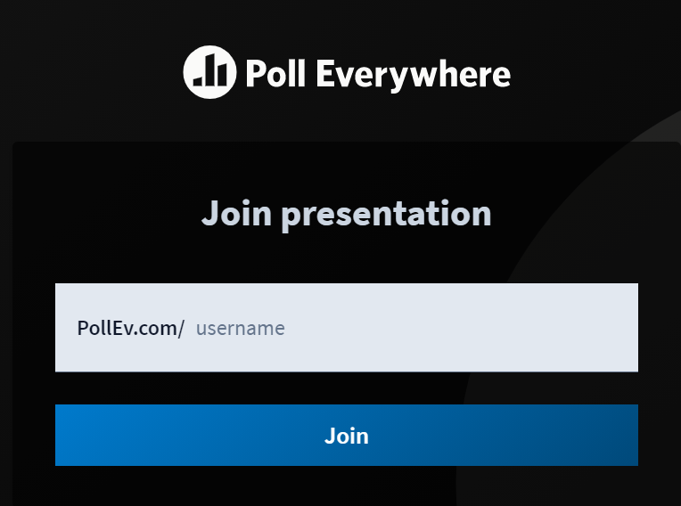
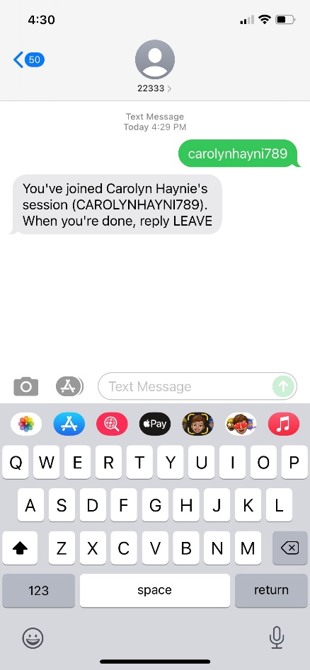
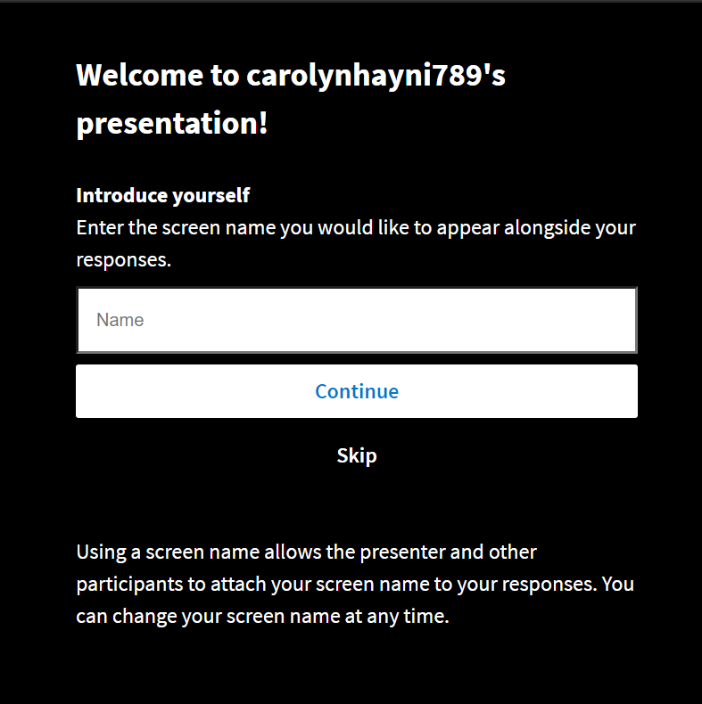
Poll Everywhere Instructions
To participate in the polls during the meeting today, change agents can visit the URL or text to submit their response to the questions. Results will be rendered in real-time.
https://pollev.com/carolynhayni789
Text carolynhayni789 to 22333
23

Slide 24
Question – Poll Everywhere
What is one word to describe your reaction to seeing the initial BrightPath Agency Pulse Assessment results?
Word cloud results
24

Slide 25
CAN Do Checklist
October 2021
25

Slide 26

“CAN Do” Checklist
October 2021
October Topics:
BrightPath Agency Pulse Assessment
CAN Office Hours
Activity | Description |  | Time Commitment | Date
MEETINGS TO ATTEND
N/A
CHANGE AGENT ACTIVITIES
BrightPath Agency Pulse Assessment Results Email |  | Send email with Agency Pulse Assessment results to agency colleagues | .5 hour | 10/27
Office Hours Email + Guide |  | Identify days and times for office hours to communicate with agency colleagues | 1 to 3 hours | 10/27 + beyond
ONGOING
Agency Feedback | Submit feedback/insights about the BrightPath project collected from agency colleagues | Submit feedback/insights about the BrightPath project collected from interactions with agency colleagues | .5 to 1 hour | ongoing
26

Slide 27
Change Agent Office Hours
27

Slide 28


Change Agent Office Hours
Change agents will hold office hours (digitally and in-person as applicable) to provide a forum for employees to ask questions about the Workday implementation.
How it Works:
Change agent(s) gather employees from their respective agencies (i.e., send an Outlook invite)
Virtually or in-person, hold an informal meeting where your fellow agency colleagues can ask questions and engage in dialogue about the BrightPath Project to continue to raise awareness about the Workday implementation
Change agents are responsible for determining the any follow-up action items from the office hours and communicating with agency colleagues as appropriate

Slide 29


Change Agent Office Hours
Change agents will hold office hours (digitally and in-person as applicable) to provide a forum for employees to ask questions about the Workday implementation.
The Format
Kick off with a quick overview of the BrightPath project, who you are and the purpose of the Change Agent Network
We recommend a flexible format where your colleagues can drop in and ask questions verbally or via the chat
✓ Remember to record the names of the individuals who attend office hours so that you can follow-up if needed
✓ Emphasize that you are a resource for the workforce at your agency to assist with the transition to Workday
✓ Highlight the case for change – why the state is implementing Workday, key benefits of Workday
Office Hours FAQ
What if there is a question that I don’t know the answer to?
Remember that you can always take down the name and contact information of the individual asking the question and let them know that you will get back to them. Reach out directly to Nick Garner or email brightpath@omes.ok.gov
What information can I refer to when conducting office hours?
Use the CAN SharePoint page and BrightPath website as a resource! The SharePoint page includes BrightPath materials that include project details. The website includes an FAQ page, project videos and the project timeline.
Where should I direct someone who wants to learn more about the BrightPath project?
Direct employees to the BrightPath website and encourage them to explore to learn more. You can also send them copies of the BrightPath talking points.
What if someone expresses negativity or concern about the BrightPath project?
If someone feels negatively about the BrightPath project, it is important to listen to their concerns and validate their feelings- change can be overwhelming! As you engage in dialogue with the individual, share information about Workday benefits and the case for change, why Workday is being implemented and the positive changes that will result from the implementation.

Slide 30
BrightPath Feedback Management
Employees will experience a range of emotions and feelings about the transition to Workday throughout the project and need to feel supported and heard by leadership, BrightPath project team and Change Agent Network.
Sentiment | Response
Positive | BrightPath is an exciting project for the State of Oklahoma Workday will streamline and enhance HR services for state employees, managers, and HR Workday will modernize HR processes, policies and improve the user experience for employees
Neutral | When an organization undertakes a large-scale initiative, employees are impacted and may experience fear and/or frustration The change management team and CAN are here to support employees and answer questions Change agents educate their colleagues about the changes and benefits of a new system
Negative | Employees can disengage early in the project as they may feel unsupported or powerless when it comes to navigating the upcoming changes Change agents collect feedback and provide insights about agency readiness to the change management team The change management team will measure employee sentiment throughout the project to optimize change management activities and communications to support employees throughout their transition to Workday
30

Slide 31
Workday Benefits
Workday will replace seven HCM systems and provide multiple benefits for the state of Oklahoma and employees.
Core HCM
Compensation
Absence Management/ Time Tracking
Enhanced User Interface
Workday offers a more user-friendly interface, making it easier to get work done
Simplified Employee Experience
Employees will spend less time navigating between systems
Reduced Administrative Burden
People Leaders will have a one-stop-shop for most transactions
Payroll
HCM Systems to be replaced by Workday
Benefits
Mobile Capabilities
Employees and People Leaders can execute more transactions on-the-go
Centralized Records
Workday provides a single source of truth for employee data to be leveraged enterprise-wide
Robust Data
Data quality will be improved and provide transparency in terms of spans, layers and levels
Talent / Performance
Recruiting
Learning
Increased Data Access
Employees and People Leaders have increased access to data to make decisions
Reduced Risk
Streamlined systems, data and integrations enable us to reduce compliance risk
Accessibility
Employees working across the state and agencies will have a more consistent, simplified experience
31

Slide 32

Celebrate!
Sent all BrightPath Assessment Emails
Conservation Commission
Corrections Department
Employment Security Commission
Human Services Department
Indigent Defense System
32

Slide 33
Celebrate!
Completed all BrightPath Activities
Agriculture Food & Forestry
Banking Department
Career & Technology Education
Chief Medical Examiner
Commerce Department
Conservation Commission
Consumer Credit Commission
Corporate Commission
Corrections Department
Educational Quality & Accountability
Educational Television Authority
Emergency Management Department
Employment Security Commission
JD McCarty Center
Public Employees Retirement System
Rehabilitation Services Department
Secretary of State
Tax Commission
Tourism & Recreation
Transportation Department
Turnpike Authority
33

Slide 34
Q&A
What questions do you have?
34

Slide 35
Appendix

Slide 36
Agency Pulse Assessment Questions
Quarterly Agency Pulse Assessments measure attitudes, perceptions and level of Implementation engagement demonstrated by those who are involved in the change at the State of Oklahoma.
Responses are evaluated on a Likert Scale from 1 to 5:
Strongly Disagree | Somewhat Disagree | Neither Agree nor Disagree | Somewhat Agree | Strongly Agree
1 | 2 | 3 | 4 | 5
Change Readiness Dimensions​*
Leadership
Awareness
Organization Readiness
Communications​
Engagement Curve
# | Question
Demographics: Agency affiliation and role within agency
1 | I feel that State of Oklahoma leadership is transparent about the changes that will take place as a result of the Workday implementation.
2 | I believe that my agency leadership is supportive of the BrightPath project’s work to implement a new human capital management system (HCM), Workday, at the State of Oklahoma.
*Change readiness dimensions will not be visible to assessment participants.
36

Slide 37
Agency Pulse Questions cont.
Responses are evaluated on a Likert Scale from 1 to 5:
Strongly Disagree | Somewhat Disagree | Neither Agree nor Disagree | Somewhat Agree | Strongly Agree
1 | 2 | 3 | 4 | 5
Change Readiness Dimensions​*
Leadership
Awareness
Organization Readiness
Communications​
Engagement Curve
# | Question
3 | I am aware of the BrightPath project’s purpose. (Unaware/Aware)
4 | I understand how implementing Workday fits into the broader goal at the State of Oklahoma to improve its HR systems and processes for its state employee workforce.​ (Buy-in)
5 | I know where to locate BrightPath resources and how to find answers to my questions.
6 | I understand the purpose of the Change Agent Network (CAN).
*Change readiness dimensions will not be visible to assessment participants.
37

Slide 38
Agency Pulse Questions cont.
Responses are evaluated on a Likert Scale from 1 to 5:
Strongly Disagree | Somewhat Disagree | Neither Agree nor Disagree | Somewhat Agree | Strongly Agree
1 | 2 | 3 | 4 | 5
Change Readiness Dimensions*​
Leadership
Awareness
Organization Readiness
Communications​
Engagement Curve
# | Question
7 | I understand there will be new policies, processes, and a new HCM system (Workday) as a result of the BrightPath project. (Understanding)
8 | Overall, I feel confident that my agency colleagues can successfully adopt the changes associated with the Workday implementation.
9 | What more can the BrightPath project team do to help employees successfully adopt the changes associated with the Workday implementation?
10 | I support the Workday implementation at the State of Oklahoma. (Commitment)
11 | I feel personally invested in the success of the Workday implementation at the State of Oklahoma. (Ownership)
*Change readiness dimensions will not be visible to assessment participants.
38

Slide 39
Agency Pulse Questions cont.
Responses are evaluated on a Likert Scale from 1 to 5:
Strongly Disagree | Somewhat Disagree | Neither Agree nor Disagree | Somewhat Agree | Strongly Agree
1 | 2 | 3 | 4 | 5
Change Readiness Dimensions​
Leadership
Awareness
Organization Readiness
Communications​
Engagement Curve
 | Question
12 | The BrightPath project communications that I have received to-date are helpful.
13 | My preferred resource for agency updates and information is: (Dropdown: agency-specific email, agency-specific internal website, peers, Change Agent Network, my manager, BrightPath team member).
14 | Please list other preferred methods of communication. (Free response)
15 | I believe there are effective mechanisms in place for me to provide feedback regarding BrightPath.​
*The change readiness dimensions will not be visible to the assessment participants.
39

Slide 40
Cohort A Participation
Cohort A agencies are defined by agency size or existing/known complexities that could drive core requirements of the overall design of Workday.

Slide 41
Engagement for Cohort A
Cohort A is appropriately located along the engagement curve in comparison to the current project stage.
Assessment Participating Agencies
Career and Technology Education
Commerce Dept.
Corrections Dept.
Environmental Quality Dept.
Health Department
Human Services Department
Juvenile Affairs Office
Labor Dept.
Mental Health and Substance Abuse Services
Military Department
Office of Management and Enterprise Services
Public Safety
Rehabilitation Services Department
Transportation Dept.
Wildlife Conservation Dept.
Degree of Commitment
ownership
commitment
buy-in
understanding
aware
3.2
Time
Address (0.0 – 2.49)
Monitor (2.5 – 3.99)
Ready (4.0 – 5.0)

Slide 42
Cohort B Participation
Cohort B agencies are defined by medium to large agency size, include mostly in-house functions, have large seasonal workers or as needed and experience mas hiring

Slide 43
Engagement for Cohort B
Cohort B is appropriately located along the engagement curve in comparison to the current project stage.
Assessment Participating Agencies
Agriculture Food and Forestry
Bureau of Investigation
Bureau of Narcotics
Corporation Commission
Educational Quality and Accountability Office
Educational Television Authority
Employment Security Commission
Health Care Authority
Historical Society
Indigent Defense System
Public Employees Retirement System
Tax Commission
Tourism and Recreation
Degree of Commitment
ownership
commitment
buy-in
understanding
aware
3.6
Time
Address (0.0 – 2.49)
Monitor (2.5 – 3.99)
Ready (4.0 – 5.0)

Slide 44
Cohort C Participation
Cohort C agencies are defined by agencies operating 24/7, field operations, limited access to technology today and WD ID/HCM FTE only.

Slide 45
Engagement for Cohort C
Cohort C is appropriately located along the engagement curve in comparison to the current project stage.
Assessment Participating Agencies
Chief Medical Examiner Officer
Conservation Commission
Emergency Management Dept.
JD McCarty Center
Turnpike Authority
Veterans Affairs
Water Resources Board
Degree of Commitment
ownership
commitment
buy-in
understanding
aware
3.4
Time
Address (0.0 – 2.49)
Monitor (2.5 – 3.99)
Ready (4.0 – 5.0)

Slide 46
Cohort D Participation
Cohort D agencies are defined by agencies with less than 50 employees, and small agencies utilizing Shared Services and includes office workers.

Slide 47
Engagement for Cohort D
Cohort D is appropriately located along the engagement curve in comparison to the current project stage.
Assessment Participating Agencies
Accountancy Board
Aeronautics Commission
Alcoholic Bev. Laws Enforce (ABLE)
Architects Board
Arts Council
Banking Dept.
Behavioral Health License Board
Center for Advancement of Science/Tech
Commission on Children and Youth
Commissioners of the Land Office
Consumer Credit Commission
Law Enforcement & Training Council
Education Department
Election Board
Firefighters Pension & Retirement
Horse Racing Commission
Law Enforcement Retirement
Legislative Services Bureau
Libraries Dept.
Lottery Commission
LP Gas Res, Mrkt. & Safety Commission
Medical Licensure & Supervision Board
Mines Dept.
Multiple Injury Trust Fund
Nursing Board
Osteopathic Examiners Board
Pardon and Parole Board
Pharmacy Board
Physician Manpower Training
Police Pension and Retirement Board
School of Science and Math
Securities Department
State Fire Marshal
Teachers Retirement System
Used Motor Vehicles and Parts
Workers Comp Commission
Degree of Commitment
ownership
commitment
buy-in
understanding
aware
3.4
Time
Address (0.0 – 2.49)
Monitor (2.5 – 3.99)
Ready (4.0 – 5.0)

Slide 48
Cohort E Participation
Cohort E agencies are defined by agencies with elected officials, the Office of the Governor and Legislature.

Slide 49
Engagement for Cohort E
Cohort E is appropriately located along the engagement curve in comparison to the current project stage.
Assessment Participating Agencies
Attorney General
Auditor and Inspector
Governor
House of Representatives
Insurance Department
Secretary of State
State Senate
Treasurer
Degree of Commitment
ownership
commitment
buy-in
understanding
aware
3.7
Time
Address (0.0 – 2.49)
Monitor (2.5 – 3.99)
Ready (4.0 – 5.0)

Slide 50
Cohort F Participation
Cohort F agencies are defined by agencies with Judicial responsibilities.

Slide 51
Engagement for Cohort F
Cohort F is appropriately located along the engagement curve in comparison to the current project stage.
Assessment Participating Agencies
District Courts
Supreme Court
Degree of Commitment
ownership
commitment
buy-in
understanding
aware
3.9
Time
Address (0.0 – 2.49)
Monitor (2.5 – 3.99)
Ready (4.0 – 5.0)

