Slide 1
SOONERHEALTH+ STAKEHOLDER MEETING
THE PACIFIC HEALTH POLICY GROUP
November 8, 2016

Slide 2
HB 1566
“The Oklahoma Health Care Authority shall initiate requests for proposals for care coordination models for aged, blind and disabled persons. Care coordination models for members receiving institutional care shall be phased in two (2) years after the initial enrollment period of a care coordination program.”

Slide 3
RFP – STATUS UPDATE
The OHCA is finalizing the RFP (model contract and proposal submission requirements) for release
The OHCA’s actuaries are analyzing historical data and program changes in preparation for establishing capitation rates and supporting data book
Enrollment phase-in remains nearly unchanged from our last meeting
Geographic regions have been established

Slide 4
RFP – STATUS UPDATE cont’d
Year 1
SoonerCare Choice Medicaid only members
Year 2
I/DD waiver members
Year 3
Residents of long term care facilities
Children in DHS custody New
“Full benefit” dual eligible members
ADvantage and Medically Fragile waiver members (subset of first two bullets)
I/DD state plan only members (subset of first two bullets)
Enrollment Phase-in

Slide 5
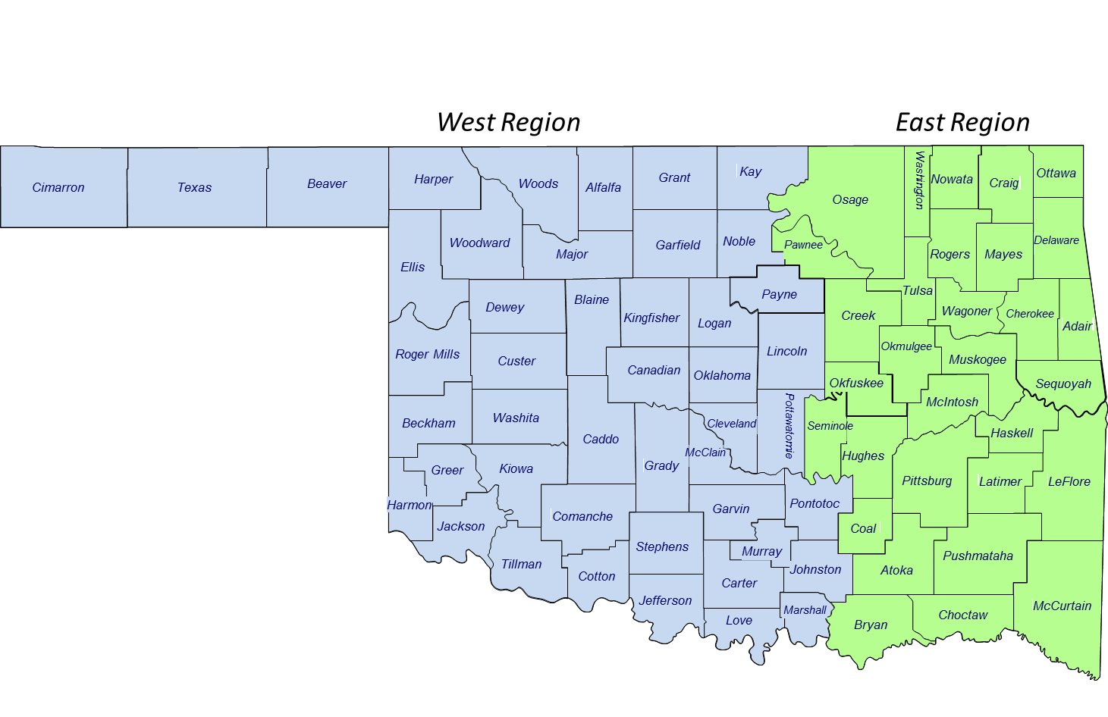
RFP – STATUS UPDATE cont’d
Geographic Regions

Slide 6
RFP – STATUS UPDATE cont’d
Comprehensive Primary Care Plus (CPC+)
Oklahoma has been selected to participate in CPC+, a multi-state initiative to improve quality, access and cost-effectiveness among participating primary care providers
CPC+ is a partnership between CMS, state Medicaid agencies, participating primary care practices and participating commercial health plans
Practices can apply to participate in one of two “tracks”, with differing requirements (the number that applied will be disclosed by CMS later this month; a second “enrollment” opportunity will be offered in 2017)
CPC+ primary care practices in both tracks must perform many of the care management activities for which SoonerHealth+ contractors will be responsible
CPC+ practices will receive payment for Medicare patients and for care management activities through a “value-based” methodology

Slide 7
RFP – STATUS UPDATE cont’d
Comprehensive Primary Care Plus (CPC+)
The SoonerHealth+ model contract aligns the two programs with respect to care management
The OHCA may require SoonerHealth+ contractors to apply to be “payer partners” within CPC+, as permitted by CMS, to further ensure alignment
More information on CPC+ is available at https://innovation.cms.gov/initiatives/comprehensive-primary-care-plus

Slide 8
RFP – STATUS UPDATE cont’d
Provider Network Contracting
As a reminder, the OHCA will not require bidders to submit complete provider networks with their proposals
Health plans awarded contracts will have a period between award and readiness review to meet network requirements
Providers are free to have discussions with plans and to sign contracts at any time but should not view the proposal submission date as an OHCA deadline for contracting

Slide 9
RFP – STATUS UPDATE cont’d
Tentative Schedule
CMS has given the go-ahead for moving forward with the RFP (the formal contract with awarded plans will still be subject to CMS review)
The schedule shown on the next slide is subject to (minor) adjustment

Slide 10
RFP – TENTATIVE SCHEDULE
STEP | TENTATIVE DATES
Release of RFP | Wednesday, November 30
Capitation rates published (target) | Wednesday, January 18
Actuarial bidders’ conference | Wednesday, February 1
Proposals due | Tuesday, February 28
Contract awards | Late Spring 2017
Readiness period | Summer – Fall 2017
Start of member plan selection | January 2018
Start of Services | April 2018

Slide 11
Aged, Blind, and Disabled Care Coordination (SoonerHealth+) Year 1 Evaluation Report
David J. Bernstein, Ph.D.
Senior Study Director, Westat
SoonerHealth+ Stakeholder Meeting
Tuesday, November 8, 2016
Notes:
I am David Bernstein, a Senior Study Director with Westat, an employee-owned social science research company. Westat was hired via a competitive RFP to conduct evaluation activities for the Aged, Blind, and Disabled, or ABD Care Coordination project.
ABD Care Coordination will be called SoonerHealth+, but the name did not come about until Year 2 of the project.
The Year 1 Evaluation covers July 2015 through June 2016.
Evaluation objectives include:
Independently/objectively document, evaluate OHCA’s planning and project management efforts for ABD Care Coordination project
Provide a written report regarding the evaluation of OHCA’s project management efforts
Attend monthly stakeholder meetings and monitor stakeholder engagement (OHCA July 2015).

Slide 12
Evaluation Question 1
How does OHCA’s approach ensure representation of the ABD population and caregivers in decision-making processes?
Process was transparent, but…
Elderly and people with significant disabilities might not be able to attend stakeholder meetings
OHCA is clearly committed to stakeholder involvement and transparency and took family member views into account
Notes:
Of 635 individuals on the OHCA stakeholder list as of November 2015, about 16% self-identified as ABD SoonerCare Members, Family Member, Caregivers, or Advocates for ABD people.
The percentage that attended the October and November stakeholder meetings was less than other major stakeholder groups, based on self-identification in stakeholder feedback surveys.
OHCA is clearly committed to stakeholder involvement and transparency.
OHCA took family member views into account.

Slide 13
Evaluation Question 2
How does OHCA’s approach to ABD Care Coordination integrate stakeholder perspectives in planning and development?
Website, email, other updates for stakeholders
Group meetings in October 2015 (parents of ABD individuals and tribal representatives)
6 regional meetings: September/October 2015
5 stakeholder meetings, other stakeholder meetings cancelled (RFP development, budget deliberations)
Stakeholder input through written responses
Notes:
Question 2 addressed how OHCA integrated stakeholder perspectives in planning and development of the project.
This slide includes a summary of those activities.

Slide 14
Stakeholder Meeting Attendees
Notes:
One indication of stakeholder involvement is attendance at two of the Year 1 stakeholder meetings, October and November 2015.
Health plan and Administrative Service Organizations were well represented at the Year 1 meetings.
The “other” categories were also well represented.
The “All Other” is made up of small numbers of highly specific categories of individuals, including providers:
Hospitals
long-term services and supports,
dental,
behavioral health,
pharmacy,
transportation.

Slide 15
OHCA Values Stakeholder Input
Notes:
Stakeholders in October and November of 2015 believed that OHCA values stakeholder input.
Nearly 90 percent of respondents at the October 2015 meeting and over 80 percent at the November meeting felt OHCA values stakeholder input.

Slide 16
OHCA and Transparency
Notes:
Over 80 percent of stakeholders felt OHCA is open and transparent as it developed the ABD Care Coordination project.
Over 70 percent shared this opinion at the November meeting.
Other stakeholder feedback responses showed consistent results regarding OHCA openness and value for stakeholder feedback.

Slide 17
Evaluation Question 3
How has OHCA ensured that the care coordination model’s features align with CMS guidelines for care coordination services for ABD?
Numerous references to new, pending Centers for Medicare and Medicaid Services (CMS) guidelines
Regulatory environment is a major focus of the ABD Care Coordination development contractor PHPG
CMS kept informed, received updates and reports
RFP design consistent with CMS regulations
Notes:
The regulatory environment is a big issue for this project, given the need to be in compliance with federal and state law and regulations.
Throughout the process there were numerous references to new, pending Centers for Medicare and Medicaid Services (CMS) guidelines., regulations, and existing waiver programs.
CMS has been kept informed, and CMS managed care regulations were incorporated into RFP development.

Slide 18
Evaluation Question 4
What environmental factors does OHCA anticipate will impact the implementation of the ABD Care Coordination model selected?
Legislation introduced
Fiscal and budget uncertainty (hiatus)
Delays in RFP development
Delays in finalizing an actuarial contract
OHCA demonstrated flexibility, transparency
OHCA complied with language in HB1566
Notes:
Legislation was considered at the Legislative Committee level to stop development of ABD Care Coordination as mandated by HB1566.
Fiscal and budget uncertainty led to a hiatus in the ABD Care Coordination project while the State Legislature deliberated the FY2017 budget.
The actuarial contract took a bit longer to put in place than had been anticipated, but is necessary for the bidding process.
OHCA demonstrated flexibility and transparency in dealing with these issues.
OHCA complied with the language in HB1566.

Slide 19
Evaluation Question 5
What strategies were developed to address anticipated or actual impediments and barriers?
Actual impediments and barriers detailed in Question 4
RFP development process confidential, so Westat is unable to fully document specific examples
Year 2 Evaluation will more fully explore anticipated and actual impediments and barriers
Notes:
As I discussed under question 4, a lot of conditions could have affected how the RFP was developed, and were speed bumps more than impediments in the RFP development process.
From discussions with OHCA staff and PHPG, it is apparent that the RFP takes into account a lot of potential impediments and barriers. Since the RFP has not been released, we did not discuss some of these in the Year 1 Evaluation.
We will more thoroughly explore anticipated and actual impediments and barriers in the Year 2 evaluation.

Slide 20
Evaluation Question 6
How did OHCA’s approach to re-design anticipate or address current local and state health system infrastructure capabilities?
Staff noted complexities of multiple agencies, programs, funding streams for health care services
Inter-agency collaboration better in recent years, but still a lot of issues to be worked out
Because of the staging of the ABD Care Coordination project, Years 2 and 3 (implementation of SoonerHealth+) are likely to provide more examples
Notes:
OHCA and other state agency staff noted some complexities in the redesign, including:
multiple agencies
multiple programs
multiple funding streams
multiple existing waivers under which the ABD population are served.
These all add to the complexity of developing the RFP.
Staff from other state departments noted that collaboration has worked better in recent years, and it seems to be an emphasis in developing ABD care coordination.
Implementation of plans will likely provide many more examples of how the re-design of services addressed local and state health system infrastructures and capabilities.

Slide 21
Implementation Feasibility
Implementation That Is Both Cost Effective and Improves Quality?
Notes:
Question 7 concerned project milestones and feasibility of implementation.
PHPG has been providing milestone updates regularly at stakeholder meetings, and the evaluation includes a chart noting milestones and delays.
Feasibility of implementation will ultimately be determined by successful issuance of an RFP, the resulting responses, and contracts in place to serve the ABD population.
Perceptions of feasibility are measured via stakeholder feedback.
Feasibility for implementation was viewed more negatively than other project aspects such as OHCA openness and transparency, but…
A majority still think both cost effectiveness and quality improvement are possible. A smaller percentage felt this way in November 2015 after the managed care model was announced.

Slide 22
Evaluation Question 8
What strategies did OHCA use to address interoperability of the ABD Care Coordination model(s)?
Interoperability, competition, and duplication are being monitored
More information about who will be served, how, and when will be known when RFP is released and responses are received and evaluated
Premature to draw conclusions about competition since the RFP not yet released and responses not submitted
Notes:
Interoperability addresses how various systems to support ABD population needs interrelate.
A key to coordination and cost effectiveness is ensuring that the RFP results in a competitive process, and that duplication is avoided.
We will know more when the RFP is released and responses are received and evaluated.

Slide 23
Evaluation Question 9
To what extent did OHCA use ABD Care Coordination models from other States in designing their ABD Care Coordination model?
PHPG was hired to help with development because of their experience with other state models
Other states were consulted about ABD care coordination and managed care
Other state practices were considered as models for the RFP development
Notes:
PHPG’s familiarity with models used in other states contributed to the RFP development.
Other states were consulted about what worked for them and how challenges were addressed.
Other state practices were taken into account as models during the RFP development.

Slide 24
Conclusions
Conclusions about feasibility of implementation are premature (multi-year project)
OHCA continued to develop an ABD Care Coordination RFP as required by HB1566 except during project hiatus while Legislature considered FY 2017 budget
Evaluation evolves consistent with project development
Frequent feedback, reporting to OHCA allowed continuous feedback to OHCA, particularly about stakeholder engagement, feedback, and transparency
Westat benefited from frequent communication with stakeholders, OHCA staff, PHPG, and other agencies
Notes:
The ABD Care Coordination project is multiyear, so conclusions about the feasibility of implementation are premature.
OHCA continued to develop the ABD Care Coordination RFP except during the project hiatus.
The evaluation and its content will evolve as the ABD Care Coordination Project develops.
Westat benefited from frequent communication, and we appreciate the cooperation we had in addressing the evaluation questions.

Slide 25
Evaluation Contributors
Westat
David J. Bernstein, Ph.D., Westat Project Director
Rebecca Noftsinger, Research Associate
Brenda Leath, Ph.D., Senior Study Director
Paradox Consulting LLC
Joe Conner, Ph.D.
Carol Conner, Ph.D.
Sharon Lee
George Raymond
OHCA, PHPG, other state agencies, stakeholders
Notes:
Westat appreciates the contributions of its staff, subcontractors, and those who contributed to the evaluation.
I think we have a few minutes for questions.

Slide 26
Oklahoma Health Care Authority (OHCA) Public Website for the Open RFP posting:
http://www.okhca.org/about.aspx?id=3217
State of Oklahoma, Office of Management and Enterprise Services (OMES), Central Purchasing (CP) site for the RFP posting:
https://www.ok.gov/dcs/solicit/app/index.php
All allowable information is listed publically on the SoonerHealth+ website:
http://okhca.org/about.aspx?id=17366&parts=19406

Slide 27
Please remember that there is to be no communication between potential Bidders and any employees of the Oklahoma Health Care Authority (OHCA) during this RFP process. If you have any questions or concerns regarding the RFP and after the RFP release, they must be submitted via email to the Contract Coordinator and will be addressed during the Question and Answer period to be scheduled.

