Slide 1


SoonerCare Demonstration Renewal and
Post Award Forum
Sherris Harris-Ososanya
Waiver Reporting Coordinator, Federal and State Policy

Slide 2
SoonerCare Choice/Insure Oklahoma
Section 1115 Demonstration Overview
Allows flexibility to design and improve Medicaid programs
Uses innovative service delivery systems that improve care, increase efficiency and reduce costs
SoonerCare Demonstration period is from January 2016 to December 2018

Slide 3
Post Award Forum
Opportunity to provide meaningful comment on progress of current demonstration programs
Looking forward

Slide 4
SoonerCare Choice
Current Program
SoonerCare Choice Waiver Objectives:
Access | Medical home
Optimize | Integrate
Health Insurance
Three-Part Aim of Centers for Medicare & Medicaid Services (CMS):
Access | Quality
Decreasing Cost
Notes:
PROVIDE DEFINITION OF EACH
Because OHCA’s programs, including SoonerCare and Insure Oklahoma, are critical in providing care to Oklahomans, the performance and administration of these programs must be continuously examined and evaluated.

Slide 5
SoonerCare Choice and Insure Oklahoma
Waiver administrative update:
Renewal of the Demonstration Waiver for three years – January 1, 2019, through December 31, 2021
Continue services provided under the waiver
Notes:
Provide brief information on each section

Slide 6
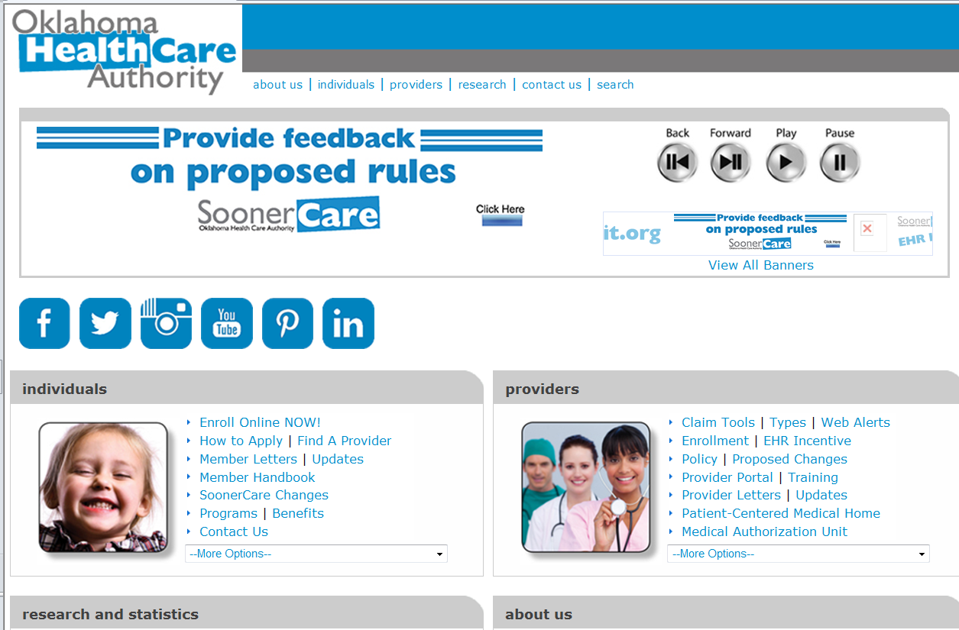
SoonerCare Choice Demonstration
For more information, please visit www.okhca.org.
Notes:
Where they can find it.

Slide 7

Questions
Notes:
Open to feedback and follow up on any questions that we may have gotten from website.

Slide 8
Contact Information
Sherris Harris-Ososanya MHR, LPC
Federal and State Policy
Waiver Reporting Coordinator
Phone: 405-522-7507
Fax: 405-530-3273
Sherris.Harris-Ososanya@okhca.org
Notes:
End!

Slide 9
References
OHCA-CMS Special Terms and Conditions September 9, 2015
OHCA Monthly Fast Facts (www.okhca.org/research)
www.Medicaid.gov
Notes:
More information and resources

