Slide 1
SoonerCare: Vaccinations at the Pharmacy
November 2024

Slide 2
disclaimer
SoonerCare policy is subject to change. The information included in this presentation is current as of November 2024. The most current information can be found on the OHCA public website at oklahoma.gov/ohca.

Slide 3
Purpose
Recent SoonerCare policy changes allow vaccinations to be performed in the pharmacy by a pharmacist. Both the pharmacy and pharmacist must be contracted with SoonerCare.

Slide 4
agenda
Eligible providers and contracting
Coverage and services
Pharmacy billing: vaccine claims
Next steps with the contracted entities
Secure provider portal
Claims submission
Claims resources
Resources
Questions

Slide 5
Eligible providers and contracting

Slide 6
Provider requirements
Provider requirements:
Must obtain and maintain a National Provider Identifier (NPI).
Must use the taxonomy number required by the state.
Apply for an NPI

Slide 7
provider contracts
To provide health care services to SoonerCare members and to be eligible for payment, providers must have an approved contract on file with OHCA.
Providers that require a new contract are:
Those new to providing services for Medicaid and have never had a SoonerCare contract.
Those that began the renewal process but have failed to complete the entire renewal process prior to contract expiration.
Those that were previously contracted but did not opt to renew during the contract renewal period.

Slide 8
pre-enrollment steps
1
Create user account
Complete an online application. (User account must be created first.)
2
Provider contract selection
The type of provider contract must be selected (i.e., individual, business, I/T/U).
3
Provider type selection
Based on the contract type selected, many different provider types are available.
4
Provider program selection
The program of desired enrollment must be selected (i.e., SoonerCare, DDSD waiver).
Notes:
Before beginning the enrollment process, users must complete 4 new application steps:

Slide 9
provider enrollment
To complete the enrollment process, providers will:
Complete the enrollment forms that are prompted for the user.
Read the provider agreement, special provisions and any applicable addendums that are prompted for the user.
General Provider Agreement contains the terms and conditions applicable to all providers.
Special Provisions contains terms for a particular provider type and/or specialty.
Electronically sign the application and upload or fax copies of all requested documentation prompted for the user to OHCA.
Federal laws require some providers to have on-site screening visits. An OHCA provider enrollment contracts representative will conduct these visits for providers that are not already screened by another state or federal agency.

Slide 10
new contracts
The SoonerCare provider enrollment application is found on the provider enrollment page by clicking the New Contracts link or by visiting ohcaprovider.com/Enrollment/Site/Home/createuser.aspx.

Slide 11
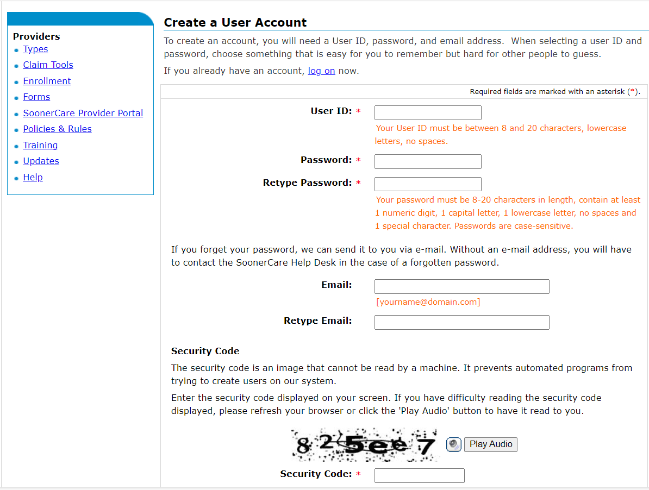

Slide 12
Business contract
Type of provider you are enrolling: Business (facility, agency, organization or group)
Type of business you are enrolling: Group
Select your primary specialty type: Pharmacy Group
The Pharmacy Group contract must be in place before the pharmacist applies for their individual contract.
Notes:
If both the pharmacy and pharmacist have to enroll, should this be added? both must enroll?

Slide 13
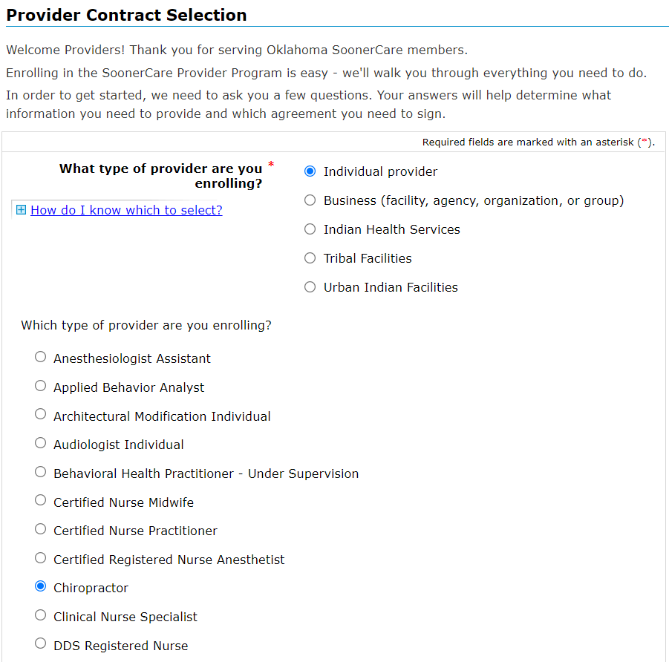
Individual contract
Type of provider you are enrolling: Pharmacist
Notes:
Both the group and individual must contract?? Should this be reworded

Slide 14
provider enrollment (conT.)
All required forms, agreements, provisions and documents will be listed on the right side of the Forms and Agreements page.

Slide 15
appendix a
Specific business provider types are required to obtain a signature from each provider who appoints the business as the agent for receipt of payment for Medicaid-compensable health-care services.
Appendix A is required for the following business provider contracts:
Groups | Outpatient Behavioral Health
Public Health Agencies | Substance Use Disorder Agencies
Rural Health Clinics (RHCs) | School-Based EPSDT
Federal Qualified Health Centers (FQHCs)

Slide 16
application submission
New provider contracts are processed by provider enrollment within 4-6 weeks of submission.
OHCA will acknowledge receipt of the application with an application tracking number (ATN). The ATN or SSN/FEIN may be used to check the status of the application. See Global Message 8/4/20.
If the application is returned for corrections, email notifications will be sent to the enrollment contact submitted on the application.
Initial email: The first notification that corrections are needed.
Second email: Sent 15 days after the initial email as a reminder.
Expiration email: Sent 30 days after the initial email as notification that the contract is expired and a new application is required.
Notes:
If you need to pause enrollment and come back to it later, or if the contract was sent back for corrections go back into the account that you created with electronic provider enrollment and not the provider portal to continue or make corrections.

Slide 17
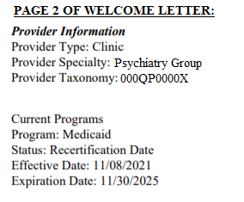
application approval
Upon application approval, official contacts will receive:
Welcome letter containing important contract information.
Provider ID
Primary taxonomy code
Zip +4
CN1 (if applicable)
Program
Effective date
Expiration date
PIN letter containing secure provider portal login instructions.
Notes:
The PIN Letter will be sent 24 hours after the Welcome Letter. Both letters are also available on the secure provider portal under the Letters tab (must know approximately when it was issued).

Slide 18
PIN Letter
Upon contract approval from OHCA, official contacts will receive a welcome letter containing important contract information and a PIN letter containing secure provider portal login instructions.
Use your provider ID, service location and PIN to register on the portal.

Slide 19
Coverage and services

Slide 20
IMMUNIZATIONS/VACCINES
No copay for children or adults.
Check the OHCA provider portal for age/code restrictions prior to administering vaccines.
The medical record must include a complete history of immunizations received if member is <21 years of age, and an appropriate history for adults.
The provider must provide an OSIIS pin number and submit data to OSIIS as appropriate.
All vaccines administered should be fully documented in the patient’s permanent medical record.

Slide 21
Immunizations/vaccines (CONT.)
As per the requirements of the National Childhood Vaccine Injury Act and best practice, documentation should include the following:
Date of administration
Vaccine manufacturer
Vaccine lot number
Name and title of person who administered vaccine and address of facility where permanent record will reside
Vaccine information statement
Date on VIS
Date provided to patient or parent/guardian
Vaccine type (ACIP abbreviation)
Route
Dosage (volume)
Site

Slide 22
Immunizations/vaccines (CONT.)
Pharmacies can participate in the VFC program.
An administration fee can be paid per vaccine/injection administered by the pharmacist.
Only one administration fee is permitted per vaccine/injection, regardless of the number of vaccine/toxoid components in the vaccine (e.g., MMR).
For members ages 0-18 and providers who choose not to participate in the VFC program, payment will not be made for vaccines that are covered through the VFC program; the member cannot be charged.
Notes:
Member cannot be charged

Slide 23
Immunizations/vaccines (cont.)
For members ages 19 and older, covered vaccines along with administration fees can be paid.
The appropriate HCPCS code and National Drug Code (NDC) must be billed.
In addition to the NDC and HCPCS code, claims must contain the drug name, strength and dosage amount.
Notes:
Customary fee??

Slide 24
Procedure codes Diagnosis code: Z23 encounter for vaccine *Diagnosis code: Z23 encounter for vaccine must be used to trigger our system to not apply a copay.
Administration Codes:
90460 90471 90472 90473 90474 90480
96380 96381 G0008 G0009 G0010 M0201
Vaccine Codes:
90585 90586 90611 90619 90620 90621 90622
90623 90632 90633 90634 90636 90644 90647
90648 90651 90653 90654 90656 90657 90658
90660 90661 90662 90670 90671 90673 90675
90676 90677 90678 90679 90680 90681 90683
90684 90696 90697 90698 90700 90702 90707
90710 90713 90714 90715 90716 90723 90732
90733 90734 90736 90739 90740 90743 90744
90746 90747 90748 90749 90750 90759 91304
91318 91319 91320 91321 91322

Slide 25
Pharmacy billing: Vaccine claims

Slide 26
Current state: Point of sale Billing
Entity | Pharmacist as Vaccine Prescriber
OHCA/Fee For Service | SCC 42
Oklahoma Complete Health | SCC 42
Aetna Better Health of Oklahoma | SCC 55
Humana Healthy Horizons in Oklahoma | SCC 55
Vaccine coverage will continue to be allowed on pharmacy POS billing until further notice
At some point, only flu and COVID vaccines will remain as pharmacy POS eligible
COVID admin fees were reduced to regular vaccine admin fee of $18.34 on Oct. 1, 2024
Reminder to pharmacies to register as a VFC provider if they intend to vaccinate members 18 and younger
VFC vaccines are only reimbursed an administration fee

Slide 27
NEXT STEPS WITH THE CONTRACTED ENTITIES

Slide 28
CONTRACTED ENTITIES
Aetna Better Health of Oklahoma Contacts:
Pharmacy Director Irene Chung: chungi1@aetna.com
Provider Engagement: ABHOKProviderEngagement@AETNA.com
Oklahoma Complete Health Contacts:
Pharmacy Director Kristen Winters: kristen.winters@centene.com
Pharmacy Team: oklahoma_complete_health_pharmacy@centene.com
Provider Engagement: oklahomacompletehealth_pr@oklahomacompletehealth.com
Humana Healthy Horizons Contacts:
Pharmacy Director Deidra Williams: dwilliams308@humana.com
Provider Engagement: OkMedicaidProviderRelations@humana.com​
Contracting: OKProviderDevelopment@humana.com​
Call Center: 855-223-9868 (TTY: 711), Monday-Friday, 8 a.m.-5 p.m.

Slide 29
Secure provider portal

Slide 30
provider portal
OHCA’s SoonerCare provider portal is a secure website that offers several services for providers:
Claim functions (submitting, editing, voiding) and status
Eligibility verification
Fee schedule search
Find a provider
Provider letters
Remittance advice and other reports
ohcaprovider.com
Notes:
The SoonerCare provider portal is available 7 days a week, 24 hours a day except during scheduled maintenance.
Providers must register for a provider portal account to access the secure site

Slide 31
provider portal resources
Several helpful resources are available online for assistance navigating the secure provider portal:
OHCA Secure Provider Portal Functions presentation
Update Provider Files presentation
Register a Clerk how-to video
Create Clerks how-to video
Add Credential Agent how-to video
Provider training manual: Medicaid on the Web
The Provider Portal Access Form is available for administrator account locks. See Global Message 3/19/21 for more information.

Slide 32
Claims Submission

Slide 33
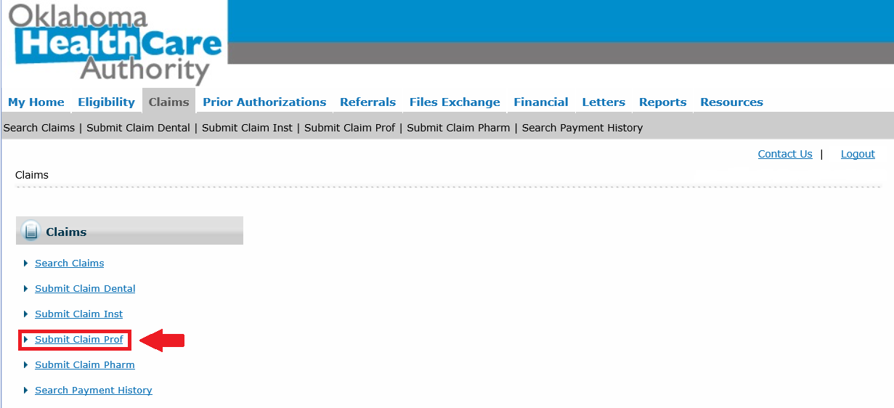
Medicaid primary
Select Submit Claim Prof under the Claims tab.

Slide 35
Medicaid primary
*Ordering Provider is the contracted pharmacist and is required.
*ID Type is NPI.
Notes:
Is ordering provider required?
These are members enrolled in SoonerCare Choice or Insure Oklahoma.
If the ordering NPI has multiple locations, the zip+4 must be entered.
Other Facility ID is only used for IEP School Based services.

Slide 36
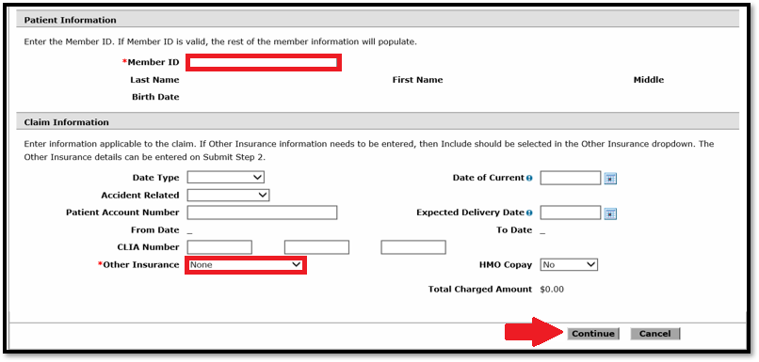
Medicaid primary
Member ID is always required. The member demographics will auto populate if the member ID is valid.
Other Insurance needs to be left at None.
Select Continue to proceed to step 2.

Slide 37
Medicaid primary
Diagnosis Code field is required. Enter the diagnosis code Z23 without the decimal point and select the Add button.
Click Continue to proceed to step 3.
Diagnosis code: Z23 encounter for vaccine must be used to trigger our system to not apply a copay.

Slide 38
Medicaid primary
Charge Amount must be entered but the code will pay at $0 if it is a VFC vaccine.
Rendering Provider is required.
ID Type is always NPI, enter the zip code that you listed on the rendering provider’s contract.
If the Ordering Provider is entered in Step 1. It will carry over to Step 3 on all line items.
Select Add to enter additional service lines.

Slide 39
Medicaid primary
The National Drug Code (NDC) information must be entered for vaccine codes.
Select the + sign to expand the NDC box. Enter the information and select Add to save to the line item of service.

Slide 40
Medicaid primary
Review the claim to verify the information was entered correctly.
Information can be changed by selecting Back to Step 1, 2 or 3.
Select Confirm to finalize the claim.

Slide 41
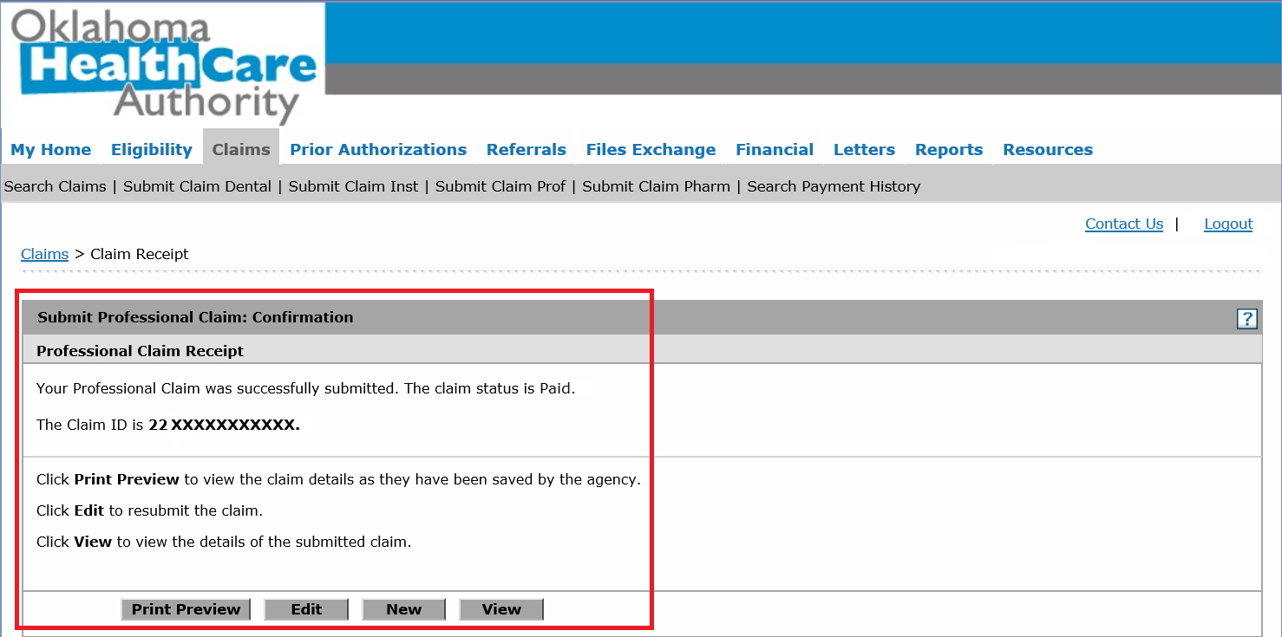
Medicaid primary
Upon confirmation, the claim will adjudicate, and the claim ID will populate.
Status is either Paid, Denied, Suspended or Resubmit.
Claim Options are Print Preview, Edit, New or View.

Slide 42
Secondary/Crossover claims
For instructions on how to bill a Medicaid secondary or a Medicare crossover claim please view the 1500 Professional Claim Submission presentation.

Slide 43
Claims resources

Slide 44
Claim resources
Payment is made to practitioners for services clearly identifiable as personally rendered and performed on behalf of a patient (see OAC 317:30-5-1 policy on eligible providers). Claims for rendered services may be billed by:
OHCA secure provider portal – direct data entry (DDE).
ASC X12N 837 – electronic data interchange (EDI).
OHCA’s claim tools web page contains many resources to help providers successfully submit claims.
Provider billing and procedures manual
SoonerCare fee schedules
Electronic Data Interchange information
Notes:
With your SoonerCare Secure Site account, you can submit claims either through direct data entry or a batch file upload. With direct entry option you can submit only one claim at a time. The batch file upload allows you to combine two or more properly formatted claims and submit them at one time.
Batch upload functionality is based on Electronic Data Interchange (EDI) technology and is the most efficient method of electronic claims submission with the Oklahoma Medicaid Management Information System (OKMMIS). It eliminates many errors, lowers operating costs, reduces turnaround time for payments, and it is free to SoonerCare (Oklahoma Medicaid) providers.

Slide 45
claim resources
The provider training page offers training materials on submitting claims via the secure provider portal.
1500 Professional Claim Submission
Medicare Crossover Claims: Claims cross over from Medicare automatically based on the Medicare NPI on the SoonerCare provider file.
If there is a failure, you may submit the claim on the provider portal or through your electronic submission source.
Effective Feb. 1, 2017, paper crossover claims are no longer accepted.

Slide 46
timely filing
The initial claim must be submitted to SoonerCare within six months from the date of service. No exceptions.
OHCA policy on timely filing: OAC 317:30-3-11.
If a problem exists (such as pending eligibility determination), the provider must still file the claim within 183 days.
Claims received after the timely filing limit must have proof of timely filing attached.
Proof of timely filing (a denied claim can be proof) must reflect a claim that was received by OHCA within the timely filing limit:
The full page from the remittance advice that includes the ICN, and all lines of service related to the claim.
A copy of the portal screen that includes the ICN and line-item details.
Date stamp on a paper claim returned by OHCA or Gainwell.
Claims nearing the timely filing limitation should not be voided without instruction from OHCA.

Slide 47
Third party liability (TPL)
Third Party Liability, or TPL, refers to another party responsible for paying health care costs before SoonerCare pays.
All available TPL resources must meet their legal obligation to pay claims first, as SoonerCare is the payer of last resort, with few exceptions:
Services provided at an I/T/U
Crime victim’s compensation
Examples of TPL include:
Private health insurance and Tricare - Estates and trusts
Casualty insurance - Tort proceeds
Worker’s compensation - Medicare
Visit OHCA’s Third Party Liability page for a list of TPL carriers.

Slide 48
tpl responsibilities
Federal regulations (42 CFR 447.20) prohibit providers from billing a member while a claim is pending adjudication.
Providers cannot refuse service because the member has third party coverage.
Providers cannot collect the copayment of the primary insurance if the member also has SoonerCare.
Providers must write off any amount over the SoonerCare allowable.
A member can only be billed if:
The service rendered is a non-covered service.
The member does not adhere to all the rules of the primary insurance and SoonerCare.
Notes:
Example: SoonerCare provider is out of network for the primary insurance and does not have an out-of-network deductible.
Final Poll #5

Slide 49
resources

Slide 50
ohca public website
OHCA’s public website is the best source for current SoonerCare information: oklahoma.gov/ohca.
A provider toolkit is available to help providers locate helpful information online more efficiently.
Find service-specific information such as rules, manuals, prior authorization, forms and contracts for enrolling in the SoonerCare program and other important topics based on the services you provide on the provider types page.
Policy and rules are available to review online.

Slide 51
provider enrollment
Phone: 800-522-0114, option 5
Hours: 8 a.m.-5 p.m. on Mon., Tue., Thu., Fri.
1-5 p.m. on Wed.
Email: ProviderEnrollment@okhca.org
Web: oklahoma.gov/ohca/providers/provider-enrollment.html

Slide 52
Helpful telephone numbers
OHCA Call Center 800-522-0114 or 405-522-6205, option 1
Internet Help Desk 800-522-0114 or 405-522-6205, option 2, 1
EDI Help Desk 800-522-0114 or 405-522-6205, option 2, 2

Slide 53
Helpful links
Agency Website oklahoma.gov/ohca
OHCA Provider Portal ohcaprovider.com
Provider Training oklahoma.gov/ohca/providers/provider-training
Provider Quick Reference Guide
OHCA Resource Guide
Notes:
The Provider Training page has upcoming trainings, training materials, previous webinars, how-to videos, resources and Q&A’s.
QRG: your guide to reaching out to OHCA based on your issue. It lists the options available on the Helpline, also PA contact info by department.

Slide 54
Training resources
Provider education specialists:
Education specialists provide education and training as needed for providers either virtually or telephonically.
Requests for assistance should be emailed to: SoonerCareEducation@okhca.org. (Requests should include the provider's name and ID, contact information, and a brief description of what assistance is being sought.)
For immediate claims or policy assistance, please contact the OHCA provider helpline at 800-522-0114.

Slide 55
Questions?

Slide 56
GET IN TOUCH
4345 N. Lincoln Blvd.
Oklahoma City, OK 73105
oklahoma.gov/ohca
MySoonerCare.org
Agency: 405-522-7300
Helpline: 800-987-7767

