Slide 1
Oklahoma Tobacco Helpline
Paola Klein, MHR, CTTS
Oklahoma Tobacco Helpline Coordinator

Slide 2
Objectives
What services are offered?
What do coaches provide?
Who can use the Oklahoma Tobacco Helpline?
How do you enroll?

Slide 3
What is the Oklahoma Tobacco Helpline?
The Oklahoma Tobacco Helpline is a FREE, 24/7 service available to all Oklahomans 13 years and older offering:
An enhanced selection of services
Quit coaches that provide nonjudgmental support
Free nicotine replacement therapy (NRT)
Spanish-language services
Hard-of-hearing services

Slide 4
Helpline Services
The Oklahoma Tobacco Helpline offers an enhanced selection of services to help Oklahomans quit their own way.
Service plans
All access
Web coach
Individual services
Text and email support are available.

Slide 5
All Access
All access is the most complete package and includes:
At least one coaching call
Web coaching
Supportive text messages
Helpful emails
A quit guide and other materials
At least a two-week supply of FREE patches, gum or lozenges

Slide 6
Web Coach
Web coach provides a private online community where you can receive:
Web coaching
Supportive text messages
Helpful emails
An electronic quit guide
A two-week supply of FREE patches, gum or lozenges

Slide 7
Web Coach
You can also:
Access helpful digital tools
Develop your own quit plan
Track your progress
Interact with an online support community
Discuss your challenges and victories

Slide 8
Individual Services
Individual services allow you to customize your own quit plan by selecting from the following services:
Supportive text messages
Helpful emails
A quit guide
A two-week supply of FREE patches, gum or lozenges

Slide 9
Quit Coaches
Quit coaches typically hold a master’s degree and have an additional 270 hours of professional training customized for the helpline in strategies such as:
Cognitive behavioral therapy
Motivational interviewing
Education
Skill building

Slide 10
Create A Quit Plan
Quit coaches help you create a quit plan that fits your lifestyle:
Building confidence and motivation to quit
Coping strategies for triggers and cravings
Assisting with the use of NRT including patches, gum or lozenges
Online tools and nonjudgmental support

Slide 11
How To Register
Phone: 1-800-QUIT NOW
Web: OKhelpline.com
Ask your health care provider for a referral

Slide 12
What To Expect: Phone
When calling the Oklahoma Tobacco Helpline:
You will first speak with a registration specialist for about 10 to 15 minutes.
Once registered, you are transferred to a quit coach or you can schedule your quit coach call for a later date or time.
Answer a few questions and select the services that work best for you.

Slide 13
What To Expect: Online
When registering online:
Visit OKhelpline.com and click the Sign Up button.
Select your health insurance and employment status.
Answer a few questions and select the services that work best for you.

Slide 14
Nicotine Replacement Therapy (NRT)
NRT options: Patches, gum or lozenges
Web enroll: Those enrolled in web coach must order NRT from their account after logging in (two-week supply)
Individual services: If enrolled online, they can log into their account to select NRT (Only a two-week supply)
NRT takes 10 – 14 business days to arrive

Slide 15
Helpful Info
When the helpline calls you, the following will appear on caller IDs:
Land lines: 1-800-QUIT NOW
Cell phones: 1-800-784-8669
If NRT is ordered, it should arrive within 10 to 14 business days.

Slide 16
Conclusions
The Oklahoma Tobacco Helpline is available 24/7 to all Oklahomans 13 years and older.
An enhanced selection of FREE services is available to help Oklahomans quit tobacco their own way.
FREE NRT is available to eligible participants.
Specially trained quit coaches offer nonjudgmental support.

Slide 17
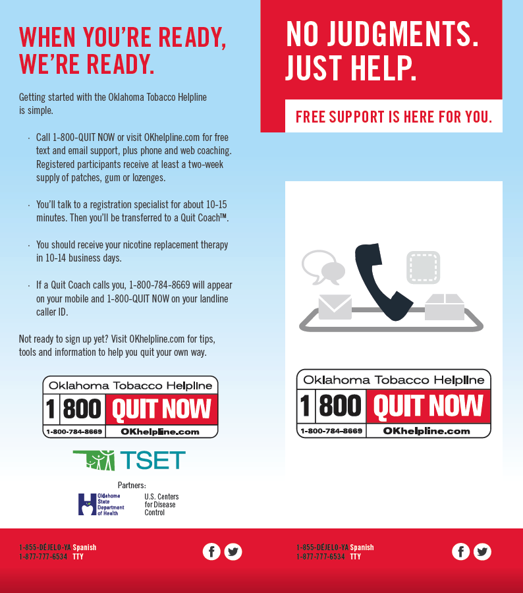
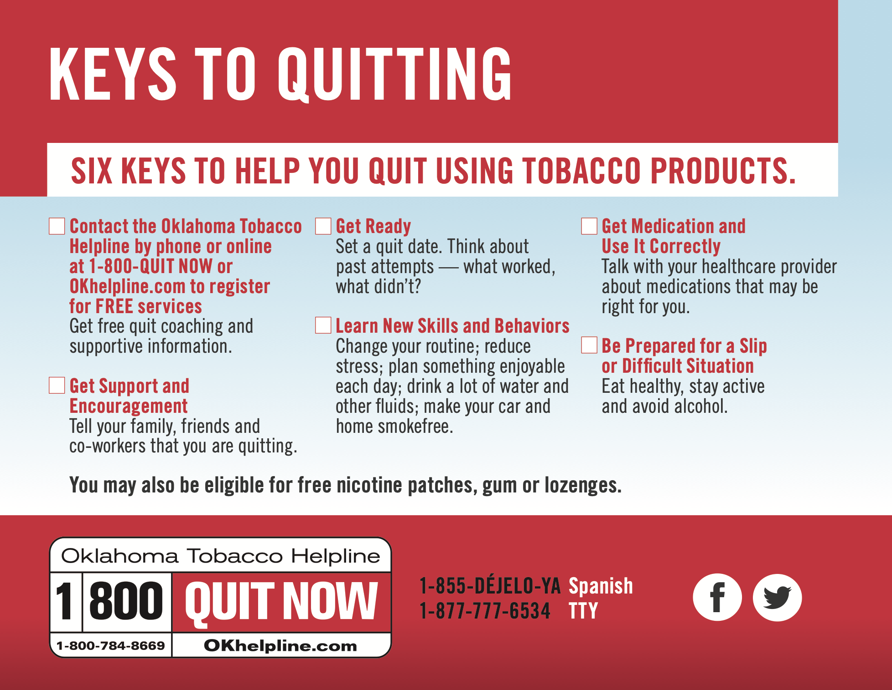
Example Creative

Slide 18
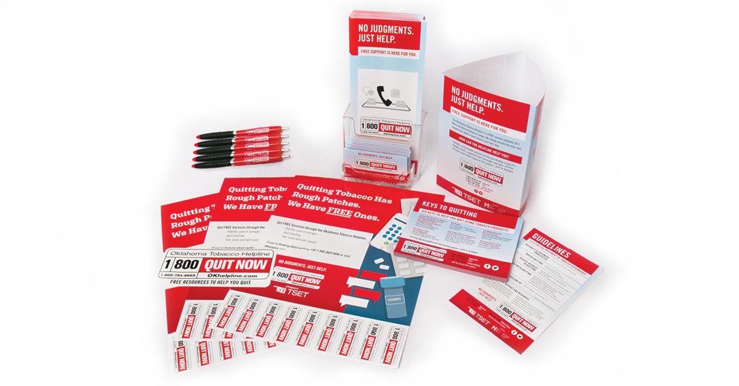
Example Creative

Slide 19
Example Creative

Slide 20
Questions
For more information, contact:
Paola Klein, MHR, CTTS
Oklahoma Tobacco Helpline Coordinator
OTRC – Oklahoma Tobacco Research Center
(405) 271-8001 Ext. 50474
Paola-Klein@ouhsc.edu

