Slide 1

Program Overview
Valenthia doolin
Homeownership director
2022 Tribal Long Term Support Infrastructure Conference

Slide 2
Public Trust created in 1975
Independent self-supporting entity with the state of Oklahoma as its beneficiary
Partners with developers, residential property owners, Realtors and Lenders to finance the construction, rental or purchase of affordable housing in communities throughout the 77 Oklahoma counties
Mission: To provide housing resources with an eagerness to serve.

Slide 3
OHFA Board of Trustees
Michael Buhl, Chair
Scott McLaws, Vice Chair
Heath Collins, Treasurer
Ann Felton, Member
Roger Beverage, Member
Joi Love, Resident Board Member

Slide 4
OHFA Executive Leadership
Deborah Jenkins, Executive Director
Kurt Fite, Deputy Executive Director/CFO
Darrell Beavers, Housing Development Director
Valenthia Doolin, Homeownership Director
Tim Shackelford, Rental Programs Director
Tamara Steele, Human Resources Director

Slide 5
OHFA Programs
Homeownership
Housing Development
Rental Assistance

Slide 6
Homeownership Programs
Single Family Home Purchase
Homeowner Assistance Fund

Slide 7
Homeownership
Single Family Home Purchase
https://www.ohfa.org/lenders-and-realtors/
https://www.ohfa.org/homebuyers/
Homeowner Assistance Fund
https://www.ohfa.org/haf/

Slide 8
Single Family Home Purchase
CREATING HOMEOWNERSHIP
Participating Lenders
Mortgage Loan Products
Down Payment Assistance
Consumer Outreach/Education
Realtor Partners

Slide 9
Homeowner Assistance Fund
PRESERVING HOMEOWNERSHIP
American Rescue Plan
COVID 19 Recovery
Grant Funds

Slide 10
Housing Development Programs
Affordable Housing Tax Credits
HOME Investment Partnerships Program
Multifamily Bonds
Housing Opportunities for Persons with AIDS
Oklahoma Housing Trust Fund
National Housing Trust Fund

Slide 11
HOUSING DEVELOPMENT
PROGRAMS
CREATING AFFORDABLE HOUSING
https://www.ohfa.org/developers/
Affordable Housing Tax Credits
Low Income Housing Tax Credit Program
Expands supply of rental units
Rehabilitates existing rental housing for qualified applicants
Stimulates private investment
Awarded to states annually, by IRS based on population size
Eligible Recipients: Non-profits, Housing Authorities, For-Profit Developers and Native Tribal Nations

Slide 12
HOUSING DEVELOPMENT
CREATING AFFORDABLE HOUSING
MULTIFAMILY BONDS
In conjunction with Affordable Housing Tax Credit Program
Tax Exempt Bonds
Reduces financing interest paid
Allocated to OHFA through the OK Council of Bond oversight

Slide 13
HOUSING DEVELOPMENT
CREATING AFFORDABLE HOUSING
HOME INVESTMENT PARTNERSHIPS PROGRAM
Federal Block Grant managed by HUD
OHFA receives annual allocation from HUD based on HUD formula
New construction, rehabilitation, multi family units for rental or homeownership, down payment/closing costs assistance, rental assistance

Slide 14
HOUSING DEVELOPMENT
CREATING AFFORDABLE HOUSING
HOUSING OPPORTUNITIES FOR PERSONS WITH AIDS (HOPWA)

Slide 15
HOUSING DEVELOPMENT
CREATING AFFORDABLE HOUSING
NATIONAL HOUSING TRUST FUND

Slide 16
HOUSING DEVELOPMENT
CREATING AFFORDABLE HOUSING
OKLAHOMA HOUSING TRUST FUND

Slide 17
Rental Assistance Programs
Housing Choice Voucher
Performance Based Contract Administration
Emergency Housing Voucher

Slide 18
RENTAL ASSISTANCE PROGRAMS
SUPPORTING STABLE HOUSING
https://www.ohfa.org/rentalassistance/
HOUSING CHOICE VOUCHER

Slide 19
RENTAL ASSISTANCE PROGRAMS
SUPPORTING STABLE HOUSING
PERFORMANCE BASED CONTRACT ADMINISTRATION

Slide 20
RENTAL ASSISTANCE PROGRAMS
SUPPORTING STABLE HOUSING
EMERGENCY HOUSING VOUCHERS

Slide 21

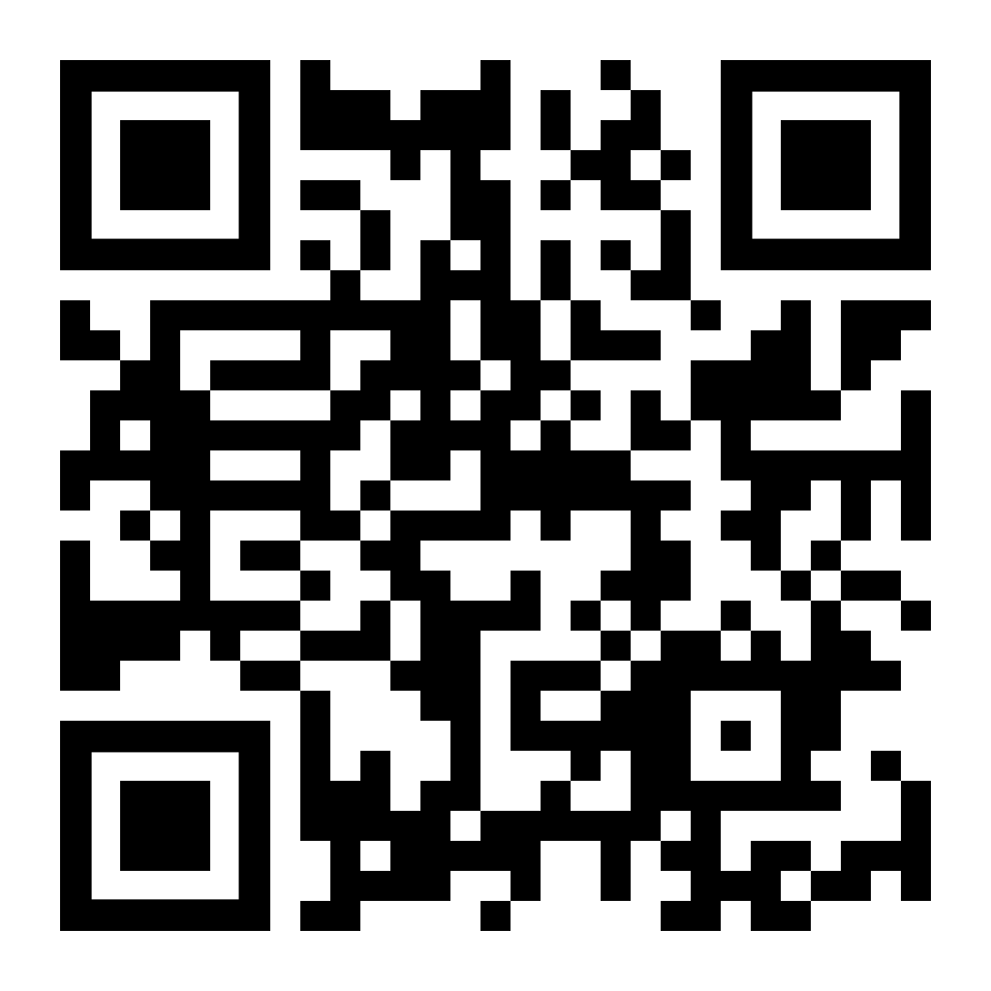
Stay in Touch
(405) 848-1144
ohfa.org
Scan to Visit
Oklahoma Housing Finance Agency
On Social Media!

