Slide 1
Hiring and serving PEOPLE WITH DISABILITIES
Charles Watt - Oklahoma Department of Rehabilitation Services

Slide 2
AGENDA
Introduction
Statistics
Application and Hiring
Inclusivity
Accommodation
Harassment

Slide 3
INTRODUCTION
The problem with stereotypes is not that they are untrue but that they are incomplete.
- Chimamanda Ngozi Adichie

Slide 4
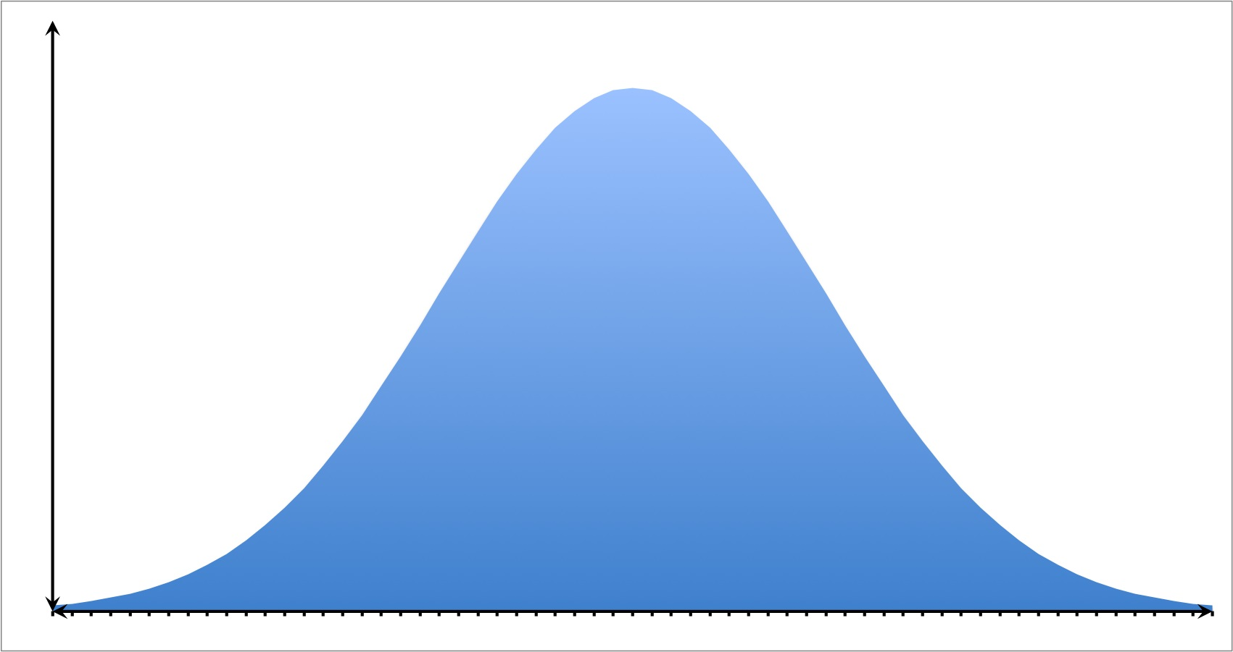
Normal Distribution

Slide 5
Employment statistics

Slide 6
Employment-to-population ratio
Notes:
Working age is 16 to 64
PWOD September & October 2023 No Change
PWD September & October 2023 37.2% Down .1%

Slide 7
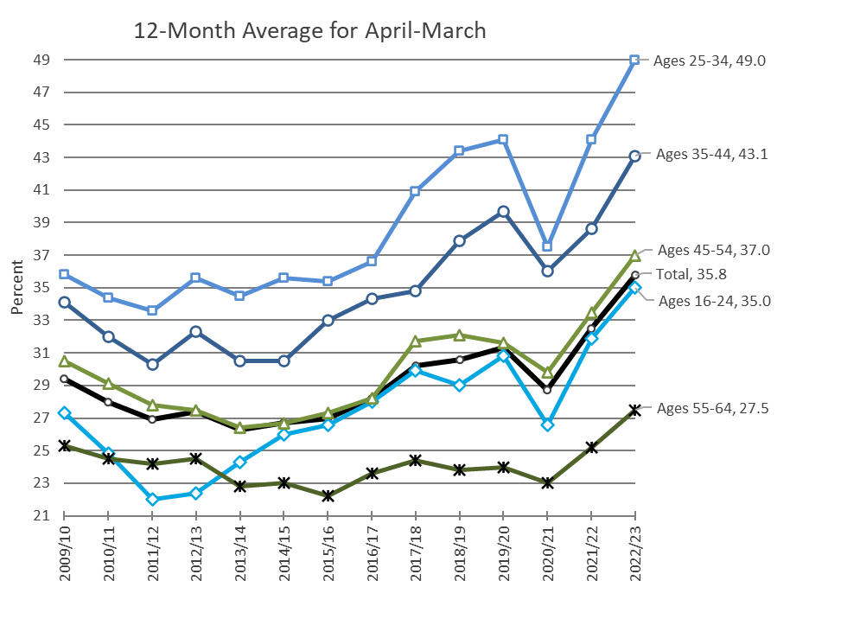
Employment-to-population ratio BY AGE GROUP FOR people with disabilities

Slide 8
Labor force 1994-2024
Group | Level |  |  |  | Change |  |  | Percent change |  |  | Percent distribution |  |  |  | Annual growth rate (percent)
 | 1994 | 2004 | 2014 | 2024 | 94–04 | 04–14 | 14–24 | 94–04 | 04–14 | 14–24 | 1994 | 2004 | 2014 | 2024 | 94–04 | 04–14 | 14–24
16 to 24 | 21,612 | 22,268 | 21,295 | 18,498 | 656 | -973 | -2,797 | 3 | -4.4 | -13.1 | 16.5 | 15.1 | 13.7 | 11.3 | 0.3 | -0.4 | -1.4
25 to 54 | 93,898 | 102,122 | 100,767 | 104,697 | 8,224 | -1,355 | 3,930 | 8.8 | -1.3 | 3.9 | 71.6 | 69.3 | 64.6 | 63.9 | 0.8 | -0.1 | 0.4
55 + | 15,547 | 23,011 | 33,860 | 40,575 | 7,464 | 10,849 | 6,715 | 48 | 47.1 | 19.8 | 11.9 | 15.6 | 21.7 | 24.8 | 4 | 3.9 | 1.8

Slide 9
Labor shortage
Notes:
Working age is 16 to 64

Slide 10
WHY DISABILITY INCLUSION?
11% of U.S. working-age adults (18-64) report having a disability. Therefore, creating inclusion-based policies and practices is essential.
Companies that lead on critical disability inclusion criteria realize:
1.6x more revenue,
2.6x more net income, and
2x more economic profit than other participants.
Notes:
In general, the WOTC is equal to 40% of up to $6,000 of wages paid to, or incurred on behalf of, an individual who is in their first year of employment; is certified as being a member of a targeted group; and
performs at least 400 hours of services for that employer. Thus, the maximum tax credit is generally $2,400.
The Disabled Access Credit is a non-refundable credit for small businesses that have expenses for providing access to people with disabilities. An eligible small business is one that earned $1 million or less or had no more than 30 full-time employees in the previous year. Small businesses claim a 50% credit for eligible access expenditures. The business can claim the credit each year they have access expenditures. 1. To remove barriers that prevent a business from being accessible to or usable by individuals with disabilities; 2. To provide qualified interpreters or other methods of making audio materials available to hearing-impaired individuals; 3. To provide qualified readers, taped texts, and other methods of making visual materials available to individuals with visual impairments; or 4. To acquire or modify equipment or devices for individuals with disabilities.
The architectural barrier removal tax deduction encourages businesses of any size to remove architectural and transportation barriers that helps people with disabilities and the elderly get around more easily. Businesses may claim a deduction of up to $15,000 a year for qualified expenses on items that normally must be capitalized. Businesses claim this deduction by listing it as a separate expense on their income tax return. Businesses may use the Disabled Access Credit and the architectural tax deduction together in the same tax year if the expenses meet the requirements of both benefits.

Slide 11
Business Services Program
Ready to Serve Your
Business
Employers, business owners and
supervisors, DRS Business Services
Program can be a resource for
your business:
We send you qualified job candidates
Our candidates are loyal employees,
offering lower turnover
Tax credits may be available
The Business Services Program helps
employers with their business needs and
helps them find employees they can
count on.

Slide 12
Tax Incentives
Work Opportunity Tax Credit:
VR Referrals
SSI Recipients
Veterans
Disabled Access Credit:
Small business expenses for providing access to PWD
Barrier Removal Tax Deduction:
Businesses which remove architectural and transportation barriers
Notes:
In general, the WOTC is equal to 40% of up to $6,000 of wages paid to, or incurred on behalf of, an individual who is in their first year of employment; is certified as being a member of a targeted group; and
performs at least 400 hours of services for that employer. Thus, the maximum tax credit is generally $2,400.
The Disabled Access Credit is a non-refundable credit for small businesses that have expenses for providing access to people with disabilities. An eligible small business is one that earned $1 million or less or had no more than 30 full-time employees in the previous year. Small businesses claim a 50% credit for eligible access expenditures. The business can claim the credit each year they have access expenditures. 1. To remove barriers that prevent a business from being accessible to or usable by individuals with disabilities; 2. To provide qualified interpreters or other methods of making audio materials available to hearing-impaired individuals; 3. To provide qualified readers, taped texts, and other methods of making visual materials available to individuals with visual impairments; or 4. To acquire or modify equipment or devices for individuals with disabilities.
The architectural barrier removal tax deduction encourages businesses of any size to remove architectural and transportation barriers that helps people with disabilities and the elderly get around more easily. Businesses may claim a deduction of up to $15,000 a year for qualified expenses on items that normally must be capitalized. Businesses claim this deduction by listing it as a separate expense on their income tax return. Businesses may use the Disabled Access Credit and the architectural tax deduction together in the same tax year if the expenses meet the requirements of both benefits.

Slide 13
First steps

Slide 14
Essential Policies
Equal Opportunity and Non-Discrimination Policy
Reasonable Accommodation Policy
Inclusive Job Descriptions and Qualifications
Accessibility
Training and Sensitivity
Harassment Policy
Anti-Retaliation Policy
Disability Disclosure
Notes:
Equal Opportunity and Non-Discrimination Policy:
Clearly state that your organization does not discriminate on the basis of disability, and that all qualified individuals will be considered for employment opportunities.
Reasonable Accommodation Policy:
Define the process for requesting reasonable accommodations, such as assistive technology, flexible work schedules, or physical modifications to the workplace.
Designate a point of contact or a specific department responsible for handling accommodation requests.
Ensure confidentiality in the accommodation request process.
Inclusive Job Descriptions and Qualifications:
Craft job descriptions and qualifications that focus on essential job functions and qualifications, avoiding unnecessary barriers that may exclude individuals with disabilities.
Accessibility:
Ensure that the hiring process is accessible to all candidates, including those with disabilities. This includes accessible online application forms and websites.
Make interview locations physically accessible to individuals with mobility impairments.
Training and Sensitivity:
Train HR staff and hiring managers on disability awareness and the importance of creating an inclusive workplace.
Provide guidelines for conducting interviews with candidates with disabilities and focus on their qualifications, not their disabilities.
Anti-Retaliation Policy:
Ensure that employees who disclose a disability or request accommodation are protected from retaliation and discrimination.
Disability Disclosure (Section 503):
Make it clear that disclosure of a disability is voluntary, and no candidate should be pressured to disclose.
Emphasize that disclosure will not have a negative impact on the hiring decision.

Slide 15
The “how” of Accessibility
Develop an accessible website and online application system
Ensure physical spaces, public areas, and emergency plans are accessible and use universal design principles
Only use accessible locations for offsite work functions
Ensure internal change management and public-facing initiatives are accessible
Use procurement checks to ensure products and services are accessible

Slide 16
The “how” of Accommodation
Educate all employees on accommodation policy and process
Train all supervisors on how to recognize accommodation requests
Centralize the accommodation process to one department
Reduce friction in the accommodation process by eliminating unnecessary steps
Make common accommodation requests self-serve (e.g., ergonomic mice, screen magnification, etc.)

Slide 17
Disclosure vs self-identification
Fear of retaliation or discrimination
Disclosure for accommodation requests
Maintaining confidentiality
Educating employees
Self-identification for affirmative action or data collection programs
Must be clearly indicated as voluntary
Must be kept confidential

Slide 18
Application and hiring: keeping the ada in mind
Notes:
SCOTUS permitting employers to adopt “voluntary affirmative action plans” where (1) preferences are intended to “eliminate manifest racial imbalance in traditionally segregated job categories”; (2) the rights of non-minority employees are “not unnecessarily trammeled”; and (3) the preferences are temporary in duration. Otherwise, absent very unique circumstances, protected characteristics cannot be the basis for making employment decisions.
A proper DEI program should seek to expand the “pool” of qualified candidates and make neutral hiring decisions within that pool. Selections based on protected characteristics are likely to be challenged and found to be discriminatory.

Slide 19
Three phases of the hiring process
Phase 1 – Pre-Employment
Make it accessible
Provide requested accommodations
No questions about disability (with exceptions)
No medical tests
Phase 2 – After a Legitimate Job Offer But Before Starting Employment
Any questions allowed
Medical tests permitted (with caveat)
Phase 3 – Employment
Job-related and consistent with business necessity

Slide 20
Application process
Non-discriminatory job applications
Accessibility for those with sensory impairments
Accessibility for those with cognitive impairments
Non-discriminatory interviews and testing
Be prepared to honor accommodation requests
Employers may only refuse to provide accommodations if doing so would create an “undue hardship”
Employer may request medical documentation for accommodation requests

Slide 21
Job interviews
Disability-related questions and medical examinations are prohibited
There are “It depends questions.” Will the question elicit information about disability?
Obvious vs. Non-Obvious Disabilities
Disability related inquiries - allowed exceptions
About affirmative action programs
Voluntary self-identification
Confidential information

Slide 22
After conditional job offer but before starting job
An employer can ask disability-related questions, including any need for reasonable accommodations
An employer can require medical examinations.
All entering employees in the same job category must be subjected to the same examination/inquiry.
If an individual’s conditional job offer is rescinded it must be done for reasons which are job-related and consistent with business necessity.

Slide 23
Legitimate job offers
All selection procedures such as background checks, employment verification, polygraph tests, criminal history checks, et al. must have been completed.
“A job offer is real if the employer has evaluated all relevant non-medical information it reasonably could have obtained and analyzed prior to giving the offer.”
(EEOC ADA Enforcement Guidance: Pre-employment Disability-Related Questions and Medical Examinations )

Slide 24
Current employment
Disability inquiries and medical exams can be made when it is job-related and consistent with business necessity.
The employer has a reasonable belief, based on objective evidence, that;
an employee’s ability to perform essential job functions will be impaired by a medical condition/disability
an employee will pose a direct threat due to a medical condition/disability
“Regarded as” considerations.
Notes:
“How can I help you?”

Slide 25
Work environment
Notes:
+-

Slide 26
Policy References
2010 ADA Standards for Accessible Design (After March 15, 2012)
1991 ADA Accessibility Guidelines (After January 26, 1992)
September 15, 2010 to March 15, 2010 – can use either 1991 ADAAG or 2010 Standards
Americans with Disabilities Act (Disproportionality)

Slide 27
Applying the Standards
New Construction
All new construction after March 23, 2012, must follow the 2010 Standards. ”Each” toilet room must be accessible.
Renovations
The part of the facility being remodeled or renovated must comply with the 2010 ADA Standards for Accessible Design.
Existing Facilities
Existing facilities are only required to make accessibility changes that are “readily achievable”, or relatively inexpensive and easy to do.
Notes:
Alteration. A change to a building or facility that affects or could affect the usability of the building or facility or portion thereof.
It shall be considered discrimination….. with respect to alterations….. to fail to make the alterations in such a manner that, to the maximum extent feasible, the path of travel to the altered area, and the bathrooms, telephones, and drinking fountains serving the altered area, are readily accessible to and usable by individuals with disabilities….. (42 U.S.C. §12147(a)
Five ADA Modifications Which Are Generally Readily Achievable
Creating additional disabled parking spaces, including “van accessible” parking spaces;
Installing “curb cuts” in sidewalks to allow wheelchair access;
Repositioning furniture or office equipment to allow a more accessible path of travel;
Installing raised toilet seats and “grab bars” in restrooms; and
Installing accessible door hardware that does not require turning or twisting to open doors.

Slide 28
Applying the Standards –cont’d
20% Rule for Renovations
Up to 20% of the cost of the renovation must be used toward bringing existing barriers into compliance. For example, $50,000 are spent on renovations. An additional $10,000 must be spent , if needed, toward making changes necessary to bring the rest of the building into compliance with the 2010 ADA Standards.
Existing Facility
If an existing facility has features such as an accessible entrance or bathroom that meets the previous 1991 ADA Standards, the facility does not have to upgrade to the 2010 ADA Standards unless there is a renovation, remodel or addition.
This is referred to as a “safe harbor.”
Notes:
This generally includes changes such as making the doorway width accessible, building a ramp to the front entrance, or restriping a parking lot to create accessible spaces. If there are no features that still need to be made ADA compliant, then the business would not be required to spend any additional funds.
After March 15, 2012 – 2010 Standards apply
September 15, 2010 to March 15, 2010 – can use either 1991 ADAAG or 2010 Standards
After January 26, 1992 – 1991 ADAAG applies

Slide 29
Definition of Alteration
A change to a building or facility that affects or could affect the usability of the building or facility or portion thereof.
Notes:
Alteration: A change to a building or facility that affects or could affect the usability of the building or facility or portion thereof. Alterations include, but are not limited to, remodeling, renovation, rehabilitation, reconstruction, historic restoration, resurfacing of circulation paths or vehicular ways, changes or rearrangement of the structural parts or elements, and changes or rearrangement in the plan configuration of walls and full-height partitions. Normal maintenance, reroofing, painting or wallpapering, or changes to mechanical and electrical systems are not alterations unless they affect the usability of the building or facility.

Slide 30
Regarding Alterations
Sec. 12147. Alterations of existing facilities
(a) General rule
With respect to alterations of an existing facility or part thereof used in the provision of designated public transportation services that affect or could affect the usability of the facility or part thereof, it shall be considered discrimination, for purposes of section 12132 of this title and section 794 of title 29, for a public entity to fail to make such alterations (or to ensure that the alterations are made) in such a manner that, to the maximum extent feasible, the altered portions of the facility are readily accessible to and usable by individuals with disabilities, including individuals who use wheelchairs, upon the completion of such alterations.
Notes:
Alteration: A change to a building or facility that affects or could affect the usability of the building or facility or portion thereof. Alterations include, but are not limited to, remodeling, renovation, rehabilitation, reconstruction, historic restoration, resurfacing of circulation paths or vehicular ways, changes or rearrangement of the structural parts or elements, and changes or rearrangement in the plan configuration of walls and full-height partitions. Normal maintenance, reroofing, painting or wallpapering, or changes to mechanical and electrical systems are not alterations unless they affect the usability of the building or facility.

Slide 31
Definition of Primary Function
A major activity for which the facility is intended.
Notes:
Primary Function: A major activity for which the facility is intended. Areas that contain a primary function include, but are not limited to, [the customer services lobby of a bank, 36.403(b)], the dining area of a cafeteria, the meeting rooms in a conference center, as well as offices and other work areas in which the activities of the public accommodation or other private entity using the facility are carried out. Mechanical rooms, boiler rooms, supply storage rooms, employee lounges or locker rooms, janitorial closets,
entrances, corridors, and restrooms are not areas containing a primary function. [Restrooms are not areas containing a primary function unless the provision of restrooms is a primary purpose of the area, e.g., in highway rest stops.]

Slide 32
Primary Function Area Alterations
Where the public entity is undertaking an alteration that affects or could affect usability of or access to an area of the facility containing a primary function, the entity shall also make the alterations in such a manner that, to the maximum extent feasible, the path of travel to the altered area and the bathrooms, telephones, and drinking fountains serving the altered area, are readily accessible to and usable by individuals with disabilities, including individuals who use wheelchairs, upon completion of such alterations, where such alterations to the path of travel or the bathrooms, telephones, and drinking fountains serving the altered area are not disproportionate to the overall alterations in terms of cost and scope (as determined under criteria established by the Attorney General).
Notes:
Over 20% of the cost is considered disproportionate.
See also

Slide 33
Prioritization in Alterations
Priority 1 - Accessible approach and entrance
Priority 2 - Access to goods and services
Priority 3 - Access to public toilet rooms
Priority 4 - Access to other items such as water fountains and public telephones
Notes:
These are from the DOJ Title III regulations

Slide 34
Best Practices for Avoiding Lawsuits
Make sure certain elements are accessible
Accessible parking
Sidewalks
Ramps
Restrooms
Sales counters
Periodic review of ADA accessibility issues by expert
Difficult to deter serial plaintiff who’s out to find a barrier

Slide 35
THANK YOU
Charles Watt
cwatt@okdrs.gov
(405) 951-3411

