Slide 1
AEM Support Forum
OMES Web Modernization Team

Slide 2
AEM Support Forum series
AEM Support Forum
A place of community on the Adobe Experience products to aid in their support, continual knowledge and training for those in state government.
Every 4th Friday of each month (most times) November & December will be combined. (8th of December)

Slide 3
Agenda
Open Forum
Release Notes
New Features
Showcase
Support Items

Slide 4
Open Forum!
Authoring questions
Show ‘n’ tell
Design patterns, creative content presentations, tips
Best practices found
Kudos received

Slide 5
New Features
New Event Feed style
Enabled search text within accordion
Open All/Close All Accordion expansion of the parent accordion only
Card V2 options/enhancements
Advanced Data Table icons switching to a style option instead of default.
The Default tables header color will now be the Theme color instead of blue.

Slide 6
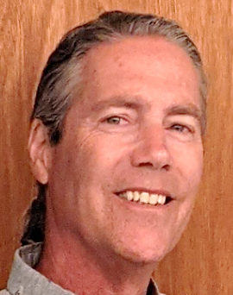
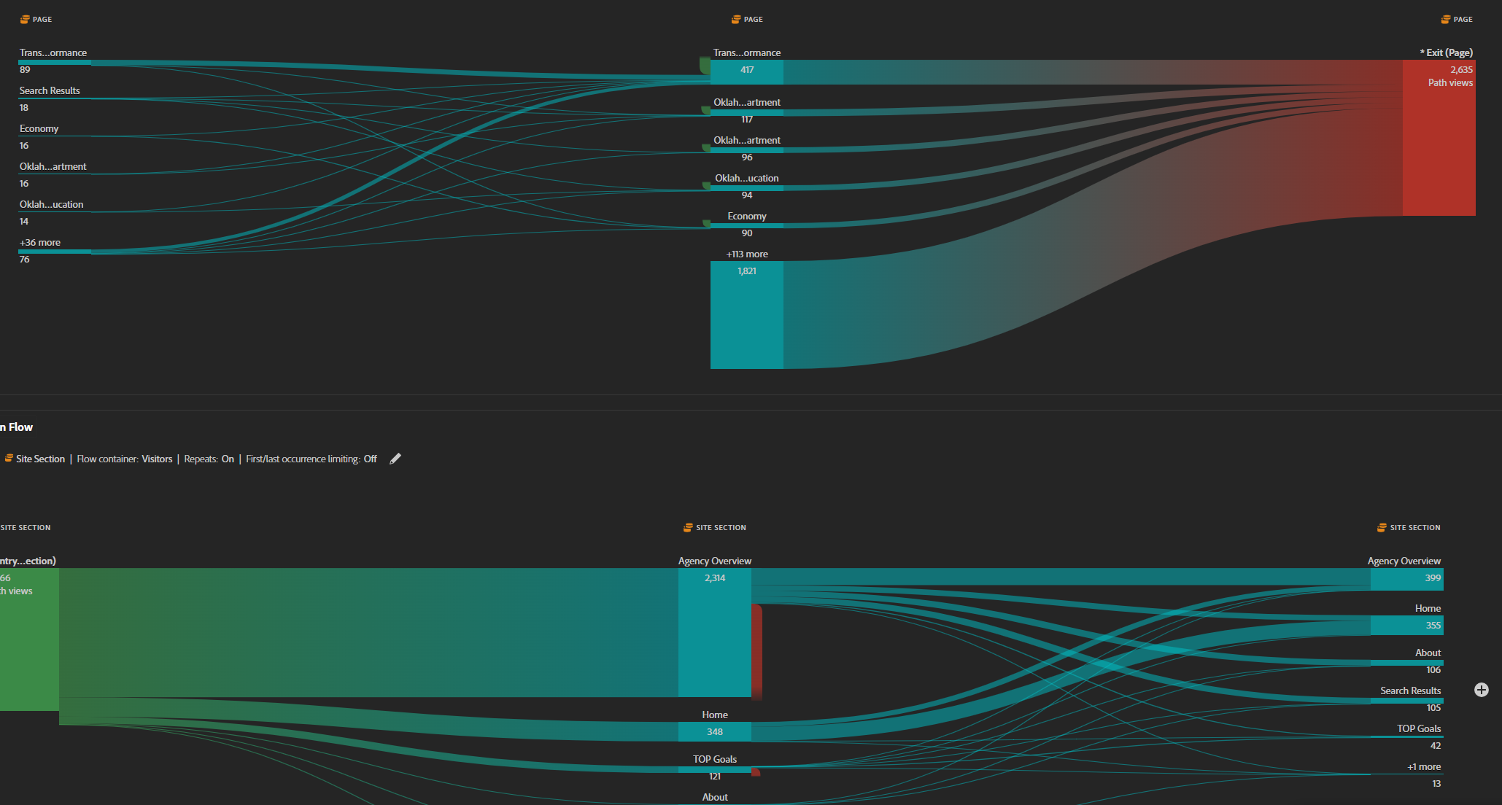
Adobe Analytics Presentation – User Fallout and Flows
Presented by Mike Cook
Sr. Technical Account Manager

Slide 7
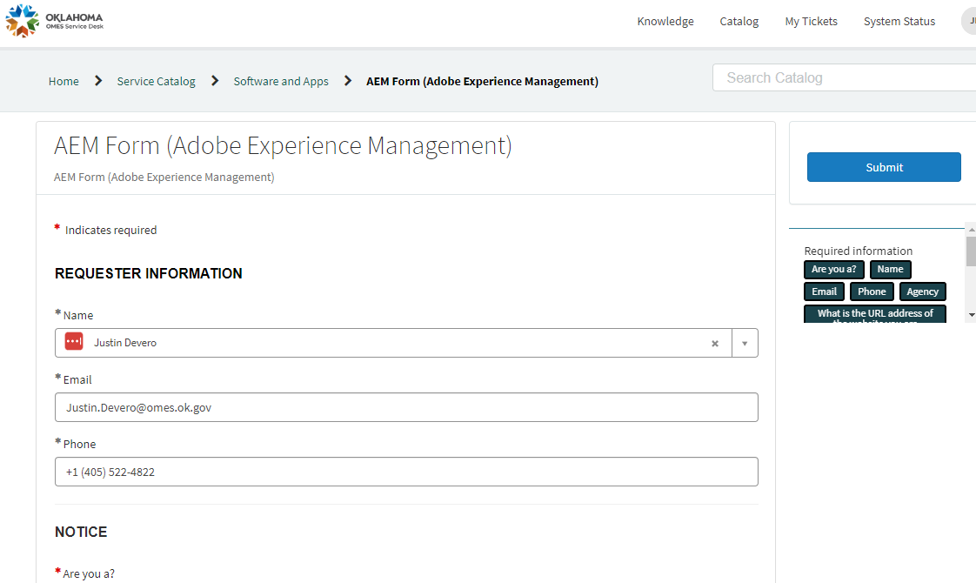
AEM User Request Form

Slide 8
Learning.adobe.com
Author and Manage Pages Using Adobe Experience Manager Sites I & II
Two separate courses now
As always these are free to any State Employee
Want specific training not in catalog? Ask us about building custom-tailored training.
learning.adobe.com/catalog

Slide 9
Adobe Activity Map Browser Extension
Chrome Web Store | Extensions

Slide 10
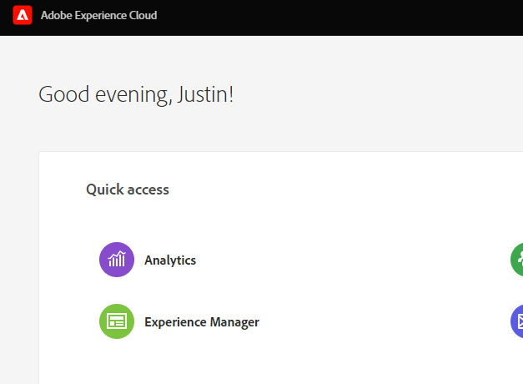
Adobe Analytics
How do I get to my Adobe Analytics?
experience.adobe.com

Slide 11
Adobe Analytics
New Items
Data dictionary
Link sharing for projects (no login required)
Latest Analytics release notes | Adobe Analytics

Slide 12
Analytics Scorecard (mobile app)

Slide 13
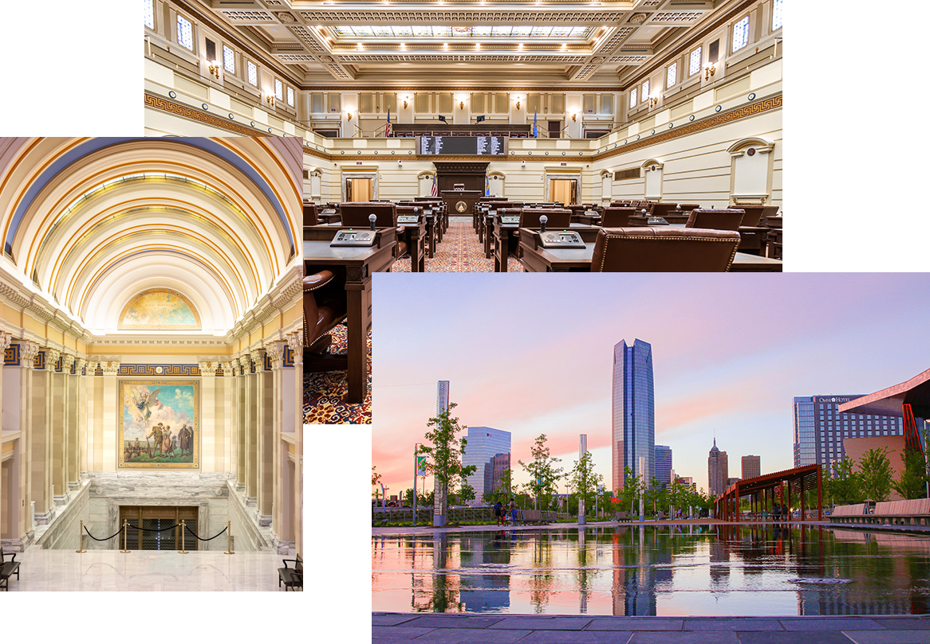
Global Assets
-New stock photography -Fontawesome Icons
Using the Asset Manager:
Global > Images > Photography
3 sources: Tourism, Commerce, Legislature 275 NEW PHOTOS!

Slide 14
AEM Deployments/Releases Cadence
Typically, every other Thursday evening
Platform Upgrades, Security Patches, Code development
Communication - mass email
Latest
Nov – Upgrading to 6.5.18

Slide 15
Tips n Tricks
Avery: New Table Headers.
Brad: New Event Feed Style

Slide 16
Design Patterns
Simple Card component
Background image using global brand elements
“open container” component surrounding cards

Slide 17
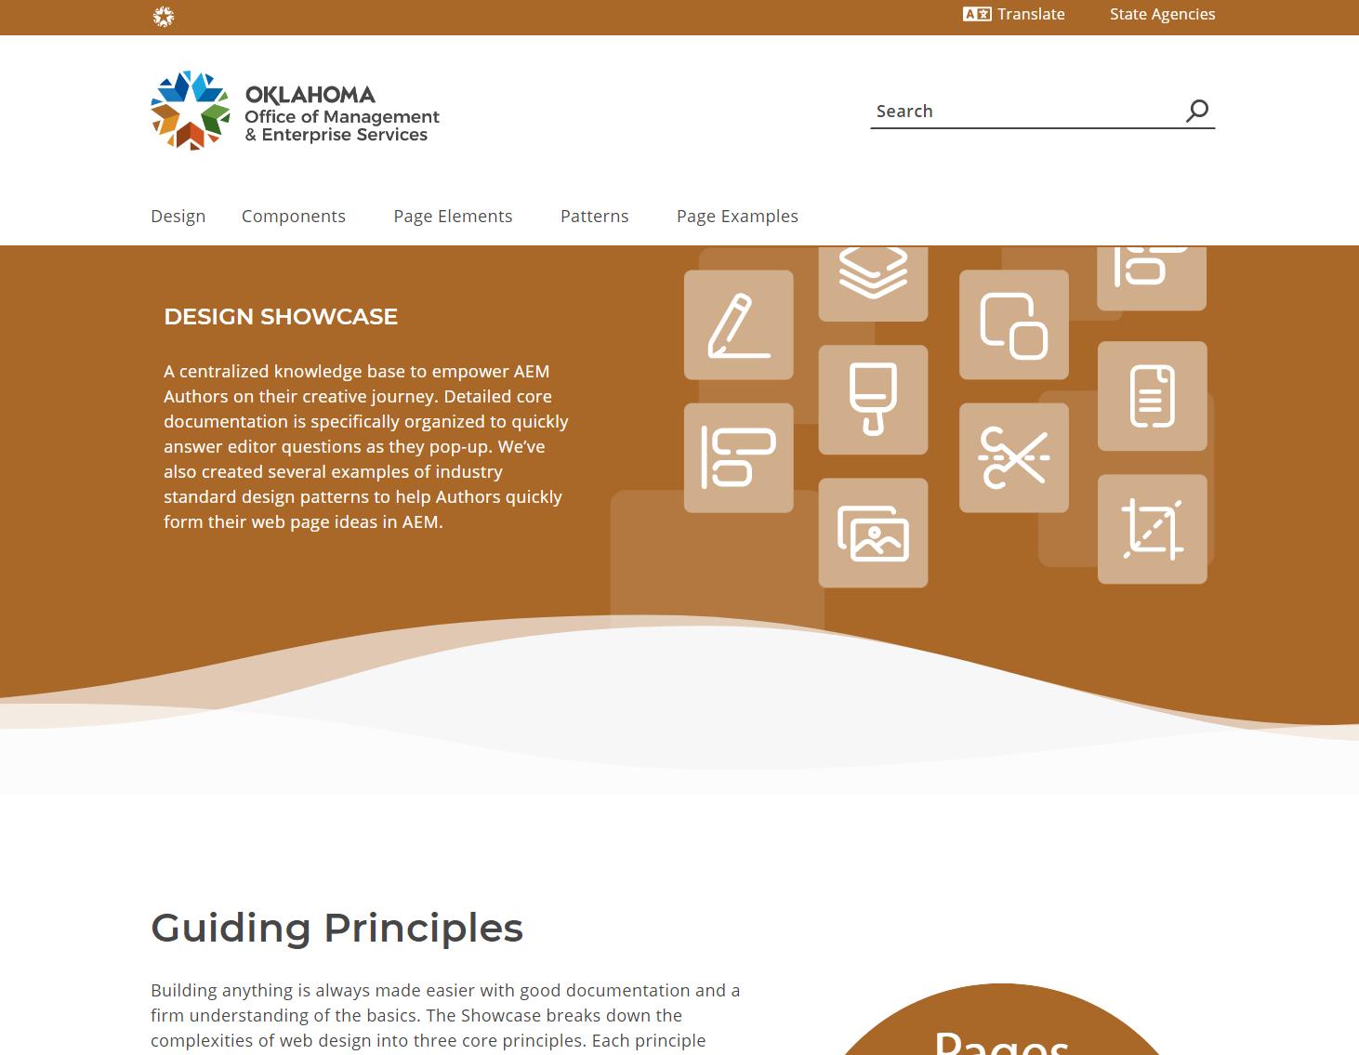
AEM Author Showcase!
For Site Authors
Design Patterns Library
Copy/Paste patterns
into your Site
Boilerplate, less work
Customize to your liking
Available Now!

Slide 18
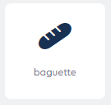
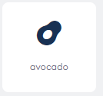
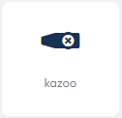
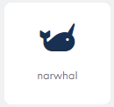
Need a Specific Icon?
Fontawesome Pro subscription -Over 7,000 icons available
Icons enabled in Cards, Text, Button components
Request to add yours
Helpdesk ticket with name of icon

Slide 19
Analytics Scorecard (mobile app)
Designed for audience of exec level or web manager
Quick insights of website
Visits, bounce rate, top sections, top pages
Fast access on the Adobe Analytics mobile app
Iphone, Android

Slide 20
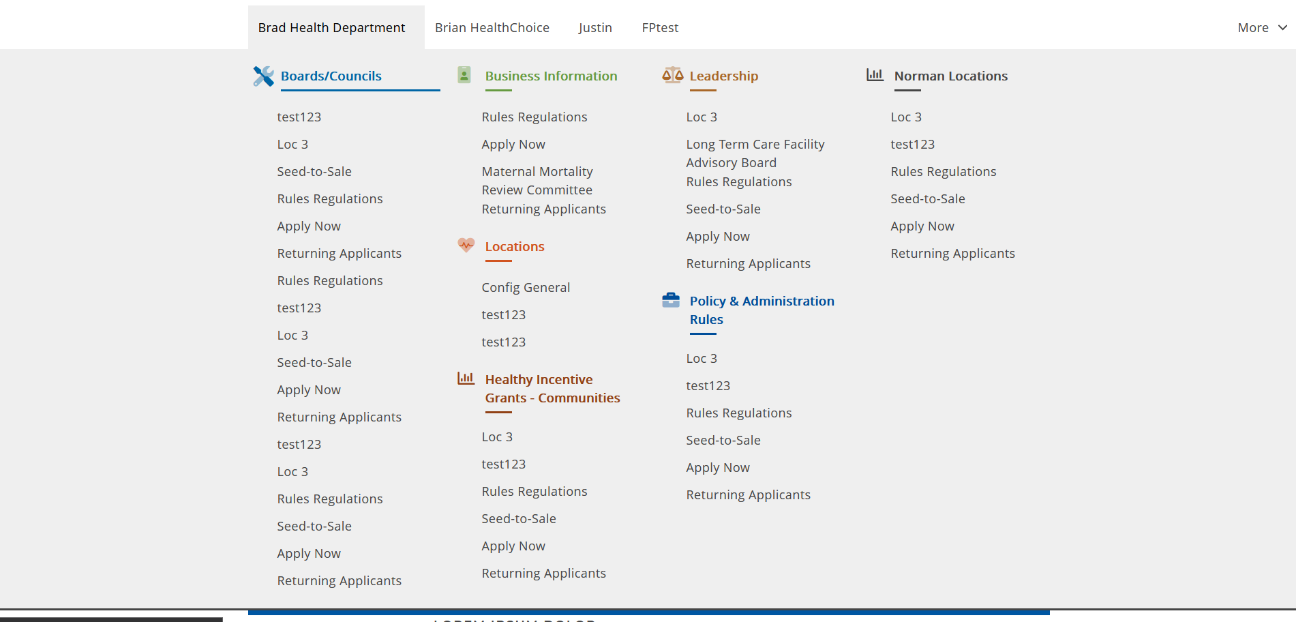
MegaMenu

Slide 21
Features and Fixes!
Released
Icon Component
Upcoming
Siteimprove
Custom-size Spacers
Headers (H1-H6)
Advanced Data Table filtered data
Sticky Menu

Slide 22
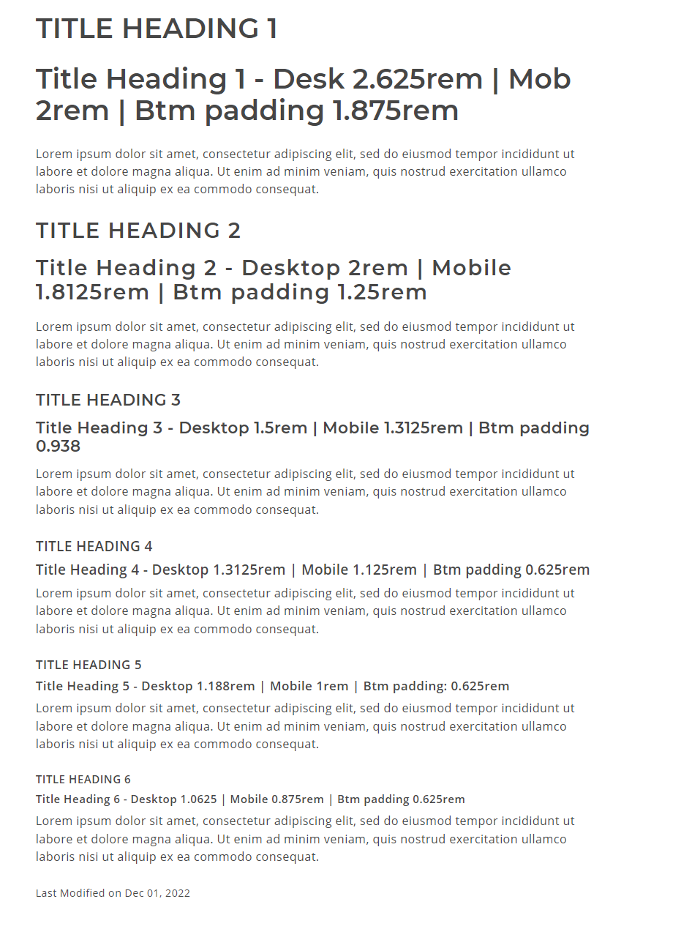
Headers (H1-H6)
Testing and Review Phase
Reaching out to Lead Authors to review in STAGE

Slide 23
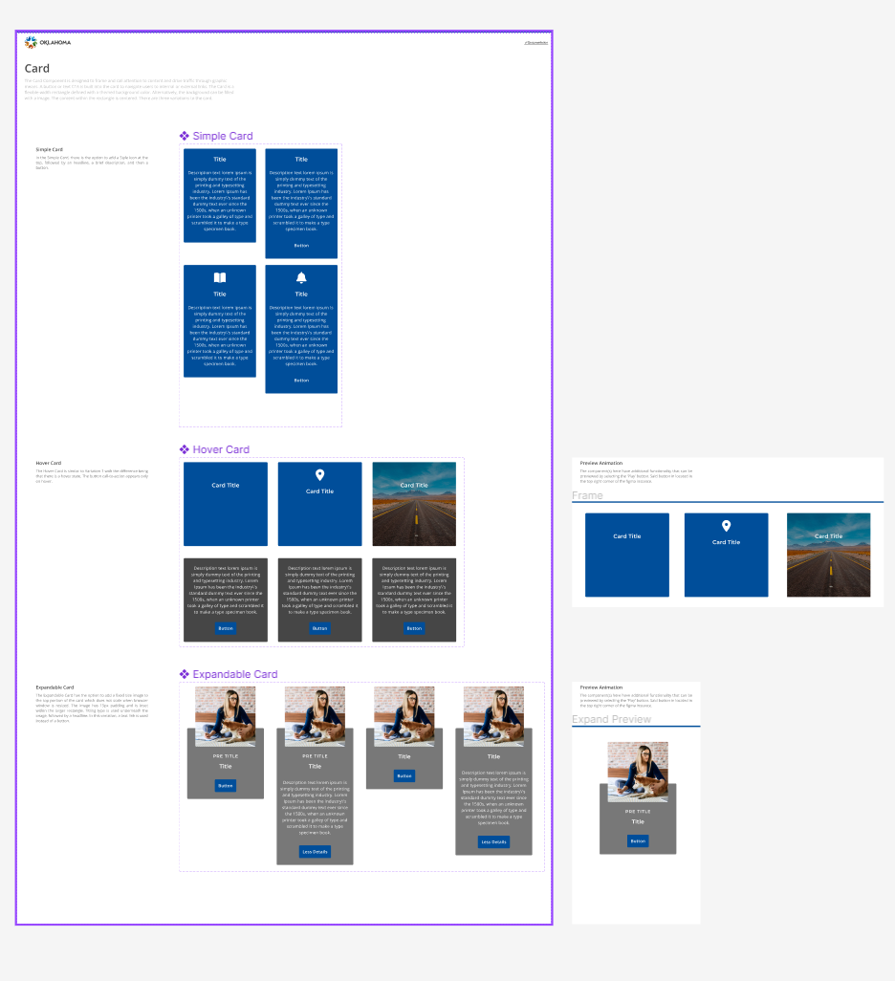
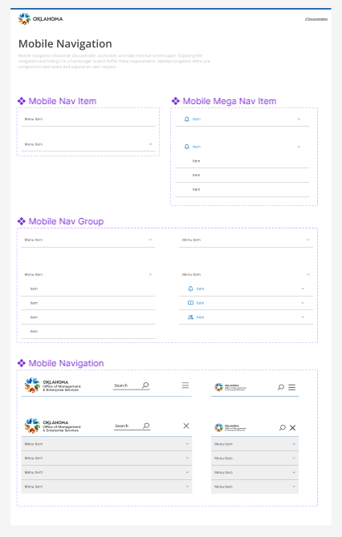
Design System and Showcase (Summer ‘23)

Slide 24
Adobe Summit
Virtual Ticket is free
https://summit.adobe.com/na/virtual-summit/
Product Sneaks
Innovation Super Sessions
Keynotes Speakers
Adobe, AMD, Aaron Sorkin, T-Mobile
Last year’s Summit sessions are “On-Demand” https://business.adobe.com/summit/2022/sessions.html

Slide 25
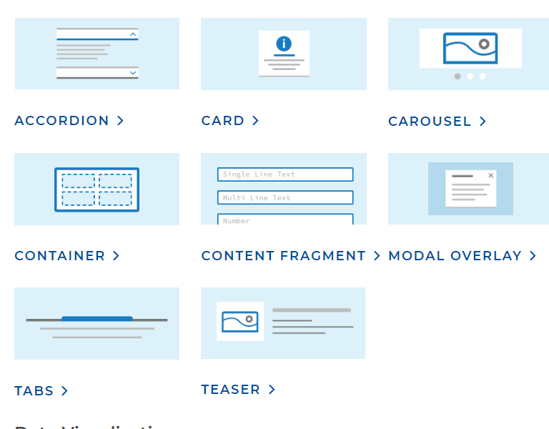
New Features/Fixes!
Previously released:
Advanced Data Table enhancements
CSV use, filters, display options
Chevrons / Arrows - List component
Recent:
Theme-color accordions
Separator Component design options
Rounded corners – teasers/hero
Footer text alignment
Center and wide alignment for buttons

Slide 26
Fixes
Tables icon bug fix. Put in a switch to turn icons on and off. Set default to off.
Table Headers will now be defaulted to theme color.

Slide 27
Release Notes for October
Release 2023-19
Embed component: added Paperform option
Typography accessibility updates added with opt-in
Font Awesome icons now managed via code
Governor's Dashboard of Metrics Table - subcomponent of Advanced Data Table
Content width for Card v2 component updated for accessibility
Title component: chevron size issue on multi line title fixed
Sticky top nav: magnifying glass bug on tablets fixed
indicator bar: now appears in editor even if empty
Advanced data table: manual row width and improved calculation
accordion: color picker style variant added
feature card: added ability to add image
Release 2023-20
Card: Remove policy duplicate
Events feed: Updated how new eventsfeed works.
Govdash table: Empty space to the right was removed.
README with PROD DNS
Notes:
We’ve released quite a bit of features and bug fixes in the past month, we want to start listing release notes every forum now. We will start emailing these release features and fixes after and perhaps the week before a new release.

Slide 28
Bug Squash!
Accordion Search, searches text component
Card fonts and letter spacings fixed
Expandable accordion bug fixed, expands only the parent

Slide 29
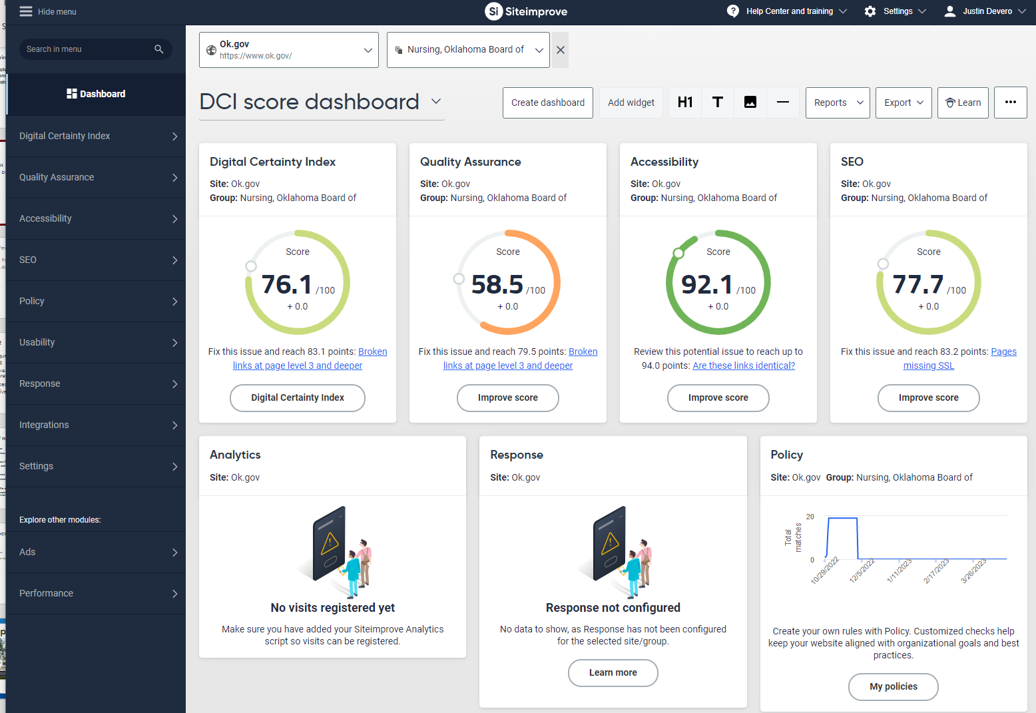
SiteImprove
Broken link checker
Readability score
SEO improvement
Web Accessibility
Inventory
New Liaiason

Slide 30
Fix/Update/Feature Upcoming Releases
New Service Pack upgrade
Tentative go-live July/August

Slide 31
Resources of note:
Analytics access https://experience.adobe.com
Adobe All Access Training https://learning.adobe.com
Adobe Experience League (QUICK VIDEOS) https://experienceleague.adobe.com
AEM Sites specific documentation https://experienceleague.adobe.com/docs/experience-manager-learn/sites/overview.html

Slide 32
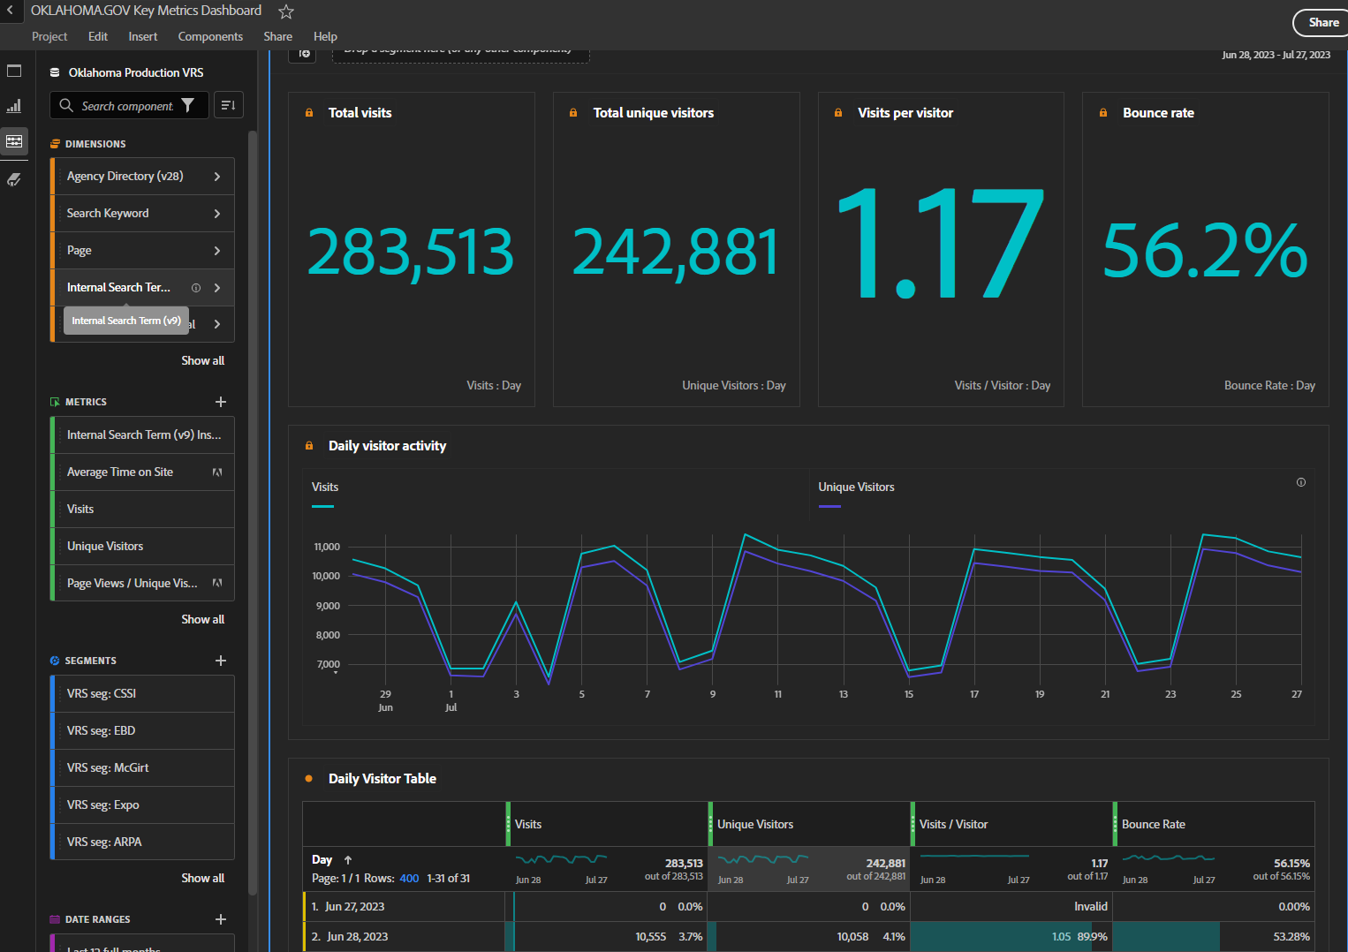
Adobe Analytics
How do I find what people are searching for on my site?

Slide 33
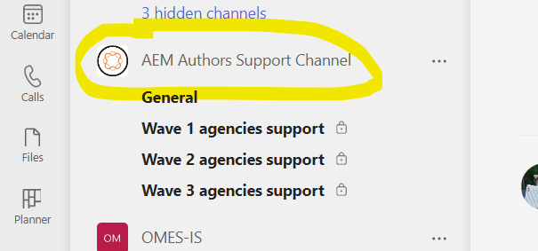
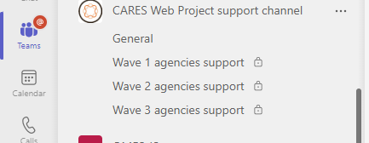
Teams Support Channel
Teams Channel name change:
“AEM Authors Support Channel”
Improved User Request form
Notes:
https://oklahoma.service-now.com/sp?id=sc_cat_item&sys_id=cdfac980971c9910e5ed9c14a253af46&sysparm_category=5383690197bc1510e5ed9c14a253af9a

Slide 34
Support Items/Notes
AEM User Access Requests Email to servicedesk@omes.ok.gov
Or AEM User Request Form
Include – Name, Email, Website URL, Role
If DSR is known, please ask for their approval in email thread
For support requests to Web Team individuals – include servicedesk@omes.ok.gov
Notes:
https://oklahoma.service-now.com/sp?id=sc_cat_item&sys_id=cdfac980971c9910e5ed9c14a253af46&sysparm_category=5383690197bc1510e5ed9c14a253af9a

Slide 35
Recent or Upcoming AEM sites
Recent Launches
Board of Licensed Social Workers
Pharmacy Board
State Treasurer
Abstractors Board
Private Vocational Schools Board
Chiropractic Board
Incentive Evaluation Commission
Upcoming Projects/Releases
Speech Pathology
Consumer Credit
Highway Safety Office
Behavior Health
Uniform Building Code Commission

Slide 36
Fall is here!

