Slide 1
OESC/Employer Meeting
Summer of 2024
Things you didn’t even know you wanted to know.

Slide 2
Agenda
Introduction
Employment Service
Unemployment Insurance Benefits
Unemployment Insurance Tax
Statistics

Slide 3
Contact Information
Online
OESC Website: https://oklahoma.gov/oesc.html
SIDES Page: https://oklahoma.gov/oesc/employers/separations.html
More SIDES information: https://info.uisides.org
SIDES E-response information will be on the OES-617
SIDES E-response Users Guide: http://www.itsc.org/SIDES%20Public%20Documents/Separation%20Information%20E-Response%20User%20Guide.pdf
EZ Tax: https://eztaxexpress.oesc.state.ok.us
OESC Statutes and Rules: https://oklahoma.gov/oesc/about/policies.html
Work Opportunity Tax Credit, Federal Bonding, Trade Adjustment Assistance and Migrant Seasonal Farm Workers: https://oklahoma.gov/oesc/individuals/programs.html
Employer resources and forms page: https://oklahoma.gov/oesc/employers/employer-resources-and-forms.html
Telephone
Employer Line (405) 552-6799
Fax Line for Protesting Claims (405) 962-7524

Slide 4
Employment Service
Special Programs and Services

Slide 5

Employer Resources and Services
OESC provides multiple employer resources to assist in recruiting and retaining employees.
Veteran Assistance
Labor Market Information (LMI) to see comparable wages, cost of living, etc.
Tax credits and bonding certifications for hiring individuals who traditionally have barriers to employment.
Assistance in registering for OJT, Work-experience or apprenticeship programs
Hiring events
Recruitment assistance

Slide 6

Veterans Employment Services
Hiring veterans has advantages.
Veterans work well as a team. It is an essential part of military life.
Veterans have self confidence, a sense of duty and a strong work ethic.
Veterans are organized and disciplined.
Veterans have dealt with difficult circumstances
Veterans can adapt to changing circumstances, follow rules, and problem solve
Returning Heroes and Wounded Warriors tax credits

Slide 7

Employment and Training Programs
In addition to connecting employers with quality employees, we also provide several employment and training programs that are beneficial to the employer. In this section we will talk about four of these programs:
Work Opportunity Tax Credit
Federal Bonding
Trade Adjustment Assistance
Migrant Seasonal Farmworkers
OESC | Employer Presentation Summer of ‘24

Slide 8

Work Opportunity Tax Credit
(WOTC)
WOTC is a federal tax credit offered to employers as an incentive to hire individuals who are members of certain groups which have traditionally faced barriers to employment. The credit is used to reduce the federal tax liability of the private/for-profit employers. Employers must submit IRS Form 8850 and ETA Form 9061.
Targeted groups are:
Qualified TANF (Temp Assistance to Needy Families) recipient;
Veteran/Disabled Vet/Unemployed Vet
Ex-Felon
Designated Community Resident
Vocational Rehab recipient
Summer Youth
Food Stamp Recipient
Supplemental Security Income (SSI) Recipient
Long-term Family Assistance Recipients
OESC Website Information: https://oklahoma.gov/oesc/individuals/programs.html

Slide 9
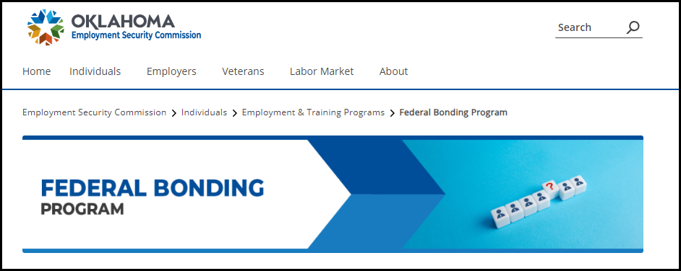
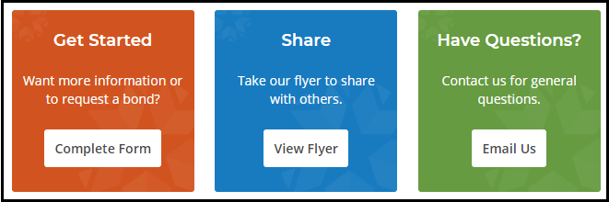
Federal Bonding
The Federal Bonding program provides fidelity bonds (protection for the employer against theft or dishonesty) to employers for job applicants that are deemed unbondable by commercial carriers. Any “at-risk” job candidate is eligible for bonding including:
Ex-offenders and other justice-involved individuals
Individuals with a history of substance abuse
TANF or public assistance recipients
Individuals with poor credit records
Economically disadvantaged individuals with little or no work history
Individuals dishonorably discharged from the military
Anyone who cannot secure employment because they are not commercially bondable.
Must have extended an offer to a qualified candidate
Does not cover liability due to poor workmanship, job injuries, or work accidents.
OESC website information: https://oklahoma.gov/oesc/individuals/programs/federal-bonding.html

Slide 10
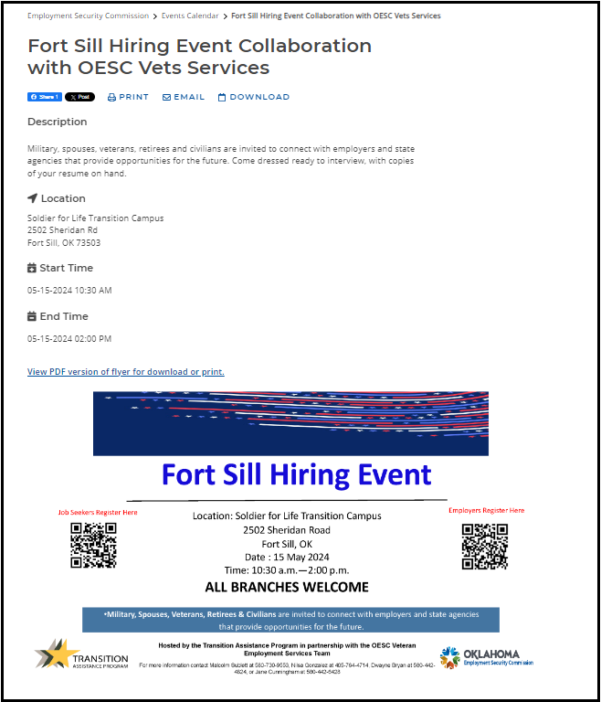
Job Fairs
Job Fairs are hiring events around the state designed to connect employers with potential employees. Held at various locations around the state, job fairs can be held with multiple employers or can be targeted to a specific employer.
Link to the “Find Workers” page, which contains the information on job fairs: https://oklahoma.gov/oesc/employers/find-workers.html
To register, click on the event you want to attend. Then select “View Full Event Details.” Follow the registration instructions. In some cases, no registration is required.
The calendar also has events such as Commission Meetings, Employer Alliance meetings, and we will add these meetings as we go forward.

Slide 11
Unemployment Insurance
Protesting, Responding to Fact-finding, and Reporting New Hires

Slide 12
Respond to Notices
Employers must respond to every notice received. There are some instances, such as lack of work claims, where a response will not matter, benefits will be paid regardless. But even in lack of work claims, you may have paid separation pay, the claimant could have issues that prevent him from seeking or accepting work, etc. Think of the down stream impact:
You will lose appeal rights to any determination and also appeal rights to the benefit wage charge.
Benefit wage charges of other base period employers could be affected.
New Hire reports are affected
Failing to provide quarterly wage reports will result in a penalty of $200 plus 10% of tax due per quarter. Interest of 1% on any outstanding balance is also applied.
Examples:
Employee was discharged but the employer didn’t respond. Benefits are allowed. The employer cannot appeal an allowed determination. The employer will lose rights to protest benefit wage charges. Other base period employers could be affected.
If you hire someone and do not submit the new hire information, the individual may not report the new job and benefits come out of the trust fund. The balance of the trust fund is what determines the conditional factors, which in turn have an effect on employer tax rates.
Employer fails to provide tax reports. (this is different from an inability to pay in part or in full) Estimated tax was $1000.00. The employer now owes $1310. ($200 + $100 for the 10% penalty + 10$ interest)

Slide 13
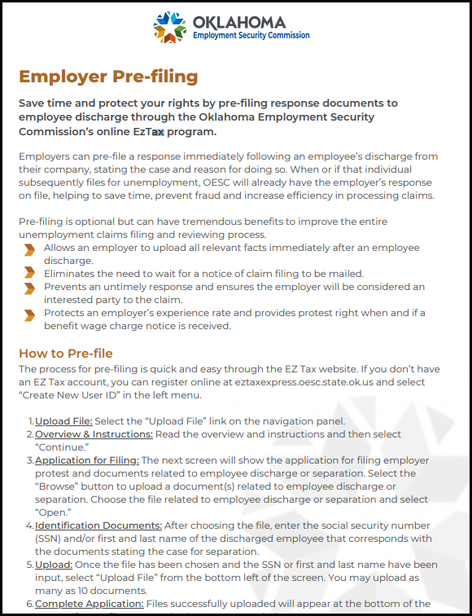
Protesting a Claim: Pre-filing
Your Protest
Pre-filing means that you can protest the payment of benefits before the claim is filed.
You must have an EZ Tax account.
You can protest while the events are fresh in your mind.
You will still be sent a notice if/when a claim is filed.
As mentioned earlier, provide copies of all warnings, notices, resignation letters, etc.
Use “Employer” link on website then go to “Additional Resources” at the bottom of the page and select “Pre-filing Guide for Employer Separations.”
Caveats: If a claim is eventually filed, you may no longer be the correct separating employer so you may not get an OES-617 notice. If that happens and you are a base period employer, you will receive the OES-502 notice to protest benefit wage charges.

Slide 14
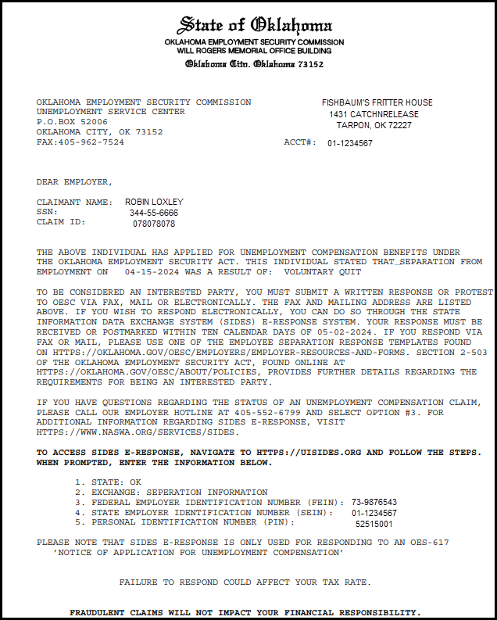
Protesting a Claim:
Responding to the OES-617
The Notice of Application for Unemployment Benefits, Form OES-617 is the notice sent to employers to advise that an Unemployment Claim was filed.
This is the mailed version of the notice.
Requires a response within 10 days of the mail date of the notice in order to be considered an interested party.
There are also electronic methods for responding to this notices. These methods, SIDES and SIDES E-response, will be covered later in this meeting.
When responding, provide details regarding the separation and any additional income the individual may be receiving from you.
We provide a template to submit the protest, shown later in this meeting.

Slide 15
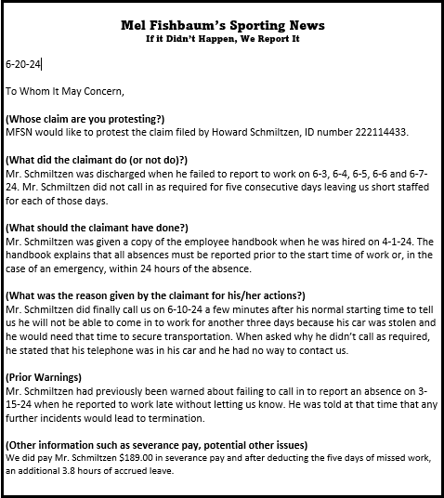
Protesting a Claim:
Responding to the OES-617 (cont)
This is your chance to provide information on why the former employee is no longer employed.
When responding, please include the claimant’s name and the ID number provided on the OES-617.
Provide full details about the separation, specifically the final incident, along with copies of any warnings.
Stay away from laundry lists. Pinpoint the reason for separation. What happened on the last day?
Include all warnings relative in time to the final incident.
More information up front will result in fewer calls down the line.
You can use the online template (next page) to submit a response.
No need to submit multiple protests. Just submit one and if we need more information, we will call.

Slide 16
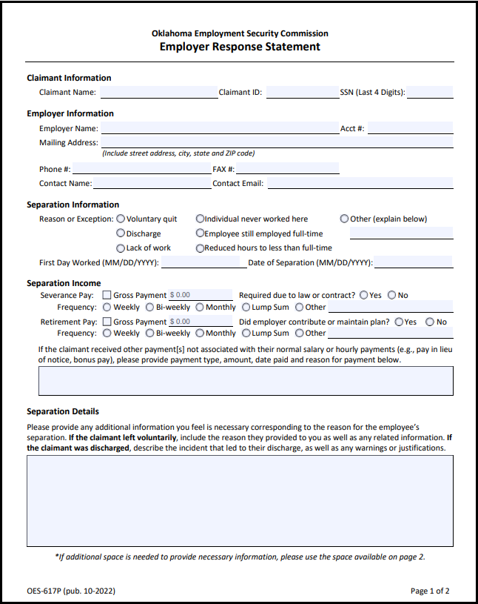
Protesting a Claim: The Employer
Response Statement
If you are unsure of what needs to be provided on your response/protest, our employer response statement can help.
Used to provide details on the separation and any separation income paid to the claimant.
Found at: https://oklahoma.gov/oesc/employers/separations.html
Send to PO Box 52006 OKC 73152 or fax to 405-962-7524
Must be submitted to OESC within 10 days of the mail date of the OES-617 notice.
This is just the first page. The 2nd page contains space to provide information on untimely protests.
You do not have to use this form. All completed forms and/or protests must be submitted to the address or fax number above.

Slide 17

Protesting a Claim: SIDES and
SIDES E-Response
There are two other options for receiving notices when claims are filed. They are SIDES and SIDES E-Response.
SIDES
Generally used by larger (25+ employees) employers with their own IT staff or who use Third Party Administrators (TPAs) to respond to notices.
No cost to use, but will require programming on employer’s side.
Electronic notifications and responses rather than mail.
Allows employers to attach supporting documentation.
Has been shown to reduce improper payments.
SIDES E-Response
Used by smaller employers with no IT staff and who have fewer than 25 employees or who do not have much turnover.
Free of charge. Does not require any programming.
All regular SIDES functionality.
Follow the instructions on the OES-617. It contains SIDES E-response login information.
Account information will only appear if the account was used when the claim was filed.

Slide 18

Responding to a Claim:
Fact-Finding
Fact-finding begins when the claim is filed.
OESC will conduct fact-finding with both the employer and claimant as well as any third parties that may have witnessed the events. We will call on quits and discharges regardless of whether you protest.
Be as specific as possible when providing information.
Include any evidence you have. This is generally limited to write-ups, warnings, witness statements, videos, etc.
Most decisions are based on the final incident. Be sure to include information on what happened that led to the separation.
Provide as much information up front as you can. This will eliminate the need for additional contacts.
If we phone you and leave a message to return our call, you have 48 hours to return the call.
Be sure to provide filing information to the former employee. This is required to be posted at the business.
Remember the 5 W’s:
Who: Who was involved, who witnessed the incident? Who was the supervisor?
What: What happened? What should have happened?
Where: Where did the final incident occur? Where was the claimant supposed to be?
When: When did the incident happen? Was it close in time to the separation date? (if not, why?)
Why? Why was the claimant separated? Why did the claimant say he did or didn’t do what he was supposed to?
Bonus: Did the claimant (or employer) do what they were accused of doing? What proof is available?

Slide 19
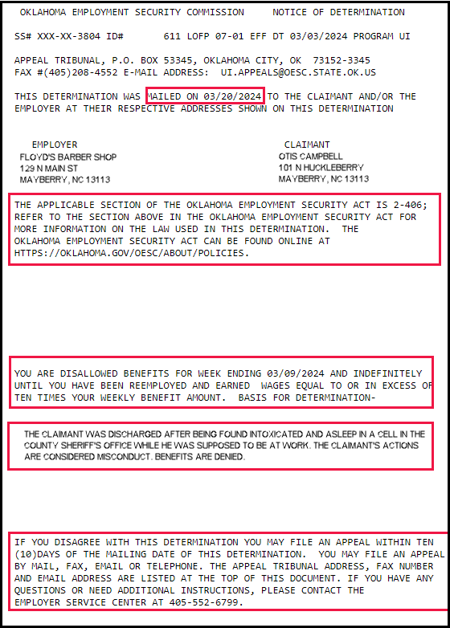
The Non-Monetary Determination
After the investigation is complete, OESC will issue a non-monetary determination.
Only sent to interested parties. If not interested, no appeal rights are given.
Provides the mail date. This is the date the appeals clock starts. You have 10 days to appeal.
Provides the section of law. This example is for a 2-406, discharge.
Provides the results, allowed or denied.
Provides the reasoning statement.
Provides appeal rights.
You may receive multiple determinations based on the particular case. Remember a denial for a week overrides an allowed determination for that week.

Slide 20
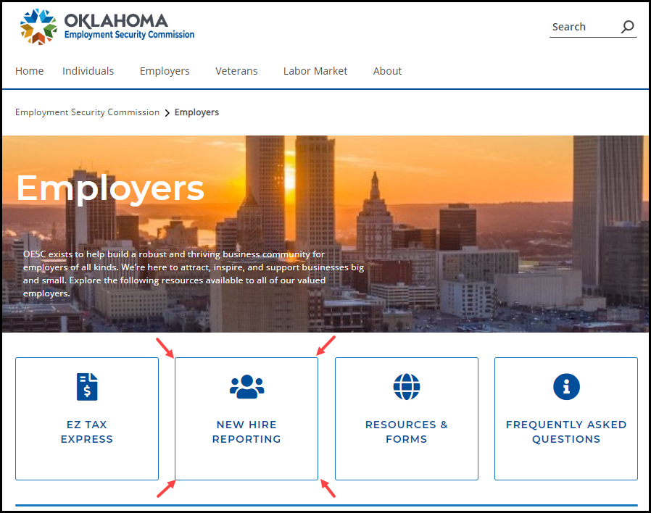
Reporting New Hires
Why complete New Hire information?
Primarily used by DHS for child support enforcement.
State Law: §40-2-802. Reports by employers to Employment Security Commission - New hire registry
Report must be made within 20 days of hiring
Failure to provide this data could result in additional payments being made to the claimant.
Trust Fund balance is what triggers conditional factors which can lead to increases in tax rates.
Providing new hire information reduces improper payments and fraud by allowing OESC to stop payments when people have returned to work.
To start the new hire reporting process, go to https://oklahoma.gov/oesc/employers.html and select the new hire reporting option.

Slide 21
Unemployment Insurance
Section 3-106 Benefit Wages Charged and Relief Therefrom

Slide 22
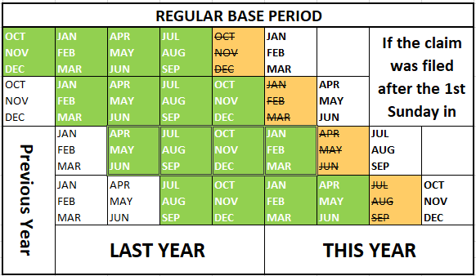
Base Period Employers
Section 3-106 A of the Act states:
The Oklahoma Employment Security Commission shall give notice to each base period employer after the claimant has been issued his or her fifth week of benefits by the Commission or after the Commission receives notice of the amounts paid as benefits by another state under a reciprocal arrangement. This notice shall give the name and Social Security number of the claimant, the date the claim was filed, and the amount of benefit wages charged to the employer in each quarter of the base period.
The “base period” is generally the first four of the last five completed calendar quarters.

Slide 23
Why Did I Not Receive a
Notice of Application (OES-617)?
There are several different reasons why an employer may not receive an OES-617:
You are not the correct separating employer. Notices are sent to the last covered employer of 15 working day or more.
Claimant selected an incorrect employer when filing the claim.
Notice was mailed to the physical address where the claimant worked rather than the address associated with the account number.
Please keep OESC updated on any contact information.
When separation occurs, you may consider giving your ex-employee the correct address to use.

Slide 24
Section 3-106 Benefit Wages
Charged and Relief Therefrom
Other reasons to relieve charges:
If the employee worked for you prior to the week he separated from other employment and continued to work for you through the fifth compensable week.
If the employee was separated as a direct result of a major natural disaster declared by the President.
Was discharged for unsatisfactory performance during an initial probationary period. Employer must have a policy in place and the employee has to be advised within a week of hiring and must be separated within 90 days.
Left work to attend training approved under the Trade Act.
Was separated for compelling family circumstances under Section 2-210.
If a separation occurred when an employee was hired to replace a U.S. serviceperson called up to active duty and laid off upon the return to work by that serviceperson.
Benefit wage charges shall not include wages paid to any employee who separated as a direct result of a pandemic declared by the Governor.
What steps should an employer take to be relieved of charges? The first level would be the initial separation determination.
If you are the separating employer, it all starts with the protest of benefits. This means you must respond to the OES-617. The response must be timely and must contain specific information showing why benefits should be denied.
“We wish to protest” will not cut it.
No charge will be assessed if:
The employee voluntarily left work without good cause connected with the work; or
The employee was discharged for misconduct connected with the work; and
You also protest the Benefit Wage Charge (OES-502)

Slide 25
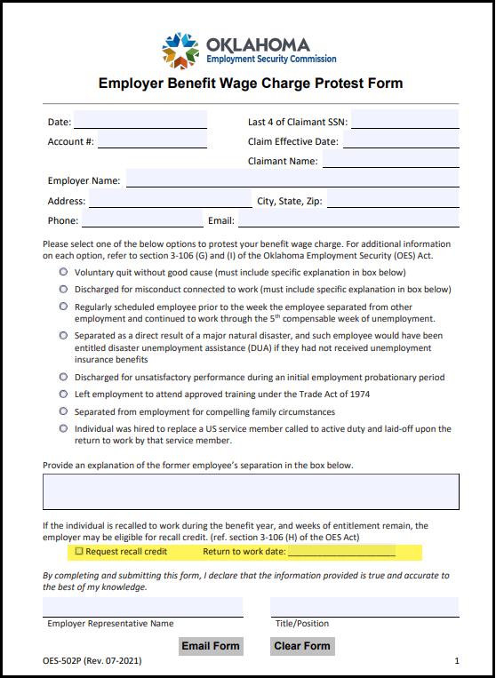
Section 3-106 Benefit Wages
Charged and Relief Therefrom (Cont)
Recall credits are found in Section 3-106 H.
Used when employees are recalled back to work.
Allows the employer experience rating for the employee to be reduced by the ratio of the number of weeks of remaining eligibility of the employee to the total number of weeks of entitlement.
To request recall credit, you must check the recall credit box on the Benefit Wage Charge Protest Form and provide the return to work date.

Slide 26
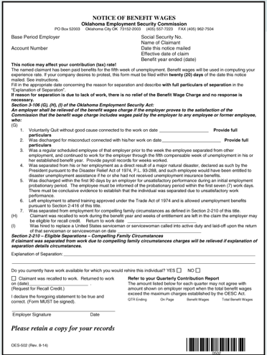
Applying for Relief of Charges
The OES-502 Notice of Benefit Wage Charge
Reference Section 3-106 of the Act.
Triggered when the claimant is paid the 5th week of benefits.
Requires a response even if you responded to the OES-617 Notice of Application for Benefits
You have 20 days to respond to this notice or charges will be assessed.
You must provide the date of termination, specific details of the separation and any other detail required by the notice.
After your protest is received, a determination on whether charges will be waived.
Responding to this notice does not guarantee your charges will be reduced.
You may not be the separating employer, you could be a base period employer.

Slide 27
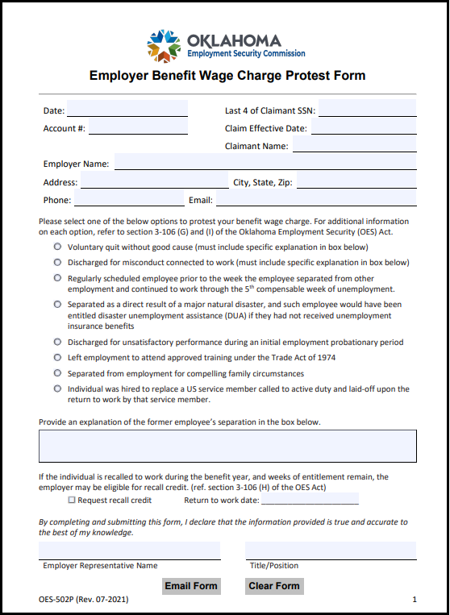
Applying for Relief of Charges
(Cont)
OESC provides a document to protest your benefit wage charge. It can be found at under “Employer Resources and Forms” on our website.
Employers must protest the application (OES-617) and the benefit wage charges (OES-502).
Lack of work cases will always be charged.
Next few slides will show various situations where benefit wage charges will not be assessed if you protest the claim and charge.

Slide 28
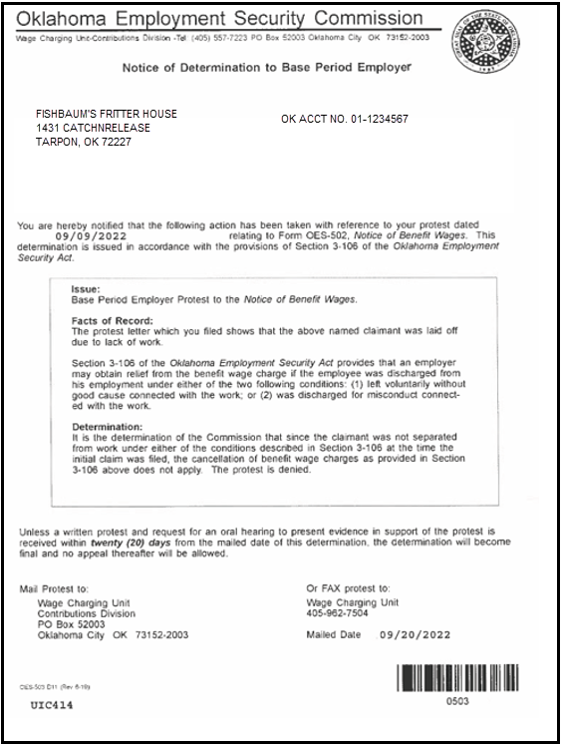
Notice of Determination to
Base Period Employer
Once all protests have been made, a Notice of Determination to Base Period Employer will be completed.
This will show whether benefit wage charges will be assessed.
In the example, they are assessed because the employee was laid off due to a lack of work.
You have 20 days to appeal this determination. If no appeal is filed within 20 days, the decision becomes final.
The appeal has to be in writing.

Slide 29
Please Keep These in Mind
3-106 K: An employer shall not be eligible to be relieved of a benefit wage charge under paragraphs 1 and 2 of subsection G of this section if the employer was sent a notice of benefit claims, pursuant to Section 2-503 of this title, and failed to timely file protest to the benefit claim. In addition, you must protest the benefit wage charge.
Remember: Employers play a substantial role in keeping the UI Trust Fund balance at a rate high enough to remove conditional factors. In order to be a good steward, report and pay taxes on time. If you report on time but wait to pay, it will have a negative impact on your rates.

Slide 30

Statistics
The numbers below are the UI Benefits statistics from May 2023 through April 2024.
Number of Initial Claims Filed: 79,046
Number of weeks compensated: 400,355
Total amount compensated: $159,644,005.00
Total non-monetary voluntary quit determinations: 7872. Total denials 6679 (85%)
Total non-monetary discharge determinations: 25,758. Total denials 11,717 (45%)
Total non-separation non-monetary determinations: 45,740. Total denials 44,589 (97%)
The numbers below are the Employment Service yearly totals from 2023.
Served 127,598 clients and provided 170,575 services to those clients
Made 9,306 employer contacts
Hosted 390 hiring events with 805 employers represented, 5,648 clients in attendance and 916 confirmed hires.
Attended 525 Community Events
Placed 626 veterans in jobs
Approximately 7,531 individuals who used our services in the last year have returned to work.
In 2024, we have approved 7 bond applications totaling $35,000. 129 qualifying letters were issued.
Between February and April of 2024, there were approximately 9,318 various applications certified through the WOTC program. This reflects a potential savings of $23,618,400 for employers who hire these individuals.

Slide 31
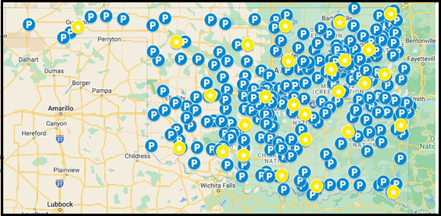
Statistics (Cont)
OESC has partnered with the USPS to allow alternate sites for individuals to provide ID.
ID Verification through USPS: 4804
USPS and OESC locations where ID can be verified:
There are approximately 107,000 active employer tax accounts.
Many businesses use Professional Employer Organizations to handle their tax accounts. Some of these handle up to 1000 employers.
73% of all employers are at the lowest possible tax rate.
Current lowest rate is .3%. If no conditional factors, it will drop to .1%.
2024 taxable wage is $27,000. Employers must pay tax on the first $27K earned by each employee.

Slide 32
Here Endeth the Lesson
Sean Connery as Jim Malone, “The Untouchables” and many others

