Slide 1

Building Resilient Infrastructure and Communities (BRIC) and Flood Mitigation Assistance (FMA) Overview

Slide 2
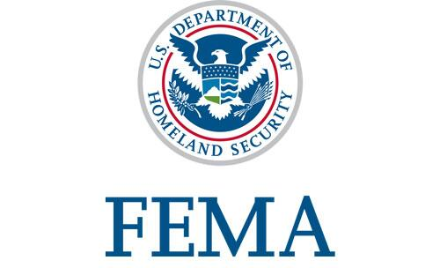

What is the State’s role?
The Oklahoma Department of Emergency Management (OEM) prepares for, responds to, recovers from and mitigates against disasters and emergencies.
Local Government, State Agencies, Tribal Partners, Private Sector Partners, Academia
Notes:
The Oklahoma Department of Emergency Management (OEM) prepares for, responds to, recovers from and mitigates disasters and emergencies.
The department maintains the State Emergency Operations Center which serves as a command center for reporting emergencies and coordinating state response activities. OEM delivers service to Oklahoma cities, towns, counties, tribes and other public and private sector entities through the network of more than 300 local emergency managers.
OEM also maintains, regularly updates and exercises the State Emergency Operations Plan.
The department provides funding and/or assistance to local emergency management departments throughout the state.
Community Preparedness
Emergency Response:
Monitoring potentially severe events
Evaluating the possibility for securing state, federal disaster assistance
Managing state and local resources
Providing emergency public information
Developing and distributing situation reports
Conducting preliminary damage assessments
Disaster Recovery: Following a state or federal emergency or disaster declaration, OEM is responsible for providing quick and efficient delivery of state and federal aid to those affected by the event. This includes coordinating the efforts of federal, state, local, volunteer and private organizations to provide relief and establish disaster recovery centers. The agency conducts public information, administers individual and public assistance programs as well as disaster mitigation projects.
Hazard Mitigation: The mitigation program is available to local communities across the state to assist them with identifying and implementing long-term hazard mitigation measures before, during and after major disaster declarations. Communities are encouraged to work with the state mitigation officer to develop an ongoing program to identify hazards and decide

Slide 3
Hazard Mitigation and Resilience
Resilience is the capacity of individuals, communities, businesses, institutions, and governments to adapt to changing conditions and to prepare for, withstand, and rapidly recover from disruptions to everyday life, such as hazard events.
Hazard Mitigation is any sustainable action that reduces or eliminates long-term risk to people and property from future disasters. Mitigation planning breaks the cycle of disaster damage, reconstruction, and repeated damage
Notes:
The mitigation program is available to local communities across the state to assist them with identifying and implementing long-term hazard mitigation measures before, during and after major disaster declarations. Communities are encouraged to work with the state mitigation officer to develop an ongoing program to identify hazards and decide the best way to reduce or eliminate them.

Slide 4

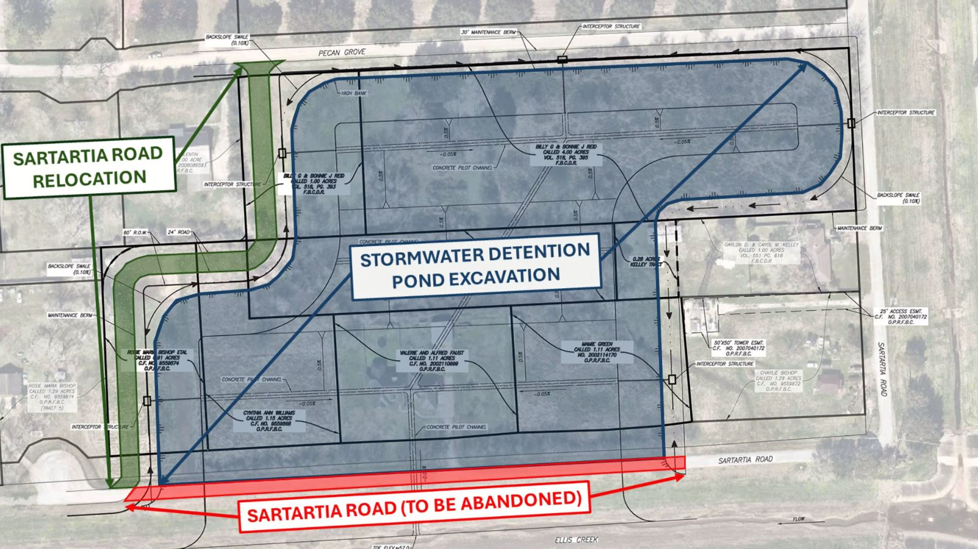

Hazard Mitigation Planning Requirement
BRIC and FMA require an approved State, Local, Tribal, Territorial Plan at the time of application AND at the time of award.
Notes:
Hazard Mitigation Planning
-Reduces loss of life and property by minimizing the impact of disasters
-Local communities identifying natural disaster risks and vulnerabilities that are common in their community
Risk Reduction: Identifies and addresses hazards to minimize risks.
Enhanced Safety: Protects lives, property, and infrastructure.
Cost Savings: Reduces repair costs and financial strain.
Community Resilience: Strengthens ability to recover and adapt.
Regulatory and Funding Opportunities: Enables access to disaster relief funds and grants.
Improved Coordination: Enhances collaboration among stakeholders.
Informed Decision-Making: Provides data for better land use and emergency planning.
Access to FEMA Funding: Hazard Mitigation Planning is required to qualify for FEMA grants and funding for mitigation projects.
In short, Hazard Mitigation Planning helps us stay safer, saves money, and makes sure we’re ready to handle emergencies better.

Slide 5

Building Resilient Infrastructure and Communities (BRIC)
FEMA’s BRIC annual grant program supports SLTTs as they implement hazard mitigation projects to reduce the risks from disasters and natural hazards. The program is authorized by the Section 203 of the Robert T. Stafford Disaster Relief and Emergency Assistance Act (Stafford Act).
Notes:
The BRIC program aims to categorically shift the federal focus away from reactive disaster spending and toward proactive investment in community resilience. FEMA funds BRIC with a 6% set-aside from federal post- disaster grant funds, such as Public Assistance and Individual Assistance grants. As a competitive grant program, applicants can apply on an annual basis.
SLTT State and Local Communities – Tribes, Territories

Slide 6

Flood Mitigation Assistance Program (FMA)
FMA grants provide funding to SLTT to reduce or eliminate the risk of repetitive flood damage to buildings insured under the National Flood Insurance Program (NFIP). The program is authorized by Section 1366 of the National Flood Insurance Act.
Notes:
SLTT State and Local Communities – Tribes, Territories
FEMA distributes funds annually to develop community or individual flood mitigation projects. These grants address community flood risk for the purpose of reducing National Flood Insurance Program (NFIP) flood claim payments and to mitigate the risk of flooding to individual flood insured structures. In addition, funding is also used for technical assistance and management costs.
As a requirement of the Flood Mitigation Assistance program, all subapplicants must be participating and in good standing with the NFIP.

Slide 7
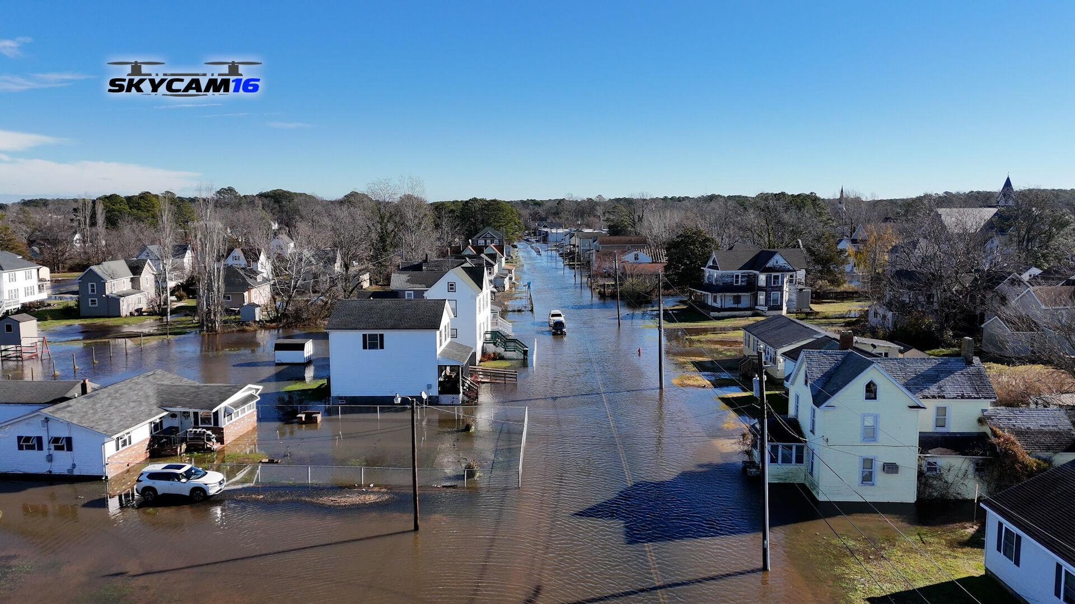
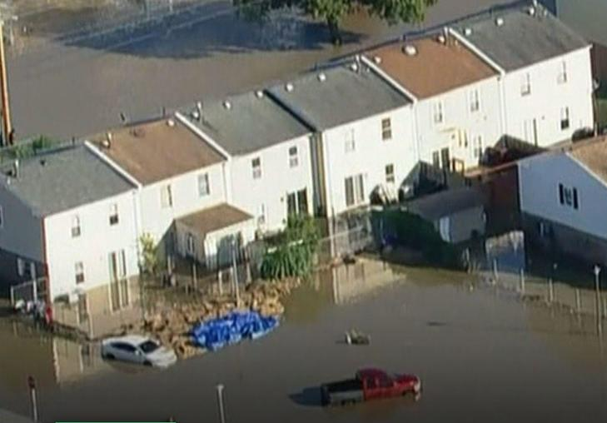
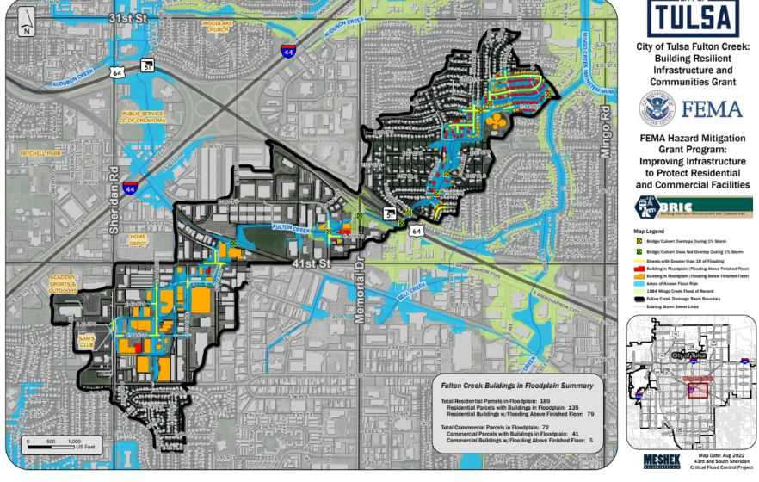
Project Examples Selected in Past BRIC Cycles
Crisfield, Maryland: A $36 million flood control project to improve flood protection, stormwater management, and wetland health
Eastwick, Philadelphia: A $2 million project to install a flood barrier
City of Tulsa Fulton Creek Drainage Basin Urban Flood and Heat Reduction: A $20 million project would protect around 50,000 cars daily, as well as 100 businesses and two schools in the area.

Slide 8
Reminders
General Requirements
Reimbursement Programs
Generally 75/25 Federal/Local Cost-Share Requirement
Projects must be technically feasible and cost-effective
Projects must comply with all National Environmental Protection Act (NEPA) and National Historic Preservation Act (NHPA) requirements
BRIC and FMA are highly competitive programs.
Your project needs to be better than all other projects from around the country to be selected.

Slide 9
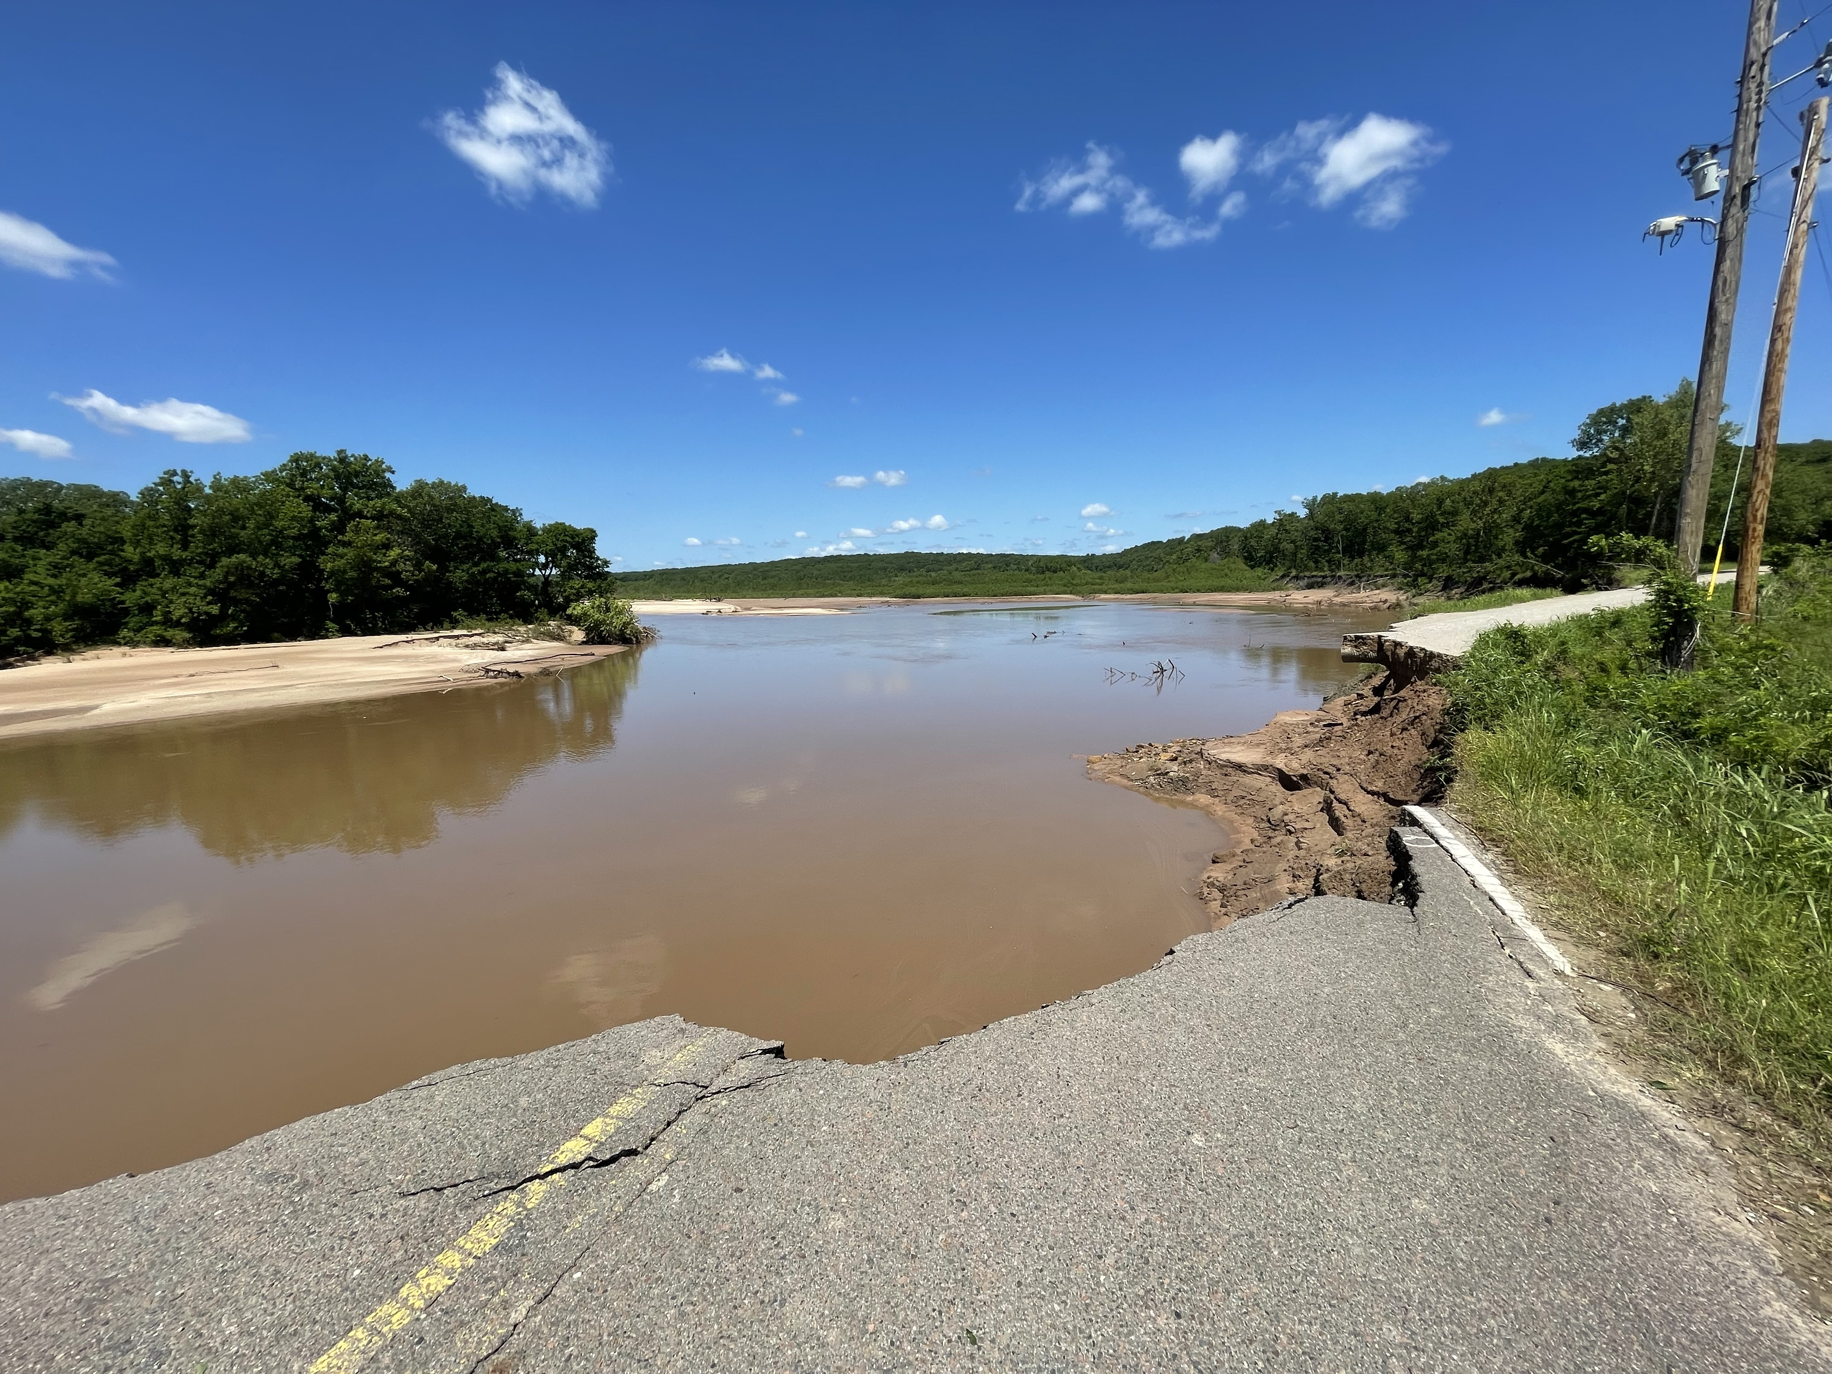
State Deadlines
Official Notice of Intent (NOI) period: August 1, 2024 – October 1, 2024 (Submit all NOIs through OK EMGrants)
Applications due to OEM December 1, 2024
FEMA application deadline is not yet known.
Notes:
We review all applications before they go to FEMA. We will not submit ineligible or incomplete applications. We are here to help you be successful and are happy to facilitate technical assistance as needed.

Slide 10
Contact Info
Annie Mack Vest, CFM
Executive Director
Oklahoma Emergency Management
annie.vest@oem.ok.gov
Michael D’Arcy
Resilience Division Manager/State Hazard Mitigation Officer
Oklahoma Emergency Management
Michael.darcy@oem.ok.gov

Slide 11
Building Resilient Infrastructure and Communities (BRIC) Program
August 7, 2024
Photo of Memphis, Tennessee
Notes:
Good afternoon all,
Intros
I will be presenting an overview on Building Resilient Infrastructure and Communities (BRIC) and Flood Mitigation Assistance (FMA) Programs.

Slide 12






  Support Community Capability & Capacity Building
Encourage and Enable Innovation
Building Resilient Infrastructure and Communities (BRIC) Guiding Principles
Promote Partnerships
Enable Large Infrastructure Projects
Maintain Flexibility
Provide Consistency
Notes:
The BRIC program is an annual competitive grant program with six foundational guiding principles
- Community Capability and Capacity Building
- encouragement of innovation in mitigation projects
- Partnership
- Large infrastructure projects
- Flexibility
And
- Consistency
The BRIC program positions the Agency to fulfill its mission of helping people before, during, and after disasters.

Slide 13

Fiscal Year 2023 BRIC Priorities
Incentivize natural hazard risk reduction activities that mitigate multi-hazard risks to public infrastructure and disadvantaged communities as referenced in EO 14008.
Incorporate nature-based solutions. This includes those designed to reduce carbon emissions.
Enhance climate resilience and adaptation.
Increase funding to applicants that facilitate the adoption and enforcement of the newest editions of building codes.
BRIC encourages mitigation projects that meet multiple program priorities.
Notes:
The Notice of Funding Opportunity (NOFO) sets priorities annually
FEMA’s priorities for the FY23 BRIC program are to:
Incentivize natural hazard risk reduction activities that mitigate risk to public infrastructure and disadvantaged communities as referenced in Executive Order 14008 – Tackling the Climate Crisis at Home and Abroad;
Incorporate nature-based solutions, including those designed to reduce carbon emissions;
Enhance climate resilience and adaptation; and
Increase funding for the adoption and enforcement of the latest published editions of building codes
The BRIC program encourages mitigation projects that meet multiple priorities

Slide 14
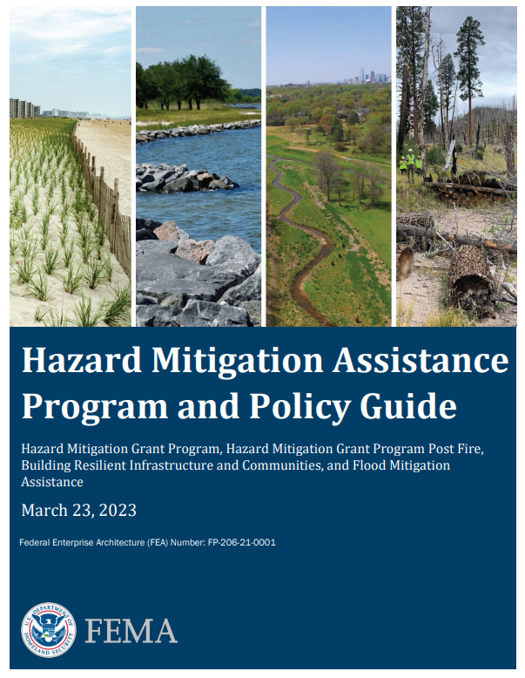
Eligible Activities
View Eligible Activities:
Projects Must:
Be cost-effective.
Reduce/eliminate risk and damage from future natural disasters.
Meet the latest consensus codes (i.e., 2018 or 2021 international building code).
Align with the hazard mitigation plan.
Meet all environmental and historic preservation requirements.
Notes:
At a high-level, projects must:
Be cost-effective- which means the benefit of the project outweighs the cost to the federal government
Reduce/eliminate risk and damage from future natural disasters.
Meet the latest consensus codes (i.e., 2018 or 2021 international building code).
Align with the local hazard mitigation plan.
Meet all environmental and historic preservation requirements.
Some eligible activities include- Infrastructure projects, such as:
Infrastructure retrofit
Localized flood risk reduction projects
Non-localized flood risk reduction projects
Non-structural retrofitting of existing buildings/facilities
Structural retrofitting of existing buildings
In addition to those construction related projects, the following are also eligible activities:
Project scoping
Building code projects
Hazard Mitigation Plans and planning activities

Slide 15
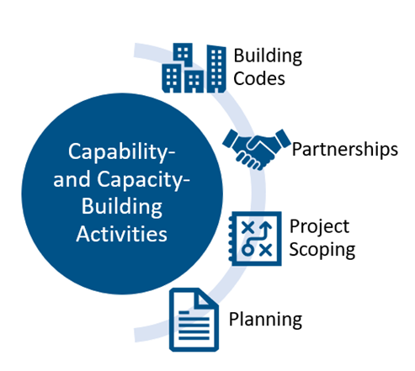
Building Resilient Communities and Infrastructure (BRIC) Capability and Capacity Building Activities
Notes:
Let’s talk about Capability- and Capacity – Building Activities (C&CB activities)
C&CB activities are those which enhance the knowledge, skills, expertise, etc., of the current workforce to expand or improve the administration of mitigation assistance
They include building codes activities, partnership activities, project scoping activities, mitigation planning and planning-related activities, and other activities
Project Scoping has its own sub-application within FEMA GO, which is the application system. Building Code projects will be submitted via the Project sub-application. Planning, planning related activities, and Partnerships will utilize the Plan sub-application.

Slide 16
Federal Cost Share and Management Costs
Generally, the cost share for the BRIC grant program is 75% federal cost share and 25% non-federal cost share.
However:
  Up to 90% for Economically Disadvantaged Rural Communities
  Up to 90% for Community Disaster Resilience Zones
  Up to 100% of Management Costs
Notes:
Generally, the cost share for the BRIC grant program is 75% federal cost share and 25% non-federal cost share.
However, the program offers an increased cost share, 90% federal share, for Economically Disadvantaged Rural Communities and Community Disaster Resilience Zones, as well as 100% management costs for all.
An economically disadvantaged community must have a population below 3,000 and the per capita income cannot exceed 80% of the national per capita income.

Slide 17
Uses of Assistance
Total Available BRIC Funding in Fiscal Year 2023 - $1 Billion
$112M
State/Territory Allocation
$50M
Tribal
Set-Aside
$112M
State/Territory Building Code Plus-Up
$25M
Tribal Building Code Plus-Up
$701M
National Competition
for Mitigation Projects
Uses of Assistance
Management Costs
Capability- and Capacity-Building Activities
Hazard Mitigation Projects
Building Code Adoption and Enforcement
Notes:
This slide displays how assistance may be used under each funding category

Slide 18
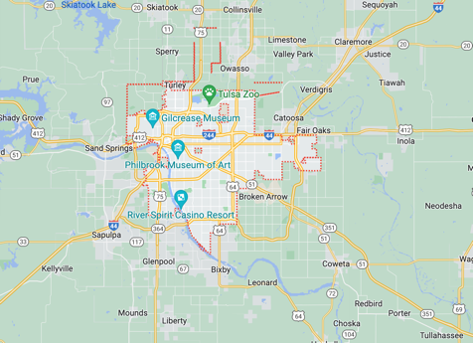
Tulsa, Oklahoma – Improving Infrastructure to Protect Residential and Commercial Facilities
BRIC FY21:
History: The city of Tulsa and region at large are extremely vulnerable to increasingly intense heat waves, making infrastructure enhancements and nature-based solutions vital to the health and safety of the city’s population.
Project Description: To reduce flooding, the city will make infrastructure enhancements along Fulton Creek by increasing the capacity of the storm sewer system and constructing two detention ponds and culverts. Stormwater run-off prevention will be enhanced by adding trees to reduce heat and limiting development.
Project Topics and Benefits:
  Community Flood Mitigation
  System-Based Solutions
  Nature-Based Solutions
Google Maps. (n.d.). [Tulsa, Oklahoma]. Retrieved Dec. 13, 2022, from https://goo.gl/maps/ncMhpH79teQqYhSx6
Federal Share $19.58 Million
Federal Emergency Management Agency
Notes:
Here is an example of a successful BRIC competitive project in OK
The city of Tulsa, Oklahoma, has a system-based approach to improving resilience to flooding, heat and water quality.
The Tulsa Fulton Creek Drainage Basin Urban Flood and Heat Reduction Project is a great example of a system-based risk mitigation project.
The project incorporates multiple flood reduction strategies – including increasing the capacity of the storm sewer system, constructing detention ponds, and planting over 200 trees – to reduce overall flood risk as well as extreme heat.
Climate change is a threat multiplier, particularly in disadvantaged communities and populations. This project recognizes the intersectional risk that climate change poses to these communities, and aims to systemically improve the resilience to flooding and extreme heat in the low-income Fulton Creek Neighborhood.
These improvements will result in a more attractive, usable, environmentally sensitive, healthier, and safer community.

Slide 19
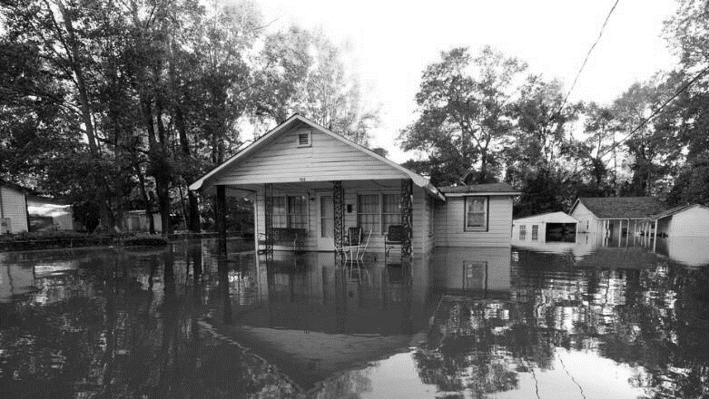

Mike Garcia– FMA Team Lead
Flood Mitigation Assistance (FMA)

Slide 20
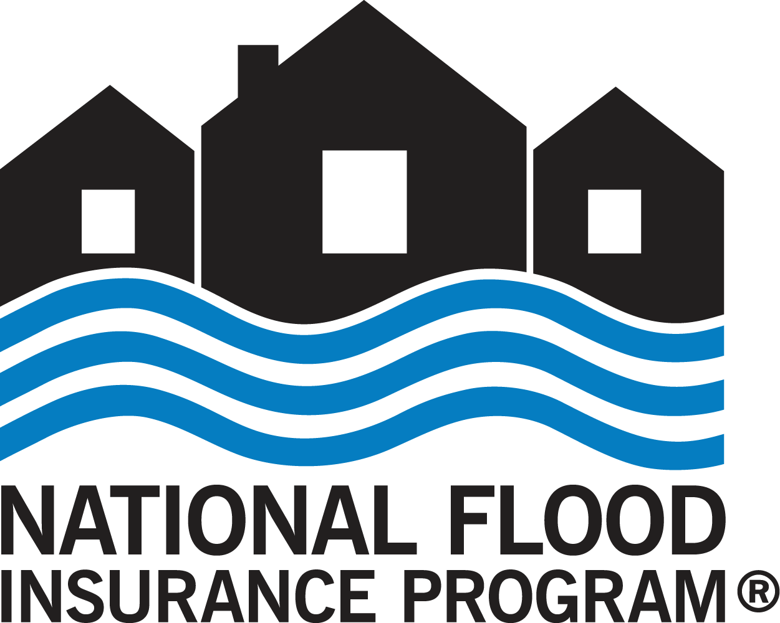
Flood Mitigation Assistance Eligibility Requirements
Subapplicants must participate in the National Flood Insurance Program (NFIP). They cannot be on probation or suspended.
All structures included in the project subapplications must be insured under the NFIP (before, during, and after the mitigation).
Elevation & Mitigation Reconstruction
  Structures listed in the subapplication must have a National Flood Insurance Program (NFIP) policy in effect at the Flood Mitigation Assistance (FMA) application start date.
    It must be maintained for the life of the structure regardless of the flood zone.
Acquisition/Demolition
  Structures listed in the subapplication must have an NFIP policy in effect at the FMA application start date.
    It must be maintained until the transfer of property occurs regardless of flood zone.
Verify at Community Status Book | FEMA.gov
Notes:
As with all Hazard Mitigation Assistance programs, FEMA requires applicants and subapplicants maintain FEMA-approved hazard mitigation plans both at the application deadline and when funding is obligated.
However, flood mitigation assistance program does have additional requirements as funds are appropriated from National Flood Insurance Program policyholders.
Subapplicants must be active participants in the National Flood Insurance Program (NFIP) without probation or suspension, and all structures in project subapplications must be insured under the NFIP throughout the mitigation process. For further details on eligibility, please refer to the complete Fiscal Year 2024 FMA notice of funding opportunity once released

Slide 21
FMA Eligibility Requirements
Available to States, Local communities, Tribes, and Territories (SLTTs)
Subapplicants must participate in the National Flood Insurance Program (NFIP) (Not on probation or suspended)
All Structures included in individual structure mitigation projects must be NFIP insured at time of Application Opening, through the project, and for life of the structure regardless of flood zone
Notes:
Subapplicants:
• Local governments, including cities, townships, counties, special district governments, and Indian tribal governments (including federally recognized tribes who choose to apply as subapplicants), are considered subapplicants and must submit subapplications to their state/territory/tribal applicant agency.

Slide 22
Flood Mitigation Assistance (FMA) Key Changes for Fiscal Year 2023
Funding allocations – increase in Localized Flood Risk Reduction Projects.
Mitigation Reconstruction cap of $220,000 federal share per structure, previously $150,000.
Bipartisan Infrastructure Law federal cost share using the following three CDC Social Vulnerability Index (SVI) themes: Socioeconomic Status, Household Characteristics, and Housing Type and Transportation.
Changes to Final Priority Scoring Criterion, tiebreakers, and Individual Flood Mitigation Projects prioritization and thresholds.
  Properties meeting FMA and NFIP definitions of Severe Repetitive Loss (SRL) and Repetitive Loss (RL) will also be recognized for project prioritization.
  Individual Flood Mitigation Project prioritization shifted to 75% FMA and NFIP SRL and RL, previously 50%.
  Equity data measure shift from CDC Social Vulnerability Index (SVI) to Climate and Economic Justice Screening Tool (CEJST)/Justice40 Communities & Community Disaster Resilience Zones.
Notes:
In Fiscal Year 2023, the FMA grant program introduces key changes to enhance its impact. This includes:
An increased funding on Localized Flood Risk Reduction Projects, ensuring targeted support where it's needed most;
The federal share cap for Mitigation Reconstruction being raised to $220,000 per structure, up from the previous $150,000 limit;
Utilizing three of the CDC SVI themes such as Socioeconomic Status, Household Characteristics, and Housing Type and Transportation scores for the enhanced BIL federal cost share provides a more nuanced approach to project funding;
Changes to the final priority scoring criteria, tiebreakers, and thresholds that aim to optimize project selection and ensure the most impactful mitigation efforts;
Enhanced project prioritization for properties meeting the FMA and NFIP definition of Severe Repetitive Loss and Repetitive Loss;
Increasing the Individual Flood Mitigation Project priority to 75% FMA and NFIP Severe Repetitive Loss (SRL) and Repetitive Loss (RL), up from the previous 50%; and
The equity data measure evolving from CDC SVI to CEJST/Justice40 Communities & Community Disaster Resilience Zones, ensuring a more comprehensive consideration of equity, community needs and resilience.

Slide 23
Flood Mitigation Assistance Eligibility Requirements
Sub applicants must participate in the National Flood Insurance Program (NFIP). They cannot be on probation or suspended.
All structures included in the project sub applications must be insured under the NFIP (before, during, and after the mitigation).
Elevation & Mitigation Reconstruction
  Structures listed in the sub application must have a National Flood Insurance Program (NFIP) policy in effect at the Flood Mitigation Assistance (FMA) application start date.
    It must be maintained for the life of the structure regardless of the flood zone.
Acquisition/Demolition
  Structures listed in the sub application must have an NFIP policy in effect at the FMA application start date.
    It must be maintained until the transfer of property occurs regardless of flood zone.
Verify at Community Status Book | FEMA.gov
Notes:
As with all Hazard Mitigation Assistance programs, FEMA requires applicants and subapplicants maintain FEMA-approved hazard mitigation plans both at the application deadline and when funding is obligated.
However, flood mitigation assistance program does have additional requirements as funds are appropriated from National Flood Insurance Program policyholders.
Subapplicants must be active participants in the National Flood Insurance Program (NFIP) without probation or suspension, and all structures in project subapplications must be insured under the NFIP throughout the mitigation process. For further details on eligibility, please refer to the complete Fiscal Year 2023 FMA notice of funding opportunity on Grants.gov.
Here are the Flood Mitigation Assistance eligibility requirements. Applicants and subapplicants must have FEMA-approved hazard mitigation plans by the application deadline. They must also have approved plans when funding is obligated.
Applicants:
Applicants are States, District of Columbia, U.S. territories, and federally recognized Indian tribal governments .
Each state, territory, the District of Columbia, and federally recognized Indian tribal government shall designate one agency to serve as the applicant for FMA funding. Each applicant’s designated agency may submit only one FMA grant application to FEMA.
Subapplicants:
Subapplicants are Local governments, including cities, townships, counties, special district governments, and Indian tribal governments (including federally recognized tribes who choose to apply as subapplicants), are considered subapplicants and must submit subapplications to their state/territory/tribal applicant agency.
Subapplicants must be participating in the NFIP and be in good standing – not on probation or suspension .
Further, structure(s) Included in a project subapplication must have NFIP policies in force at the time of the opening of the application period and have insurance requirements post-award depending on the project type.
For all projects, a structure must have an active NFIP policy at the application period's opening on October 16. If mitigation actions, such as elevation or reconstruction, are employed, flood insurance must be maintained throughout the project's duration and the structure's life. In cases where a structure is removed for open space, flood insurance must be maintained until property transfer, regardless of the flood zone.
Regarding NFIP insurance requirements, there are generally two types of insurance requirements depending on whether a structure’s risk is mitigated and remains after the project or if a structure is removed as a result of mitigation.
For all projects, the structure must have a NFIP policy in force at the time of the opening of the application period (September 30).
In the case of mitigated structure remaining, for instance structure elevation, reconstruction, and floodproofing – the structure must maintain flood insurance during the entire project lifecycle and for the life of the structure irrespective of the flood zone.
In the case where the project results in structure removal and the property is returned to open space (acquisition and demolition), flood insurance must be maintained until transfer of the property occurs, regardless of the flood zone.

Slide 24
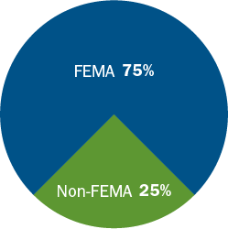
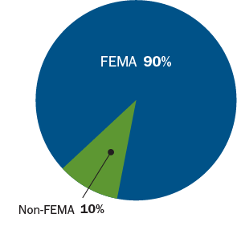
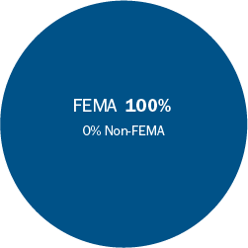
Flood Mitigation Assistance (FMA) Program Cost Share
Non-Repetitive Loss
Repetitive Loss (RL) Structures
Severe Repetitive Loss (SRL) Structures
Individual Property Flood Mitigation
Not SRL or RL
Community Flood Mitigation
Project Scoping
Individual Property Flood Mitigation – Repetitive Loss (RL)
Individual Property Flood Mitigation – Severe Repetitive Loss (SRL)
Notes:
Standard cost share for NFIP insured is 75/25
RL properties is 90/10
SRL is 100 fed share

Slide 25
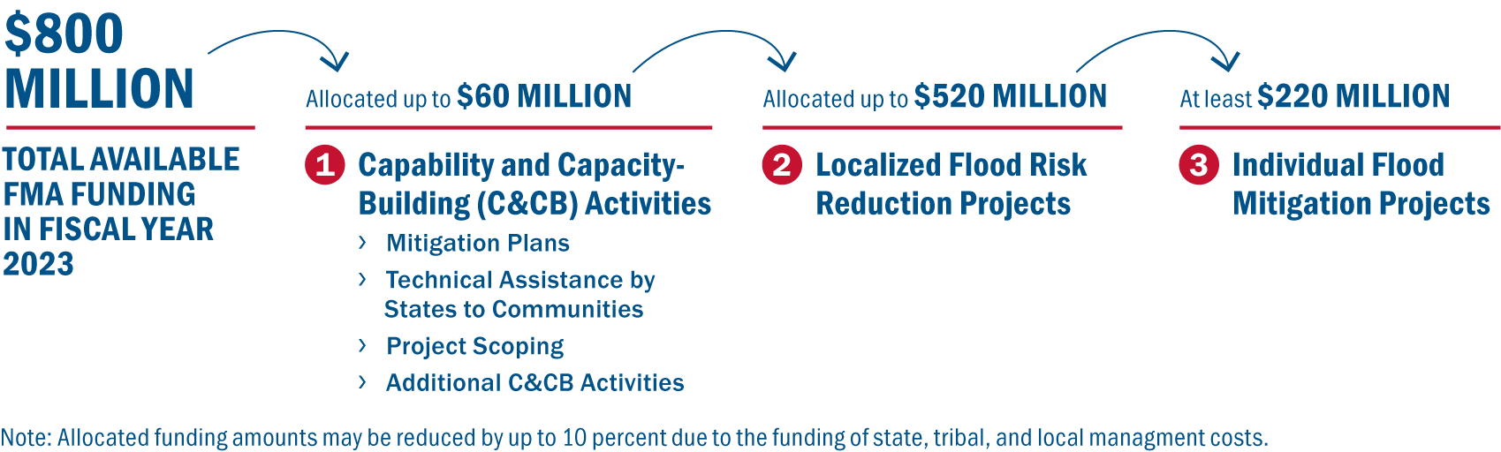
Available Funding for FY23
Notes:
The FY 2023 FMA grant program’s total available funding is $800 million.
The fiscal year 2023 funding order and federal activity caps include:
Up to $60 million for Capability and Capacity Building (C&CB) Activities which enhance the knowledge, skills, expertise, etc., of the current workforce to expand or improve the administration of FMA and aimed at fostering the development of future Localized Flood Risk Reduction Projects and Individual Flood Mitigation Projects, ultimately reducing claims against the National Flood Insurance Program (NFIP).;
Up to $520 million for Localized Flood Risk Reduction Projects to address community flood risk for the purpose of reducing NFIP flood claim payments; and
At least $220 million for Individual Flood Mitigation Projects that mitigate the risk of flooding to individual NFIP-insured buildings.
FYSA
Additional C&CB Activities include:
Partnership Development to Conduct Eligible Mitigation Activities,
Enhancing Local Floodplain Management
Severe Repetitive Loss (SRL)/Repetitive Loss (RL) Strategy Development
other eligible C&CB Activities under 42 U.S.C. 4104c(c)(3)(G))

Slide 26
Thank you!

