Slide 1
THE BRAIN MODEL OF ADDICTION
Drug Court Conference
Normal, OK. September, 2014
Matrix Institute On Addictions
Sam Minsky, MA, LMFT

Slide 2
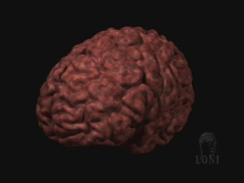
A Major Reason People
Take a Drug is They Like
What it Does to Their
Brains

Slide 3
Initially, A Person Takes A Drug
Hoping to Change their Mood,
Perception, or Emotional State
Translation---
…Hoping to Change their Brain

Slide 4
But Then…
After A Person Uses Drugs
For A While,
Why Can’t They Just Stop?

Slide 5
Their Brains
have been
Re-Wired
by Drug Use
Because…

Slide 6
TRIGGER
Definition
A trigger is a stimulus which has been repeatedly associated with the preparation for, anticipation of or the use of drugs and/or alcohol. These stimuli include people, things, places, times of day, and emotional states.
Notes:
Definition of a trigger.

Slide 7
Triggers and Cravings
Human Brain
Notes:
The brain is your body’s “Command Central.”
Your brain controls more than the way you think. The brain controls our physical sensations and body movements. How we understand what we see, hear, smell, taste, and touch. Our sense of balance and coordination. Memory. Feelings of pleasure and reward. The ability to make judgments. When we catch a football, dance, jog, speak, sing, laugh, whistle, smile, cry—that’s our brain receiving, processing, and sending out messages to different parts of our body.
When we feel good for whatever reason—laughing with a friend or seeing a good movie or eating our favorite ice cream—the brain’s reward system is activated. As we said before, the reward system is the part of the brain that makes you feel good. The reward system is a collection of neurons that release dopamine, a neurotransmitter. When dopamine is released by these neurons, a person feels pleasure.
Scientists have linked dopamine to most drugs of abuse—including cocaine, marijuana, heroin, alcohol, and nicotine. These drugs all activate the reward system and cause neurons to release large amounts of dopamine. Over time, drugs damage this part of the brain. As a result of this damage, things that used to make you feel good—like eating ice cream, skateboarding, or getting a hug—no longer feel as good.
Photo courtesy of the NIDA Web site. From A Slide Teaching Packet: The Brain and the Actions of Cocaine, Opiates. and Marijuana.

Slide 8
Natural Rewards Elevate Dopamine Levels
FOOD
SEX
200
200
NAc shell
150
150
DA Concentration (% Baseline)
100
100
15
% of Basal DA Output
Empty
10
50
Copulation Frequency
Box
Feeding
5
0
0
0
60
120
180
Scr
Scr
Scr
Scr
Time (min)
Bas
Female 1 Present
Female 2 Present
Sample
Number
1
2
3
4
5
6
7
8
9
10
11
12
13
14
15
16
17
Mounts
Intromissions
Ejaculations
Source: Di Chiara et al.
Source: Fiorino and Phillips

Slide 9
Effects of Drugs on Dopamine Release
1500
1000
500
0
COCAINE
METHAMPHETAMINE
400
Accumbens
Accumbens
300
DA
DOPAC
% of Basal Release
HVA
% Basal Release
200
100
0
1
2
3hr
0
Time After Methamphetamine
Time After Cocaine
250
NICOTINE
250
ETHANOL
Accumbens
200
Accumbens
200
Dose (g/kg ip)
Caudate
0.25
150
0.5
% of Basal Release
1
% of Basal Release
2.5
100
150
100
0
0
1
2
3 hr
0
Time After Nicotine
0
1
2
3
4hr
Time After Ethanol
Source: Shoblock and Sullivan; Di Chiara and Imperato

Slide 10
Triggers and Cravings
Notes:
In 1904, I.P. Pavlov, a Russian scientist, received the Nobel Prize for a series of experiments he conducted on the physiology of digestion. These experiments were continued by some of his students and later came to be known as the principles of classical conditioning.

Slide 11
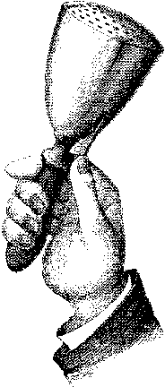
Triggers and Cravings
Pavlov’s Dog
Notes:
Pavlov would feed dogs and ring a bell at the same time. The dogs would see and smell the food which would then stimulate, or trigger, their lower brains ( the autonomic nervous systems) causing the dogs to produce saliva and secrete gastric fluids in anticipation of digestion. In a relatively short amount of time, Pavlov and his colleagues would ring the bell without the presence of food, and the dogs would still produce saliva and gastric fluid as if food were present. The dogs connected the sound of the bell, the trigger, with anticipation of eating, and responded involuntarily to the powerful trigger, or stimulus, of the bell. Once a dog has been conditioned in this way, no matter how smart or well-trained the dog is, a dog will continue to produce fluids at the sound of the bell. He has no choice. The human brain responds in exactly the same way to the conditioned drugs and alcohol triggers that produce cravings. Drugs and alcohol produce changes in the brain, which result in feelings of pleasure. When triggers cause a person to experience cravings, the brain responds as if the actual chemicals are taken into the system. In other words, the brain is “drooling” in reaction to these triggers. This reaction occurs whether or not the person intends to use. The only way that Pavlov’s dog can avoid drooling is by avoiding the bell. The chemically dependent person can also avoid his or her brain’s reaction by avoiding triggers.

Slide 12

Triggers and Cravings
Notes:
The part of the brain affected by mood-altering substances is the same part of the brain that makes us seek food when we are hungry, water when we are thirsty, and is responsible for sexual pleasure. It promotes our survival modes. When a person hasn’t eaten for a long period of time, the focus on getting food or water overpowers all other concerns. When long-term drugs or alcohol use occurs, the brain can become “short-circuited” and adapt to these chemicals as if survival depends on them.
There is a demonstration that reflects the power of drugs on the brain and behavior. If you release a caged mouse and it has the option to run into a well-lit area or a dark area, it will always run into the dark. Mice and other small rodents are conditioned by nature to automatically seek out the dark, which will protect them from predators. This is a ingrained survival mechanism. If the mouse is given small doses of cocaine in the light, in a relatively short span of time, it will automatically go into the lit field. Thus reversing and changing normal mouse brain chemistry.
This demonstrates that the power of drugs has the ability to grossly distort normal mammalian brain chemistry.

Slide 13
MATRIX MODEL TREATMENT
Triggers - People
Drug-using friends/dealer
Voices of drug friends/dealer
Absence of significant other
Sexual partners in illicit sex
Groups discussing drug use
Notes:
People who are triggers.

Slide 14
MATRIX MODEL TREATMENT Triggers - Things
Paraphernalia
Sexually explicit magazines/movies
Money/bank machines
Music
Movies/TV shows about alcohol and other drugs
Secondary alcohol or other drug use
Notes:
Objects or things that are triggers.

Slide 15
MATRIX MODEL TREATMENT
Triggers - Places
Drug dealer’s home
Bars and clubs
Drug use neighborhoods
Freeway offramps
Worksite
Street corners
Notes:
Places that are triggers.

Slide 16
MATRIX MODEL TREATMENT Triggers - Times
Periods of idle time
Periods of extended stress
After work
Payday/AFDC payment day
Holidays
Friday/Saturday night
Birthdays/Anniversaries
Notes:
Periods of time that are triggers.

Slide 17
Triggers and Cravings
Stimulant Users
Alcohol Use
Drug Using Friends
Environmental Cues
  Money
  ATM
  Freeway Exits
  Neighborhoods
Stimulant - Sex Connection
Boredom
Notes:
Triggers for stimulant users - in order by most frequently reported triggers for this class of drugs.

Slide 18
Triggers and Cravings
Alcohol Users
Negative Affective States - Especially Anger and Depression
Discontinuation of AA Involvement
Social Availability of Alcohol
Relationship Disruptions
Situational Issues
  Happy Hour
  Airplane Trips
  Holidays
Notes:
Triggers for alcohol users - in order by most frequently reported triggers for this class of drugs.

Slide 19
Cognitive Process During Addiction
Introductory Phase
Relief From
Depression
Anxiety
Loneliness
Insomnia
Euphoria
Increased Status
Increased Energy
Increased Sexual/Social Confidence
Increased Work Output
Increased Thinking Ability
May Be Illegal
May Be Expensive
Hangover/Feeling Ill
May Miss Work
AOD
Notes:
Alcohol and other drug (AOD) use is relatively infrequent during the Introductory Phase of the cognitive process of addiction. It may be limited to a few times a year, by chance or on special occasions. The positives of AOD use seem to outweigh the negatives.

Slide 20
Conditioning Process During Addiction
Introductory Phase
Strength of Conditioned Connection
Triggers
Parties
Special Occasions
Mild
Responses
Pleasant Thoughts about AOD
No Physiological Response
Infrequent Use
Notes:
Unknowingly, the AOD user is conditioning his brain every time a dose of his/her drug of choice is ingested. There is no automatic limbic response associating people, places or times with AOD use.

Slide 21
Development of Craving Response
Introductory Phase
Entering Using Site
Use of AODs
AOD Effects
Heart/Pulse Rate
Respiration
Adrenaline
Energy
Taste
Notes:
Craving response is the combined experiences of AOD triggers activating the limbic system and the continuing AOD thoughts associated with these triggers.
During this Introductory Phase, the limbic system is activated directly AODs, and depending upon whether the substance is a stimulant or a depressant, results in the increase or decrease of physiological arousal.

Slide 22
Development of Obsessive Thinking
Introductory Phase
Food
Sports
School
TV
Hobbies
Girlfriend
Job
Family
AOD
Parties
Exercise
Notes:
During this Introductory Phase, AOD use is one small component of a person’s overall thought process.

Slide 23
Cognitive Process During Addiction
Maintenance Phase
Vocational Disruption
Relationship Concerns
Financial Problems
Beginnings of Physiological Dependence
Depression Relief
Confidence Boost
Boredom Relief
Sexual Enhancement
Social Lubricant
Notes:
During the Maintenance Phase of the cognitive process during addiction, the frequency of AOD use increases, to perhaps, monthly or weekly. In terms of effects and negative consequences, the scales are beginning to lean more in the negative direction.

Slide 24
Development of Craving Response
Maintenance Phase
Entering Using Site
Physiological Response
Use of AODs
AOD Effects
 Heart
Rate
 Breathing Effects
 Adrenaline Effects
 Energy
 Taste
 Heart
 Blood Pressure
 Energy
Notes:
A mild physiological arousal occurs in situations closely associated with AOD use. As the person encounters AOD triggers, the limbic system is activated and AOD cravings occur. When drugs and/or alcohol are finally ingested, a concurrent physiological state (arousal or quiescence in relation to the properties of the drug ingested) will usually occur.

Slide 25
Development of Obsessive Thinking
Maintenance Phase
Food
AOD
School
TV
Hobbies
Girlfriend
Job
Family
AOD
Parties
Exercise
Notes:
Thoughts of AOD use begin to occur more frequently.

Slide 26
Cognitive Process During Addiction
Dependence Phase
Social Currency
Occasional Euphoria
Relief From Lethargy
Relief From Stress
Nose Bleeds
Infections
Relationship Disruption
Family Distress
Impending Job Loss
Notes:
During the Dependence Phase of the cognitive process of a developing addiction, the scales tip from the positive to the negative. The consequences of AOD use are severe and the user’s life begins to become unmanageable. At this point the cortical rational decision is to stop using, but the cortex is not in control any longer. Thinking, evaluating, and decision making appear to be happening, but behavior is contradictory. The user may sincerely resolve to quit using, and yet, may find himself out of control at the first thought of AODs, the first encounter with a fellow user, or at the availability of cash or other potent triggers.

Slide 27
Conditioning Process During Addiction
Dependence Phase
Strength of Conditioned Connection
Triggers
Weekends
All Friends
Stress
Boredom
Anxiety
After Work
Loneliness
Responses
Continual Thoughts of AOD
Strong Physiological Arousal
Psychological Dependency
Strong Cravings
Frequent Use
STRONG
Notes:
It is usually at this point that a person crosses the line into addiction. Despite the negative consequences of continued AOD use the addiction is evidenced by the loss of rational control. Triggers in this phase produce a powerful physiological response that drives the user to acquire and use AODs. The higher rational brain is observing that it makes to use anymore.

Slide 28
Development of Craving Response
Dependence Phase
Thinking of Using
Mild Physiological Response
Entering Using Site
 Heart Rate
 Breathing Rate
 Energy
 Adrenaline Effects
Powerful Physiological Response
Use of AODs
AOD Effects
 Heart Rate
 Breathing Rate
 Energy
 Adrenaline Effects
Heart
Blood Pressure
Energy
Notes:
In this phase, the craving response is a powerful event. The person feels an overpowering physical reaction in situations further and further removed from the drugs themselves. The craving response is almost as powerful as the actual AOD’s physical reaction.

Slide 29
Development of Obsessive Thinking
Dependence Phase
Food
AOD
AOD
TV
AOD
Girlfriend
Job
Family
AOD
Parties
AOD
Notes:
During the Dependence Phase, the frequency of AOD thinking increases, which begins to crowd out thoughts of other aspects in life.

Slide 30
Cognitive Process During Addiction
Disaster Phase
Relief From Fatigue
Relief From Stress
Relief From Depression
Weight Loss
Paranoia
Loss of Family
Seizures
Severe Depression
Unemployment
Bankruptcy
Notes:
In the Disaster Phase, the AOD use is often robotic and automatic. There is no rational restraint upon the drug use; it makes no sense at all. The user’s behavior in the phase is much like the behavior of addicted laboratory animals that use drugs until they die.

Slide 31
Conditioning Process During Addiction
Disaster Phase
Strength of Conditioned Connection
OVERPOWERING
Triggers
Any Emotion
Day
Night
Work
Non-Work
Responses
Obsessive Thoughts About AOD
Powerful Autonomic Response
Powerful Physiological Dependence
Automatic Use
Notes:
Here the person is either using daily or in binges, which most likely will be interrupted by physical collapse, hospitalization, or arrest. The constant powerful craving from the limbic system and/or severe physiological dependency overwhelms the cortex.

Slide 32
Development of Craving Response
Disaster Phase
Thoughts of AOD Using Place
Powerful Physiological Response
 Heart Rate
 Breathing Rate
 Energy
 Adrenaline Effects
Notes:
In the Disaster Phase, the craving can often be compared to actual AOD effects, and in some cases, these powerful effects may be the result of merely thinking about certain drugs.

Slide 33
Development of Obsessive Thinking
Disaster Phase
AOD
AOD
AOD
AOD
AOD
AOD
AOD
AOD
AOD
AOD
AOD
Notes:
Thoughts of AODs dominate the user’s consciousness.

Slide 34
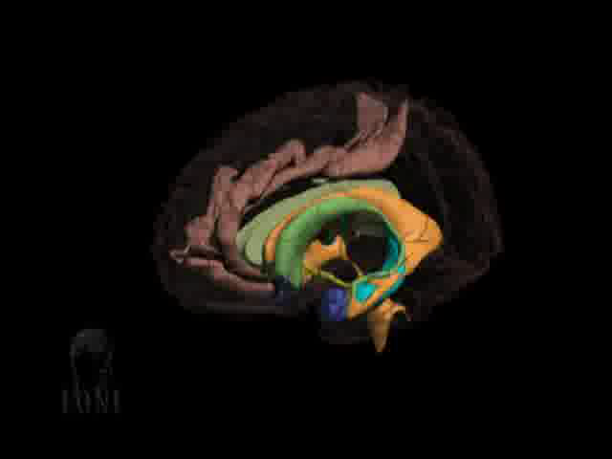

Slide 35
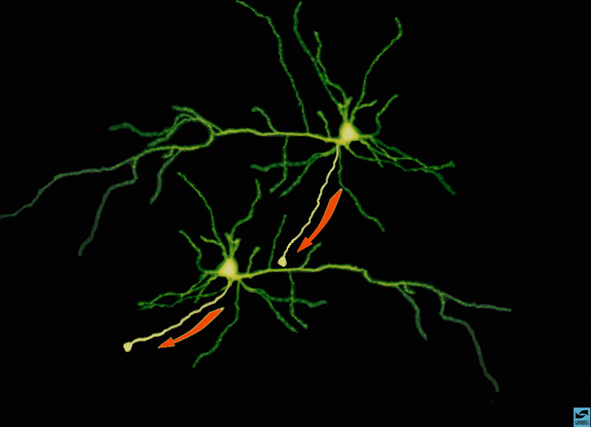
Alan Leshner NIDA
Notes:
This is a picture of two neurons and the pathway electrical impulses travel. The red arrows show the direction of communication along the axon to the dendrite, through the soma and further down another axon at speeds of 150 miles and hour.

Slide 36
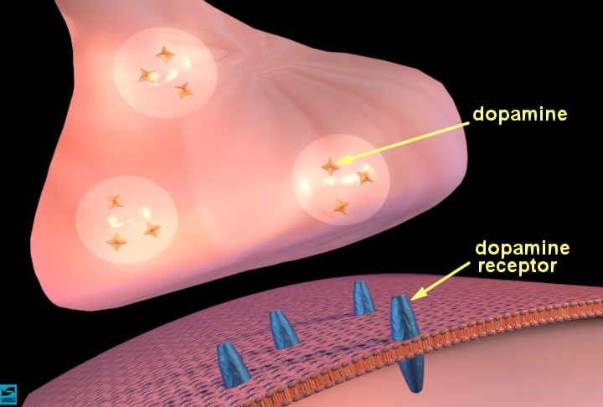
Alan Leshner NIDA
Notes:
This picture is the end of the axon called the terminal which stores neurotransmitters. Dopamine is one of numerous transmitters that communicate with the receptor site. There is a gap between the terminals called a synapses. This is where all the actions takes place and where drugs have there effects. The receiving receptor is activated when it dopamine is lodged into its site. Once it is activated a electrical impulse is sent down the terminal to be received by another neuron.

Slide 37
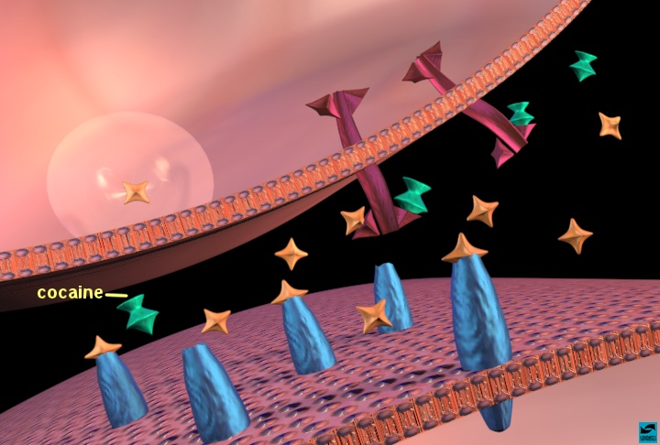

Slide 38
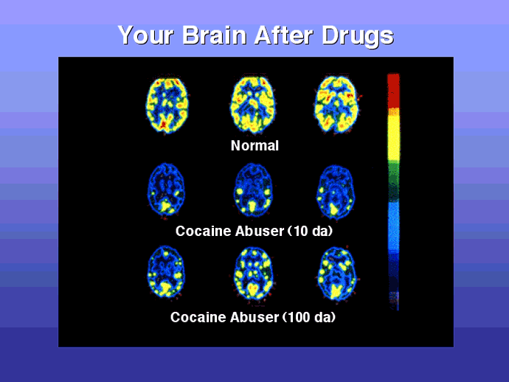
Notes:
This is all about activity. If you look at the color represented in the normal brain that is representation of dopamine in brain. After 10 days you can see the dopamine depletion. In the 100 day slide you are beginning to see the activity coming back. Critical implications for treatment. You can understand why individuals wants to return to use. Things looking pretty bleak even after 100 days of sobriety.

Slide 39
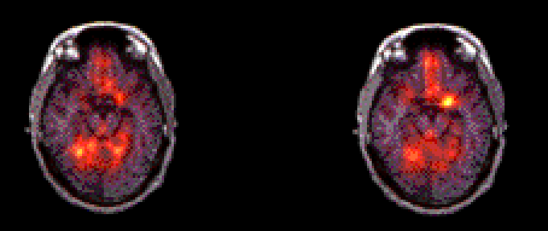
The Memory of Drugs
Amygdala
activated
Amygdala
not lit up
Front of Brain
Back of Brain
Nature Video
Cocaine Video

Slide 40
MA >
Control
5
4
3
2
1
0

Slide 41
Control
> MA
4
3
2
1
0

Slide 42
Prolonged Drug Use Changes
the Brain In Fundamental
and Long-Lasting Ways

Slide 43
Voluntary
Drug Use
Compulsive
Drug Use
(Addiction)

Slide 44
Addiction Is A Brain Disease
Expressed As Compulsive Behavior
Both Developing and
Recovering From It Depend on
Behavior and Social Context

Slide 45
Which is why:
Treatment is critical component
for long term recovery
and must develop
effective interventions!
Alan Leshner NIDA

Slide 46
Triggers & Cravings
Trigger Thought Craving Use
Notes:
Slide 10
Environmental stimuli (external triggers) or emotional conditions (internal triggers) will often cause the recovering addict to think of using drugs and/or alcohol. For example, the patient runs into his old source of drugs at the market. Or, the patient gets into a fight with her husband, and immediately thinks of having a drink. Historically, she has always had a drink after fighting with her spouse. A single thought of drinking or using will typically pass through one’s mind in 30 to 90 seconds, allowing one to continue thinking about AODs. AOD use is often the beginning of the relapse process. This inflames the neurochemistry of the addiction and moves the brain into the craving stage. At this craving stage, it is very difficult, if not impossible, to stop the slide into drug or alcohol use. To the actively using addict/alcoholic or the substance abuser in early recover, the Trigger - Thought - Craving - Use sequence feels as if it happens simultaneously. You feel triggered, and you immediately want to use. Knowing this process can be very helpful to the recovering addict/alcoholic. The successful key in dealing with the process is to avoid it getting started. It is extremely important to stop the thought when it first begins and to prevent it from building into an overpowering craving. It is vitally important to do this as soon as you recognize the thoughts occurring. This can be accomplished by using a number of Thought Stopping techniques.

Slide 47
Triggers & Cravings
Trigger
Thought
Craving
Use
Notes:
Slide 11
Another way to envision this process is to see the Trigger - Thought - Craving - Use sequence as moving along a steep downhill slide. The time to use Thought Stopping is right after one recognizes the first thought of using. The biological process, as shown by the small circle moving towards the man, is still relatively small. It is possible to stop this process when it is in the craving stage, but much more difficult. When in craving mode, the small circle is now enormous -- a huge mountain. The addict/alcoholic may truly not want to use and attempt to deflect the cravings, but more often than not, the cravings are so powerful that they roll over the addict/alcoholic propelling him/her to relapse.

Slide 48
Triggers and Cravings
Thought Stopping
Visual Imagery
Snapping
Relaxation
Call Someone
Pray
Urge Surfing
Notes:
Simply put, thought stopping interrupts the usual process that culminates in using/drinking. The usual reaction to thoughts is to argue with the developing thought/craving. The argument usually results in the addiction winning. Arguing proceeds negotiation, compromise, justification, and, possibly, relapse. Thought stopping ends this process before relapse can begin. Saying, “STOP” either in your head, or aloud, in response to the first hint of a thought usually stops cravings in their tracks.
Here some thought stopping techniques.
Visualization or other sensory imagery - Picture a switch, or lever, in your mind. Imagine yourself actually moving it from ON to OFF stopping the drug or alcohol thoughts. Have another picture ready to think about in place of the drug or alcohol thoughts. It should be an image, or thought, that is pleasurable or meaningful to you and, historically, did not involve drug or alcohol use. If the thought stopping works, but the thoughts frequently keep coming back, you may have to change your environment or engage yourself in a task that requires your full concentration.
Snapping - Tie a rubber band loosely around your wrist. Pull the band and snap pit lightly against your wrist as you say, “NO”, to the drug/or alcohol thoughts. As above, have another thought ready to take the place of the drug and alcohol thoughts.
Prayer - Praying can be an effective thought stopping technique.
Relaxation - Feelings or hollowness, heaviness, and cramping in the stomach are cravings. These can often be relieved by breathing in deeply (filling the lungs with air) and slowly breathing out. Do this three times. You should be able to feel the tightness leave your body. Repeat this whenever the feeling returns.
Call someone - Talking to another person provides an outlet for your feelings and allows you to hear your own thinking process. Have phone numbers of supportive people with you always, so you can use the numbers when you need them.

Slide 49
CREATE EXPLICIT STRUCTURE AND EXPECTATIONS
Scheduling creates a portable structure
Eliminates avoidable triggers
Conceptualizes “One day at a time”.
Reduces anxiety
Counters the addicted lifestyle
Provides the basic foundation for an ongoing recovery
Gives the facilitator and the group a window into areas of relapse risk exposure.

Slide 50
  Daily/Hourly Schedule
Date: ________ Date: ________ Date: ________
7:00 ____________________ 7:00 ____________________ 7:00 ____________________
8:00 ____________________ 8:00 ____________________ 8:00 ____________________
9:00 ____________________ 9:00 ____________________ 9:00 ____________________
10:00 ___________________ 10:00 ___________________ 10:00 ___________________
11:00 ___________________ 11:00 ___________________ 11:00 ___________________
12:00 ___________________ 12:00 ___________________ 12:00 ___________________
1:00 ____________________ 1:00 ____________________ 1:00 ____________________
2:00 ____________________ 2:00 ____________________ 2:00 ____________________
3:00 ____________________ 3:00 ____________________ 3:00 ____________________
4:00 ____________________ 4:00 ____________________ 4:00 ____________________
5:00 ____________________ 5:00 ____________________ 5:00 ____________________
6:00 ____________________ 6:00 ____________________ 6:00 ____________________
7:00 ____________________ 7:00 ____________________ 7:00 ____________________
8:00 ____________________ 8:00 ____________________ 8:00 ____________________
9:00 ____________________ 9:00 ____________________ 9:00 ____________________
10:00 ___________________ 10:00 ___________________ 10:00 ___________________
11:00 ___________________ 11:00 ___________________ 11:00 ___________________
Notes: _____________________________________________________________________________
Reminders: ______________________________________________________________________________

