Slide 1
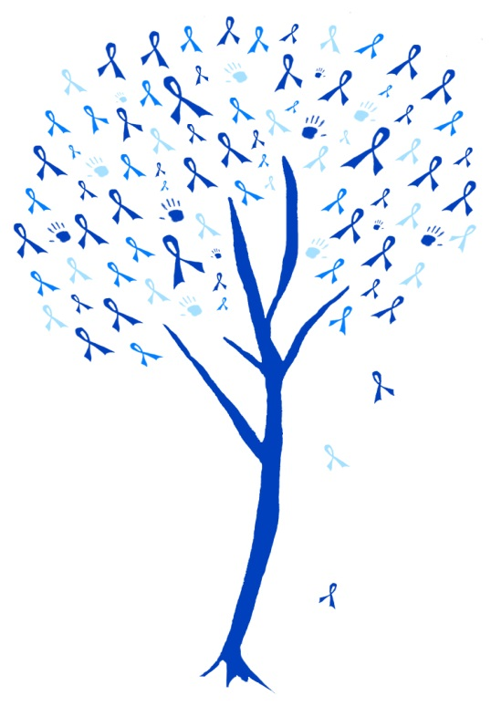
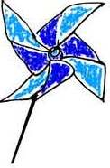
Blue Ribbon Tree
The ribbons on this tree represent
Signage for you to personalize what ribbons represent: # of families served in your program/agency;
# of babies born in your community;
# of confirmed child abuse & neglect cases in
your county, (OKDHS stats for county
available by clicking here; or
General support of all children (added
benefit of this choice – no counting ribbons.)
April is National Child Abuse Prevention Month
Add logo here

