Slide 1
National CMP Reinvestment Network OK Senior Smiles Project September 16, 2020 2:00 pm CST
Notes:
*begin recording* Good afternoon, thank you all for joining us today. Tennessee and Oklahoma are proud to host today’s webinar on the Oklahoma Senior Smiles Project through our National CMP Reinvestment Network. My name is Kristyn Long and I am the Assistant Director of the TN CMP Reinvestment Program. I am going to ask everyone on the line to use the chat box to let us know you’re in attendance, please be sure to type your name and state. Also, please make sure your line is muted.

Slide 2
Chat Box
Notes:
To use the chat box to sign in, you can hover over the lower part of the screen and a tool bar will pop up. The icon that looks like a bubble, shown on the screen, should allow you to click.

Slide 3
Chat Box
Notes:
A bar on the side of your screen, like the one shown here, will pop up and allow you to use the chat box to let us know that you’re in attendance. Simply type your name and state and press enter. I encourage you all to utilize the chat box throughout today’s presentation to ask any questions you have, and we will address those questions at the end of the presentation.

Slide 4
Our Purpose
A national network to share experiences, challenges, and successes with the reinvestment of CMP funds to improve care in nursing homes.
Notes:
We are a national network created to share our experiences, challenges, and successes with managing CMP funds and improving care and quality of life for residents within nursing homes throughout their state. Tennessee and Oklahoma (with your participation and feedback) work as a team to schedule and plan these webinars. Anyone who has a CMP Program within their state is invited to join the National CMP Reinvestment Nework. My co-host today is Luvetta Abdullah, she is Oklahoma’s CMP Program Manager. Luvetta, would you like to say a few words?

Slide 5
OK Senior Smiles Project
September 2020
Shelley Mitchell, M.Ed., RDH Rebecca Mahaney, MD, MPH Dental Health Services Oklahoma State Department of Health Contact info: 405-271-5502 CMP@health.ok.gov
Notes:
At this time, it is my pleasure to introduce our speakers for today’s webinar---- Our first speaker is Shelley Mitchell (read from bio) and our second speaker is Rebecca Mahaney (read from bio).

Slide 6
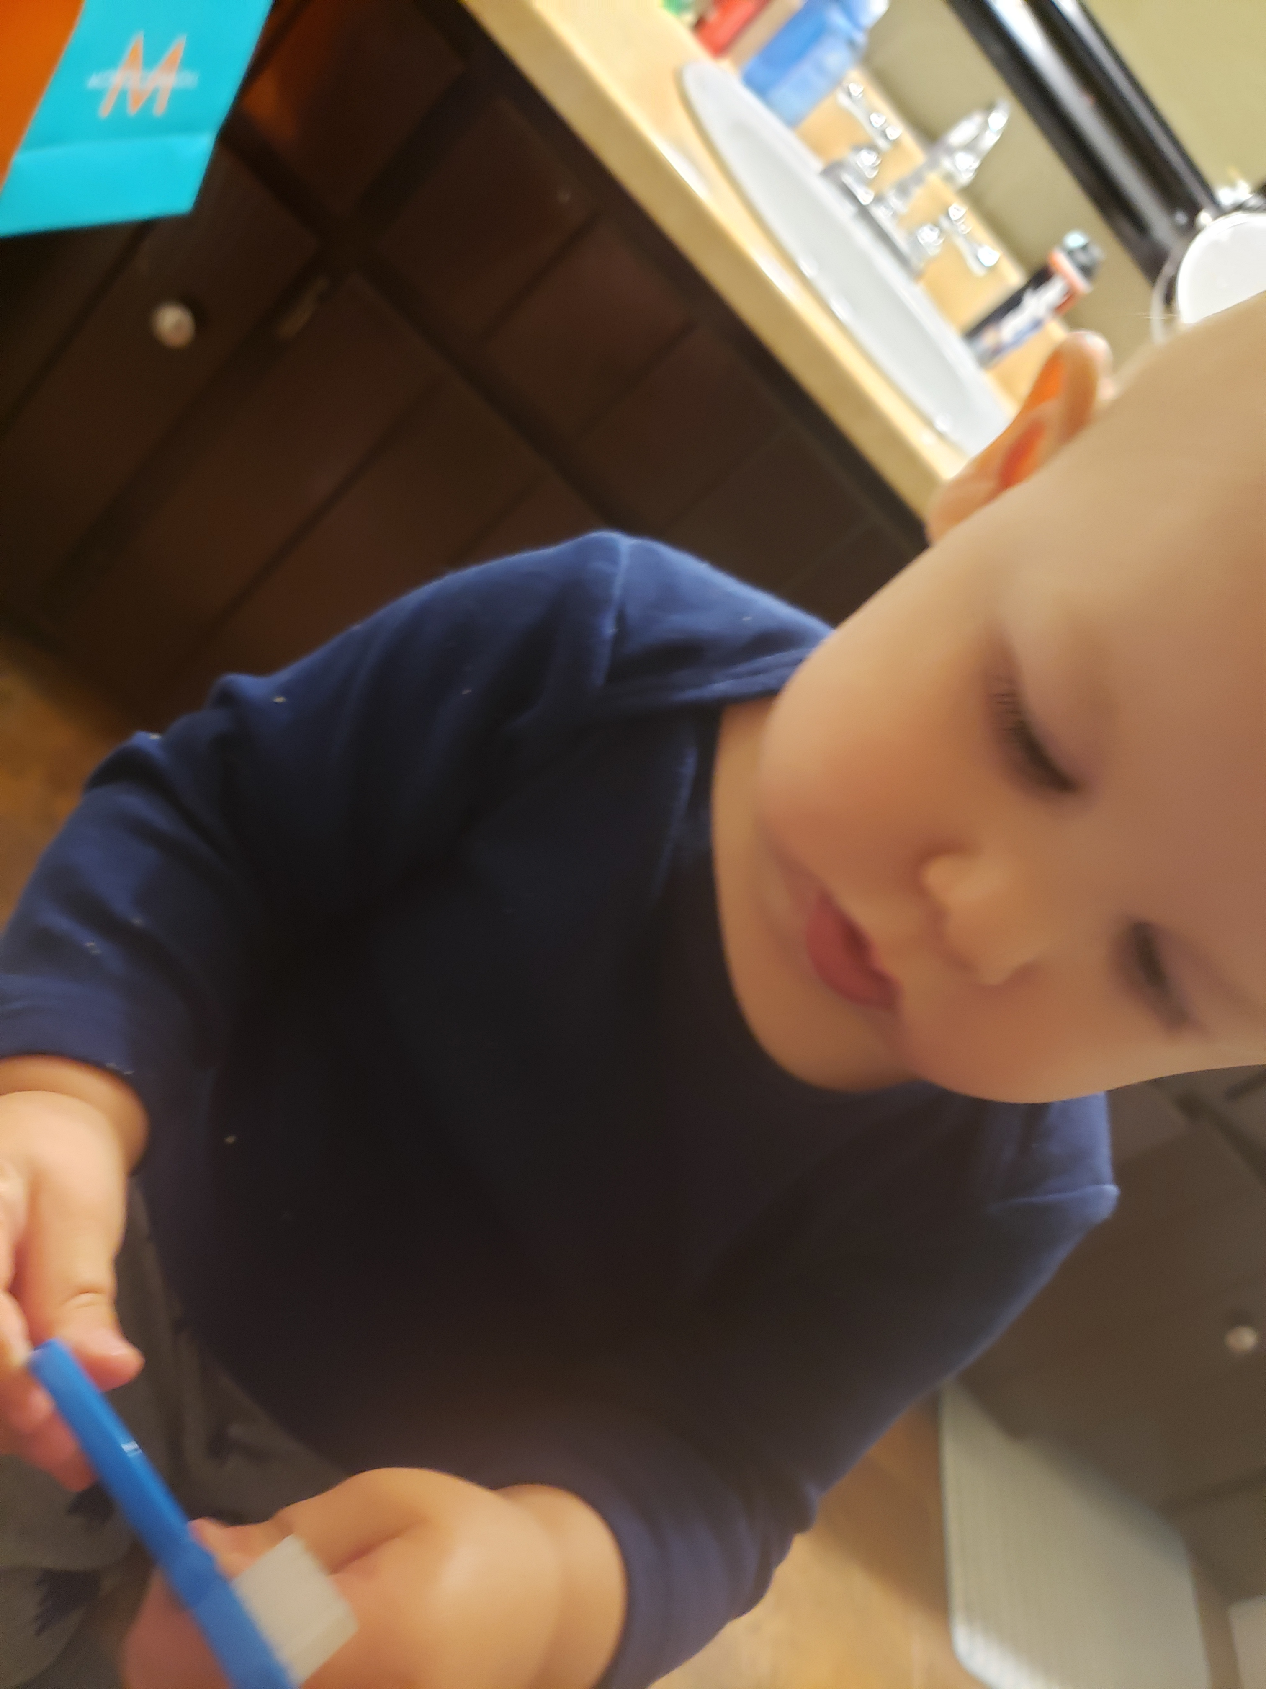
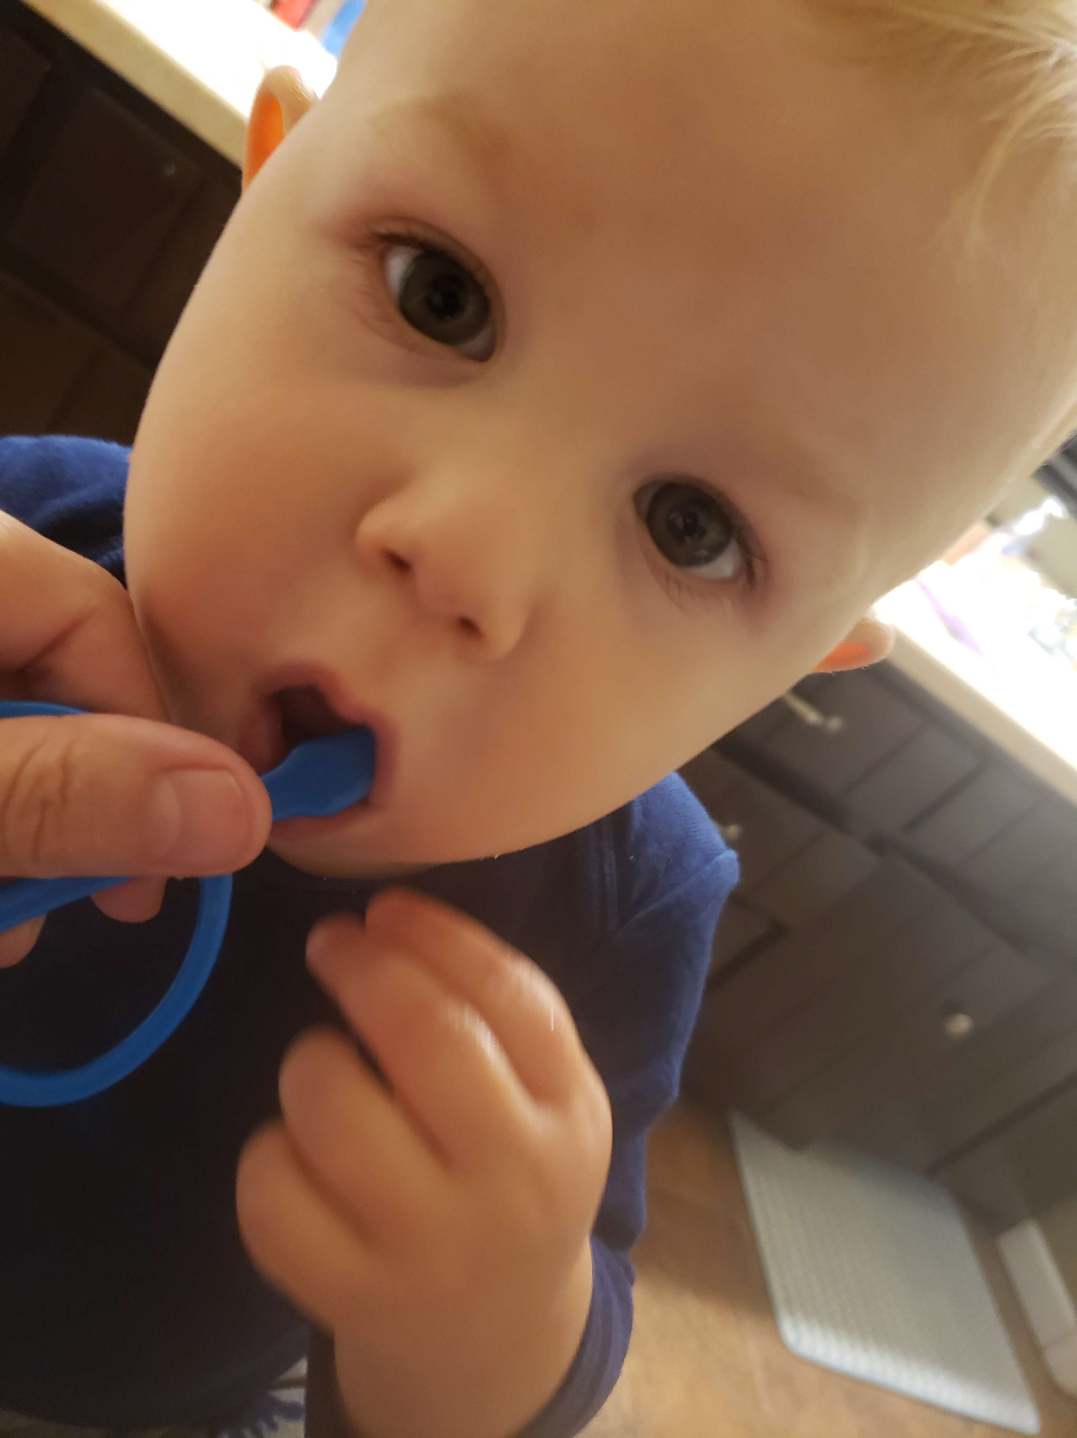
Dental Health Services Goal
To provide leadership in oral disease prevention, anticipate needs, and mobilize efforts that will help protect and promote good oral health for Oklahoma citizens.
Notes:
Our goal for Dental Health Services with the Oklahoma State Department of Health is to provide leadership in oral disease prevention, anticipate needs, and mobilize efforts that will help protect and promote good oral health for Oklahoma citizens.

Slide 7
OK Senior Smiles Objectives
Train and educate all Long Term Care Nursing Staff on the importance of residents’ daily oral hygiene and its link to overall health.
Demonstrate steps in performing proper oral hygiene.
Show steps in performing a daily oral health assessment and writing an oral care plan.
Teach nursing home staff how to correctly clean dentures.
Show oral lesions and discuss importance in oral cancer screenings.
Show products that can be used for dry mouth.
Review strategies for avoiding resistant care behavior during oral care.
Teach nursing home residents importance of daily oral hygiene and its link to overall health.
Demonstrate steps in daily oral hygiene to nursing home residents.
Perform Basic Screening Surveys (BSS) on nursing home residents to collect data to indicate need of dental treatment in our nursing home population.

Slide 9
OK Senior Smiles Project
Two forty five minute educational trainings.
Pre- and Post- tests
Sign-in Sheet
Basic Screening Surveys (BSS) on 10 Residents from Each home.
a) BSS-Screening tool used by states to assess oral health status
b) Oral Health Screening results form for LTC administrator to determine needs for follow up
Pre and Post Assessment Survey by Nursing Home Administrator
Educational Toolkit
a) Oral Care Posters
b) Training video, online oral care continuing ed. class & online oral care education for sustainability
c) Guide for Free/Reduced cost Dental Clinics in Oklahoma
Training materials-oral care brochures and online resources for residents and family

Slide 10
Oral Care Champion Certification

Slide 11
The impact of Oral Health on COVID-19
Three ways OK Senior Smiles can help in the fight of COVID-19:
As people get older their immune system grows weaker. Harmful bacteria in the mouth from poor oral hygiene or decay can enter the blood stream. This causes inflammation, which weakens immune system even more.
Poor oral hygiene is a contributing factor in respiratory infections, cardiovascular disease, stroke, and diabetes. These pre-existing conditions are the reason some people are more vulnerable to serious complications from COVID-19.
Breathing in harmful bacteria is a significant risk factor for aspiration pneumonia. Pneumonia sends many LTC residents to the hospital. It is important to keep LTC residents out of the hospital and to prevent exposure to COVID-19.
Poor oral hygiene can lead to diseases that result in death
BRITISH DENTAL JOURNAL | VOLUME 228 NO. 8 | April 24 2020
https://www.healthline.com/health/coronavirus-tips-and-advice-for-older-adults#medical-care
www.thelancet.com/microbe Vol 1 July 2020

Slide 12
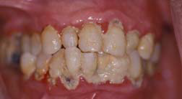
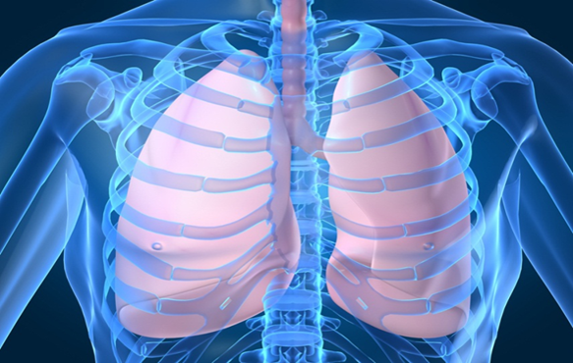
Breathing in germs from a dirty mouth is a significant risk factor for pneumonia
Study by Quagliarello V et al. Modifiable risk factors for nursing home acquired pneumonia. Clin Infect Dis 2005;40:1-6
Notes:
Note- When a person has all this plaque (bacteria) in their mouth they are breathing in bacteria that is a significant risk factor for pneumonia.

Slide 13
2008 Florida nursing home study
Nursing home residents who had daily mouth care provided by nursing assistants whose only job was to provide oral care had three times less risk of dying from pneumonia.
Bassam CW, Gibson G, Ward T, Paphides BM, DeNucci DJ.. Modification of Risk of Mortality from Pneumonia with Oral Hygiene Care, J Am Ger Soc, 2008, 56 (9): 1601-1607
Notes:
Speaker Note- This project that was done in 2008 in a Florida Nursing Home found that residents who had daily mouth care provided by nursing assistants had three times less risk of dying from pneumonia.

Slide 14
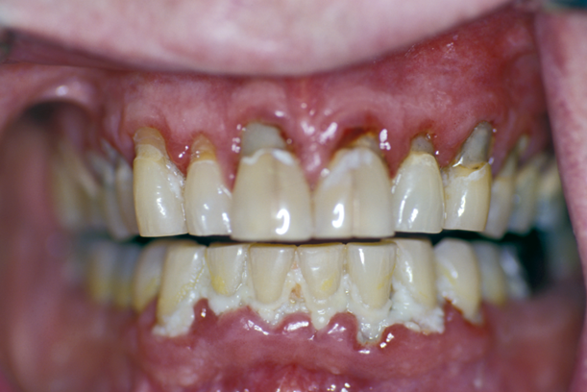
Similar Wound Surface Area
Notes:
University of Kentucky School of Dentistry oral health training video by Dr. Robert Henry
Speaker Note-The picture on the right shows a mouth with periodontal disease. There is infection present. This is a wound in the mouth. The surface area of mouth wound, is about the same surface area of the palm of your hand. Look at the picture on the left. If you saw this wound, you would treat the area by debriding it and applying medications. The same is needed for the mouth wound you see in the picture on the right..

Slide 15
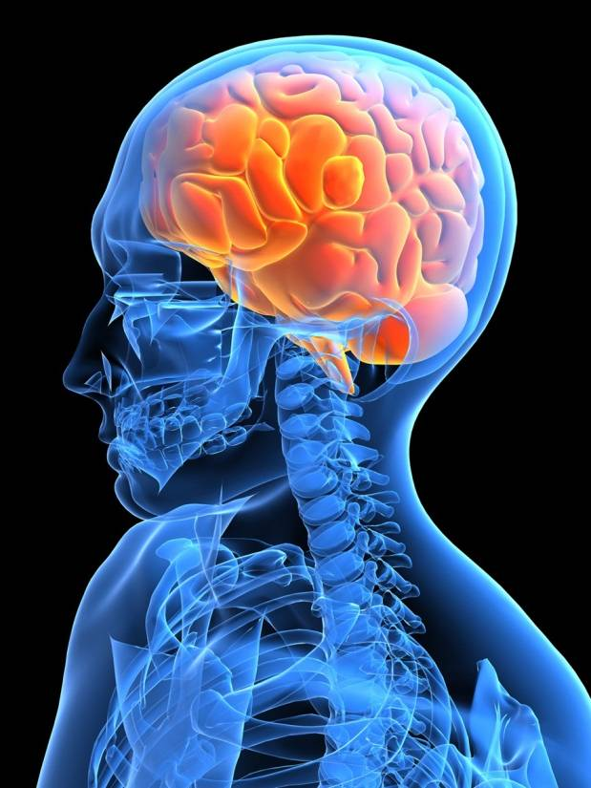
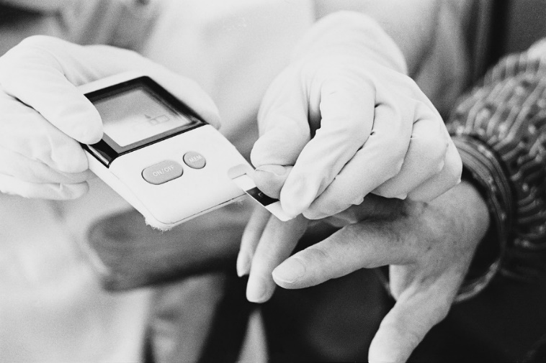
A dirty mouth increases risk of heart disease, stroke, and Diabetes
(Saremi et al. Periodontal disease and mortality in Type 2 Diabetes Care. 2005; 28:27-32)
Notes:
Speaker Note- Residents that have diabetes and gum disease have more trouble controlling their blood sugar. This is related to inflammation and our immune system. The inflammation created by gum disease makes controlling blood sugar levels difficult. An eleven year study found that people with severe gum disease have three times the risk of death from heart disease and/ or kidney disease.

Slide 16
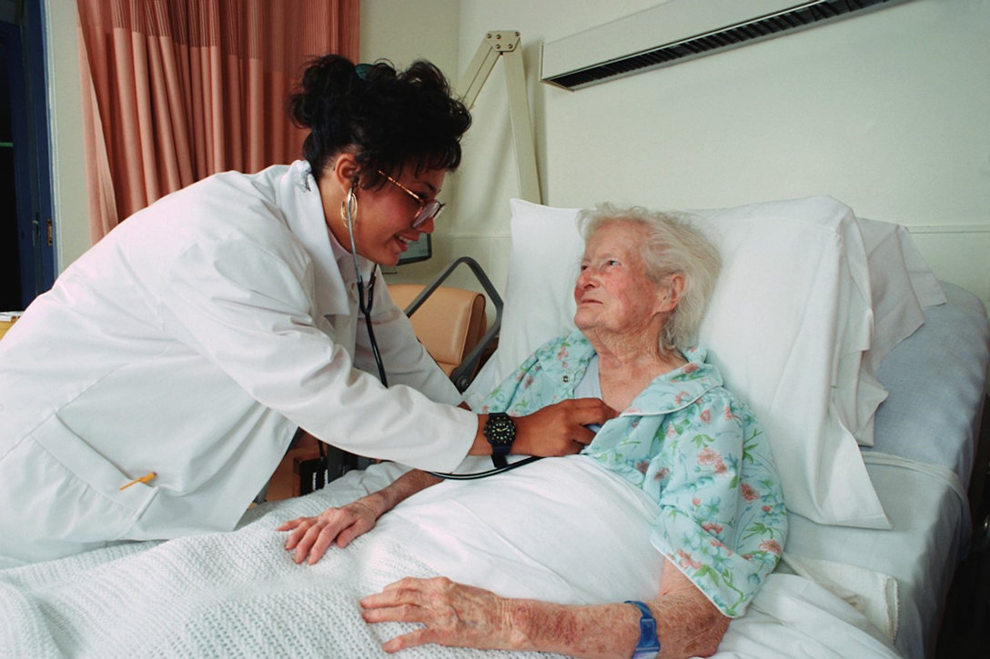
A dirty mouth makes residents sick
Notes:
Speaker Notes- This information that I have provided shows that it is imperative that nursing home residents need good daily oral hygiene to stay healthy!

Slide 17
REVIEW
Poor oral hygiene is linked to:
Cardiovascular disease
Poor glycemic control
Pneumonia
Stroke
Weight loss
Pressure ulcers
Hospital readmission rates

Slide 18
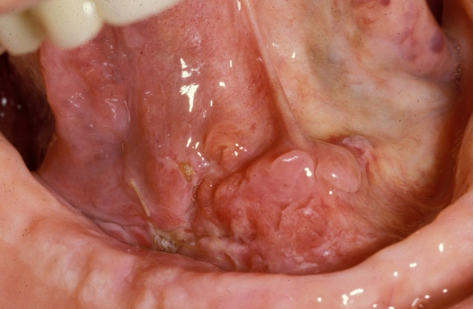
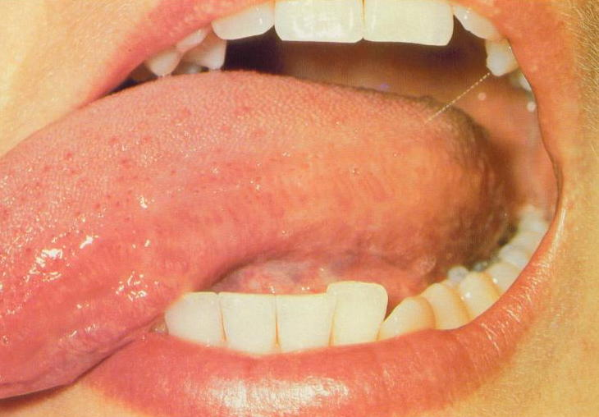
Take 60 seconds each day to do an oral health assessment
Oral Cancer is seven times more likely to be diagnosed in those age 65 and older.
When in doubt always refer out!

Slide 19
Things that staff commented on learning from previous Oral Health Care Project
Notes:
We gave nursing home staff an opportunity to give us comments on what they learned from the oral health trainings. We were able to use this feedback as qualitative data on our final report to CMP.

Slide 20
OK Senior Smiles to Go

Slide 21
OK Senior Smiles Project
September 2020
Shelley Mitchell, M.Ed., RDH Rebecca Mahaney, MD, MPH Dental Health Services Oklahoma State Department of Health Contact info: 405-271-5502 CMP@health.ok.gov

Slide 22
Wrap-Up
A recording of today’s webinar and PowerPoint slides will be available on the TN CMP website
Save the date for our next webinar:
December 16, 2020 at 2:00 pm CST
Topic is TBD
Please send additional questions to:
Kristyn.long@tn.gov
Shaquallah.shanks@tn.gov
CMP@health.ok.gov
Notes:
A recording of today’s webinar and PowerPoint slides will be available on the TN CMP website. (Put hyperlink in chat box: https://www.tn.gov/health/health-program-areas/nursing-home-civil-monetary-penalty--cmp--quality-improvement-program/redirect-cmp/national-cmp-reinvestment-network.html ) Please be sure to save the date for our next webinar on December 16, 2020. And if you think of any questions after we end this call, feel free to submit them to the email addresses shown on our screen. Thank you for your participation and feedback today. I look forward to connecting with everyone again on December 16th!

Slide 23
Thank you!

