Slide 1
STI/STD

Slide 2
STI/STD: True or False?
You CANNOT get an STI from oral sex.
Birth control protects against pregnancy and STIs.
Once you’ve had an STI, you CANNOT get it again.
Anal sex has a higher risk of spreading STIs than many other types of sexual activity.
You CANNOT get an STI if your partner is a virgin.
Only promiscuous or “trashy” people get STIs.
You CANNOT have two STIs at once.
You can get an STI from a toilet seat.
Women are more likely to get tested for STIs.
Lesbians CANNOT get STIs.
If my partner has an STI, I’ll know/see it.
Notes:
1. FALSE: Any exposure to genitalia or body fluids puts you at risk for getting an STI. There are many STIs that can be transmitted through oral sex, including genital herpes, genital warts (HPV), gonorrhea, hepatitis A, hepatitis B, chlamydia, chancroid, and syphilis. To prevent getting an STI from oral sex, you and your partner should get tested for all STIs, and you should always use a condom or dental dam (a latex square or cut open condom) during oral sex.
2. FALSE: The birth control pill does not protect against STIs. Couples having sex must always use condoms or another barrier along with the Pill to protect against STIs and pregnancy at the same time.
3. FALSE: You can get some STIs more than just once. Some STIs are yours for life, like herpes and HIV. Others, like chlamydia and gonorrhea, can be treated, but you may get infected again if you have sexual contact with someone who has them.
4. TRUE: Anal sex does have a higher risk of spreading STIs. The lining of the anus is thin and can easily be damaged, which makes it more vulnerable to infection.
5. FALSE: Depending on how your partner defines being a virgin, it is possible for them to have contracted an STI/STI. Your partner might not have had vaginal sex but may have had oral sex with someone (and still consider themselves a virgin), putting themselves at risk for an STI. Also, there are other STIs (herpes and HPV) that are passed through skin-to-skin contact, even if no penetration has taken place. It is important to discuss with your partner all sexual activity they have participated in and to always practice safer sex.
6. FALSE: STIs don’t discriminate. The only people who have no risk of getting an STI are people who haven’t had sex or any kind of sexual contact. 1 in 2 sexually active young people will get an STI before the age of 25.
7. FALSE: You can have multiple STIs at a time. For example, if you have just one other untreated STI, you are 10 times more likely to have HIV. Your chances are greater if you have genital warts, lesions or ulcers like those you can get with syphilis or herpes.
8. FALSE: STI’s cannot be passed from a toilet seat. Even if the bacteria and viruses that can cause an STI got onto the seat, they cannot survive for long after leaving the human body. Most organisms do not last any more than a few minutes, because they dry out and die.
9.TRUE: Women account for a disproportionate number of these new infections. Anatomical differences place women at greater risk than men of contracting sexually transmitted infections, and age-related physiological changes in the cervix make risk of infection even higher for adolescent women.
10. FALSE: While women who sleep with women can be at a lower risk for some forms of STIs, they can – and do – contract STIs as well. Any form of unprotected genital contact carries some risk of exposure, so safer sex practices are important, no matter what your sexual orientation. Surrounding these myths is the overarching notion that outside of HIV/AIDS, LGBTQ youth do not have to worry about STIs. The truth is that anyone engaging in unprotected genital contact is at risk for contracting an STI.
11. FALSE: There’s often no sign that a person has an STI. Even doctors often can't tell by looking if people have STIs. They need to do tests, like bloodwork. People with STIs might not know they have them: STIs don't always cause symptoms. But it is possible to carry and spread the virus without ever having an outbreak.

Slide 3
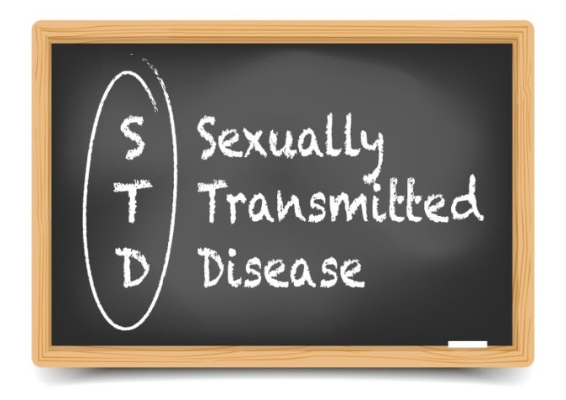
What is an STI/STD?
Infection transmitted through sexual contact with an infected individual. Sexually transmitted infection or STI and can develop into a sexually transmitted disease or STD.
FIVE MODES OF TRANSMISSION
Vaginal sex
Anal sex
Oral sex
Skin-to-skin contact
Infected Mother to child
Notes:
STI’s transmitted by exchange of body fluids:
Gonorrhea
Chlamydia
Syphilis
Trichomoniasis
HIV
Hepatitis
STI’s transmitted by skin-to-skin contact:
Genital warts
Herpes
Scabies
Pubic Lice

Slide 4
Why Is This Important About STI/STDs?
Often NO signs or symptoms
UNAWARE of infection, and don’t receive treatment.
LONG-TERM damage
May have PASSED infection to others
20 million new infections every year in the U.S.
More than 50% of all people will have an STI at some point in their lifetime.

Slide 5
Are STI/STDs Curable?
Antibiotics can cure bacterial STDs, but cannot reverse the long-term damage:
Treatment can improve the lives of many people living with viral STDs, but there is NO cure:
Chlamydia
Gonorrhea
Syphilis
Trichomoniasis*
*parasitic protozoan
HIV
Herpes
HPV
Hepatitis B
Notes:
*While gonorrhea is curable with antibiotics, a growing number of strains are now resistant to penicillin and other drugs used in treatment. The vast majority of infections, however, are treatable.
Bacterial diseases such as chlamydia, gonorrhea, and syphilis are curable STIs. They can be treated by antibiotics.
Viral STIs such as HIV, Herpes, HPV, and Hepatitis B are life-long STIs. There is treatment available, but no cure.

Slide 6
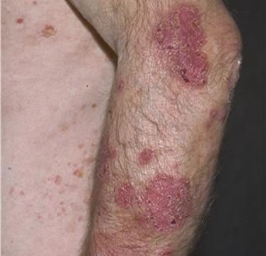
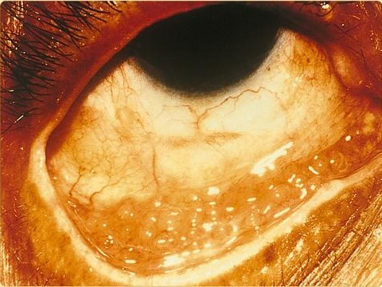
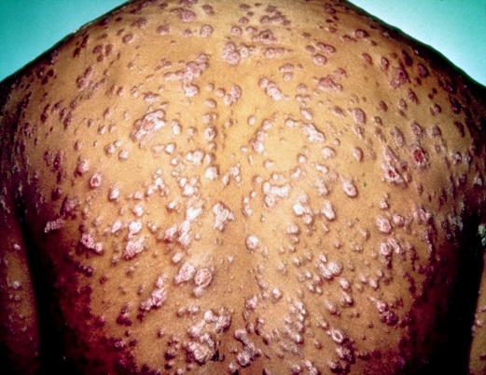
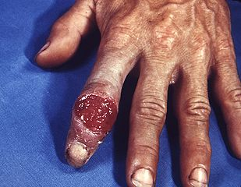
Most Bacterial STIs Antibiotics can cure most bacterial STIs but not always the long-term damage.
Notes:
*While gonorrhea is curable with antibiotics, a growing number of strains are now resistant to penicillin and other drugs used in treatment. The vast majority of infections, however, are treatable.
Arm (far left) - Reiter’s disease is a complication of untreated chlamydial infection.
Eye – conjunctivitis due to chlamydia.
Back – Rash caused by secondary syphilis. (usually occurs on the palms of hands & soles of feet, but can occur anywhere)
Finger lesion (far right) – Lesions caused by syphilis.
Note: Stress that these are LONG TERM SYMPTOMS/COMPLICATIONS. These are usually not seen until LONG after infection. Most STDs have no symptoms, so just because your body does not have these damages, does not mean you are STD free!
Note: Both young men and young women are heavily affected by STDs — but young women face the most serious long-term health consequences. It is estimated that undiagnosed STDs cause 24,000 women to become infertile each year.

Slide 7
Chlamydia
The “Silent” Disease
In the U.S.
Most frequently reported STD
Estimated 1.76 million new cases in 2018
(Could fill the OU Football Stadium 20x)
How is it Spread?
Vaginal, anal, or oral sex with someone who has chlamydia.
Infected pregnant women can pass it to her baby during pregnancy or childbirth.
Notes:
Note: If your sex partner is male you can still get chlamydia even if he does not ejaculate (cum).
People who have had chlamydia and have been treated may get infected again if they have sexual contact with a person infected with chlamydia
Infected pregnant women can pass it to their baby during pregnancy or childbirth.
If a woman is infected while pregnant, her developing fetus is at risk, because chlamydia can be passed on during her pregnancy or delivery and could lead to eye infections or pneumonia in the infant. If chlamydia is detected early, it can be treated easily with an antibiotic taken by mouth.
https://www.nichd.nih.gov/health/topics/STIs/conditioninfo/Pages/types.aspx
Note: Most prevalent, reportable STI in Oklahoma, as well as the U.S.

Slide 8
Chlamydia
Symptoms:
Abnormal vaginal/penile discharge Burning sensation when urinating
Rectal pain, discharge, or bleeding Pain/swollen in one or both testicles
Can lead to:
Sterility or infertility Infection of tube that carries sperm
Pelvic Inflammatory Disease (PID) to/from the testicles (pain, fever)
Long-term abdominal/pelvic pain
Scar tissue formation in fallopian tubes
Ectopic pregnancy
Notes:
Most frequently reported STI in the U.S.
Known as a “silent” disease (usually no symptoms are shown)
A large number of cases are not reported because most people with chlamydia are asymptomatic and do not seek testing.
Female: (~69% of infections in 2018; increase of approximately 3% from 2017)
Ectopic pregnancy - pregnancy outside the uterus (potentially deadly?)
If you are a woman, untreated chlamydia can spread to your uterus and fallopian tubes (tubes that carry fertilized eggs from the ovaries to the uterus), causing pelvic inflammatory disease (PID).
75% of women with chlamydia infections are asymptomatic.
The CDC reports that women have reported rates of chlamydia infection 2x higher than men.
Male: (~30% of infections in 2018; decrease of approximately 4% from 2017)
Men rarely have health problems linked to chlamydia. Infection sometimes spreads to the tube that carries sperm from the testicles, causing pain and fever. Rarely, chlamydia can prevent a man from being able to have children.
Note: Men and women can also get infected with chlamydia in their rectum, either by having receptive anal sex, or by spread from another infected site (such as the vagina). While these infections often cause no symptoms, they can cause:
•Rectal pain
•Discharge
•Bleeding

Slide 9
Gonorrhea
In the U.S.
2nd most common disease reported
Estimated 583,405 new cases in 2018
How is it Spread?
Vaginal, anal, or oral sex with someone who has gonorrhea.
Infected pregnant woman can pass it to her baby during childbirth.
Notes:
Gonorrhea can cause infections in the genitals, rectum, and throat.
Age group 20-24 years had the highest rates of gonorrhea among both males and females.
2nd most prevalent STI reported in Oklahoma (8,998 cases reported in 2018)

Slide 10
Gonorrhea
Symptoms:
Abnormal vaginal/penile discharge Burning sensation when urinating
(white, yellow or green) Vaginal bleeding between periods
Rectal discharge, itching or bleeding Pain/swollen in one or both testicles
Can lead to:
Sterility or infertility Disseminated infection (rash, fever, Painful infection tubes attached testicles arthritis, meningitis, etc.)
Pelvic Inflammatory Disease (PID)
Long-term abdominal/pelvic pain Ectopic pregnancy
Scar tissue form in fallopian tubes Inability to get pregnant
Notes:
Note: Rectal infections of gonorrhea may either cause no symptoms or cause symptoms in both men and women that may include:
•Discharge
•Anal itching
•Soreness
•Bleeding
•Painful bowel movements
Untreated gonorrhea may also increase your chances of getting or giving HIV – the virus that causes AIDS.
Rarely, untreated gonorrhea can also spread to your blood or joints.
Some men with gonorrhea may have no symptoms at all.
Most women with gonorrhea do not have any symptoms. Even when a woman has symptoms, they are often mild and can be mistaken for a bladder or vaginal infection.

Slide 11
Diagnoses of Chlamydia and Gonorrhea Cases in Oklahoma, by Age

Slide 12
Diagnoses of Chlamydia and Gonorrhea Cases in Oklahoma, by Race/Ethnicity
Oklahoma State
Department of Health
| STI 101 | 2022
Notes:
In 2018, Chlamydia and Gonorrhea diagnoses by race/ethnicity in Oklahoma are as follows:
Chlamydia
American Indian/Alaska Native: 1,781 (8.11%)
Asian/Pacific Islander: 247 (1.12%)
Black: 4,822 (21.94%)
Hispanic (all races): 2,590 (11.79%)
White: 8,776 (39.94%)
Multi Race: 1,831 (8.33%)
Other/unknown: 1,927 (8.77%)
Gonorrhea
American Indian/Alaska Native: 760 (8.45%)
Asian/Pacific Islander: 59 (0.66%)
Black: 2,671 (29.68%)
Hispanic (all races): 717 (7.97%)
White: 3,496 (38.85%)
Multi Race: 734 (8.16%)
Other/unknown: 561 (6.23%)

Slide 13
Primary & Secondary Syphilis
“The Great Imitator”
In the U.S.
Estimated 35,063 new cases in 2018
How is it Spread?
Direct contact with a syphilis sore (chancre) during vaginal, anal, or oral sex.
Can be spread from an infected mother to her unborn baby.
Primary
Syphilis
Secondary Syphilis
Tertiary/Late Syphilis
Notes:
“The Great Imitator”
Many signs and symptoms of syphilis are very similar from many other diseases, giving it the nickname “the great imitator”.
Symptoms of syphilis vary among the different stages of disease. Many people do not have any symptoms for years yet remain at risk for complications if left untreated.
You could also be infected with syphilis and have very mild symptoms or none at all.
Note:
Like many other STIs, syphilis infection facilitates HIV transmission.
The infection is treatable with antibiotics but may have serious health consequences such as weight loss, rash, and permanent damage to internal organs if left untreated.
Note:
Pregnant women with syphilis have a chance of delivering stillbirths, depending on how long she has been infected.

Slide 14
Primary Syphilis
Chancre (primary syphilis sore)
Firm, round, and painless or open and wet
Appears within 2-6 weeks after exposure usually but possibly up to 3 months
Found on the part of the body exposed to the infection such as penis, vagina, anus, lips, in rectum, or in mouth
Disappears after a few weeks without treatment and still progresses to next stage of Secondary Syphilis
Notes:
Chancre
The painless syphilis sore can be confused for an ingrown hair, zipper cut, or other seemingly harmless bump.
You could also be infected with syphilis and have very mild symptoms or none at all.
Sores can be found on the penis, vagina, anus, in the rectum, or on the lips and in the mouth (the part of the body exposed to infection).
Note: The primary stage of syphilis is generally characterized by the appearance of a single chancre which typically appears within 2-6 weeks after exposure but could take up to 3 months to appear. The sore appears at the location where syphilis entered the body and is usually firm, round, and painless. These sores typically disappear within a few weeks and heal without treatment. However, without adequate treatment, the infection will still progress to the secondary stage.
Note:
A syphilis infection is called an ‘early’ case if a patient has been infected for a year or less, such as during the primary or secondary stages of syphilis. People who have ‘early’ syphilis infections can more easily spread the infection to their sex partners.

Slide 15
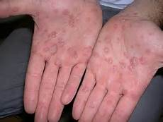
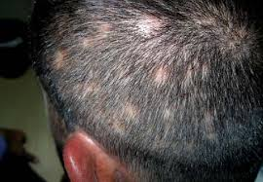
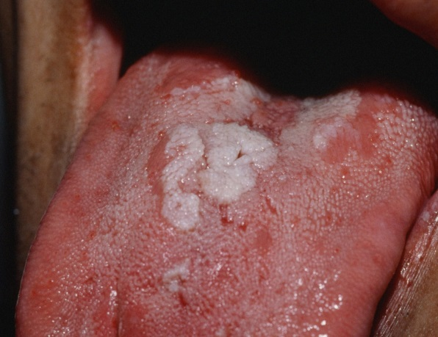
Secondary Syphilis
Appears about 4 weeks after chancre heals.
Disappears after a few weeks without treatment and still progresses to next stage Late (Tertiary) Syphilis
Condylomata lata (C. lata) or “fleshy warts” in anogenital region
non-itchy RASH with rough red or
Reddish-brown spots
Alopecia or
patchy hair loss
Mucous Patches usually in the mouth, vagina, or anus
Notes:
Usually, 2-8 weeks after chancre appears.
Like primary syphilis, the symptoms will go away with or without treatment. Without appropriate treatment, the infection will progress to later stages of syphilis.
The non-itchy body rash that develops during the second stage of syphilis can show up on the palms of your hands and soles of your feet, all over your body, or in just a few places.
Secondary syphilis typically begins with a rash that can develop anywhere on the body. This rash usually does not cause itching and can appear while the chancre is healing or several weeks after the chancre has healed. This rash typically looks like rough, red or reddish-brown spots on the palms of the hands and/or the bottoms of the feet but can look different on other parts of the body. The rash can also look like rashes caused by other diseases.
Alopecia is patchy hair loss.
Mucous Patches (mucous lesions) can occur in the mouth, throat, cervix, vagina, or anus.
Condylomata lata (C-lata) or moist papules occur in the anogenital region, and their appearance can be confused with “fleshy” warts.

Slide 16
Latent Syphilis
The period of time when there are
no signs or symptoms
but syphilis is still present in the body.
If left untreated, you can continue to have syphilis
in your body for years
without any signs or symptoms.
Notes:
Latent stage occurs between primary and secondary and then after secondary until late syphilis symptoms appear.

Slide 17
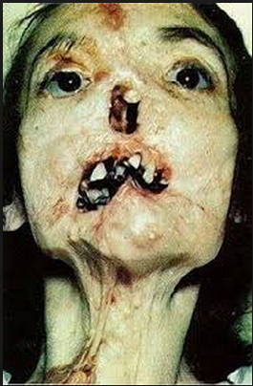
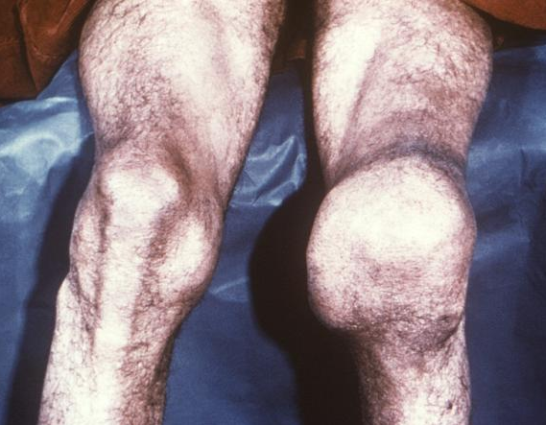
Late (Tertiary) Syphilis
Typically Occurs 10-30 years after infection begins!
Can damage almost any part of the body including the heart, brain, spinal cord, eyes and bones
Can result in mental illness, blindness, deafness, heart disease and death
Gumma: soft, gummy tumor
Types:
Cardiovascular Syphilis
Late Benign Syphilis
Neurosyphilis Syphilis
(Occurs sooner among People Living with HIV.)
Oklahoma State Department of Health | STI 101 | 2022
Notes:
Most people with untreated syphilis do not develop late-stage syphilis because of the widespread use of antibiotics
However, when it does happen it is very serious and would occur 10–30 years after your infection began.
A Gumma is a soft, gummy tumor that occurs with late syphilis.
Meningitis or infection of the vessels in the brain can occur in early syphilis.
Neurosyphilis is often asymptomatic and can occur at any stage of syphilis.
Tabes dorsalis and general paresis do not occur until 10 years or more following infection.

Slide 18
Neurosyphilis Syphilis
Usually occurs during late syphilis but can occur
at anytime during the infection.
Symptoms:
Difficulty coordinating muscle movements
Paralysis (not able to move certain parts of your body)
Numbness
Blindness
Dementia (mental disorder)
Damage to internal organs
Can result in death
More likely to occur early in the disease process if HIV infection is also present.
Notes:
Neurosyphilis typically occurs in the late stage of syphilis but can occur as early as the primary stage especially if co-infected with HIV

Slide 19
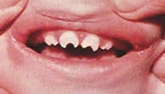
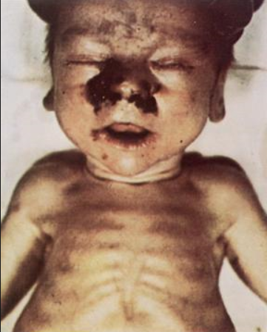
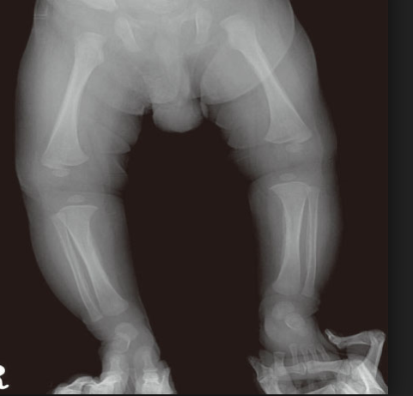
Congenital Syphilis
40% will be stillborn or die in the hospital.
Transmission can occur during any stage of syphilis and during any trimester of pregnancy.
Can cause:
Prematurity
Birth defects
Hutchinson’s teeth
Osteochondritis
Developmental delays
Notes:
Full treatment regimen must be completed <30 days prior to delivery for baby to be treated
Defects not always reversible
Osteochondritis: bone and joint separate and lose blood flow
Long Bone Disease, Saber Shin, Saddle Nose

Slide 20
Trichomoniasis In the U.S. Estimated 3.7 million new cases in 2018
How is it Spread?
Parasite passed during vaginal sex.
70% of infected people have NO signs/symptoms
Symptoms:
Abnormal thin vaginal/penile discharge Burning urinating and ejaculation
white, yellow or green with foul odor Genitals itching, sore, red, burning
Site:
Lower genital tract (vulva, vagina, penis or urethra)
Greatly increases the risk of getting/spreading other STIs.
Notes:
A parasitic infection.
Most common curable STI in young sexually active women in the U.S.
Treatment is inexpensive and effective.
Many infected persons, especially men, experience no symptoms.
When trichomoniasis does cause symptoms, they can range from mild irritation to severe inflammation. Some people with symptoms get them within 5 to 28 days after being infected, but others do not develop symptoms until much later. Symptoms can come and go.
Having trichomoniasis can make it feel unpleasant to have sex. Without treatment, the infection can last for months or even years.
It is not common for the parasite to infect other body parts, like the hands, mouth, or anus.
Trichomoniasis can increase the risk of getting or spreading other sexually transmitted infections. For example, trichomoniasis can cause genital inflammation that makes it easier to get infected with the HIV virus, or to pass the HIV virus on to a sex partner.
In pregnant women, Trichomoniasis may lead to a premature delivery.

Slide 21
Pelvic Inflammatory Disease (PID)
Serious infection of woman’s reproductive organs
Often untreated STDs like chlamydia and gonorrhea
Symptoms
Pain in your lower abdomen Unable to undo damage
Pain & bleeding when you have sex Fallopian tube scar tissue
Burning sensation with urination Ectopic pregnancy
Vaginal discharge with a bad odor Infertility
Bleeding between period Long-term pelvic/
Fever abdominal pain
May have Mild or No symptoms
Notes:
Often caused by untreated STDs, like chlamydia and gonorrhea: Other infections that are not sexually transmitted can also cause PID.
No tests for PID: diagnosis usually based on medical history, physical exam, and other test results.
You are more likely to get PID if you:
•Have an STD and do not get treated
•Have more than one sex partner
•Have a sex partner who has sex partners other than you
•Have had PID before
•Are sexually active and are age 25 or younger
•Douche
•Use an intrauterine device (IUD) for birth control

Slide 22
Genital Herpes (HSV-1 and HSV-2)
1 in 8 people 14-49 years old have genital herpes.
Many infected people have NO signs/symptoms.
How is it Spread?
Vaginal, Oral, or Anal sex OR Skin-to-Skin Contact
with someone who has genital herpes.
Symptoms (“Having an outbreak”):
One or more blisters on or around the genitals, rectum, or mouth.
Blisters break & leave painful sores that take weeks to heal.
Usually characterized by NO or very mild symptoms AND NO cure.
Notes:
Herpes Simplex Virus 1 (HSV-1):
mainly transmitted by oral-to-oral contact
periodic appearance of “cold sores” or painful ulcers around the mouth area
Infected persons will often experience a tingling, itching or burning sensation around their mouth, before the appearance of sores
can also be transmitted to the genitals through oral-genital contact, leading to genital herpes.
Herpes Simplex Virus 2 (HSV-2):
Can cause genital herpes (one or more genital or anal blisters or open sores called ulcers)
mainly spread during sex through skin-to-skin contact (through contact with genital surfaces, skin, sores or fluids of someone infected with the virus)
the occasional appearance of painful genital ulcers. Genital ulcers can have an important negative effect upon a person’s mental wellness and personal relationships.
symptoms of new genital herpes infections often include fever, body aches, and swollen lymph nodes.
can be transmitted from skin in the genital or anal area that looks normal.
HSV-1 and HSV-2: are both highly infectious and can be transmitted to neonates (newborn babies), which is rare, but which can be fatal.
Note: Majority of genital and perirectal herpetic outbreaks in the U.S. are caused by HSV-2
NO CURE:
There is no cure for herpes. However, there are medicines that can prevent or shorten outbreaks. One of these herpes medicines can be taken daily, and makes it less likely that you will pass the infection on to your sex partner(s).
Women are more susceptible to the herpes virus
A majority of people with the virus are unaware that they are infected, increasing the likelihood of transmitting the infection to their partners. Although anti-viral drugs are available to manage genital herpes, no cure exists.
Herpes increases a person’s susceptibility to HIV and causes HIV-infected individuals to be more infectious.
How is Herpes Spread?
Fluids found in a herpes sore carry the virus and contact with those fluids can cause infection. You can also get herpes from an infected sex partner who does not have a visible sore or who may not know he or she is infected because the virus can be released through your skin and spread the infection to your sex partner(s).
Symptoms:
You may not notice mild symptoms or you may mistake them for another skin condition, such as a pimple or ingrown hair.
An “outbreak”:
The first time someone has an outbreak they may also have flu-like symptoms such as fever, body aches, or swollen glands.
Repeat outbreaks of genital herpes are common, especially during the first year after infection. Repeat outbreaks are usually shorter and less severe than the first outbreak. Although the infection can stay in the body for the rest of your life, the number of outbreaks tends to decrease over a period of years.
Note: If you touch your sores or the fluids from the sores, you may transfer herpes to another part of your body, such as your eyes. Do not touch the sores or fluids to avoid spreading herpes to another part of your body. If you touch the sores or fluids, immediately wash your hands thoroughly to help avoid spreading your infection.
Note:
Genital herpes can cause sores or breaks in the skin or lining of the mouth, vagina, and rectum. The genital sores caused by herpes can bleed easily. When the sores come into contact with the mouth, vagina, or rectum during sex, they increase the risk of giving or getting HIV if you or your partner has HIV.
Note:
If you have herpes, you should tell your sex partner(s) and let him or her know that you do and the risk involved. Using condoms may help lower this risk but it will not get rid of the risk completely. Having sores or other symptoms of herpes can increase your risk of spreading the disease. Even if you do not have any symptoms, you can still infect your sex partners.

Slide 23
Human Papillomavirus (HPV)
HPV is VERY common.
Estimated 80% sexually-active men and women will get at least one type of HPV at some point in their lives.
How is it Spread?
Mainly transmitted through vaginal & anal sex and can also occur through oral sex and skin-to-skin contact.
Most people with HPV do not know they are infected and never develop symptoms or health problems.
There is No treatment for HPV, but there are treatments for the
health problems that HPV causes:
Cervical pre-cancer Genital warts Other HPV-related cancers
Notes:
HPV is VERY common:
There are many types of HPV.
Greater than 100 strains, more than 40 different types of HPV are sexually transmitted. Certain “high risk” strains of HPV have been linked to cervical cancer; however, many common strains of HPV, including genital warts, are considered "low-risk." Most of the "low risk" infections resolve themselves on their own without any treatment. There are 14.0 million new cases of HPV diagnosed in the U.S. each year. Regular screenings for changes in the cervix (pap smears) are the best known ways to prevent possible complications from HPV infection (for women).
HPV Vaccination (9-valent Gardasil 9):
As of May 2017, only HPV vaccine available for use in U.S (NIH National Cancer Institute).
Vaccinates against 9 common strains of HPV (Types 6, 11, 16, 18, 31, 33, 45, 52, 58).
Females and Males age 9 through 45 (Merck)
Females age 9 until 27 (CDC)
Males age 9 until 22 or MSM, Transgender and immunocompromised until 27 (CDC)
CDC recommends ages 11 or 12 two shots of HPV vaccine six to twelve months apart (best immune response).
Only 2 doses if started before age 15; otherwise, 3-dose series
HPV vaccines quadrivalent Gardasil and bivalent Cervarix used in other countries.
HPV associated with approximately 92% of anal cancer

Slide 24
Hepatitis
“Inflammation of the liver”
 | Hepatitis A | Hepatitis B | Hepatitis C
How is it spread? | Person ingests infected fecal matter—even in very small amounts—from contact with contaminated objects, food, drinks. | Blood, semen, or other body fluids from a person with the virus - even in very small amounts - enters the body of a non-infected person. | Blood from a person infected with the virus - even in very small amounts - enters the body of a non-infected person.
How long does it last? | A few weeks to several months. | Mild illness (a few weeks) but Lifelong or chronic condition. | Mild illness (a few weeks) but Lifelong.
How serious is it? | Most recover from mild illness with no lasting liver damage, but death can occur (although rare). | 15-20% develop chronic liver disease including cirrhosis, liver failure, or liver cancer. | 75-85% develop chronic liver disease, 5-20% develop cirrhosis and 1-5% will die.
Notes:
“Hepatitis” means inflammation of the liver:
The liver is a vital organ that processes nutrients, filters the blood, and fights infections. When the liver is inflamed or damaged, it may not be able to function properly.
Hepatitis A: can be sexually transmitted by oral sex (oral to anal contact). Not near as common to be sexually transmitted as B & C.
The Hepatitis B virus can also be transmitted from:
•Birth to an infected mother
•Sex with an infected person
•Sharing equipment that has been contaminated with blood from an infected person, such as needles, syringes, and even medical equipment, such as glucose monitors
•Sharing personal items such as toothbrushes or razors
•Poor infection control has resulted in outbreaks in health care facilities
Vaccine available for A and B: should be done for all infants at birth (most of you are already vaccinated)
Symptoms:
Many people with hepatitis do not have symptoms and do not know they are infected. If symptoms occur with an acute infection, they can appear anytime from 2 weeks to 6 months after exposure. Symptoms of chronic viral hepatitis can take decades to develop.
Symptoms of hepatitis can include: fever, fatigue, loss of appetite, nausea, vomiting, abdominal pain, dark urine, grey-colored stools, joint pain, and jaundice.
Usually characterized by NO or very mild symptoms, but NO CURE.
How long does Hepatitis last?
Hepatitis A: can last from a few weeks to several months.
Hepatitis B: can range from a mild illness, lasting a few weeks, to a serious life-long or chronic condition.
More than 90% of unimmunized infants who get infected develop a chronic infection occurs, whereas 6%–10% of older children and adults who get infected develop chronic Hepatitis B.
Hepatitis C: can range from a mild illness, lasting a few weeks, to a serious life-long infection. Most people who get infected develop chronic Hepatitis C.
How serious is it?
Hepatitis A:
•People can be sick for a few weeks to a few months
•Most recover with no lasting liver damage
•Although very rare, death can occur
Hepatitis B:
•The risk for chronic infection depends on age when infected. When infected as an infant, 90% will develop a chronic infection
•15%–25% of chronically infected people develop chronic liver disease, including cirrhosis, liver failure, or liver cancer
Hepatitis C:
•75%-85% of people who get infected with the Hepatitis C virus develop a chronic infection
•5%-20% of people with chronic Hepatitis C develop cirrhosis
•1%–5% will die from cirrhosis or liver cancer

Slide 25
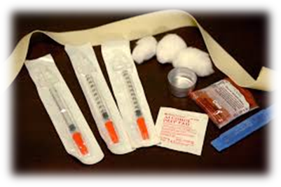
Reducing the Risk
NO RISK
Abstinence from Sex
Abstinence from Injection Drugs
Mutual Monogamy w/STI Negative Partner
REDUCED RISK
Protected Sex “Correctly and Consistently”
Fewer Sexual Partners
Never Sharing Needles or “Works”
Regular HIV/STI Testing
Oklahoma State Department of Health | STI 101 | 2022
Notes:
No Risk
Abstinence (sex): Not having any sexual contact. Someone can choose to abstain even if they have had sex before (are not a virgin). Abstinence can be chosen for any period of time (a day, a week, a month, a year, etc.)
Abstinence (drugs): Not using injection drugs.
Mutual Monogamy-When you and your sex partner are both STI/HIV free (have been tested), and you ONLY have sex with each other.
Reduced Risk
Protected Sex
Use a new condom (male, now called external, or female, now called internal, condom) CORRECTLY for every act of vaginal, anal and oral sex throughout the entire sex act (from start to finish).
Before any genital contact, put the condom on the tip of the erect penis with the rolled side out. (looks like a sombrero)
If the condom does not have a reservoir tip, pinch the tip enough to leave a half-inch space for semen to collect. Holding the tip, unroll the condom all the way to the base of the erect penis. (guiding any air bubble out)
After ejaculation and before the penis gets soft, grip the rim of the condom (at the base of the penis) and carefully withdraw the penis. Then gently pull the condom off the penis, making sure semen doesn't spill out.
Tie a knot on the open end of the condom and throw it in the trash. DO NOT FLUSH CONDOMS!
If you feel the condom break at any point during sexual activity, stop immediately, withdraw, remove the broken condom, and put on a new condom.
OTHER FORMS OF BIRTH CONTROL DO NOT PROTECT AGAINST HIV/AIDS OR ANY OTHER STIs! (is not a barrier)
Suggestion:
Sock video if condom application (w/ penis model) demonstration is not allowed.
https://www.youtube.com/watch?v=06kT9yfj7QE
Fewer sexual partners: The less number of people someone has sex with, the less chance of being exposed. If you have sex with 3 people, reduce that number to 2 people.
IF APPROPRIATE AUDIENCE:
Not sharing needles/”works”:
Works- the spoon, cotton ball, needle, syringe, etc. used while injecting and sharing the drugs.
Equipment used to inject drugs/steroids are NOT made to be reused.
The steps below are not 100% safe; but they can reduce the risk of HIV and HCV infection.
Only perform these steps if a new, sterile needle and syringe is not available. New sterile needles and syringes are safer than bleach-cleaned needles.
Clean used needles and syringes immediately following use and again just before the needle and syringe is re-used.
1. PRE-WASH:
Wash out the needle and syringe by flushing (at least 3 times) with clean water.
Use fresh water each time. After each time the needle and syringe is flushed, dispose of the water.
Shake and tap the syringe while it is filled with water.
By flushing the needle and syringe, you are potentially reducing the amount of blood in the syringe.
2. WASH:
Draw bleach into the syringe through the needle.
Completely fill the syringe, at least 3 times, with full strength bleach.
Use fresh bleach every time.
After each time the needle and syringe is flushed with bleach, dispose of the bleach.
Let the bleach stay in the syringe for at least 30 seconds.
Shake and tap the syringe while it is filled with bleach.
3. RINSE:
Draw clean water into the syringe through the needle. (Best is sterile saline)
Completely fill the syringe at least 3 times with clean water (sterile saline, if possible).
Use fresh water each time.
Shake and tap the syringe while it is filled with water.
Notes:
Bleach should not be diluted.
Sterile saline is the best water to use. (i.e. contacts lens saline solution)
Taking the syringe apart may improve cleaning.
Do not share other items such as cooker or cotton swabs.
Regular HIV/STI Testing
HIV:
Everyone aged 13 to 64 should get tested at least one time by their healthcare provider, regardless of their risk factors.
People who have occasional exposure to HIV risks should be tested at least once a year.
People who are at high risk for HIV should get tested every 3 to 6 months.
All pregnant women should be tested during the 1st trimester of pregnancy.
If at high risk for HIV: again in the 3rd trimester.
STIs:
Syphilis:
Are pregnant
Are a man who has sex with men
Exchange sex for money, drugs or other life needs
You have HIV or another STI
You’ve had sex with someone who tested positive for syphilis
http://healthfinder.gov/HealthTopics/Category/health-conditions-and-diseases/hiv-and-other-STIs/syphilis-testing-questions-for-the-doctor
Chlamydia & Gonorrhea:
For women:
If you are age 24 or younger and having sex, get tested once every year.
If you are age 25 or older, get tested if you have more than one sex partner or a new sex partner.
If you have had sex with someone who tested positive for chlamydia or gonorrhea.
For men:
Talk with a doctor about getting tested if you have had sex with someone who tested positive for chlamydia or gonorrhea.

Slide 26
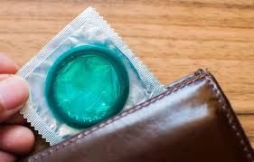
Incorrect External Condom Use 1
DO NOT:
Reuse a condom.
Use expired condoms.
Unroll the condom before putting it on the penis.
Leave condoms in hot or extreme cold places (wallet, car, etc.).
Oklahoma State Department of Health | STI 101 | 2022
Notes:
4-year study on HIV & condoms:
245 couples – one partner HIV+ and one HIV-
123 used a condom “correctly and consistently”
0 cases of HIV transmission
Note: Communication is key.
If keeping an erection while putting a condom on is challenging (very common problem).
Try new things with condom application so using a condom is not dreaded.
Make putting on the condom a part of foreplay and/or have your partner put the condom on for you, etc.

Slide 27
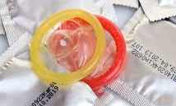
Incorrect External Condom Use 2
DO NOT:
Use oil-based products (oils, hand lotion or Vaseline) as lubricants with latex condoms.
Use your fingernails, scissors or teeth to open the wrapper.
Use more than one condom at a time, including an internal AND external condom (‘double wrapping’).
Oklahoma State Department of Health | STI 101 | 2022
Notes:
4-year study on HIV & condoms:
245 couples – one partner HIV+ and one HIV-
123 used a condom “correctly and consistently”
0 cases of HIV transmission
Note: Communication is key.
If keeping an erection while putting a condom on is challenging (very common problem).
Try new things with condom application so using a condom is not dreaded.
Make putting on the condom a part of foreplay and/or have your partner put the condom on for you, etc.

Slide 28
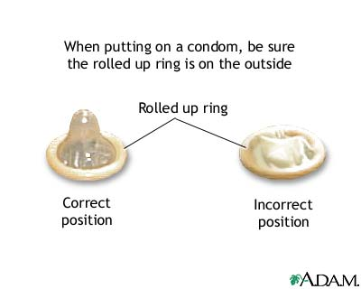
Correct External Condom Use
DO:
Keep condoms in a cool, dry place.
Put condom on an erect/hard penis before genital contact.
Hold the condom in place at the base of the penis before withdrawing (pulling out) after sex.
Throw the condom away after it has been used in the trash.
Use lubrication of Water-based or Silicone and apply as often as needed to reduce potential tears in the condom.
Oklahoma State Department of Health | STI 101 | 2022

Slide 29
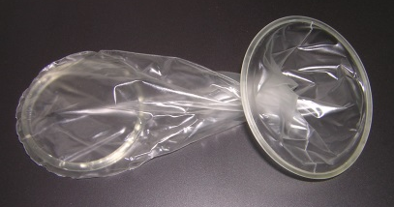
Internal (Female) Condom
Worn inside the vagina or anus
Thicker, more tear-resistant
Always latex-free
Wider opening covers more of the external area
Oklahoma State Department of Health | STI 101 | 2022
Notes:
Internal (Female) Condoms:
A pouch used during vaginal or anal intercourse to prevent pregnancy and reduce the risk of STIs (collects pre-cum and semen when a man ejaculates).
It has flexible polyurethane rings at each end. Before intercourse it is inserted into the vagina or anus.
The ring at the closed end holds the pouch inside the vagina.
For anal sex, remove this interior ring, if you so choose.
The ring at the open end stays outside the vaginal/anal opening during intercourse.
Note: Internal condoms may be worn for up to 8 hours before intercourse.
To insert an internal condom into the vagina:
1. Put lubricant on the outside of the closed end.
2. Find a comfortable position. You can stand with one foot on a chair, sit on the edge of a chair, lie down, or squat.
3. Squeeze together the sides of the inner ring at the closed end of the condom and insert it into the vagina like a tampon.
4. Push the inner ring into the vagina as far as it can go — it will rest against the cervix. If you are unable to place it against the cervix, your partner may be able to help.
5. Pull out your fingers and let the outer ring hang about an inch outside the vaginal opening.
To insert an internal condom into the anus/rectum:
1. Remove the inner ring and place the condom on the penis.
2. Put plenty of lubricant on the outside of the condom.
3. After insertion, ensure the outer ring hangs about an inch outside the anal opening.
4. Ensure the penis and/or the inside of the condom is well lubricated to prevent the condom from moving.
To remove an internal condom:
1. Squeeze and twist the outer ring to keep semen inside the pouch.
2. Gently pull it out of the vagina or anus.
3. Throw it away in trash. Do not flush it down the toilet.
When used correctly all of the time, internal condoms are 95% effective.
Where to get internal condoms:
Possibly online at https://fc2.us.com/how-to-find/
Community Based Organizations or Health Centers
Sexual Health and Harm Reduction Service

Slide 30
Dental Dams
Thin, square pieces of latex
Used for oral sex (NOT on a penis)
Could make your own dental dam (from a condom, latex glove, or non-microwavable plastic wrap)
Oklahoma State Department of Health | STI 101 | 2022
Notes:
Dental Dams:
Dental dams are small, thin, square pieces of latex that are used for oral-vaginal or oral-anal sex.
They get their name from their use in dental procedures.
Dental dams prevent STIs during oral sex by keeping vaginal and anal fluids that may contain bacteria and viruses away from the mouth.
They come in a variety of sizes and flavors.
When using the dental dam, be sure to ONLY use One side. Don't flip the dam over for another round because you will expose yourself to the very fluids you're trying to avoid.
Do not re-use a dam on another body part (e.g. from anus to vulva or vice-versa) because you can transfer bacteria or viruses from one body area to another.
Do not re-use a dam for another act of oral sex later either. Dental Dams are for one-time use only.
Note:
If you don’t have a dental dam you can make one out of an external or internal condom, latex glove, or non-microwavable plastic wrap.
To make a dental dam out of a condom, simply cut off the tip and cut down one side.
To make a dental dam out of a latex glove, cut off the finger and cut down one side.
If using plastic wrap, it is important that it be non-microwavable because the pores in microwaveable plastic wrap are large enough to allow viruses and bacteria to pass through.
Where to buy dental dams:
Some drugstores
Sexual health centers
Online
Adult Stores (18+)

Slide 31
Get Tested!
HIV
Everyone aged 13 through 64 should get tested at least once
People who have occasional exposure to HIV risks at least once a year
People who are at high risk for HIV infection 3-6 months
Syphilis
If you are pregnant
Man who has sex with other men (MSM)
Have sex for drugs or money
Have HIV or another STD
Had sex with someone who tested positive for syphilis
Chlamydia & Gonorrhea
Age 24 or younger having sex get tested once every year
Age 25 or older and more than one sex partner or with a new sex partner
Talk with a doctor about getting tested if you have had sex with someone who tested positive for chlamydia or gonorrhea.
Notes:
HIV:
Everyone aged 13 through 64 should get tested one time, regardless of their risk factors.
People who have occasional exposure to HIV risks should be tested at least once a year.
People who are at high risk for HIV infection should get tested every 3 to 6 months.
All pregnant women should be tested during the 1st trimester of pregnancy.
If at high risk for HIV: again in the 3rd trimester.
Syphilis:
Get tested for syphilis if you:
Are pregnant
Are a man who has sex with men
Have sex for drugs or money
You have HIV or another STD
You’ve had sex with someone who tested positive for syphilis
Chlamydia & Gonorrhea:
For women:
If you are age 24 or younger and having sex, get tested once every year.
If you are age 25 or older, get tested if you have more than one sex partner or a new sex partner.
If you have had sex with someone who tested positive for chlamydia or gonorrhea.
For men:
Talk with a doctor about getting tested if you have had sex with someone who tested positive for chlamydia or gonorrhea.
Note: Don't let embarrassment at the thought of having an STD keep you from seeking medical attention. Waiting to see a doctor may allow a disease to progress and cause more damage. If you think you may have an STD, or if you have had a partner who may have an STD, you should see a doctor right away.

Slide 32
Where to Get Tested?
https://gettested.cdc.gov
www.stdcheck.com
www.gytnow.org
Community-Based Organizations
Local
Health Departments
www.health.ok.gov
Oklahoma State Department of Health | STI 101 | 2022

Slide 33
Resources
www.cdc.gov
www.health.ok.gov
www.hiv.gov
www.healthfinder.gov
www.plannedparenthood.org
www.gytnow.org
www.stophiv.org
www.iwannaknow.org
Oklahoma HIV/AIDS Hotline: 1-800-535-2437
Oklahoma State Department of Health | STI 101 | 2022
Notes:
NOTE: It is important you use truthful and reliable resources when searching for health information.
Government health sites like CDC, or health departments are always a good place to start.

Slide 34
Questions?
HIV/STI
HIV/STI
Oklahoma State Department of Health | STI 101 | 2022

