Slide 1
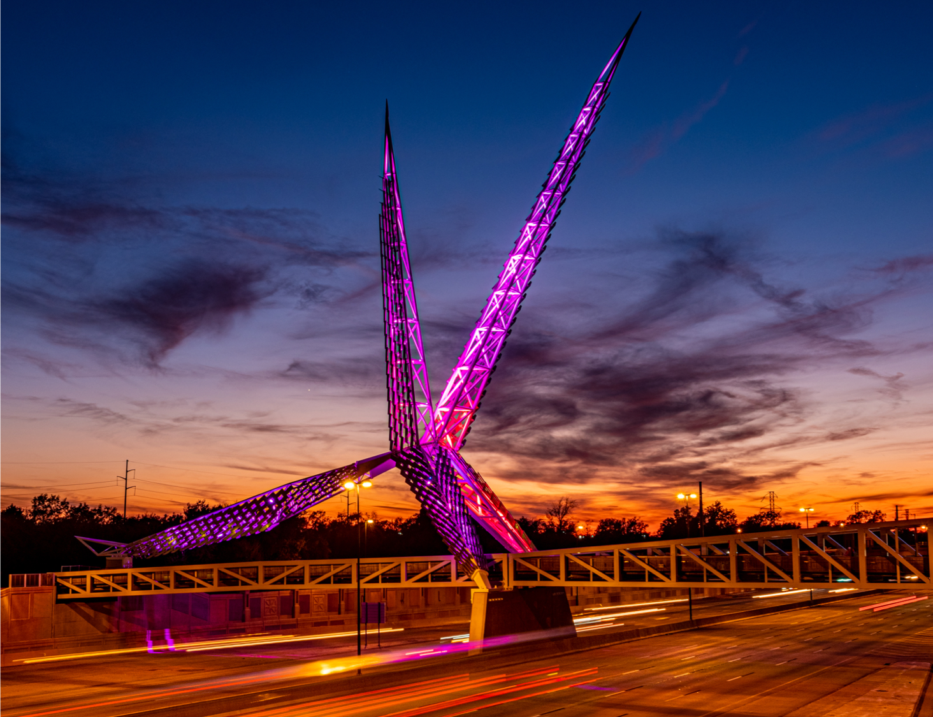
Welcome
Call to Order
Notes:
Welcoming AC team and quest
AC members and quest must sign in per the attendance sheet
Provide team with any Handout material

Slide 2
Preventive Health and Health Services (PHHS) Block Grant (BG)
Advisory Committee Meeting
2:00 pm
March 05, 2025
To learn more about the PHHSBG, please visit our SharePoint page or public webpage.
Notes:
Let Chair-person know the meeting can start- Call to Order
Thank you joining the March’s AC meeting

Slide 3
Agenda
Call to Order
Welcome and Introductions
Review and Approval of the Meeting Minutes
APR Success Stories
FY24 PHHS Block Grant Budget Spend-down Update
and Budget Revision Requests
FY25 Proposal Requests, Evaluations
and Funding Recommendations
Advisory Committee Meeting Dates
Closing Remarks and Adjournment
Oklahoma State Department of Health | Preventive Health and Health Services Block Grant | 2025
Notes:
Chair-person - has called to order the meeting;
document or note the time start time
Today’s agenda:
Call to Order
Welcome and Introductions
Review and Approval of the Meeting Minutes from Dec2024
Interim APR’s Success Stories
FY24 Block Grant Budget Spend-down Update
and Budget Revision Requests
FY25 Proposal Requests, Evaluations
and Funding Recommendations
Advisory Committee Meeting Dates
Closing Remarks and Adjournment
NOTE* If less than 4 board members are there, won't have a quorum. Can still have meeting if they want but cannot vote on anything.

Slide 4
Advisory Committee
and
Introductions
Notes:
Round robin for intro’s – provide your name and work title- starting with me, the Block Grant Coordinator, Solina

Slide 5
Review and Approval - Meeting Minutes
Notes:
Chair will ask if there is discussion on the minutes.
If not, chair will ask if there is a motion to approve minutes.
Note who motions and who seconds approval. Go around – to AC members and ensure each one either say 'yay' or 'nae' and note that.
If there is a discussion and minutes not approved, will table to approve at next meeting and just note it. Or can motion to approve with changes.

Slide 6
Success Stories:
Fluoride program has dispensed 324 children’s toothbrushes to county health departments.
CATCH program has provided 9 rural and low-income after school programs education training that has increased MVPA in an out of schools setting.
Go NAPSACC has increased the community’s interest in the program, that has resulted in an increased the number of consultants across Oklahoma providing technical assistance to the early childcare centers.
A new monthly Go NAPSACC newsletter is now in circulation for participants.
Collaboration fluoride program has increased access to preventive oral health measures to children at risk
Notes:
Success stories shared per the FY24 Interim report
Fluoride program dispensed 324 children’s toothbrushes to county health departments
CATCH program provided 9 rural and low-income after school programs- education training that has increased MVPA in an out of schools setting.
GoNapsacc has a monthly newsletter in circulation and has increased the community’s interest in the program which resulted in an increase in number of consultants providing TA

Slide 7
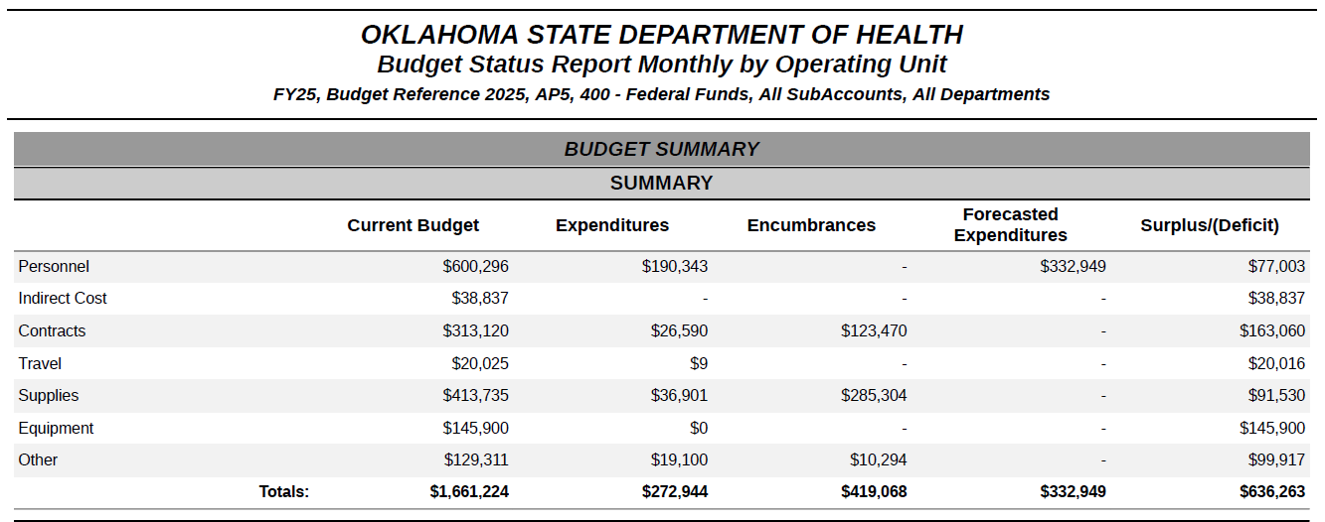
FFY25PHHS Block Grant Budget Spend-down Update
Notes:
Feb2025 BSR Summary This is the PHHS Block Grant combined summary roughly $636,000 and the program recipients' budget (actual or real-time) will be shared at the end.

Slide 8
Budget Revision Requests
No current revisions requested
Notes:
At this time there are No current revisions request.
There will be Three Spenddown reviews will be conducted
Feb and March 2025 - for Oct, Nov, Dec Jan
May 2025 - for Feb, March April
Late-July 2025 for May, June, mid-July to ensure encumbrance and surplus are forecasted
Budget revisions;
starting in April, the plan is to confirm by June 2025….and Finalize by late July any potential funding surplus . This funds will be disseminated to current existing program that are on the WISH-list

Slide 9
Notes:
Open for questions at this time.

Slide 10
FY25- FFY2026
Proposal Requests
and Evaluations
Notes:
During the Application/Proposal meeting on Feb 28, 2025 everyone in attendance had the opportunity to get a brief overview of the PHHS BG application program goals. Per today’s slides will provide a snapshot of the application that entails their program strategies

Slide 11
Enhancing Access & Promoting Wellness Initiative
Budget Request: $300,000 – Enhance or expand FTEs: 3 existing staff Other: Supplies/ IT/travel
Healthy People 2030:Decrease the proportion of adults who report poor communication with their health care provider — HC/HIT-02
Program Goal:
The goal of the program is to improve communication between health care providers and patients in Oklahoma, reducing the proportion of adults reporting poor communication.
Notes:
Enhancing Access & Promoting Wellness Initiative
Budget Request: $300,000 – Enhance or expand FTEs: 3 existing staff Other: Supplies/ IT/travel
H P 2030: to decrease the proportion of adults who report poor communication with their health care provider — HC/HIT-02
Program Goal:
Is to improve communication between health care providers and patients in Oklahoma, reducing the proportion of adults reporting poor communication.

Slide 12
Enhancing Access & Promoting Telehealth Wellness
Budget Request: $300,000 – Enhance or expand FTEs: 3 existing staff Other: Supplies/ IT/travel
Healthy People 2030: Increase the use of telehealth to improve access to health services - AHS - R02
Program Goal:
The program goal is to utilize existing staff to provide training, resources and collaborative efforts with CHDs, healthcare providers, and businesses to increase the use of telehealth services to improve health outcome by reducing travel and costs to access healthcare for Oklahomans.
Notes:
Enhancing Access & Promoting Telehealth Wellness
Budget Request: $300,000 – Enhance or expand FTEs: 3 existing staff Other: Supplies/ IT/travel
HP 2030: Increase the use of telehealth to improve access to health services - AHS - R02
Program Goal:
Is to utilize existing staff to provide training, resources and collaborative efforts with CHDs, healthcare providers, and businesses to increase the use of telehealth services to improve health outcome by reducing travel and costs to access healthcare for Oklahomans

Slide 13
Increasing Nutrition Security in CHDs Statewide Partners
Budget Request: $119,314 – Enhance or expand FTEs: 1 existing staff Other: Supplies/ IT/ Travel/Contractual
Healthy People 2030: Reduce household food insecurity and hunger – NWS01
Program Goal:
To partner with the two Feeding America associated food banks that serve Oklahoma to reduce food insecurity and health disparities throughout the state.
Notes:
Nutrition Security Budget Request: $119,314 – Enhance or expand FTEs: 1 existing staff Other: Supplies/ IT/ Travel/Contractual
HP 2030: To Reduce household food insecurity and hunger – NWS01
Program Goal:
To partner with the two Feeding America associated food banks that serve Oklahoma to reduce food insecurity and health disparities throughout the state.

Slide 14
Community Engagement & Partnership Community of Practice Training
Budget Request: $27,000 – Enhance or expand FTEs: 0 existing staff
Other: Supplies/ Travel / Contractual
Healthy People 2030: Increase the number of community organizations that provide prevention services — ECBP D07
Program Goal:
The program goal is to strengthen prevention services in Oklahoma by expanding comprehensive training opportunities for internal and external partners by 50% between October 1, 2025, and September 31, 2026.
Notes:
Community Engagement & Partnership Community of Practice Training
Budget Request: $27,000 – Enhance or expand FTEs: 0 existing staff
Other: Supplies/ Travel / Contractual
HP 2030: Increase the number of community organizations that provide prevention services — ECBP D07
Program Goal:
Is to strengthen prevention services in Oklahoma by expanding comprehensive training opportunities for internal and external partners by 50% between October 1, 2025, and September 31, 2026.

Slide 15
Oral Health Outreach Project
Budget Request: $50,200 – Enhance or expand FTEs: 0 Other: Supplies
Healthy People 2030: Increased use of oral health care system-OH-08
Program Goal:
The goal of this program is to increase access to dental caries prevention programs and increase the proportion of children, adolescents, and adults who use the oral health system.
Notes:
Oral Health Outreach Project
Budget Request: $50,200 – Enhance or expand FTEs: 0 Other: Supplies
HP 2030: to Increased use of oral health care system-OH-08
Program Goal:
Is to increase access to dental caries prevention programs and increase the proportion of children, adolescents, and adults who use the oral health system.

Slide 16
Partner-Inflicted Brain Injury Training & Surveillance
Budget Request: $72,504 – Maintain existing (as is) FTEs: 1 existing staff Other: Supplies/ IT/ Travel /Contractual
Healthy People 2030: Reduce intimate partner violence – IVP D04
Program Goal:
Increase awareness of and accommodations and resources for partner-inflicted brain injury among domestic violence service providers and allied professionals; implement surveillance of adverse childhood experiences to enhance the understanding of the connection between ACEs and intimate partner violence in Oklahoma.
Notes:
Partner-Inflicted Brain Injury Training & Surveillance
Budget Request: $72,504 – Maintain existing (as is) FTEs: 1 existing staff Other: Supplies/ IT/ Travel /Contractual
HP2030: Reduce intimate partner violence – IVP D04
Program Goal:
To Increase awareness of and accommodations and resources for partner-inflicted brain injury among domestic violence service providers and allied professionals. Implement surveillance of adverse childhood experiences to enhance the understanding of the connection between ACEs and intimate partner violence in Oklahoma.

Slide 17
A Way to Wellness +
Budget Request: $43,478 – Start up FTEs: 0 Other: Supplies / Travel
Healthy People 2030: Reduce the proportion of adults with high blood pressure - HDS-04
Program Goal:
To reduce 3-5% body fat over and eight-week period by implementing healthy choices for participants.
Notes:
A Way to Wellness
Budget Request: $43,478 – Start up FTEs: 0 Other: Supplies / Travel
Healthy People 2030: Reduce the proportion of adults with high blood pressure - HDS-04
Program Goal:
To reduce 3-5% body fat over and eight-week period by implementing healthy choices for participants.

Slide 18
Suicide Prevention & Surveillance
Budget Request: $136,018 – Enhance or expand FTEs: 1 existing staff Other: Supplies/ IT/ Travel
Healthy People 2030: Reduce the suicide rate – MHMD 01
Program Goal:
The IPS will use the project period to continue building capacity for suicide prevention across the state that is aligned with the 2024 National Strategy for Suicide Prevention, with an added focus on the older adult population, and enhance existing suicide surveillance with data on adverse childhood experiences and suicide attempts and ideation through the Behavioral Risk Factor Surveillance System (BRFSS).
Notes:
Suicide Prevention & Surveillance
Budget Request: $136,018 – Enhance or expand FTEs: 1 existing staff Other: Supplies/ IT/ Travel
Healthy People 2030: Reduce the suicide rate – MHMD 01
Program Goal:
The IPS will use the project period to continue building capacity for suicide prevention across the state that is aligned with the 2024 National Strategy for Suicide Prevention, with an added focus on the older adult population, and enhance existing suicide surveillance with data on adverse childhood experiences and suicide attempts and ideation through the Behavioral Risk Factor Surveillance System (BRFSS).

Slide 19
Healthy Aging and Injury Prevention
Budget Request: $218,114 – Enhance or expand FTEs: 3 existing staff Other: Supplies/ IT/ Travel
Healthy People 2030: Reduce fall-related deaths among older adults – IVP-08
Program Goal:
Engage state and community partners across sectors to implement strategies to reduce the number of falls leading to injury death, promote healthy aging, and improve health outcomes among persons 65 years and older statewide.
Notes:
Aging and Injury Prevention
Budget Request: $218,114 – Enhance or expand FTEs: 3 existing staff Other: Supplies/ IT/ Travel
Healthy People 2030: Reduce fall-related deaths among older adults – IVP-08
Program Goal:
Engage state and community partners across sectors to implement strategies to reduce the number of falls leading to injury death, promote healthy aging, and improve health outcomes among persons 65 years and older statewide.

Slide 20
Sexual Assault Training & Surveillance
Budget Request: $80,575 (82,656)– Start up FTEs: 0 existing staff Other: Supplies/ ACEs Questions / Contractual
Healthy People 2030: Reduce contact sexual violence — IVP D05
Program Goal:
The IPS will collaborate with the OSDH Nursing Service and public health nurses across the state to implement and conduct training related to the topic of sexual violence in Oklahoma; implement surveillance of adverse childhood experiences (ACEs) to enhance the understanding of the connection between ACEs and sexual violence in Oklahoma.
Notes:
Sexual Assault Training & Surveillance
Budget Request: $80,575 but PHHS block GRANT SETASIDE TOTAL IS (82,656)– Start up FTEs: 0 existing staff Other: Supplies/ ACEs Questions / Contractual
Healthy People 2030: Reduce contact sexual violence — IVP D05
Program Goal:
The IPS will collaborate with the OSDH Nursing Service and public health nurses across the state to implement and conduct training related to the topic of sexual violence in Oklahoma; implement surveillance of adverse childhood experiences (ACEs) to enhance the understanding of the connection between ACEs and sexual violence in Oklahoma.

Slide 21
OSDH PHL -Microbiology Department Enteric Culture Initiative
Budget Request: $299,979 – Maintain existing FTEs: 5 existing staff Other: Supplies/ IT/ Travel / Contractual
Healthy People 2030: Reduce infections caused by Shiga toxin-producing E. coli - FS-02
Program Goal:
The OSDH PHL Microbiology department will reduce infections caused by Shiga toxin-producing E.coli by utilizing sequencing information from isolates submitted to and clinical samples isolated by the laboratory to identify outbreaks, so that appropriate action can be taken to identify and eliminate the source of the outbreak.
Notes:
OSDH PHL -Microbiology Department Enteric Culture Initiative
Budget Request: $299,979 – Maintain existing FTEs: 5 existing staff Other: Supplies/ IT/ Travel / Contractual
Healthy People 2030: Reduce infections caused by Shiga toxin-producing E. coli - FS-02
Program Goal:
The OSDH PHL Microbiology department will reduce infections caused by Shiga toxin-producing E. coli by utilizing sequencing information from isolates submitted to and clinical samples isolated by the laboratory to identify outbreaks, so that appropriate action can be taken to identify and eliminate the source of the outbreak.

Slide 22
Child Passenger Safety Program
Budget Request: $299,980 – Maintain existing FTEs: 0 Other: Supplies
Healthy People 2030: Reduce the proportion of deaths of car passengers who weren't buckled in — IVP‑07
Program Goal:
Distribute an average of 300 child safety seats monthly to participating sites statewide.
Notes:
Child Passenger Safety Program
Budget Request: $299980 – Maintain existing FTEs: 0 Other: Supplies
Healthy People 2030: To Reduce the proportion of deaths of car passengers who weren't buckled in — IVP‑07
Program Goal:
Distribute an average of 300 child safety seats monthly to participating sites statewide.

Slide 23
OSDH PHL - Molecular Department Enteric Screening Initiative
Budget Request: $299,987 – Maintain existing FTEs: 2 existing staff
Other: Supplies
Healthy People 2030: Reduce infections caused by Salmonella - FS-04
Program Goal:
The OSDH PHL Molecular Department aims to reduce the number of infections by Salmonella utilizing PCR screening of stool specimen submitted for testing to quickly detect potential outbreaks and to inform patient management and contact investigations.
Notes:
OSDH PHL - Molecular Department Enteric Screening Initiative
Budget Request: $299,987 – Maintain existing FTEs: 2 existing staff
Other: Supplies
Healthy People 2030: Reduce infections caused by Salmonella - FS-04
Program Goal:
The OSDH PHL Molecular Department aims to reduce the number of infections by Salmonella utilizing PCR screening of stool specimen submitted for testing to quickly detect potential outbreaks and to inform patient management and contact investigations.

Slide 24
OSDH PHL - TB/Mycology Department
Budget Request: $ 299,929– Maintain existing program (as is) FTEs: 5 existing staff Other: Supplies/ IT/ Travel /Contractual
Healthy People 2030: Reduce tuberculosis cases - IID-17
Program Goal:
The OSDH PHL TB/Mycology Department will reduce tuberculosis cases by decreasing the average time between specimen submission and result reporting for specimens sent for acid-fast smear and culture, so that the results can be used to inform patient management and contact investigations to contain and prevent potential outbreaks.
Notes:
OSDH PHL - TB/Mycology Department
Budget Request: $ 299,929– Maintain existing program (as is) FTEs: 5 existing staff Other: Supplies/ IT/ Travel /Contractual
Healthy People 2030: Reduce tuberculosis cases - IID-17
Program Goal:
The OSDH PHL TB/Mycology Department will reduce tuberculosis cases by decreasing the average time between specimen submission and result reporting for specimens sent for acid-fast smear and culture, so that the results can be used to inform patient management and contact investigations to contain and prevent potential outbreaks.

Slide 25
OSDH PHL - Sexual Transmitted Infections (STI) Department HIV Testing Initiative
Budget Request: $300,000 – Maintain existing program (as is) FTEs: 5 existing staff Other: Supplies/ IT /Contractual
Healthy People 2030: Increase knowledge of HIV status- HIV-02
Program Goal:
The OSDH PHL STI Department will achieve at least a rate of 95% meets turn-around time for HIV specimens between 10/2025 to 09/2026.
Notes:
Budget Request: $300,000 – Maintain existing program (as is) FTEs: 5 existing staff Other: Supplies/ IT /Contractual
Healthy People 2030: Increase knowledge of HIV status- HIV-02
Program Goal:
The OSDH PHL STI Department will achieve at least a rate of 95% meets turn-around time for HIV specimens between 10/2025 to 09/2026.

Slide 26
Improving School Health Statewide
Budget Request: $69,657 – Enhance or expand FTEs: 1 existing staff
Other: Supplies/ IT/ Travel /Contractual
Healthy People 2030: Reduce the proportion of children and adolescents with obesity — NWS 04
Program Goal:
The program goal would be to provide technical assistance to 30 schools across the State of Oklahoma.
Notes:
Improving School Health Statewide
Budget Request: $69,657 – Enhance or expand FTEs: 1 existing staff
Other: Supplies/ IT/ Travel /Contractual
Healthy People 2030: Reduce the proportion of children and adolescents with obesity — NWS 04
Program Goal:
The program goal would be to provide technical assistance to 30 schools across the State of Oklahoma.

Slide 27
Go NAPSACC Technical Assistance
Budget Request: $60,364 – Enhance or expand FTEs: 1 existing staff Other: Supplies/ IT/ Travel
Healthy People 2030: Reduce the proportion of children and adolescents with obesity — NWS 04
Program Goal:
The program goal would be to increase by 10 the number of childcare providers making a policy, practice, or environmental change.
Notes:
Go NAPSACC Technical Assistance
Budget Request: $60,364 – Enhance or expand FTEs: 1 existing staff Other: Supplies/ IT/ Travel
Healthy People 2030: Reduce the proportion of children and adolescents with obesity — NWS 04
Program Goal:
The program goal would be to increase by 10 the number of childcare providers making a policy, practice, or environmental change.

Slide 28
Certified Healthy Oklahoma Statewide Technical Assistance
Budget Request: $70,630 – Enhance or expand FTEs: 2 existing staff Other: Supplies/ IT/ Travel
Healthy People 2030: Reduce the proportion of adults with obesity- NWS03
Program Goal:
The program goal is to increase awareness and technical assistance for Certified Healthy Oklahoma, including businesses, campuses, communities, congregations, early childhood programs, and schools.
Notes:
Certified Healthy Oklahoma Statewide Technical Assistance –CHO
Budget Request: $70,630 – Enhance or expand FTEs: 2 existing staff Other: Supplies/ IT/ Travel
Healthy People 2030: Reduce the proportion of adults with obesity- NWS03
Program Goal:
The program goal is to increase awareness and technical assistance for Certified Healthy Oklahoma, including businesses, campuses, communities, congregations, early childhood programs, and schools.

Slide 29
Oklahoma CHW Training Program: Building a Unified & Sustainable Workforce
Budget Request: $297,598 – Enhance or expand FTEs: 3 existing staff Other: Supplies/ IT/ Travel /Contractual
Healthy People 2030: Increase the proportion of local public health agencies that use core competencies in continuing education - PHI 07
Program Goal:
The goal of the program is to develop a standardized Community Health Worker (CHW) curriculum alongside CHWs and subject matter experts.
Notes:
Oklahoma Community Health Workers Training Program: Building a Unified & Sustainable Workforce
Budget Request: $297,598 – Enhance or expand FTEs: 3 existing staff Other: Supplies/ IT/ Travel /Contractual
Healthy People 2030: Increase the proportion of local public health agencies that use core competencies in continuing education - PHI 07
Program Goal:
The goal of the program is to develop a standardized Community Health Worker (CHW) curriculum alongside CHWs and subject matter experts.

Slide 30
Northeastern Oklahoma CATCH Coordinated Health Initiative
Budget Request: $60,364 – Enhance or expand FTEs: 4 existing staff
Other: Supplies/ IT / Equipment
Healthy People 2030: Increase the proportion of children who do enough aerobic physical activity - PA-09
Program Goal:
The goal of the Northeastern Oklahoma CATCH Coordinated Health Initiative, is to increase the amount of rural and low-income children who attend daycare in District 4 participating in an evidence based physical activity and exercise CATCH Kids Club program.
Notes:
Northeastern Oklahoma CATCH Coordinated Health Initiative
Budget Request: $60,364 – Enhance or expand FTEs: 4 existing staff
Other: Supplies/ IT / Equipment
Healthy People 2030: Increase the proportion of children who do enough aerobic physical activity - PA-09
Program Goal:
The goal of the Northeastern Oklahoma CATCH Coordinated Health Initiative, is to increase the amount of rural and low-income children who attend daycare in District 4 participating in an evidence based physical activity and exercise CATCH Kids Club program.

Slide 31
Southcentral Oklahoma Healthy Youth Initiative
Budget Request: $23,927 – Enhance or expand FTEs: 0 Other: Supplies/ Contractual
Healthy People 2030: Reduce the proportion of children and adolescents with obesity – NWS-04. Increase the proportion of children who do enough aerobic physical activity - PA-09
Program Goal:
The goal of the Southcentral Oklahoma Healthy Youth Initiative is to increase the number of rural and low-income children pre-K – 12 grades who receive evidence-based nutritional, physical, social and emotional education that incorporates physically skilled based activities.
Notes:
Final applicant----
Southcentral Oklahoma Healthy Youth Initiative
Budget Request: $23,927 – Enhance or expand FTEs: 0 Other: Supplies/ Contractual
Healthy People 2030: Reduce the proportion of children and adolescents with obesity – NWS-04. Increase the proportion of children who do enough aerobic physical activity - PA-09
Program Goal:
The goal of the Southcentral Oklahoma Healthy Youth Initiative is to increase the number of rural and low-income children pre-K – 12 grades who receive evidence-based nutritional, physical, social and emotional education that incorporates physically skilled based activities.

Slide 32
Notes:
Open for questions at this time
Just completed the FY25 – AP6 WP and budget application material
5 min Break before discussion of the budget recommendations.

Slide 33
AP6
Discussion
Funding Recommendations
Notes:
During the Application/Proposal meeting on Feb 2025 everyone in attendance had the opportunity to get a brief overview of the PHHS BG application process and evaluation tool.
To expedite this meeting the Proposal evaluation Proposal Evaluation forms were sent via email for ranking and to be discussed today during the March’s AC meeting to identify the Block Grant awardees for FFY26.
Next step is the Proposal evaluation scores and funding recommendations.
DEMO the excel files

Slide 34
Evaluation Scoring Document
Notes:
This is also a snapshot of the Evaluation scoring document
Complete the form and the highlighted sections. Questions 1-2, Questions 3-8, and add comments on the bottom portion of the form, also question number. Strikethrough for Q3 . Form being revised per EO
AC instructed to recuse themselves if the manager a program(s)
DEMO at the end

Slide 35
Funding Recommendations
Notes:
Evaluation and scoring – timeline was extended from 3/3/2025 to 3/10/2025, due to Office closures (weather) and or mitigating circumstances. Upon receipt of all the forms, I will share this information. Office closures delayed the timeline.
Review and discuss this document with the AC team.
Due to the inclement weather and office closures- We extended the submission of the funding recommendation until 3/10/2025 EOD.
I will conduct a special meeting if required or a TEAMs meeting to finalize the funding totals and program awardees.

Slide 36
2025 PHHS Block Grant Advisory Committee Dates
April 2025
Funding recommendation
May 07, 2025 @ 2:00pm
Public Hearing of the FY25 Work Plans & Budgets
December 03, 2025 @ 2:00pm
FY25 Work Plan Update
Final APR FY25 Update
Notes:
April funding recommendations
May 7 Public Hearing
Dec 3, AC meeting

Slide 37
Notes:
Questions

Slide 38
Next steps:
Funding recommendations:
April 2025
Public Hearing: Proposal Request
May 7, 2025
Budget Revision:
May-June 2025
Advisory Committee Meetings:
December 3, 2025
To learn more about the PHHSBG, please visit our SharePoint page or public webpage.
Notes:
Funding recommendations: April 2025 or March 2025 if no special meeting is required.
Public Hearing: Proposal Request May 7, 2025
Budget Revision: May-June 2025
Advisory Committee Meetings: December 3, 2025
The proposals will be exported to an excel spread sheet, were be discussed via a TEAMs meeting in February 2025 (virtual option only). excel spread sheet
The Evaluation tool was sent via email for ranking /score the application, after scoring and ranking of the applications/proposals discussed during the AC meeting in March to identify the Block Grant awardees for FY25 will be addressed.
The proposal request forms, and the budget justifications are due no later than February 10, 2025. The proposal request and budget justification will also be available on Health Hub, and on the Prevent Block SharePoint site
Office hours are
January 9, 2025 at 10:00 am,
January 24, 2025 at 1:00 pm and
February 7, 2025 at 10:00 am.

Slide 39
Closing Remarks and Adjournment
Notes:
Closing remarks –
Chair to call the meeting to end and note the time.

Slide 40
To learn more about the PHHSBG, please visit our SharePoint page or public webpage.
Notes:
Any additional Questions at this point

