Slide 1
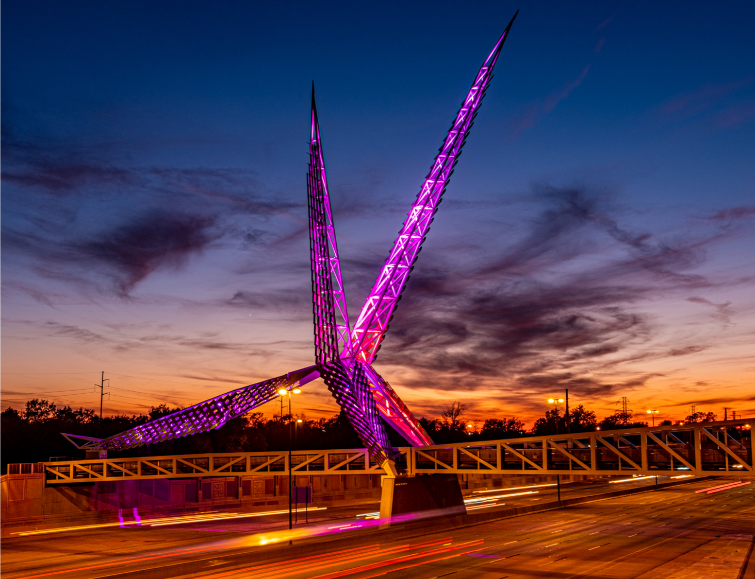

Welcome
To learn more about the PHHSBG, please visit
our SharePoint page or public webpage.
Notes:
Welcoming AC team
AC members and quest must sign in per the attendance sheet
Provide team with any Handout material

Slide 2

Preventive Health and Health Services (PHHS) Block Grant (BG)
Advisory Committee Meeting
2:00 pm
December 11, 2024
Notes:
Let Chair-person know the meeting can start- Call to Order
Thank you joining the first AC meeting for the FY24 workplan and FFY25 budget project period

Slide 3

Agenda
Call to Order
Welcome and Introductions
Grant Deliverables
FY23 Final Annual Progress Report (APR) Success Stories
FY23 Program Budget Summary Spend-down update and Budget Revision
~~~
FY24 Work Plan Updates, Budget summary and Revisions
Year 2025 Advisory Committee Meeting Dates
Closing Remarks, Q&A and Adjournment
Oklahoma State Department of Health | Preventive Health and Health Services Block Grant | 2024
Notes:
Chair-person - has called to order the meeting;
document or note the time start time
Today’s agenda:
Welcome and Intro – round robin
Recap the PHHSBG- Grant deliverables
Review FY23 final APR, success stories and
FY23 program budget spenddowns
Per the FY24 Workplan, I will discuss the program goal and Budgets
Address The next AC Meeting Dates
Questions, closing remarks
NOTE* If less than 4 board members are there, won't have a quorum. Can still have meeting if they want but cannot vote on anything.

Slide 4

Advisory Committee
and
Introductions
Notes:
Round robin for intro’s – provide your name and work title- starting with me, the Block Grant Coordinator, Solina

Slide 5
PHHS Block Grant Deliverables
Interim Annual Performance Report (APR) and Success stories
Final Performance Report (APR)
Budget and/or Program Workplan Revision
Oklahoma State Department of Health | Preventive Health and Health Services Block Grant | 2024
Notes:
Just as a refresher and to recap, the following is a list of the block grant deliverables from the Kick-off meeting in Sept 2024.
During the meeting- AC members will be provided program information which include the challenges, successes, and progress of the program’s workplan goals and activities.
And will also be allowed to review and/or approval budgets or workplan revisions as required - deliverables for the grant

Slide 6

FY23 APR
Success Stories and Final Progress Summary
Report
Oklahoma State Department of Health | Preventive Health and Health Services Block Grant | 2024
Oklahoma State Department of Health | Preventive Health and Health Services Block Oklahoma State Department of Health | Preventive Health and Health Services Block Grant | 2024
Grant | 2024
Notes:
FY23 Grant project period begun on the state fiscal year- SFY which was (July 1 of 2023 – Sept 30 2024)
This next section will cover the FY23 programs- APR success stories, final progress summary- objectives and activities that were met or not met
I will refer to the FY23 Grant project period as AP4 per the next slides

Slide 7

FY23 Success stories
AP4 Programs:
Successful births- Doula Services
ESL equipped residents with English language skills to effectively communicate with their healthcare providers about their care
CATCH provided 13 rural and low-income schools in D4 with new physical education equipment.
Increased access to Oral Health measures for Oklahoma’s children at risk. With a 53% outreach increase in the CHDs.
Notes:
Program success stories: Just to name a few
Healthy Aging & Fall prevention- provided education with their community partner OKCares and conducted ‘A Matter of Balance” training sessions
OMHHE Minority Health – provided ongoing resources and interpretive services to the community
Birth Partner- provided Doula services that resulted in successful birth
CATCH provided D4 rural and low- income schools with physical education equipment
Fluoride had an increase of 53% to oral health measures in the CHDs and local area
ESL provided English language skills
GoNAPSacc- has successful enrollment into community programs to reduce obesity (children and adolescents)
CPS - had a distribution car/booster seats statewide.

Slide 8
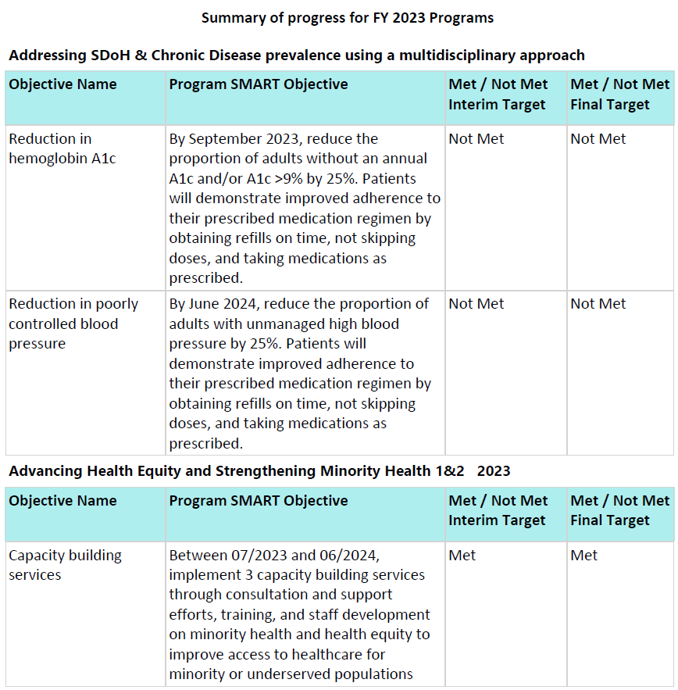
AP4 Program Final Progress Summary:
Goals
Met or
Not Met
Notes:
The following next slide will display the FY23 program reporting progress summary, it reflects which program recipients achieve the work plan interim and final goals & activities
This Summary contained a list of the 15 program recipients that were initially awarded BG funding in May 2023- the FY23 PHHS BG project year, one program returned their funds in July 2023, that resulted in only 14 programs
Starting with Chronic Disease I will provide an explanation of why programs did not meet their target objectives
Addressing SDoH & Chronic Disease prevalence using a multidisciplinary approach-
The program returned funding; personnel challenges, staff shortage and was unable to complete the
PHHS BG workplan.
Advancing Health Equity and Strengthening Minority Health 1&2 2023 - met

Slide 9
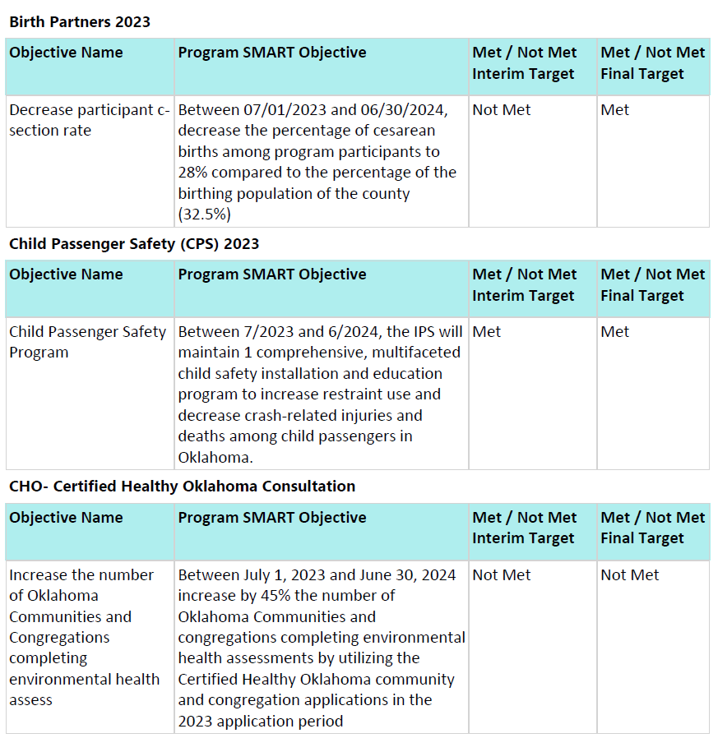
AP4 Program Progress
Notes:
Birth Partner- 25% of the 30% target value;
Their Biggest Challenge was only having 1 doula - while the other was on maternity leave
for 3 months. This decreased the amount of birth services we have been able to provide and made
our numbers look low.
CPS - met
and
CHO - 50 of 62 and 50 of 76 target value; Program had a late start to marketing of the CHO Community and
Congregation applications.

Slide 10
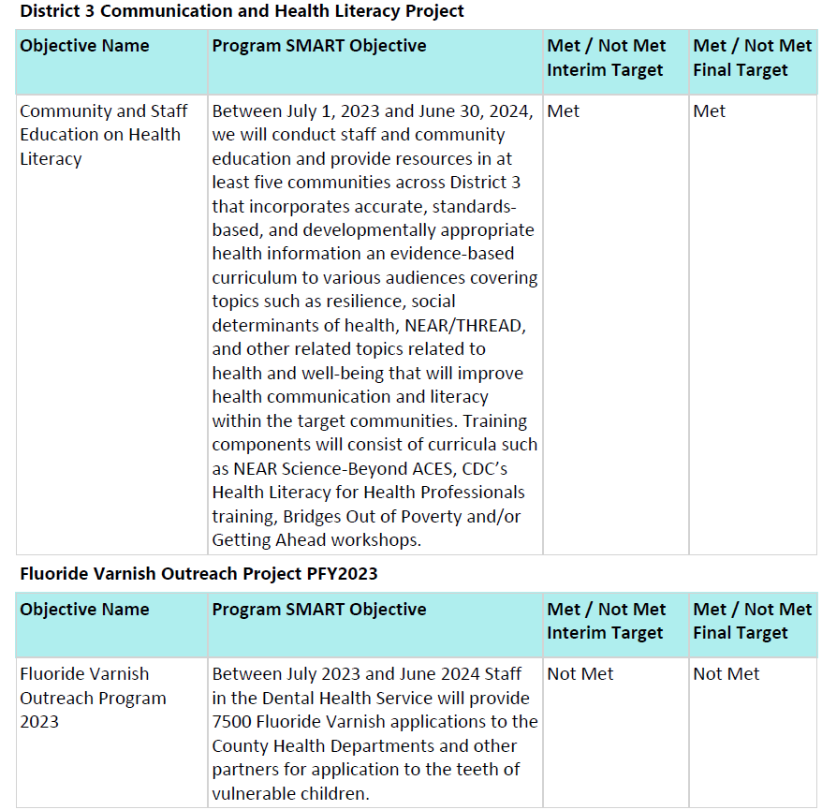
AP4 Program Progress
Notes:
District 3 Communication and Health Literacy Project ---met
Fluoride Varnish Outreach Project PFY2023 2400 of the 3000 of 6300 of 7500 target value
The challenge was working with smaller partners in counties that were further away.
This leads to less demand for the fluoride varnish due to fewer encounters, and more cost/time for
training.

Slide 11
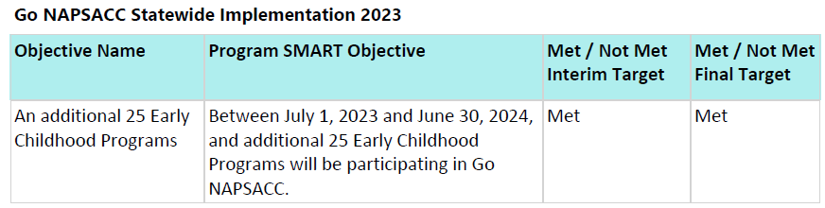
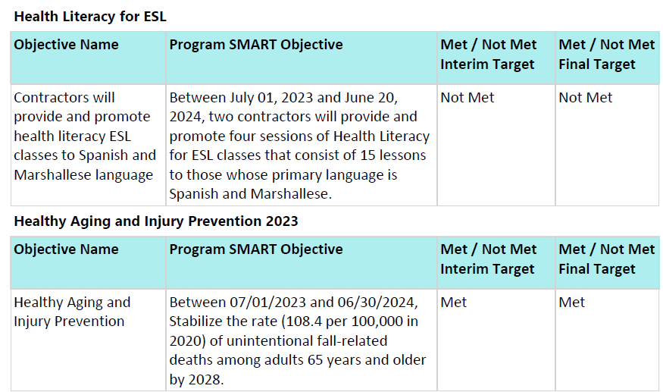
AP4 Program Progress
Notes:
Go NAPSACC Statewide Implementation 2023
Health Literacy for ESL 11 of 50, 32 of 100 target value
Communication issues with partners and the location dates that were held, lack of participants in
Logan County for our Spanish ESL Health Literacy classes.
Healthy Aging and Injury Prevention 2023- met

Slide 12
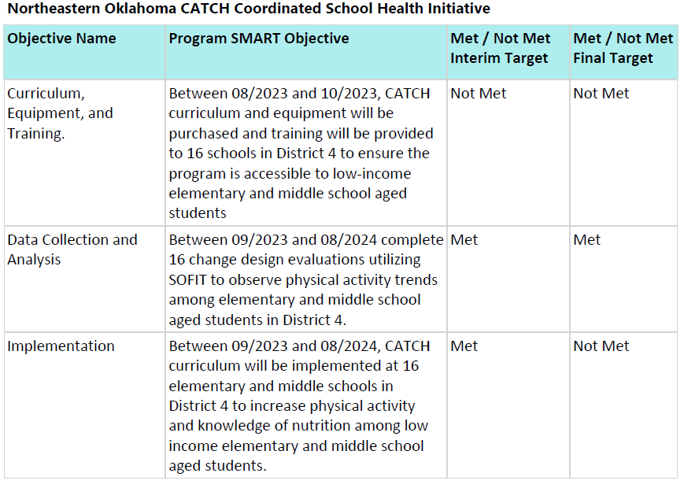
AP4 Program Progress
Notes:
Explain why not met information
Northeastern Oklahoma CATCH Coordinated School Health Initiative
13 of 16 target value
quick turnaround times for training location and
participants, last minute dropouts due to staff shortages, and logistical challenges related to
equipment distribution.

Slide 13
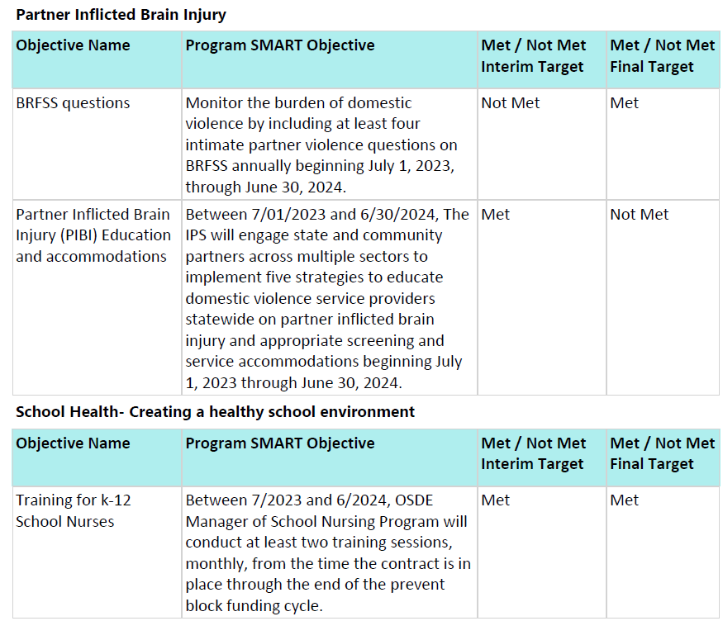
AP4 Program Progress
Notes:
Partner Inflicted Brain Injury 0 of 4 revised WP ; 99 of 150 target value- inability to meet the BRFSS reporting requirement, so a budget and workplan revision was approved by AC team and CDC in May 2024
School Health- Creating a healthy school environment- met

Slide 14
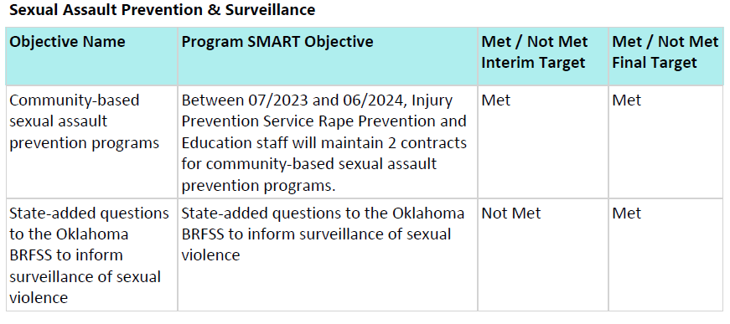
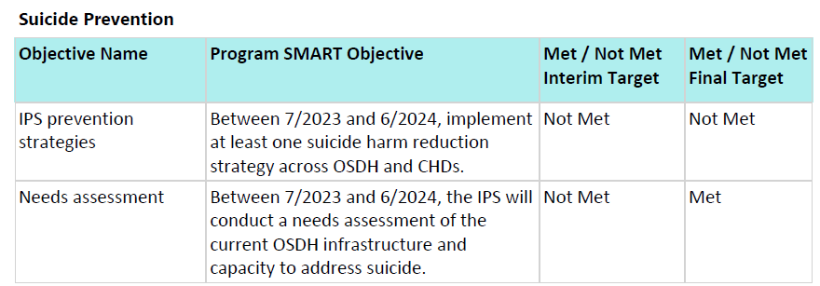
AP4 Program Progress
Notes:
Final two programs
Sexual Assault Prevention & Surveillance 0 of 4 revised WP BRFSS questions, budget and workplan revision was approved by AC team and CDC
These funds are blended with Rape Prevention and Education (RPE) funds to support 2 contracts with
community service providers. These contracts were in year 5 of a 5-year contract cycle. One of the
programs lost staff at the end of July. They chose not to refill the position due to it being the last year
of the contract cycle and RPE changing its focus in the next funding cycle.
Suicide Prevention - 0 of 50; 129 or 200 target value number of trained employees
Challenged with the planning/learning process.

Slide 15

This Photo by Unknown Author is licensed under CC BY-NC
Notes:
Any Questions at this point

Slide 16
PHHS BG Budget Summary
FY23 Program Budget Spenddown Update &
Budget Revision
Notes:
This next section will address the Current AP4 program budget spenddown totals as of 11/1/2024, the budget will be finalized by via the PMS on Dec28, 2024
AP4 budget summary for the FY23 Workplans- 14program that received FY23 funding, unobligated or surplus funds are still being confirmed.

Slide 17
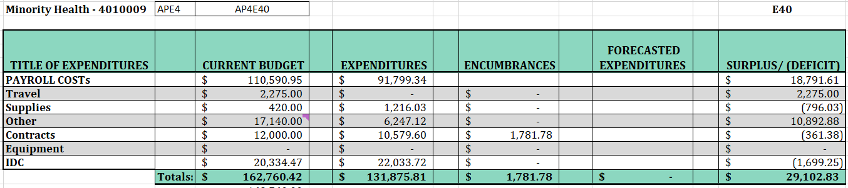
Advancing Health Equity and Strengthening Minority Health - OMHHE Program
Notes:
The Next several slides will address the programs current budget status and reflect which programs were …….On track for spending down program funds
There were fourteen (14) AP4 programs that received PHHS Block Grant FY23 funding. This is an estimate and There may be some lapse funding that remains - some unobligated or surplus funds are still being confirmed
This slide starts with Advancing Health Equity and Strengthening Minority Health, OMHHE- Office of Minority Health and Health Equity – program 29k

Slide 18
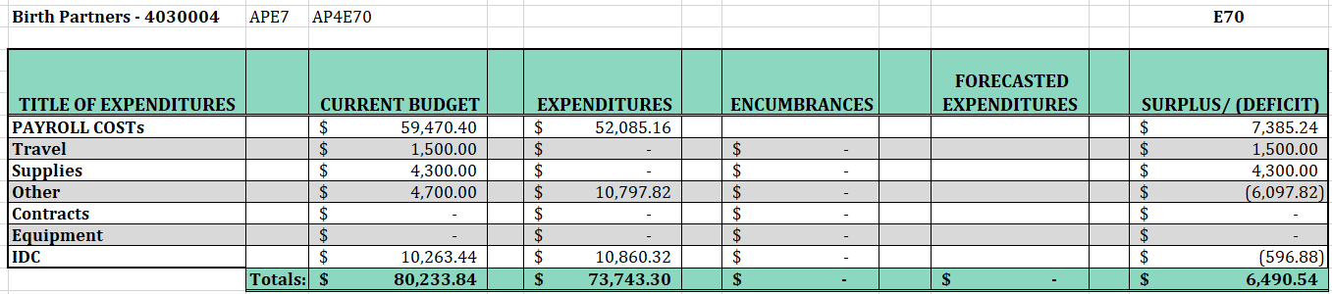
Birth Partners D10
Notes:
Birth Partner 6k

Slide 19
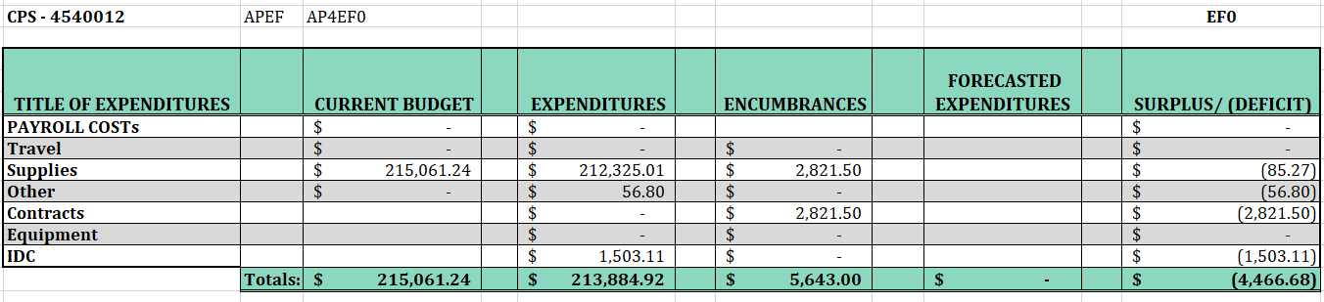
Child Passenger Safety
Notes:
CPS over spent. This is one of the program that rec most of the additional remaining funds at the end of the project period

Slide 20
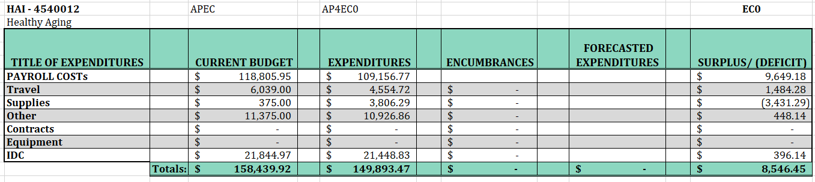
Healthy Aging and Falls Prevention
Notes:
Aging and Fall prevention 8k

Slide 21
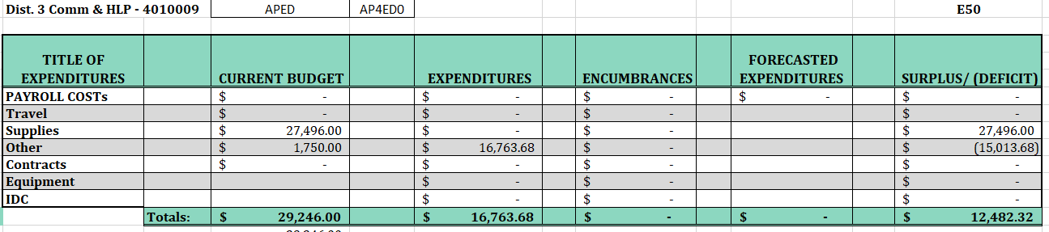
D3 Community & Literacy
Notes:
D3 Community and Literacy program 12k

Slide 22
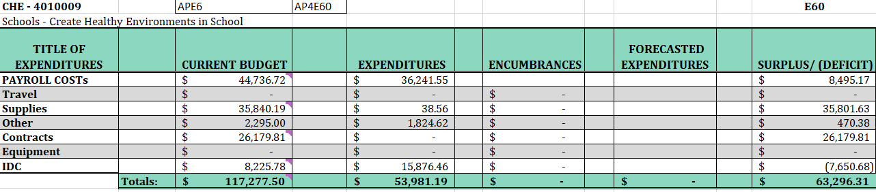
Schools - Create Healthy Environments in School
Notes:
Schools 63k as discussed early the program attempted to spend these funds but had issue with procurement, revised their method

Slide 23
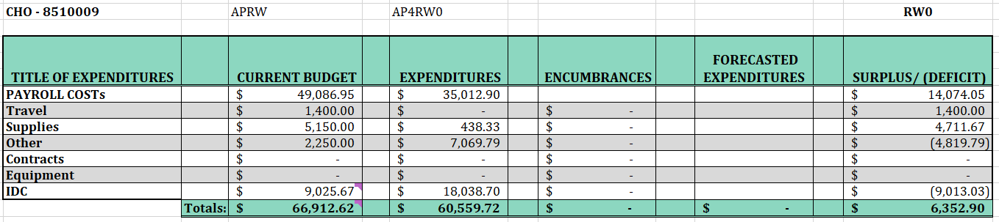
Cert. Healthy OK Consultation
Notes:
CHO 6k

Slide 24
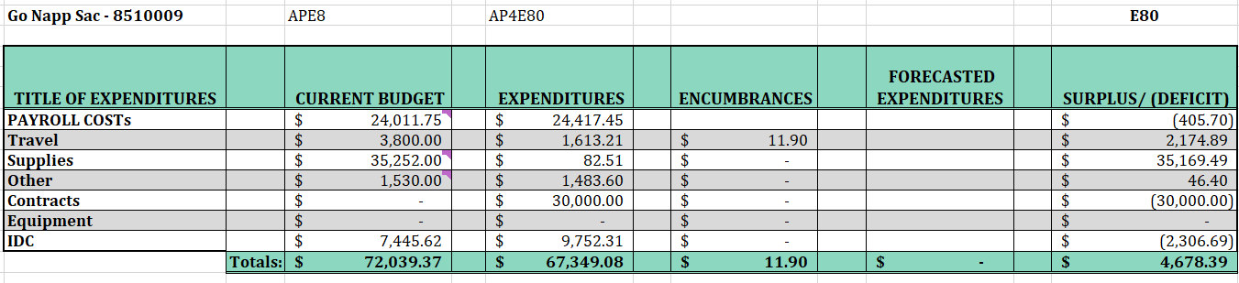
Early Childhood- NAPSACC
Notes:
GoNapsacc roughly 5k

Slide 25
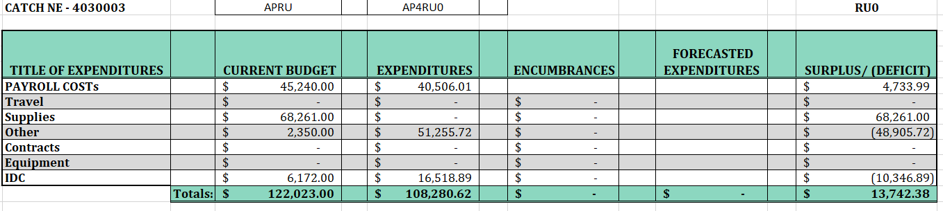
CATCH NE-District 4
Notes:
CATCH had roughly 14k
Early reported last-minute dropouts due to staff shortages, and logistical challenges related to equipment distribution.

Slide 26
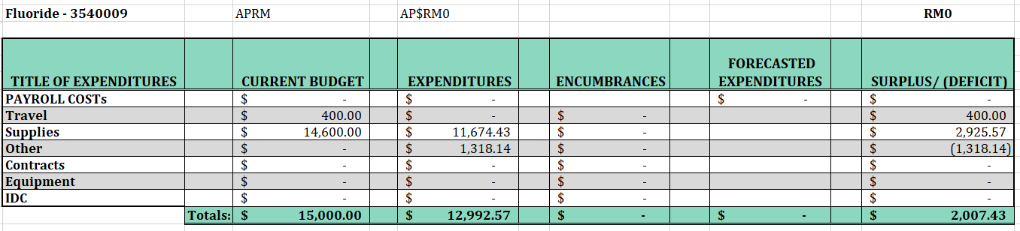
Fluoride Varnish Program
Notes:
Fluoride

Slide 27
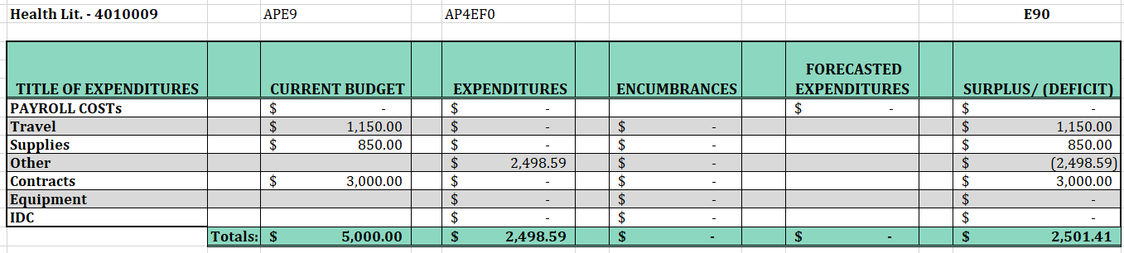
Health & Literacy for ESL- D2
Notes:
ESL underspent by 2500 low to attendance

Slide 28

Partner Inflicted Brain Injury
Notes:
PIBI under spent budget by 8k

Slide 29
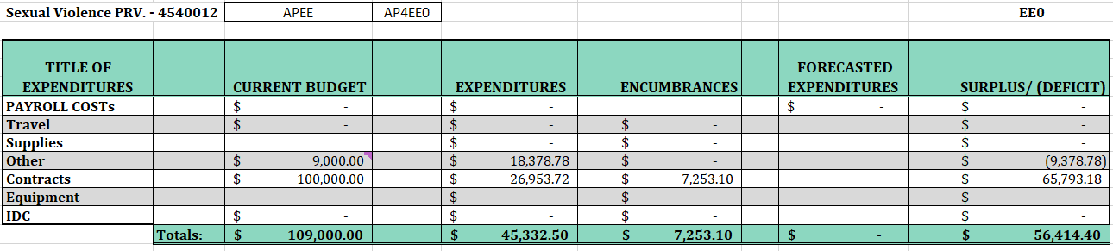
Sexual Assault
Notes:
Sexual assault - staff loss that resulted in contractual issue

Slide 30
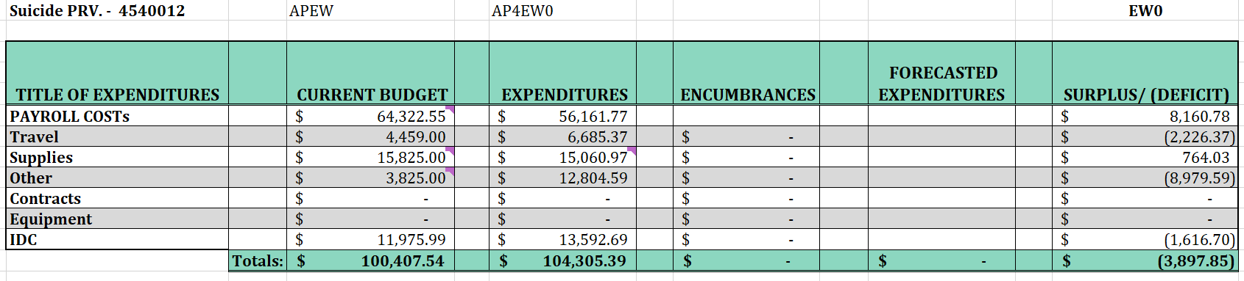
Suicide
Notes:
Suicide over spent budget total

Slide 31
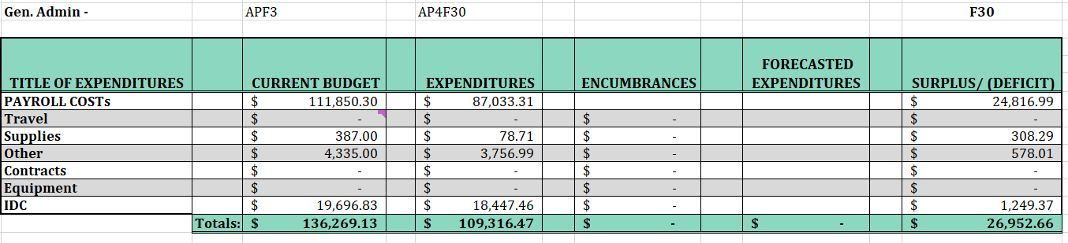
Gen. Admin
Notes:
Loss of staff

Slide 32
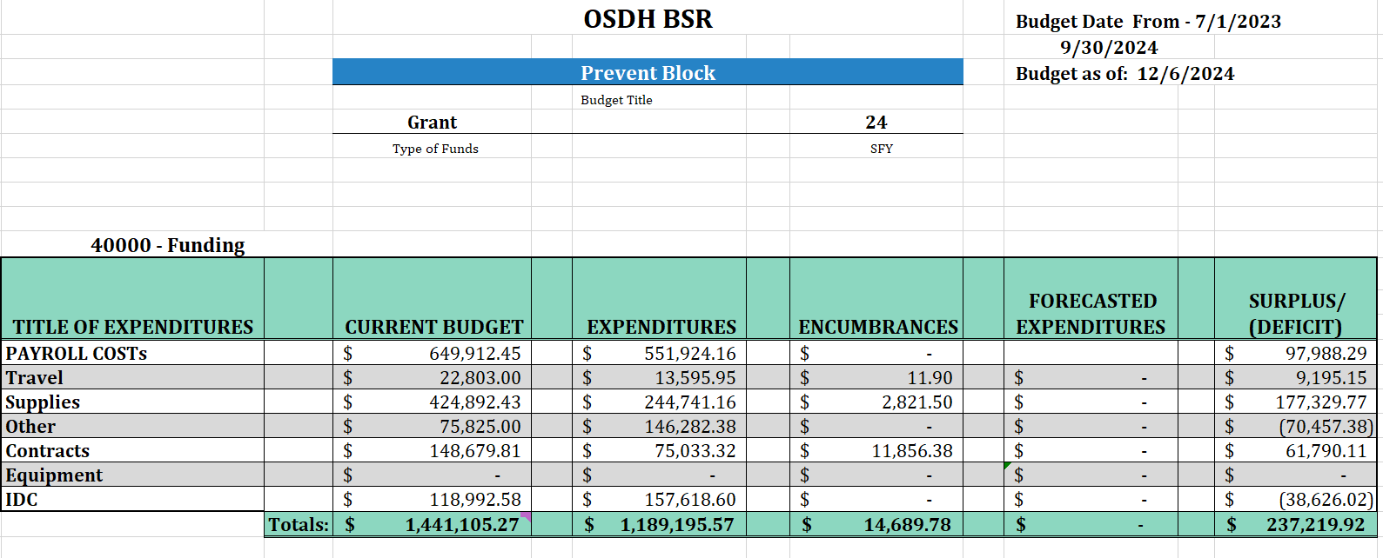
PHHS Block Grant Budget- Closeout
Notes:
Budget Revisions must be reviewed by the AC which is the first step of the approval process and then sent to CDC for final approval.
Budget projections for non-personnel normally occurs during the month of July but due to challenges that the Block Grant were faced with ei. the of loss BA, transition of new AC team, IDC rate, budget corrections. There was No revision for AP4 budget due to timeline restrictions.
There is an estimate of Surplus of $237k – unobligated funds.
Funding Projections can be estimated … if each program recipient underspend funds of their budget by 10K= example 17, AP5 programs $170k remaining each year.
This forecast is under review and quarterly budget tracking will be implemented to ensure lapsed funds are disseminated to current existing program per a WISH List.
Tracking budgets quarterly to ensure spenddown (Jan/ April/ June between the months of April to August revisions will be implement to ensure to limit surplus or lapse funds. The monthly review will continue.

Slide 33
This Photo by Unknown Author is licensed under CC BY-NC
Notes:
Any Questions or break

Slide 34
PHHS BG Program’s
FY24
Program Recipients
Budget Summary
Work Plan Updates
Challenges
Budget Revision
Notes:
FY24
Program Recipients
Budget Summary
Work Plan Updates
Challenges
Budget Revisions that occurred in Oct 2024

Slide 35
FY24 Program Recipients
Advancing Health Equity and Strengthening Minority Health 2024
Healthy Aging and Injury Prevention
Office of Communications - CHD Digital Display System
Chronic Disease Prevention Service (CDPS) – Community Health Screenings
Increasing Nutrition Security in County Health Departments with Statewide Partners
Go NAPSACC Expansion
Creating Healthy Environments in Schools Technical Assistance
Child Passenger Safety Program- CPS
Certified Healthy Oklahoma Consultation -CHO
Fluoride Outreach 2024
Northeastern Oklahoma CATCH Coordinated School Health Initiative
Partner Inflicted Brain Injury
Sexual Assault Prevention & Surveillance
Suicide Prevention
District 5 Birth Certification Wavier for Homeless
Project Combatting Heavy Advertisement of Tobacco (CHAT) in Oklahoma
Oklahoma State Department of Health | Preventive Health and Health Services Block Grant | 2024
Notes:
Provided here is the list of the 16-program recipients that were approved for PHHS Block Grant funding for FY24 Work plan project period and budget period FFY2025

Slide 36
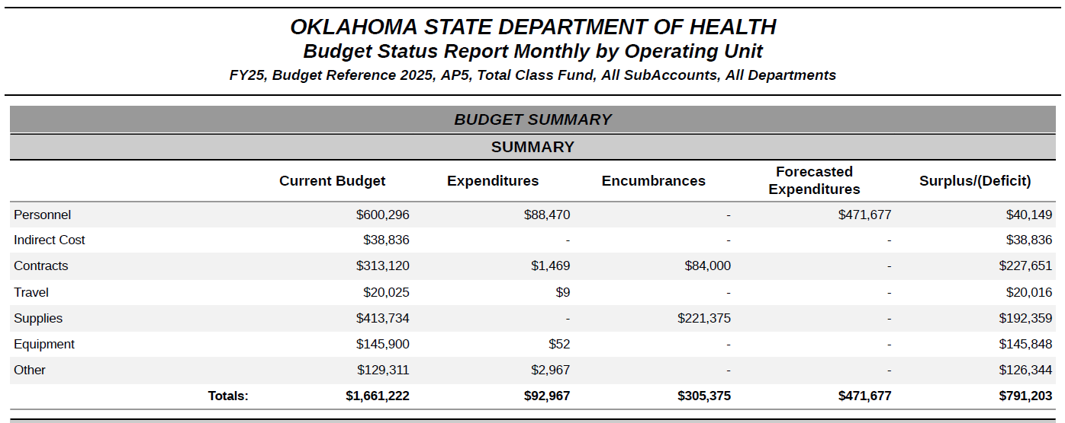
FY24 Workplan Budget Summary as of
December 2024
Notes:
Internal OSDH --New process infonin report – NOA was $1,661,224. The next slides will include the AP5 program and budget allotments. Off by 2 dollars
When there is a Surplus of funds, this is due to funding returns by programs and/or budget revisions.
If budget revisions are required, they will be disseminated to existing programs. Via their Wish-List

Slide 37
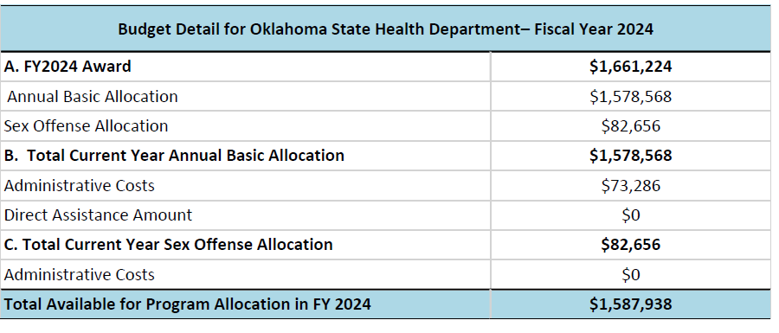
PHHS Block Grant - Funding Details
Notes:
The NOA award to Oklahoma was $1,661,224 and the breakdown of funding is identified per this slide.

Slide 38
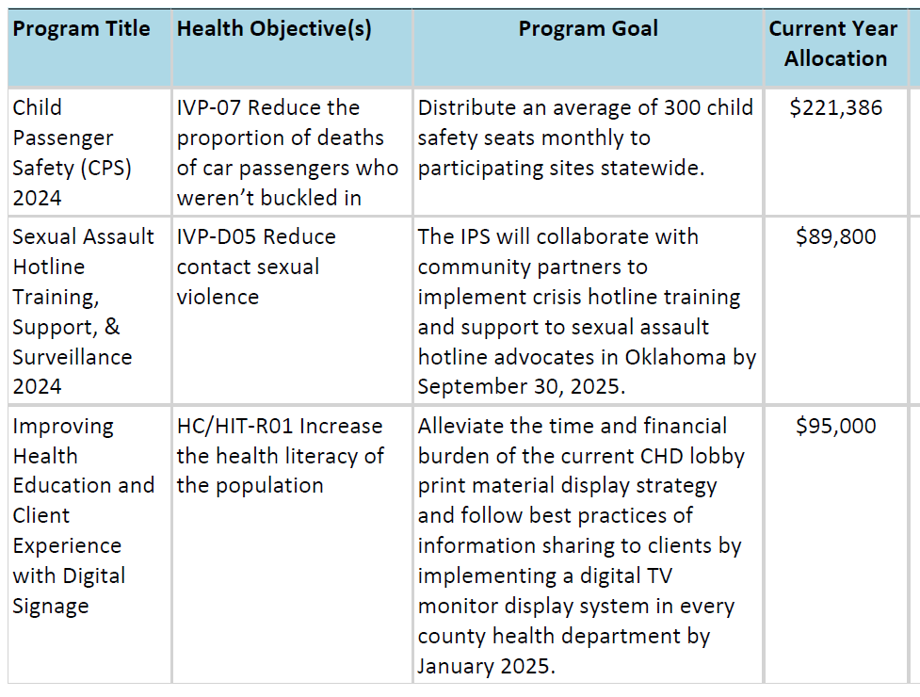
FY2024 Work Plan Goals and Budget
Notes:
FY24 Workplans and for the 16 programs participating in the Block Grant-
The program goal is for the:
CPS - Distribute an average of 300 child safety seats monthly to participating sites statewide.
Sexual Assault - Collaborate with community partners to implement crisis hotline training and support to sexual assault hotline advocates in Oklahoma
Digital Display- Alleviate the time and financial burden of printed material displays to CHD lobbies by sharing information to clients via digital display - TV monitor display system

Slide 39
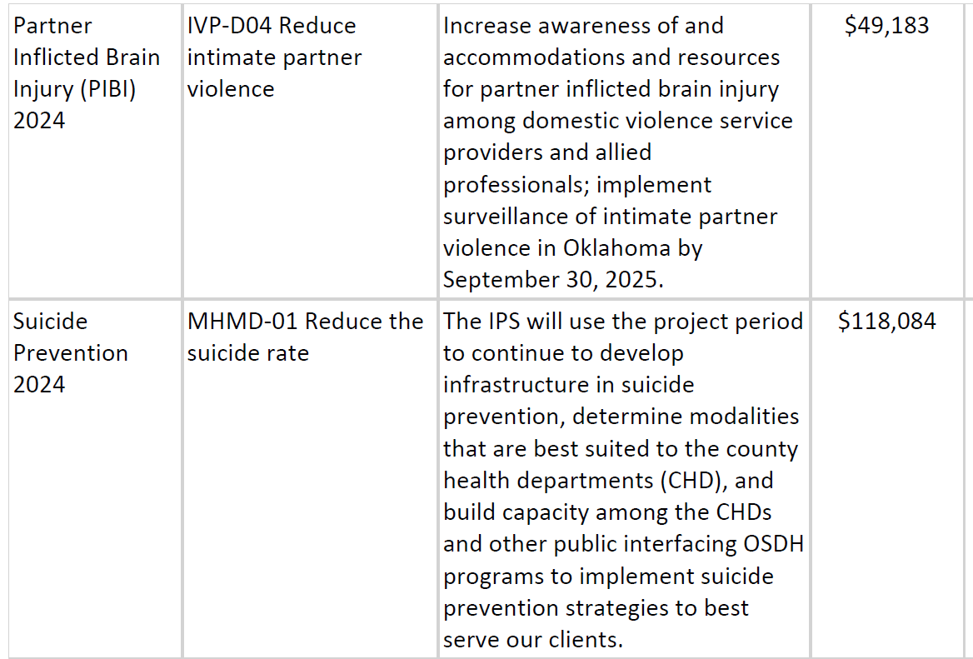
FY2024 Work Plan Goals
Notes:
Partner Inflicted Brain Injury (PIBI) – to increase awareness of and accommodations and resources for partner inflicted brain injury among domestic violence service providers and allied professionals; implement surveillance of intimate partner violence in Oklahoma by September 30, 2025.
Suicide - To continue to develop infrastructure in suicide prevention, determine modalities that are best suited to the county health departments (CHD), and build capacity among the CHDs and other public interfacing OSDH programs to implement suicide prevention strategies to best serve our clients.

Slide 40
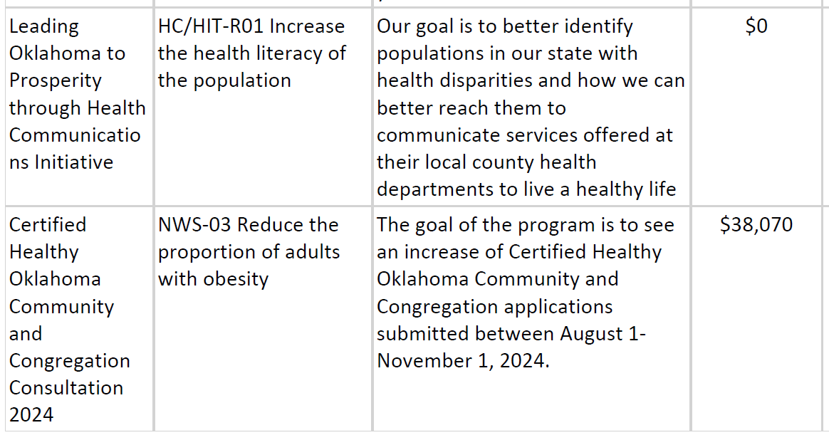
Notes:
Health Communications Initiative – returned funds
CHO- To see an increase of CHO Certified Healthy Oklahoma Community and Congregation applications submitted between August 1-November 1, 2024.

Slide 41
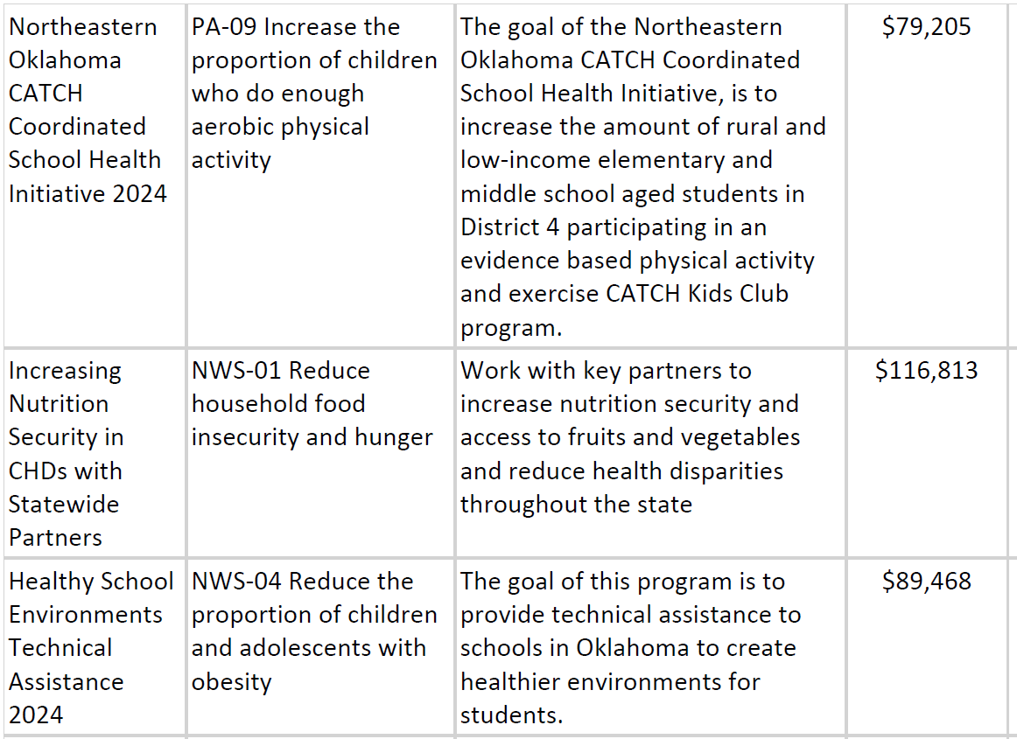
Notes:
CATCH- To increase the amount of rural and low-income elementary and middle school aged students in District 4 participating in an evidence based physical activity and exercise
CATCH Kids Club program.
Nutrition security- Work with key partners to increase nutrition security and access to fruits and vegetables and reduce health disparities throughout the state
Schools- To provide technical assistance to schools in Oklahoma to create healthier environments for students.

Slide 42
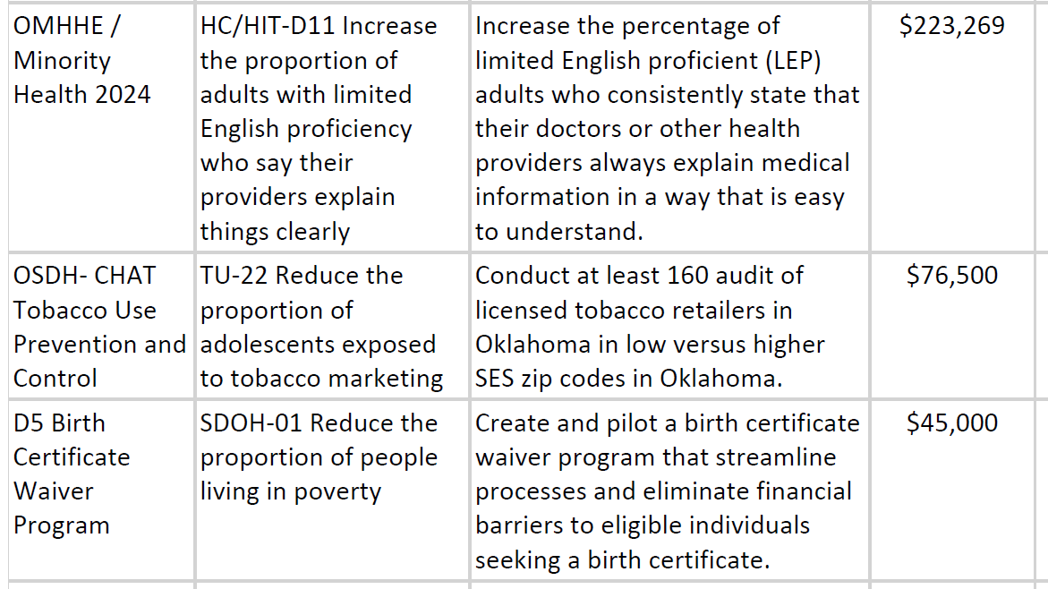
Notes:
Minority Health- Increase the percentage of limited English proficient (LEP) adults who consistently state that their doctors or other health providers always explain medical information in a way that is easy to understand.
CHAT- Conduct at least 160 audit of licensed tobacco retailers in Oklahoma in low versus higher SES zip codes in Oklahoma.
Birth Cert Wavier Program- Create and pilot a birth certificate waiver program that streamline processes and eliminate financial barriers to eligible individuals seeking a birth certificate.

Slide 43
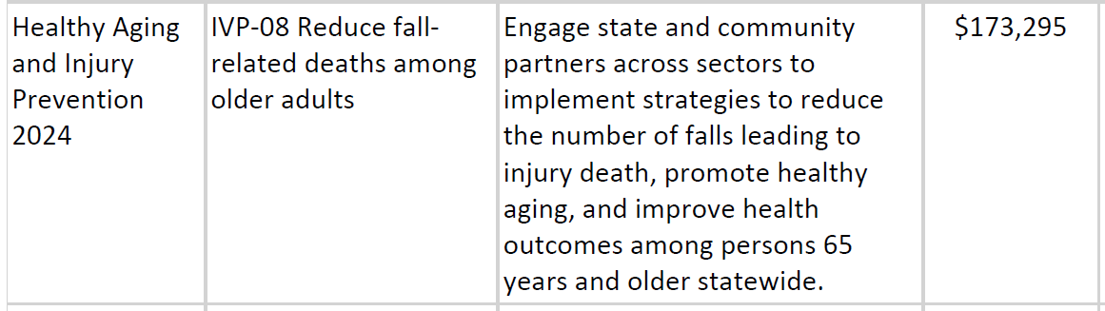
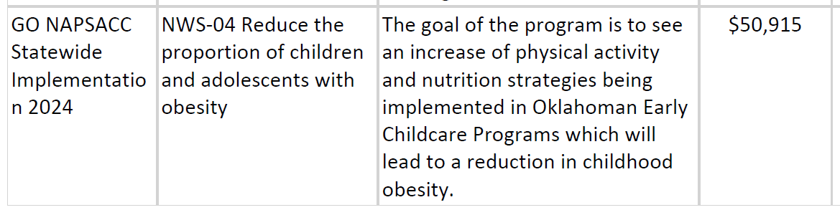
Notes:
Aging and Prevention -Engage state and community partners across sectors to implement strategies to reduce the number of falls leading to injury death, promote healthy aging, and improve health outcomes among persons 65 years and older statewide.
Go Napsacc- To see an increase of physical activity and nutrition strategies being implemented in Oklahoman Early Childcare Programs which will lead to a reduction in childhood obesity.

Slide 44
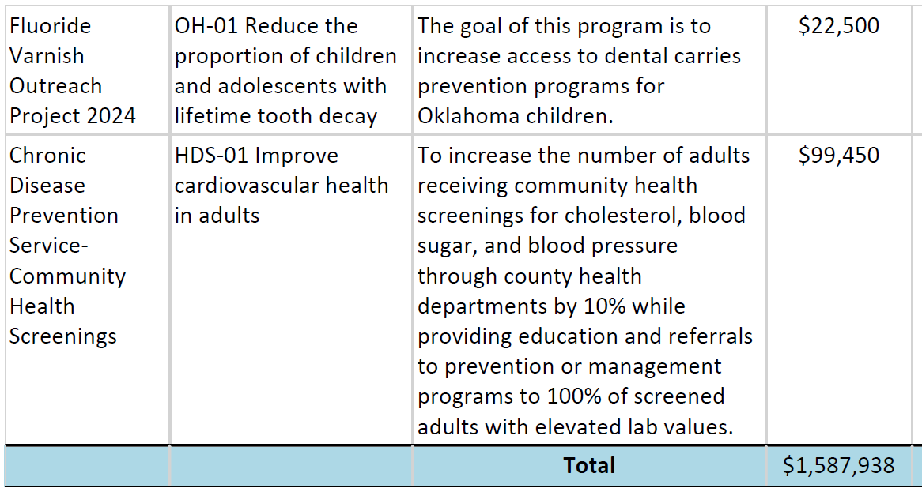
Notes:
The final two program recipients- and the budgets will be address in the next section
Fluoride –To increase access to dental carries prevention programs for Oklahoma children.
and
Community Health screening - To increase the number of adults receiving community health screenings for cholesterol, blood sugar, and blood pressure through county health departments by 10% while providing education and referrals to prevention or management programs to 100% of screened adults with elevated lab values.

Slide 45




Challenges
Program and PHHS BG challenges:
Executive Order - FY23
FY24 New PHHS BG Process-
Transition from SFY to FFY,
Advisory Committee Team, IDC rate, Purchase tracking ledger,
& Workday transitions for Programs
Notes:
Challenges reported by program recipients included:
Loss of staff that resulted in training new temporary staff (executive order in place), BA loss three lapse
New PHHS BG process-
1st time operating on the federal fiscal year instead of the state fiscal year
New AC team and the selection process
Learning new process example LEP/UPE
To elevate the program tracking system for non personnel expenditure. I tracking email are sent to confirm accurate, send invoice and complete the : Budget

Slide 46
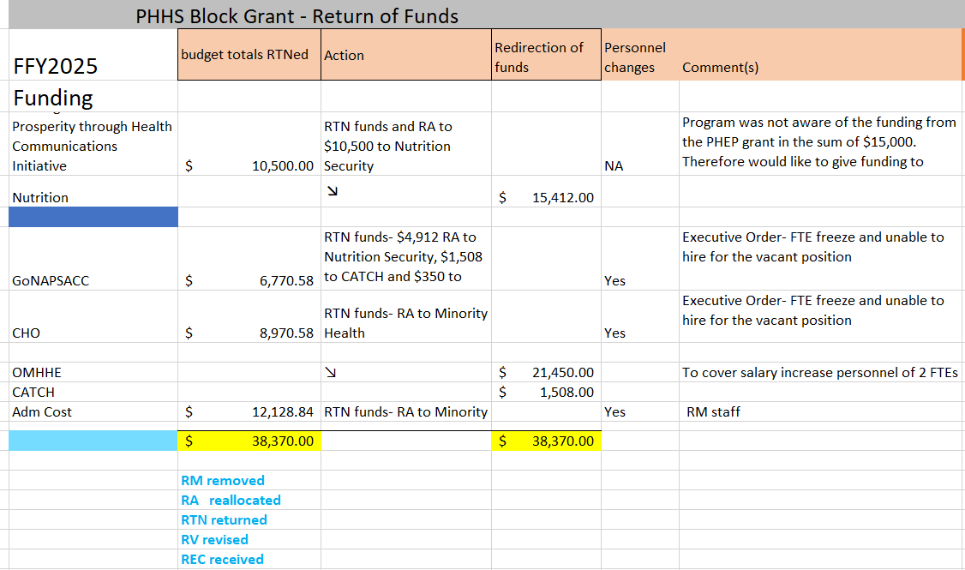
FY24 Workplan and FFY2025 Budget Revision
$38,370
Reallocation
Notes:
Budget Revision was required Any discussion –
Discussed the budget information below; return of funds in the sum of $38,370 and reallocated to existing programs.
No additional questions related to the topic.
Voted on the material presented.
The AC committee met via a teams call on Oct 28th and finalized the approval of the workplan budget for FY24.
All in Favor Aye:
Cathy Billings
Aisha Shah
Isabella Valderrama
Shelly Patterson
Daryn Kirkpatrick
Jacqueline Mullen-Steyn
All opposed Nay: (NA)
Abstain Cathy Billings
The following funds were reallocated to existing programs:
Returned funds:
Health Community Initiative returned $10,500
GoNAPSacc returned $6770.58
CHO returned $8,970.58
Adm Cost returned $12,128.84
Received that existing funding:
Nutrition Security $15412
CATCH $1508
Minority Health $21,450
This information is preliminary. The reviews was conducted - approved by the AC and CDC but pending the final CDC budget error report.

Slide 47
This Photo by Unknown Author is licensed under CC BY-NC
Notes:
Open for any questions?

Slide 48
2025 PHHS Block Grant Advisory Committee Dates
March 05, 2025 @2pm​
Success stories​
Revision Requests​
FY24 Program and Budget Spend Down Update​
FY25 Proposal Requests​
May 7, 2025 @ 2pm​
Public Hearing - FY25 Work Plans​​
December 3, 2025 @2pm​
FY25 Update ​
Final APR FY24 Update

Slide 49
Next steps:
February
  TEAMs meeting to address the FY2025 PHHS Block Grant Proposals (annual applications)
Advisory Committee Meetings
  March 5, 2025
  May 7, 2025 -Public Hearing
  December 3, 2025
Notes:
Invite will be sent in Jan 2025 to AC members to review and discuss the FY25 application/proposals request
The proposals will be exported to an excel spread sheet, will be discussed via a TEAMs meeting in February 2025 (virtual option only) excel spread sheet
The Evaluation tool will be sent via email for ranking /score the application, after scoring and ranking of the applications/proposals discussed during the AC meeting in March to identify the Block Grant awardees for FY25 will be addressed.
The proposal request forms, and the budget justifications are due no later than February 10, 2025. The proposal request and budget justification will also be available on Health Hub, and on the Prevent Block SharePoint site
Office hours are
January 9, 2025 at 10:00 am,
January 24, 2025 at 1:00 pm and
February 7, 2025 at 10:00 am.

Slide 50

Q&A:
solina.searcy-martin@health.ok.gov
405-817-6483
To learn more about the PHHSBG, please visit our SharePoint page or public webpage.
Oklahoma State Department of Health | Preventive Health and Health Services Block Grant | 2024
Notes:
This is the End of the presentation. Do anyone have any questions?
Link has been provided …. If you would like to Learn more about the Block Grant
Also, the PHHS BG Coordinator’s contact information is listed here
All material will be sent via email

Slide 51
Closing Remarks and Adjournment
Notes:
Closing remarks –
Chair to call the meeting to end and note the time.

Slide 52

Notes:
Have a Wonderful DAY!

