Slide 1
Call To Order
March 23, 2022

Slide 2
Roll Call

Slide 3
Preventive Health and Health Services Block Grant (PHHSBG)
Special Advisory Committee Meeting
March 23, 2022

Slide 4
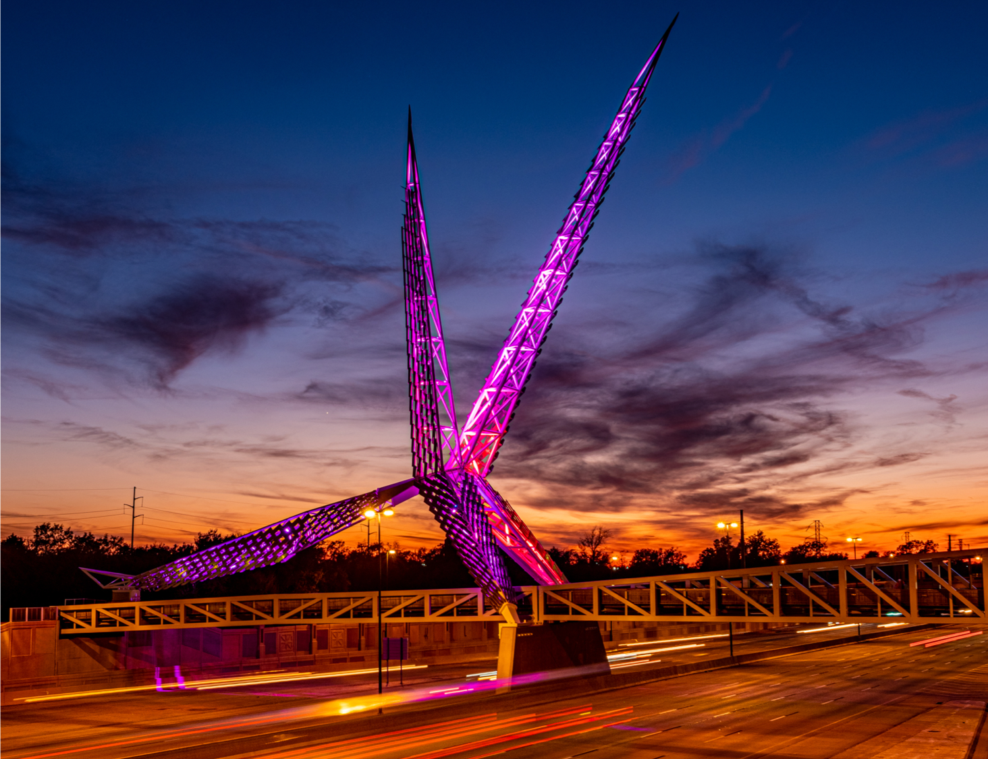
Meeting Agenda
Call to Order
Roll Call
Advisory Committee Overview
Recommendation and Appointment of New Members
Nominate and Elect New Chairperson
Budget Updates for Budget Revision Proposal
Closing Remarks, Questions, and Adjournment
Oklahoma State Department of Health | Preventive Health and Health Services Block Grant | March 2022

Slide 5
Advisory Committee Overview

Slide 6
PHHSBG Advisory Committee
COMMITTEE MEMBERS
Interim Chair - Mendy Spohn, MPH, Deputy Commissioner for Community Health Promotion and Protection, OSDH
Member - Michael Peercy, MPH, MT(ASCP)H, Epidemiologist and IRB Administrator, Chickasaw Nation Department of Health
Member - Kelly Baker, MPH, State Registrar of Vital Records, OSDH
Member - Melissa Blanton, JD, Assistant Attorney General; Chief, Victim Services Unit Chief, Office of the Attorney General
Member - Dr. David Gahn, MD, MPH, FACOG, Medical Director, Cherokee Nation Public Health
Member - Jan Fox, RN, MPH, Deputy Commissioner Health Preparedness, OSHD
Member - Cara Gluck, MPH, Chief, Community Health Services, OCCHD

Slide 7
PHHSBG Advisory Committee Overview
What is the Advisory Committee?
Also known as the State Preventive Health Advisory Committee
Leadership
State Public Health Officer services as Chair or may designate someone else to serve as Chair of the State Preventive Health Advisory Committee
Composition of the Advisory Committee
Members of the general public, and such officials of the health departments of political subdivisions of the state, as may be necessary to provide adequate representation of the general public and of such health departments
Representatives of community-based organizations (including minority community-based organizations), schools of public health and entities to which the State involved awards grants or contracts to carry out activities

Slide 8
PHHSBG Advisory Committee Overview
Duties
Hold public hearings on the state plan
Held in May or June and will coincide with a committee meeting
The Committee must meet at least twice each fiscal year
Oklahoma may meet up to 4 times a year – March, April, June and December
Make recommendations regarding the development and implementation of the work plan including:
Assessments of public health status
Activities to be carried out in the work plan
Allocation of funds
Coordination of activities in work plan with other organizations
Collection and reporting of data

Slide 9
2022 PHHSBG Updated Process Timeline
BG Coordinator sends out Notice of Funding Opportunity
& Proposal Questionnaire through Communications and share link on Health Hub.
March 14th
Advisory Committee enters executive session
at May meeting to reach consensus on funding recommendations
May 11th
FY22 Work Plan Submission to CDC Deadline July 1st, 2022
FY 2022 Work
Plan reviewed at
Public Hearing of Advisory Committee / Discuss FY21 remaining funds
June 15th
Special ACM to nominate and appoint new members and chair
March 23rd
BG Coordinator performs initial review and compiles applications for Advisory Members
April 25th – April 29th
Notify Programs Approved for Funding
May 16th
BG Coordinator prepares FY22 Work Plan, Budget Justification, and other administrative forms
May 30th – June 3rd
Potential Applicants complete & submit Proposal Questionnaire and Budget Justification Forms March 14th – April 22nd
Advisory Committee Reviews Applications
May 2nd – May 10th
Meet with Budget Staff and F/U with Programs, if necessary to finalize FY22 Work Plan
June 16th – June 22nd
Programs selected for funding initiate drafts of FY22 Work Plans
May 16th - May 27th
Meet with Budget Staff and FY21 Programs to discuss money remaining for FY21
June 6th – June 7th
Meet with Budget Staff to discuss FY22 Allocation and FY22 Requested Amounts
May 12th
PHHSBG Advisory Committee
Approves FY22 Application
March 9th
Advisory Committee Regular Meeting
December 14th
Oklahoma State Department of Health | Preventive Health and Health Services Block Grant | March 2022

Slide 10
New Member Appointment/Confirmation
Oklahoma State Department of Health | Preventive Health and Health Services Block Grant | March 2022

Slide 11
New Chairperson Election
Oklahoma State Department of Health | Preventive Health and Health Services Block Grant | March 2022

Slide 12
Budget Updates for Budget Revision Proposal

Slide 13
Budget Proposal Review
Background
The OSDH is undergoing transformational organizational change
27 initiatives included in 2022 to address priorities
Focus on Quality Improvement (QI) areas within OSDH
Current State
QI position is coordinating the agency’s quality improvement plan, aiding efforts to rapidly identify and solve pain points impacting the program areas’ ability to drive public health improvements
Future State
QI position identified as a key role to carry out this new body of work.
Funding Amount Requested
$20,900
Is Funding Available?
Due to one unfilled vacancy and one staff member being promoted out of the existing position in OMHHE as well as a vacancy earlier in the grant period in Unintentional Poisoning, there is funding available to approve the salary increase.
Oklahoma State Department of Health | Preventive Health and Health Services Block Grant | March 2022

Slide 14
Closing Remarks, Questions, and Adjournment
Thank you!

