Slide 1
Take Charge!
Breast and Cervical Cancer Screening Form Training
(ODH Form No. 274A, Revised June 2019)

Slide 2
Before Proceeding with Training
Have the revised Take Charge! Breast and Cervical Cancer Screening Form (ODH Form No: 274A) in front of you for easy reference.
Plan on completing the skill assessment at the end of the training.
Allow approximately 20 minutes for training (including completion of the skill assessment).
Find a quiet place to listen and participate in the training. Individual participation is required. Please do not work as a group.

Slide 3
Who is required to take the new
ODH Form No. 274A Training?
Patient Navigator
Administrative Assistant
Medical Assistant
Billing/Invoice Personnel
Licensed healthcare provider (DO, MD, PA, Nurse Practitioner, RN, LPN, etc.) who provides Take Charge! services for Take Charge! eligible women
ALL individuals who assist with Take Charge! related clients and services

Slide 4
Training Objectives
Goal
Provide an opportunity to gain knowledge and skill in completion of the Take Charge! ODH Form No. 274A
Objective
Upon completion of this self-study training participants will be able to:
Recall the steps for completion of the revised ODH Form N. 274A
Correctly complete the revised ODH Form No. 274A

Slide 5
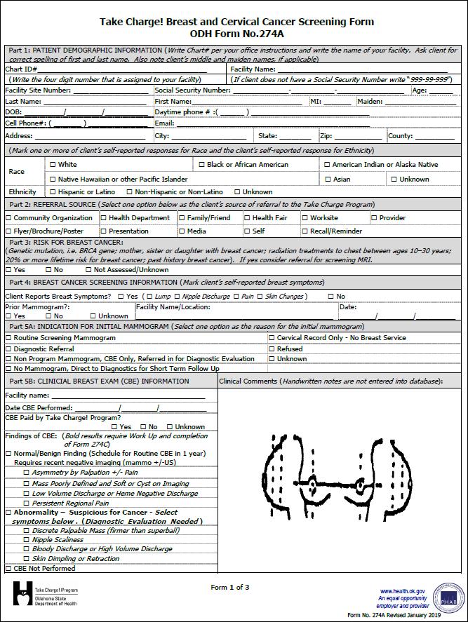
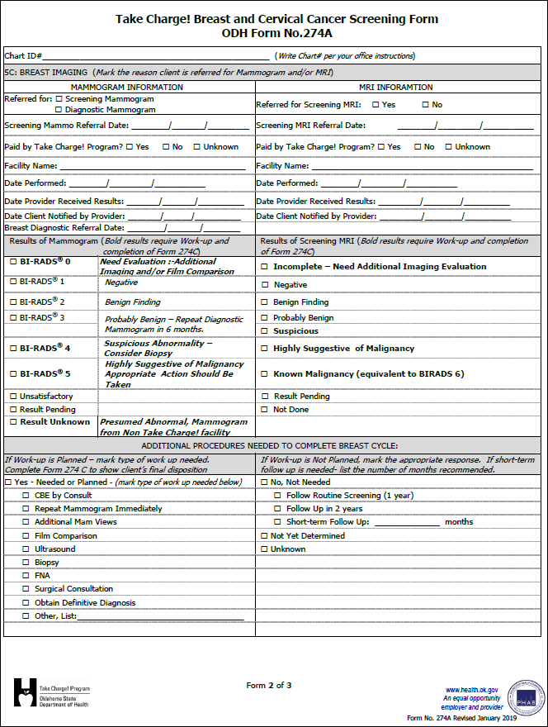
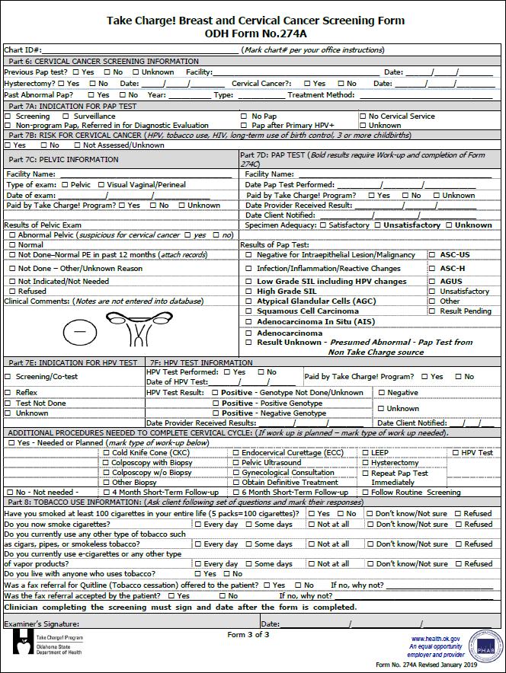
Take Charge!
Breast and Cervical Cancer Screening Form
(ODH Form No. 274A Revised June 2019)

Slide 6
Background Information
ODH Form 274A is currently a 3 page/2 part No copy required (NCR) form
When the current NCR forms have been used, the ODH Form 274A will be printed on regular paper.
Write neatly using black ink
Do not write on the stack of NCR ODH Form No. 274A Forms
The revised ODH Form No. 274A contains NEW requirements from CDC

Slide 7
Implementation Information
Shred all previous versions of ODH Form No. 274A upon receipt of the revised forms
Services documented on the old forms will be denied until the revised ODH Form No. 274A has been submitted
To order additional ODH Form No. 274A, complete the Take Charge! order form and fax it to 405-271-6315 or email it to CancerPCP@health.ok.gov

Slide 8
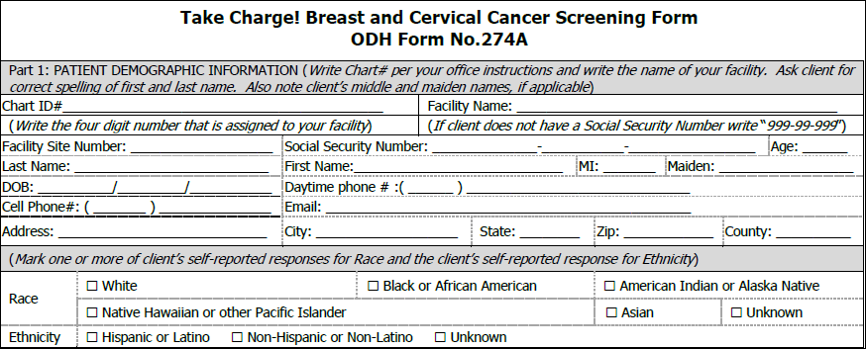
Completing Page 1, Part 1
Demographic Information
Part 1 can be completed by a non-clinician
If client does not have a social security number, write “999-99-9999”
If client is homeless, write a locating address in the address section, and message phone number in the phone number section
Ask client which race(s) they identify with, do not guess
If client has different name or Date of Birth from the Take Charge! Letter, please provide a proof of ID or correct the name on the Take Charge! Letter

Slide 9
Completing Page 1, Parts 2-4: Referral Source – Risk for Breast Cancer – Breast Cancer Screening Information
All sections should be thoroughly completed
Part 2: The Referral Source section can be completed by a non-clinician
Part 3: Risk for Breast Cancer section informs if a client was assessed and determined to have risk of developing breast cancer
Part 4: Breast Cancer Screening Information section gathers information about current breast symptoms, and informs if a prior mammogram was done

Slide 10
Completing Page 1, Part 5A Indication for Initial Mammogram
X
Mark only one response in Part 5A
Indicate the reason for the imaging, if routine screening mark that box
If a client only receives cervical services, mark cervical record only. Mark through the breast services areas (Part 5B, 5C, and Additional Procedures to complete breast cycle)

Slide 11
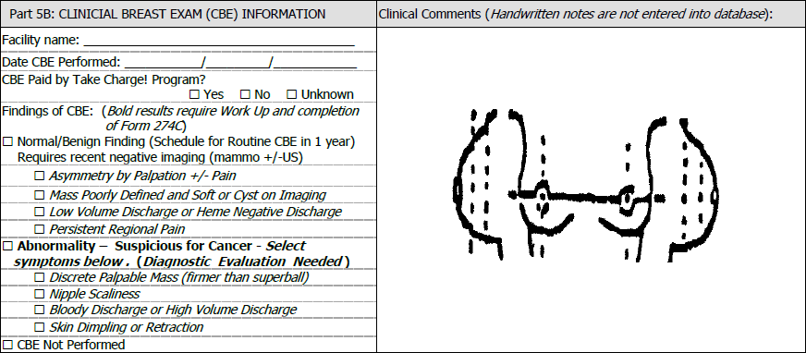
Completing Page 1, Part 5B Clinical Breast Exam
ABC Community Health Center
09
30
2019
The information in this area is not required to be considered completed as part of form completion.
X
X
The information in this area is required to be considered completed as part of form completion.
All sections should be thoroughly completed
Mark “yes” if the Take Charge! program is reimbursing the provider/contractor. Mark “no” if the CBE (clinical breast exam) charges will be or were billed to another funding source
Mark only one clinical breast finding. The Take Charge! Database – CaST only allows entering one answer
Abnormal findings always require complete work-up within 60 calendar days or less of the abnormal finding date
If an abnormal finding is marked --immediately complete the top portion of the ODH Form 274C

Slide 12
Completing Page 2, Part 5C Breast Imaging - Mammogram
040001000012345 /Liang, Lisa/ 12/21/1967
Select one mammogram type
Enter the date the mammogram was performed, the date your clinic received the results, and the date the client was notified
If the client was referred for breast diagnostic services, enter the date of the referral. If the client does not need breast diagnostic services, draw a line through the date fields
If mammogram was paid for by the Take Charge! Program, mark "yes"
If the mammogram was paid for by other funding sources, mark "no"
X
09
03
2019
X
XYZ Breast Imaging
09
12
2019
09
15
2019
09
15
2019
09
17
2019

Slide 13
Completing Page 2, Part 5C Breast Imaging - Mammogram (cont.)
Results of Mammogram
Bolded results should be marked – check “Yes” indicating work-up is needed
If the clinical breast exam and the mammogram results are inconsistent, a referral for a surgical consultation is offered
Additional Procedures Needed
If bolded results are marked – check the procedure needed to complete the cycle
Abnormal findings always require complete work-up within 60 calendar days or less of the abnormal finding date
Breast Surgical Consult is required:
Abnormal Clinical Breast Exam (CBE) such as a discrete palpable mass, bloody or serous nipple discharge, nipple or areolar scaliness, skin dimpling or retraction and an imaging result of Bi-Rads® 0, Bi-Rads® 1 , Bi-Rads® 2 or Bi-Rads® 3
Imaging result of Bi-Rads® 4 (Only for clients not eligible for Oklahoma Cares due to citizenship status or non-compliance with child support enforcement)
Imaging result of Bi-Rads® 5 (Only for clients not eligible for Oklahoma Cares due to citizenship status or non-compliance with child support enforcement)
If the client has had a previous diagnosis of breast cancer

Slide 14
Completing Page 2, Part 5C Breast Imaging - MRI
MRI Information
Indicate if client was referred for Screening MRI
Referral for MRI must be requirements listed below*
MRI must have prior approval
Review the Take Charge! Screening and Diagnostic Coupon Training for approval instructions.
If client was not referred for MRI, mark “No” and draw a line through the remaining fields
If the MRI was paid for by the Take Charge! Program, mark "yes"
If the MRI was paid for by other funding sources, mark "no"
*MRI Requirements (Prior Approval Required)
See MRI Guidelines
Documentation of carrying a genetic mutation proven to increase the risk of breast cancer
A first-degree relative who is a documented BRCA carrier
A lifetime risk of 20-25% or greater as defined by risk assessment models
As an evaluation tool for those with a personal history of breast cancer treatment
Has an area of concern not sufficiently addressed by diagnostic mammogram or ultrasound. For example-newly inverted nipple (not present at birth) mammogram/ultrasound presenting as normal

Slide 15
Completing Page 2, Part 5C Breast Imaging - MRI
Results of Screening MRI
Select only one result of the screening MRI
Results that are in bold font require work-up
If the client was not referred for an MRI, draw a line through the results of the MRI

Slide 16
Completing Page 2,
Additional Procedures Needed to Complete Breast Cycle
X
X
The information in this area is required to be considered completed as part of form completion.
If a client needs work-up, mark “Yes” and then indicate the type of work-up needed
Abnormal findings always require complete work-up within 60 days or less of the abnormal finding date
All findings listed under the work-up planned field require a complete work-up
Failure to meet guidelines results in client not receiving timely care, unmet data quality and reduced funding from CDC
The type of Work-up marked on this form must match the current findings indicated on the ODH Form No. 1342 (Take Charge! Screening and Diagnostic Form) and ODH Form No. 274C (Take Charge! Diagnostic and Treatment Follow-up Form)

Slide 17
Completing Page 3, Part 6
040001000012345 /Doe, Jane/ 12/31/1967
The client’s chart ID #, first name, last name and date of birth must be written in this section, in case the forms get separated
If a client only receives breast services or cervical services, all three pages of the form must be completed and sent in to the Take Charge! administrative office

Slide 18
Completing Page 3, Part 6-7B
X
Women’s Clinic
11
08
09
X
08
08
09
X
X
X
X
Cervical Cancer Screening Information
If a client had a hysterectomy, enter the date of the hysterectomy if known. If the client had a hysterectomy due to cervical cancer, the client may continue to receive Pap screening through the Take Charge! program
If the hysterectomy was for other reasons, the client is allowed to receive one Pap test funded through the Take Charge! program
Indication for Pap Test
The reason for a Pap test must be completed even if a client is only receiving breast services
If the client is only receiving breast services (CBE and/or mammogram) mark breast record only
Risk for Cervical Cancer
If a client was assessed and determined to have risk for cervical cancer – mark “Yes”
If a client was assessed and not determined to have risk of cervical cancer – mark “No”
If an assessment was not completed - mark “Not Assessed/Unknown”

Slide 19
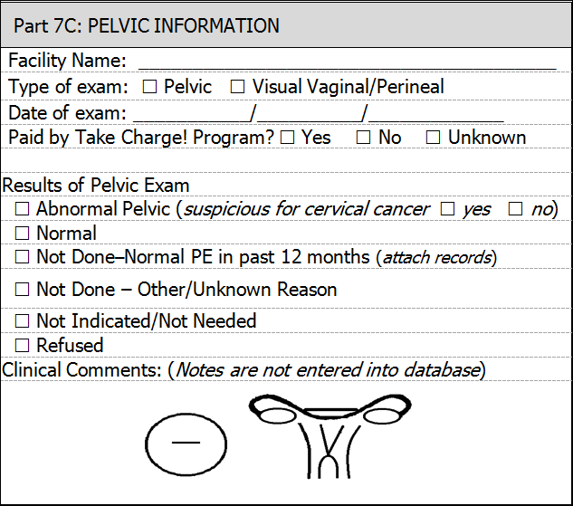
Completing Page 3, Part 7C
Pelvic Information
Mark only one type of exam
Mark either pelvic exam or visual vaginal/perineal
Mark “Yes” if provider is requesting Take Charge! reimbursement from Take Charge! for the exam
Mark “No” if exam was paid by another program
.
Results of Pelvic Exam
Mark only one result
The pelvic illustrations may be used to make notes for clarification
Handwritten notes are not entered into CaST database
ABC Community Health Center
X
09
03
2019
X
X

Slide 20
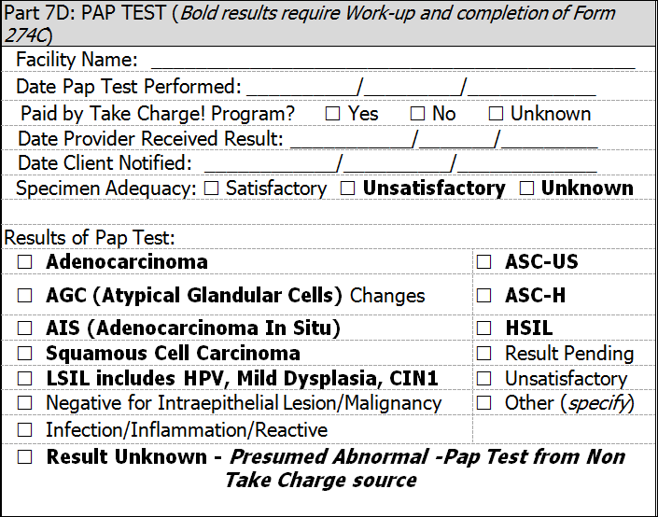
Completing Page 3, Part 7D
Pap Test Information
Enter the name of the facility where the Pap test was performed
This is usually the same name of the facility where the clinical breast exam is performed
Thoroughly complete all information in the section
Results of Pap Test
Mark only one result of the Pap test
Any finding in Bold font requires a work-up
Please refer to current USPTSF guidelines for follow-up
Abnormal findings (bold results) always require complete work-up within 60 days or less of the abnormal finding date
ABC Community Health Center
09
03
2019
X
09
10
2019
09
11
2019
X
X

Slide 21
Completing Page 3, Part 7E-F
X
X
X
09
03
2019
X
09
10
2019
09
11
2019
HPV Testing
Mark indication for HPV testing
Refer to guidelines for cervical cancer screening on Take Charge! website Take Charge! (oklahoma.gov)
HPV Test Information
Thoroughly complete all sections
If HPV testing was performed with or without Genotyping for HPV types 16 & 18 – mark the appropriate response
The results listed in bold are abnormal findings and require work-up
Abnormal findings always require complete work-up within 60 days or less of the abnormal finding date

Slide 22
Completing Page 3
Additional Procedures Required to Complete Cycle
X
X
If any cervical findings are abnormal, mark “Yes” work-up is needed or planned. If you are unsure of the next steps, call Take Charge! Administrative Office for assistance (indicate the timeline for follow-up)
Mark the type of work-up needed (if work-up is indicated)
Refer to the current Dysplasia Guidelines and Orders which reflect the American Society for Colposcopy and Cervical Pathology (ASCCP) guidelines if assistance is needed to determine the type of work-up. The guidelines are posted on the Take Charge! website Take Charge! (oklahoma.gov)
Abnormal findings always require complete work-up within 60 days or less of the abnormal finding date
Mark "No" if no cervical work-up is not needed (indicate the timeline for follow-up)
The type of work-up marked on this form must match the current findings indicated on the ODH Form No. 1342 (Take Charge! Screening and Diagnostic Form) and ODH Form No. 274C (Take Charge! Diagnostic and Treatment Follow-up Form)

Slide 23
Completing Page 3, Part 8
Tobacco Use Information
X
X
X
X
X
X
X
Refused, not ready to quit
Dr. Pepper
09/15/2019
The client should be asked the questions in this section
Once the ODH Form No. 274A is complete, the healthcare provider that performed the services should sign the form
If other staff have assisted with completion of the form, they may sign underneath the box in the examiner’s signature box
The date the clinician signs the form must be after every procedure date listed on the ODH Form No. 274A

Slide 24
Final Instructions for Completing ODH Form No. 274A
Clinical components must be completed by the Take Charge! contracted licensed healthcare provider that is providing the service
Non-clinical components (Part 1, Part 2 and Part 8) may be completed by non-clinicians
Every field or box must have an answer
Do not leave a blank area
Draw a line through areas that will not be completed
ODH Form 274A is signed by the Take Charge! contracted licensed healthcare provider only when the form has been reviewed and completed by the licensed healthcare provider

Slide 25
Final Instructions for Completing ODH Form No. 274A
Prior to processing the ODH Form No. 274A for reimbursement, please review the form for completeness
Draw a line in the sections that do not apply to the Take Charge! client
The ODH Form No. 274A is complete once all information on the form is provided. Incomplete forms will be returned to the contractor for correction, utilizing Box account from www.box.com
The final step for completing the ODH Form No. 274 is to follow the operating procedures for your facility's billing office

Slide 26
Final Instructions for Completing ODH Form No. 274A
Do not hold the ODH Form No. 274A if the client needs diagnostic testing
Once the form is complete, maintain the original of all pages of the form in the client’s chart for seven years in accordance with the terms of the contract and Business Associate Agreement (BAA)
The Take Charge! program will review completed ODH Form No. 274A forms at your request prior to submitting ODH Form No. 274A forms with your monthly invoice
Contact Take Charge! Administrative office at 405-271-3619 for assistance

Slide 27
Skill Assessment
Please complete the electronic post assessment located at the link below.
274A Training Quiz
For issues with the skill assessment, contact:
Take Charge! administrative staff
at 405-271-3619

Slide 28
Contact Information
Take Charge! toll free number
1-888-669-5934
Center for Chronic Disease Prevention and Health Promotion
405-271-3619
Email CancerPCP@health.ok.gov
(Please do not email protected health/confidential information)
Confidential Fax Number
405-271-6315
Take Charge! website
Take Charge! (oklahoma.gov)

