Slide 1
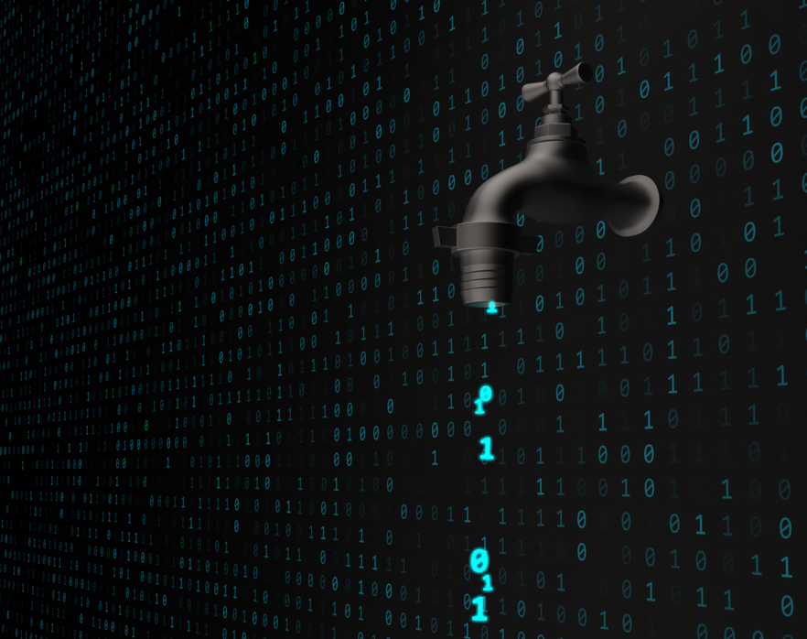

Cybersecurity Preparedness and Incident Response
Notes:
Good morning/afternoon, my name is _____ and today I would like to talk about cybersecurity preparedness and incident response. Cyber attacks to critical infrastructure are becoming more common and are targeting systems of all sizes. Not only that, they are increasingly being carried out by nation-state actors attempting to disrupt essential services. A cyber incident at a water system can not only be costly but could potentially impact the lives of the communities you all serve.

Slide 2

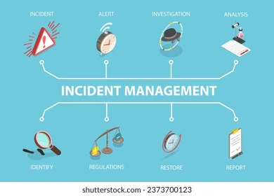
Steps for Incident Response
Preparation
Detection & Analysis
Containment, Eradication & Recovery
Post-Incident Activity
Notes:
Today we will briefly go over the steps involved in response to a cyber incident, but we will primarily focus on the preparation aspect of these steps, and outline some actions you can take today to secure your water systems.
Step Preparation: Ensures an organization is better able to prevent and respond to cyber incidents. Proper preparation can reduce the negative impacts from a cyber event and reduce the time it takes to recover.
Detection & Analysis: In this stage it is important that the incident is reported quickly and accurately to understand the full scope and impact, and to determine best methods to remove the threat.
Containment, Eradication & Recovery: Water systems will continue to follow their response plan while partner agencies help to coordinate containment, eradication, and recovery
Post-Incident Activity: After an incident has concluded, it is important to conduct an analysis of the incident and the response to create a “lessons learned” for future use by the system effected and other systems.

Slide 3

Preparation
Build a Plan
Unique to each system
Roles and Responsibilities
Aware of vulnerabilities
Community Resources
DEQ
AWWA
SoonerWARN
EPA
CISA
WaterISAC
Mitigation
Controls and safeguards
System backups
Sufficient logging practices
Basic training
Notes:
Step one preparation is potentially the most important. A system that is prepare not only provides a more difficult target to attackers, when an incident does occur, you can recover quickly, saving time, money, and potentially people’s lives.
It is important to remember no two systems will be the same, so create a plan specific to your system ahead of time. There are a number of steps you can take, some of which we will discuss further today to mitigate cybersecurity attacks. As always it is crucial to know who your community resources are ahead of time. No system should have to face a cyber incident alone, so be sure you know who your contacts are and how to reach out to them.

Slide 4
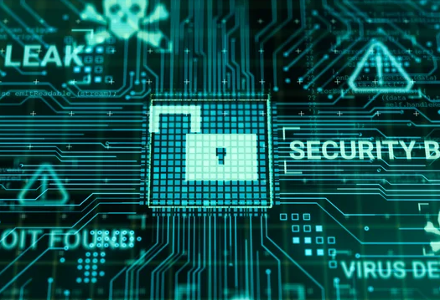
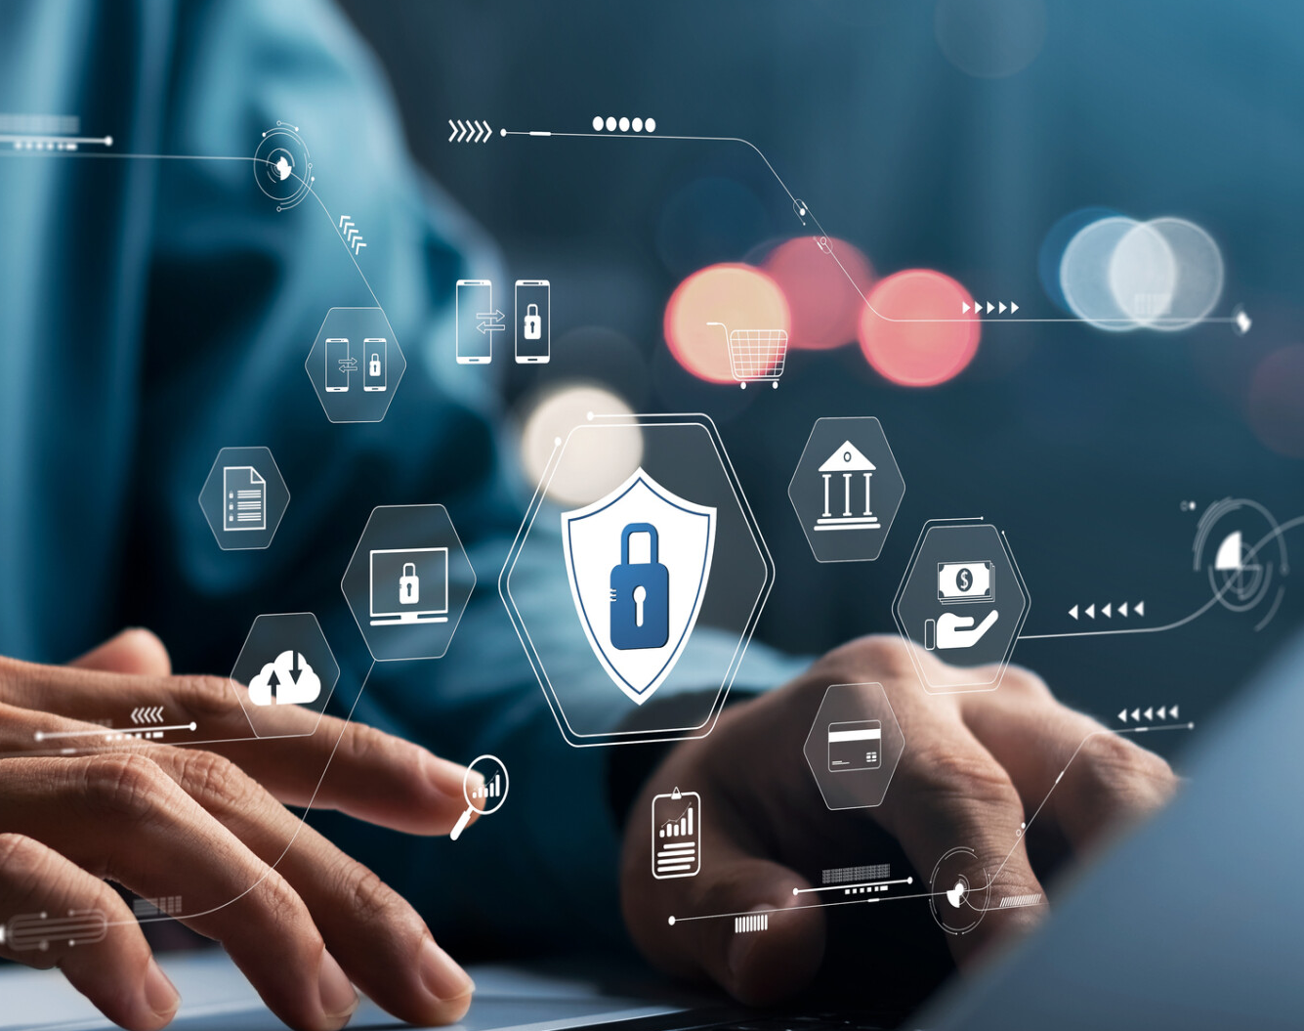

Detection & Analysis
Validate
Unusual system behavior
Unfamiliar network activity
Unexplained data loss or modification
Technical Analysis & Support
Onsite or virtual analysis and support
Tailored guidance
Report
Organizational
State Level
Federal Level
EPA: watercyberta@epa.gov
CISA: report@cisa.gov
FBI: www.ic3.gov
Notes:
Detection and analysis. The first step to dealing with a cyber attack is to detect the attack. Understanding your systems normal behavior ahead of time will reduce the time it takes to recognize an attack. This is also why it is important for all employees to be trained on cybersecurity and what an attack could look like. It is recommended that all systems have a local IT or cybersecurity professional who they can quickly reach out to for technical analysis and support. Finally report the incident to the appropriate authorities. There is a page in your booklet that outlines the steps in reporting an incident should one happen to you.

Slide 5

Containment, Eradication & Recovery
Coordinate Communications
Remediation Assistance
Fast Recovery = Money and Lives Saved
Notes:
Containment, eradication, and recovery. Agencies such as CISA, EPA, and WaterISAC develop and publish advisories with relevant and up-to-date information related to ongoing cyber incidents. These agencies also provide remediation assistance to systems under attack. Remember, you don’t have to handle an incident alone. With the right assistance your system can recover quickly which leads to reduce financial damage, protection of people’s health, and reduced impact on our infrastructure.

Slide 6

Post Incident Activity
Evidence Retention
Share Data with others
Lessons learned
Prevent future incidents
Cyber criminal prosecution
Indicators of compromise
Tactics
Techniques
Procedures
Improves situational awareness
Mitigate future threats
Improve response processes
Notes:
Post incident activity. Once an incident is over there is still some work to be done. Some important notes to keep in mind are:
Evidence retention: properly documented evidence can be used for future prosecution and investigation into the cyber criminals
Share your data with others: The more information others have the less likely a future incident will occur. Some important aspects to share are indicators of compromise, as well as tactics, techniques, and procedures of the attacker.
Lessons learned: It is important to collect lessons learned into a formal report to understand key factors, educate new personnel, raise situational awareness across the organization, and update your systems policies and procedures.

Slide 7

Actions to Take Now
Change Default Passwords
Update Software to Reduce Exposure to Vulnerabilities
Backup OT/IT Systems
Reduce Exposure to the Internet
Create an Inventory of OT/IT Assets
Conduct a Cybersecurity Assessment
Create an Incident Response and Recovery Plan
Cybersecurity Awareness Training
Notes:
Now that you have learned the four steps to incident response we will get into some actions you can take now to better secure your water system. These 8 actions are all equally important but I’ve arranged them in order of the easiest ones to implement to some that may require a bit more time and coordinated effort. To learn more about each of these actions and for access to free tools and resources, please follow the QR code included in your booklet.

Slide 8
Change Default Passwords
Require unique, strong, and complex passwords for all water systems and connected infrastructure
Notes:
The first a possibly easiest step you can take is to change all default passwords. This is one of the main ways threat actors access systems. Ensure that your passwords are unique, strong, and complex. Be sure to include everything connected to or that could be connected to the internet.

Slide 9
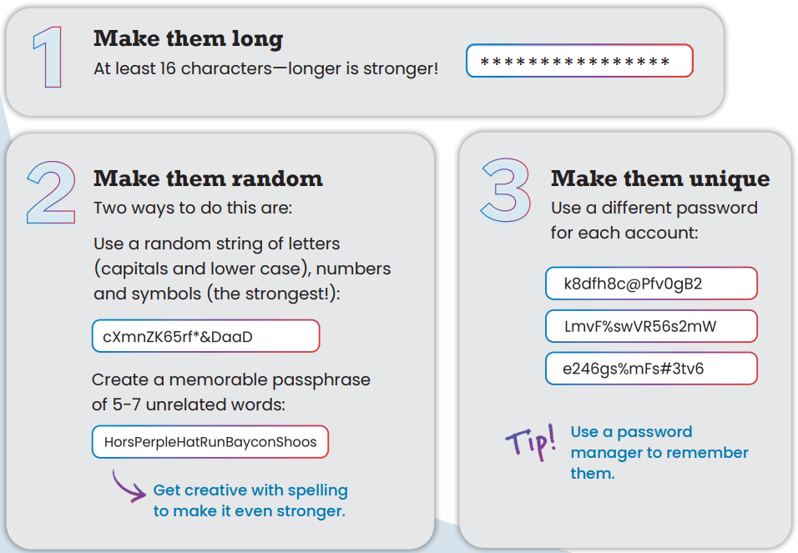
Change Default Passwords
What makes a good password?
Notes:
So we know we should change our password but what should we change it to? Some tips for making strong passwords are first, make it long. It is recommended a password be at lease 16 characters but the longer it is, the stronger it is. Next make your password random. You can do this with a password generator or you can create a passphrase that connects 5-7 unrelated words that you will remember. Finally make each password unique. Whether it’s your own personal devices or devices you log into for work, each password should be different. You might be saying to yourself, how am I supposed to remember all these passwords? Well you shouldn’t. Use a password manager to keep track of all your passwords. There are many options out there, even many free options.

Slide 10
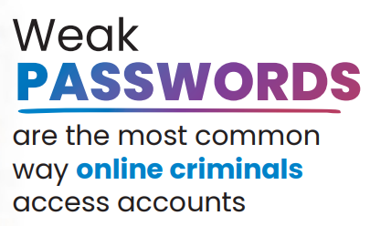
Change Default Passwords
Common mistakes to avoid:
Based on personal information
Not enough variation
Using common phrases, famous quotes, or song lyrics
Using words from the dictionary
Trying to memorize all your passwords
Notes:
There are also many mistakes people make when creating new passwords. These are some common mistakes to avoid. First is creating passwords based on your personal information. Information such as birth days, anniversaries, and loved ones names are easier to find than you think. Not including enough variation in a password is also a common downfall. Be sure to include upper and lower case letters, and symbols within your passwords. Using common phrases, lyrics, quotes, or words from the dictionary are easy to look up, and even if you alter spellings or include symbols, they are still easier for threat actors to crack than a string of random words. Finally, again, trying to memorize all your passwords is impossible. Get a password manager to help you.

Slide 11
Update Software to Reduce Exposure to Vulnerabilities
Prioritize Operational Technology (OT) patches during scheduled downtime, prioritize Informational Technology (IT) patches as applicable
Notes:
Step 2: update software to reduce exposure to vulnerabilities. Just as with your home computer, as known vulnerabilities are patched, updates are pushed out to those OT and IT systems that are connected to the internet. It is important to install these updates as soon as possible to protect both your OT or operations technology which is your physical process and equipment, such as your SCADA and PLCs, and your IT or information technology which is your software used to manage electronic data such as your billing and payroll systems.

Slide 12

Three simple steps
Watch for notifications
Install as soon as possible
Automatic updates
Notes:
It is generally pretty easy to install updates. Just follow these three simple steps: watch for notifications of new, available updates, install those updates as soon as is feasible without interrupting operations, and you can always turn on automatic updates, especially for you office systems. Updates help fix bugs, improve performance, provide enhanced features, and of course ensure you are as protected from known vulnerabilities as possible.

Slide 13
Backup OT/IT Systems
Regularly backup systems so you can recover to a known safe state in the event of a security breach
Notes:
Always backup all of your systems so in the event of an incident you can quickly recover and get back to business as usually. As with all document retention there are some best management practices to follow.

Slide 14
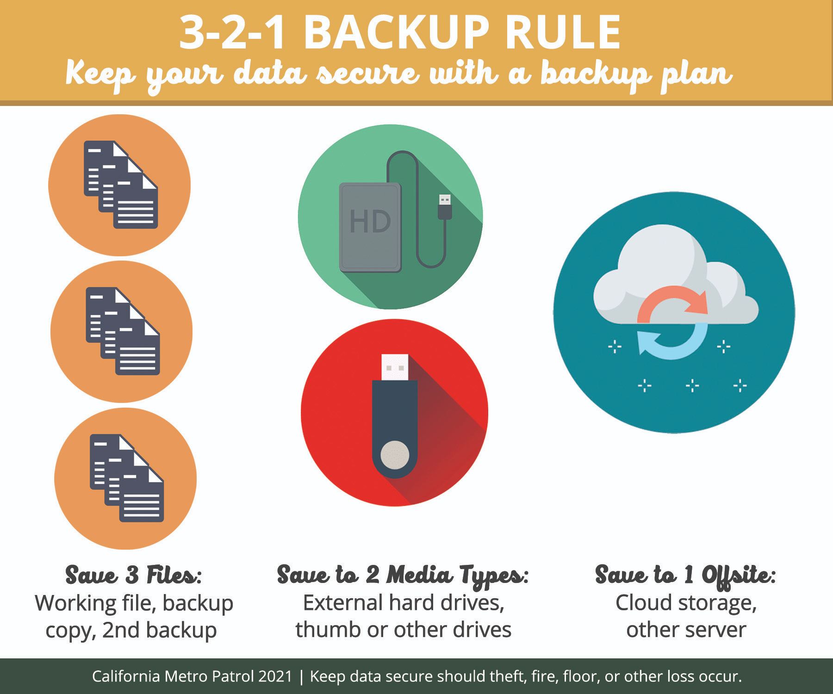
Protecting your data and systems
Regularly scheduled backups
Test procedures and isolate from network
Implement 3-2-1 rule
Notes:
A backup is only useful if you can access it, no matter the situation. To ensure you will always have a back-up to turn to, it is smart to implement the 3-2-1 rule. That is saving three files of a backup or other important documents. Next ensure that you have a copy of your backup saved in at least two different forms, that can be an external hard drive, thumb drive, or on other devices. And finally, make sure at least one of your copies is saved off site. Having one copy at the water office and one copy at town hall would work so long as they are separate buildings. This is in the event of a physical disaster such as a tornado or fire.

Slide 15
Reduce Exposure to the Internet
Scan internet-accessible systems to determine where there might be vulnerabilities and weakness
Notes:
Next reduce exposure to the internet. If possible, it is recommended to remove systems from the internet, but that is not always feasible or in the best interest of the system. Be sure to scan all internet connected systems to ensure they understand their vulnerabilities and weaknesses.

Slide 16
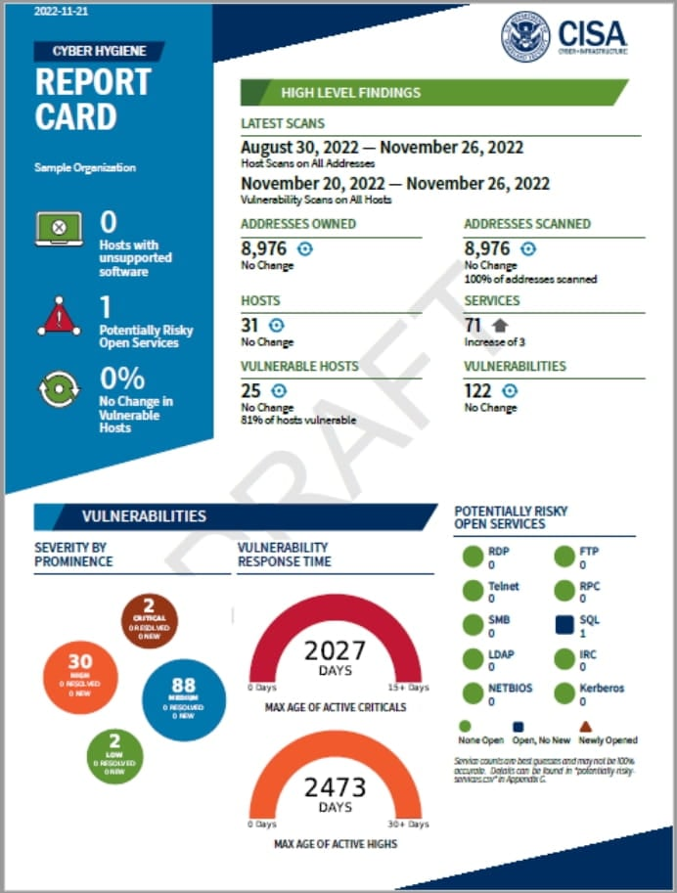
CISA offers free Vulnerability Scanning
Identify assets
Known exploited vulnerabilities
Recommendations for mitigating vulnerabilities
Ongoing detection and reporting of new vulnerabilities
Notes:
Vulnerability scanning is an action you will need to complete with your cybersecurity specialist or an outside agency. CISA offers free vulnerability scanning which helps to identify assets, and explores known exploited vulnerabilities within those assets. This scan only accesses external networks and is non-intrusive. Once the scan is complete you will receive a report card that provides recommendations to mitigate vulnerabilities and CISA can also provide ongoing detection and reporting of new vulnerabilities as they arise.

Slide 17
Create an Inventory of OT/IT Assets
Operational Technology and Informational Technology, understanding your software and hardware
Notes:
On the topic of inventorying assets, even without conducting a vulnerability scan, you should inventory all of your OT and IT so that you are aware of what you have and each systems capabilities. You will hear/have heard another presentation today on Asset Management Plans. Including your OT and IT on these plans is a good first step to assessing your systems. There are also resources you can use to complete OT & IT specific inventories.

Slide 18
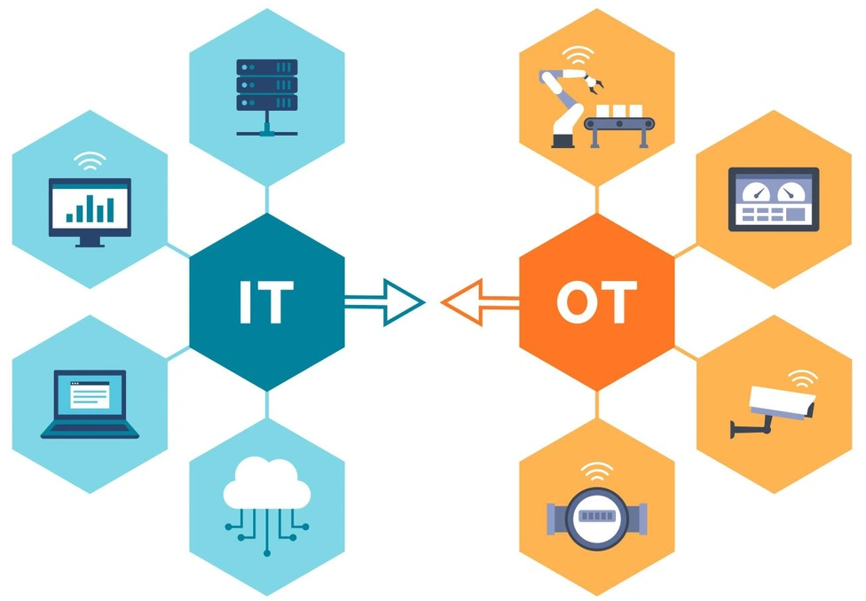
Understand what you need to protect
Include all software and hardware
Focus initial efforts on internet-accessible devices
Reach out for assistance
Notes:
We have already talked a little bit about OT and IT. Be sure to include all software and hardware in your inventory and begin your focus on internet-accessible devices. Always reach out to your IT specialist or you can even reach out to DEQ for assistance in completing an inventory.
As a reminder your IT or informational technology includes: networks, the cloud, internet, programs, content, devices, and data
And OT or operational technology includes: HMIs, machinery, PLCs, RTUs, monitoring systems, embedded computers, and SCADA software

Slide 19
Conduct a Cybersecurity Assessment
Regularly asses existing vulnerabilities in the system
Notes:
Conduct a cybersecurity assessment. It is recommended to include a cybersecurity assessment as party of your annual update to policies and plans.

Slide 20
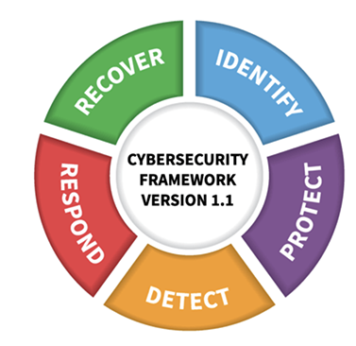
EPA Water Cybersecurity Assessment Tool (WCAT)
All systems should have a cybersecurity assessment
Assistance or self-evaluation
Identify gaps or potential vulnerabilities
Assessment Report and Risk Mitigation Plan
Notes:
You may be wondering how is an assessment different from a vulnerability scan: a vulnerability scan, scans your systems and networks for known vulnerabilities so that patches can be applied. An assessment is an overall view of practices and procedures in place to mitigate the occurrence or impact of a cyber incident. All systems should complete a cybersecurity assessment either on your own or by reaching out for technical assistance. EPA has created the WCAT which helps identify gaps or potential vulnerabilities in you systems practices and procedures, and provides a report on these issues. It will then lay out a risk mitigation plan specific to your system’s needs.

Slide 21
Create an Incident Response and Recovery Plan
Develop a plan and practice a response
Notes:
Create and Incident Response and Recovery Plan. Hopefully everyone here knows how important it is to have an emergency response plan. Well you should also create and practice a plan that is specific to responding to a cyber incident.

Slide 22
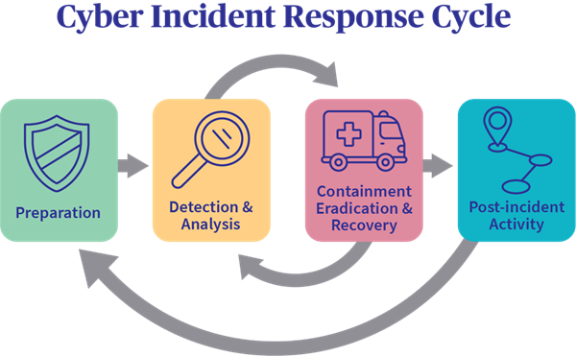
Start to Create a Plan
Use information from your assessment
EPA Incident Action Checklist
Review CISA Incident Response Plan (IRP) Basics
Notes:
The first step is of course to create a plan. You can use information from your cybersecurity assessment to help form this plan. Also, EPA has an incident action checklist, and CISA has an Incident Response Plan Basics PDF both of which can assist in the creation of actions to take before, during, and after an incident.

Slide 23
Start to Create a Plan
Before: identify roles, contact partners, review plan regularly, train staff, practice exercises
During: important roles to consider – Incident Manager, Tech Manager, Communications Manager
After: hold a meeting to asses strengths and weaknesses, update policies and procedures, communicate findings
Notes:
When creating your plan it is important to keep each step in mind. Be sure to identify roles and provide partner contact information. A plan is also only useful if employees know how to use it and what to do with it in the event of an incident. During an incident your plan will help guide you and ensure that the incident is resolved as quickly and with as little damage as possible. Once an incident has passed, ensure you review your plan and make any necessary updates based on how the incident unfolded.

Slide 24
Cybersecurity Awareness Training
Employees should undergo annual training on the importance of cybersecurity and how to prevent and respond to an incident
Notes:
And finally, ensure all of your employees are up to date on the latest cybersecurity awareness training. It only takes one person accidentally clicking on the wrong email for an adversary to enter your system.

Slide 25
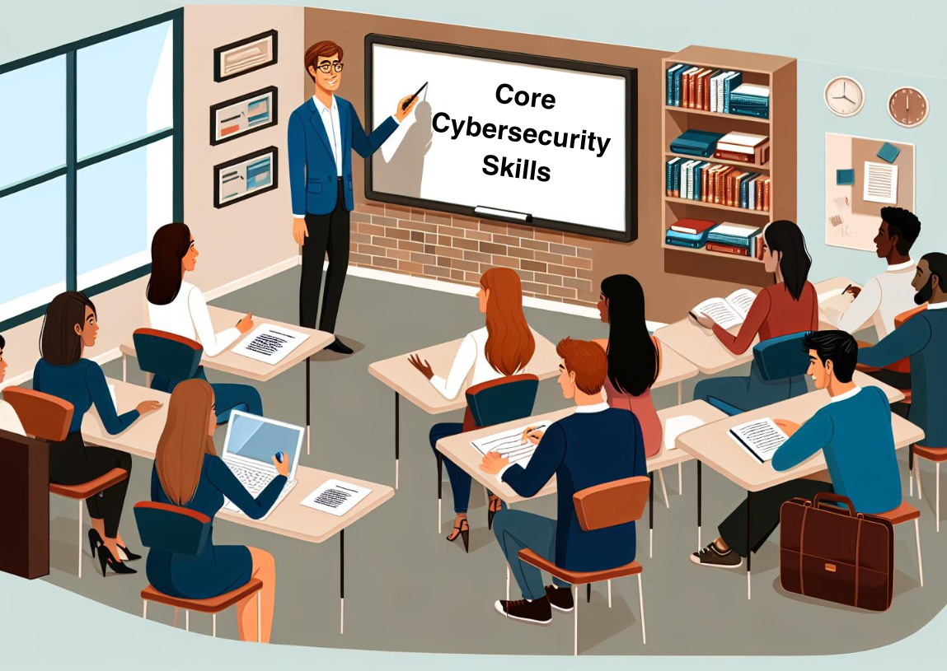
Free Workshops
Cybersecurity 101 Training for Water Systems Webinar
What we talked about today and more
Notes:
EPA and CISA both provide free workshops that go over much of what we talked about today and more. Create a plan with your team to ensure you are keeping your system and your community safe.

Slide 26
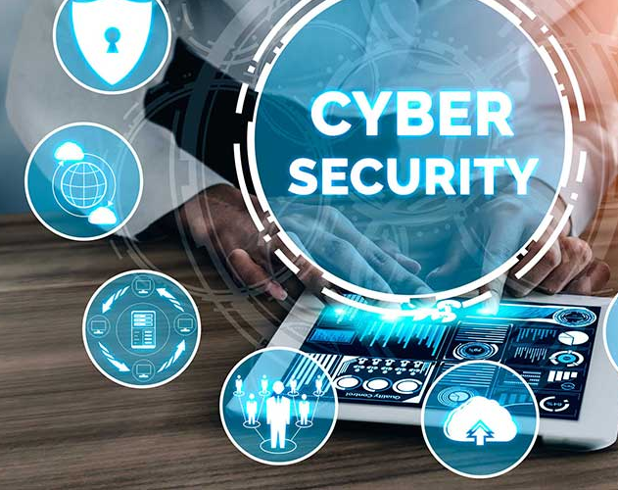

THANK YOU
For more information, please contact:
Capacity Development
Water Quality Division - DEQ
Lisa Stewart (405) 702-8270
DEQ.CapDev@deq.ok.gov
Notes:
With that I thank you for listening and am open to any questions you might have.

